Slide 1
Section 14.3
Double Integrals in Polar Coordinates

Slide 2
The Form of Double Integrals in Polar Coordinates
Recall that the polar coordinates (r,θ ) corresponding to the Cartesian coordinates (x, y) are related by the equations
x = r cosθ, y = r sinθ, and r² = x² + y².

Slide 3
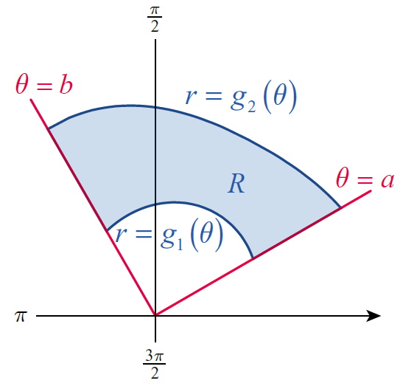
The Form of Double Integrals in Polar Coordinates (cont.)
Polar coordinates may be the “natural” system to use when integrating a function f(r,θ ) defined on a region R if R is bounded between two rays θ = a and θ = b and two continuous functions r = g₁(θ ) and r = g₂(θ ), as shown in Figure 1.
Figure 1

Slide 4
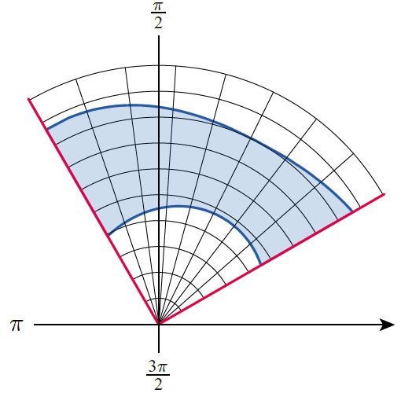
The Form of Double Integrals in Polar Coordinates (cont.)
In order to integrate over R using polar coordinates, we need to partition R in a manner consistent with the coordinate system. Figure 2 illustrates such a manner: each of the elements of the partition P is a polar rectangle described by and for some i and j, where is a partition of an interval of radii covering R, and is a partition of the interval of angles [a, b].
Figure 2

Slide 5
The Form of Double Integrals in Polar Coordinates (cont.)
The contribution of each small polar rectangle to the Riemann sum based on the partition is where is a sample point chosen from the rectangle and ΔA is its area. All we have left to do, in order to make the transition from the approximating Riemann sums to the integral, is express ΔA in terms of Δr and Δθ. The choice of sample point is immaterial in the limit, so we can specify that the sample point in the polar rectangle where is

Slide 6
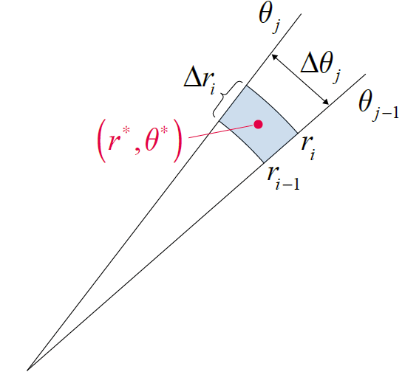
The Form of Double Integrals in Polar Coordinates (cont.)
That is, is chosen to be the center point of each polar rectangle, as shown in Figure 3. And since the area of the sector of a circle of radius r and subtended angle Δθ is (as derived in Section 9.4), the area of the polar rectangle in Figure 3 is as follows.
Figure 3 Center Point of a Polar Rectangle

Slide 7
The Form of Double Integrals in Polar Coordinates (cont.)
This gives us all we need to express the entire Riemann sum in terms of radial and angle increments.
In the limit of finer and finer partitions, we have arrived at the following result.

Slide 8
Theorem: Double Integral in Polar Coordinates
Given an integrable function f(r,θ ) defined on the region R bounded between rays θ = a and θ = b and two continuous functions the double integral of f over R is

Slide 9
Theorem: Double Integral in Polar Coordinates (cont.)
If f is defined in terms of Cartesian coordinates x and y, we can express the double integral over R as

Slide 10
Evaluating Double Integrals in Polar Coordinates
The key steps to perform, in order to actually evaluate a double integral using polar coordinates, are as follows.
Step 1: Ensure the integrand is defined purely in terms of r and θ.
Step 2: Identify rays θ = a and θ = b and curves and that bound the region R.
Step 3: Include the factor of r in the area differential, since dA = r dr dθ.

Slide 11
Evaluating Double Integrals in Polar Coordinates (cont.)
To illustrate these steps, consider again Example 4 from
Section 9.4, this time using double integration with
polar coordinates.

Slide 12
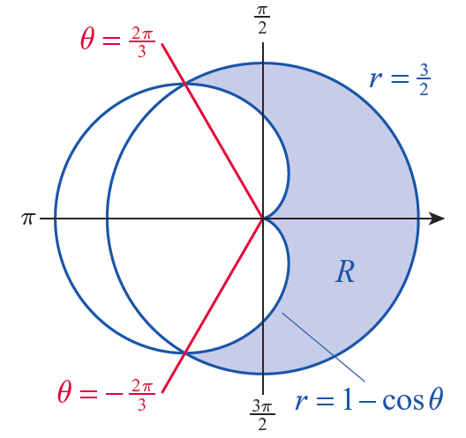
Example 1: Finding the Area Bounded between the Graphs of Two Polar Equations
Find the area of the region R inside the circle and outside the cardioid r = 1 − cosθ.
Solution
Solving the equation yields so the region as described is depicted in Figure 4. Note that although the bounding rays were not explicitly provided, we now know that they are
Figure 4

Slide 13
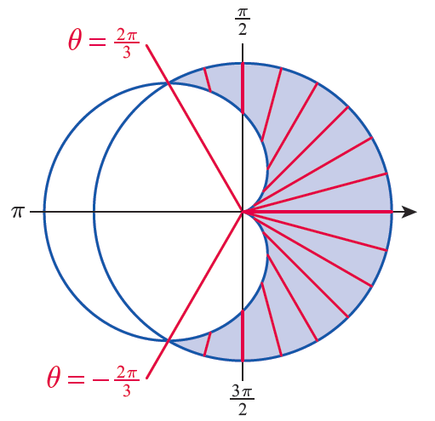
Example 1: Finding the Area Bounded between the Graphs of Two Polar Equations (cont.)
Since we are interested only in determining the area of R, the integrand is f(r,θ ) = 1. The θ -limits of integration are clear, and the r-limits reflect the extreme values of r for each radial slice through R, fifteen of which are shown in Figure 5.
Figure 5

Slide 14
Example 1: Finding the Area Bounded between the Graphs of Two Polar Equations (cont.)
Remember that θ is fixed for each such slice, is the smallest value of r among points on the slice, and is the largest value.
With the double integral set up, we can proceed to evaluate the area.

Slide 15
Example 1: Finding the Area Bounded between the Graphs of Two Polar Equations (cont.)

Slide 16
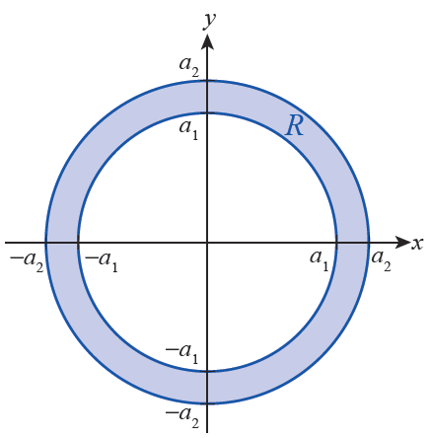
Example 2: Using Polar Coordinates to Find the Moment of Inertia about the Origin of an Annulus
Suppose the annulus R shown in Figure 6 represents a planar object with total mass M. Determine its moment of inertia about the origin.
Solution
Assuming the annular object is made of a material with constant density ρ, its moment of inertia about the origin is calculated as follows.
Figure 6 An Annulus Centered at the Origin

Slide 17
Example 2: Using Polar Coordinates to Find the Moment of Inertia about the Origin of an Annulus (cont.)
We have again used the fact that the mass of the annulus is the mass of a solid disk of radius a₂ minus the mass of a solid disk of radius a₁.

Slide 18
Example 3: Evaluating a Double Integral by Converting from Cartesian to Polar Coordinates
Evaluate the integral
where R is the unit disk centered at the origin.
Solution
Such integrals appear frequently in statistical applications and elsewhere, and it is desirable to be able to evaluate them exactly.

Slide 19
Example 3: Evaluating a Double Integral by Converting from Cartesian to Polar Coordinates (cont.)
Unfortunately, the integral as given is nonelementary—there is no antiderivative of the integrand with respect to either x or y. But the presence of x² + y² in the integrand and the fact that the region of integration is a disk are cues to try converting the integral to polar coordinates. When we do so, we are able to evaluate the integral without difficulty.

Slide 20
Example 3: Evaluating a Double Integral by Converting from Cartesian to Polar Coordinates (cont.)

Slide 21
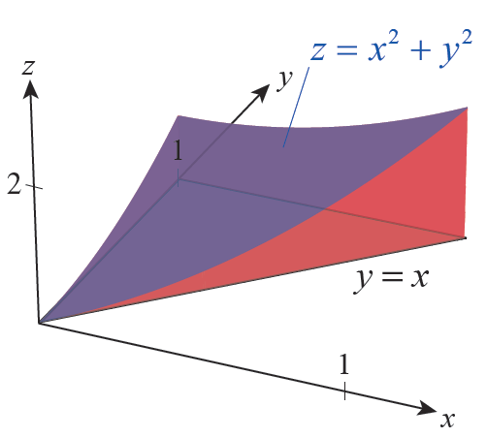
Example 4: Using a Double Integral in Polar Coordinates to Find Volume of a Solid
Let R be the triangle in the xy-plane with boundary lines y = x, x = 0, and y = 1. Find the volume of the solid bounded below by the region R and above by the surface z = x² + y².
Solution
The solid as described is pictured in Figure 7, and the region R is shown in Figure 8.
Figure 7

Slide 22
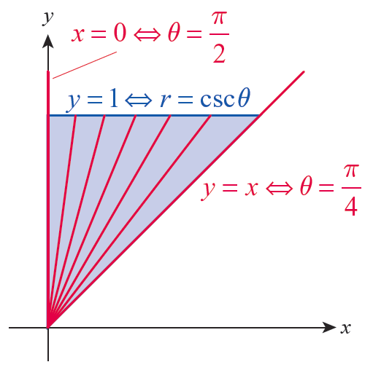
Example 4: Using a Double Integral in Polar Coordinates to Find Volume of a Solid (cont.)
The lines y = x and x = 0 correspond to the θ-limits and each radial slice through R has a lower r-limit r = 0. Each upper r-limit corresponds to a point on the line y = 1, but this must be expressed in the form r = g₂(θ) for us to integrate using polar coordinates.
Figure 8

Slide 23
Example 4: Using a Double Integral in Polar Coordinates to Find Volume of a Solid (cont.)
We make the translation by noting that y = r sinθ, so
Putting all the pieces together, we obtain the following volume.

Slide 24
Example 4: Using a Double Integral in Polar Coordinates to Find Volume of a Solid (cont.)

