Slide 1
Section 14.4
Triple Integrals

Slide 2
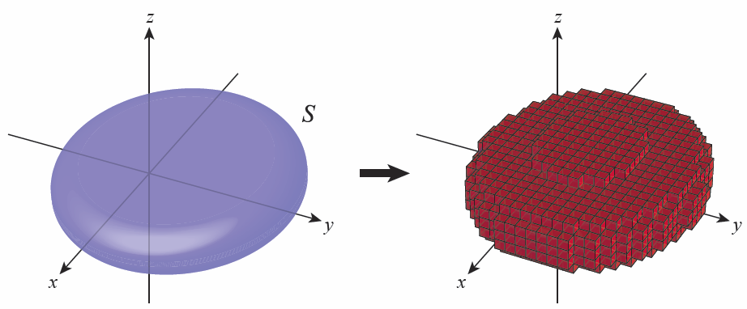
Triple Integrals and Riemann Sums
Suppose S is a closed bounded region of ℝ³ and that f (x, y, z) is defined on S. We can partition ℝ³ with families of planes parallel to the coordinate planes, and by doing so arrive at a collection of boxes that approximate S, as shown in Figure 1.
Figure 1

Slide 3
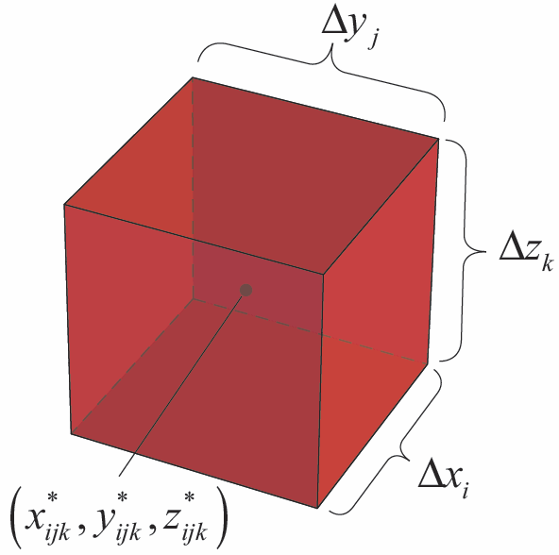
Triple Integrals and Riemann Sums (cont.)
We choose a sample point from each box at which to evaluate f, and form the triple Riemann sum
where is the volume of the box defined by and (see Figure 2).
Figure 2

Slide 4
Triple Integrals and Riemann Sums (cont.)
In keeping with previous usage, we define the norm of any such partition P as
and define the triple integral of f over S to be the common limit as if the limit exists.

Slide 5
Definition: Triple Integral
Given a function f(x, y, z) defined on the region S ⊆ ℝ³, we define the triple integral of f over S to be the value
provided the limit exists. If the limit exists, we say f is integrable over S.

Slide 6
Theorem: Fubini’s Theorem for Triple Integrals
If f(x, y, z) is continuous on the region
then
Further, any permutation of the order of integration yields an identical result.

Slide 7
Example 1: Using Fubini’s Theorem to Evaluate a Triple Integral
Evaluate where
Solution
Using one of the six possible orders of integration, we have the following.

Slide 8
Example 1: Using Fubini’s Theorem to Evaluate a Triple Integral (cont.)

Slide 9
Theorem: Properties of Triple Integrals
Assume that f(x, y, z) and g(x, y, z) are continuous, that k is a constant, and that S₁ and S₂ are two regions of ℝ³ with at most boundary points in common. Assume also that all the integrals below exist. Then the following properties hold.
Constant Multiple Property

Slide 10
Theorem: Properties of Triple Integrals (cont.)
Sum/Difference Property
Domination Property
Disjoint Region Property

Slide 11
Triple Integrals over General Bounded Regions
When S is not a rectangular box, more attention must be paid to determining the limits of integration in a triple integral. Usually only some of the six possible orders of integration will be suitable for a given triple integral, but the process of setting up the integral is similar for any order. For the purpose of illustration, the steps below assume integration first with respect to z, then y, and finally x.

Slide 12
Procedure: Setting Up a Triple Integral
To express as an iterated integral of the
form perform the following steps.

Slide 13
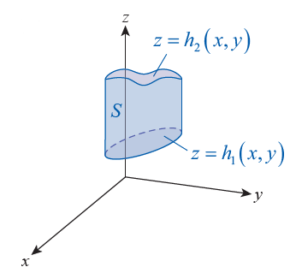
Procedure: Setting Up a Triple Integral (cont.)
Step 1: Draw a rough sketch of S as an aid in determining the z-limits. Identify the lower surface and the upper surface
of S. These two functions of x and y constitute the z-limits
(see Figure 3a).
Figure 3a

Slide 14
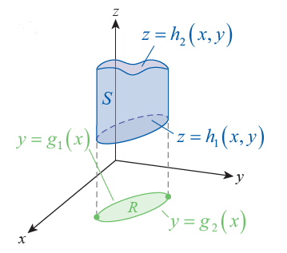
Procedure: Setting Up a Triple Integral (cont.)
Step 2: Define R to be the “shadow,” or projection, of S in the xy-plane. Sketch R, this time as an aid in determining the y-limits.
The lower curve and upper curve constitute the y-limits
(see Figure 3b).
Figure 3b

Slide 15
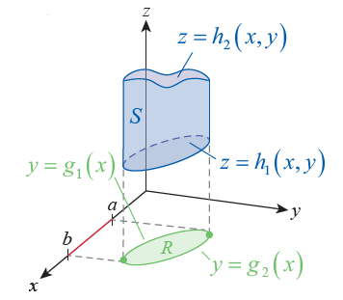
Procedure: Setting Up a Triple Integral (cont.)
Step 3: The lower x-limit is the left-hand edge x = a of R (that is, the minimum value of x among all
points of R) and the upper x-limit is the right-hand edge x = b
(see Figure 3c).
Figure 3c

Slide 16
Procedure: Setting Up a Triple Integral (cont.)
The result will be

Slide 17
Caution
Note that the limits of integration of the innermost integral may be functions of the other two variables (x and y in the order shown previously). The limits of the middle integral may be functions of the outer variable (x in the order shown previously), but not the variable corresponding to the inner limits of integration (z in the order shown previously). The limits of the outermost integral can only be constants.

Slide 18
Example 2: Finding the Volume of a Solid Bounded by
Two Surfaces
Find the volume of the solid S bounded below by the surface z = x² + 3y² + 2 and above by the surface z = 6 − x² − y².
Solution
The volume V of S is expressed as a triple integral with the integrand f(x, y, z) = 1.

Slide 19
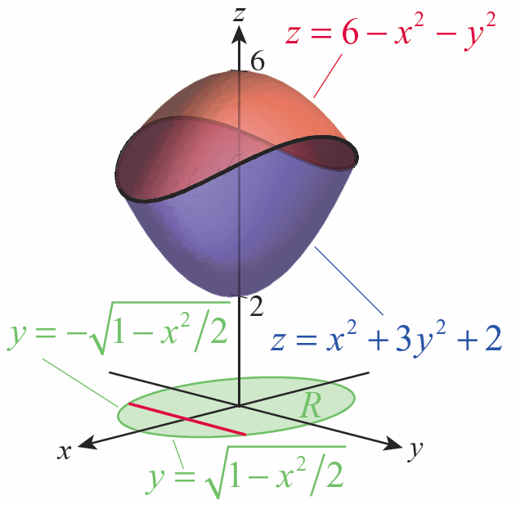
Example 2: Finding the Volume of a Solid Bounded by
Two Surfaces (cont.)
The two surfaces are both elliptical paraboloids, one opening upward and one downward, as shown in Figure 4. The two surfaces intersect where the two
functions
and
have the same value, namely over the curve in the xy-plane where
Figure 4

Slide 20
Example 2: Finding the Volume of a Solid Bounded by
Two Surfaces (cont.)
The equation is the boundary of the region R in the xy‑plane, also shown in Figure 4. The lower curve (in the sense of y-values) is the function
and the upper curve is the function
which we obtain by solving the equation for y. Finally, the line defines the left-hand edge of R, and the line the right-hand edge (set y = 0 in the equation and solve for x). Putting the pieces together, the volume can be calculated as follows.

Slide 21
Example 2: Finding the Volume of a Solid Bounded by
Two Surfaces (cont.)

Slide 22
Example 2: Finding the Volume of a Solid Bounded by
Two Surfaces (cont.)

Slide 23
Example 3: Changing the Order of Integration in a
Triple Integral
Evaluate the triple integral of Example 2 with the order of integration of the middle and outer integrals reversed.

Slide 24
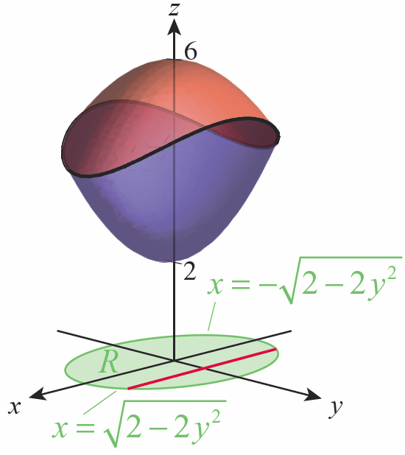
Example 3: Changing the Order of Integration in a
Triple Integral (cont.)
Solution
The inner integral remains the same, but to integrate next with respect to x, we need to express the “left-
hand” and “right-hand” curves of
as functions of y, giving
us and
respectively
(see Figure 5).
Figure 5

Slide 25
Example 3: Changing the Order of Integration in a
Triple Integral (cont.)
The limits of the outer integral are y = −1 and y = 1, so the integral as a whole is as follows.
It can be shown that the value of the integral is again

Slide 26
Definition: First Moments about the Planes, Mass, and Center of Mass of an Object in ℝ³
Given an object in space modeled by the region S ⊆ ℝ³, and whose density is represented by its first moments M_{yz}, M_{xz}, and M_{xy} about the coordinate planes, its mass M, and its center of mass are as follows, assuming the integrals exist.

Slide 27
Definition: First Moments about the Planes, Mass, and Center of Mass of an Object in ℝ³ (cont.)
First moment about the yz-plane
First moment about the xz-plane
First moment about the xy-plane

Slide 28
Definition: First Moments about the Planes, Mass, and Center of Mass of an Object in ℝ³ (cont.)
Mass
Center of mass

Slide 29
Definition: Second Moments and Radii of Gyration of an Object in ℝ³
Given an object in space modeled by the region S ⊆ ℝ³, and whose density is represented by its second moments I_{x}, I_{y}, and I_{z} about the coordinate axes and its corresponding radii of gyration are as follows, assuming the integrals exist.
Second moment about the x-axis

Slide 30
Definition: Second Moments and Radii of Gyration of an Object in ℝ³ (cont.)
Second moment about the y-axis
Second moment about the z-axis
Radii of gyration

Slide 31
Example 4: Finding the First and Second Moments, Center of Mass, and Radii of Gyration of a Tetrahedron
Find the first and second moments, center of mass, and radii of gyration of the tetrahedron S bounded by the coordinate planes and the plane z = 2 − 2x − y. Assume S is made of a substance with constant density ρ.
Solution
The shadow of S on each of the three coordinate planes is a triangle; we can determine the third edge of the shadow in the xy-plane by setting z = 0 in the equation z = 2 − 2x − y, giving us 2x + y = 2.

Slide 32
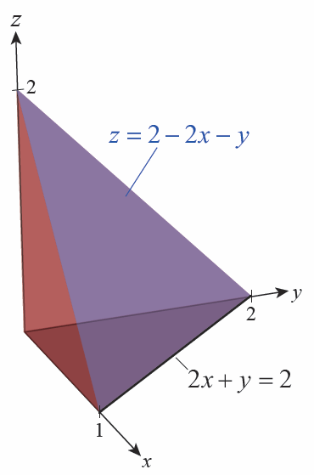
Example 4: Finding the First and Second Moments, Center of Mass, and Radii of Gyration of a Tetrahedron (cont.)
Figure 7 is an illustration of S.
Figure 7

Slide 33
Example 4: Finding the First and Second Moments, Center of Mass, and Radii of Gyration of a Tetrahedron (cont.)
Using the first moment formulas, we determine the following.

Slide 34
Example 4: Finding the First and Second Moments, Center of Mass, and Radii of Gyration of a Tetrahedron (cont.)

Slide 35
Example 4: Finding the First and Second Moments, Center of Mass, and Radii of Gyration of a Tetrahedron (cont.)

Slide 36
Example 4: Finding the First and Second Moments, Center of Mass, and Radii of Gyration of a Tetrahedron (cont.)

Slide 37
Example 4: Finding the First and Second Moments, Center of Mass, and Radii of Gyration of a Tetrahedron (cont.)
Although the calculations for M_{xz} and M_{xy} differ in the details, we shouldn’t be surprised by the fact that these two moments are the same, since the distribution of the points of S above the xz-plane is symmetric to the distribution above the xy-plane. But S is distributed differently with respect to the yz-plane—for one thing, its “height” above the yz-plane is 1 unit, instead of 2 as it is above the other two coordinate planes.

Slide 38
Example 4: Finding the First and Second Moments, Center of Mass, and Radii of Gyration of a Tetrahedron (cont.)
With the first moments and mass in hand, we can find the center of mass of the tetrahedron.
Hence the center of mass of S (also known as its centroid, since S has constant density) is the point

Slide 39
Example 4: Finding the First and Second Moments, Center of Mass, and Radii of Gyration of a Tetrahedron (cont.)
Similarly, it can be shown that

Slide 40
Example 5: Finding the Centroid, Second Moment, and Radius of Gyration of a Solid
Find the centroid, I_{z}, and r_{z} for the solid of Example 2, assuming constant density ρ.
Solution
By the symmetry of the solid, it must be the case that but will be some as yet unknown value between 2 and 6. To find we calculate the following, using the techniques of Section 7.3 to evaluate the trigonometric integral in the second to last line.

Slide 41
Example 5: Finding the Centroid, Second Moment, and Radius of Gyration of a Solid (cont.)

Slide 42
Example 5: Finding the Centroid, Second Moment, and Radius of Gyration of a Solid (cont.)
The volume of the solid (from Example 2) is so its mass is
Therefore the centroid is
The moment of inertia about the z-axis can be found as follows.

Slide 43
Example 5: Finding the Centroid, Second Moment, and Radius of Gyration of a Solid (cont.)
See Section 7.3.

Slide 44
Example 5: Finding the Centroid, Second Moment, and Radius of Gyration of a Solid (cont.)
This gives us the radius of gyration about the z-axis.

