Slide 1
Section 14.5
Triple Integrals in Cylindrical and Spherical Coordinates

Slide 2
The Cylindrical Coordinate System
As the name implies, the cylindrical coordinate system of ℝ³ is based on cylinders, and equations for cylinders in the cylindrical system are particularly simple in form. A point in ℝ³ with Cartesian coordinates (x,y,z) has cylindrical coordinates (r,θ,z), where r is the length of the line segment joining (0,0,0) and (x,y,0), θ is the angle between the positive x-axis and the same line segment, and z has the same meaning as in Cartesian coordinates.

Slide 3
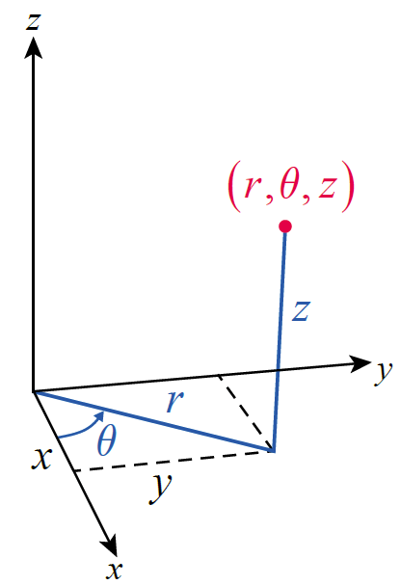
The Cylindrical Coordinate System (cont.)
Figure 1 illustrates the relationship between (x,y,z) and (r,θ,z).
Figure 1 Cylindrical Coordinates of a Point in Space

Slide 4
The Cylindrical Coordinate System (cont.)
A few points deserve mention. First, note that the cylindrical coordinate system is simply the polar coordinate system of the xy-plane with the addition of a z-coordinate. This means that the familiar conversions between r, θ, x, and y still hold, as listed below. Second, as with polar coordinates, points in space are associated with more than one set of cylindrical coordinates—for instance, for every n ∈ ℤ.

Slide 5
Theorem: Coordinate Conversion
Converting from cylindrical to Cartesian coordinates:
Converting from Cartesian to cylindrical coordinates:

Slide 6
The Cylindrical Coordinate System (cont.)
The order of integration shown for illustrative purposes is one of the more frequently used, but the best order for a given problem may be different.

Slide 7
Procedure: Setting Up a Triple Integral in Cylindrical Coordinates
To express as an iterated integral using
cylindrical coordinates, perform the following steps.

Slide 8
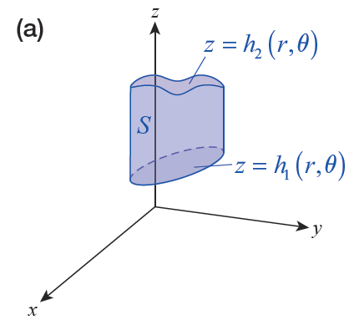
Procedure: Setting Up a Triple Integral in Cylindrical Coordinates (cont.)
Step 1: Draw a rough sketch of S as an aid in determining the z-limits. Identify the lower surface and the upper surface of S—these two functions of r and θ constitute the z-limits (see Figure 3a).
Figure 3

Slide 9
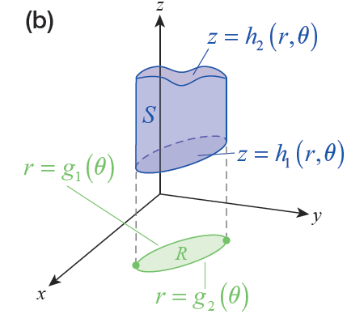
Procedure: Setting Up a Triple Integral in Cylindrical Coordinates (cont.)
Step 2: Define R to be the “shadow,” or projection, of S in the xy-plane. Sketch R, this time as an aid in determining the
r-limits. The curve r = g₁(θ ), closer to the origin, and the farther curve r = g₂(θ ) constitute the r-limits (see Figure 3b).
Figure 3

Slide 10
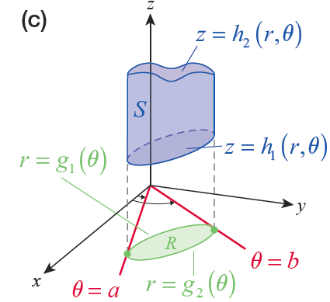
Procedure: Setting Up a Triple Integral in Cylindrical Coordinates (cont.)
Step 3: The lower limit of θ, θ = a, defines one ray that bounds R, and the upper limit of θ, θ = b, defines the other ray—R should be captured between the two rays (see Figure 3c).
Figure 3

Slide 11
Procedure: Setting Up a Triple Integral in Cylindrical Coordinates (cont.)
The result will be

Slide 12
Caution
Note that the limits of integration of the innermost integral may be functions of the other two variables (r and θ in the order above). The limits of the middle integral may be functions of the outer variable (θ above), but not the variable corresponding to the inner limits of integration (z above). The limits of the outermost integral can only be constants.

Slide 13
Example 1: Using a Triple Integral in Cylindrical Coordinates to Find the Volume of a Solid
Find the volume of the paraboloid solid S bounded below by the surface z = x² + y² and above by z = 1.
Solution
Since x² + y² = r², the lower and upper surfaces z-limits are z = r² and z = 1. The shadow, or projection, of the object in the xy-plane is the disk R defined by the equation x² + y² = 1, which in terms of r and θ reduces to the equation r = 1. Note that in cylindrical coordinates, the equation r = 1 is a cylinder of radius 1, which entirely contains the solid S.

Slide 14
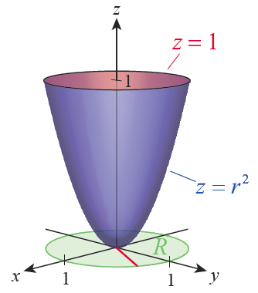
Example 1: Using a Triple Integral in Cylindrical Coordinates to Find the Volume of a Solid (cont.)
Figure 4 illustrates S and R.
Figure 4 A Paraboloid and Its Shadow

Slide 15
Example 1: Using a Triple Integral in Cylindrical Coordinates to Find the Volume of a Solid (cont.)
Since we want to find the volume of S, the integrand is the function and we are led to the following integral.

Slide 16
Example 2: Using Cylindrical Coordinates to Find the Mass and Center of Mass of a Solid of Varying Density
Find the mass and center of mass of the paraboloid solid of Example 1 if its density is described by the function
Solution
The moment formulas of Section 14.4 remain valid, but we must convert them to cylindrical coordinates if we wish to integrate with respect to r, θ, and z. In this case the conversion is easy, since z plays the same role in both Cartesian and cylindrical coordinates and symmetry tells us that without integration.

Slide 17
Example 2: Using Cylindrical Coordinates to Find the Mass and Center of Mass of a Solid of Varying Density (cont.)
To determine we need to evaluate the mass M and the first moment M_{xy} .

Slide 18
Example 2: Using Cylindrical Coordinates to Find the Mass and Center of Mass of a Solid of Varying Density (cont.)

Slide 19
Example 2: Using Cylindrical Coordinates to Find the Mass and Center of Mass of a Solid of Varying Density (cont.)
This gives us meaning the
z-component of the center of mass is halfway between the bottom and top of the solid.

Slide 20
Example 3: Using Cylindrical Coordinates to Find the Mass of a Solid of Varying Density
Determine the mass of the solid bounded by the cylinder the xy-plane, and the cone
given that its density function is
Solution
Although the particulars of this problem are given in Cartesian coordinates, the integral is far easier to evaluate in cylindrical coordinates. So the first order of business is to restate the geometry of the solid and its density in terms of r, θ, and z.

Slide 21
Example 3: Using Cylindrical Coordinates to Find the Mass of a Solid of Varying Density (cont.)
Cylinder:
Cone:
Density:

Slide 22
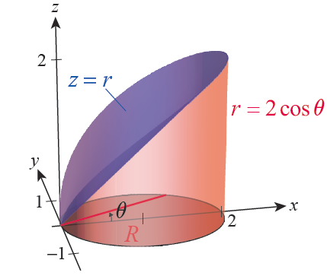
Example 3: Using Cylindrical Coordinates to Find the Mass of a Solid of Varying Density (cont.)
Figure 5 is an illustration of the solid and its shadow R described in cylindrical coordinates. Note that the θ -interval needed to define the
cylinder is the red
line segment shown extending
out from the origin corresponds
to one particular angle θ.
Figure 5

Slide 23
Example 3: Using Cylindrical Coordinates to Find the Mass of a Solid of Varying Density (cont.)

Slide 24
Example 3: Using Cylindrical Coordinates to Find the Mass of a Solid of Varying Density (cont.)

Slide 25
The Spherical Coordinate System
The spherical coordinate system is most useful when the geometry of a problem has some sort of symmetry about a point, especially if that point can be made the
origin of the system. A point with Cartesian coordinates (x,y,z) corresponds to the spherical coordinates (ρ,θ,φ), where ρ is the distance between the origin and the point, θ has the same meaning as in cylindrical coordinates, and φ is the angle (sometimes called the polar angle) between the positive z-axis and the line segment joining the origin to the point.

Slide 26
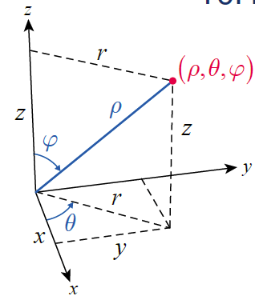
The Spherical Coordinate System (cont.)
Unlike r, ρ is required to be nonnegative, and φ is restricted to the interval [0,π ]. Figure 6 illustrates the relationship between (x,y,z) and (ρ,θ,φ), as well as the coordinate r of the cylindrical system—we
will soon summarize all the relationships in a complete conversion table.
Figure 6

Slide 27
Caution
A few words of warning are in order: both the symbols used and the order of the coordinates vary somewhat with the field of study and between texts. In physics texts, θ is typically used to denote the polar angle and φ the angle in the xy‑plane (sometimes called the azimuth).

Slide 28
Caution (cont.)
And if spherical coordinates alone appear, r might be used in place of ρ (if both spherical and cylindrical coordinates are in use, it’s convenient to have different symbols for the two different coordinates). Finally, some texts swap the order of the polar and azimuth angles when listing the coordinates. Be sure to know how the symbols and their order are defined in any text you read.

Slide 29
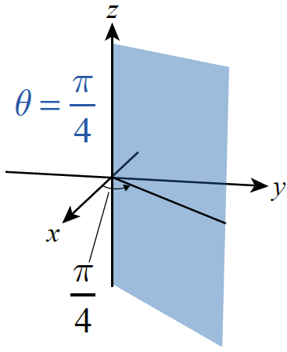
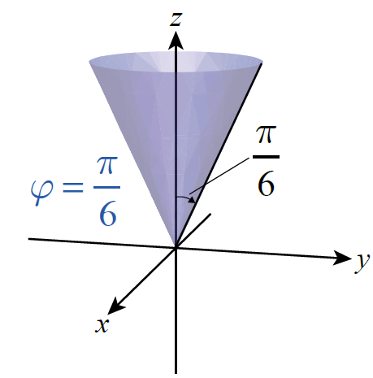
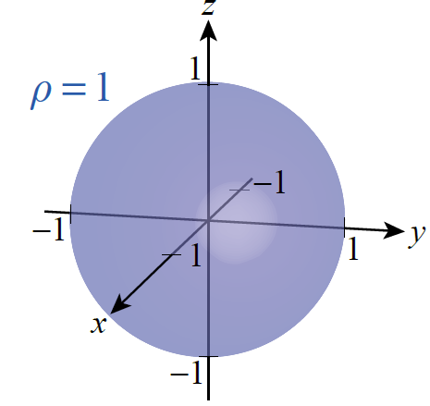
The Spherical Coordinate System (cont.)
To get a sense of the kinds of objects that can easily be described with spherical coordinates, consider the graphs of ρ = 1, and shown in Figure 7.
Half-Plane
(Remember  ≥ 0)
Sphere of
Radius 1
Cone
Figure 7 Graphs of Equations in Spherical Coordinates

Slide 30
The Spherical Coordinate System (cont.)
The following table, based on Figure 6, expresses the relationships between Cartesian, cylindrical, and spherical coordinates and can be used as a reference when converting from one system to another.
Figure 6 Spherical Coordinates
of a Point in Space

Slide 31
The Spherical Coordinate System (cont.)
Coordinate Conversion Relationships
Cylindrical and Cartesian | Spherical and Cylindrical | Spherical and Cartesian
r² = x² + y² | ρ² = r² + z² | ρ² = x² + y²+ z²
x = r cosθ | r = ρ sinφ
y = r sinθ | θ = θ
z = z | z = ρ cosφ | z = ρ cosφ
Table 1

Slide 32
Example 4: Converting an Equation from Cartesian to Spherical Coordinates
Convert the equation to spherical coordinates.
Solution
The equation describes a sphere of radius 2 centered at (2,0,0). In order to convert to spherical coordinates, we group terms and use the conversion formulas.

Slide 33
Example 4: Converting an Equation from Cartesian to Spherical Coordinates (cont.)
This defines the sphere as those points having spherical coordinates The surface is traced out completely over the intervals and 0 ≤ φ ≤ π ; allowing θ and φ to take on all the values 0 ≤ θ ≤ 2π and 0 ≤ φ ≤ π actually results in each point of the sphere being visited twice.

Slide 34
Procedure: Setting up a Triple Integral in Spherical Coordinates
To express as an iterated integral using
spherical coordinates, perform the following steps.

Slide 35
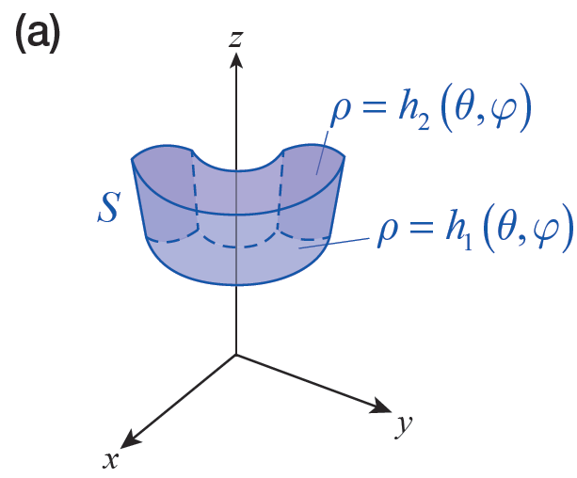
Procedure: Setting up a Triple Integral in Spherical Coordinates (cont.)
Step 1: Draw a rough sketch of S as an aid in determining the ρ-limits. Identify the lower ρ-limit as a function ρ = h₁(θ,φ) and the upper ρ -limit as a function ρ = h₂(θ,φ) (see Figure 9a).
Figure 9(a)

Slide 36
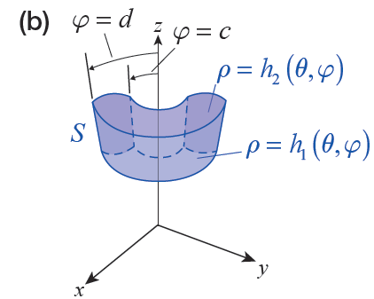
Procedure: Setting up a Triple Integral in Spherical Coordinates (cont.)
Step 2: Determine the least angle φ among the φ -coordinates of all the points of S, and use this as the lower φ -limit φ = c. Use a similar analysis to determine the upper φ -limit φ = d (see Figure 9b).
Figure 9(b)

Slide 37
Procedure: Setting up a Triple Integral in Spherical Coordinates (cont.)
While it is possible for the φ -limits to be functions of θ, this rarely happens in practice when using spherical coordinates.

Slide 38
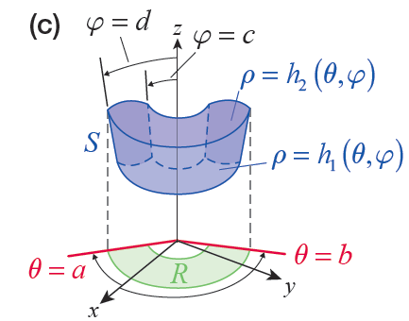
Procedure: Setting up a Triple Integral in Spherical Coordinates (cont.)
Step 3: Define R to be the projection of S in the xy-plane. The lower θ -limit θ = a defines one ray that bounds R, and the upper θ -limit θ = b defines the other ray—R should be captured between the two rays (see Figure 9c).
Figure 9(c)

Slide 39
Procedure: Setting up a Triple Integral in Spherical Coordinates (cont.)
The result will be

Slide 40
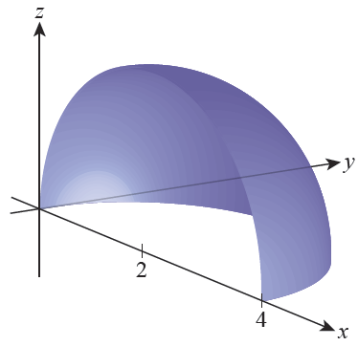
Example 5: Setting Up a Triple Integral in Spherical Coordinates
Set up the general form for the integral of a function
f(x, y, z), over the solid S defined as the first-octant portion of the sphere
Solution
Figure 10 shows the outer surface
of the portion of the sphere we are
to integrate over.
Figure 10

Slide 41
Example 5: Setting Up a Triple Integral in Spherical Coordinates (cont.)
From Example 4, we know that ρ = 4 sin φ cosθ describes the surface in spherical coordinates, so to limit the integral to the part in the first octant we restrict θ and φ to and The lower ρ -limit is ρ = 0, while the upper ρ -limit is the equation for the sphere. All that remains is to convert the arguments of f appropriately and to remember to include the factor of ρ² sinφ in the integral.

Slide 42
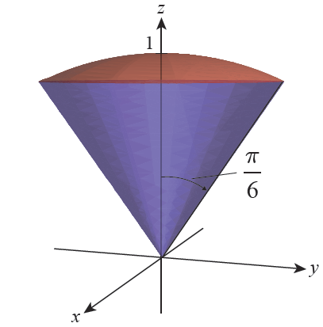
Example 6: Using a Triple Integral in Spherical Coordinates to Find the Volume of a Solid
Find the volume of the solid, shown in Figure 11, bounded below by the cone and above by the sphere ρ = 1.
Figure 11

Slide 43
Example 6: Using a Triple Integral in Spherical Coordinates to Find the Volume of a Solid (cont.)
Solution
The lower and upper limits on ρ are 0 and 1, respectively, while the φ -interval is and the θ-interval is Since we seek only the volume, we integrate the constant function 1 over S. However, don’t forget to include the factor of ρ²sinφ, which is part of the volume differential dV.

Slide 44
Example 6: Using a Triple Integral in Spherical Coordinates to Find the Volume of a Solid (cont.)

