Slide 1
Section 14.6
Substitutions and Multiple Integrals

Slide 2
Substitutions in Double Integrals
To set the stage for the general theory, recall the Substitution Rule (u-substitution).
While to this point we have used the Substitution Rule to replace the integral on the right with the one on the left, we focus attention now on the factor of we can think of it as a transformation factor necessary to convert the integral from one variable to the another.

Slide 3
Substitutions in Double Integrals (cont.)
Similarly, the factor of r allows us to convert a double integral from Cartesian coordinates to polar coordinates.

Slide 4
Substitutions in Double Integrals (cont.)
More generally, consider a transformation function T of the form T(u, v) = (x, y) from the uv-coordinate system to the xy-coordinate system. T takes a point with coordinates (u, v) and converts it to coordinates (x, y), where both x and y are functions of u and v.

Slide 5
Substitutions in Double Integrals (cont.)
For our purposes, we will assume that g and h have continuous first-order partial derivatives (such a function T is said to be a C¹ transformation). We also assume that T is a one-to-one function on a domain region S in the uv-plane onto a region R in the xy-plane, so that for each point there is a unique point such that

Slide 6
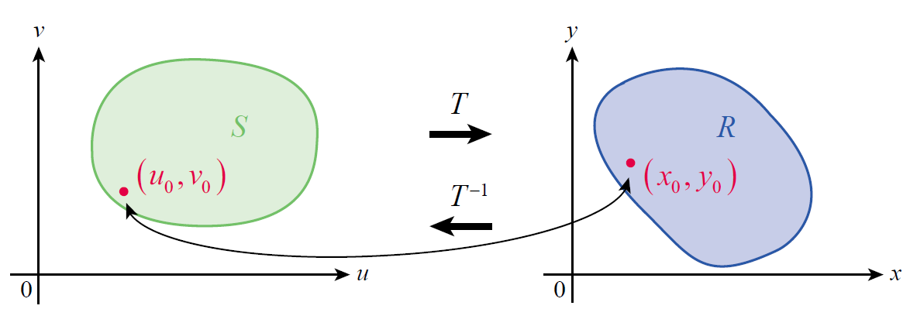
Substitutions in Double Integrals (cont.)
We call (u₀, v₀) the preimage of (x₀, y₀), and (x₀, y₀) the image of (u₀, v₀); similarly, we say the region S is the preimage of R, or that R is the image of S. Figure 1 illustrates these relationships; note that since T is one­-to-one, the inverse transformation T ⁻¹ is a function from R to S.
Figure 1 A Transformation and Its Inverse

Slide 7
Substitutions in Double Integrals (cont.)
Our goal is to convert a double integral of a function f(x, y) over R into a double integral of f(g(u, v), h(u, v)) over S, ideally in such a manner that the converted integral is easier to evaluate. But to do so, we need to know how each differential area element dx dy relates to its corresponding differential area element du dv. The relationship is a ratio of areas, and can informally be determined by the following argument (a formal proof is best left for a class in advanced calculus).

Slide 8
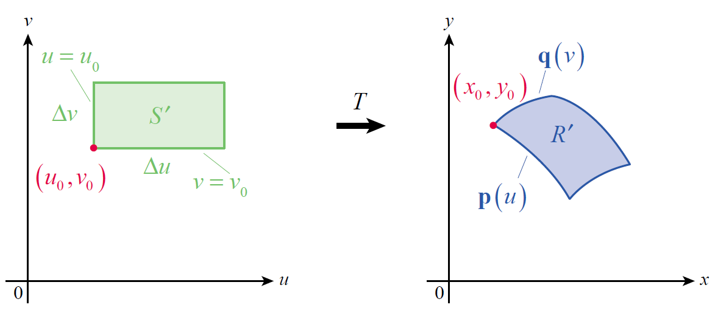
Substitutions in Double Integrals (cont.)
Beginning with a fixed point (u₀, v₀) in the interior of S, let Δu and Δv be small positive increments and consider the rectangle S′ shown on the left in Figure 2 (we assume the increments are small enough so that
S′ ⊆ S). The function T then transforms S′ into a region R′ ⊆ R, shown on the right in Figure 2.
Figure 2

Slide 9
Substitutions in Double Integrals (cont.)
Let
and define
Then both p(u₀) and q(v₀) are position vectors for the point (x₀, y₀), and p(u) and q(v) are vector functions that trace out edges of R′ as shown in Figure 2.

Slide 10
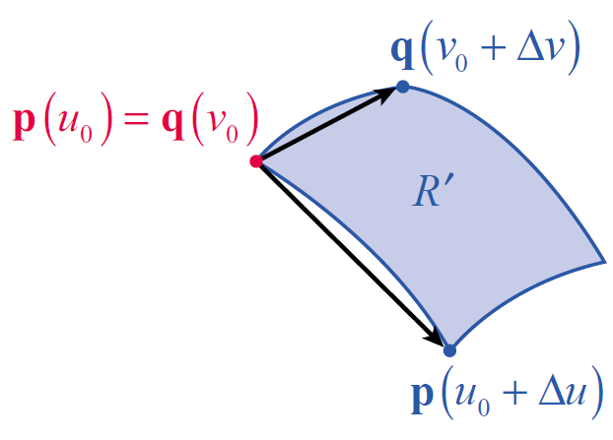
Substitutions in Double Integrals (cont.)
We can approximate the area of R′ with the area of the parallelogram defined by the vectors
and (see Figure 3), and from Section 11.4 we know that the area of the parallelogram
is the magnitude of the cross
product of the vectors.
Figure 3

Slide 11
Substitutions in Double Integrals (cont.)
Since
the area of the parallelogram is

Slide 12
Substitutions in Double Integrals (cont.)
Note that
and

Slide 13
Substitutions in Double Integrals (cont.)
so
and hence
Before proceeding, we use this as the basis for a definition.

Slide 14
Definition: The Jacobian of a Transformation
The Jacobian (or Jacobian determinant) of the coordinate transformation T defined by x = g(u, v) and
y = h(u, v) is

Slide 15
Substitutions in Double Integrals (cont.)
Given this definition, the area of the region R′ is approximately
where the Jacobian is evaluated at (u₀, v₀).

Slide 16
Substitutions in Double Integrals (cont.)
So if we let ΔA denote the area of any such region R′ in R (see Figure 4), we can approximate the double integral of a function f(x, y) over R by a Riemann sum of the form
where each Jacobian is evaluated at (u*, v* ).

Slide 17
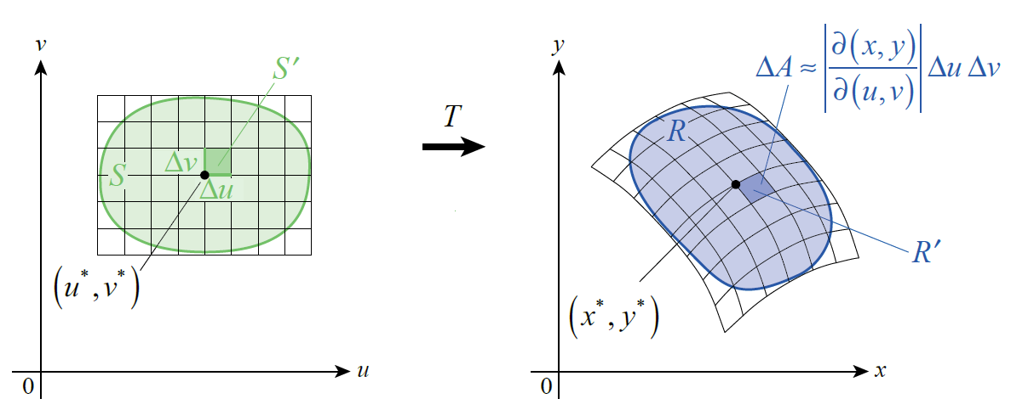
Substitutions in Double Integrals (cont.)
This gives rise to the following theorem.
Figure 4

Slide 18
Theorem: Change of Variables in a Double Integral
Assume T is a coordinate transformation from S to R defined by x = g(u, v) and y = h(u, v), where g and h both have continuous first-order partial derivatives, and that T is one-to-one on S (except possibly on the boundary of S). Assume also that the Jacobian of T is nonzero on S and that f is continuous on R. Then

Slide 19
Example 1: Using a Jacobian to Derive a Double Integral in Polar Coordinates
Use a Jacobian to derive the formulation of double integrals in polar coordinates.
Solution
The coordinate transformation T from polar coordinates to Cartesian coordinates is defined by
x = r cosθ and y = r sinθ.

Slide 20
Example 1: Using a Jacobian to Derive a Double Integral in Polar Coordinates (cont.)
Hence,
(under the assumption that r > 0).

Slide 21
Example 2: Using a Change of Variables to Evaluate a Double Integral
Use a change of variables to evaluate
where R is the region bounded by x = 0, y = 0, and
3x + 2y = 2.
Solution
This double integral is awkward to evaluate using Cartesian coordinates, but the right choice of change of variables makes it much easier. One possibility is to let u equal the numerator and v the denominator of the integrand.
u = 3x + 2y and v = x + 4y

Slide 22
Example 2: Using a Change of Variables to Evaluate a Double Integral (cont.)
In order to determine the Jacobian of the transformation from the uv-plane to the xy-plane, we need to solve these two equations for x and y.

Slide 23
Example 2: Using a Change of Variables to Evaluate a Double Integral (cont.)
We can now calculate

Slide 24
Example 2: Using a Change of Variables to Evaluate a Double Integral (cont.)
A diagram of the region S in the uv‑plane that corresponds to R in the xy‑plane is helpful in determining limits, and Figure 5 illustrates both. Each boundary of R corresponds to a boundary of S as follows.

Slide 25
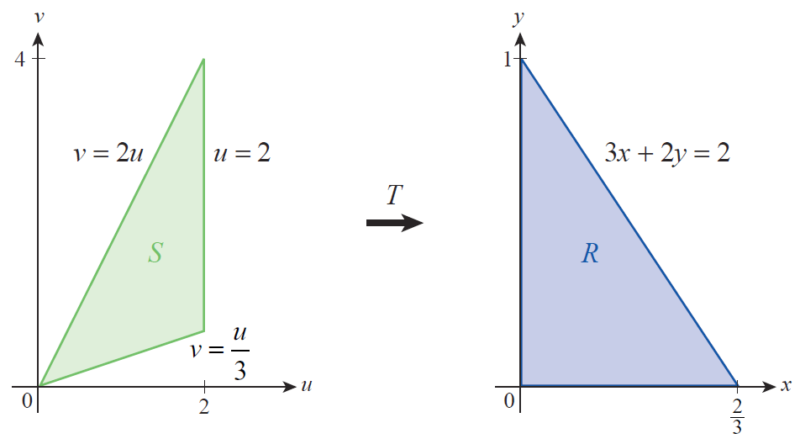
Example 2: Using a Change of Variables to Evaluate a Double Integral (cont.)
Figure 5

Slide 26
Example 2: Using a Change of Variables to Evaluate a Double Integral (cont.)
(By calculating the area of each triangle, note that the area of R is the area of S.) We are now ready to change variables in the integral and evaluate it.

Slide 27
Definition: The Jacobian of a Transformation (Three-Dimensional Version)
The Jacobian of the coordinate transformation T defined by x = g(u, v, w), y = h(u, v, w), and z = k(u, v, w) is

Slide 28
Theorem: Change of Variables in a Triple Integral
Assume T is a coordinate transformation from S to R defined by x = g(u, v, w), y = h(u, v, w), and
z = k(u, v, w), where g, h, and k all have continuous first-order partial derivatives, and that T is one-to-one on S (except possibly on the boundary of S). Assume also that the Jacobian of T is nonzero on S and that f is continuous on R. Then

Slide 29
Example 3: Using a Jacobian to Derive a Triple Integral in Spherical Coordinates
Use a Jacobian to derive the formulation of triple integrals in spherical coordinates.
Solution
The coordinate transformation T from spherical coordinates to Cartesian coordinates is defined by

Slide 30
Example 3: Using a Jacobian to Derive a Triple Integral in Spherical Coordinates (cont.)

Slide 31
Example 3: Using a Jacobian to Derive a Triple Integral in Spherical Coordinates (cont.)

Slide 32
Example 3: Using a Jacobian to Derive a Triple Integral in Spherical Coordinates (cont.)
Once we take the absolute value of the Jacobian (and use the fact that 0 ≤ φ ≤ π, so sin φ ≥ 0), we obtain the following.

Slide 33
Example 4: Using a Change of Variables to Evaluate a Triple Integral
Use a change of variables to evaluate
where R is the solid bounded by the planes y = 0, y = 3, z = 0, z = 4, 3x = z, and 3x = z + 3.
Solution
As in Example 2, the first step is to decide on a change of variables to try. On the basis of the integrand, and also guided by the form of two of the six planes, the assignment u = 3x − z appears promising.

Slide 34
Example 4: Using a Change of Variables to Evaluate a Triple Integral (cont.)
This will allow two of the faces of the parallelepiped to be expressed as u = 0 and u = 3. If we let and
then
and

Slide 35
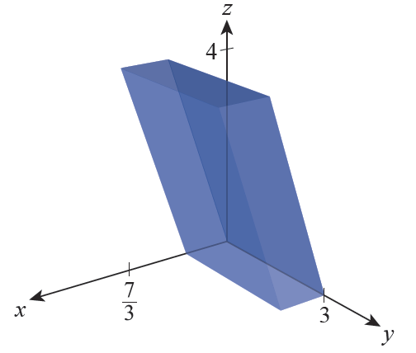
Example 4: Using a Change of Variables to Evaluate a Triple Integral (cont.)
The solid S corresponding to the limits, in xyz-space, appears in Figure 6.
Figure 6

