Slide 1
Section 15.2
Line Integrals

Slide 2
Integrals along Curves in Space
Suppose C is a curve in space (either ℝ² or ℝ³) defined by a vector function r(t) over the interval a ≤ t ≤ b; that is, C is described by a function of the form or Assume also that C is smooth meaning that r′ is continuous and never zero on [a, b].

Slide 3
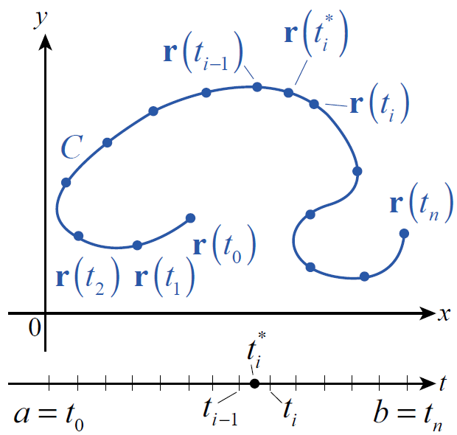
Integrals along Curves in Space (cont.)
To define an integral over the curve, consider a partition P of C such as shown in Figure 1, defined by a corresponding partition of the interval [a, b]. For each subinterval let Δs_{i} be the arc length of the portion of C between and
Figure 1

Slide 4
Integrals along Curves in Space (cont.)
Then for any function f whose domain contains C, we can form the Riemann sum
Where is a sample point chosen from the subinterval If, for a given function f , each such Riemann sum approaches the same value as the partitions get finer and finer, we define that value to be the line integral of f along C.

Slide 5
Definition: Line Integral
Given a function f defined on a curve C described by the smooth vector function r(t), a ≤ t ≤ b, the line integral of f along C is the value
provided the limit exists.

Slide 6
Integrals along Curves in Space (cont.)
While the formal definition can be used as the basis for numerical approximations of line integrals, we also desire techniques to evaluate exactly, if possible. The most common formula uses the relationship between the arc length differential ds and parameter differential dt.

Slide 7
Integrals along Curves in Space (cont.)
This allows us to express as an integral in the
variable t over the interval [a, b].

Slide 8
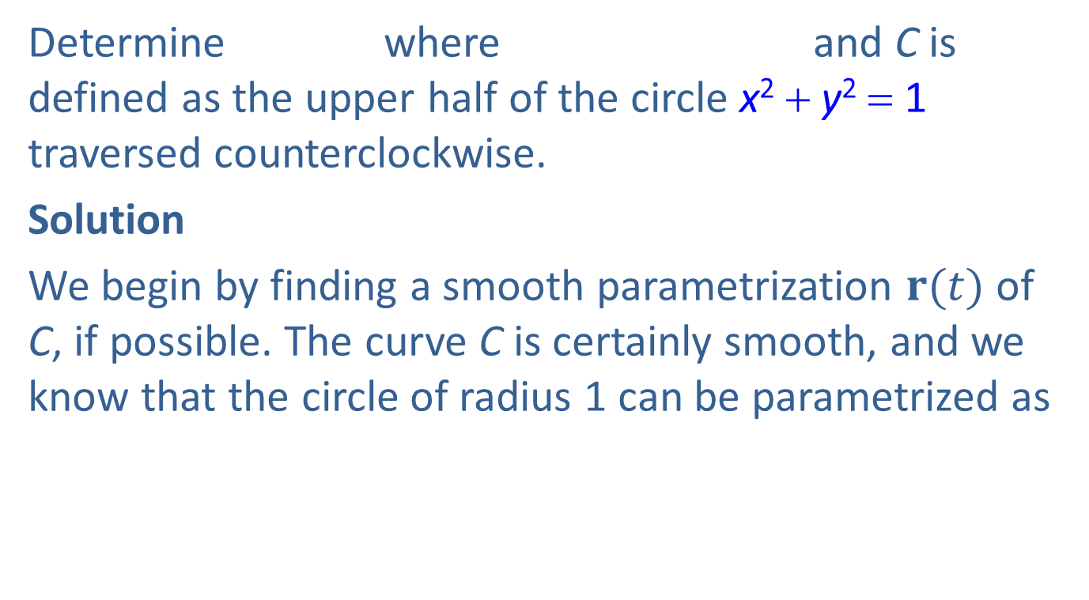
Example 1: Evaluating a Line Integral
Determine where and C is defined as the upper half of the circle x² + y² = 1 traversed counterclockwise.
Solution
We begin by finding a smooth parametrization $r(t)$ of C, if possible. The curve C is certainly smooth, and we know that the circle of radius 1 can be parametrized as

Slide 9
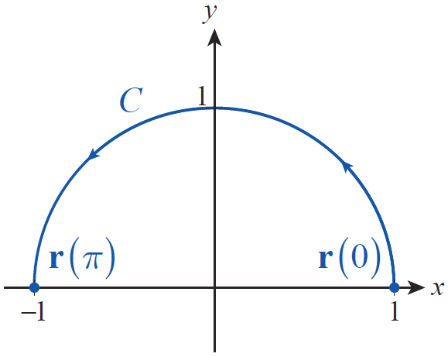
Example 1: Evaluating a Line Integral (cont.)
To describe the upper half of the circle traversed counterclockwise, we use the t-interval (see Figure 2). And since
Figure 2

Slide 10
Example 1: Evaluating a Line Integral (cont.)
On C,
So,

Slide 11
Example 2: Evaluating a Line Integral
Determine where and C is
defined as the line segment starting at (−1,2,5) and ending at (2,0,1).
Solution
The vector points in the direction from the initial point to the terminal point, so we can describe C with the following parametrization.

Slide 12
Example 2: Evaluating a Line Integral (cont.)
Alternatively, the line segment between (−1,2,5) and (2,0,1) can be described as a linear combination of the position vectors and
Either derivation results in and
so

Slide 13
Integrals along Curves in Space (cont.)
If C₁ and C₂ are smooth curves such that the terminal point of C₁ coincides with the initial point of C₂, and if f is integrable over each of C₁ and C₂, then f is also integrable over the piecewise smooth path C₁ ∪ C₂ and
This is analogous to the property and extends to any finite number of smooth curves joined together.

Slide 14
Definition: Mass, First and Second Moments, Center of Mass, and Radii of Gyration
Given an object in space modeled by the curve C and whose density is represented by ρ, its mass M, its first moments M_{yz}, M_{xz}, and M_{xy} about the coordinate planes, its second moments I_{x}, I_{y}, and I_{z} about the coordinate axes, its center of mass and its radii of gyration r_{x}, r_{y}, and r_{z} are as follows, assuming the integrals exist.

Slide 15
Definition: Mass, First and Second Moments, Center of Mass, and Radii of Gyration (cont.)
Mass
First moment about the yz-plane
First moment about the xz-plane
First moment about the xy-plane
Center of mass

Slide 16
Definition: Mass, First and Second Moments, Center of Mass, and Radii of Gyration (cont.)
Second moment about the x-axis
Second moment about the y-axis
Second moment about the z-axis
Radii of gyration

Slide 17
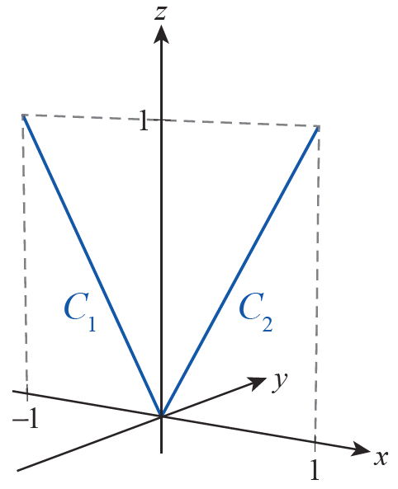
Example 3: Finding the Mass, First Moments, and Center of Mass of an Object
Determine the mass, first moments, and center of mass of the V-shaped object in the xz-plane shown in Figure 4, constructed from two rods of constant linear density ρ = 1.
Figure 4

Slide 18
Example 3: Finding the Mass, First Moments, and Center of Mass of an Object (cont.)
Solution
We will let C denote the given object, which consists of the line segment C₁ from (−1,0,1) to (0,0,0) joined to the line segment C₂ from (0,0,0) to (1,0,1). C₁ can be parametrized as and C₂ by both over 0 ≤ t ≤ 1.

Slide 19
Example 3: Finding the Mass, First Moments, and Center of Mass of an Object (cont.)
These lead to
By symmetry, and

Slide 20
Definition: Line Integral of a Vector Field
Assume F is a continuous vector field whose domain contains the curve C defined by the smooth vector function r(t), with t taking on values between a and b. Then the line integral of F along C is as follows.

Slide 21
Definition: Line Integral of a Vector Field (cont.)
Further, if F is a vector field in ℝ² or ℝ³ and has component form or and if or respectively, the line integral can be evaluated as
or

Slide 22
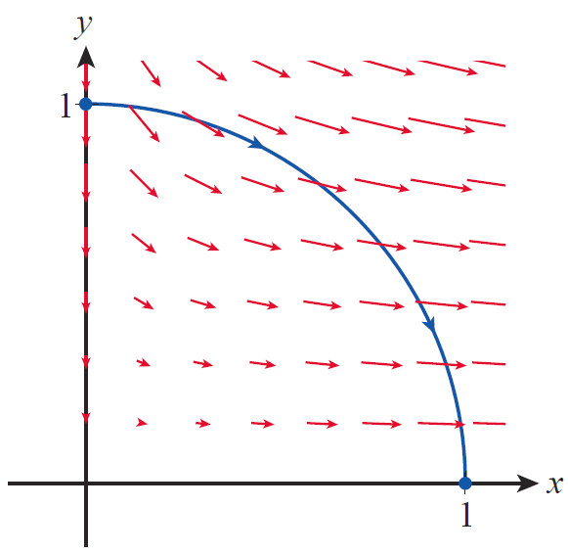
Example 4: Finding the Work Done by a Force Field in Moving a Particle
Determine the work done by the force field in moving a particle clockwise along the quarter circle shown in Figure 6.
Solution
The force field F is depicted in Figure 6 by the red vectors (shown scaled, not to actual length).
Figure 6

Slide 23
Example 4: Finding the Work Done by a Force Field in Moving a Particle (cont.)
We know that the circle of radius 1 can be parametrized by the vector function but to describe the path C taken by the particle, we let and b = 0. We now proceed to express the work as an integral in t.

Slide 24
Example 4: Finding the Work Done by a Force Field in Moving a Particle (cont.)

Slide 25
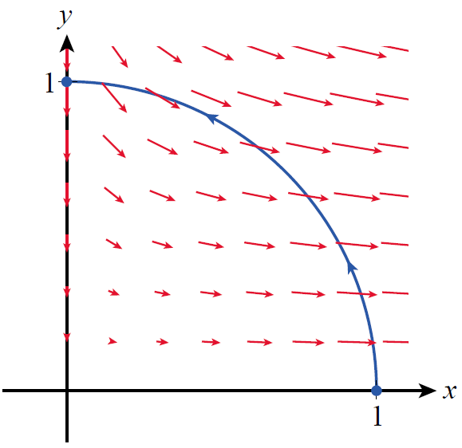
Work, Flow, and Line Integrals (cont.)
Note that the orientation of the path C is important. If we had instead evaluated the integral
In Example 4, we would have arrived
at a work value of −2. A negative
result in this context means that
the particle was moved against the
force of the vector field (in other
words, work was done to oppose
the vector field), as illustrated in Figure 7.
Figure 7

Slide 26
Work, Flow, and Line Integrals (cont.)
Symbolically, if we let −C denote the reverse orientation of a curve C, then
If a given vector field F represents the velocity of a fluid in a region, F is a velocity field. The line integral of F along C may then be called a flow integral, and its value represents the flow of the fluid along the curve. If C happens to be a closed loop, the flow is called the circulation of the fluid around the curve.

Slide 27
Example 5: Determining a Fluid's Flow along a Curve
Given a fluid velocity field defined by the gradient of the potential function determine the fluid’s flow along the curve from the point (0,0,0) to the point (1,1,1).
Solution
We start by finding the velocity field explicitly.

Slide 28
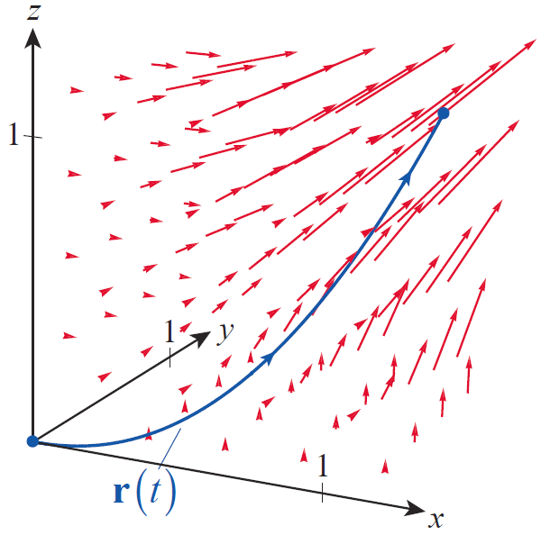
Example 5: Determining a Fluid's Flow along a Curve (cont.)
This vector field is depicted in Figure 8, with the vectors again shown scaled. To determine the flow, we compute the line integral of F along the curve, as in Example 4.
Figure 8

Slide 29
Example 5: Determining a Fluid's Flow along a Curve (cont.)

