Slide 1
Section 15.4
Green’s Theorem

Slide 2
Divergence and Curl Operators
Notational Note: The del operator ∇ can be interpreted as a vector consisting of partial differentiation operators, with the vector components determined by the context. For instance, if f is a function of two variables, and when applied to a function g of three variables,

Slide 3
Definition: Divergence (Flux Density) of a Vector Field
The divergence, or flux density, of a vector field is the scalar function
For a vector field of three variables,

Slide 4
Definition: Divergence (Flux Density) of a Vector Field (cont.)
In general, we can denote the divergence of a vector field F as the dot product of the del operator and F.
div F = ∇ ⋅ F

Slide 5
Divergence and Curl Operators (cont.)
The divergence of a vector field has a physical interpretation that is important in physics and related disciplines. We develop the interpretation for a vector field of two variables, but the idea is valid for any number of variables.
Suppose that represents the velocity field of a fluid flowing in the plane, and (x, y) is the lower-left corner of a rectangle lying entirely in the domain of F. Assume the rectangle has width Δx and height Δy.

Slide 6
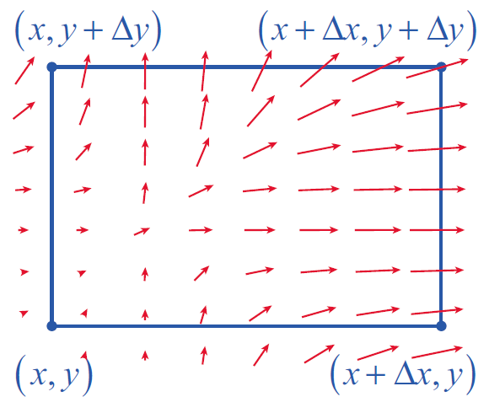
Divergence and Curl Operators (cont.)
Then the rate at which the fluid leaves the rectangle by flowing across a given boundary of the rectangle is approximated by the dot product of F (evaluated at some point along the boundary) and the outward normal vector to the boundary, times the length of the boundary (see Figure 1).
Figure 1

Slide 7
Divergence and Curl Operators (cont.)
For instance, since −j is the outward normal vector for the bottom of the rectangle, the flow rate of the fluid across the bottom is approximately (if more fluid is entering than leaving the rectangle across a given boundary, the dot product is negative). In all, the rates at which the fluid flows outward across the four edges of the rectangle are as follows.

Slide 8
Divergence and Curl Operators (cont.)

Slide 9
Divergence and Curl Operators (cont.)
Combining opposite edges of the rectangle, note that
so the total net flow rate of the fluid out of the rectangle is approximately

Slide 10
Divergence and Curl Operators (cont.)
When we divide the flow (or flux) rate by the area ΔxΔy of the rectangle, we obtain the total flow per unit area, which we have defined as the divergence or flux density of the fluid.

Slide 11
Example 1: Finding and Interpreting the Divergence of a Vector Field at a Point
Suppose that represents the velocity field of a gas. Calculate the divergence of F at the points (1, 2, −1), (0, 4, 1), and (1, 6, 1) and interpret the results.
Solution

Slide 12
Example 1: Finding and Interpreting the Divergence of a Vector Field at a Point (cont.)
The fact that means the gas is expanding at (1, 2, −1), the fact that means the gas is condensing (or is being compressed) at (0, 4, 1), and the fact that div F(1, 6, 1) = 0 means the volume of gas flowing toward the point (1, 6, 1) is the same as the volume of gas flowing away.

Slide 13
Definition: Curl of a Vector Field
The curl of a vector field is the vector function
The curl of a vector field F can be remembered as the cross product of the del operator and F.
curl F = ∇ × F

Slide 14
Divergence and Curl Operators (cont.)
In order to compare curl with divergence, we develop the physical interpretation of ∇ × F for a field F(x, y).
Accordingly, suppose again represents the velocity field of a fluid in the plane, and that (x, y) is the lower-left corner of a rectangle lying entirely in the domain of F. We first extend F as

Slide 15
Divergence and Curl Operators (cont.)
This time, we are interested in quantifying the counterclockwise circulation of F around the rectangle, instead of the flow of F out of the rectangle (the counterclockwise, or positive, orientation around a closed curve is used to maintain consistency with the right-hand rule).

Slide 16
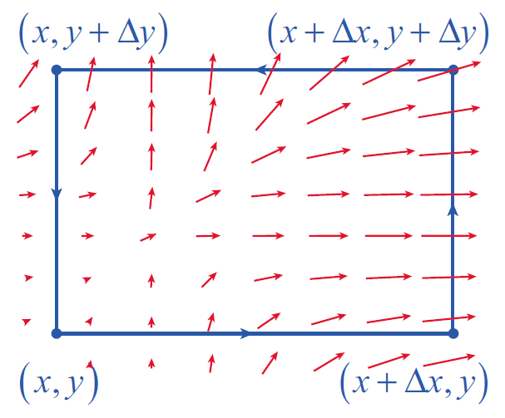
Divergence and Curl Operators (cont.)
To do so, we calculate the dot product of F with the vector associated with each edge of the rectangle (see Figure 2); a positive result indicates F is flowing in the direction of the edge, while a negative result means the flow of F is opposite the orientation of the edge.
Figure 2

Slide 17
Divergence and Curl Operators (cont.)
This gives us the following rates of flow.

Slide 18
Divergence and Curl Operators (cont.)
This time, when we combine the results for opposite sides, we obtain
and adding them together we have a total circulation (in the counterclockwise direction) around the rectangle of approximately

Slide 19
Divergence and Curl Operators (cont.)
As with divergence, we divide by the area ΔxΔy of the rectangle to obtain what is sometimes called the circulation density of F. It constitutes the component of curl F in the k direction. This means for a vector field in the plane,

Slide 20
Example 2: Finding the Curl of a Vector Field
Find the curl of the vector field in the plane.
Solution
The calculation itself is easily accomplished.

Slide 21
Example 2: Finding the Curl of a Vector Field (cont.)

Slide 22
Example 2: Finding the Curl of a Vector Field (cont.)
The physical interpretation of this result is worth our attention. If F models the velocity field for a fluid in the plane, such as water flowing toward a drain over the flat bottom of a sink, then the curl of F at any given point tells us something about the forces felt by a very small paddle wheel with axis in the k direction (see Figure 3).

Slide 23
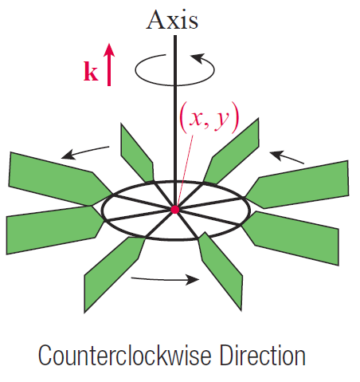
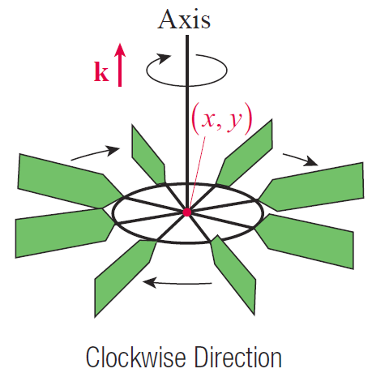
Example 2: Finding the Curl of a Vector Field (cont.)
Figure 3

Slide 24
Example 2: Finding the Curl of a Vector Field (cont.)
If curl F(x, y) = ck, with c > 0, the paddle wheel at (x, y) spins in the positive (counterclockwise) direction; if curl F(x, y) = ck, with c < 0, the wheel spins in the opposite direction. And if curl F(x, y) = 0, the wheel doesn’t spin at all, though that doesn’t mean that there are no forces at the point (x, y)—a paddle wheel at such a point may feel a force pushing it, but not spinning it.

Slide 25
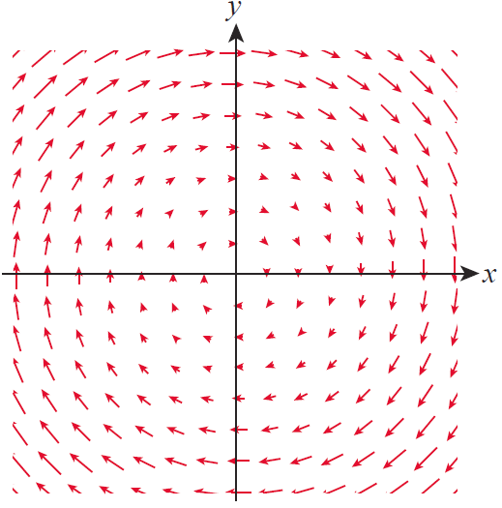
Example 2: Finding the Curl of a Vector Field (cont.)
Figure 4 is a scaled illustration of the velocity field Since we know the curl of F is −2k at every point, a small paddle wheel at any point in the plane spins in the clockwise direction (at the same rate) as a result of the field.
Figure 4

Slide 26
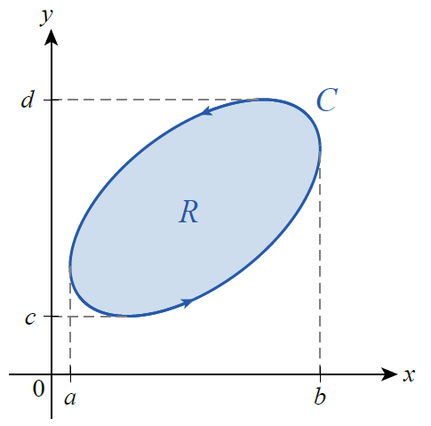
Green’s Theorem
Green’s Theorem relates line integrals around a closed path to double integrals over the region enclosed by the path.
The principle at the heart of Green’s Theorem is most evident if we first apply it to a simple closed path C such as in Figure 5, where every line parallel to a coordinate axis intersects C in at most two points.
Figure 5

Slide 27
Green’s Theorem (cont.)
We develop the theorem under the assumption that the orientation of C is positive, which we denote with a counterclockwise circle on the integral sign, such as ∳, and we let R denote the region enclosed by C. To use Green’s Theorem in evaluating the line integral of a vector field around C, we assume that F has continuous first partial derivatives on an open region containing R.

Slide 28
Green’s Theorem (cont.)
We already know that the total circulation of F around C can be written as
and we now examine the two integrals ∳_{C} Pdx and
∳_{C} Qdy individually.
∳_{C}
∳_{C}
∳_{C}

Slide 29
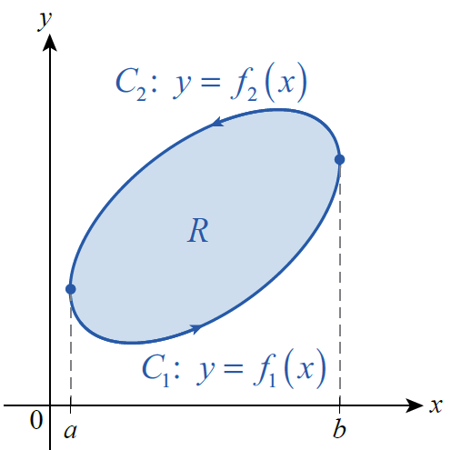
Green’s Theorem (cont.)
∳_{C}
Claim 1: To prove this, split C into
the two functions of x illustrated in Figure 6, and note that by the Fundamental Theorem of Calculus
Figure 6

Slide 30
Green’s Theorem (cont.)
so
∳_{C}

Slide 31
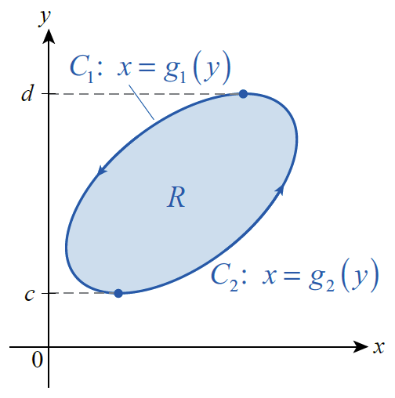
Green’s Theorem (cont.)
∳_{C}
Claim 2: We prove this in a similar
fashion, but this time by splitting C into the two functions of y illustrated in Figure 7. Then again by the Fundamental Theorem of Calculus,
Figure 7

Slide 32
Green’s Theorem (cont.)
so
∳_{C}

Slide 33
Green’s Theorem (cont.)
Combining the two pieces gives us one form of Green’s Theorem:
As it turns out, Green’s Theorem applies to simple closed paths much more general than what we have used to derive the formula, but we will only sketch how the proof can be extended. Before doing so, we illustrate the theorem’s use.
∳_{C}

Slide 34
Example 3: Using Green's Theorem to Evaluate a Line Integral
∳_{C}
Evaluate where C is
the circle x² + y² = 25.
Solution
Since
the vector field implicit in the integral is not conservative and the Fundamental Theorem for Line Integrals can’t be used.

Slide 35
Example 3: Using Green's Theorem to Evaluate a Line Integral (cont.)
However, using Green’s Theorem,
∳_{C}

Slide 36
Example 3: Using Green's Theorem to Evaluate a Line Integral (cont.)
This example demonstrates how Green’s Theorem can be used to easily evaluate integrals which would be extremely difficult to evaluate directly using a parametrization of C.

Slide 37
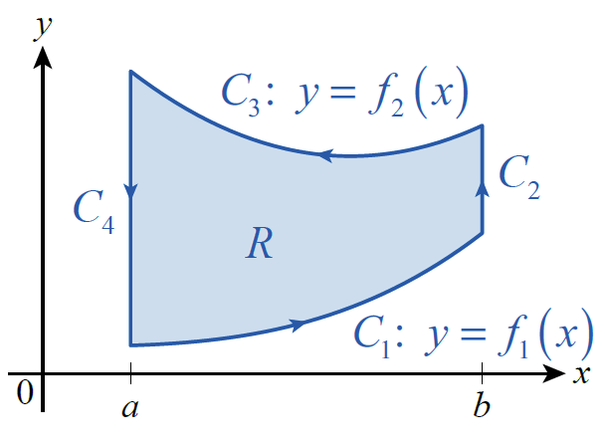
Green’s Theorem (cont.)
To see how the theorem applies to more general simple closed paths, consider the region R and closed path C = C₁ ∪ C₂ ∪ C₃ ∪ C₄ of Figure 8. Suppose C₁ and C₃ represent the graphs of functions f₁(x) and f₂(x), respectively. Note that x is constant on C₂ and C₄, so dx = 0 along both sides.
Figure 8

Slide 38
Green’s Theorem (cont.)
∳_{C}

Slide 39
Green’s Theorem (cont.)
To see that
for the path C of Figure 8, we have to modify the argument slightly, as shown next.
∳_{C}

Slide 40
Green’s Theorem (cont.)
Although we proved Green’s Theorem for a simply connected region bounded by a particularly nice simple closed path, the properties of line integrals and double integrals allow us to extend the theorem to regions and paths that are finite unions of simpler regions and paths.

Slide 41
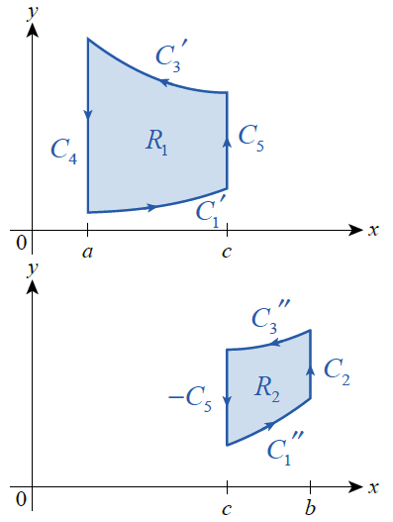
Green’s Theorem (cont.)
For example, we can divide the region R of Figure 8 into R₁ ∪ R₂ , with boundaries as labeled in Figure 9.
Figure 8
Figure 9

Slide 42
Green’s Theorem (cont.)
We use the facts that
and
to obtain

Slide 43
Green’s Theorem (cont.)
∳_{C}

Slide 44
Theorem: Green’s Theorem (Tangential-Curl Form)
Let C be a positively oriented, piecewise smooth, simple closed curve in the plane, and let R be the region enclosed by C. If and P and Q have continuous partial derivatives on an open region containing R, then
∳_{C}
∳_{C}
∳_{C}

Slide 45
Theorem: Green’s Theorem (Tangential-Curl Form) (cont.)
Extending F to and using the fact that
we can write this version of the formula as
∳_{C}

Slide 46
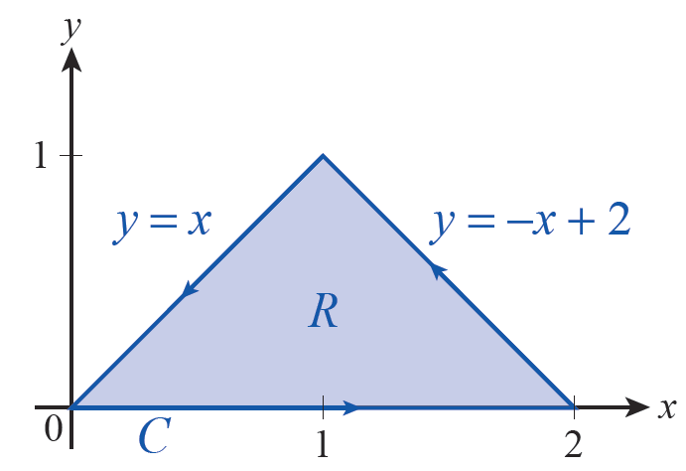
Example 4: Using Green's Theorem (Tangential-Curl Form) to Evaluate a Line Integral
∳_{C}
Evaluate where C is the path shown
in Figure 10.
Solution
Since P = y² and Q = 3xy,
(Alternatively, and
Figure 10

Slide 47
Example 4: Using Green's Theorem (Tangential-Curl Form) to Evaluate a Line Integral (cont.)
So
∳_{C}

Slide 48
Green’s Theorem (cont.)
Remember what the result in Example 4 means physically: if F represents the velocity field of a fluid in the plane, the total circulation of F around C is
In other settings, we need to calculate the flux of F outward across the boundary of a simple closed path, and Green’s Theorem can be used for that purpose as well.

Slide 49
Green’s Theorem (cont.)
If we let n denote the unit vector normal to C at any given point of the path, then we have the following formula for the flux.
This is the counterpart to the integral for the circulation of F around C.
∳_{C}
∳_{C}

Slide 50
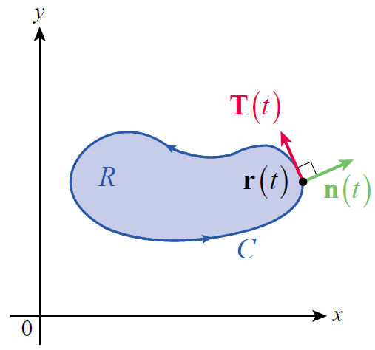
Green’s Theorem (cont.)
We can now develop the second version of Green’s Theorem from the first. Since
the outward normal unit vector n is the vector function
(see Figure 11).
Figure 11

Slide 51
Green’s Theorem (cont.)
So we have
∳_{C}

Slide 52
Theorem: Green’s Theorem (Normal-Divergence Form)
Let C be a positively oriented, piecewise smooth, simple closed curve in the plane, and let R be the region enclosed by C. If and P and Q have continuous partial derivatives on an open region containing R, then
∳_{C}
∳_{C}

Slide 53
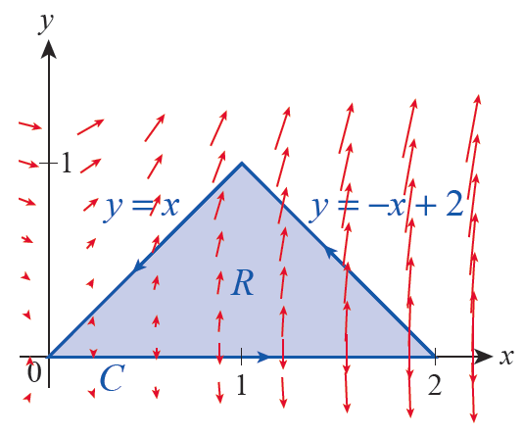
Example 5: Evaluating the Outward Flux of a Vector Field across a Closed Path
Evaluate the outward flux of the vector field across the path C of Figure 12.
Figure 12

Slide 54
Example 5: Evaluating the Outward Flux of a Vector Field across a Closed Path (cont.)
Solution
Since P = y² and Q = 3xy,
∳_{C}

Slide 55
Example 5: Evaluating the Outward Flux of a Vector Field across a Closed Path (cont.)
The vector field F is also shown in Figure 12. The flux into and out of the enclosed region along the lower edge of C is 0 (since y = 0), and the flux is positive (outward) along the other two edges, consistent with the result we have calculated for total flux.
Figure 12

Slide 56
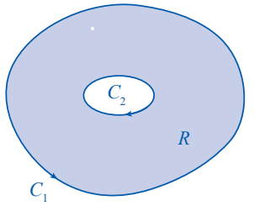
Green’s Theorem (cont.)
The fact that two line integrals cancel if they are evaluated along the same path with opposite
orientation means that we can decompose even nonsimply connected regions and apply Green’s Theorem, as long as the boundary paths are oriented appropriately. Consider, for example, the region R of
Figure 13.
Figure 13

Slide 57
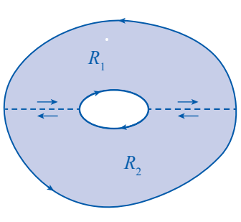
Green’s Theorem (cont.)
Its boundary C consists of two simple closed curves C₁ and C₂, which we orient so that R is always on the left as we traverse either curve. Then if we divide R into two subregions R₁ and R₂,
as shown in Figure 14, the
additive properties of area
and line integrals (along with
Green’s Theorem) again allow
us to state
Figure 14

Slide 58
Green’s Theorem (cont.)

Slide 59
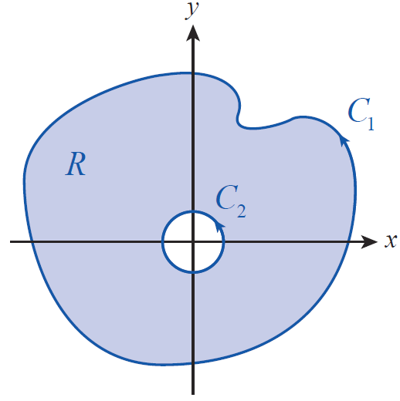
Example 6: Showing That Two Circulations Are Equivalent
∳_{C1}
∳_{C2}
Let Show that for
C₁ and C₂ as shown in Figure 15.
Figure 15

Slide 60
Example 6: Showing That Two Circulations Are Equivalent (cont.)
Solution
Both C₁ and C₂ are oriented counterclockwise, but if we define the region R as being bounded by then R is to the left as we traverse any part of its boundary, so

Slide 61
Example 6: Showing That Two Circulations Are Equivalent (cont.)
Hence,
which is equivalent to
It can be shown that this implies
for every such simple closed path C enclosing the origin.
∳_{C1}
∳_{C2}
∳_{C}

