Slide 1
Section 15.8
The Divergence Theorem

Slide 2
The Divergence Theorem
Recall the Normal-Divergence Form of Green’s Theorem: given a vector field F defined on an open region containing R ⊆ ℝ², whose boundary is a positively oriented piecewise smooth simple closed curve C,
∳_{C}

Slide 3
The Divergence Theorem (cont.)
In words, the total outward flux of F across C is equal to the integral of the divergence of F over the region bounded by C. This is often informally stated with a phrase like the net flow of a vector field out of a region is equal to the sum of the sources and sinks of the field in the region. In this context, a source of F is a point where its divergence ∇ ⋅ F is positive, and a sink is a point where ∇ ⋅ F is negative.

Slide 4
The Divergence Theorem (cont.)
This principle holds true in any number of dimensions, and its statement in three dimensions is known as the Divergence Theorem. While the theorem applies to a variety of regions, a complete classification of them would lead us too far astray from the task of introducing the topic. For our purposes, we are interested in regions that are simple or that can be decomposed into a union of a finite number of simple regions. A simple region D in space, as illustrated in Figure 1, is one that can be described in each of the following ways:

Slide 5
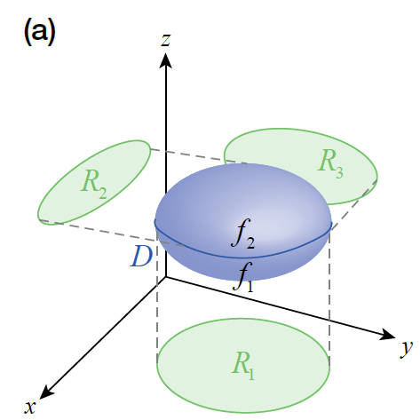
The Divergence Theorem (cont.)
Figure 1a

Slide 6
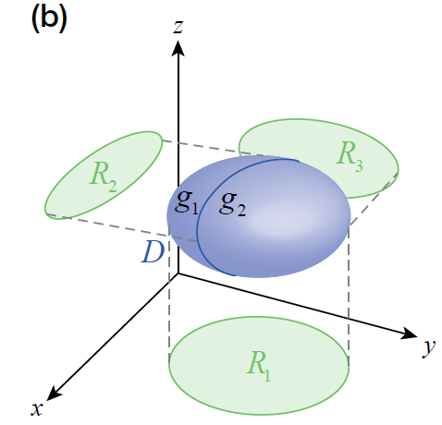
The Divergence Theorem (cont.)
Figure 1b

Slide 7
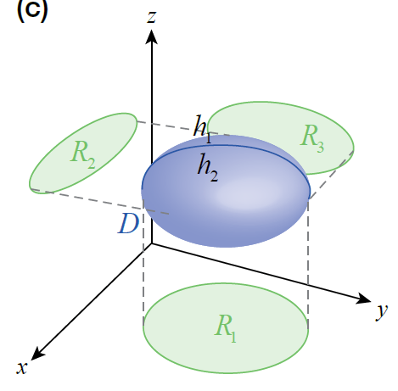
The Divergence Theorem (cont.)
where the bounding surfaces
are all
smooth.
With this definition, we can now
state the Divergence Theorem.
Figure 1c

Slide 8
Theorem: The Divergence Theorem
Assume F is a vector field with continuous partial derivatives in an open region of space containing
D ⊆ ℝ³, and assume D is either a simple region or a finite union of simple regions. Let S denote the surface of D, and let n be the outward-pointing field of unit vectors normal to S. Then

Slide 9
Proof
We prove the theorem under the assumption that D is a single simple region.
If we denote the component functions of F as
then the dot product of F with the unit vector field n normal to the surface S is
and so

Slide 10
Proof (cont.)
Similarly,
and the theorem will be proved if we can show that the corresponding terms in the two expressions above are equal. We will demonstrate the process by showing that

Slide 11
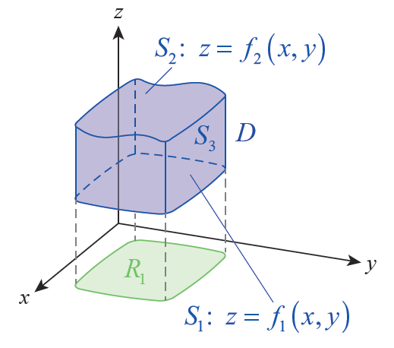
Proof (cont.)
With this goal in mind, let R₁ be
the projection of D in the
xy-plane and assume the lower
surface S₁ and upper surface S₂
of S are the graphs of z = f₁(x, y)
and z = f₂(x, y), respectively,
as shown in Figure 2.
Figure 2

Slide 12
Proof (cont.)
The lower and upper surfaces may or may not coincide at any given point (x, y) ∈ R₁; in Figure 2, they are shown separated by some distance, so the third surface S₃ of S is part of a right cylinder perpendicular to the
xy-plane. Note that k ⋅ n is therefore 0 on S₃ (since n is perpendicular to k throughout S₃), so

Slide 13
Proof (cont.)
On S₁ and S₂, we need to know something about n so we can evaluate k ⋅ n dσ. Toward this, note that we can parametrize S₂ with the vector function
and then that

Slide 14
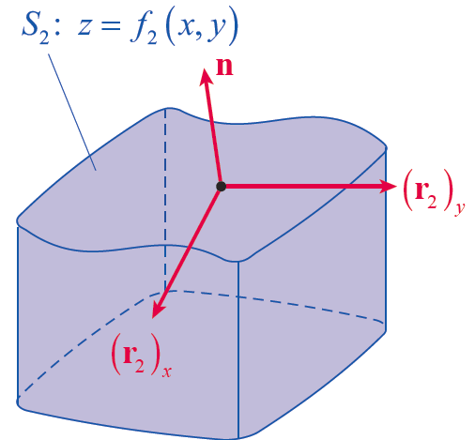
Proof (cont.)
is outwardly normal to
S₂—remember to use the
right-hand rule in
visualizing the direction of
the cross product, as shown
in Figure 3.
Figure 3

Slide 15
Proof (cont.)
So
and hence

Slide 16
Proof (cont.)
Similarly, we can parametrize S₁ with
but this time, in order to construct an outwardly pointing vector, we have to form the cross product

Slide 17
Proof (cont.)
The effect of this is that k ⋅ n dσ = −dA on S₁, so we are led to
and hence

Slide 18
Proof (cont.)
We are nearing the end of the argument. By the Fundamental Theorem of Calculus,
so the two integrals are equal.

Slide 19
Proof (cont.)
By the same sort of reasoning,
and the Divergence Theorem is thus proved for a single simple region. The fact that the theorem is also true for a finite union of simple regions follows from properties of integrals, including the fact that two surface integrals with opposite orientations over the same surface cancel one another.

Slide 20
Example 1: Using the Divergence Theorem to Find the Flux of a Vector Field
Find the flux of the vector field over the surface of
a. the sphere x² + y² + z² = r²;
b. the cube [0, a]³.

Slide 21
Example 1: Using the Divergence Theorem to Find the Flux of a Vector Field (cont.)
Solution
a. Instead of calculating directly, we use the Divergence Theorem.

Slide 22
Example 1: Using the Divergence Theorem to Find the Flux of a Vector Field (cont.)
b. The reduction in effort is even more pronounced with this region, since evaluating the surface integral directly would involve calculating a surface integral over each of the six sides. But using the Divergence Theorem,

Slide 23
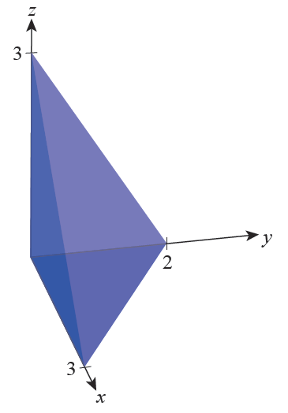
Example 2: Using the Divergence Theorem to Find the Flux of a Vector Field
Find the flux of the vector field
over the surface of the solid
bounded by the coordinate
planes and the plane
2x + 3y + 2z = 6 (see Figure 4).
Figure 4

Slide 24
Example 2: Using the Divergence Theorem to Find the Flux of a Vector Field (cont.)
Solution
To calculate the flux directly would require evaluating four rather complicated surface integrals, but the volume integral of the divergence of F is a routine calculation. First,

Slide 25
Example 2: Using the Divergence Theorem to Find the Flux of a Vector Field (cont.)
Omitting some of the intermediate simplifications, this gives us

Slide 26
The Fundamental Theorem of Calculus in Review
Table 1
Fundamental Theorem of Calculus
Fundamental Theorem for Line Integrals
Tangential-Curl Form of Green’s Theorem
Normal-Divergence Form of Green’s Theorem
∳_{C}
∳_{C}

Slide 27
The Fundamental Theorem of Calculus in Review (cont.)
Table 1
Stokes’ Theorem
Divergence Theorem
∳_{C}

