Slide 1
Section 2.1
Rates of Change and Tangent Lines

Slide 2
The Velocity Problem
The simple relationship distance = rate x time, or d = rt, is often one of the first applications of basic algebra to be studied. This equation can be taken as the definition of average rate r of travel for an object moving distance d over time t (that is, the average rate is the ratio of d over t), or it can be used to solve for any one of the variables if the other two quantities are known. It is undeniably useful in situations where an object’s average rate is all that is desired (especially so if the object is moving at a constant rate), but it is just as undeniably limited in scope.

Slide 3
The Velocity Problem (cont.)
By convention, we often use the word velocity or speed when discussing a rate of travel that is not necessarily constant (later, we will further refine our usage and differentiate between speed and velocity). To emphasize the distinction with average rate even more, the word instantaneous sometimes appears before velocity. One of the best examples of instantaneous velocity is the number you read off your speedometer as you drive—at any given moment, the gauge indicates your velocity at that instant.

Slide 4
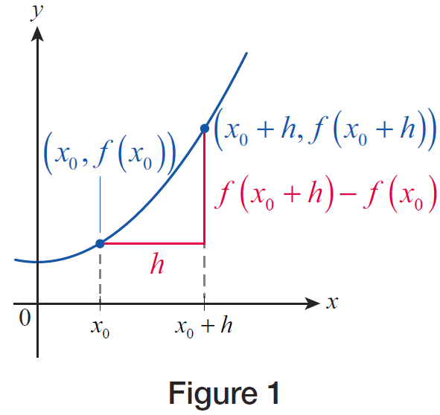
The Velocity Problem (cont.)
At this time, it will be convenient to introduce some more terms and notation. Given a real-valued function f defined at a point x₀, the difference quotient of f at x₀ with increment h is the following ratio (see Figure 1).
Figure 1

Slide 5
The Velocity Problem (cont.)
Note that if f represents a distance function as described above, this ratio corresponds to the average rate of travel over an interval containing x₀, with x₀ serving as either the left endpoint (if h is positive) or the right endpoint (if h is negative). More generally, if x₀ is contained in the interval [a, b], the ratio
corresponds to the average rate of travel over the interval and also serves as an approximation to the instantaneous velocity at x₀.

Slide 6
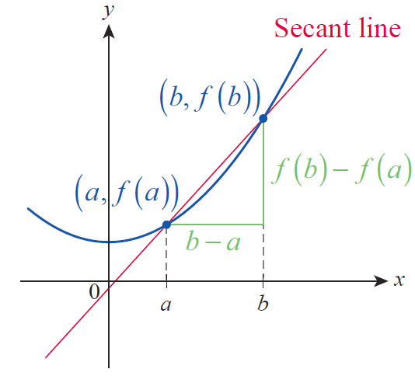
The Velocity Problem (cont.)
You have probably seen the symbol Δ before: it is the Greek letter delta and is used to designate a change in the quantity that follows it. The above ratio is read “change in f over change in x” and can be interpreted as the slope of the line (known as the secant line) shown in Figure 2.
Figure 2

Slide 7
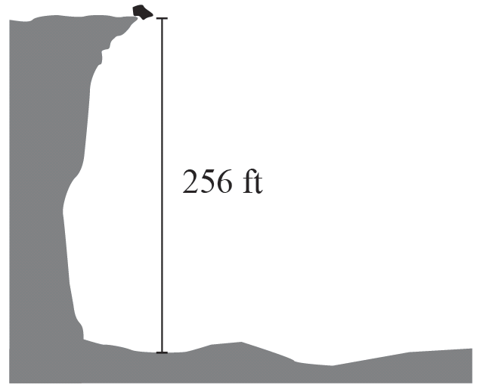
Example 1: Using Average Velocities to Estimate Instantaneous Velocity
A piece of rock falls into a 256-foot-deep canyon from its rim, as illustrated in Figure 3. If we ignore air resistance, its distance below the rim at time t is
where d is measured in feet and t is measured in seconds. Estimate a. the instantaneous velocity of the rock after 2 seconds and b. the velocity of impact.
Figure 3

Slide 8
Example 1: Using Average Velocities to Estimate Instantaneous Velocity (cont.)
Solution
a. We will start by calculating the average velocity of the rock from t = 2 to t = 3. Note that the elapsed time is Δt = 3 − 2 = 1, while the distance traveled is Δd = d(3) – d(2), so we can set up the following difference quotient to calculate the desired average velocity over the interval [2, 3].

Slide 9
Example 1: Using Average Velocities to Estimate Instantaneous Velocity (cont.)
However, this is not expected to be an accurate reflection of the instantaneous velocity at t = 2, since the rock is accelerating significantly between t = 2 and t = 3. We obtain a more accurate guess if we work over a much shorter time interval, say the one from t = 2 to t = 2.1.

Slide 10
Example 1: Using Average Velocities to Estimate Instantaneous Velocity (cont.)
This is a much better guess, but there is no need to stop here. The following table summarizes the average velocities over time intervals of decreasing lengths, all the way down to a length of 0.01 seconds.

Slide 11
Example 1: Using Average Velocities to Estimate Instantaneous Velocity (cont.)
Time interval | Average velocity Δd/Δt
[2,2.09] | 65.44
[2,2.08] | 65.28
[2,2.07] | 65.12
[2,2.06] | 64.96
[2,2.05] | 64.80
[2,2.04] | 64.64
[2,2.03] | 64.48
[2,2.02] | 64.32
[2,2.01] | 64.16

Slide 12
Example 1: Using Average Velocities to Estimate Instantaneous Velocity (cont.)
Since the velocity numbers in the table seem to be approaching 64 ft/s as the intervals are becoming shorter, we might guess that number to be the instantaneous velocity of the rock at t = 2. Notice also that in the above table, 2 serves as the left endpoint of all of the intervals. Intuitively, we expect the same instantaneous velocity to be obtained if t = 2 were the right endpoint, or if it were in the interior of each interval, as long as the interval’s length is decreasing and approaching 0. In our next table, we chose t = 2 to be the right endpoint of each time interval.

Slide 13
Example 1: Using Average Velocities to Estimate Instantaneous Velocity (cont.)
Time interval | Average velocity Δd/Δt
[1.91,2] | 62.56
[1.92,2] | 62.72
[1.93,2] | 62.88
[1.94,2] | 63.04
[1.95,2] | 63.20
[1.96,2] | 63.36
[1.97,2] | 63.52
[1.98,2] | 63.68
[1.99,2] | 63.84

Slide 14
Example 1: Using Average Velocities to Estimate Instantaneous Velocity (cont.)
Notice that the average velocities here are all less than in the first table, but are increasing as the time interval is getting shorter, “shrinking” onto the point t = 2. This is precisely what should be expected because of the steady acceleration of the rock. In conclusion, both tables support our guess that the rock’s instantaneous velocity at t = 2 is 64 ft/s downward. As a final confirmation, let us calculate the difference quotient over the very short interval [1.999,2].

Slide 15
Example 1: Using Average Velocities to Estimate Instantaneous Velocity (cont.)
b. To estimate the velocity of impact, we first need to find when exactly impact occurs. Being in possession of the position function and knowing that at impact the position of the rock is exactly the depth of 256 feet, we can find the time of impact by solving
which gives us t = 4, since we can safely discard the negative root of t = −4.

Slide 16
Example 1: Using Average Velocities to Estimate Instantaneous Velocity (cont.)
To find the velocity of impact, we use the same strategy as in part a. but this time using t = 4 as the right endpoint of our intervals for our difference quotients. The table below summarizes our calculations.

Slide 17
Example 1: Using Average Velocities to Estimate Instantaneous Velocity (cont.)
Time interval | Average velocity Δd/Δt
[3.91,4] | 126.56
[3.92,4] | 126.72
[3.93,4] | 126.88
[3.94,4] | 127.04
[3.95,4] | 127.20
[3.96,4] | 127.36
[3.97,4] | 127.52
[3.98,4] | 127.68
[3.99,4] | 127.84

Slide 18
Example 1: Using Average Velocities to Estimate Instantaneous Velocity (cont.)
As before, we examine the table and conclude that the velocity of impact is approximately 128 ft/s (you may want to further confirm our finding by calculating difference quotients over even shorter time intervals).

Slide 19
Example 2: Using Difference Quotients to Estimate Instantaneous Velocity
Daniela lives just a few miles down a straight stretch of highway from her college campus. One morning she left for class, and her position relative to her house was given by the function
where d is measured in miles, t in hours, with t = 0 corresponding to the time when she left her house. Use difference quotients to estimate her instantaneous velocity a. 3 minutes after she left, b. 6 minutes after she left, and c. 7.5 minutes after she left.

Slide 20
Example 2: Using Difference Quotients to Estimate Instantaneous Velocity (cont.)
From your calculations, can you guess what might have happened?
Solution
a. Just like in Example 1, we will evaluate difference quotients over shorter and shorter time intervals, each using t = 3 minutes as the left endpoint. In this example, however, we will denote the length of a time interval by h, and call it an increment.

Slide 21
Example 2: Using Difference Quotients to Estimate Instantaneous Velocity (cont.)
With this notation, and by noting that 3 minutes = 0.05 hours, a typical difference quotient becomes the following.
For example, consider the average velocity on the time interval starting at 3 minutes into the drive and lasting for h = 0.6 minutes = 0.01 hours.

Slide 22
Example 2: Using Difference Quotients to Estimate Instantaneous Velocity (cont.)
We will get a better approximation of the instantaneous velocity at t = 3 minutes if we shorten the time intervals over which we calculate the average velocities. The following table summarizes our calculations over several intervals of decreasing length.
So we conclude that at exactly three minutes into the trip, Daniela was driving at approximately 60 mph.
h | 0.01 | 0.005 | 0.001 | 0.0005 | 0.0001
v_{ave} | 57.24 | 58.81 | 59.79 | 59.90 | 59.98

Slide 23
Example 2: Using Difference Quotients to Estimate Instantaneous Velocity (cont.)
b. Next, we will estimate the instantaneous velocity at t = 6 minutes = 0.1 hours. This time, however, we will use negative increments when setting up the difference quotients. For example, with h = −0.03, we obtain

Slide 24
Example 2: Using Difference Quotients to Estimate Instantaneous Velocity (cont.)
Interestingly, it appears from the above calculation that Daniela is slowing down considerably. In search of the instantaneous velocity, we shorten the time intervals and summarize our calculations in the following table.
From the table we must conclude that Daniela slowed down and stopped, for the instantaneous velocity at t = 6 minutes appears to be 0. Did she stop due to a traffic jam, or did she turn back? Our next calculation has the answer.
h | −0.03 | −0.01 | −0.001 | −0.0005 | −0.0001
v_{ave} | 22.92 | 7.96 | 0.80 | 0.40 | 0.08

Slide 25
Example 2: Using Difference Quotients to Estimate Instantaneous Velocity (cont.)
c. If we evaluate several difference quotients with decreasing increments, using
t = 7.5 minutes = 0.125 hours as the left endpoint, using the now‑familiar formula
we obtain the following table.
h | 0.01 | 0.005 | 0.001 | 0.0005 | 0.0001
v_{ave} | −43.56 | −40.65 | −38.15 | −37.82 | −37.56

Slide 26
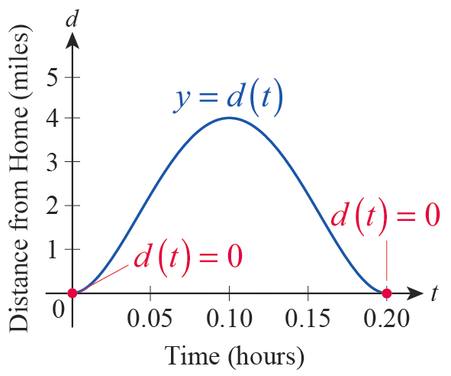
Example 2: Using Difference Quotients to Estimate Instantaneous Velocity (cont.)
We estimate the instantaneous velocity at t = 7.5 minutes to be −37.5 mph. The negative sign indicates
that the direction changed, so Daniela is actually driving back toward her house. (She might have left something at home.) In fact, the graph of the position function is quite revealing, so we show it in Figure 4.
Figure 4

Slide 27
The Tangent Problem
In mathematics, a line is tangent to a given curve if it “just touches” the curve. In some cases, it is easy to identify such lines; in Figure 5, each of the two red lines is tangent to its associated curve, while the green lines are not. In these two examples, the tangent line touches the curve at exactly one point and doesn’t cross the curve.

Slide 28
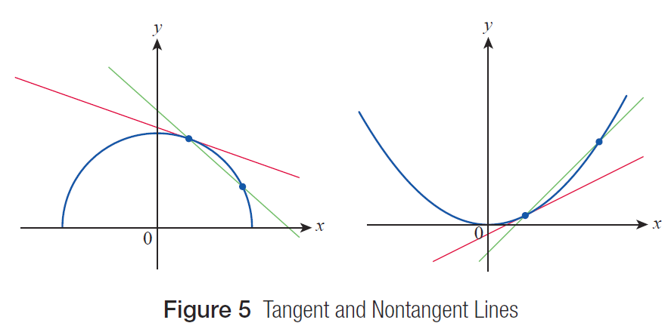
The Tangent Problem (cont.)
Figure 5 Tangent and Nontangent Lines

Slide 29
The Tangent Problem
It is not at all clear how to construct the line tangent to a curve at a given point, and, in any event, we will soon need a precise method of construction that results in an equation for a line. How should we proceed?

Slide 30
The Tangent Problem (cont.)
We might be led to the idea that a tangent line should represent the relative rise or fall of the curve at a particular point—in other words, the tangent line should have the same “slope” or trend as the curve at that point. With this interpretation, it’s clear that sometimes a tangent line will intersect the curve at more than one point, and that sometimes it is not possible for a unique line to capture the trend at all. Figure 6 illustrates these possibilities.

Slide 31
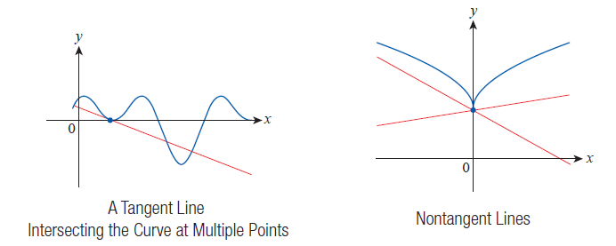
The Tangent Problem (cont.)
Figure 6

Slide 32
The Tangent Problem (cont.)
To set the stage, let’s assume that we have a function f for which we want to construct the tangent line at
x = x₀, that is, at the point on the graph of f .
An easy way to denote a “slightly removed” point on the graph is to let x = x₀+ h, where h is as close (but not equal) to 0 as we wish it to be. The “slightly removed” point is then and the slope of the
associated secant line is as follows.

Slide 33
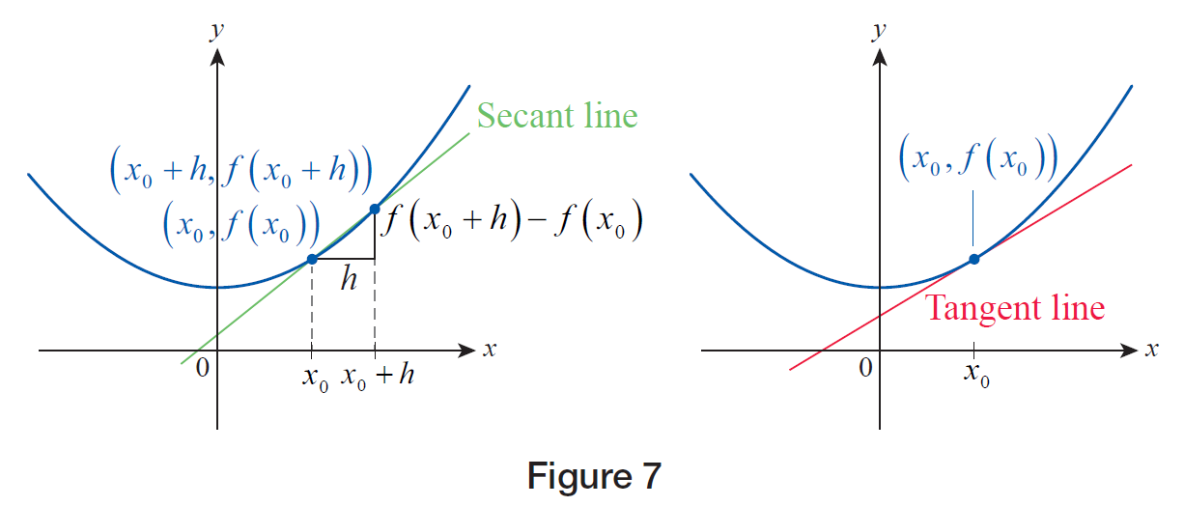
The Tangent Problem (cont.)

Slide 34
The Tangent Problem (cont.)
The connection between the tangent problem and the velocity problem is now clear, as we have just constructed a difference quotient again. To make the connection even more apparent, note that in both problems the key concept is “rate of change.” In the first, we seek the instantaneous rate of change of the position of an object, and we label the result “velocity.” In the second, we seek the rate of change of the graph of a function at a particular point, and we interpret the result as the slope of the line tangent to the graph at that point. The next few examples illustrate how we can actually construct such tangent lines.

Slide 35
Example 3: Using Difference Quotients to Approximate the Slope of a Tangent Line
Construct difference quotients to approximate the slope of the line tangent to the graph of
f(x) = 0.2x³ −1.8x² + 3.6x at the point (1, 2).
Solution
Note that in this problem, x₀ = 1. Just as in Examples 1 and 2, we will construct difference quotients using several h-values that are decreasing in magnitude.

Slide 36
Example 3: Using Difference Quotients to Approximate the Slope of a Tangent Line (cont.)
To start off, letting h = 1 we obtain the following.

Slide 37
Example 3: Using Difference Quotients to Approximate the Slope of a Tangent Line (cont.)
This means that −0.4 is the slope of the secant line corresponding to h = 1. However, given that x₀ = 1, our choice of h = 1 means that the x‑coordinate of the “slightly removed” point in this case is x = 2, which is a rather big step away from x₀, so we don’t yet expect the above slope to reflect the trend of the graph in any meaningful way.

Slide 38
Example 3: Using Difference Quotients to Approximate the Slope of a Tangent Line (cont.)
Let us check what happens if h = 0.5.

Slide 39
Example 3: Using Difference Quotients to Approximate the Slope of a Tangent Line (cont.)
This shows us that the associated secant line is now nearly horizontal, and its slope went from negative to positive. Decreasing h even further, we evaluate several more difference quotients, and the following table displays our results.
h | 0.3 | 0.1 | 0.05 | 0.01 | 0.001
m_{sec} | 0.258 | 0.482 | 0.5405 | 0.58802 | 0.59880

Slide 40
Example 3: Using Difference Quotients to Approximate the Slope of a Tangent Line (cont.)
In the second row of the above table, the slope of the secant associated with each corresponding h‑value is denoted by m_{sec} , and we conclude that the slope of the actual tangent line approaches m = 0.6. (Later we will learn how to confirm that it actually is equal to 0.6.)

Slide 41
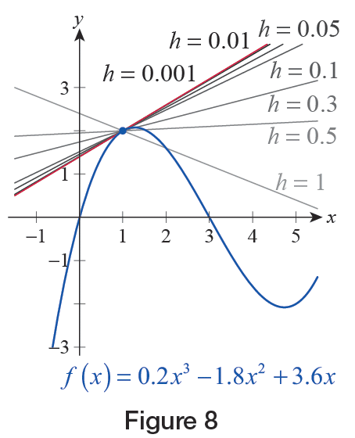
Example 3: Using Difference Quotients to Approximate the Slope of a Tangent Line (cont.)
Figure 8 shows the graph of f(x) and the calculated secant lines, as well as the predicted tangent. Note how the secant lines move closer and closer to the tangent as h decreases. Also, the secant line corresponding to h = 0.001 is virtually indistinguishable from the tangent line shown in red.
Figure 8

Slide 42
Example 4: Showing That a Tangent Line Does Not Exist
Show that the slope of a tangent line of the absolute value function A(x) = |x| at (0, 0) can’t be inferred from a table of difference quotients.
Solution
In this example, x₀ = 0, so using the formula for the difference quotient with, say, h = 0.5, we obtain the following calculation.

Slide 43
Example 4: Showing That a Tangent Line Does Not Exist (cont.)
On the other hand, if h is negative, say h = −0.5, the difference quotient is as follows.

Slide 44
Example 4: Showing That a Tangent Line Does Not Exist (cont.)
In fact, if we construct a table like before, but this time alternating between positive and negative h‑values, something curious happens.
First of all, it seems that ±1 are the only possible values for the slope of the secant, and second, it seems to be +1 when h > 0 and −1 when h < 0. Notice that this is an observation we can prove fairly easily.
h | 0.1 | −0.1 | 0.05 | −0.05 | 0.01 | −0.01
m_{sec} | 1 | −1 | 1 | −1 | 1 | −1

Slide 45
Example 4: Showing That a Tangent Line Does Not Exist (cont.)
If h > 0, since in this case |h| = h, the difference quotient becomes
regardless of the value of h. On the other hand, if h < 0, then |h| = −h, so
and again, h can be any negative real number.

Slide 46
Example 4: Showing That a Tangent Line Does Not Exist (cont.)
Notice that our results indicate that any secant line corresponding to a positive h‑value will coincide with the right branch of the graph, while all secant lines obtained from h < 0 coincide with the left branch.
What does all this mean? There is no single real number being approached by the difference quotients or slopes as h is getting smaller. Graphically, this means that there is no tangent, no single line that would “best capture” the trend of the graph, none that would best align itself to the graph of A(x) at (0, 0).

Slide 47
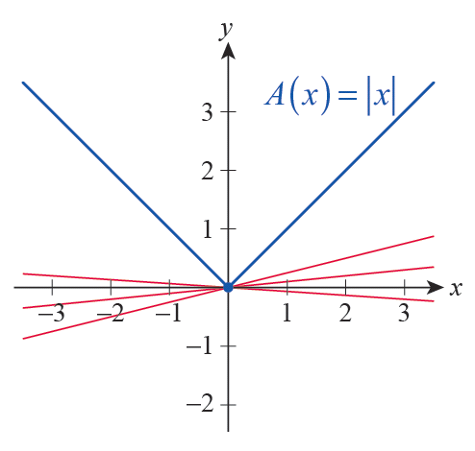
Example 4: Showing That a Tangent Line Does Not Exist (cont.)
The graph has a “sharp turn” there, making it impossible for a tangent line to exist, as shown in Figure 9. We also express this fact by saying that the graph is not “smooth” at x = 0.
Figure 9

Slide 48
The Tangent Problem (cont.)
We might summarize the underlying idea in both the velocity and tangent line problems as follows: The true value of the quantity we seek can be approximated to any desired degree of accuracy through the use of smaller and smaller increments. Perhaps it won’t come as a surprise that the same technique can be used in a wide variety of settings, not just for velocity and the slope of a tangent.

Slide 49
Example 5: Estimating Area under a Curve and Arc Length
Consider the graph of the function on the interval [0, 1]. By successively dividing [0, 1] into smaller and smaller subintervals, estimate
a. the area of the region R between the curve and the x‑axis from x = 0 to x =1, and
b. the arc length s of the segment of the graph connecting the points (0, 0) and (1, 1).
Solution
a. First, we divide [0, 1] into four subintervals of equal width, by considering [0, 0.25], [0.25, 0.5], [0.5, 0.75], and [0.75, 1], respectively.

Slide 50
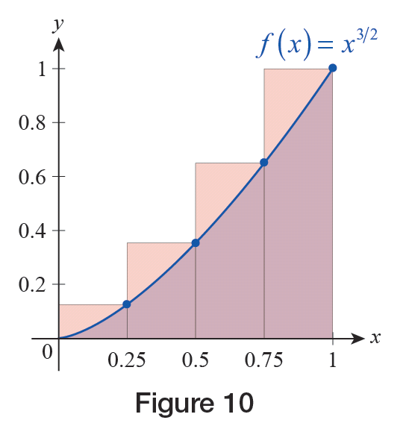
Example 5: Estimating Area under a Curve and Arc Length (cont.)
Then we create rectangles of width 0.25 on top of each interval, using the function value at the right endpoint to serve as the height, as shown in Figure 10. Then we simply add up the four areas to serve as our first approximation for the area under the curve.
Figure 10

Slide 51
Example 5: Estimating Area under a Curve and Arc Length (cont.)

Slide 52
Example 5: Estimating Area under a Curve and Arc Length (cont.)
As is evident from our illustration in Figure 10, this calculation is overestimating the actual area of the region, since the union of the four rectangles completely covers R with lots to spare, but we can produce better estimates if we use more and more rectangles by dividing [0, 1] into more and more subintervals. For example, performing a similar calculation with 10 rectangles, each of width 0.1,
and again using the function values at the right endpoints for the height of each (see Figure 11), yields the approximation S₁₀ ≈ 0.4512.

Slide 53
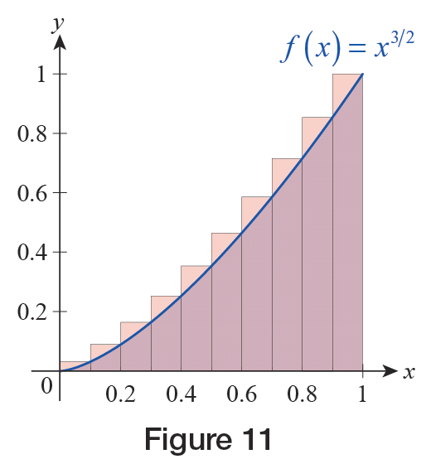
Example 5: Estimating Area under a Curve and Arc Length (cont.)
We shouldn’t be surprised that this number is smaller than our result for S₄, if we compare Figures 10 and 11. S₁₀ is still overestimating the true area of R, but as we can see, the error is much less, and we expect it to go down even further if we increase the number of rectangles.
Figure 11

Slide 54
Example 5: Estimating Area under a Curve and Arc Length (cont.)
Hand calculations quickly become tedious as n increases, but a computer algebra system or a programmable calculator helps us create a table of values like the one below.
From the previous table, we conjecture that the true value of the area of R might be A = 0.4. Later we will learn how to exactly calculate this type of area.
n | 50 | 100 | 1000 | 10,000
S_{n} | 0.41005 | 0.40501 | 0.40050 | 0.40005

Slide 55
Example 5: Estimating Area under a Curve and Arc Length (cont.)
b. As far as the arc length of the curve connecting (0, 0) with (1, 1), we will illustrate the calculations by first dividing [0, 1] into four subintervals, as we did in part a.

Slide 56
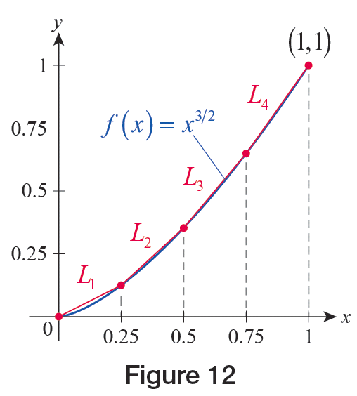
Example 5: Estimating Area under a Curve and Arc Length (cont.)
If we label the endpoints as x₁ = 0, x₂ = 0.25, …, x₅ = 1, and connect the points (x_{i}, f(x_{i})) on the graph with (x_{i + 1}, f(x_{i + 1})) for i = 1, …, 4, a “crude” first approximation for the arc length will simply be the sum of the lengths of the four resulting line segments (see Figure 12).

Slide 57
Example 5: Estimating Area under a Curve and Arc Length (cont.)
This can be calculated using the Pythagorean Theorem as follows.

Slide 58
Example 5: Estimating Area under a Curve and Arc Length (cont.)
Upon dividing [0, 1] into 10 equal parts, a similar, but a bit longer, calculation yields the much better approximation of
As before, with the help of a computer or programmable calculator we can generate a table of values such as the following.
From the table above, we conclude that the true value of the arc length is approximately s ≈ 1.43971.
n | 50 | 100 | 1000 | 10,000
S_{n} | 1.43966 | 1.43970 | 1.43971 | 1.43971

