Slide 1
Section 2.2
Limits All around the Plane

Slide 2
Limits in Verbal, Numerical, and Visual Forms
Every limit scenario, when described verbally, contains phrases of a dynamic nature. Examples of such phrases are “as h approaches 0,” “as x goes to 3,” and “as N grows without bound.” In a less mathematical setting, the phrases might be something like “mortgage rates are expected to approach 5 percent” or “assuming the national debt keeps getting bigger and bigger.” We might also see tables of data that hint at some limiting behavior.

Slide 3
Limits in Verbal, Numerical, and Visual Forms (cont.)
For the purpose of discussion, let us suppose we have a function f(x) defined on an open interval containing c, except possibly at c itself (the reason for this exception will be explained shortly). We say that the limit of f(x) is L as x approaches c, and write
if the value of f(x) is closer and closer to L as x takes on values closer and closer (but not equal) to c. That is, as the difference between x and c approaches 0, the difference between f(x) and L also approaches 0.

Slide 4
Limits in Verbal, Numerical, and Visual Forms (cont.)
Note the small but important caveat: the limit of a function f(x) as x approaches c does not depend at all on the value of f at c; in fact, the limit may exist when f is not even defined at c. This technical detail highlights one distinction between the mathematical meaning of “limit” and casual usage of the word—in everyday language, the boundary between limiting behavior and behavior at the limit point is often blurred. The distinction is important mathematically because, as we will see repeatedly, the behavior of a function near the point c, but not at c, is the key.

Slide 5
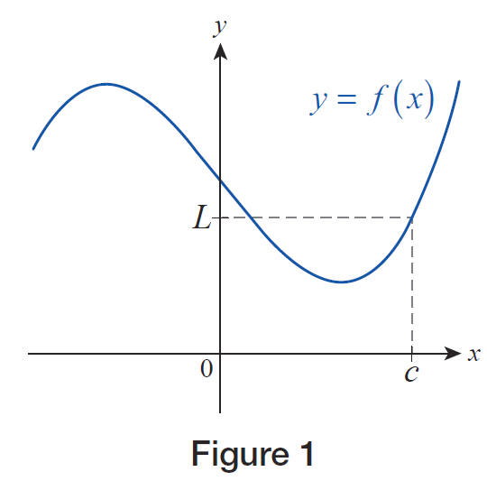
Example 1: Using Graphs to Find Limits
Suppose the graph shown in Figure 1 is that of the function y = f(x). Using your previous experience with graphs of functions, It is reasonable to conclude that the function value at x = c is L, that is, f(c) = L.
Figure 1

Slide 6
Example 1: Using Graphs to Find Limits (cont.)
Also, since the graph is a nice, smooth, unbroken curve, we expect f(x) to be close to L if x is close to c. In other words, as x approaches c from either side along the x‑axis, f(x) will be approaching L, a fact we can confirm visually. As before, we can express this by writing

Slide 7
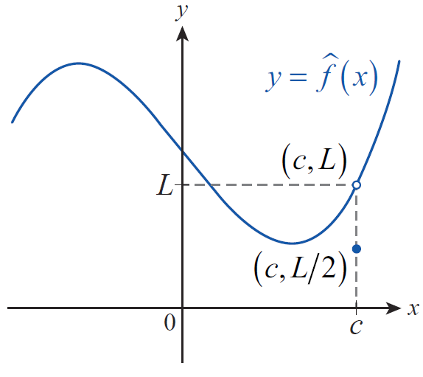
Example 1: Using Graphs to Find Limits (cont.)
Next, suppose we redefine f(c) to be (or some other number), but do not change anything else about f (let’s call the resulting function f ). Graphically, this means that the point “jumps out” of the graph, and moves down to the level, as shown in Figure 2.
ˆ
ˆ
Figure 2

Slide 8
Example 1: Using Graphs to Find Limits (cont.)
In other words, by redefining a single function value, we have relocated one point from the graph of f , but we haven’t changed a bit the behavior of the function near If x takes on values closer and closer to c, but not equal to c, the function value will still move closer and closer to L, which is the second coordinate of the open circle (i.e., its altitude over the x‑axis). In other words, we can still write
ˆ
ˆ

Slide 9
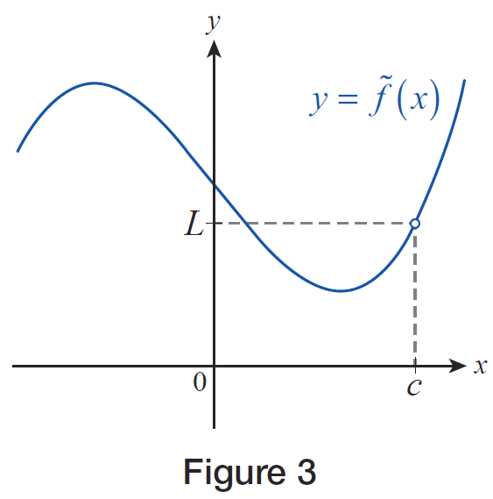
Example 1: Using Graphs to Find Limits (cont.)
Finally, we will consider one last scenario. Suppose that we delete the function value corresponding to x = c
altogether, thus making the function undefined at x = c. We will call the resulting function f. The open circle in Figure 3 indicates that one point is “missing” from the graph; that is, the vertical line x = c doesn’t meet the graph at all.
∼
Figure 3

Slide 10
Example 1: Using Graphs to Find Limits (cont.)
However, notice that this still doesn’t have any influence on the function values near x = c. As before, when x approaches c, but is not equal to c, the function values f(x) approach L, that is,
The conclusion to be drawn is that may exist
without the actual function value f(c) being equal to it or, indeed, even defined.
∼
∼

Slide 11
Example 2: Applying Limits to a Paradox
According to a classic paradox, you can never eat an apple for the following reason. A certain amount of time is needed to consume the first half of the apple, and at that point half the apple remains. Additional time is needed to eat half of the remaining half, which constitutes one-quarter of the original apple. After that, more time is needed to consume half of the remaining quarter, or one-eighth of the apple, and so on. By this reasoning, the process of eating the apple never ends.

Slide 12
Example 2: Applying Limits to a Paradox (cont.)
Of course, this runs counter to our experience, so where does the problem lie? If you were challenged by an argument such as the one above, could you provide a mathematically correct resolution of the paradox?
Solution
As we shall see, the concept of limits can help resolve the apparent flaw in the argument. Let us assume that a calculus student performs the experiment, and holding a stopwatch in her left hand, eats an apple in exactly 4 minutes.

Slide 13
Example 2: Applying Limits to a Paradox (cont.)
We will make the realistic assumption that the time necessary to eat a certain portion of the apple is directly proportional to its size, and we will monitor the portion of the fruit having been consumed. Proceeding as in the above argument, we first note that half of the apple is gone in the first 2 minutes. At the end of the third minute, another quarter is gone, so we stand at
of the apple consumed, with 1 minute left on the clock. At 3 and a half minutes, is gone, and at 3 minutes and 45 seconds, is gone.

Slide 14
Example 2: Applying Limits to a Paradox (cont.)
With half of the remaining time left, that is, at 3 minutes and 52.5 seconds, of the apple is gone, and so on. If we examine the fractions we obtain, it is easy to see that they get closer and closer to 1 as time progresses toward 4 minutes. In fact, a little later, we will have the rigorous mathematical tools to prove that the portion of the apple consumed, as time approaches 4 minutes, is as close to 1 as we desire.

Slide 15
Example 2: Applying Limits to a Paradox (cont.)
Mathematically, we say that the limit of these values is 1, that is, the student indeed ate the entire apple in 4 minutes, in accordance with what we would expect from our own experience.

Slide 16
Limits in Verbal, Numerical, and Visual Forms (cont.)
As important as it is to understand what it means when we say that a certain limit exists, it is just as important to understand what it means when a limit fails to exist.
Assume again that we have a function f defined on an open interval containing the point c, except possibly at c itself. The limit of f(x) as x approaches c then fails to exist if the values of f(x) do not approach any particular real number L.

Slide 17
Limits in Verbal, Numerical, and Visual Forms (cont.)
This could occur for various reasons: f(x) might be getting larger and larger (in absolute value), the values of f(x) may “jump” as x passes from one side of c to the other, or the values of f(x) may simply not “settle down” to any particular value no matter how narrowly we focus on the region around c.

Slide 18
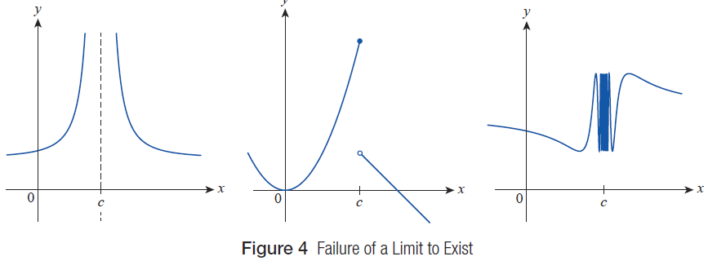
Limits in Verbal, Numerical, and Visual Forms (cont.)
Figure 4 illustrates these three possibilities.
Figure 4 Failure of a Limit to Exist

Slide 19
Limits in Verbal, Numerical, and Visual Forms (cont.)
While potentially confusing, we use the notation
to indicate the nonexistence of a limit when it fails to exist because the function f either increases without bound (approaches positive infinity) or decreases without bound (approaches negative infinity) as x → c. It should be remembered, however, that in either scenario the limit does not exist since f is not approaching a fixed real number. The notation simply describes the particular way in which the limit fails to exist.

Slide 20
Vertical Asymptotes and One‑Sided Limits
A distinguishing feature of a vertical asymptote is that, at least from one side, the function under discussion grows in magnitude without bound. Our first task is to introduce notation that succinctly and accurately describes such behavior. Assume the function f is defined on an open interval with right endpoint c. We write
if the values of f(x) increase without bound as x approaches the point c from the left.

Slide 21
Vertical Asymptotes and One‑Sided Limits (cont.)
Similarly, we write
if the values of f(x) decrease without bound (approach negative infinity) as x approaches the point c from the left.

Slide 22
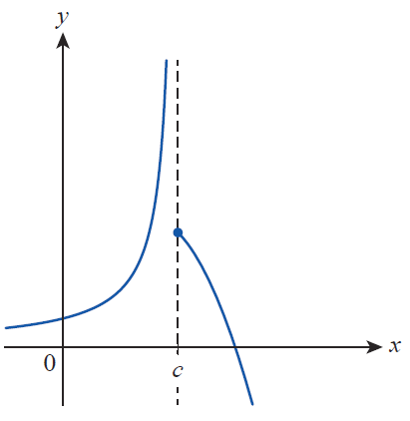
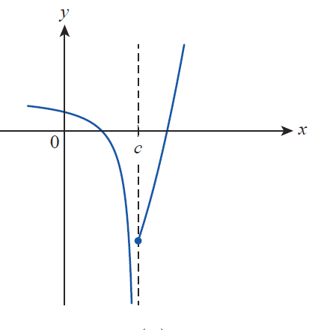
Vertical Asymptotes and One‑Sided Limits (cont.)
Figure 5 illustrates these two scenarios.
Figure 5 Asymptotic Behavior from the Left

Slide 23
Vertical Asymptotes and One‑Sided Limits (cont.)
Similarly, we use the notation in discussing the
limit of the function f as x approaches the point c from the right, with the implicit assumption that f is defined on an open interval whose left endpoint is c. And as noted before, we need to be careful in interpreting the four statements
all four indicate that
these one‑sided limits of f at c do not exist, since f is either increasing or decreasing without bound.

Slide 24
Example 3: Using One-Sided Limit Notation to Describe Asymptotic Behavior
Use one‑sided limit notation to describe the behavior of the following functions near their vertical asymptote(s).

Slide 25
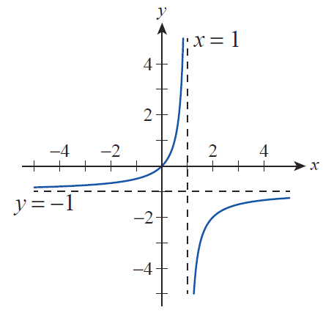
Example 3: Using One-Sided Limit Notation to Describe Asymptotic Behavior (cont.)
Solution
a. As we can see from the graph in Figure 6, the sole vertical asymptote occurs at x = 1, a fact we can deduce from the formula as well.
Figure 6

Slide 26
Example 3: Using One-Sided Limit Notation to Describe Asymptotic Behavior (cont.)
A further examination of the graph reveals that as x approaches 1 from the left, the function values increase without bound, a fact we can express as follows.
On the other hand, as x approaches 1 from the right, the function values decrease.

Slide 27
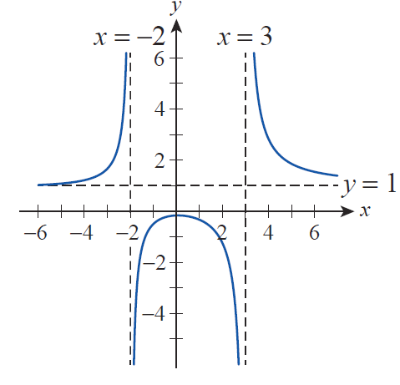
Example 3: Using One-Sided Limit Notation to Describe Asymptotic Behavior (cont.)
b. As seen from the graph in Figure 7, g(x) has two vertical asymptotes, at
x = −2 and x = 3, a fact we can confirm algebraically by factoring the denominator of g(x).
Figure 7

Slide 28
Example 3: Using One-Sided Limit Notation to Describe Asymptotic Behavior (cont.)
The function values increase without bound as x approaches −2 from the left and decrease in a similar manner as x approaches −2 from the right. Therefore, we can write and
Examining the graph on both sides of the vertical asymptote x = 3 in a similar manner, we conclude that
and

Slide 29
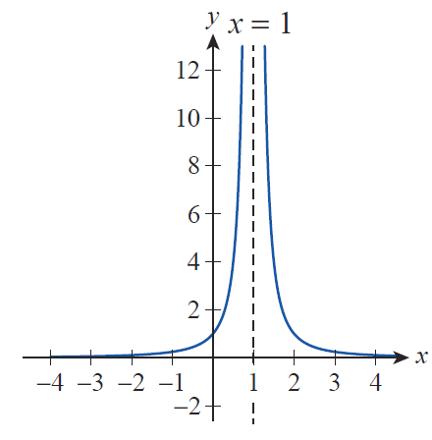
Example 3: Using One-Sided Limit Notation to Describe Asymptotic Behavior (cont.)
c. Examining the graph of h(x) in Figure 8, we see that the behavior is the same on both sides of the vertical asymptote x = 1; namely, that of the function values increasing without bound as x approaches 1.
Figure 8

Slide 30
Example 3: Using One-Sided Limit Notation to Describe Asymptotic Behavior (cont.)
This makes it unnecessary to distinguish between the two one‑sided limits in this case; instead, we can simply write

Slide 31
Example 4: Finding One-Sided Infinite Limits without a Graph
Deduce the one‑sided infinite limits of
at its vertical asymptote without graphing the function.
Solution
We see from the formula that the sole vertical asymptote of f(x) occurs at x = 3 (which is where the denominator is 0). We will examine the two one‑sided limits separately. Let us assume first that x is approaching 3 from the left.

Slide 32
Example 4: Finding One-Sided Infinite Limits without a Graph (cont.)
This means that the x‑values are moving closer and closer to x = 3 through values less than 3 (though approaching it in magnitude). For example, when
x = 2.99,

Slide 33
Example 4: Finding One-Sided Infinite Limits without a Graph (cont.)
Throughout this process of x approaching 3, f(x) stays positive, but its denominator decreases; thus the function values themselves increase in magnitude.
A couple of quick calculations underscore this observation:
and so on.

Slide 34
Example 4: Finding One-Sided Infinite Limits without a Graph (cont.)
The closer x is to 3, the greater the function value f(x) is in magnitude (remember, x never actually reaches the value of 3).
We can now summarize our observations by writing

Slide 35
Example 4: Finding One-Sided Infinite Limits without a Graph (cont.)
If, on the other hand, x approaches 3 from the right, the denominator and thus the function value becomes negative. As an example,

Slide 36
Example 4: Finding One-Sided Infinite Limits without a Graph (cont.)
It is still true that the closer x is to 3, the greater the function values are in magnitude, but this time, they are all negative. For example, as you can easily verify,
and so on. As before, we can express this by writing

Slide 37
Example 4: Finding One-Sided Infinite Limits without a Graph (cont.)
We can briefly summarize the above as follows. The presence of a vertical asymptote x = 3 indicates that the values of f(x) increase or decrease without bound near x = 3.
In general, these tendencies may or may not be different on the two sides of the asymptote, that is, for x < 3 and x > 3, respectively. We were, however, able to find out whether the respective one‑sided limits were +∞ or −∞ from the sign of the expression as x approached 3 from a fixed side, even though a graph was not readily available.

Slide 38
Definition: Vertical Asymptote
We say that a function f has a vertical asymptote at the point c if at least one of the following statements holds.

Slide 39
Vertical Asymptotes and One‑Sided Limits (cont.)
And now that one‑sided limit notation has been introduced, it is easy to extend its meaning. We write
if the values of f(x) get closer and closer to L as x approaches c from, respectively, the left or right. The next example illustrates the use of this notation.

Slide 40
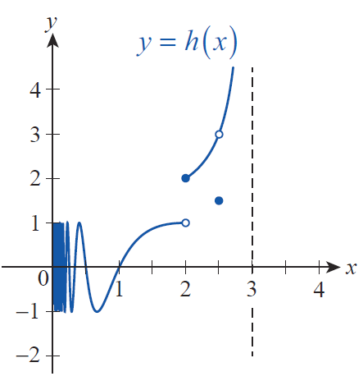
Example 5: Using a Graph to Find One-Sided Limits
Use the graph of the function h in Figure 9 to decide whether the given one‑sided limits exist. For those that do, find their values.
Figure 9

Slide 41
Example 5: Using a Graph to Find One-Sided Limits (cont.)
Solution
a. We see from the graph that h(x) oscillates “wildly” between +1 and −1 on the right‑hand side of x = 0. Moreover, the closer x moves to 0, the more oscillations we have; in fact, there are infinitely many oscillations near 0. (Our technology is incapable of graphing infinitely many “waves,” which is the reason why we see a “shaded rectangle” immediately to the right of the y‑axis.) Therefore, there is no single value being approached by the values of h(x), so we conclude that does not exist.

Slide 42
Example 5: Using a Graph to Find One-Sided Limits (cont.)
b. As x approaches 2 from the left, the function values are approaching 1, so we conclude
Notice, however, that the actual function value is h(2) = 2. In general, we cannot expect the limit of a function at c to always equal the function value at c. In other words, as we previously observed in Example 1, what a function does near c may not be the same as what it does at c.

Slide 43
Example 5: Using a Graph to Find One-Sided Limits (cont.)
c. Examining the tendency of the function values as x approaches 2 from the right, we see that
In other words, the one‑sided limit and the function value agree in this case.

Slide 44
Example 5: Using a Graph to Find One-Sided Limits (cont.)
d–e. The graph shows that the function values h(x) approach 3 as x approaches 2.5 from either direction, so we can write
Notice that just like in Example 1, since both one‑sided limits exist and are equal, we conclude that the two‑sided limit exists at 2.5, and

Slide 45
Example 5: Using a Graph to Find One-Sided Limits (cont.)
The last important observation we wish to make here is that the function value at x = 2.5 differs from the limit, so once again

Slide 46
Example 5: Using a Graph to Find One-Sided Limits (cont.)
f. Because x = 3 is a vertical asymptote,
does not exist, but we can write

Slide 47
Horizontal Asymptotes and Limits at Infinity
We have just seen examples of when it is appropriate to say that a given limit (two‑sided or one‑sided) is ±∞; we will now study limits at ±∞.
Just as an unbounded limit at a point c corresponds to a vertical asymptote at that point, there is a connection between horizontal asymptotes and limits at infinity. Recall that a horizontal line passing through L on the y‑axis is a horizontal asymptote for the function f if the graph of f approaches the line as x is allowed to either increase or decrease without bound.

Slide 48
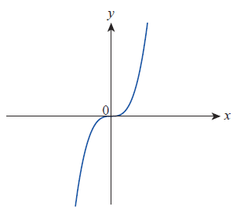
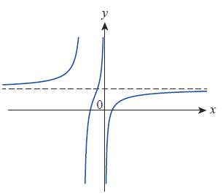
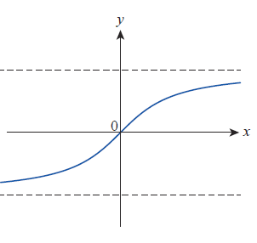
Horizontal Asymptotes and Limits at Infinity (cont.)
A given function can have either 0, 1, or 2 horizontal asymptotes, as illustrated in Figure 10; unlike vertical asymptotes, a function can cross a horizontal asymptote any number of times (or not at all).
Figure 10 Limits at Infinity

Slide 49
Definition: Horizontal Asymptote
We say that the line y = L is a horizontal asymptote for the function f if either of the following statements is true.

Slide 50
Example 6: Using Limits at Infinity to Identify Horizontal Asymptotes
Identify the horizontal asymptotes of the following functions using their graphs shown in Figures 11 and 12, respectively.

Slide 51
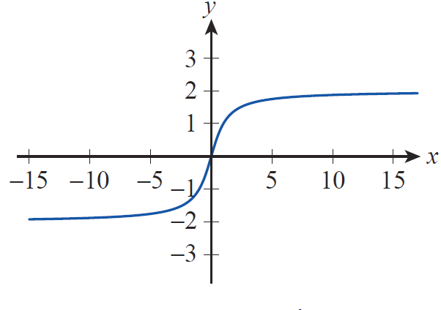
Example 6: Using Limits at Infinity to Identify Horizontal Asymptotes (cont.)
Solution
a. As shown by the graph in Figure 11, the values of f(x) approach the value of 2 as x increases without bound, and they will be as close to 2 as we wish if we make sure x is large enough.
Figure 11

Slide 52
Example 6: Using Limits at Infinity to Identify Horizontal Asymptotes (cont.)
In other words, we can write
and conclude that the line y = 2 is a horizontal asymptote for f . Similarly, we conclude that
and thus the line y = −2 is another horizontal asymptote for f .

Slide 53
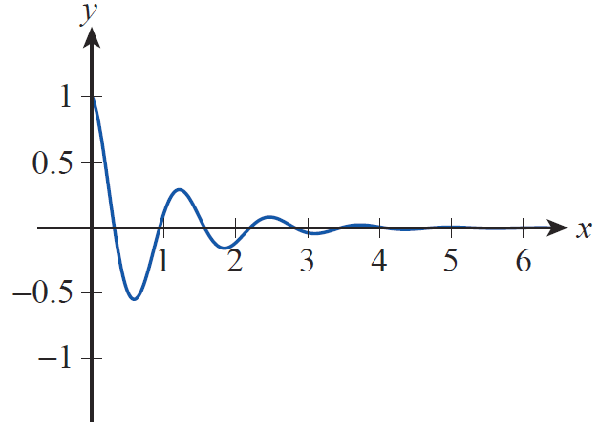
Example 6: Using Limits at Infinity to Identify Horizontal Asymptotes (cont.)
b. The graph of g, though oscillating, is approaching the x‑axis more and more as x increases (see Figure 12). In other words, as we will soon be able to prove, the function values of g(x) will be as small in absolute value as we wish, if we merely choose x large enough.
Figure 12

Slide 54
Example 6: Using Limits at Infinity to Identify Horizontal Asymptotes (cont.)
This is precisely what we need to conclude that the x‑axis or y = 0 is a horizontal asymptote for g. Using limit notation, this means
As a final remark, since the cosine factor causes g(x) to oscillate, the graph actually crosses its horizontal asymptote infinitely often.

Slide 55
Horizontal Asymptotes and Limits at Infinity (cont.)
Many functions tend to increase in magnitude without bound as x goes to ∞ or −∞; the first graph in Figure 10 is an example. In such cases, it is natural to use limit notation to provide more information on the behavior of the function. We write
if the values of f increase without bound as x → ∞, with similar meanings attached to the remaining three possibilities,

Slide 56
Example 7: Using Limit Notation to Describe Unbounded Behavior
Decide whether the given functions increase or decrease without bound as x goes to ∞ and −∞. Use limit notation to express your conclusion.

Slide 57
Example 7: Using Limit Notation to Describe Unbounded Behavior (cont.)
Solution
a. First, we will examine the function values f(x) as x goes to ∞. Our first observation is that for any positive real number x, if x > 1 then x² > x, so if x tends to ∞, then x² will certainly grow in magnitude, without bound. Therefore, will decrease without bound as x tends to ∞. Using limit notation,

Slide 58
Example 7: Using Limit Notation to Describe Unbounded Behavior (cont.)
Next, let us assume x goes to −∞. Like before, x² will grow without bound, and since x² is positive for any nonzero x, we conclude that again decreases without bound. Thus,

Slide 59
Example 7: Using Limit Notation to Describe Unbounded Behavior (cont.)
b. We again let x go to ∞ first. Then by an argument similar to the one given in part a., x³ grows without bound. This tendency is not influenced by subtracting 7 from x³, so
If on the other hand, x goes to −∞, x³ − 7 will decrease without bound, since the cube of a negative number is negative. Thus, we conclude that

Slide 60
Example 7: Using Limit Notation to Describe Unbounded Behavior (cont.)
c. As for the function h, we will first argue that its values grow without bound as x tends toward ∞. The reasoning is as follows. It is clear that the first term, x⁵ increases without bound as x goes to ∞. And as x grows, the fifth‑degree term increases so much faster than the quadratic term, that their difference x⁵ − 6x² still increases. As an illustration, when x = 3, x⁵ − 6x² = 3⁵ − 6 ⋅ 9 = 243 − 54 = 189, but when, say, x = 10, x⁵ − 6x² = 10⁵ − 6 ⋅ 10²
= 100,000 − 600 = 99,400.

Slide 61
Example 7: Using Limit Notation to Describe Unbounded Behavior (cont.)
Adding 3 to the previous expression (or adding or subtracting any constant, for that matter) will not change the increasing tendency of the function values, so we conclude that

Slide 62
Example 7: Using Limit Notation to Describe Unbounded Behavior (cont.)
We can argue in a similar fashion in the case of x going to −∞, but since the fifth power of a negative number is negative, x⁵ decreases without bound in this case. This time, however, subtracting 6x² only helps (but like before, the quadratic term would not be able to change the process, even if we added it to x⁵). Again, the constant term is immaterial from the perspective of the tendency of the function values, so we conclude that

Slide 63
Limits and Technology
Consider the function
If we needed to determine the behavior of this function as x goes to 0, without the benefit of the tools we will soon encounter, we might take several different approaches. One approach would be to note that the denominator of the fraction goes to 0 as x goes to 0, so we might guess that the function “blows up”, that is, increases in magnitude without bound. That guess would be wrong—our analysis so far misses an important fact.

Slide 64
Limits and Technology (cont.)
A closer examination of the fraction reveals that the numerator also approaches 0 as x goes to 0, and this common situation can lead to a variety of possible outcomes.
A second approach would be to evaluate this function for a number of values of x that are increasingly small; this may or may not lead to a correct guess for the limit, depending on the specific values chosen for x and the technology used to calculate the values of the function (see Table 1).

Slide 65
Limits and Technology (cont.)
And a third approach would be to use a graphing calculator (see Figure 13) or computer algebra system (see Figure 14) to graph the function near 0. Again, this may or may not lead to a correct guess, depending on the viewing window specified for the graph.

Slide 66
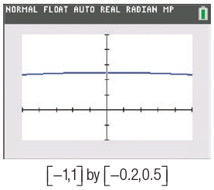
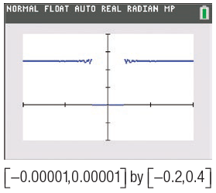
Limits and Technology (cont.)
x | f(x)
0.00001 | 0.25
0.000001 | 0.2
0.0000001 | 0
0.00000001 | 0
Table 1
Figure 13
Exploring
Using a Graphing Calculator

Slide 67
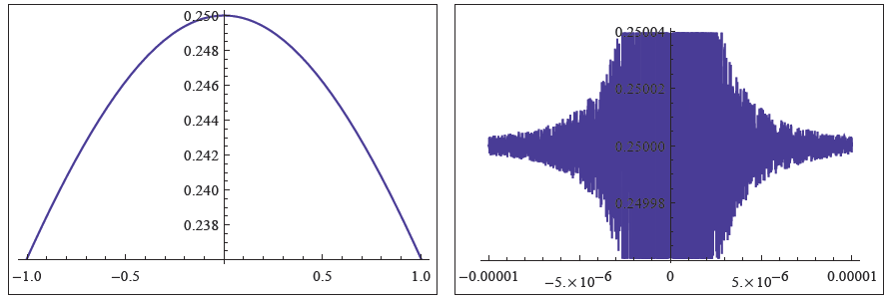
Limits and Technology (cont.)
Figure 14 Exploring Using a Computer Algebra System

Slide 68
Example 8: Using a Graphing Utility to Approximate a Limit
Use a graphing utility to predict the value of
where
Solution
Since cos x approaches 1 as x goes to 0, we once again face the ambiguity of both the numerator and denominator approaching 0 as x goes to 0. Again we don’t have enough information to guess at any particular number since, as we said before, a “0/0‑type” limit can lead to a variety of different answers.

Slide 69
Example 8: Using a Graphing Utility to Approximate a Limit (cont.)
Using a graphing calculator, we can sketch and examine the graph, which appears to be approaching the origin as x goes to 0 (see Figure 15). This is confirmed by a table of values that we can create with the help of a calculator, using decreasing x‑values.

Slide 70
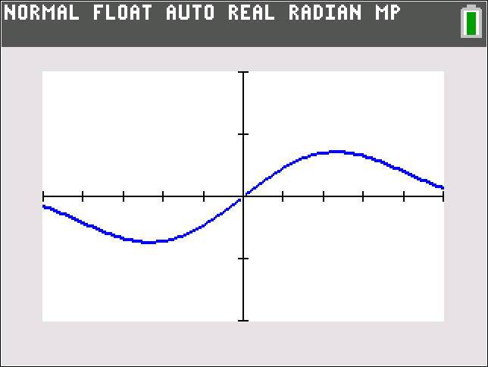
Example 8: Using a Graphing Utility to Approximate a Limit (cont.)
x | g(x)
0.1 | 0.05
0.01 | 0.005
0.001 | 0.0005
0.0001 | 0.00005
Figure 15
Table 2

Slide 71
Example 8: Using a Graphing Utility to Approximate a Limit (cont.)
From the above observations it is natural to expect that the function values will steadily move toward 0 when x approaches 0, as illustrated by the first graph in Figure 16. However, if we zoom in, again something strange may happen. We used a computer algebra system to illustrate.

Slide 72
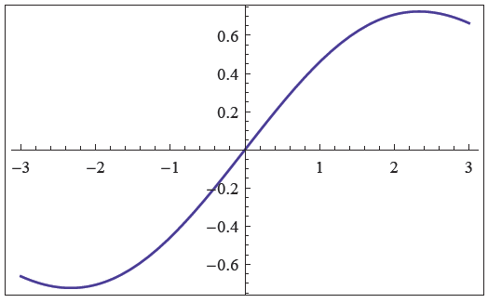
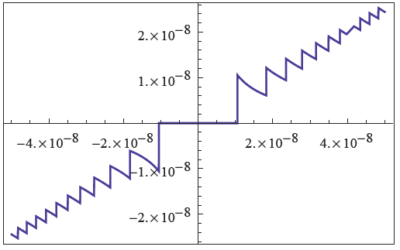
Example 8: Using a Graphing Utility to Approximate a Limit (cont.)
Figure 16 Exploring Using a Computer Algebra System

Slide 73
Example 8: Using a Graphing Utility to Approximate a Limit (cont.)
Again we see that, because of rounding errors and other reasons, our technology can sometimes mislead us by giving seemingly conflicting or inaccurate feedback, and we must be aware of this when using it.
We will stick with our guess that
but realize that we haven’t actually proved this at all. We will learn how to do that after discussing limit theorems in upcoming sections.

Slide 74
Technology Note: Finding a Limit
Computer algebra systems such as Mathematica provide additional tools for determining limits, but it should always be remembered that software has limitations and can be fooled. Mathematica contains the built‑in command Limit that uses the same mathematical facts we will learn in the next two sections to correctly evaluate many types of limits.

Slide 75
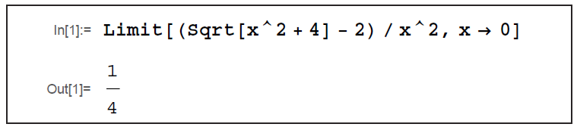
Technology Note: Finding a Limit (cont.)
Its use is illustrated below.
Figure 17

