Slide 1
Section 2.3
The Mathematical Definition of Limit

Slide 2
Limits Formally Defined
We need to capture the idea that all the values of f(x) become as close to L as we care to specify as x gets close enough to c.
The two parts of that previous sentence that need more work are “as close to L as we care to specify” and “as x gets close enough to c.” The most common definition of limit refines those two phrases through the use of two Greek letters, epsilon (ε) and delta (δ), and the following is often referred to as the epsilon‑delta definition of limit.

Slide 3
Definition: Formal Definition of Limit
Let f be a function defined on an open interval containing c, except possibly at c itself. We say that the limit of f(x) as x approaches c is L, and write
if for every number ε > 0 there is a number δ > 0 such that whenever x satisfies

Slide 4
Limits Formally Defined (cont.)
The use of the letters ε and δ originated with the French mathematician Augustin‑Louis Cauchy
(1789–1857). His choice was deliberate, and served to remind the reader of the words error and difference (the French spellings are similar); you may find this correspondence useful as well. We may now interpret the statement in this way: if we wish to guarantee that the error between f (x) and L is less than the amount ε, it suffices to make sure that the difference between x and c is less than the amount δ. (but remember that we do not allow x to equal c).

Slide 5
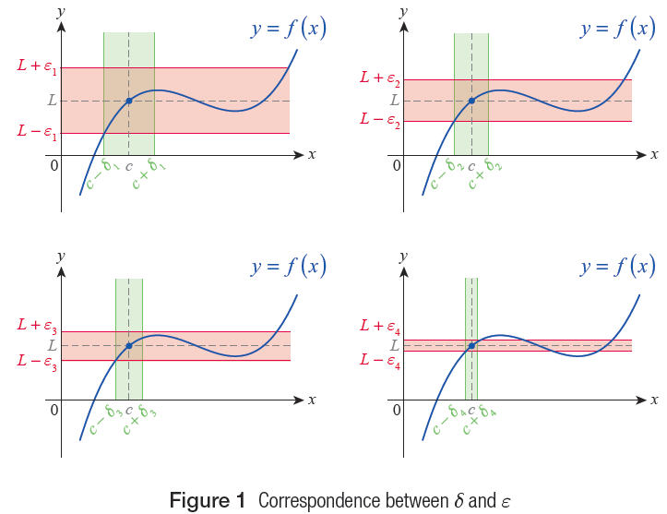
Limits Formally Defined (cont.)
Figure 1 Correspondence between δ and ε

Slide 6
Limits Formally Defined (cont.)
The true value of the formal limit definition is that it allows us to prove limit claims absolutely. In fact, you might consider the correspondence between ε and δ as a series of challenges and responses. If a skeptic wished to challenge the claim that for the function f shown in Figure 1, each of the four ε’s might be presented in turn with the demand “tell me a condition that guarantees f (x) is within ε of L.” The response, for each ε, would be the corresponding δ : if x ≠ c is chosen between c − δ and c + δ then f (x) is guaranteed to fall between L − ε and L + ε.

Slide 7
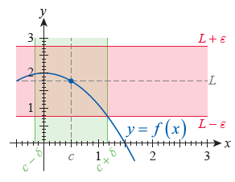
Example 1: Using Graphs to Estimate δ Given ε
In our first example, we will use the graph of with c = 0.5 to estimate the value of δ corresponding to a. ε = 1, b. ε = 0.5, c. ε = 0.25, and d. ε = 0.1.
Solution
a. Like in our discussion before, we see that for ε = 1, the value of δ is dictated by where the line y = L − ε intersects the graph of f (see Figure 2).
Figure 2

Slide 8
Example 1: Using Graphs to Estimate δ Given ε (cont.)
If, for example, we choose δ = 0.65, we can ensure that for any x ≠ c between c − δ and c + δ, f(x) will fall between L − ε and L + ε.

Slide 9
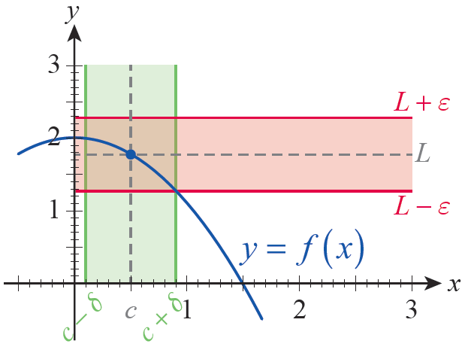
Example 1: Using Graphs to Estimate δ Given ε (cont.)
b. As for the case of ε = 0.5, using the illustration in Figure 3, it is clear that if x ≠ c falls between, say, 0.1 and 0.9, then
Thus δ = 0.4 (or any smaller
number) is a good choice.
Figure 3

Slide 10
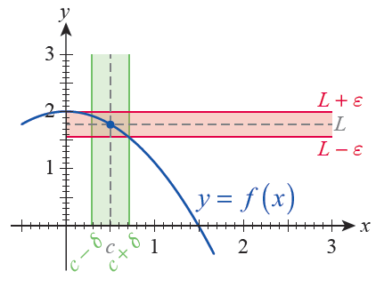
Example 1: Using Graphs to Estimate δ Given ε (cont.)
c. As before, visually inspecting the graph in Figure 4 leads to the conclusion that when ε = 0.25, the
value of δ = 0.2 (or any smaller number) is a good choice, since 0.2 is less than the distance between c and either of the green vertical lines.
Figure 4

Slide 11
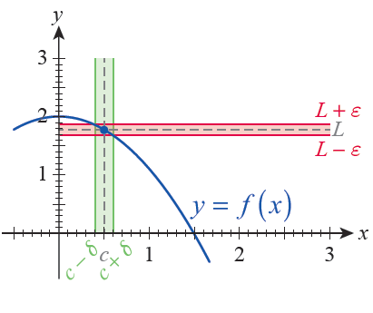
Example 1: Using Graphs to Estimate δ Given ε (cont.)
d. Again, a visual inspection reveals that ε = 0.1 will require a much smaller δ; δ = 0.1 (or any smaller number) works well
(see Figure 5).
Figure 5

Slide 12
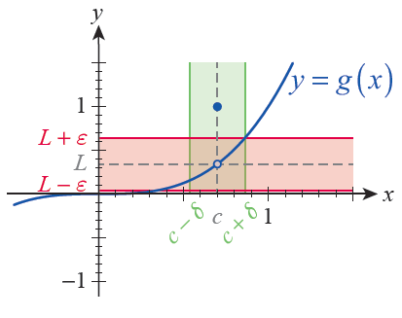
Example 2: Using Graphs to Find a Limit
Consider the following function.
The open and closed circles in the graph in Figure 6 reflect the fact that has been redefined at x = 0.7: the coordinates of the “hole” are
while
Figure 6

Slide 13
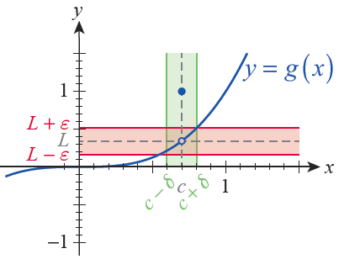
Example 2: Using Graphs to Find a Limit (cont.)
In addition, we can also learn from Figure 6 that there is a δ > 0 corresponding to ε = 0.3 so that if we choose any x ≠ c from the interval the
corresponding g‑value will fall within ε of
Figures 7, 8, and 9 are illustrations of the existence of δ‑values corresponding to smaller and smaller ε’s.
Figure 7

Slide 14
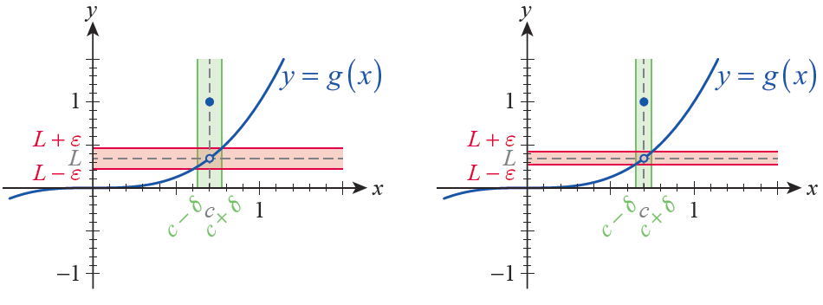
Example 2: Using Graphs to Find a Limit (cont.)
Figure 8
Figure 9

Slide 15
Example 2: Using Graphs to Find a Limit (cont.)
From these illustrations, it is at least visually clear that
even though the function value In other words,
the limit and the function value at c = 0.7 are not equal.

Slide 16
Example 2: Using Graphs to Find a Limit (cont.)
More is actually true: we could define g(0.7) to be any real number, without affecting the limit. In general, the function value g(c) and the limit are entirely independent of each other, that is, the existence and/or value of one does not affect that of the other.

Slide 17
Limits Formally Defined (cont.)
Our formal definitions for the other varieties of limits are similar. Figures 10 and 11 illustrate the construction of the largest δ corresponding to a given ε when one‑sided limits are under consideration.

Slide 18
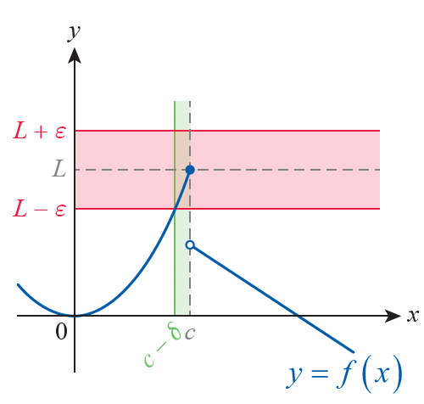
Definition: Limits from the Left
(Left‑Hand Limits)
Let f be a function defined on an open interval whose
right endpoint is c. We say that the limit of f(x) as x approaches c from the left is L, and write if for every number ε > 0 there is a number δ > 0 such that whenever x satisfies c − δ < x < c.
Figure 10 Left-Hand Limit

Slide 19
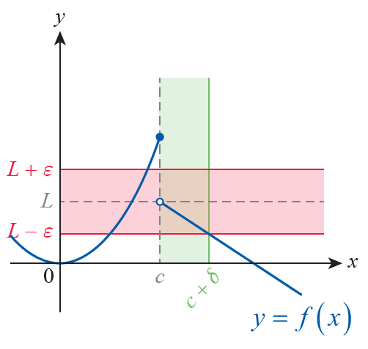
Definition: Limits from the Right
(Right‑Hand Limits)
Let f be a function defined on an open interval whose
left endpoint is c. We say that the limit of f(x) as x approaches c from the right is L, and write if for every number ε > 0 there is a number δ > 0 such that whenever x satisfies c < x < c + δ.
Figure 11 Right-Hand Limit

Slide 20
Definition: Infinite Limits
Let f be a function defined on an open interval containing c, except possibly at c itself. We say that the limit of f(x) as x approaches c is positive infinity, and write if for every positive number M there
is a number δ > 0 such that whenever x satisfies

Slide 21
Definition: Infinite Limits (cont.)
Similarly, we say that the limit of f(x) as x approaches c is negative infinity, and write if for every negative number N there is a number δ > 0 such that whenever x satisfies Infinite one‑sided limits are defined in a manner analogous to finite one‑sided limits.

Slide 22
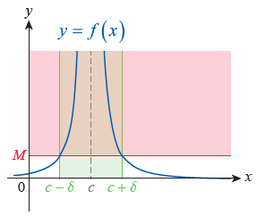
Definition: Infinite Limits (cont.)
Figure 12
Correspondence between
M and δ for an Infinite Limit

Slide 23
Limits Formally Defined (cont.)
If we wish to prove that a given function has an infinite limit at a point c, our task is to prove that given some (presumably large) number M, there is an interval on which the function is larger than M (except possibly at the point c itself). Figure 12 shows how an appropriate δ can be chosen for the given value of M.

Slide 24
Definition: Limits at Infinity
Let f be a function defined on some interval We say the limit of f at infinity is L, and write
if for every number ε > 0 there is a number N such that for all x > N.
Similarly, for a function defined on some interval we say the limit of f at negative infinity is L, and write if for every number ε > 0 there is a number N such that for all x < N.

Slide 25
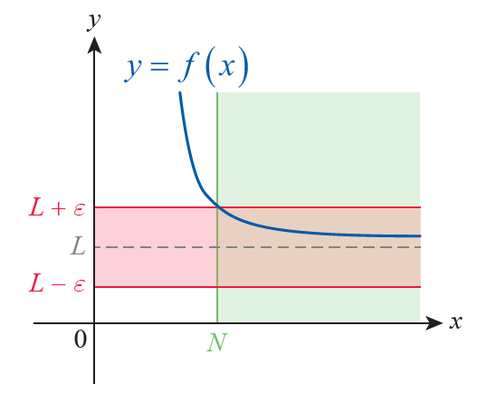
Definition: Limits at Infinity (cont.)
Figure 13

Slide 26
Proving a Limit Exists
Although the formal definition of limit gives us the ability to prove limit claims beyond a shadow of a doubt, it does not immediately give us the means by which to determine the value of a given limit in the first place. In other words, we need to know what L is before we can prove that Fortunately, as
we will soon see, our limit definition is the basis for a number of theorems that will make determination of limits much easier.

Slide 27
Example 3: Using the ε-δ Definition of Limit to Prove a Limit Exists
Use the ε-δ definition of limit to prove that
Solution
Suppose an ε > 0 is given. We need to find a δ > 0 such that

Slide 28
Example 3: Using the ε-δ Definition of Limit to Prove a Limit Exists (cont.)
Notice that this latter inequality is equivalent to the following:
Reading the above chain of equivalent inequalities from the bottom up, this means that (or any smaller number) works.

Slide 29
Example 3: Using the ε-δ Definition of Limit to Prove a Limit Exists (cont.)
In other words, given ε > 0, if we choose then implies
just as we needed to show.
What all this means is that if a skeptic were to challenge you with a small ε > 0 of their choosing, you could always respond, for each ε, by picking if x ≠ c is chosen between 3 − δ and 3 + δ, then 2x − 1 is guaranteed to fall between 5 − ε and 5 + ε.

Slide 30
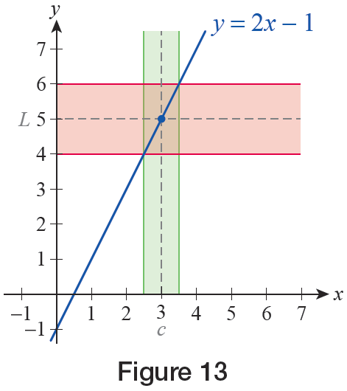
Example 3: Using the ε-δ Definition of Limit to Prove a Limit Exists (cont.)
For example, given ε = 0.1, let δ = 0.05. For the reason why x needs to be “twice as close” to 3 as the skeptic’s challenge, examine the graph in Figure 14, and note that the slope of the line is 2.
Figure 14

Slide 31
Example 4: Using the ε-δ Definition of Limit to Prove a Limit Exists
Use the ε-δ definition of limit to prove that
Solution
Again, supposing that ε > 0 is given, we need to find a
δ > 0 such that
Our first observation is that

Slide 32
Example 4: Using the ε-δ Definition of Limit to Prove a Limit Exists (cont.)
Next, we will agree to choose a δ > 0 while also making sure that δ < 1. Note that we can do this, since once a successful δ > 0 is chosen, any smaller number works just fine.
Since translates into 4 − δ < x < 4 + δ, which implies 3 < x < 5 if δ < 1, we have and thus

Slide 33
Example 4: Using the ε-δ Definition of Limit to Prove a Limit Exists (cont.)
So for the given ε > 0, let δ > 0 be chosen so that it is less than the smaller of the numbers 1 and
Then if
this latter inequality finishing our proof.

Slide 34
Example 5: Using the ε-δ Definition of Limit to Prove a Limit Exists
Use the ε-δ definition of limit to prove that
Solution
As before, let ε > 0 be given. We need to find a number N such that

Slide 35
Example 5: Using the ε-δ Definition of Limit to Prove a Limit Exists (cont.)
Notice that since this latter inequality is equivalent to
Since is nonnegative. Also observe that if we choose N large enough so that then x > N will imply The above choice is always possible, by simply making sure

Slide 36
Example 5: Using the ε-δ Definition of Limit to Prove a Limit Exists (cont.)
We can summarize our observations as follows. For a given ε > 0, choose and fix a positive number N satisfying Then if x > N,
and this latter chain of inequalities finishes our argument.

Slide 37
Example 6: Proving a Limit Does Not Exist
Prove that
Solution
For an arbitrary, but fixed, positive number M, we need to exhibit a number δ > 0 such that whenever x satisfies To that end, let us assume that M > 0 is fixed, and choose a δ > 0 small enough so that

Slide 38
Example 6: Proving a Limit Does Not Exist (cont.)
Note that this is possible; for example, (or any smaller number) works: if then
which is precisely the inequality we wanted.
As a final remark, we wish to emphasize that
actually does not exist, since ∞ is not a
number.

Slide 39
Example 6: Proving a Limit Does Not Exist (cont.)
What is happening is that the limit fails to exist because the function grows without bound as x approaches 2. We have established this using techniques as in the previous examples, and expressed the same fact using limit notation and the ∞ symbol.

Slide 40
Example 7: Proving a Limit Does Not Exist
Prove that for the function
does not exist, by showing that the function does not satisfy the ε-δ definition for any possible L at c = 0.
Solution
We will first need to think carefully about what it means for the definition to fail at c = 0. This will happen precisely when no number L works as the limit of the function at 0, in other words, when x can move closer to 0 than any given δ > 0 without the corresponding function values f(x) approaching any number.

Slide 41
Example 7: Proving a Limit Does Not Exist (cont.)
You can think about this, too, as a challenge game. Suppose a skeptic challenges you with a very small number δ, and you are able to show that the function values f(x), corresponding to nonzero x-values with
−δ < x < δ, do not approach any number L. If you are always able to respond to the challenge, no matter how small δ > 0 becomes, you will have proved that does not exist. This is exactly what we endeavor to do in this example.

Slide 42
Example 7: Proving a Limit Does Not Exist (cont.)
Suppose that δ > 0 is given. Recall that cos 2kπ = 1 and for all k ∈ ℤ. Choose and fix a big enough positive integer k such that (since δ is already fixed, you can achieve this by merely choosing k big enough).
Next, we will use the real numbers and
as follows.

Slide 43
Example 7: Proving a Limit Does Not Exist (cont.)
Note that both are less than δ in magnitude, but
while

Slide 44
Example 7: Proving a Limit Does Not Exist (cont.)
What this means is that we were able to find x-values less than δ in magnitude, namely for which the corresponding function values and are a full 2 units apart. More importantly, we can do the same, no matter how small a δ > 0 is specified. Thus, the values of f(x) cannot be approaching any limit L at all.
To put our argument on a more precise footing, we will show that the definition for the existence of
fails, by showing that there is an ε > 0 for which no
δ > 0 exists to satisfy the definition.

Slide 45
Example 7: Proving a Limit Does Not Exist (cont.)
Let us pick, say, ε = 1, and suppose that there is a δ > 0 such that for some L,
whenever Then proceed to find as above. Since both and by assumption we have first of all the inequality

Slide 46
Example 7: Proving a Limit Does Not Exist (cont.)
What this means is that L is less than 1 unit away from 1; in particular, L is positive.
On the other hand, because of the choice of we also have the inequality
in other words, L is less than 1 unit from −1 and therefore is negative.
Since such a number does not exist, cannot exist either.

