Slide 1
Section 2.4
Determining Limits of Functions

Slide 2
Theorem: Basic Limit Laws
Let f and g be two functions such that both
and exist, and let k be a fixed real number.
Then the following laws hold.
Sum Law
Difference Law
Constant Multiple Law

Slide 3
Theorem: Basic Limit Laws (cont.)
Product Law
Quotient Law

Slide 4
Proof
We will prove the Sum Law here.
For ease of exposition, let and
we need to show that
using our ε-δ definition of limit. To this end, assume
ε > 0 is given. Then by assumption there exist δ₁ > 0 and δ₂ > 0 such that

Slide 5
Proof (cont.)
and
Note that we have found δ₁ and δ₂ so that the differences between the functions and their respective limits are smaller than We did so in order to obtain the following consequence for all x ≠ c chosen within δ of c, where δ is the smaller of δ₁ and δ₂.

Slide 6
Proof (cont.)

Slide 7
Proof (cont.)
Since we have demonstrated that the function is within ε of L + M for all x such that our proof is complete.

Slide 8
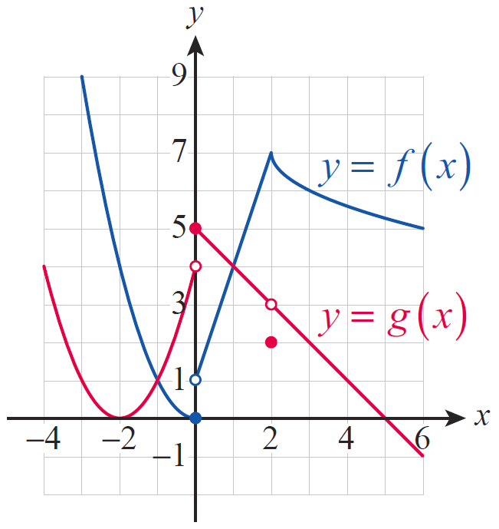
Example 1: Using Limit Laws and a Graph to Find Limits
For the functions f and g graphed in Figure 1, determine if the following limits exist. If a particular limit exists, evaluate it. If not, give reasons why it fails to exist.
Figure 1

Slide 9
Example 1: Using Limit Laws and a Graph to Find Limits (cont.)
Solution
a. As we can see from the figure, the limits of both f and g exist at c = 2. In case of g, we note once again that the actual function value at 2 has no bearing on the value of the limit.

Slide 10
Example 1: Using Limit Laws and a Graph to Find Limits (cont.)
Now we evaluate the limit using the Product Law.

Slide 11
Example 1: Using Limit Laws and a Graph to Find Limits (cont.)
b. Here we are going to use the Sum Law and the Constant Multiple Law.

Slide 12
Example 1: Using Limit Laws and a Graph to Find Limits (cont.)
c. We will first examine the behavior of f near 0. It is clear from the graph that both one‑sided limits exist, but they don’t agree; thus the two‑sided limit of f cannot exist at x = 0. In fact, while
and so does not exist.
Similarly for g, while and thus cannot exist.

Slide 13
Example 1: Using Limit Laws and a Graph to Find Limits (cont.)
In words, since the one‑sided limits are unequal, the two‑sided limit of g cannot exist at 0. However, the limit laws do apply to one‑sided limits, so we can
determine those for

Slide 14
Example 1: Using Limit Laws and a Graph to Find Limits (cont.)
Notice from our findings that something interesting is actually going on here. Even though the two‑sided limits of f and g do not exist individually, the one‑sided limits of g − f exist and agree at x = 0. What this means is that the limit of g − f at 0 actually exists.

Slide 15
Example 1: Using Limit Laws and a Graph to Find Limits (cont.)
d. Using the Product Law for one‑sided limits, we obtain
Since the one‑sided limits of the product function f ⋅ g are unequal, we conclude that does not exist.

Slide 16
Example 2: Using Limit Laws to Find Limits
Let and Determine
whether exists.
Solution
We will first examine the behavior of near 0. If x approaches 0 from the left, then since x < 0, we have
so f is the constant −1 for all negative x‑values.

Slide 17
Example 2: Using Limit Laws to Find Limits (cont.)
Therefore,
On the other hand, for all positive x‑values so
thus

Slide 18
Example 2: Using Limit Laws to Find Limits (cont.)
Since the one-sided limits are unequal,
does not exist. Consequently, the Product Law is not applicable, but since it does apply to one‑sided limits, we can proceed to examine those separately. Recalling the well‑known fact that we obtain
Thus we conclude that the two‑sided limit,
does not exist.

Slide 19
Theorem: Positive Integer Power Law
Let f be a function for which exists, and let m
be a fixed positive integer. Then

Slide 20
Theorem: Polynomial Substitution Law
Let p be a polynomial function. Then

Slide 21
Theorem: Rational Function Substitution Law
Let p and q be polynomial functions. Then if

Slide 22
Example 3: Using Limit Laws to Find Limits
Find the following limits.
a. b.
c. d.

Slide 23
Example 3: Using Limit Laws to Find Limits (cont.)
Solution
a. First, using the Sum and Difference Laws, we obtain
where in the last step we used the Constant Multiple Law. Next, the Positive Integer Power Law comes to bear.

Slide 24
Example 3: Using Limit Laws to Find Limits (cont.)
Notice that our repeated application of the various rules eventually led us to finding the limit by simply substituting x = 2 into the polynomial. This is exactly what the Polynomial Substitution Law allows us to do; so henceforth we don’t even have to go through the above, somewhat lengthy, process when finding the limits of polynomials.

Slide 25
Example 3: Using Limit Laws to Find Limits (cont.)
b. In this case, we will simply use the Polynomial Substitution Law.

Slide 26
Example 3: Using Limit Laws to Find Limits (cont.)
c. Notice that our third limit is that of a rational function. Since both the numerator and denominator are polynomials, we can apply the Quotient Law combined with a repeated application of the Polynomial Substitution Law as follows.

Slide 27
Example 3: Using Limit Laws to Find Limits (cont.)
Notice, however, that what we did was in effect substituting x = 3 into the given rational function. This is exactly what the Rational Function Substitution Law says we can always do unless the process results in a 0 denominator.

Slide 28
Example 3: Using Limit Laws to Find Limits (cont.)
d. This time, we will simply refer to the Rational Function Substitution Law.

Slide 29
Example 3: Using Limit Laws to Find Limits (cont.)
In summary, we wish to emphasize that when evaluating limits of a polynomial or rational function, our theorems allow for the calculation to be reduced to a simple matter of evaluating the function at the limit point. The only exception is for those c‑values that cause the denominator of a given rational limit to equal 0.

Slide 30
Theorem: Positive Integer Root Law
Let f be a function for which exists, and let n
be a fixed positive integer. Then
with the assumption that is nonnegative if n is even.

Slide 31
Theorem: Rational Power Law
Let f be a function for which exists, and let m and n be fixed nonzero integers with no common factor. Then
with the assumption that is nonnegative if n is even.

Slide 32
Example 4: Using Limit Laws to Find Limits
Use the Rational Power Law to evaluate the following limits.
a. b.
c.

Slide 33
Example 4: Using Limit Laws to Find Limits (cont.)
Solution
a. First of all, we claim that for
exists. In fact, by direct substitution we have the following.

Slide 34
Example 4: Using Limit Laws to Find Limits (cont.)
It follows that the Rational Power Law applies.

Slide 35
Example 4: Using Limit Laws to Find Limits (cont.)
b. To start us off, notice that
a fact easily verified by direct substitution. Also since the above limit is positive and
the Rational Power Law applies.

Slide 36
Example 4: Using Limit Laws to Find Limits (cont.)

Slide 37
Example 4: Using Limit Laws to Find Limits (cont.)
c. Since and since
the Rational Power Law once again applies.

Slide 38
Limit Determination Techniques
The limit laws we have stated greatly simplify the determination of many limits and also show that limits of polynomial and rational functions can be found simply by evaluating the function at the limit point (remember that in the case of rational functions the limit point must be in the domain of the function). Functions possessing this property, which we will refer to as the Direct Substitution Property, are called continuous.

Slide 39
Example 5: Using Algebraic Techniques to Find a Limit
Find
Solution
First of all we note that we cannot use direct substitution to evaluate this limit, for the denominator
equals 0 at x = −3. In fact,
is not even defined at x = −3. However, as far as the limit is concerned, that is not a problem at all (recall that the existence and/or value of f(c) and
have no bearing on each other).

Slide 40
Example 5: Using Algebraic Techniques to Find a Limit (cont.)
The limit not only exists, but finding it is surprisingly easy, using a bit of algebra.

Slide 41
Example 5: Using Algebraic Techniques to Find a Limit (cont.)
A few very important remarks are in order. First of all, canceling the factor of (x + 3) is legitimate, since even though x is approaching −3, it never is actually equal to −3 throughout the limit process, so we have not divided by 0. Second, the function g(x) = x − 3 is actually different from f(x). In fact, they agree everywhere but at x = −3; at which point f(x) is undefined, but g(−3) = −6 (see Figure 2).

Slide 42
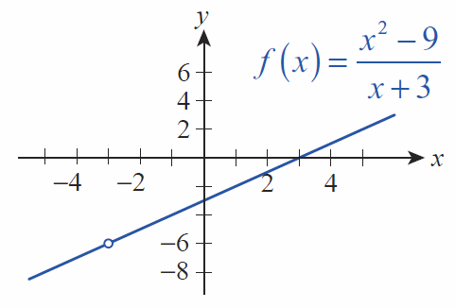
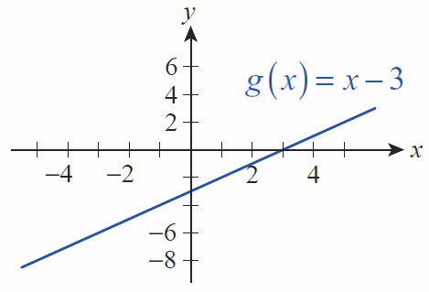
Example 5: Using Algebraic Techniques to Find a Limit (cont.)
Figure 2

Slide 43
Example 5: Using Algebraic Techniques to Find a Limit (cont.)
However, the behaviors of f and g are identical as x approaches −3, and therefore, so are their limits. (Examining the chain of equalities above, note that we never actually stated the equality of f and g, but merely the fact that their limits at −3 were equal.)

Slide 44
Example 6: Using Algebraic Techniques to Find a Limit
Use algebra to evaluate
Solution
The trick with a limit such as this is to use the “conjugate product rule” If we multiply both the numerator and denominator by the “conjugate” of the expression containing the radical (in this case, that is we obtain the following.

Slide 45
Example 6: Using Algebraic Techniques to Find a Limit (cont.)

Slide 46
Example 7: Using Algebraic Techniques to Find a Limit
Find the limit:
Solution
We will take an algebraic approach very similar to the previous examples, but keeping in mind the fact that in the current problem, the variable is denoted by h, rather than the usual x. This, however, should not cause any difficulties.

Slide 47
Example 7: Using Algebraic Techniques to Find a Limit (cont.)
Again, canceling h is legitimate, since h never actually assumes the value 0.

Slide 48
Limit Determination Techniques (cont.)
Another technique for determining calls for finding two other functions, g and h, such that f is “squeezed between” g and h and for which and are easier to determine.

Slide 49
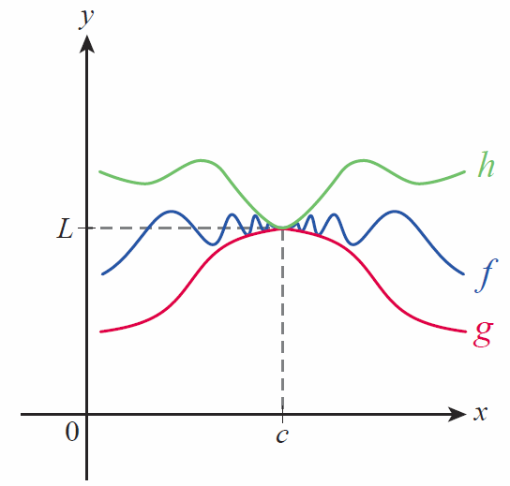
Theorem: The Squeeze Theorem
If for all x
in some open interval
containing c, except possibly
at c itself, and if
then
as well. The statement also
holds for limits at infinity,
that is, for c = −∞ or c = ∞.
Figure 3 The Squeeze Theorem

Slide 50
Limit Determination Techniques (cont.)
The Squeeze Theorem also goes by names such as the Sandwich Theorem and the Pinching Theorem.

Slide 51
Example 8: Using the Squeeze Theorem to Prove a Limit Claim
Use the Squeeze Theorem to prove
Solution
As a first observation, we recall that the sine value of any angle is never greater than 1 or less than −1; that is, we have the well‑known inequalities
for any α. This certainly means that for any nonzero x, choosing
a fact you have seen before.

Slide 52
Example 8: Using the Squeeze Theorem to Prove a Limit Claim (cont.)
We now consider the effect of multiplying all the terms in this double inequality by x, for which we must consider two cases.

Slide 53
Example 8: Using the Squeeze Theorem to Prove a Limit Claim (cont.)
Case 1: x < 0. Since we are multiplying through by a negative quantity, all inequality symbols must be reversed. We must obtain
or
Since we are assuming x < 0, we know that x = −|x| and −x = |x|, so that last double inequality can be written as

Slide 54
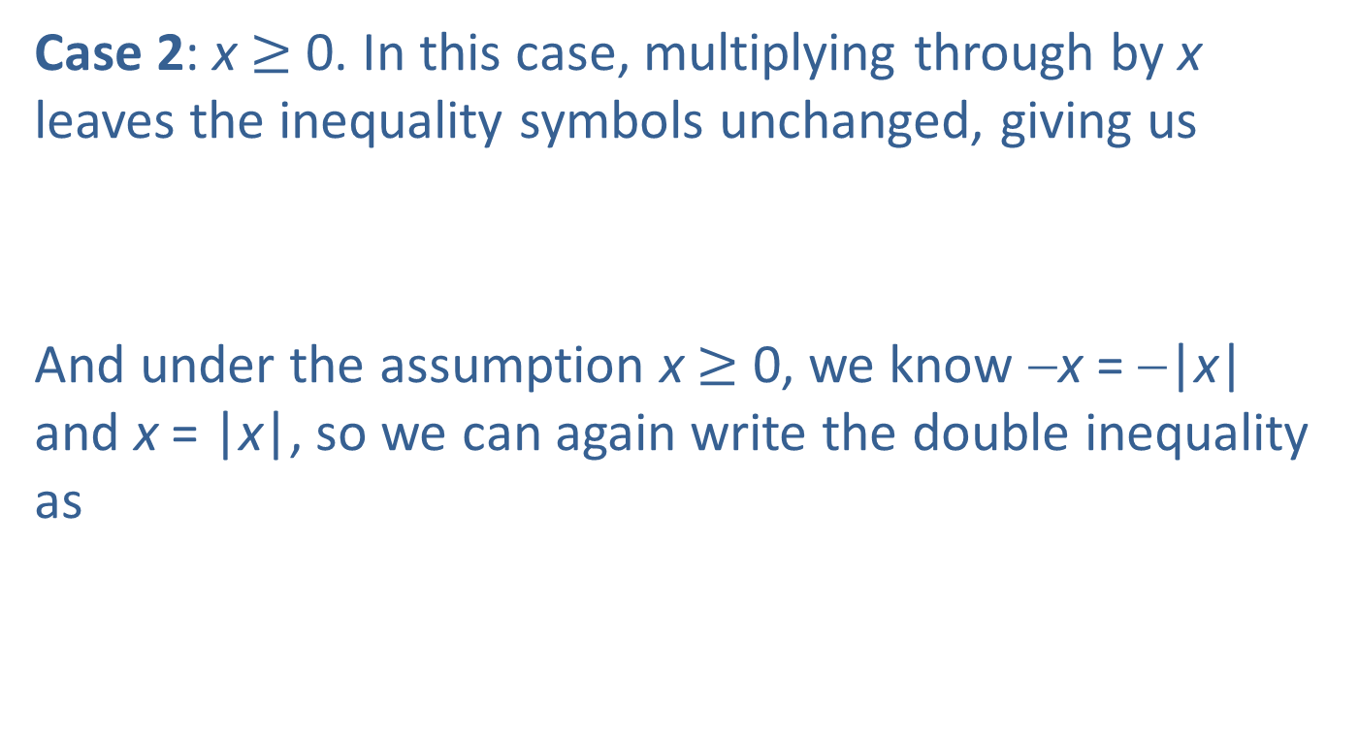
Example 8: Using the Squeeze Theorem to Prove a Limit Claim (cont.)
Case 2: x $≥$ 0. In this case, multiplying through by x leaves the inequality symbols unchanged, giving us
And under the assumption x $≥$ 0, we know −x = −|x| and x = |x|, so we can again write the double inequality as

Slide 55
Example 8: Using the Squeeze Theorem to Prove a Limit Claim (cont.)
In words, we can say that while the sine function oscillates between −1 and 1, will oscillate between −|x| and |x|. The previous inequality coupled with the fact that means that the functions and satisfy the hypotheses of the Squeeze Theorem. Thus, we can simply invoke the theorem, which ensures that the claim
is now proven.

Slide 56
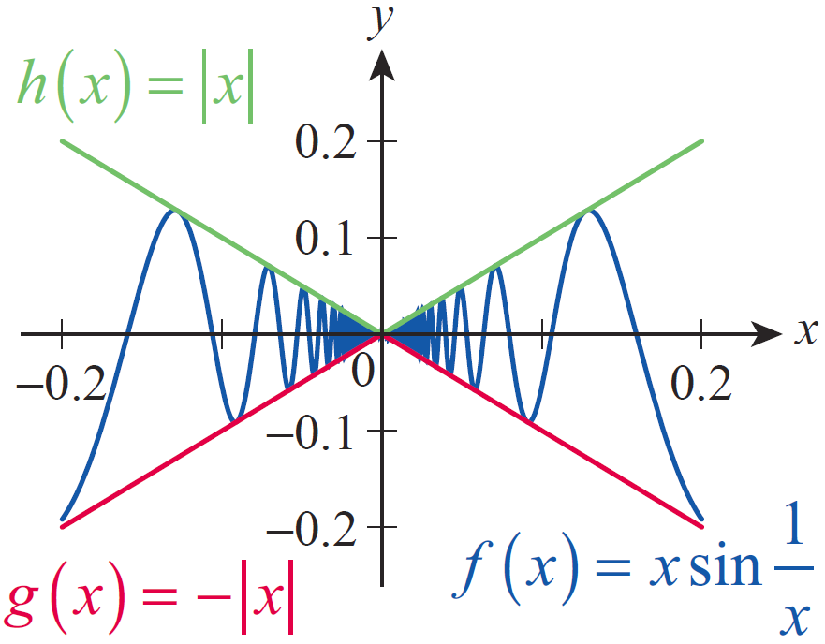
Example 8: Using the Squeeze Theorem to Prove a Limit Claim (cont.)
Figure 4 shows the Squeeze Theorem at work. Notice how f is “squeezed between” g and h near the origin.
Figure 4

Slide 57
Theorem: Upper Bound Theorem
If for all x in some open interval containing c, except possibly at c itself, and if the limits of f and g both exist at c, then

