Slide 1
Section 3.1
Differentiation Notation and Consequences

Slide 2
Alternative Notations and Higher-Order Derivatives
Recall that the fraction
is called the difference quotient of f at c with increment h, and that we let
provided this limit exists.

Slide 3
Alternative Notations and Higher-Order Derivatives (cont.)
This is our definition of the derivative of f at c, and we quickly extend it to all points x at which a similar limit exists to define the derivative of f as the function whose value at x is given by

Slide 4
Alternative Notations and Higher-Order Derivatives (cont.)
If exists for a given function f, we say f is differentiable at c, and if exists for all x in some open interval we say f is differentiable on that interval. If, as is common, the function f appears in the form of the equation y = f(x), any of the following notations may be used to refer to the derivative of the function at x.

Slide 5
Alternative Notations and Higher-Order Derivatives (cont.)
The symbols d/dx, D, and D_{x} are called differentiation operators (with respect to x, at the moment), and the formal meaning of, for instance, dy/dx is “the derivative of y with respect to x.”

Slide 6
Example 1: Finding the Derivative of a Function
Find for the function
Solution
Since is just alternative notation for we have the following.

Slide 7
Example 1: Finding the Derivative of a Function (cont.)

Slide 8
Example 1: Finding the Derivative of a Function (cont.)
After combining like terms in the numerator, this expression becomes
Thus, we conclude that for

Slide 9
Alternative Notations and Higher-Order Derivatives (cont.)
The prime notation allows us to easily denote the evaluation of a derivative at a point. In order to indicate the same concept with the differential notation, we need one additional symbol, as follows:
given is synonymous with
The notation is read “the derivative of y with
respect to x evaluated at x = c.”

Slide 10
Example 2: Evaluating the Derivative of a Function at a Point
Let For y = f (x), use both the prime and the differential notations to evaluate Use the derivative to find and express your answer in both notations.

Slide 11
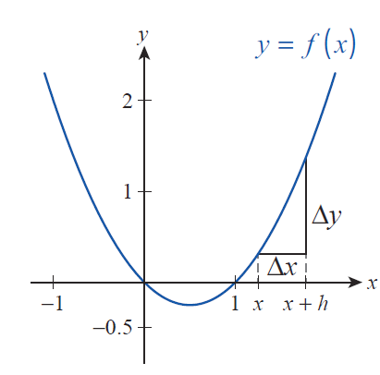
Example 2: Evaluating the Derivative of a Function at a Point (cont.)
Solution
As shown in Figure 1, is just an alternate notation for the increment h, while
Thus the corresponding difference quotient can be rewritten as
Figure 1

Slide 12
Example 2: Evaluating the Derivative of a Function at a Point (cont.)
and hence

Slide 13
Example 2: Evaluating the Derivative of a Function at a Point (cont.)
Finally, we will use the alternate notations to express the derivative at x = 2.

Slide 14
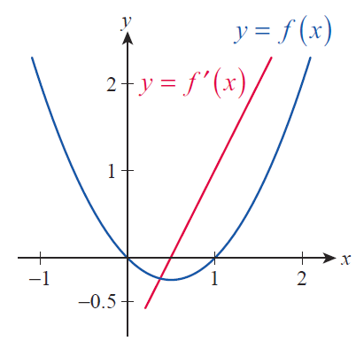
Example 2: Evaluating the Derivative of a Function at a Point (cont.)
Figure 2 shows the graphs of y = f (x) and that of dy/dx = f ’(x) on the same set of axes. The reader is invited to examine the relationship between the rate of change, or “slope” of the graph of f and the function values f ’(x) as x ranges over the real numbers. We will examine this relationship in great depth over the coming sections.
Figure 2

Slide 15
Alternative Notations and Higher-Order Derivatives (cont.)
Given a function f and the equation y = f(x), the following all denote the second derivative of f (or y) with respect to x.

Slide 16
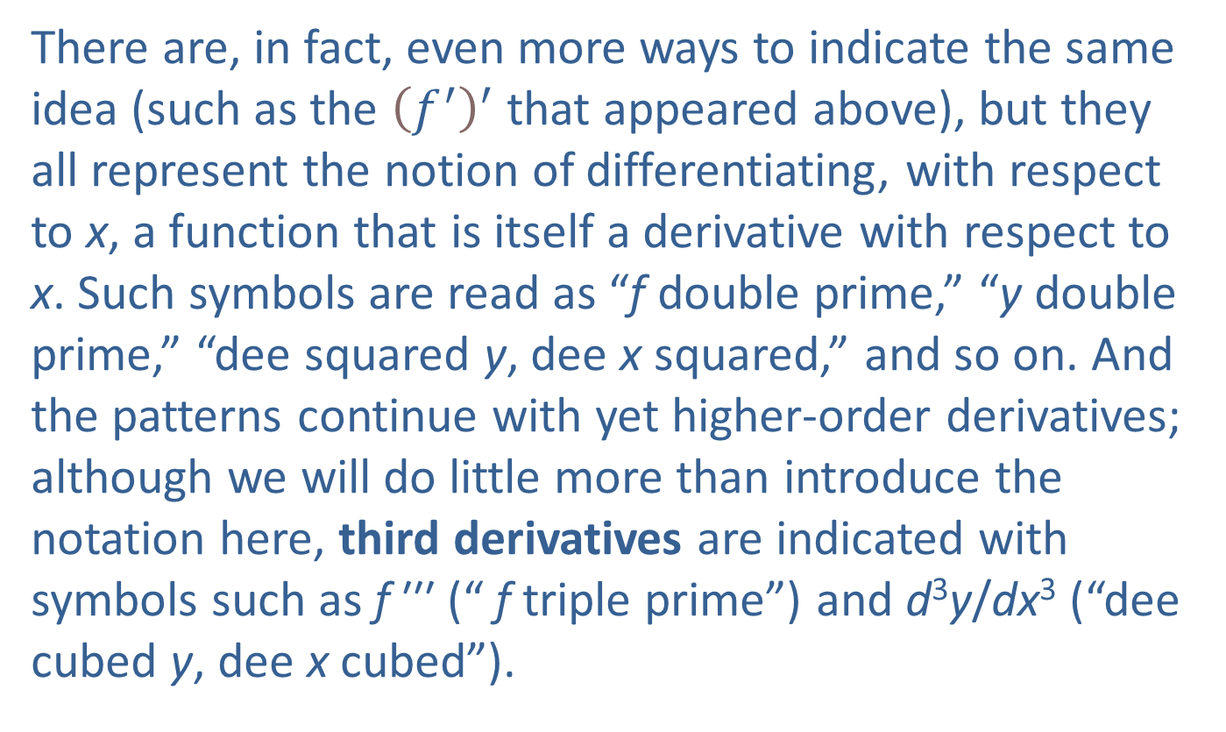
Alternative Notations and Higher-Order Derivatives (cont.)
There are, in fact, even more ways to indicate the same idea (such as the ${\left(f^{′}\right)}^{′}$ that appeared above), but they all represent the notion of differentiating, with respect to $\text{x}$, a function that is itself a derivative with respect to x. Such symbols are read as “f double prime,” “y double prime,” “dee squared y, dee x squared,” and so on. And the patterns continue with yet higher‑order derivatives; although we will do little more than introduce the notation here, third derivatives are indicated with symbols such as f ′′′ (“ f triple prime”) and d³y/dx³ (“dee cubed y, dee x cubed”).

Slide 17
Alternative Notations and Higher-Order Derivatives (cont.)
Beyond this level, the order of the derivative is often indicated with a number inside parentheses (instead of “prime” marks). The n^{th} derivative of f (or y) can be written as

Slide 18
Alternative Notations and Higher-Order Derivatives (cont.)
Consider again an example in which x(t) denotes the position, at time t, of an object moving along a straight path. As we now know, represents the object’s instantaneous rate of change of position (at time t), better known as velocity.
So represents the object’s instantaneous rate of change of velocity; that is, tells us how quickly the object’s velocity is increasing or decreasing at time t. This “rate of change of velocity” goes by the common name acceleration.

Slide 19
Example 3: Finding Velocity and Acceleration Functions
A tennis ball is hit vertically upward so that its position function is given by h(t) = −16t² + 96t + 4 feet above the ground at t seconds. Find the velocity and acceleration functions. What are the initial position, velocity, and acceleration values?

Slide 20
Example 3: Finding Velocity and Acceleration Functions (cont.)
Solution
As we have seen, velocity is the first derivative of position, commonly labeled as v(t), which we shall obtain using the definition of the derivative.

Slide 21
Example 3: Finding Velocity and Acceleration Functions (cont.)
After expanding, combining, and canceling like terms in the numerator we obtain

Slide 22
Example 3: Finding Velocity and Acceleration Functions (cont.)
We see from the position and velocity functions that the initial position and initial velocity, respectively, are
and
Next, as we have discussed above, the acceleration function of the tennis ball is the second derivative of position, in other words, the first derivative of velocity.

Slide 23
Example 3: Finding Velocity and Acceleration Functions (cont.)
Using the common notation of a(t) for the acceleration function, once again with the help of the definition of the derivative we obtain

Slide 24
Example 3: Finding Velocity and Acceleration Functions (cont.)
What this means is that the tennis ball’s acceleration is constant; that is,
The reason for the negative sign is our convention of treating “upward” velocities as positive, but in many contexts, the negative sign can be omitted. In fact, any falling object that is under the influence of gravity only (that is, all other forces including air resistance are negligible) moves at the same constant acceleration.

Slide 25
Example 3: Finding Velocity and Acceleration Functions (cont.)
This law of nature was discovered by Galileo Galilei (1564–1642) who was the first scientist to claim that in the absence of air resistance, all objects fall with the same constant acceleration, anywhere on the Earth. This constant acceleration caused by gravity is denoted by g, and if we exit the specific context of our problem for a moment and omit the negative sign, we have
or using metric units,

Slide 26
Example 3: Finding Velocity and Acceleration Functions (cont.)
One way to remember the constant accelerating action of gravity is to note that its effect is to “add” to the velocity of a falling object an “extra” downward velocity of 32 ft/s every second (or an “extra” downward 9.8 m/s every second if we are working with metric units).

Slide 27
Example 3: Finding Velocity and Acceleration Functions (cont.)
In conclusion, to answer our last question of the initial acceleration of the tennis ball, we note that since acceleration is constant and pointing downward,
and our solution is complete.

Slide 28
Alternative Notations and Higher-Order Derivatives (cont.)
Although it is seen less often, the third derivative of a position function x(t) also has a common name. Since a relatively large value (in magnitude) for at a particular time t would mean a rapid change in the acceleration of the object, which corresponds to a very sudden change in the object’s position, the third derivative is sometimes called the jerk.

Slide 29
Example 4: Finding the First, Second, and Third Derivatives of a Function
Find the first three derivatives of
Solution
We start by calculating f′ using the definition.

Slide 30
Example 4: Finding the First, Second, and Third Derivatives of a Function (cont.)

Slide 31
Example 4: Finding the First, Second, and Third Derivatives of a Function (cont.)
Notice that the derivative of the given cubic polynomial is a quadratic function. Next, knowing that
we obtain the second derivative of f as follows.

Slide 32
Example 4: Finding the First, Second, and Third Derivatives of a Function (cont.)

Slide 33
Example 4: Finding the First, Second, and Third Derivatives of a Function (cont.)
Perhaps it doesn’t come as a surprise that the derivative of the above quadratic function is linear. To obtain the third derivative, we will differentiate yet again. As you might have observed already, the derivative of a linear function is a constant, so that is what we expect f ′′′ to be (see Example 3).

Slide 34
Example 4: Finding the First, Second, and Third Derivatives of a Function (cont.)

Slide 35
Example 4: Finding the First, Second, and Third Derivatives of a Function (cont.)
The derivative of any constant function is identically 0, so we would like to note as we conclude this example that the fourth, fifth, and any subsequent higher‑order derivatives of f are identically 0.

Slide 36
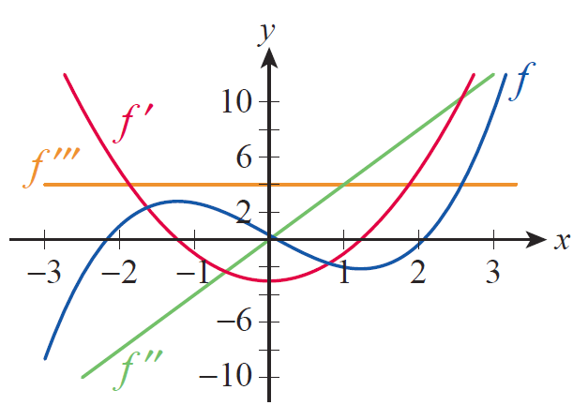
Example 4: Finding the First, Second, and Third Derivatives of a Function (cont.)
Figure 3 shows the graph of f along with those of its first three derivatives on the same axes. Compare the graphs and examine how the rate of change of each at every x is reflected by the corresponding value of its derivative.
Figure 3

Slide 37
Theorem: Differentiability Implies Continuity
If f is differentiable at c, then f is continuous at c.

Slide 38
Proof
Since we seek to prove that f is continuous at the point c, we need to show The one fact we
have to work with is that exists.
By our definition of this means that
exists, and so implicitly we are also given that f is defined at c; in other words, f(c) exists.

Slide 39
Proof (cont.)
Further, the fact that the above limit exists means that f(x) is defined for all x in some open interval containing c (that is, “sufficiently close to c”), so it makes sense to talk about For x ≠ c, we can multiply the difference quotient by x − c and note that

Slide 40
Proof (cont.)
We can now apply the limit laws to evaluate the limit as follows.

Slide 41
Proof (cont.)

Slide 42
Consequences of Differentiability
The behavior of the function f(x) = |x| at the point x = 0 gives us one example. For x > 0 the difference quotient is
and for x < 0 the difference quotient is

Slide 43
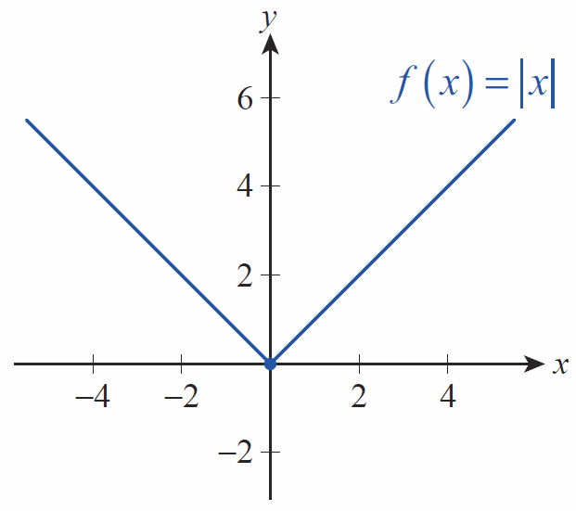
Consequences of Differentiability (cont.)
The fact that the two one-sided limits do not agree at 0 means that f(x) = |x| is not differentiable at 0; such a point on the graph of a function, where the one-sided difference quotient limits exist but are unequal, is called a corner (see Figure 5).
Figure 5 A Corner

Slide 44
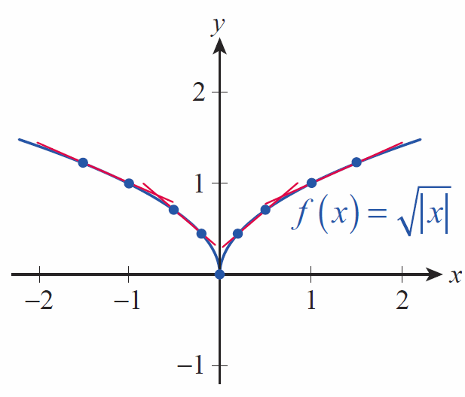
Consequences of Differentiability (cont.)
If one of the one-sided difference quotients tends to −∞ and the other to +∞; such a point on the graph of f
is called a cusp. In the graph of from Figure 6, note how the secant lines to the right of the cusp all have positive slopes (and increase without bound as x
approaches 0), while the secant lines on the left all have negative slopes.
Figure 6 A Cusp

Slide 45
Consequences of Differentiability (cont.)
If both one-sided difference quotients have a limit of +∞, or if both have a limit of −∞, the graph of f at c actually has a tangent line but its slope is undefined; we (naturally enough) refer to such a situation as a vertical tangent line, and the graphs of and both possess this property at 0 (see Figure 7). Note that
the secant lines approximating the vertical tangent all have positive slope on the graph of and all have negative slope on the graph of .

Slide 46
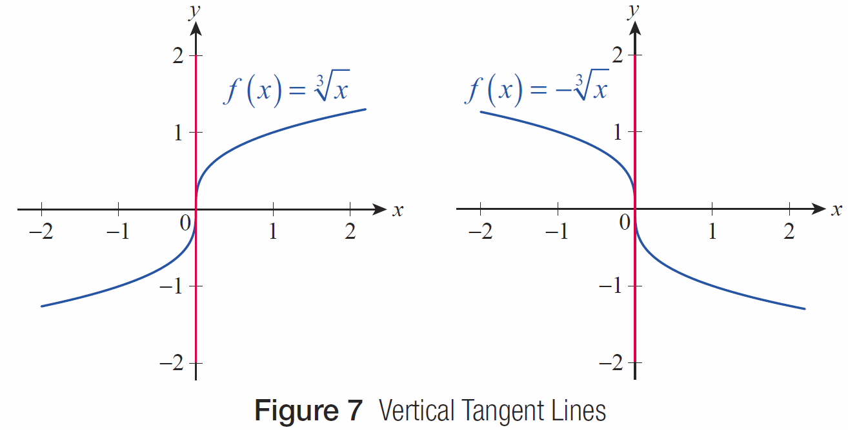
Consequences of Differentiability (cont.)
Figure 7 Vertical Tangent Lines

Slide 47
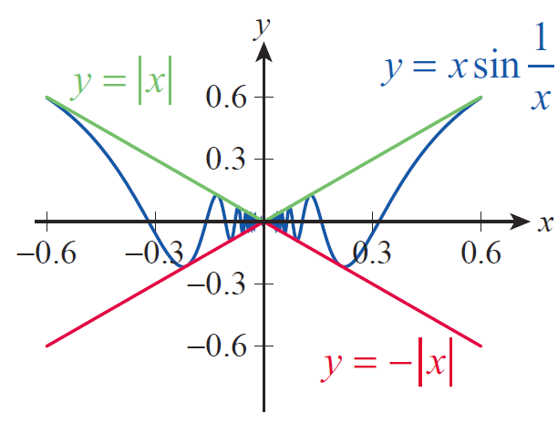
Example 5: Proving a Function Is Continuous but Not Differentiable
Prove that the function
is continuous, but not differentiable, at 0.
Solution
To see the continuity of f (x) at 0, observe that since
for all nonzero x, it follows that
if x ≠ 0 (see Figure 8).
Figure 8

Slide 48
Example 5: Proving a Function Is Continuous but Not Differentiable (cont.)
We can now apply the Squeeze Theorem, since
Thus, so f(x) is
continuous at 0.

Slide 49
Example 5: Proving a Function Is Continuous but Not Differentiable (cont.)
To prove the nondifferentiability of f, we will show that the limit of its difference quotients does not exist at 0. This will be due to extensive (in fact, infinitely many) oscillations of f near the origin, as we shall see shortly. Let us first assume that x > 0, and examine the difference quotient

Slide 50
Example 5: Proving a Function Is Continuous but Not Differentiable (cont.)
In other words, proving that the one-sided difference quotient limit does not exist for x > 0 is now equivalent to proving that does not exist. (Note that
this also means that not only f oscillates “too much” near 0, but so do its difference quotients.)

Slide 51
Example 5: Proving a Function Is Continuous but Not Differentiable (cont.)
Suppose that the above limit exists, and Then for ε = 1, there is a δ > 0 such that
whenever
Recall from your studies of the sine function that for any integer k,

Slide 52
Example 5: Proving a Function Is Continuous but Not Differentiable (cont.)
In addition, we can choose and fix a big enough positive integer k such that
Using the notation
note that x₂ < x₁ < δ, while

Slide 53
Example 5: Proving a Function Is Continuous but Not Differentiable (cont.)
By assumption,
which implies that L > 0, but also
implying in turn that L < 0, an obvious impossibility.

Slide 54
Example 5: Proving a Function Is Continuous but Not Differentiable (cont.)
Thus, cannot be approaching any limit L at all as x approaches 0 from the right; that is,
The case of x < 0 is handled in an analogous fashion, and it will follow that neither one‑sided difference quotient limit exists, and thus f(x) is not differentiable at 0, just as we needed to show.

Slide 55
Definition: One-Sided Derivatives
If a function f is defined on an interval of the form [a, p) (that is, at a and on some half‑open interval to the right of a), the right‑hand derivative of f at a is defined to be
provided the limit exists.

Slide 56
Definition: One-Sided Derivatives (cont.)
Similarly, if f is defined on an interval of the form (p, b], the left‑hand derivative of f at b is defined to be
provided the limit exists.

Slide 57
Example 6: Finding One-Sided Derivatives
Consider the following piecewise defined function.
a. Find the one‑sided derivatives of f at 1 and use them to decide whether f is differentiable at c = 1.
b. Find the appropriate one‑sided derivatives at the endpoints of the domain of f .

Slide 58
Example 6: Finding One-Sided Derivatives (cont.)
Solution
a. First of all, since
f is certainly continuous at 1. But is it differentiable? The one‑sided derivatives will have the answer.

Slide 59
Example 6: Finding One-Sided Derivatives (cont.)

Slide 60
Example 6: Finding One-Sided Derivatives (cont.)
Thus, we see that the left‑hand derivative of f at 1 equals 1. The right‑hand derivative at the same point is determined as follows.

Slide 61
Example 6: Finding One-Sided Derivatives (cont.)

Slide 62
Example 6: Finding One-Sided Derivatives (cont.)
Since the one‑sided derivatives agree, we conclude that f is differentiable at c = 1. Graphically this means that even though the graph is “patched together” at c = 1 from two “pieces,” this is done in a “smooth” way, in other words, without the formation of any corner or cusp.

Slide 63
Example 6: Finding One-Sided Derivatives (cont.)
b. Since a = 0 is the left endpoint of the domain of f, only the right‑hand derivative is defined.
So the right‑hand derivative of f at 0 does not exist.

Slide 64
Example 6: Finding One-Sided Derivatives (cont.)
Finally, at the right endpoint b = 2,

Slide 65
Example 6: Finding One-Sided Derivatives (cont.)
To summarize our findings, the graph of f is joined together “smoothly” from two pieces at c = 1, it goes “vertical” at the left endpoint of its domain, and has a “slope” of 2 at the right endpoint, since the right-hand derivative exists there.

Slide 66
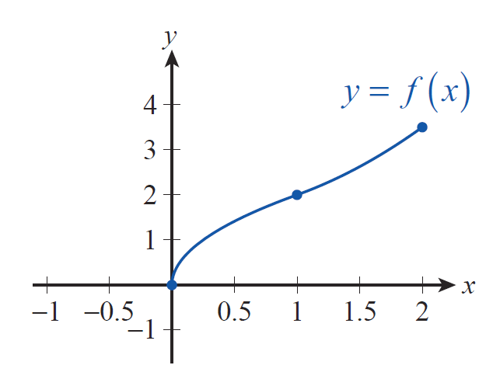
Example 6: Finding One-Sided Derivatives (cont.)
Figure 9 graphically reflects these observations.
Figure 9

Slide 67
Darboux’s Theorem
If f is differentiable on [a, b], then f ′ takes on every value between and That is, f ′ has the Intermediate Value Property (IVP) on the interval [a, b]: if L is a value between and there is a
point c in [a, b] such that

