Slide 1
Section 3.2
Derivatives of Polynomials, Exponentials, Products, and Quotients

Slide 2
Theorem: The Constant Rule
If f is a constant function, say then In other notation, we write

Slide 3
Theorem: The Positive Integer Power Rule
If where n is a positive integer, then
In other notation, we write

Slide 4
Proof
There are actually several ways to prove this first Power Rule, and because they introduce useful techniques we will provide two common proofs here.
Proof 1
The identity
can be verified by multiplying out the right‑hand side and canceling the common terms. With this identity in hand, we can use one of the alternative forms of the difference quotient to obtain the following derivative.

Slide 5

Proof (cont.)

Slide 6
Proof (cont.)
Proof 2
Alternatively, we can use the Binomial Theorem to expand the term as follows.

Slide 7
Proof (cont.)

Slide 8
Example 1: Using the Constant Rule and the
Positive Integer Power Rule
Use the Constant Rule and Positive Integer Power Rule to determine the derivative of the given function.
a. b.
c. d.
e. f.

Slide 9
Example 1: Using the Constant Rule and the
Positive Integer Power Rule (cont.)
Solution
a. Since f is a constant function, the Constant Rule applies. Using the various notations, we obtain
Recall that there are even more ways to express our answer. For example, or if f appears in the form of y = 5, we might write dy/dx = 0, etc.

Slide 10
Example 1: Using the Constant Rule and the
Positive Integer Power Rule (cont.)
b. Again, since g is constant, its derivative will be identically 0, just like that of any other constant function.

Slide 11
Example 1: Using the Constant Rule and the
Positive Integer Power Rule (cont.)
c. At first, it might be tempting to try to use the Positive Integer Power Rule on h, but we must be careful to avoid that mistake. Notice that π ³ is a constant, so h(x) is a constant function and when differentiated it behaves like any other constant function.

Slide 12
Example 1: Using the Constant Rule and the
Positive Integer Power Rule (cont.)
d. Since k(x) is a positive integer power of the independent variable x, the Positive Integer Power Rule applies with n = 4.

Slide 13
Example 1: Using the Constant Rule and the
Positive Integer Power Rule (cont.)
e. Notice that the independent variable of s is denoted by t, but the Positive Integer Power Rule applies, just like it would with the variable x.

Slide 14
Example 1: Using the Constant Rule and the
Positive Integer Power Rule (cont.)
f. Since is not a positive integer power of z, we cannot apply the Positive Integer Power Rule for w, but will proceed using the definition of the derivative instead. Our conclusion will be pleasantly consistent.

Slide 15
Example 1: Using the Constant Rule and the
Positive Integer Power Rule (cont.)
Notice that if we had applied the Positive Integer Power Rule, we would have obtained
which is precisely the correct answer. In other words, the pattern of the rule still applies to the exponent of −1. As mentioned immediately preceding this example, the Power Rule actually holds true for any real exponent, a fact we will prove later.

Slide 16
Theorem: The Constant Multiple Rule
Given a constant k and a differentiable function f, the derivative of is In other notation,

Slide 17
Theorem: The Sum and Difference Rules
If f and g are both differentiable at x, the sum f + g is
also differentiable at x and In other notation,
Similarly, f − g is differentiable and

Slide 18
Proof

Slide 19
Proof (cont.)
To prove the corresponding Difference Rule, we can make use of the Sum Rule and the Constant Multiple Rule.

Slide 20
Example 2: Using Elementary Differentiation Rules
Use the above rules to find the derivative of the given function.
a.
b.
c.

Slide 21
Example 2: Using Elementary Differentiation Rules (cont.)
Solution
a. Since p is a polynomial of two terms, the Sum Rule immediately ensures that we can differentiate it termwise; that is, we can differentiate the terms separately and add up the results.

Slide 22
Example 2: Using Elementary Differentiation Rules (cont.)
Next, the Constant Multiple Rule and the Power Rule come to bear, and we obtain
Thus we conclude that Notice what we found here is that the derivative of a quadratic polynomial is a linear polynomial. This is indeed the case in general; it is not hard to see that if the degree of p is n, then its derivative has degree n − 1.

Slide 23
Example 2: Using Elementary Differentiation Rules (cont.)
b. Even though q(x) has more than two terms, a repeated use of the Sum Rule still enables us to differentiate termwise, as shown.

Slide 24
Example 2: Using Elementary Differentiation Rules (cont.)

Slide 25
Example 2: Using Elementary Differentiation Rules (cont.)
This illustrates the fact that the Sum Rule makes it possible for us to differentiate any polynomial term by term. This observation along with the first two rules of this section will then imply that the derivative of a polynomial is always another polynomial. We now complete the differentiation of q.

Slide 26
Example 2: Using Elementary Differentiation Rules (cont.)

Slide 27
Example 2: Using Elementary Differentiation Rules (cont.)
c. With regards to f(x), recall that from Example 1 we know the derivative of 1/x to be −1/x²; and also
We previously calculated this latter
derivative, or you might arrive at it by using the yet‑unproven Power Rule for a fractional exponent.

Slide 28
Example 2: Using Elementary Differentiation Rules (cont.)
Armed with these facts, we use a combination of the Difference Rule and Constant Multiple Rule to complete our solution, as follows.

Slide 29
Example 2: Using Elementary Differentiation Rules (cont.)

Slide 30
Example 3: Finding the Equation of a Tangent Line
Find the equation of the line tangent to the graph of
at the point (1,3).
Solution
Recall that the slope of the tangent is the derivative of p at x = 1.

Slide 31
Example 3: Finding the Equation of a Tangent Line (cont.)
Termwise differentiation yields

Slide 32
Example 3: Finding the Equation of a Tangent Line (cont.)
and thus the slope we are seeking is
Now the point‑slope form of the equation of a line yields
or equivalently, the requested equation of the tangent is

Slide 33
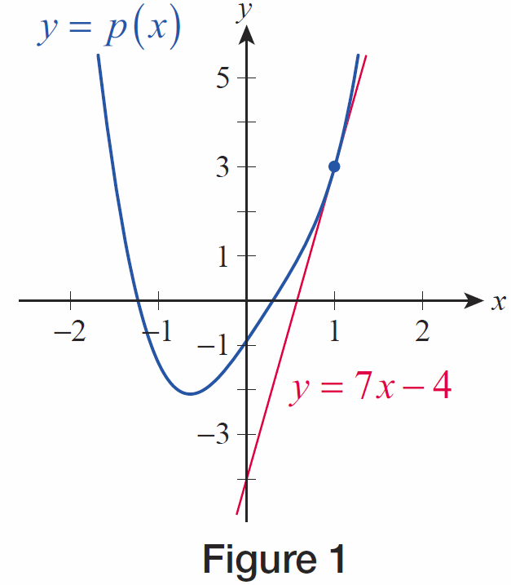
Example 3: Finding the Equation of a Tangent Line (cont.)
The curve and its tangent line are graphed in Figure 1.
Figure 1

Slide 34
Example 4: Finding Instantaneous Velocity and Acceleration
The distance from the origin of a particle moving along the x‑axis is described by the function
inches, where t is measured in seconds. Find the instantaneous velocity and acceleration of the particle at t = 2 seconds.
Solution
As we have seen before, velocity is the derivative of the position function. Note, however, that in this example x is actually the dependent variable, and differentiation takes place with respect to the independent variable t.

Slide 35
Example 4: Finding Instantaneous Velocity and Acceleration (cont.)
Thus, the instantaneous velocity of the particle at t = 2 seconds is

Slide 36
Example 4: Finding Instantaneous Velocity and Acceleration (cont.)
To find the acceleration, we differentiate the velocity function.

Slide 37
Example 4: Finding Instantaneous Velocity and Acceleration (cont.)
Substituting t = 2 into the acceleration function gives the instantaneous acceleration of the particle at t = 2 seconds.

Slide 38
Theorem: Derivative of e^{x}

Slide 39
Example 5: Finding the First, Second, and Third
Derivatives of a Function
Find the first three derivatives of the following functions.
a.
b.
c. a ∈ ℝ

Slide 40
Example 5: Finding the First, Second, and Third
Derivatives of a Function (cont.)
Solution
a. Using the Constant Multiple Rule along with the fact that e^{x} is its own derivative we find the first derivative as follows
In other words, we find that f(x) is also the derivative of itself. Repeating the above calculation two more times, we conclude that the second and third derivatives of f are also equal to f , that is,

Slide 41
Example 5: Finding the First, Second, and Third
Derivatives of a Function (cont.)
In fact, it is easy to generalize and observe that all derivatives of f(s) are equal to itself. We will have more to say about this observation in part c. of this example.

Slide 42
Example 5: Finding the First, Second, and Third
Derivatives of a Function (cont.)
b. In addition to the rules used in part a., we will also need the Sum Rule to find the derivative of g(s).

Slide 43
Example 5: Finding the First, Second, and Third
Derivatives of a Function (cont.)
A similar calculation yields the second derivative.
You might already have figured out the third derivative by observing that differentiation only affects the first term. Here are the details.

Slide 44
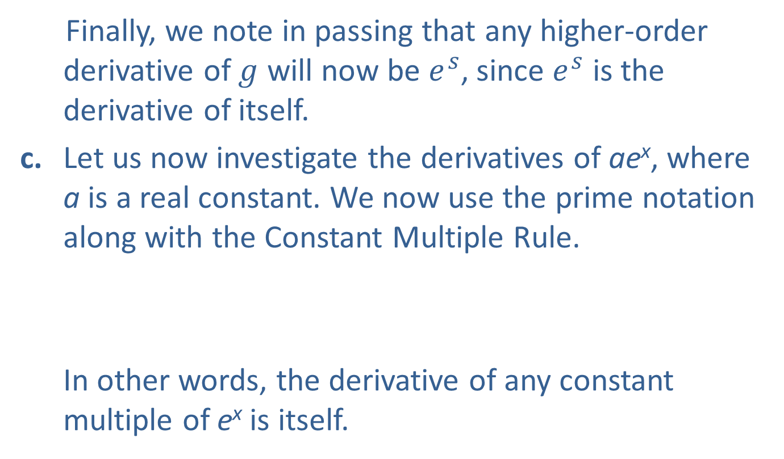
Example 5: Finding the First, Second, and Third
Derivatives of a Function (cont.)
Finally, we note in passing that any higher‑order derivative of $g$ will now be $ⅇ^{s}$, since $ⅇ^{s}$ is the derivative of itself.
c. Let us now investigate the derivatives of ae^{x}, where a is a real constant. We now use the prime notation along with the Constant Multiple Rule.
In other words, the derivative of any constant multiple of e^{x} is itself.

Slide 45
Example 5: Finding the First, Second, and Third
Derivatives of a Function (cont.)
Repeating the above procedure any number of times allows us to conclude that derivatives of all orders of the function h(x) = ae^{x} are equal to h itself for all a∈ℝ. This is a generalization of the observation we made in part a. of this example.

Slide 46
Caution
The derivative of a product is not the product of the derivatives.
Similarly, the derivative of a quotient is not the quotient of the derivatives.

Slide 47
Theorem: The Product Rule
If f and g are both differentiable at x, the product fg is also differentiable at x and
In other notation,

Slide 48
Proof

Slide 49
Proof (cont.)
We begin above, unsurprisingly, with the limit of a difference quotient. In order to make the limit tractable, however, we need to rewrite the difference quotient in such a way that difference quotients for f and g make an appearance, and the easiest way to do this is to add and subtract the expression in the numerator, as shown in the second step.

Slide 50
Proof (cont.)
The third step then splits the difference quotient into two fractions, and we proceed by applying additional limit properties.

Slide 51
Proof (cont.)
Note that we have used the fact that differentiability implies continuity in order to replace with g(x) in the last step.

Slide 52
Example 6: Using the Product Rule
Use the Product Rule to find the derivative of each function.
a. b.
c. d.
Solution
a. In order to differentiate F, we could certainly use the approach of Example 2 and, with the help of the Constant Multiple Rule, arrive at the answer of

Slide 53
Example 6: Using the Product Rule (cont.)
However, our aim here is to demonstrate the truth of the Product Rule, so let’s think of F as the product of the constant function f(x) = 5 and the function g(x) = x and apply the Product Rule.

Slide 54
Example 6: Using the Product Rule (cont.)
b. Again, the Positive Integer Power Rule is perhaps the easiest way to determine G’, but let us see how the Product Rule gives us the same answer. Since x² = x ⋅ x, we have
which is exactly what the Positive Integer Power Rule would tell us.

Slide 55
Example 6: Using the Product Rule (cont.)
With the assignments and
see that so applying
the Product Rule gives us

Slide 56
Example 6: Using the Product Rule (cont.)

Slide 57
Example 6: Using the Product Rule (cont.)
Notice that we can check our answer by multiplying the two factors of H together and differentiating the resulting polynomial the usual way:
so applying our rules,
as we expected.

Slide 58
Example 6: Using the Product Rule (cont.)
d. While all the previous derivatives could be handled in alternative ways, in the case of the function K there is no apparent way to avoid the Product Rule. Using the prime notation this time, we can write
where we again used the fact that e^{x} is the derivative of itself.

Slide 59
Example 7: Using the Product Rule
Find F(1) if and and
Solution
First of all, since we know finding F(1) or g(1) are equivalent problems. Keeping this in mind, it is not hard to see that the Product Rule provides us with an equation to determine g(1), as follows.

Slide 60
Example 7: Using the Product Rule (cont.)

Slide 61
Example 7: Using the Product Rule (cont.)
Substituting x = 1, we have
(Note that in general, if x = c, it follows from the Product Rule that
We used this fact with c = 1 in our equation above.)

Slide 62
Example 7: Using the Product Rule (cont.)
Next, substituting the known quantities of and our equation becomes
Solving the above for g(1), we obtain
Finally, recalling that F(1) = g(1), we conclude that F(1) = −2.

Slide 63
Theorem: The Reciprocal Rule
If g is differentiable at x and then is also differentiable at x and

Slide 64
Proof

Slide 65
Proof (cont.)
We are hoping to relate the derivative of 1/g to the derivative of g if possible, so we are again seeking a way to rewrite the difference quotient so that g′ will make an appearance. Using the fact that 1/g(x) is independent of h and can be pulled out of the above limit, and using the continuity of g at x, we can rearrange the quotient to obtain the following.

Slide 66
Proof (cont.)

Slide 67
The Product and Quotient Rules (cont.)
One immediate application of the Reciprocal Rule is the extension of the Power Rule to negative integers. Given a positive integer n, note the following.

Slide 68
Example 8: Using the Reciprocal Rule
Use the Reciprocal Rule to find the derivative of
Solution
Recall that Using this fact along with
the Reciprocal Rule, we can write

Slide 69

Example 8: Using the Reciprocal Rule (cont.)
Notice that our result is yet another illustration of the validity of the Power Rule for fractional exponents
($n=\frac{1}{2}$ in this case). We will prove the Power Rule for all real exponents later as we acquire the necessary tools.

Slide 70
Theorem: The Quotient Rule
If f and g are both differentiable at x and the quotient is also differentiable at x and

Slide 71
Proof
The Product and Reciprocal Rules together allow us to quickly arrive at the Quotient Rule, as follows.

Slide 72
Example 9: Using the Quotient Rule
Use the Quotient Rule to find the following derivatives.
a. b.
c.

Slide 73
Example 9: Using the Quotient Rule (cont.)
Solution
a. Using the Quotient Rule with and we obtain the following.

Slide 74
Example 9: Using the Quotient Rule (cont.)

Slide 75
Example 9: Using the Quotient Rule (cont.)
b. While we could certainly proceed with the Quotient Rule for this function, this is a situation when it pays to rewrite our quotient before differentiating. Notice that by multiplying both the numerator and denominator by x, we obtain an expression that is free of reciprocals and therefore is more convenient to handle.

Slide 76
Example 9: Using the Quotient Rule (cont.)

Slide 77
Example 9: Using the Quotient Rule (cont.)
c. Again, we can make the expression look simpler if we rewrite before differentiating. We will start by multiplying both the numerator and denominator
by

Slide 78
Example 9: Using the Quotient Rule (cont.)

Slide 79
Example 9: Using the Quotient Rule (cont.)
What you should remember from the last two differentiations is that it might not always be the best idea to proceed right away with the Quotient Rule whenever you see a quotient. While you can certainly obtain the correct answer that way, often you can save a lot of time just by rewriting the expression before differentiating.

