Slide 1
Section 3.3
Derivatives of Trigonometric Functions

Slide 2
Lemma
Measuring θ in radians (as is customary),

Slide 3
Proof
Neither limit is trivial, as the numerator and denominator approach 0 in both cases—the key to the evaluation is determining the relative rate at which this happens.

Slide 4
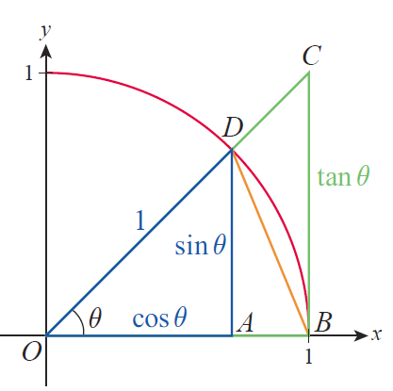
Proof (cont.)
We can construct some bounds on the relative rate for the first limit by referring to Figure 1. For any angle θ between 0 and π/2, the area of triangle OBD is less than the area of the circle sector OBD, which in turn is less than the area of triangle OBC.

Slide 5
Proof (cont.)
Note also that since the radius of the circle is 1, the lengths of the two legs of triangle OAD are cosθ and
sinθ, while the length of the leg opposite θ in triangle OBC is tanθ. Using the area formulas for triangles and circular sectors, we have the following.

Slide 6

Proof (cont.)

Slide 7
Proof (cont.)
So the above statements imply
Since sinθ is positive for all θ in this range, dividing by sinθ and multiplying by 2 leaves each inequality unchanged.

Slide 8
Proof (cont.)
Taking the reciprocal of each fraction does reverse each inequality, so the above is equivalent to
This is the sort of upper and lower bound on
that we need. Since cosθ has a limit of 1 as θ → 0, the Squeeze Theorem tells us that

Slide 9
Proof (cont.)
Since is an even function,
and we also have
so the first limit is proved.

Slide 10
Proof (cont.)
We can now use this result to prove the second limit, making use of the trigonometric identity
Replacing 2x with θ and subtracting 1 from both sides of this identity, we have

Slide 11
Proof (cont.)
and dividing through by θ results in
So we calculate the limit as follows.

Slide 12
Proof (cont.)

Slide 13
Caution
The assumption that the angles in the preceding lemma are measured in radians is critical, as our formula for the area of a circular sector is based on radian measure. We will later learn how to find derivatives of trigonometric functions when using other angle measurements.

Slide 14
Example 1: Finding Limits Involving Trigonometric Functions
Use the lemma to find the following limits.

Slide 15
Example 1: Finding Limits Involving Trigonometric Functions (cont.)
Solution
a. In order for us to be able to use the lemma, we first multiply and divide by 3:
where in the last step we used the fact that when x approaches 0, so does 3x and vice versa.

Slide 16
Example 1: Finding Limits Involving Trigonometric Functions (cont.)
Next, if we rename 3x by calling it θ, we can rewrite our limit as
Now by a direct application of the lemma,

Slide 17
Example 1: Finding Limits Involving Trigonometric Functions (cont.)
b. This limit does not directly resemble either of those in the lemma, but we can rewrite it as follows.

Slide 18
Example 1: Finding Limits Involving Trigonometric Functions (cont.)
Applying the limit laws and both parts of the lemma, along with the fact that we now obtain

Slide 19
Theorem: Derivative of Sine

Slide 20
Proof

Slide 21
Proof (cont.)

Slide 22
Example 2: Analyzing Slopes of Lines Tangent to the Sine Function
If we follow the slopes of tangent lines along the graph y = sin x starting, say, at x = 0,we discover an oscillating sinusoidal pattern.

Slide 23
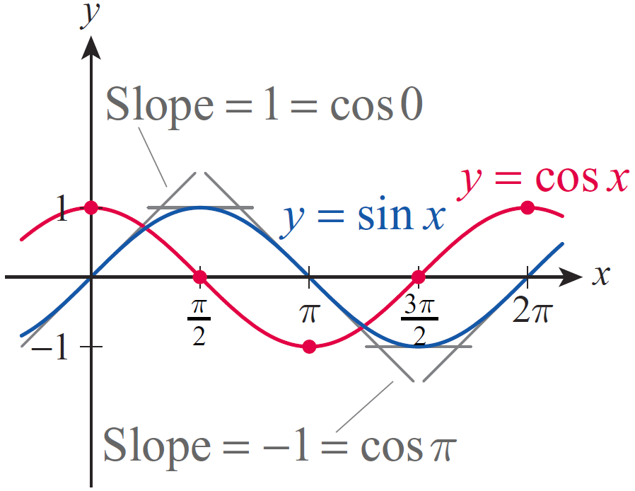
Example 2: Analyzing Slopes of Lines Tangent to the Sine Function (cont.)
As shown in Figure 2, when x = 0 the corresponding tangent is a line through the origin, which appears to have a slope of 1. As x increases, the slopes of the tangent lines decrease, reaching 0 when The slopes then become negative as x continues to increase from
Figure 2

Slide 24
Example 2: Analyzing Slopes of Lines Tangent to the Sine Function (cont.)
When x reaches the value of π, the slope of the corresponding tangent of the sine function is −1. The slopes then start to increase, reaching the value of 0 again at as a close examination of the sine graph reveals. Notice that this is exactly the behavior of the function values of y = cos x, that is, the slope of the tangent to the sine graph at any given x‑value appears to equal the corresponding function value of the cosine function, which is exactly what we proved in the previous theorem.

Slide 25
Example 3: Using Differentiation Rules with
Trigonometric Functions
Use differentiation rules to find the derivative of
Solution
The Product Rule along with the previous theorem yields

Slide 26
Theorem: Derivative of Cosine
Proof
This can be proven using the methods used to show that the derivative of the sine function is cosine.

Slide 27
Example 4: Using Differentiation Rules with
Trigonometric Functions
Use differentiation rules to find the following derivatives.

Slide 28
Example 4: Using Differentiation Rules with
Trigonometric Functions (cont.)
Solution
We will need the differentiation rules of the previous section along with the derivatives of sine and cosine, as follows.

Slide 29
Example 4: Using Differentiation Rules with
Trigonometric Functions (cont.)
b. Note that we need to start with the Quotient Rule.

Slide 30
Example 5: Applying Position, Velocity, and
Acceleration Functions
If an object is oscillating so that the so-called restoring force acting on the object is directly proportional to the negative of its displacement at any time, the resulting motion is called simple harmonic motion. This happens, for example, when an object is attached to a spring, pulled or pushed, and then let go. (We are ignoring air resistance, friction, and all other forces here.)

Slide 31
Example 5: Applying Position, Velocity, and
Acceleration Functions (cont.)
Recall that the equation of this motion, or the position function of the object, can be either or
depending on initial conditions (ω is a constant related to the spring, A is the amplitude).

Slide 32
Example 5: Applying Position, Velocity, and
Acceleration Functions (cont.)
Suppose an object of mass m is hanging on a spring and is at equilibrium. If we pull it downward by 50 cm and release it, the equation of motion is given by
where y is the vertical distance from equilibrium, measured in meters with upward displacement considered positive, and t is measured in seconds.

Slide 33
Example 5: Applying Position, Velocity, and
Acceleration Functions (cont.)
a. Find the position at t = 10 seconds.
b. What is the maximum displacement of the object and when does it occur?
c. Find the maximum velocity and the position where it occurs.
d. Find the maximum acceleration value. When does it occur?

Slide 34
Example 5: Applying Position, Velocity, and
Acceleration Functions (cont.)
Solution
a. The position at t = 10 seconds is quickly found by evaluating the position function.
The positive sign means that the object is found approximately 41.95 cm above equilibrium at t = 10 seconds.

Slide 35
Example 5: Applying Position, Velocity, and
Acceleration Functions (cont.)
b. Since displacement is “signed distance” from equilibrium, maximum displacement will occur precisely when the position function assumes its maximum value (positive or negative). Stated more precisely, this happens when the absolute value of the position is maximum. Since the cosine function oscillates between +1 and −1 reaching these maximum absolute values at kπ, k ∈ ℤ, we conclude that the absolute value of the position function given in this example is greatest when t = kπ seconds, for k ∈ ℤ, k ≥ 0.

Slide 36
Example 5: Applying Position, Velocity, and
Acceleration Functions (cont.)
The greatest displacement value is
Note that this is consistent with our everyday experience. Since there was no initial velocity (no initial “push” or “shove” at the start of motion), we expect the initial displacement of 50 cm to remain maximal throughout the motion. (As we have stated already, we are ignoring all other forces and therefore the fact that the motion actually “dies down” over the long term.)

Slide 37
Example 5: Applying Position, Velocity, and
Acceleration Functions (cont.)
Also, recalling that if k is even and
for an odd k, in light of the position function we conclude that the object reaches its maximum displacement of 50 cm below equilibrium when t = kπ and k is a nonnegative even integer. If k is odd, on the other hand, the object is 50 cm above equilibrium at t = kπ seconds.

Slide 38
Example 5: Applying Position, Velocity, and
Acceleration Functions (cont.)
c. The velocity function is the derivative of the position function.
By an argument similar to the one given in part b., and keeping the graph of the sine function in mind, we see that velocity is greatest when the absolute value of the sine function is 1, that is, when
k ∈ ℤ.

Slide 39
Example 5: Applying Position, Velocity, and
Acceleration Functions (cont.)
Moreover, since
we conclude that velocity is maximal and pointing upward when for a nonnegative even k.

Slide 40
Example 5: Applying Position, Velocity, and
Acceleration Functions (cont.)
On the other hand, if k is odd and positive,
that is, velocity is maximal and is pointing downward in this case. Note that for the above t‑values the cosine function is 0, so maximum velocity (or speed) occurs each time the object is passing through the equilibrium position.

Slide 41
Example 5: Applying Position, Velocity, and
Acceleration Functions (cont.)
d. Since acceleration is the derivative of velocity, we will obtain the acceleration function by differentiating.

Slide 42
Example 5: Applying Position, Velocity, and
Acceleration Functions (cont.)
Since this is precisely the negative of the position function, we can use our observations made in part b. and conclude that the acceleration values are greatest when the object is in its extreme positions, but acceleration is positive when the object’s position is negative, that is, the object is accelerating downward when above the equilibrium position and vice versa.

Slide 43
Example 5: Applying Position, Velocity, and
Acceleration Functions (cont.)
The maximum acceleration values are
when k is an even nonnegative integer and
when k is odd.

Slide 44
Theorem: Derivatives of Tangent, Cotangent, Secant, and Cosecant

Slide 45
Proof
We will prove two of the above statements, and leave the remaining two as exercises.

Slide 46
Proof (cont.)
For the derivative of cosecant, we could either use the Quotient Rule or, more quickly, its specialized form as shown.

Slide 47
Proof (cont.)

Slide 48
Example 6: Using Differentiation Rules with
Trigonometric Functions
Use the above theorem to find the derivatives of the following functions.
Solution
a. Using the Product Rule, we calculate the derivative as follows.

Slide 49
Example 6: Using Differentiation Rules with
Trigonometric Functions (cont.)

Slide 50
Example 6: Using Differentiation Rules with
Trigonometric Functions (cont.)
Notice, however, that differentiation will be much easier if we rewrite f before differentiating. Since
our theorem tell us that

Slide 51
Example 6: Using Differentiation Rules with
Trigonometric Functions (cont.)
However, is this answer equivalent to the one we obtained above? The answer, reassuringly, is yes, which we can show by using the identity

Slide 52
Example 6: Using Differentiation Rules with
Trigonometric Functions (cont.)
We have just witnessed an illustration of the fact that when working with trigonometric expressions, sometimes very different-looking answers may be equivalent.

Slide 53
Example 6: Using Differentiation Rules with
Trigonometric Functions (cont.)
b. Using the Quotient Rule this time, we obtain the following.

Slide 54
Example 6: Using Differentiation Rules with
Trigonometric Functions (cont.)

Slide 55
Example 7: Finding the Second Derivative of a Trigonometric Function
Determine the second derivative of
Solution
Since we will obtain the second
derivative of f by differentiating
We can differentiate by using the Generalized Positive Integer Power Rule or simply by an application of the Product Rule.

Slide 56
Example 7: Finding the Second Derivative of a Trigonometric Function (cont.)

Slide 57
Example 8: Finding Points Where Tangent
Lines Have a Given Slope
Find all points on the graph of where the slope of its tangent line is −3.
Solution
Our plan is to find first, and then by solving the equation identify all values such that
In order to differentiate g, we will use the identity
sin2t = 2sintcost followed by the Product Rule.

Slide 58
Example 8: Finding Points Where Tangent
Lines Have a Given Slope (cont.)

Slide 59
Example 8: Finding Points Where Tangent
Lines Have a Given Slope (cont.)
Next, we solve the trigonometric equation 6 cos 2t = −3.
Equivalently, the solutions are
k ∈ ℤ
k ∈ ℤ.

Slide 60
Example 8: Finding Points Where Tangent
Lines Have a Given Slope (cont.)
The corresponding points on the graph of g where the tangents have a slope of −3 are as follows.
k ∈ ℤ

