Slide 1
Section 3.4
The Chain Rule

Slide 2
Theorem: The Chain Rule
If g is a function differentiable at the point c, and if f is a function differentiable at g(c), then f ∘ g is differentiable at c and
In Leibniz notation, if we let y = f(u) and u = g(x), then
∘

Slide 3
Proof
Our overall goal is to evaluate
and to do so we have to find a convenient way to rewrite the term f(g(c + h)).
Given the function g and the fixed point c, define a new function

Slide 4
Proof (cont.)
Note that the differentiability of g at c means
Similarly, let and define a function
and note that
∼
∼
∼
∼

Slide 5
Proof (cont.)
We can now rearrange these two equations to obtain
and
(While equations (1) and (2) may be somewhat intimidating in appearance, don’t be deterred—just keep in mind that both v(h) and w(k) go to 0 as their arguments go to 0.)
∼
∼
∼

Slide 6
Proof (cont.)
We can now rewrite as follows.
Denoting by k, we can use (2) to continue.
∼

Slide 7
Proof (cont.)
We now subtract f (g(c)) from both sides to obtain
∼
∼
∼
∼
∼
∼

Slide 8
Proof (cont.)
If we now divide our last equation by h, we have
∼

Slide 9
Proof (cont.)
Note that our definition of k implies k → 0 as h → 0, so taking the limit gives us the desired result.

Slide 10
Example 1: Using the Chain Rule
Differentiate the following functions.

Slide 11
Example 1: Using the Chain Rule (cont.)
Solution
a. We recognize F as a composite function; with the notation g(x) = x⁵ + 3, and f(x) = x², F can be written as F = f ∘ g. Since both f and g are certainly differentiable everywhere, the Chain Rule applies, and we obtain the following.
∘

Slide 12
Example 1: Using the Chain Rule (cont.)
b. While one could argue that in part a. we could simply have expanded F(x) and differentiated the resulting polynomial, therefore rendering the use of the Chain Rule unnecessary, this is clearly not the case in part b. While an expansion is theoretically possible, it is certainly not feasible. In fact, G(x) is our first illustration of how much we have gained with the Chain Rule; our task turns out to be just as easy as it was in part a.

Slide 13
Example 1: Using the Chain Rule (cont.)
c. Here once again the Chain Rule is the only practical way to proceed. We first identify the outer function to be while the inner function is g(x) = 7x³ − 4x + 5. The Chain Rule then implies
∘

Slide 14
Example 1: Using the Chain Rule (cont.)
d. We will illustrate Leibniz notation when differentiating K(x). Since the inner function is u = cos x, while the outer function is y = f(u) = e^{u}, we obtain the following.

Slide 15
Example 1: Using the Chain Rule (cont.)
e. To differentiate T(x), we will need to apply the Quotient Rule in combination with the Chain Rule, since the inner function is a rational function. Notice, however, that the order is important. We start with the Chain Rule, since T is composite, and then use the Quotient Rule to differentiate the inner function.

Slide 16
Example 1: Using the Chain Rule (cont.)

Slide 17
Example 2: Using the Chain Rule with Trigonometric Functions
Find the first and second derivatives of where α is measured in degrees.
Solution
We know that if x is measured in radians. In light of the conversion formula between degrees and radians, you can actually think of f as a composite function.

Slide 18
Example 2: Using the Chain Rule with Trigonometric Functions (cont.)
Our first application of the Chain Rule yields the first derivative of f .

Slide 19
Example 2: Using the Chain Rule with Trigonometric Functions (cont.)
In order to obtain the second derivative of f, we will differentiate with respect to α again, using the Power Rule in combination with the Chain Rule.

Slide 20
Example 3: Repeatedly Applying the Chain Rule
Find the derivatives of the following functions by repeatedly applying the Chain Rule.

Slide 21
Example 3: Repeatedly Applying the Chain Rule (cont.)
Solution
a. What sets F apart from the functions previously considered is the fact that it is a composite function with an inner function that is itself composite. Using the usual function notation,
where
∘
∘

Slide 22
Example 3: Repeatedly Applying the Chain Rule (cont.)
Keeping this in mind, when we come to the point in our first application of the Chain Rule where the inner function is being differentiated, we will need to use the Chain Rule a second time. We work through the following steps.

Slide 23
Example 3: Repeatedly Applying the Chain Rule (cont.)

Slide 24
Example 3: Repeatedly Applying the Chain Rule (cont.)
b. G(x) is another example of a “compound‑composite” function. Using the notation of part a., if we write G(x) as
a close examination of the formula reveals that
Proceeding like we did in part a., we obtain the derivative as follows.
∘
∘

Slide 25
Example 3: Repeatedly Applying the Chain Rule (cont.)

Slide 26
Consequences of the Chain Rule
The Chain Rule, in combination with the Power Rule, tells us that if u is a function of the variable x, then
This is worth noting because the need to differentiate functions of the form u^{n} arises often, and the fact that it is true for all real numbers n makes the observation all the more useful.

Slide 27
Proof: The Power Rule for Rational Exponents
We will first prove that for every nonzero integer n,
Given such an n, let and
Note then that
so we already know that
∘
∘

Slide 28
Proof: The Power Rule for Rational Exponents (cont.)
But by the Chain Rule,
So it must be the case that
∘

Slide 29
Proof: The Power Rule for Rational Exponents (cont.)
Solving this equation for we obtain the desired result.
Now let m be an integer as well; we will use the above result to prove the Power Rule for the rational exponent m/n.

Slide 30
Proof: The Power Rule for Rational Exponents (cont.)

Slide 31
Example 4: Using the Chain Rule with the Power Rule
Combine the Chain Rule with the Power Rule to differentiate the following functions.

Slide 32
Example 4: Using the Chain Rule with the Power Rule (cont.)
Solution
a. We identify as the outer function, while
is the inner function. Now the Chain Rule can be applied. We also need to use the Power Rule to differentiate f.

Slide 33
Example 4: Using the Chain Rule with the Power Rule (cont.)
b. Notice that we can rewrite G as
Now we proceed in a manner similar to part a.

Slide 34
Example 4: Using the Chain Rule with the Power Rule (cont.)
Finally, notice that we could have started out with the Reciprocal Rule and arrived at the same result.

Slide 35
Example 5: Finding the Equation of a Tangent Line
Find an equation for the tangent line to the graph of
at the point
Solution
We shall start by determining and evaluating it at
Using the Chain Rule and the fact that e^{x} is the derivative of itself,

Slide 36
Example 5: Finding the Equation of a Tangent Line (cont.)
Substituting yields
which is the slope of the requested tangent. Thus, using the point‑slope form of the equation of a line, we obtain
or equivalently,

Slide 37
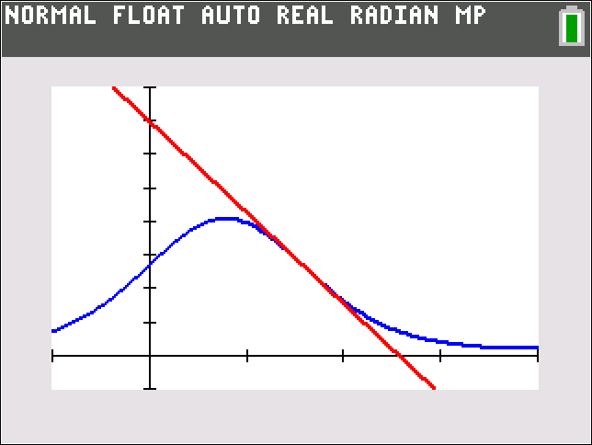
Example 5: Finding the Equation of a Tangent Line (cont.)
Figure 1 confirms our findings. Note that the function and its tangent line were graphed in a viewing window of
Figure 1

Slide 38
Example 6: Using the Chain Rule with Trigonometric Functions
Use the Chain Rule to find the derivatives of the following trigonometric functions.
Solution
All three functions are composite, and therefore we will use the Chain Rule, but careful attention is needed in examining the structure of each function, that is, in identifying the inner and outer components.

Slide 39
Example 6: Using the Chain Rule with Trigonometric Functions (cont.)
a. In the case of f, cosine is the outer function, while 2x serves as the inner function. (Using parentheses, we could actually rewrite f as f(x) = cos(2x)). Thus the derivative is determined as follows.

Slide 40
Example 6: Using the Chain Rule with Trigonometric Functions (cont.)
b. Since we see that the cosine function is the inner function here, and the outer function is y = x². Thus the Chain Rule in this case yields

Slide 41
Example 6: Using the Chain Rule with Trigonometric Functions (cont.)
c. Unlike in part b., the “squaring function” y = x² is the inner function this time, and cosine is the outer. Using the Chain Rule accordingly, we obtain

Slide 42
Consequences of the Chain Rule (cont.)
The Chain Rule, along with the fact that tells us that for any function u of x,
We can use this observation to find the derivative of the exponential function a^{x} for any base a > 0.

Slide 43
Consequences of the Chain Rule (cont.)
We begin by noting that
and conclude that

Slide 44

Consequences of the Chain Rule (cont.)
We record this result here as our latest differentiation rule. (Note that this rule is consistent with the fact that
as $\ln{ⅇ}=1$).

Slide 45
Theorem: Derivatives of a^{x} and a^{u}
Given a fixed real number a > 0,
More generally, if u is a differentiable function of x, then

Slide 46
Example 7: Finding the Equation of a Tangent Line and Locations of Horizontal Tangents
Find an equation for the tangent line to the graph of
at (0, 1). Then find all x-values between −2𝜋 and 2𝜋 where the tangent line to the graph is horizontal.
Solution
As we have seen in Example 3, F is yet another example of a composite function with a composite inner function, so a repeated application of the Chain Rule will be needed to determine its derivative (be sure you understand each of the following steps).

Slide 47
Example 7: Finding the Equation of a Tangent Line and Locations of Horizontal Tangents (cont.)

Slide 48
Example 7: Finding the Equation of a Tangent Line and Locations of Horizontal Tangents (cont.)
At x = 0, the derivative is

Slide 49
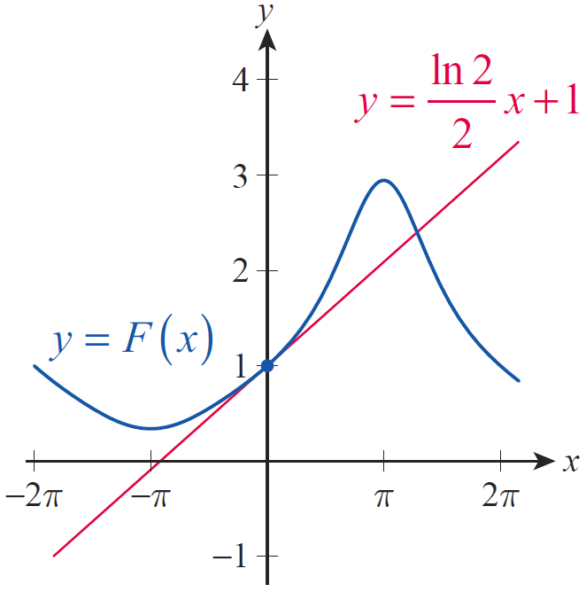
Example 7: Finding the Equation of a Tangent Line and Locations of Horizontal Tangents (cont.)
So keeping in mind that the y‑intercept of the requested tangent is 1, its equation is
The function and its tangent line are graphed in Figure 2.
Figure 2

Slide 50
Example 7: Finding the Equation of a Tangent Line and Locations of Horizontal Tangents (cont.)
Next, we will determine the x‑values between −2π and 2π at which In other words, we need to solve the equation

Slide 51
Example 7: Finding the Equation of a Tangent Line and Locations of Horizontal Tangents (cont.)
Since the exponential factor is never 0, after dividing and converting the secant to cosine the equation reduces to

Slide 52
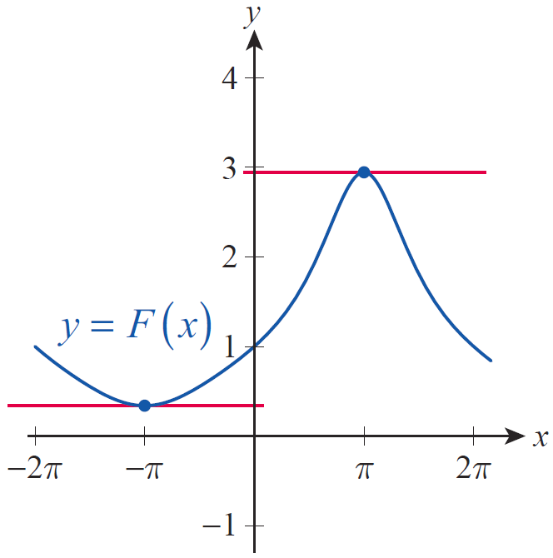
Example 7: Finding the Equation of a Tangent Line and Locations of Horizontal Tangents (cont.)
This latter equation is satisfied if and only if
which is true within the specified interval when x = π or x = −π.
The function and the two horizontal tangent lines are shown in Figure 3.
Figure 3

