Slide 1
Section 3.5
Implicit Differentiation

Slide 2
Derivatives of Implicitly Defined Functions
Given an equation in x and y, the notion of dy/dx may make perfect sense and be what we seek—we just need a method to determine dy/dx without first expressing y as a function of x. This method is called implicit differentiation.

Slide 3
Example 1: Comparing the Methods of Explicit and Implicit Differentiation
Given the equation y² = x, determine
Solution
We can actually solve this equation for y, but we can express the result in functional form only if we distinguish between the two solutions of the equation. Accordingly, let

Slide 4
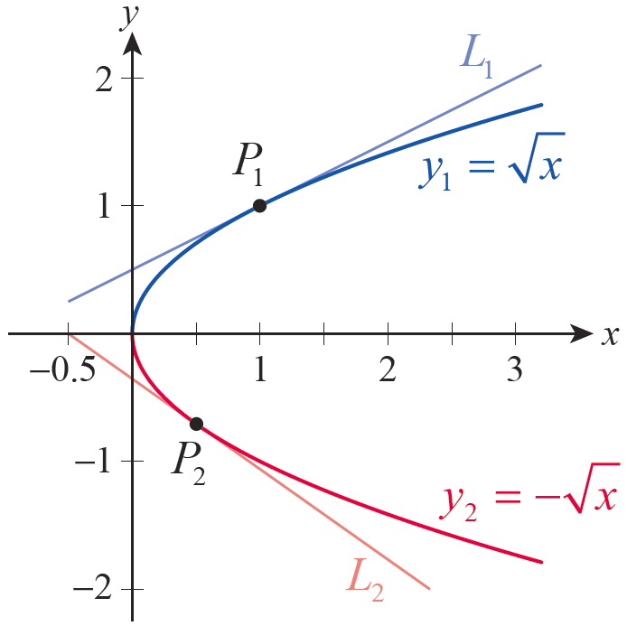
Example 1: Comparing the Methods of Explicit and Implicit Differentiation (cont.)
Note that y₁ corresponds to the upper half of the horizontally oriented parabola shown in Figure 1, while y₂ corresponds to the lower. Using the Power Rule of differentiation,
Figure 1

Slide 5
Example 1: Comparing the Methods of Explicit and Implicit Differentiation (cont.)
If we were asked to find the rate of change of y with respect to x at, say, P₁ = (1,1) and we would calculate
These two values represent the slopes of the two tangent lines L₁ and L₂ that are shown in Figure 1.

Slide 6
Example 1: Comparing the Methods of Explicit and Implicit Differentiation (cont.)
Alternatively, using the method of implicit differentiation, we leave the equation in its original form and differentiate both sides with respect to x. To differentiate the left‑hand side, we implicitly assume that y is a differentiable function of x and apply the Chain Rule.

Slide 7
Example 1: Comparing the Methods of Explicit and Implicit Differentiation (cont.)
This one formula contains the same information as the two formulas for y₁′ and y₂′ , and using it to calculate the slopes of the lines L₁ and L₂ we obtain the same results.

Slide 8
Procedure: Method of Implicit Differentiation
Step 1: Given an equation in x and y, differentiate both sides with respect to x under the assumption that y is a differentiable function of x.
Step 2: Solve the resulting equation for

Slide 9
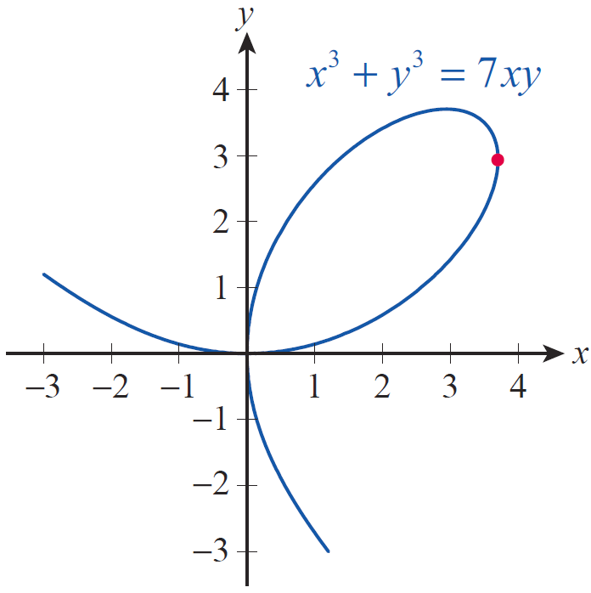
Example 2: Using Implicit Differentiation to
Locate a Vertical Tangent
Determine for the graph of the equation x³ + y³ = 7xy (this famous curve is called the folium of Descartes). Use your result to find the coordinates of the rightmost point on the loop (see Figure 2).
Figure 2

Slide 10
Example 2: Using Implicit Differentiation to
Locate a Vertical Tangent (cont.)
Solution
We will start by differentiating both sides of the equation with respect to x, treating the variable y as a differentiable function of x (you can actually think of y as y = y(x)).

Slide 11
Example 2: Using Implicit Differentiation to
Locate a Vertical Tangent (cont.)
Next, we rearrange terms and solve the equation for

Slide 12
Example 2: Using Implicit Differentiation to
Locate a Vertical Tangent (cont.)
To find the coordinates of the rightmost point on the loop, note that it is a point where the corresponding tangent line is vertical, in other words, one whose coordinates make undefined. This will happen when 3y² − 7x = 0, that is, when
Substituting this expression for x into the equation of the folium, we obtain

Slide 13
Example 2: Using Implicit Differentiation to
Locate a Vertical Tangent (cont.)
which reduces to

Slide 14
Example 2: Using Implicit Differentiation to
Locate a Vertical Tangent (cont.)
Note that dividing both sides of the equation by y³ was justified, for y ≠ 0 in the problem at hand. Next, the x‑coordinate of the point is obtained.
We conclude that the coordinates of the point in the extreme‑right position on the loop are as follows.

Slide 15
Technology Note: Solving a System of Two
Equations in Two Variables
We remark that while determining the x‑ and y‑coordinates from Example 2 can be done by hand, a computer algebra system is very useful in shortening the calculations. Mathematica’s output is shown in Figure 3. Notice that multiple solutions are given, but we are interested in the one with the largest x-value.

Slide 16
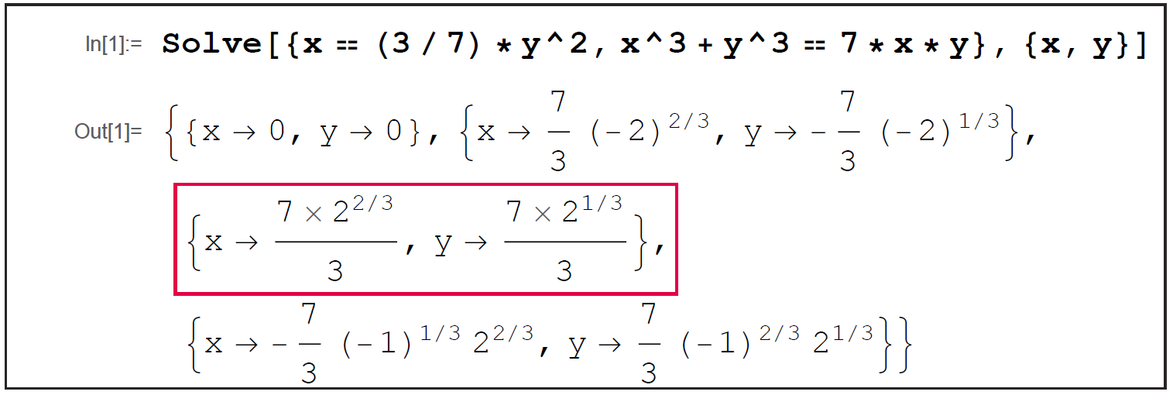
Technology Note: Solving a System of Two
Equations in Two Variables (cont.)
Figure 3

Slide 17
Example 3: Finding the Equation of a Normal Line and Locations of Horizonal Tangents
Determine for the curve 3 − y³ + y² + 5y − x² = 0, and use it to find the equation of the line that is perpendicular to the tangent at (3, 2) (such a line is called normal to the curve). At what points does the curve have horizontal tangents?

Slide 18
Example 3: Finding the Equation of a Normal Line and Locations of Horizonal Tangents (cont.)
Solution
Implicit differentiation of the equation defining the curve yields
an equation that we now solve for

Slide 19
Example 3: Finding the Equation of a Normal Line and Locations of Horizonal Tangents (cont.)
At the point (3,2), the slope of the tangent line is calculated by substituting x = 3 and y = 2 in the formula for dy/dx.

Slide 20
Example 3: Finding the Equation of a Normal Line and Locations of Horizonal Tangents (cont.)
Since the normal line is perpendicular to the tangent, its slope is

Slide 21
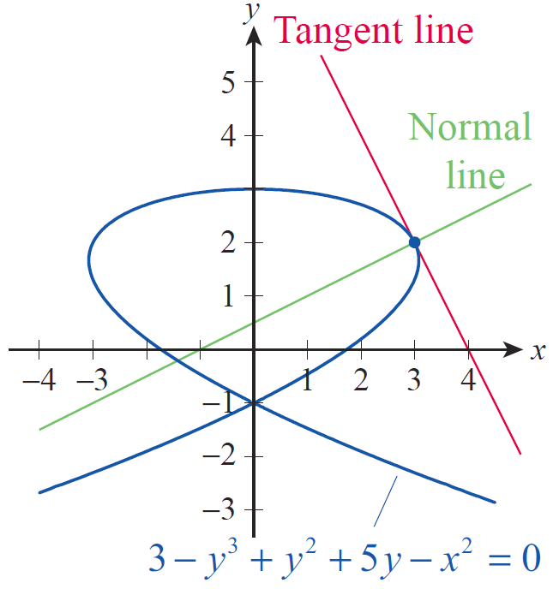
Example 3: Finding the Equation of a Normal Line and Locations of Horizonal Tangents (cont.)
Figure 4 confirms that the values we found for the slopes of the tangent and normal lines at (3, 2) are reasonable.
Figure 4

Slide 22
Example 3: Finding the Equation of a Normal Line and Locations of Horizonal Tangents (cont.)
So using the point‑slope form, the equation of the normal line at (3, 2) can be written as
or equivalently,

Slide 23
Example 3: Finding the Equation of a Normal Line and Locations of Horizonal Tangents (cont.)
Finally, we wish to determine all points at which the tangent to the curve is horizontal. Since the formula we derived for dy/dx is a rational expression, and such expressions are equal to 0 if and only if their numerator is 0 (provided that the denominator does not vanish at the same point), we conclude that the only horizontal tangent line occurs at the point (0, 3); while x = 0 also at the point (0,−1), the derivative dy/dx is undefined there.

Slide 24
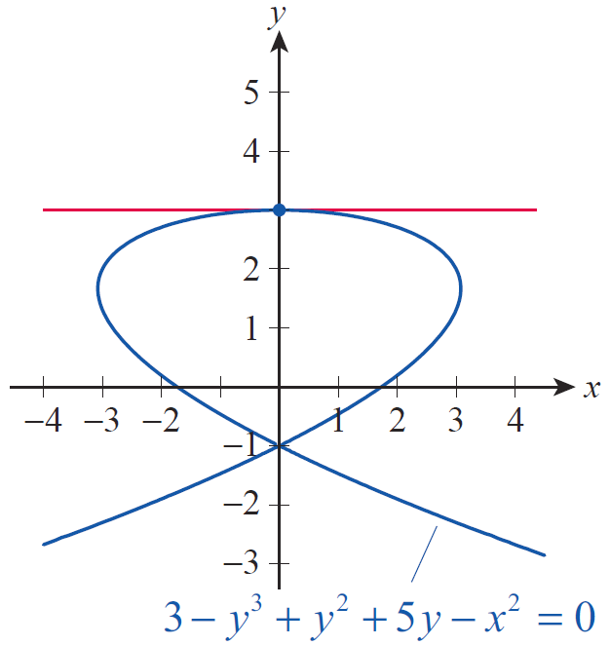
Example 3: Finding the Equation of a Normal Line and Locations of Horizonal Tangents (cont.)
The curve and its horizontal tangent line are graphed in Figure 5.
Figure 5

Slide 25
Example 4: Using Implicit Differentiation
Given the equation 2y⁵ + 4xy² − 5x³y − x⁵ + 10 = 0, find by implicit differentiation.
Solution
As in the previous examples, treating y as a function of x, we differentiate both sides with respect to x.

Slide 26
Example 4: Using Implicit Differentiation (cont.)
Next, we rearrange terms and solve for

Slide 27
Example 4: Using Implicit Differentiation (cont.)
In conclusion, two important remarks are in order. First, note that the variables x and y play fairly symmetrical roles in the given equation. Therefore, we could have treated x as a differentiable function of the independent variable y. This is not the most common approach, but it is correct and sometimes warranted. Differentiating implicitly, we can then determine
We show the differentiation step below (remember that y is the variable and x = x(y) is the function this time).

Slide 28
Example 4: Using Implicit Differentiation (cont.)
Solving for yields the final answer, which turns out, not surprisingly, to be the reciprocal of our solution above.

Slide 29
Example 4: Using Implicit Differentiation (cont.)
Finally, if a function is defined implicitly in terms of a polynomial equation of degree five or higher, in general we have no hope of expressing the function explicitly with a formula. This follows from the brilliant insights of Niels Henrik Abel (1802–1829) and Évariste Galois (1811–1832), who showed that in general it is impossible to solve a polynomial equation of degree five or higher with a formula (like we can, for example, solve quadratic equations with the quadratic formula).

Slide 30
Proof: Second Proof of the Power Rule for Rational Exponents
Let m and n be nonzero integers, and let we seek an alternate proof of the formula
First, raise both sides to the n^{th} power to obtain the equation y^{n} = x^{m}, and assume that y is a differentiable function of x. Implicit differentiation with respect to x then yields the following.

Slide 31

Proof: Second Proof of the Power Rule for Rational Exponents (cont.)

Slide 32
Proof: Second Proof of the Power Rule for Rational Exponents (cont.)

Slide 33
Example 5: Using Implicit Differentiation to
Find a Second Derivative
Find for the circle x² + y² = 1.
Solution
Differentiating both sides with respect to x and solving for we obtain the following.

Slide 34
Example 5: Using Implicit Differentiation to
Find a Second Derivative (cont.)
Before proceeding to find the second derivative, it is worthwhile to check that our work to this point is believable. One way to do this is to ask questions such as the following: where is the first derivative 0, where is it undefined, and what sign does it have in each of the four quadrants?

Slide 35
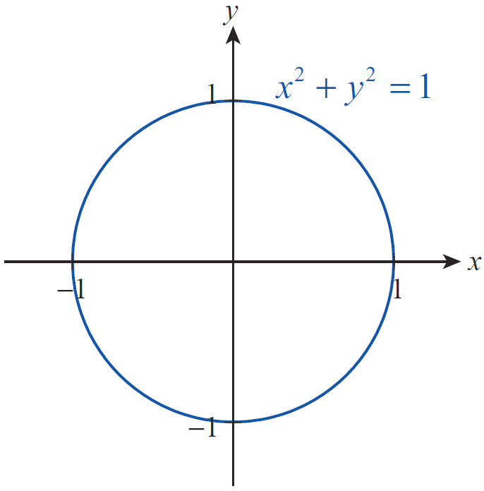
Example 5: Using Implicit Differentiation to
Find a Second Derivative (cont.)
From Figure 6, we expect dy/dx to be 0 at the two points (0,1) and (0, −1), and that is certainly confirmed by our formula.
Figure 6

Slide 36
Example 5: Using Implicit Differentiation to
Find a Second Derivative (cont.)
We also expect an undefined first derivative at the points (−1, 0) and (1, 0) (i.e., when y = 0), and that also agrees with our result for dy/dx. We leave it to the reader to verify that the sign of dy/dx in each of the quadrants is what we would expect.

Slide 37
Example 5: Using Implicit Differentiation to
Find a Second Derivative (cont.)
We can now take our result for dy/dx and differentiate with respect to x once more.

Slide 38
Example 5: Using Implicit Differentiation to
Find a Second Derivative (cont.)

Slide 39
Example 5: Using Implicit Differentiation to
Find a Second Derivative (cont.)
Note that the second derivative is a formula depending only on y. It is again instructive to verify that this formula makes sense for points along the upper half of the circle and for points along the lower half.

Slide 40
Example 6: Using Implicit Differentiation to
Find a Second Derivative
Find given that xy + x − 2 = y.
Solution
As in the previous example, we proceed to find first.

Slide 41
Example 6: Using Implicit Differentiation to
Find a Second Derivative (cont.)
Next, differentiating with respect to x once more, we obtain the second‑order derivative.

