Slide 1
Section 3.9
Linearization and Differentials

Slide 2
Definition: Linear Approximation
Given a function f, differentiable at the point (c, f(c)), we call
the linear approximation or linearization of f at the point c. Because L is a first‑degree polynomial in x, such a formula is also referred to as a first‑order approximation, a phrase that hints at the higher‑order approximations we will discuss when we study Taylor series later in this text.

Slide 3
Example 1: Finding the Linearization of a Function
Find the linearization of at x = 0.
Solution
Since f(0) = 1 and
and hence

Slide 4
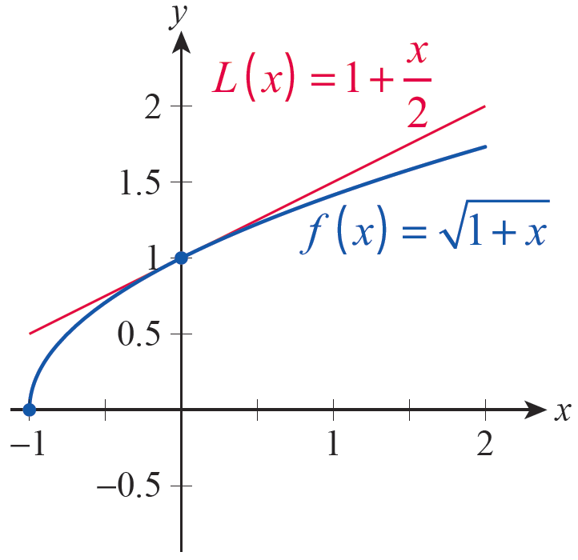
Example 1: Finding the Linearization of a Function (cont.)
The graph in Figure 2 is an illustration of how f and L relate to one another.
Figure 2

Slide 5
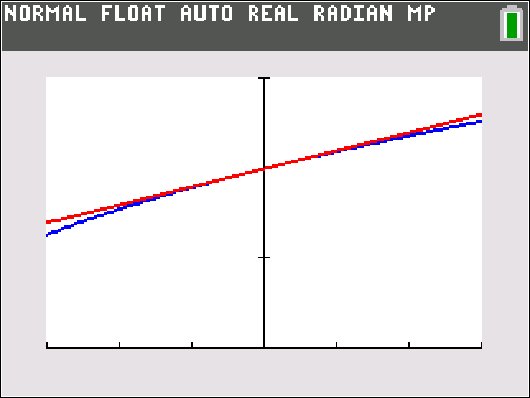
Example 1: Finding the Linearization of a Function (cont.)
In this example, note that the linearization lies above the graph of f in the neighborhood of x = 0, so using L to approximate f for nearby points would result in an overestimate. The critical observation, however, is that the difference between f and L is vanishingly small as x → 0, as shown in Figure 3.

Slide 6
Example 2: Finding Linearizations of Trigonometric Functions
Find the linearizations of sinθ, cosθ, and tanθ at θ = 0.
Solution
We have sin 0 = 0 and
So Similarly, we find that
cosθ ≈ 1 and tanθ ≈ θ at θ = 0.
How close are these approximations? As we will learn later when we study Taylor series, the difference between sinθ and θ is no larger than

Slide 7
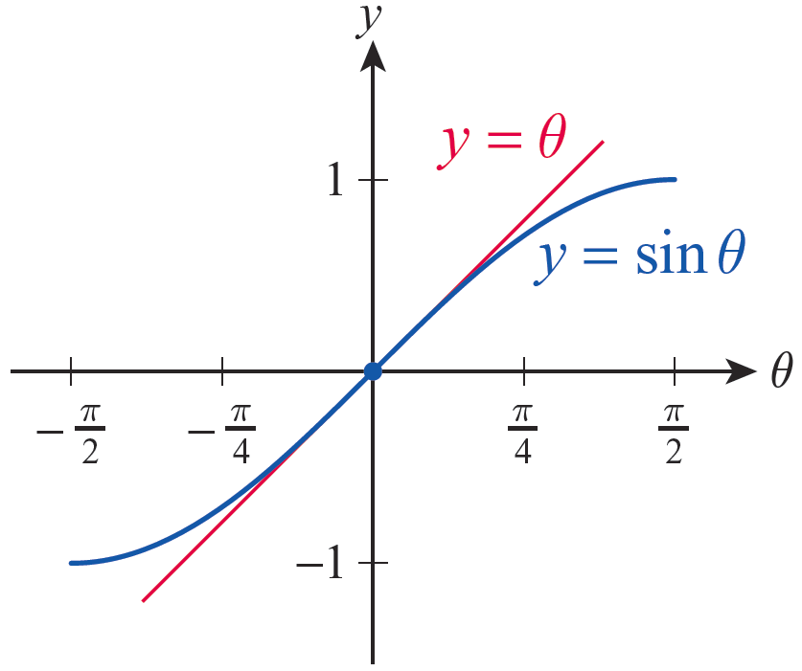
Example 2: Finding Linearizations of Trigonometric Functions (cont.)
So for example, over the interval [−0.1, 0.1], the error in the approximation for sinθ is no larger than
Figure 4 indicates how closely
sinθ and its linearization
correspond over small
intervals centered at 0.
Figure 4

Slide 8
Definition: Differentials
Given a differentiable function y = f(x), the differential dx is defined to be an independent variable and the differential dy is a dependent variable defined by
That is, dx can take on any real number value, while the value of dy depends on the values of f ’(x) and dx.

Slide 9
Example 3: Finding Values of Differentials
Determine the requested values of the differentials.
a. Find dy if when x = 8 and
b. Find if θ = 0 and dθ = 0.05.
Solution
Substituting x = 8 and we calculate the value of the differential as follows.

Slide 10
Example 3: Finding Values of Differentials
(cont.)
b. Note that so if θ = 0 and
dθ = 0.05,

Slide 11
Example 4: Estimating Propagated Error and Percentage Error
The radius of a ball bearing is measured by a micrometer to be 1.2 mm with a margin of error of 0.05 mm. Given this possible error, estimate the propagated error in the calculated volume of the ball bearing.
Solution
Since We will use a value of r = 1.2 mm for the radius, and note that the actual radius could be as much as dr = 0.05 mm larger. This potential error in the measurement of r gives rise to a propagated error in volume, which we estimate with the differential dV.

Slide 12
Example 4: Estimating Propagated Error and Percentage Error (cont.)
To put this into perspective, it is useful to estimate the percentage error for both the radius and the volume.

Slide 13
Example 4: Estimating Propagated Error and Percentage Error (cont.)
So the propagated error in the calculated volume, in percentage terms, is three times larger than the margin of error in the measured radius. This factor of three will always hold true for such volume calculations;

