Slide 1
Section 4.1
Extreme Values of Functions

Slide 2
Definition: Absolute (Global) Extrema
We say the function f has an absolute maximum (or global maximum) on the domain D at the point c if f(c) ≥ f(x) for all x ∈ D. Consequently f(c) is called the maximum value of f on D.
Similarly, if f(c) ≤ f(x) for all x ∈ D, we would say f has an absolute minimum (or global minimum) at c. We call f(c) the minimum value of f on D.
These extreme values of f are termed absolute or global because they are, respectively, the largest and smallest values of the function over D.

Slide 3
Example 1: Using a Graph to Identify Absolute Extrema
Identify the absolute extrema, if they exist.

Slide 4
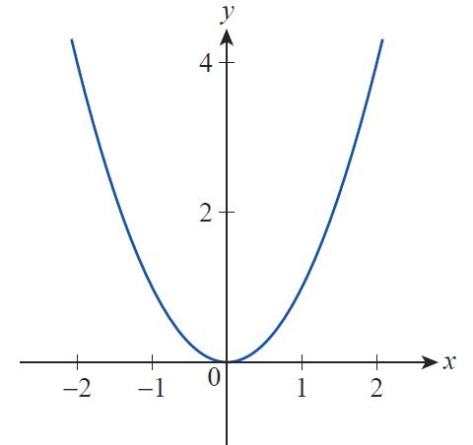
Example 1: Using a Graph to Identify Absolute Extrema (cont.)
Solution
a. The function f(x) = x² increases without bound as x → ±∞, so it has no absolute maximum over (−∞, ∞), But clearly f(0) = 0 is the absolute minimum over the domain (see Figure 1).
Figure 1
f(x) = x² on D = (−∞, ∞)

Slide 5
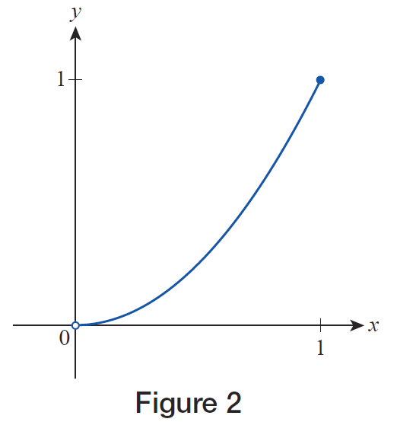
Example 1: Using a Graph to Identify Absolute Extrema (cont.)
b. On the interval (0, 1] f(x) = x² has an absolute maximum of f(1) = 1, but no absolute minimum value (see Figure 2).
Figure 2
f(x) = x² on D = (0,1)

Slide 6
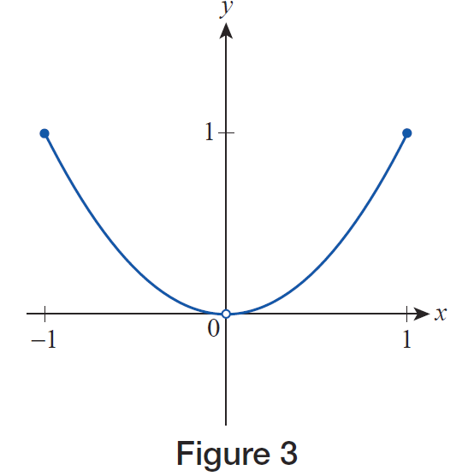
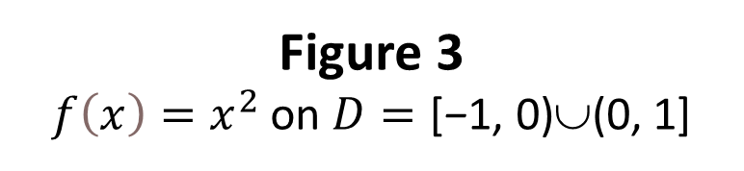
Example 1: Using a Graph to Identify Absolute Extrema (cont.)
c. On the domain
[−1, 0)∪(0, 1], f(x) = x² has an absolute maximum of f(−1) = f(1) = 1, but no absolute minimum (see Figure 3).
Figure 3
$f\left(x\right)=x^{2}$ on $D=\text{[}\text{−}\text{1, 0)}\text{∪}\text{(0, 1]}$

Slide 7
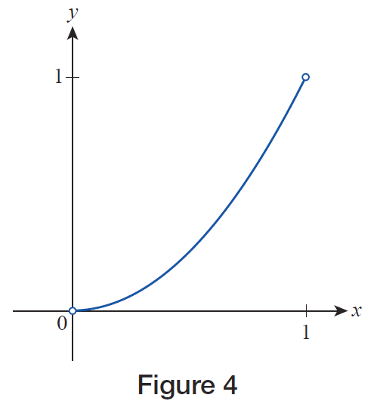
Example 1: Using a Graph to Identify Absolute Extrema (cont.)
On the interval (0, 1), f(x) = x² has neither an absolute maximum nor an absolute minimum
(see Figure 4).
Figure 4 f(x) = x² on D=(0,1)

Slide 8
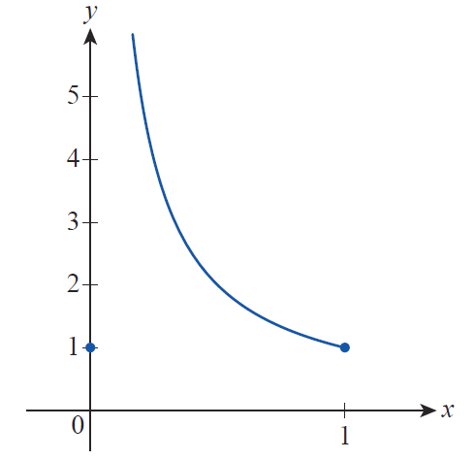

Example 1: Using a Graph to Identify Absolute Extrema (cont.)
e. On the domain [0, 1],
has an absolute minimum of f(0) = f(1) = 1, but no absolute maximum (see Figure 5; note the different scales on the axes).
Figure 5

Slide 9
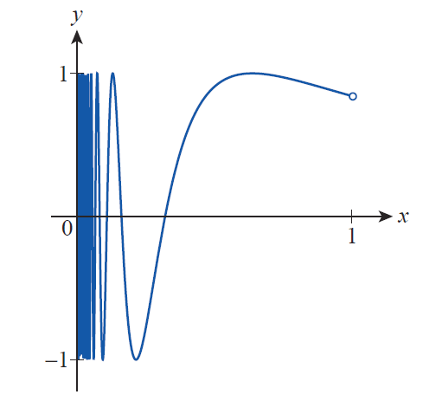

Example 1: Using a Graph to Identify Absolute Extrema (cont.)
f. On the interval (0, 1), f(x) = sin (1/x) attains both its absolute maximum of 1 and its absolute minimum of −1 infinitely often (see Figure 6).
Figure 6

Slide 10
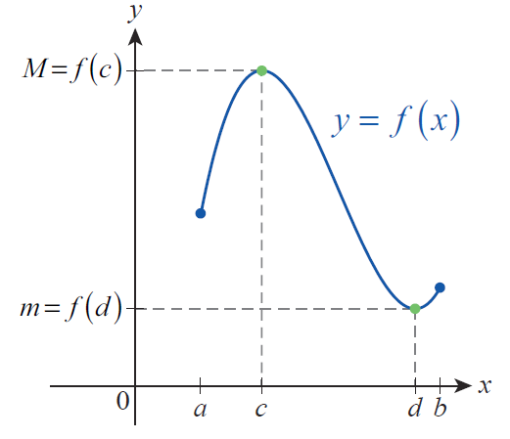
Theorem: The Extreme Value Theorem
If f is a continuous function defined on the closed interval [a,b], then there exist points c and d in [a,b] where f attains both its absolute maximum value M = f(c) and absolute minimum value
m = f(d). (See Figure 7 for an illustrative depiction.)
Figure 7 Extreme Values

Slide 11
Absolute and Relative Extrema
The Extreme Value Theorem tells us quite a lot: first, the absolute extrema exist for a continuous function defined on a closed and bounded interval, and second, there are points in the interval where those extreme values are actually attained.

Slide 12
Definition: Relative (Local) Extrema
We say the function f has a relative maximum (or local maximum) at the point c if f(c) ≥ f(x) for all x in some open interval containing c.
Similarly, if f(c) ≤ f(x) for all x in some open interval containing c, we say f has a relative minimum (or local minimum) at c.

Slide 13
Definition: Relative (Local) Extrema (cont.)
We can extend the definition to the endpoints of an interval by saying f has a relative extremum at an endpoint of [a,b] if f attains its maximum or minimum value at that endpoint in a half‑open interval containing it.

Slide 14
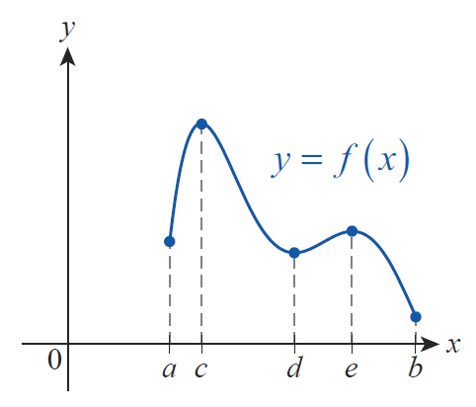
Example 2: Using a Graph to Identify Relative and Absolute Extrema
Identify the relative and absolute extrema for the function f over the interval [a,b] graphed in Figure 8.
Figure 8

Slide 15
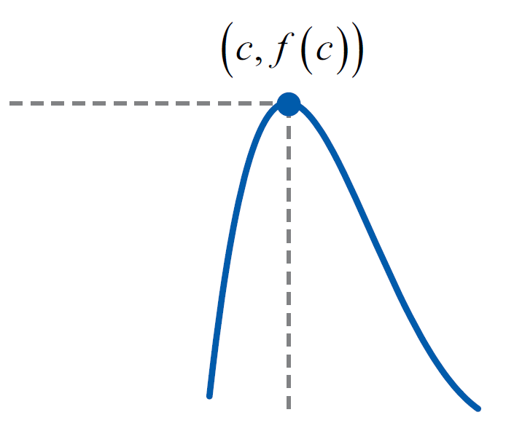
Example 2: Using a Graph to Identify Relative and Absolute Extrema (cont.)
Solution
The function has relative maxima at the points c and e, since f(c) and f(e) are the largest values f attains over small open intervals containing c and e. To illustrate this fact, a small portion of the graph focusing on (c, f(c)) is reproduced in Figure 9; note that f(c) ≥ f(x) for all x near c.
Figure 9

Slide 16
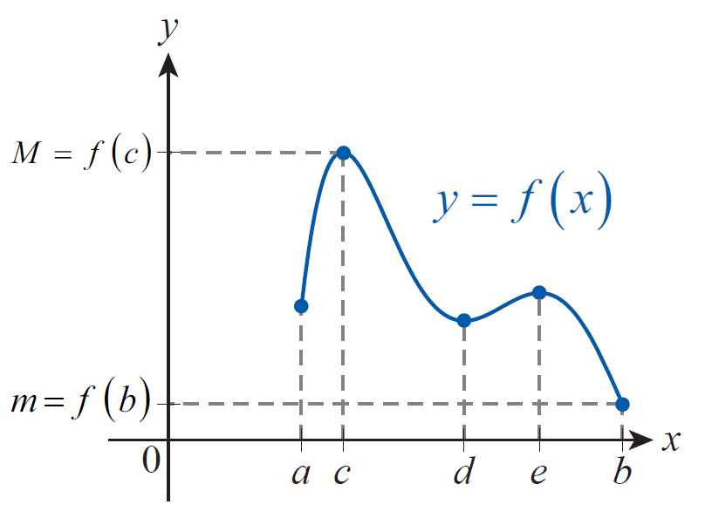
Example 2: Using a Graph to Identify Relative and Absolute Extrema (cont.)
Similarly, a, d, and b are points where f has relative minima (note that a and b are also the endpoints of the interval).
By comparing the values of f at each of the five points a through e, we see that f(c) is the absolute maximum and f(b) is the absolute minimum (see Figure 10).
Figure 10

Slide 17
Finding Extrema
The following theorem, the essence of which was conceived by the French mathematician Pierre de Fermat (1601–1665) even before the formalization of calculus, shows how differentiation greatly simplifies the task of finding extrema.

Slide 18
Theorem: Fermat’s Theorem
If f has a relative extremum at a point c ∈ (a,b), and if f ’(c) exists, then f ’(c) = 0.

Slide 19
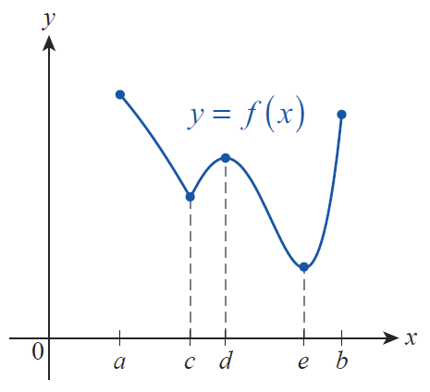
Finding Extrema (cont.)
Before proving Fermat’s Theorem, it’s useful to consider a graph such as the one sketched in Figure 11. For this function, there are three points in (a,b), referred to as the interior of the interval [a,b], where relative extrema occur.
Figure 11
Applying Fermat’s Theorem

Slide 20
Finding Extrema (cont.)
The first point, (c, f(c)), is a cusp of the graph, and so
f ′(c) does not exist—Fermat’s Theorem does not apply here. At points d and e, the function f makes a transition from rising to falling and then from falling to rising. This means that the sign of f ′ will pass from positive to negative and then back to positive as we scan the graph from left to right through d and e, and it makes intuitive sense to suppose that f ′ will equal 0 at the two transition points. The proof is merely a rigorous rendition of this argument.

Slide 21
Proof
We will first assume that f has a relative maximum at c ∈ (a,b) and that f ’(c) exists; from these two facts, we will prove that f ’(c) = 0. A similar argument can be used to show that if f has a relative minimum at c and if f ’(c) exists, then again f ’(c) = 0.

Slide 22
Proof (cont.)
Since f ’(c) exists, we know that the limit
exists (recall that this is one
formulation of the difference quotient), and since f has a relative maximum at c, we know f(x) − f(c) ≤ 0 for all x close to c; this is just a different way of expressing the fact that f(c) ≥ f(x) for all x in some open interval containing c.

Slide 23
Proof (cont.)
The existence of the two‑sided limit above means both one‑sided limits exist and are equal to f ’(c), so

Slide 24
Proof (cont.)
The only number that is both nonnegative and nonpositive is 0, so f ’(c) = 0.
The only change necessary if we begin with the assumption that f has a relative minimum at c are to note that f(x) − f(c) ≥ 0 for all x sufficiently close to c and to reverse the two inequalities above.

Slide 25
Definition: Critical Point
Assume that f is defined on an open interval containing c. We say c is a critical point of the function f if f ’(c) = 0 or f ’(c) does not exist.

Slide 26
Finding Extrema (cont.)
Thus, if f is defined on a closed interval [a,b], the only candidates for extrema (relative or absolute) are critical points in (a,b) and the two endpoints a and b.

Slide 27
Caution
Don’t read too much into the definition of critical point and Fermat’s Theorem. Points where the derivative fails to exist are not guaranteed to be relative extrema, as Figure 12a illustrates. Similarly, the converse of the theorem is false: points at which the derivative is 0 are not necessarily relative extrema, as shown in Figure 12b.

Slide 28
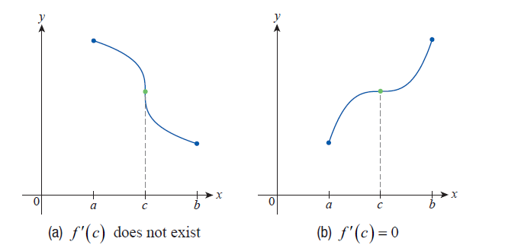
Caution (cont.)
Figure 12 Critical Points That Are Not Extreme Points

Slide 29
Finding Extrema (cont.)
Nevertheless, the Extreme Value Theorem and Fermat’s Theorem together provide a very useful method for locating the absolute extrema of a function defined on a closed and bounded interval.

Slide 30
Procedure: Finding Absolute Extrema
Assume that f is continuous on the interval [a,b]. To find the absolute extrema of f on [a,b], perform the following steps.
Step 1: Find the critical points of f in (a,b).
Step 2: Evaluate f at each of the critical points in (a,b) and at the two endpoints a and b.
Step 3: Compare the values of the function found in Step 2. The largest is the absolute maximum of f on [a,b] and the smallest is the absolute minimum of f on [a,b].

Slide 31
Example 3: Finding the Absolute Extrema of a Function
Find the absolute extrema of on the interval [−2,3].
Solution

Slide 32
Example 3: Finding the Absolute Extrema of a Function (cont.)
The derivative of f is defined for all real numbers. So the only critical points are those where f ’(x) = 0; the solutions of this equation are 0, 2, and −1, all of which are in the interval [−2,3]. We now compute f at the endpoints and the three critical points in the given interval.

Slide 33
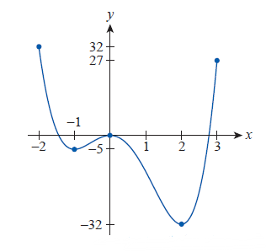
Example 3: Finding the Absolute Extrema of a Function (cont.)
Figure 13

Slide 34
Example 3: Finding the Absolute Extrema of a Function (cont.)
 | Point in [−2, 3]
 | Left endpoint
 | Critical point
 | Critical point
 | Critical point
 | Right endpoint
Comparing these values, we see that the absolute maximum of f on [−2,3] is f(−2) = 32 and that the absolute minimum is f(2) = −32 (Figure 13).

Slide 35
Example 4: Finding the Absolute Extrema of a Function
Find the absolute extrema of on the interval [−1,2].
Solution
The derivative of f is never 0. Since f ’ is, however, undefined at x = 0, 0 is the one critical point of f. Comparing the values of f at the two endpoints and 0, we have

Slide 36
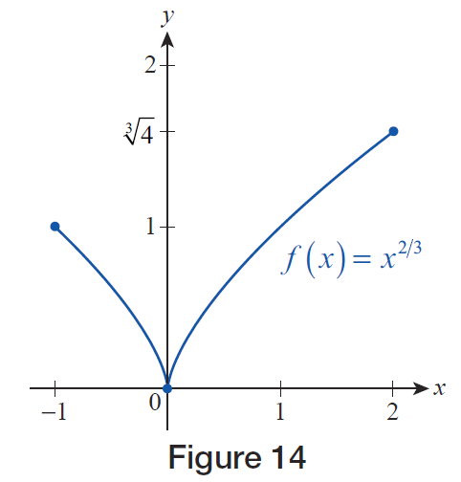
Example 4: Finding the Absolute Extrema of a Function (cont.)
So the absolute minimum value of f on [−1,2] is 0 and the absolute maximum value is (see Figure 14).
Figure 14

Slide 37
Example 5: Finding the Absolute Extrema of a Function
Find the absolute extrema of on the interval [−1,2].
Solution
We can use the Product Rule to find f ’, as follows.

Slide 38
Example 5: Finding the Absolute Extrema of a Function (cont.)
From this, we see that f ’ does not exist at x = 0 and that We now note that f(−1) = −3, f(0) = 0,
and f(2) = 0. So f has its absolute
minimum value of −3 at the left endpoint of [−1,2] and its absolute maximum value of approximately 1.05 at a (see Figure 15).

Slide 39
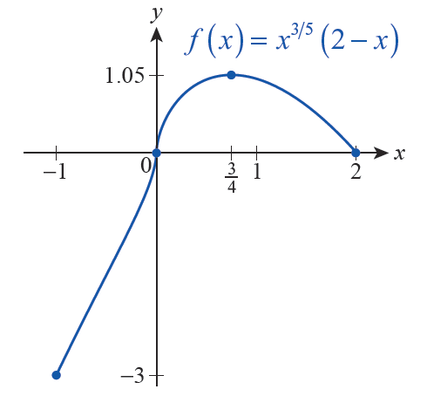
Example 5: Finding the Absolute Extrema of a Function
Figure 15

Slide 40
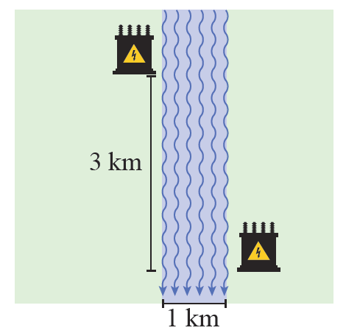
Example 6: Minimizing Cost
A new electrical power substation is being built on the right bank of a river. Cables to the substation need to be laid underground and underwater from another substation 3 kilometers upstream and on the opposite bank.
Figure 16

Slide 41
Example 6: Minimizing Cost (cont.)
The river follows a straight route through this stretch and has a fairly constant width of 1 kilometer. Given that the cost of laying cable underground is $30,000/km and the cost of laying cable underwater is $50,000/km, how should the cable be laid in order to minimize cost?
Solution
Even bearing in mind that the shortest distance between two points is a straight line, there are an infinite number of what could be deemed as reasonable solutions to this problem.

Slide 42
Example 6: Minimizing Cost (cont.)
One very elementary approach would be to simply lay all the cable diagonally underwater in one straight shot, but given the fact that underwater installation is more expensive than underground installation, this is unlikely to be the most economical solution. Another approach would be to cross the river in the shortest possible path (so as to minimize underwater installation) and then run cable 3 kilometers along the bank of the river. But any combination of the two approaches is also a possibility, and some combination may lead to the absolute minimum cost. Calculus allows us to find that optimal solution.

Slide 43
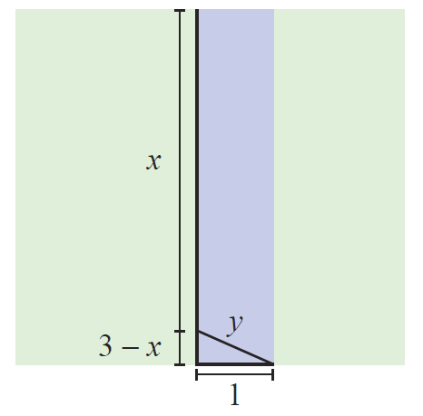
Example 6: Minimizing Cost (cont.)
We will begin with a schematic that defines and relates the variable quantities that we have at our disposal. We can assume that the underground installation follows the left bank of the river, as shown in Figure 17; let x represent the length of the underground cable in kilometers.
Figure 17

Slide 44
Example 6: Minimizing Cost (cont.)
Let y then represent the length of the underwater installation. (We could have proceeded by first crossing the river and then laying cable down the right bank, but for given lengths x and y the cost would be the same.)
Note that x = 0 corresponds to the solution in which all the cable is underwater, and x = 3 corresponds to the solution in which the shortest length of underwater installation (y = 1) is called for. Any value for x in the interval [0,3] corresponds to an intermediate solution, as discussed above.

Slide 45
Example 6: Minimizing Cost (cont.)
From the diagram, so and the total cost of laying the cable for a given value of x is as follows.

Slide 46
Example 6: Minimizing Cost (cont.)
We are looking for the absolute minimum of the function C on the interval [0,3], so we proceed to find the critical points of C.

Slide 47
Example 6: Minimizing Cost (cont.)
The derivative C’ exists for all x, but there are two values of x for which C’(x) = 0.

Slide 48
Example 6: Minimizing Cost (cont.)
The point does not actually solve the original equation, so we only have to evaluate C at the two endpoints 0 and 3 and at the critical point

Slide 49
Example 6: Minimizing Cost (cont.)
From this comparison, we see that the minimal cost of installation can be achieved by laying the cable with an underground run of and a diagonal
run underwater of

