Slide 1
Section 4.2
The Mean Value Theorem

Slide 2
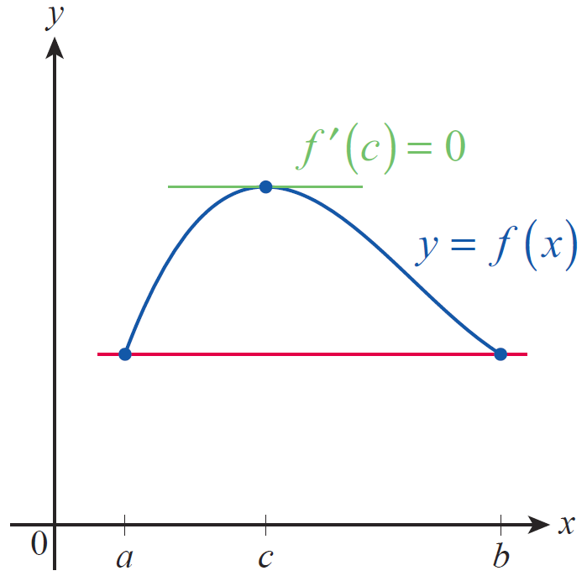
Rolle’s Theorem and the Mean Value Theorem
Our development begins with a preliminary observation first proved by the French mathematician Michel Rolle (1652–1719) in 1691. Suppose f is a function that is continuous on the interval [a,b], and suppose further that f has the same value at the two endpoints a and b, as illustrated in Figure 1.
Figure 1

Slide 3
Rolle’s Theorem and the Mean Value Theorem (cont.)
Your intuition may suggest that if the graph of f begins and ends with the same value and varies in a sufficiently “smooth” manner over the course of the interval, then there must be at least one point c where it has a horizontal tangent line. This is exactly what Rolle’s Theorem guarantees, and the precise property corresponding to a “smoothly” varying graph is differentiability on the open interval (a,b).

Slide 4
Theorem: Rolle’s Theorem
If f is continuous on the closed interval [a,b] and differentiable on (a,b), and if f(a) = f(b), then there is at least one point for which

Slide 5
Proof
Because f is continuous on the closed interval [a,b], the Extreme Value Theorem tells us that f attains its absolute maximum and minimum values on [a,b]. If f attains both its absolute maximum and absolute minimum at an endpoint of the interval, then f is a constant function on [a,b] (note that in this case f(x) = f(a) = f(b) for all x in the interval) and so we know that for all proving the claim.

Slide 6
Proof (cont.)
If, on the other hand, f assumes either its absolute maximum or absolute minimum at an interior point then f(c) is a relative extremum of the function and by Fermat’s Theorem since by assumption exists for all x in (a,b).

Slide 7
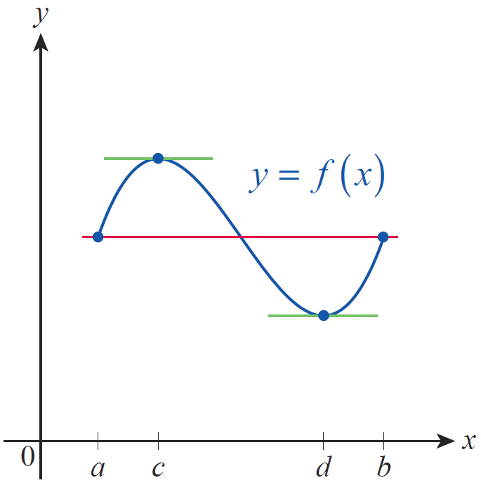
Rolle’s Theorem and the Mean Value Theorem (cont.)
There may be more than one point in (a,b) where f has a horizontal tangent line when the hypotheses of Rolle’s Theorem are satisfied, but in practice it suffices to know for certain that there is at least one such point. Theorems of this sort are known as existence theorems, and they often provide great insight into the nature of objects under study. Note that in Figure 2, f ’(c) = f ’(d) = 0.
Figure 2

Slide 8
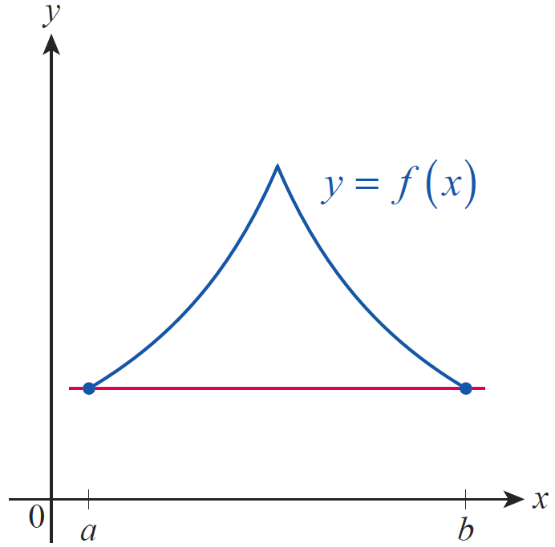
Rolle’s Theorem and the Mean Value Theorem (cont.)
In Figure 3, there is no point c in [a,b] for which f ’(c) = 0, but this does not violate Rolle’s Theorem as the function is not differentiable everywhere on (a,b).
One of the most notable uses of Rolle’s Theorem is as a stepping‑stone toward the Mean Value Theorem, but it can also be put to more immediate use.
Figure 3

Slide 9
Example 1: Proving an Equation Has Exactly One Solution
Show that the equation x⁵ + 3x = 2 has exactly one real solution.
Solution
Let f(x) = x⁵ + 3x − 2. Then which is defined and positive (in fact, greater than or equal to 3) for all real x. If there were two solutions x = a and x = b of the equation x⁵ + 3x = 2, then we would have f(a) = 0 = f(b), and by Rolle’s Theorem there would then be a point c between a and b for which contradicting for all x. So x⁵ + 3x = 2 has no more than one solution.

Slide 10
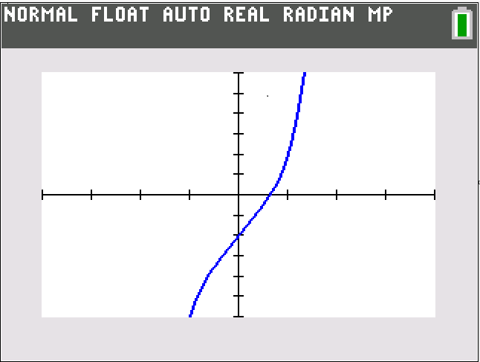
Example 1: Proving an Equation Has Exactly One Solution (cont.)
The fact that it does indeed have a solution follows from the observation that and so by the Intermediate Value Theorem, there is a point c between 0 and 1 for which f(c) = 0 (see Section 2.5 for a refresher on the use of the IVT in locating zeros of functions).

Slide 11
Example 2: Applying Rolle's Theorem to a Position Function
Suppose that f(t) is a differentiable function describing the location at time t of an object moving along a straight line. If f(t₁) = f(t₂) for two points in time t₁ and t₂, then by Rolle's Theorem there must be a time t₃ between t₁ and t₂ for which That is, the velocity of the object at t₃ is 0.
As a particular example, if h(t) represents the vertical height of a thrown object with, say, h(t₁) = h(t₂) = 0, then h’(t₃) = 0 and h(t₃) represents the maximum height achieved by the object.

Slide 12
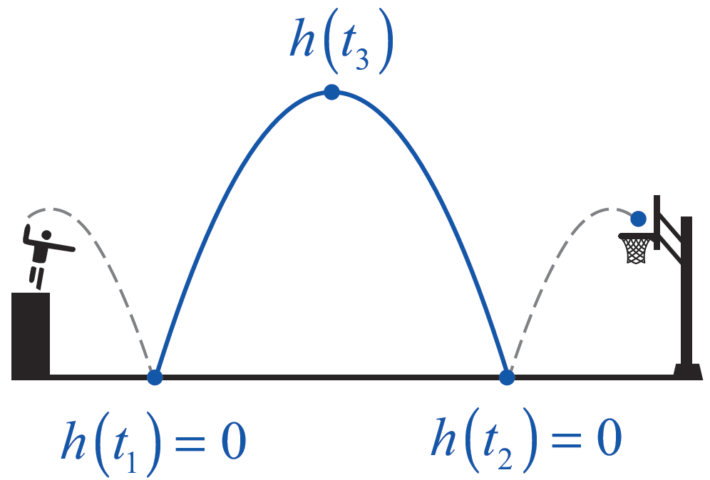
Example 2: Applying Rolle's Theorem to a Position Function (cont.)
(Note that in this example, h(t) represents the motion up and down relative to ground level; The object may also travel horizontally, as shown in Figure 5, but such motion happens independently of h(t) and would be measured by another function.)
Figure 5

Slide 13
Rolle’s Theorem and the Mean Value Theorem (cont.)
The Mean Value Theorem (MVT), first stated in a form similar to the following by Joseph-Louis Lagrange (1736–1813), is a generalization of Rolle’s Theorem—it provides the same sort of insight into the behavior of a function defined on an interval [a,b] while relaxing one
of the hypotheses.

Slide 14
Theorem: The Mean Value Theorem
If f is continuous on the closed interval [a,b] and differentiable on (a,b), then there is at least one point
for which

Slide 15
Rolle’s Theorem and the Mean Value Theorem (cont.)
In preparation for proving the MVT, it’s important to understand geometrically what it says. Figure 6 shows how the MVT can be viewed as a “slanted” version of Rolle’s Theorem, in that it guarantees the existence of at least one point at which the line tangent to the graph of f is parallel to the secant line through and

Slide 16
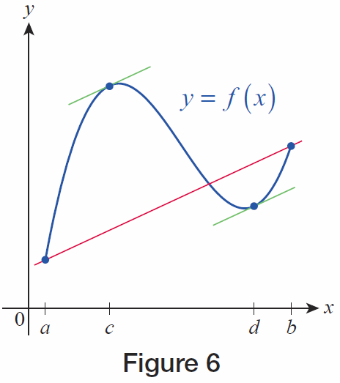
Rolle’s Theorem and the Mean Value Theorem (cont.)
In Figure 6, this conclusion is actually true for two points c and d in the interval.
Figure 6

Slide 17
Proof
The sort of depiction shown in Figure 6 points the way toward a proof of the MVT: if we can modify the function under consideration by “unslanting” it, we can then apply Rolle’s Theorem. To do this, we want to consider a new function
defined as the difference between f and the function whose graph is the secant line passing through (a, f(a)) and (b, f(b)), shown in red in the figure.

Slide 18
Proof (cont.)
The slope of the secant line is
So is an equation for the secant line in point‑slope form; solving for y, the secant line is the graph of the function If we now define a new function g by

Slide 19
Proof (cont.)
then we have, by design, constructed a function for which
and
That is, satisfying one of the hypotheses of Rolle’s Theorem.

Slide 20
Proof (cont.)
The other two hypotheses of Rolle’s Theorem are also satisfied by g. Since L is continuous on [a,b] and differentiable on (a,b), as is f , then g = f − L possesses these two properties as well. Rolle’s Theorem thus tells us there is at least one point c in (a,b) for which

Slide 21
Proof (cont.)
Since we have
or

Slide 22
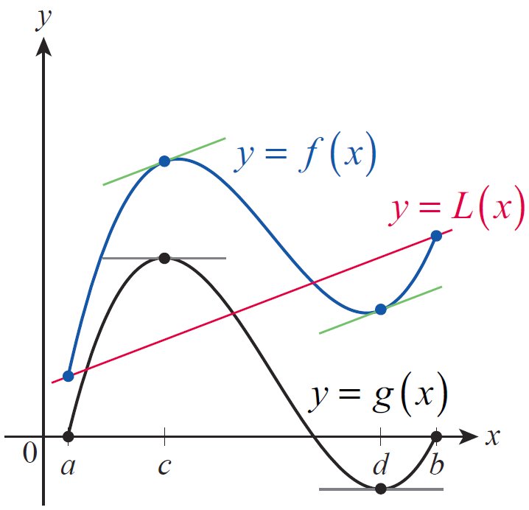
Rolle’s Theorem and the Mean Value Theorem (cont.)
Figure 7 illustrates the process of subtracting the secant line L from the function f of Figure 6 in preparation for applying Rolle’s Theorem. Note that c and d are points where g has horizontal tangent lines and f has tangent lines with slope m_{sec}.
Figure 7

Slide 23
Example 3: Finding Points That Satisfy the Mean Value Theorem
The function is differentiable everywhere, so it satisfies the hypotheses of the Mean Value Theorem over any closed, bounded interval. Find the point(s) satisfying the conclusion of the MVT over the interval [0,4].
Solution
We begin by calculating the slope of the secant line over the interval.

Slide 24
Example 3: Finding Points That Satisfy the Mean Value Theorem (cont.)
The Mean Value Theorem guarantees the existence of at least one point where but we want to go one step further and actually find the point (or points). Since we proceed to solve the equation

Slide 25
Example 3: Finding Points That Satisfy the Mean Value Theorem (cont.)

Slide 26
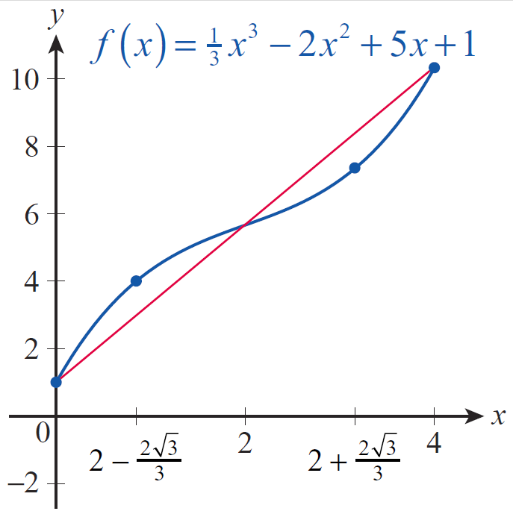
Example 3: Finding Points That Satisfy the Mean Value Theorem (cont.)
These two solutions, approximately equal to 0.85 and 3.15, both satisfy the conclusion of the MVT (see Figure 8).
Figure 8

Slide 27
Consequences of the Mean Value Theorem
Recall that a discussion of average and instantaneous velocities was one of the motivating examples we used to develop the concept of differentiation. The MVT provides a more quantitative connection between these ideas.

Slide 28
Example 4: Using the Mean Value Theorem to Find Velocity
An aerial surveillance crew is monitoring traffic on the roads below and timing the passage of cars between painted road marks that are 1 mile apart. The crew spots a distinctive yellow Lotus Elise and records its passage between two marks at 47 seconds. What speed can the crew assert the Elise must have reached during the 47 seconds?

Slide 29
Example 4: Using the Mean Value Theorem to Find Velocity (cont.)
Solution
If we let f(t) denote the position of the Elise along the stretch of road over the time interval [0,47], then f ’(t) denotes the car’s velocity and the Mean Value Theorem guarantees that there is at least one for which
That is, at least once over the mile‑long stretch of road, the Elise was moving at a rate of approximately 77 miles per hour.

Slide 30
Consequences of the Mean Value Theorem (cont.)
We already know that a constant function has a derivative of zero at all points of its domain, but we don’t yet know that the converse is true. That is, does the fact that f’(x)=0 for all x in a given interval mean that f is a constant function? The Mean Value Theorem provides an elegant answer to this question.

Slide 31
Theorem: Corollary 1
If f ‘(x) = 0 for each x in an open interval (a,b), then f is constant on (a,b).

Slide 32
Proof
We will show that given any two distinct points x₁ and x₂ in (a,b), f (x₁) = f (x₂). Since x₁ ≠ x₂, one is less than the other; we can assume x₁ < x₂. The fact that f is differentiable on all of (a,b) means that f is continuous on [x₁, x₂], and differentiable on (x₁, x₂), so by the MVT, there is a point such that

Slide 33
Proof (cont.)
But since f ‘ is 0 throughout (a,b), this means that
so

Slide 34
Consequences of the Mean Value Theorem (cont.)
While much of the text to this point has focused on the theory and mechanics of differentiation (that is, gaining knowledge about a function’s derivative), Corollary 1 is a good illustration of just the reverse: what does knowledge of a function’s derivative tell us about the function itself? The next corollary is similar in nature, and we will see the theme continue to develop in subsequent sections.

Slide 35
Theorem: Corollary 2
If f ‘(x) = g‘(x) for all x in an open interval (a,b), then there is a constant C such that f(x) = g(x) + C for all

Slide 36
Proof
Since f ’(x) = g‘ (x), we know that for all x in (a,b). So, by Corollary 1, it must be the case that f − g is a constant function on (a,b). That is, there is a constant C such that (f – g)(x) = C for all or

Slide 37
Example 5: Using the Mean Value Theorem
Suppose that f(0) = −2 and that for all x. What is the largest possible value of f(4)?
Solution
The implication is that f ‘ exists everywhere, so f is certainly continuous on [0,4] and differentiable on (0,4). So by the MVT,
for some

Slide 38
Example 5: Using the Mean Value Theorem (cont.)
Since for all x, rearranging the above equation gives us the following results.
Hence the largest possible value of f(4) is 10.

Slide 39
Example 6: Using Corollary 2 of the Mean Value Theorem
Find the unique function f whose derivative is 3x² and whose graph passes through (1,5).
Solution
By now, we have differentiated enough polynomials to recognize 3x² as the derivative of x³. If we let g(x) = x³, then g and f have the same derivative; and by Corollary 2, it must be the case that f(x) = g(x) + C for some constant C. We can determine C as follows.

Slide 40
Example 6: Using Corollary 2 of the Mean Value Theorem (cont.)
Now it can be easily verified that f(x) = x³ + 4 satisfies the given criteria, and by Corollary 2 it is the unique function to do so.

