Slide 1
Section 4.3
The First and Second Derivative Tests

Slide 2
First Derivative Tools
In our first example of an application of Rolle’s Theorem in Section 4.2, we used the fact that f ’(x) was positive for all x to show that the equation f(x) = 0 couldn’t have more than one solution. The reasoning in that example can be extended to make the following more general observations.

Slide 3
Theorem: Monotonicity Test
Assume f is differentiable at all points of an interval I.
1. If for all x ∈ I, then f is strictly increasing on I.
2. If for all x ∈ I, then f is strictly decreasing on I.
In other words, if is either entirely positive or entirely negative on I, then f is strictly monotonic on I. (Note that I may be an unbounded interval.)

Slide 4
Proof
Following the definition of strict monotonicity (Section 1.1), we start by assuming x₁, x₂ ∈ I with x₁ < x₂. Since exists on all of I, we know that f is continuous on [x₁,x₂] and differentiable on (x₁,x₂); by our definition of one‑sided differentiation, this conclusion is true even if x₁ or x₂ is an endpoint of I.

Slide 5
Proof (cont.)
Now, by the Mean Value Theorem, there is a point c ∈ (x₁,x₂) such that

Slide 6
Proof (cont.)
Since x₂ − x₁ > 0, the right‑hand side of the above equation is either positive if is positive or negative if is negative, leading to the respective results of or Since this can be done for each such pair of points x₁ and x₂, we are done.

Slide 7
First Derivative Tools (cont.)
In practice, the Monotonicity Test is used to find intervals where a function is monotonic by first locating the function’s critical points. If a and b are successive critical points of f and if f ’ exists on all of (a,b), then f ’ must be either positive or negative on (a,b). The easiest way to determine which is to evaluate f ’ at what is called a test point in (a,b).

Slide 8
Example 1: Determining Intervals of Monotonicity
Determine the intervals of monotonicity of the function
Solution
The critical points of f are −2, 0, and 1. These divide the real line (the domain of f) into the open intervals and The following table indicates the sign of and the corresponding monotonicity of f in each of these intervals as determined by evaluating at a convenient test point.

Slide 9
Example 1: Determining Intervals of Monotonicity (cont.)
Interval
f ’ at test point
Sign of f ’ | − | + | − | +
Monotonicity of f | Decreasing | Increasing | Decreasing | Increasing

Slide 10
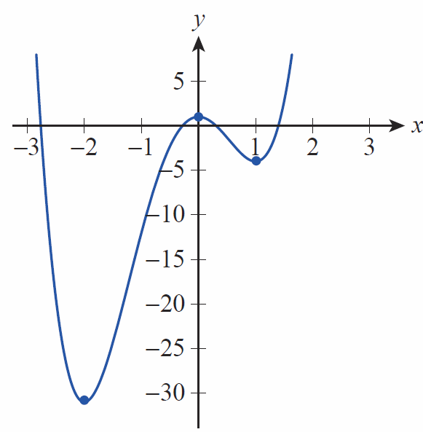
Example 1: Determining Intervals of Monotonicity (cont.)
So, f is decreasing on (−∞, −2) and (0,1) and increasing on (−2,0) and (1,∞), as shown in Figure 1.

Slide 11

Example 1: Determining Intervals of Monotonicity (cont.)
(By our definition of monotonicity, it would also be correct to identify the intervals as $(−∞,−2]$, $[−2,0]$, $[0,1]$, and $[1,∞)$, but we are typically more interested in making a distinction between the critical points and the intervals between them.)

Slide 12
Example 1: Determining Intervals of Monotonicity (cont.)
Note that we are actually only interested in the sign of at each test point, and this can typically be determined very quickly, especially if has been factored as in this example—there is no need to determine the actual numerical value of In much of our work to come, we will make use of this shortcut.

Slide 13
First Derivative Tools (cont.)
Given a differentiable function defined on an open interval, Fermat’s Theorem tells us that relative extrema occur only at critical points, but we’ve seen that not every critical point is a relative extremum—we need a test that we can apply to critical points. The conclusions of the previous theorem can be used for just this purpose.

Slide 14
Theorem: First Derivative Test
Suppose c is a critical point of a function f that is continuous on an open interval containing c and differentiable on the same interval, except possibly at c itself. Moving through c from left to right,
1. if changes from positive to negative at c, then f has a relative maximum at c;

Slide 15
Theorem: First Derivative Test (cont.)
2. if changes from negative to positive at c, then f has a relative minimum at c;
3. if does not change sign at c (that is, if it is either positive on both sides of c or negative on both sides of c), then f does not have a relative extremum at c.

Slide 16
Proof
The conclusions of the First Derivative Test follow from applying the Monotonicity Test and determining whether f is increasing or decreasing to the left and to the right of a given critical point c. If, for instance, f is an increasing function to the left of c and a decreasing function to the right of c, then f has a relative maximum value at c. Figure 2 illustrates some of the possible combinations of intervals of monotonicity and critical points.

Slide 17
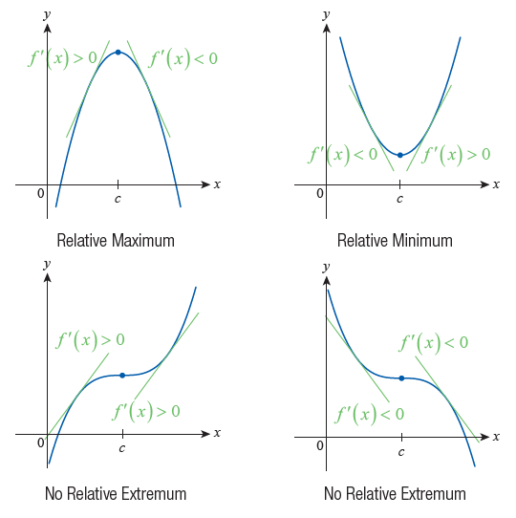
First Derivative Tools (cont.)
Figure 2 Conclusions of the First Derivative Test

Slide 18
Example 2: Using the First Derivative Test
Find the critical points of and then use the First Derivative Test to locate the relative extrema of f.
Solution
We note first that f is continuous everywhere, and then proceed to find

Slide 19
Example 2: Using the First Derivative Test (cont.)

Slide 20
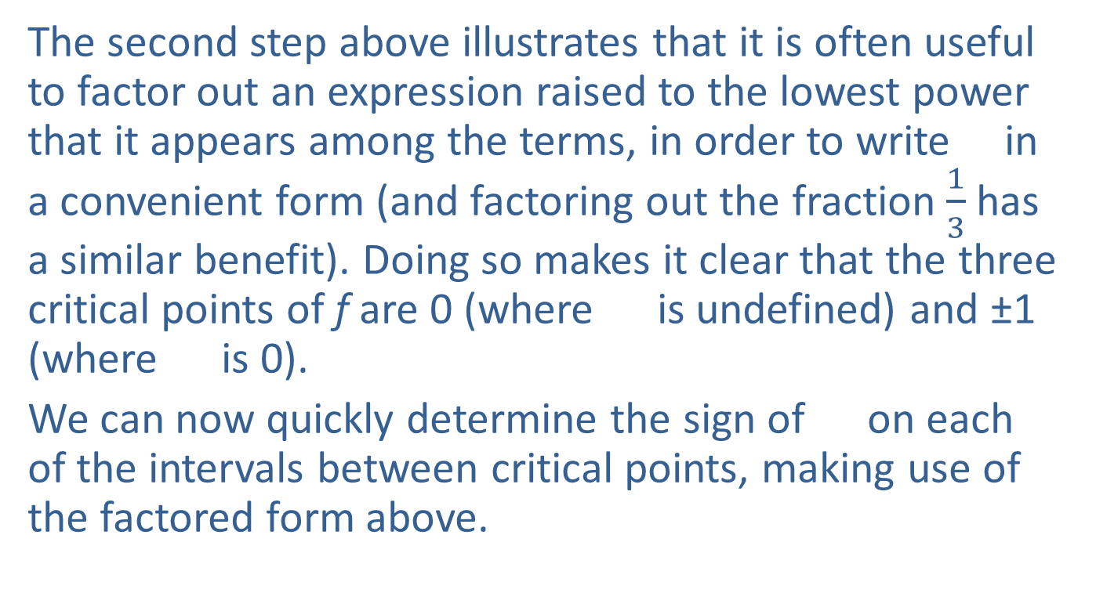
Example 2: Using the First Derivative Test (cont.)
The second step above illustrates that it is often useful to factor out an expression raised to the lowest power that it appears among the terms, in order to write in a convenient form (and factoring out the fraction $\frac{1}{3}$ has a similar benefit). Doing so makes it clear that the three critical points of f are 0 (where is undefined) and ±1 (where is 0).
We can now quickly determine the sign of on each of the intervals between critical points, making use of the factored form above.

Slide 21
Example 2: Using the First Derivative Test (cont.)
Interval
f ’ at test point
Sign of f ’ | + | − | − | +
Monotonicity of f | Increasing | Decreasing | Decreasing | Increasing

Slide 22
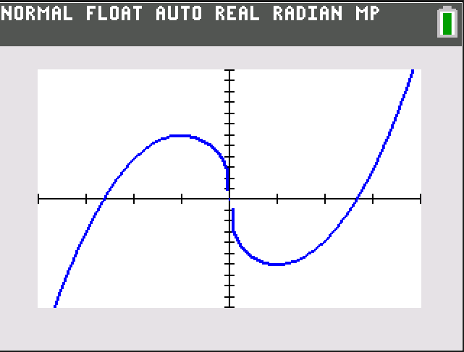
Example 2: Using the First Derivative Test (cont.)
The First Derivative Test now tells us that f has a local maximum at −1, a local minimum at 1, and 0 is neither a local maximum nor minimum. The values of these local extrema are, respectively, and
Figure 3 confirms our findings.

Slide 23
Second Derivative Tools
In reading a detailed analysis of, say, national economic trends, you might run across a complicated‑sounding phrase like “the rate of growth is expected to decrease” or “the pace of increase picked up in the third quarter.” What do these statements actually mean?

Slide 24
Second Derivative Tools (cont.)
A careful study of such phrases shows that they are saying something about the rate of change of a rate of change—in other words, they refer to the second derivative of a quantity. Geometrically, they tell us whether the slopes of the tangent lines of a function are decreasing or increasing as we scan the graph from left to right. Figure 4a illustrates the first sort of situation and Figure 4b the second.

Slide 25
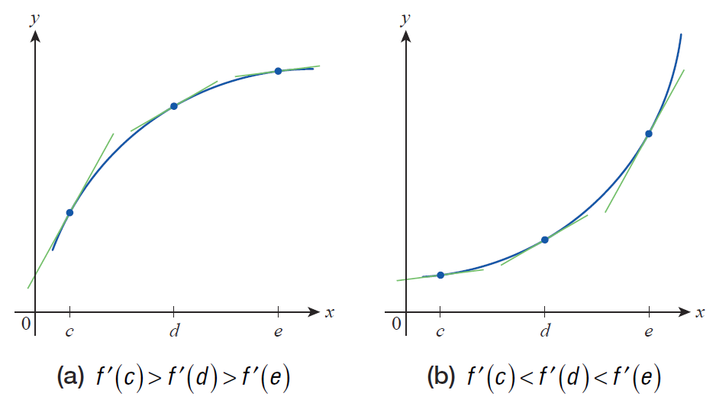
Second Derivative Tools (cont.)
Figure 4 Decreasing and Increasing Slopes of Tangent Lines

Slide 26
Definition: Concavity
Given a differentiable function f on an interval I, we say f is concave up on I if is an increasing function on the interval and concave down on I if is a decreasing function on the interval.

Slide 27
Second Derivative Tools (cont.)
Equivalently, we could define a concave up function as one that lies above all of its tangent lines on an interval and a concave down function as one that lies below all of its tangent lines; note how the graphs in Figure 4 illustrate downward and upward concavity by either definition.

Slide 28
Theorem: Concavity Test
Assume f is twice differentiable at all points of an interval I.
1. If for all x ∈ I, then f is concave up on I.
2. If for all x ∈ I, then f is concave down on I.

Slide 29
Example 3: Determining Intervals of Concavity
Determine the intervals of concavity of the function
Solution
We identified the intervals of monotonicity for this function in Example 1, and we will resume our study of f by determining its second derivative.

Slide 30
Example 3: Determining Intervals of Concavity (cont.)
Using the quadratic formula to solve the equation
yields the two solutions of or
approximately −1.22 and 0.55. Since these are the only two points where is 0, we would expect (and Figure 5 would lead us to believe) that will be either consistently positive or consistently negative on each of the three intervals defined by the two points. We proceed then to make a table to determine the sign of on each interval.

Slide 31
Example 3: Determining Intervals of Concavity (cont.)
Interval
at test point
Sign of | + | − | +
Concavity of f | Concave up | Concave down | Concave up

Slide 32
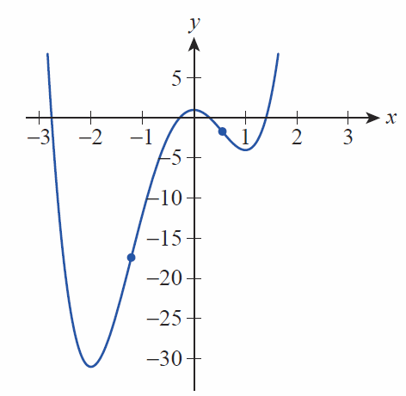
Example 3: Determining Intervals of Concavity (cont.)
The three test points of −2, 0, and 1 were chosen merely for convenience—they lie in the interior of each interval, and it is relatively easy to compute at each. Note the behavior of f at each of the two points where as shown in the graph in Figure 5.

Slide 33
Second Derivative Tools (cont.)
In Example 3, we determined the intervals of concavity of f by locating those points where f ” changed sign, a process very similar to determining intervals of monotonicity. Informally, Darboux’s Theorem (Section 3.1) says that derivatives always possess the Intermediate Value Property, so f ” (being the derivative of f ’) can only change sign at a point where it is zero or where it is undefined.

Slide 34
Second Derivative Tools (cont.)
Keep in mind, however, that points where f ” is either undefined or zero are only candidates for points where the concavity of f may change, and the concavity on either side of such a point must be checked in order to determine whether it actually does change. For example, if f (x) = x⁴, f ”(x) = 12x² and hence f ”(0) = 0, but f is concave up everywhere (f ” is always nonnegative). As you might expect, those points where a function changes concavity are deserving of a name.

Slide 35
Definition: Inflection Point
A point on the graph of a function f is called an inflection point if f is continuous there and changes concavity from upward to downward or from downward to upward. If the graph has a tangent line at the inflection point, the graph will cross the tangent line at that point.

Slide 36
Definition: Inflection Point (cont.)
(An alternate definition found in some settings requires the graph of f to actually possess a tangent line at the point of inflection, a stronger condition than just being continuous and one that guarantees the crossing behavior.)

Slide 37
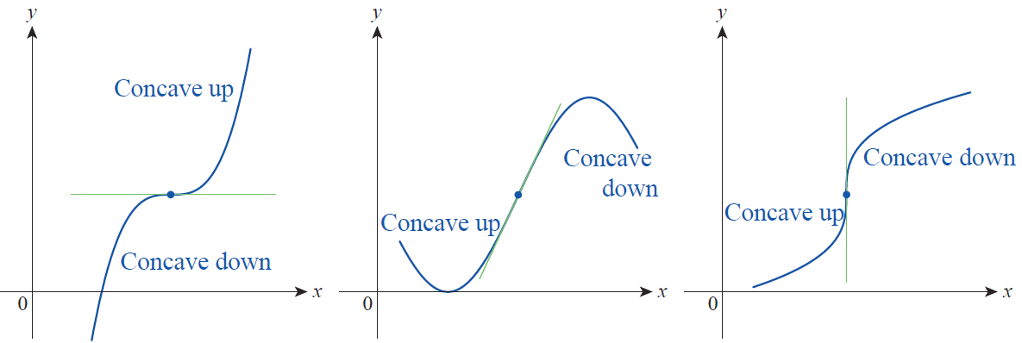
Second Derivative Tools (cont.)
Note that, as shown in Figure 6, f ’ can have any value or be undefined at a point of inflection. The second derivative f ”, however, will either be zero or undefined at such points.
Figure 6 Inflection points

Slide 38
Second Derivative Tools (cont.)
Inflection points occur in many different settings and go by many different names. The commonly heard phrase “point of diminishing returns” actually refers to a point of inflection—although often used loosely, in economics the phrase means that point past which increased inputs (worker hours, raw materials, etc.) yield smaller increases in outputs (finished products).

Slide 39
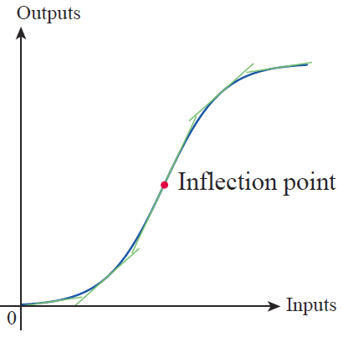
Second Derivative Tools (cont.)
It doesn’t mean that production actually starts to decline at that point, but it does mean that the rate of growth of productivity becomes negative; that is, the graph of the outputs versus the inputs changes concavity (see Figure 7).
Figure 7
Point of Diminishing Returns

Slide 40
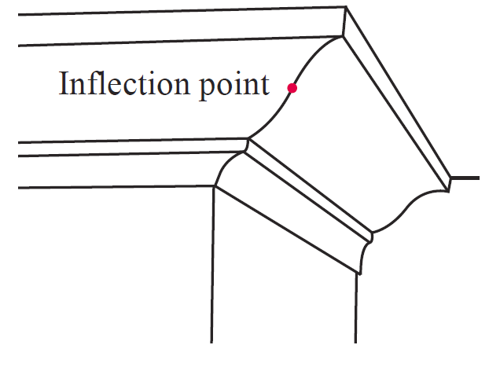
Second Derivative Tools (cont.)
In architecture, an ogee curve refers to a shape in which a concave curve and a convex curve join in a point—ogee curves are often found, for example, in crown molding and in the designs of building columns (see Figure 8).
Figure 8 Ogee Curve

Slide 41
Second Derivative Tools (cont.)
One last application of the second derivative will be mentioned here. Suppose that f ”(c) < 0 on an open interval containing c and f ’(c) = 0. Then f is concave down on the interval and the graph of f has a horizontal tangent line at c. A sketch of how f must roughly appear close to c will likely convince you that f must have a relative maximum at c. This is, in fact, true, and the formal statement of the observation and a parallel one for f ”(c) > 0 comprise the last theorem of this section.

Slide 42
Theorem: Second Derivative Test
Suppose that and that exists at c.
1. If then f has a relative maximum at c.
2. If then f has a relative minimum at c.
If the test does not apply and the graph of f may have a relative maximum, a relative minimum, or neither at c.

Slide 43
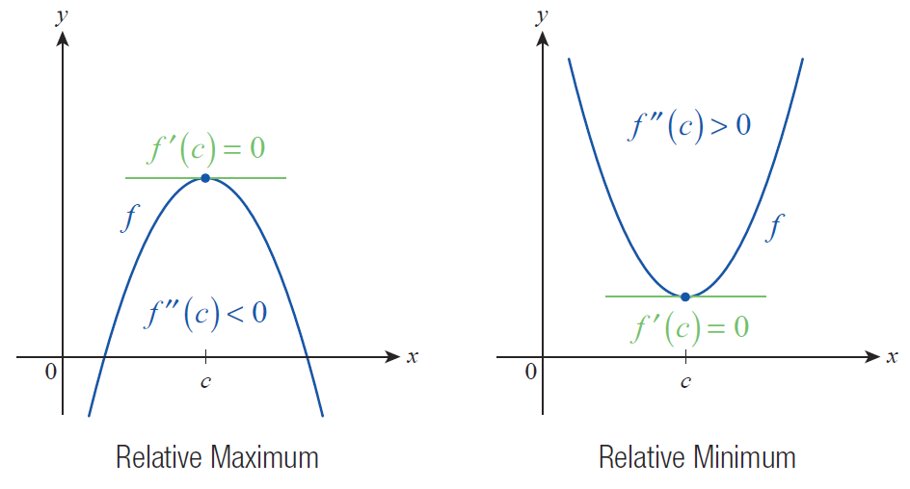
Second Derivative Tools (cont.)
Figure 9 Conclusions of the Second Derivative Test

Slide 44
Proof
Recall that “Differentiability Implies Continuity”; this is one of our theorems from Section 3.1. So the fact that
exists at c means that is differentiable at c and hence continuous at c. This, in turn, means that there exists an open interval containing c for which is defined. If we know further that and that then for all h sufficiently close to 0,

Slide 45
Proof (cont.)
and so must be positive for h < 0 and negative for h > 0. Restated, this means that is positive to the left of c and negative to the right of c; so by the First Derivative Test, we can conclude that f has a relative maximum at c. The proof of the second statement is similar in nature.
To see that the test does not apply if consider the graphs of and at x = 0.

Slide 46
Example 4: Using the First and Second Derivative Tests to Analyze a Graph
Use the first and second derivatives of to identify the intervals of monotonicity, extrema, intervals of concavity, and inflection points on its graph.
Solution
and
Solving the equation gives us the critical points 0 and

Slide 47
Example 4: Using the First and Second Derivative Tests to Analyze a Graph (cont.)
Solving gives us the possible inflection points 0 and 1 (note that 0 is both a critical point and a potential inflection point).
We proceed to evaluate the signs of on the intervals of interest.
Interval
Sign of
Monotonicity of f | Decreasing | Decreasing | Increasing

Slide 48
Example 4: Using the First and Second Derivative Tests to Analyze a Graph (cont.)
We now have a wealth of information about f at our disposal, and can easily answer all of the questions about its graph.
Interval
Sign of
Concavity of f | Concave up | Concave down | Concave up

Slide 49
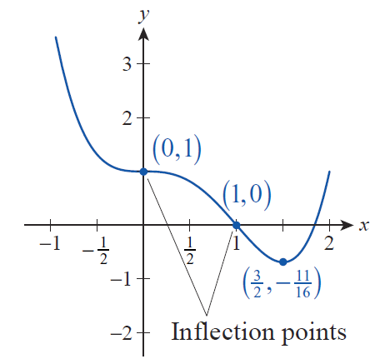
Example 4: Using the First and Second Derivative Tests to Analyze a Graph (cont.)
First, the two tables above identify the intervals of constant monotonicity and concavity and whether f is increasing, decreasing, concave up, or concave down on each. Note how those intervals correspond to the graph of f shown in Figure 10.

Slide 50
Example 4: Using the First and Second Derivative Tests to Analyze a Graph (cont.)
Second, we can use the First Derivative Test to realize that f does not have a relative extremum at the critical point 0, but does have a relative minimum at And since the concavity changes from up to down at 0 and from down to up at 1, both 0 and 1 are inflection points.

Slide 51
Example 4: Using the First and Second Derivative Tests to Analyze a Graph (cont.)
We could also have used the Second Derivative Test to determine that f has a relative minimum at the critical point even though we never actually evaluated at the point. The reason is that we know exists on the open interval containing (indeed, exists everywhere), and that it is positive on the interval. In particular, it is positive at

Slide 52
Example 4: Using the First and Second Derivative Tests to Analyze a Graph (cont.)
The last step is to evaluate f at the two inflection points and the one relative extremum—those values are shown in Figure 10. Note that f has no absolute maximum value, but the relative minimum at is also its absolute minimum.

