Slide 1
Section 4.5
Calculus and Curve Sketching

Slide 2
Procedure: Curve-Sketching Strategy
To sketch the graph of the function f(x), perform the following steps.
Step 1: Determine the domain of f and any symmetry it may have (e.g., symmetry with respect to a certain point or line). Check also to see if f may be periodic, a trait frequently found, for example, in trigonometric functions.

Slide 3
Procedure: Curve-Sketching Strategy (cont.)
Step 2: Identify the intercepts, if possible. The y‑intercept value of f(0) is normally easy to determine, if 0 is in the domain of f. The x‑intercepts are found by solving the equation f(x) = 0.

Slide 4
Procedure: Curve-Sketching Strategy (cont.)
Step 3: Identify and plot any asymptotes for f. Recall that these can be horizontal, vertical, or oblique and are especially helpful in sketching the graphs of rational functions. Use L’Hôpital’s Rule as necessary to help evaluate limits.

Slide 5
Procedure: Curve-Sketching Strategy (cont.)
Step 4: Find f ’ and f ”. Critical points of f are located where f ’ is undefined or 0, and potential inflection points are located where f ” is undefined or 0.
Step 5: Use the Monotonicity Test and the Concavity Test to find intervals where f is increasing, decreasing, concave up, and concave down. Use either the First Derivative Test or the Second Derivative Test, whichever is more convenient, to locate relative extrema.

Slide 6
Procedure: Curve-Sketching Strategy (cont.)
Compare the values of the relative extrema to locate the absolute extrema. The actual inflection points are points where f is continuous and where the concavity of the graph changes.

Slide 7
Procedure: Curve-Sketching Strategy (cont.)
Step 6: Combine all of the information found to either sketch a graph by hand or use it in conjunction with a graph generated by a calculator or computer. If the graph is being constructed as part of solving some larger problem, the extrema, points of inflection, and asymptotic behavior you have found are likely to be of great use.

Slide 8
Example 1: Using the Curve-Sketching Strategy
Use the curve-sketching strategy to construct a graph of
Solution
The function f is a cubic polynomial, so from this we know that its domain is all of ℝ and, since its leading coefficient is positive, we know and

Slide 9
Example 1: Using the Curve-Sketching Strategy (cont.)
The y‑intercept is easily seen to be 0, and to determine the x‑intercept(s) we need to solve the equation
10x³ − 6x² + x = 0, or x(10x² − 6x + 1) = 0; since
10x² − 6x + 1 = 0 has no real number solutions (by the quadratic formula), this tells us that the only x‑intercept is also 0.

Slide 10
Example 1: Using the Curve-Sketching Strategy (cont.)
Since f is a polynomial, the function has no asymptotes. The first and second derivatives are as follows.

Slide 11
Example 1: Using the Curve-Sketching Strategy (cont.)
Solving 30x² − 12x + 1 = 0 by the quadratic formula gives us the two critical points of or approximately 0.12 and 0.28. Setting f ” equal to 0, we see that the only potential inflection point is at We can now use the derivatives and these three points to make the following table, which succinctly captures a great deal of information about the behavior of f.

Slide 12
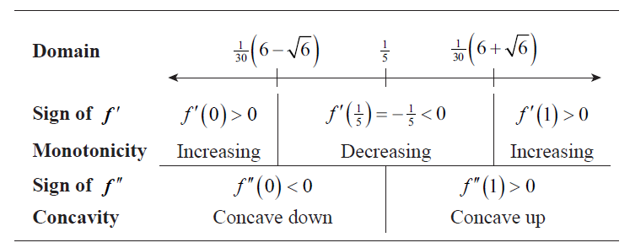
Example 1: Using the Curve-Sketching Strategy (cont.)

Slide 13
Example 1: Using the Curve-Sketching Strategy (cont.)
The first row of the table depicts the domain of f with the two critical points and the potential inflection point marked. In the second row, the sign of f ′ is determined by evaluating f ′ at three test points on the intervals defined by the critical points. Why were those particular test points used? For no better reason than convenience: the sign of f ′ is easily determined at 0 and 1, and the test point for the middle interval was selected merely because it lies halfway between the two critical points.

Slide 14
Example 1: Using the Curve-Sketching Strategy (cont.)
Note that all we care about is the sign of f ’, but to determine this for the middle interval we actually computed the value of f ’. Given the signs of f ’ on the three intervals, we are led immediately to the conclusions about monotonicity on the intervals
and
listed in the third row.

Slide 15
Example 1: Using the Curve-Sketching Strategy (cont.)
At this point, the First Derivative Test tells us, from the information in row two, that f has a relative maximum at and a relative minimum at
we could also use the Second
Derivative Test to conclude the same thing, as f ” is negative at the first critical point and positive at the second. And since the concavity does indeed change at this potential inflection point actually is an inflection point.

Slide 16
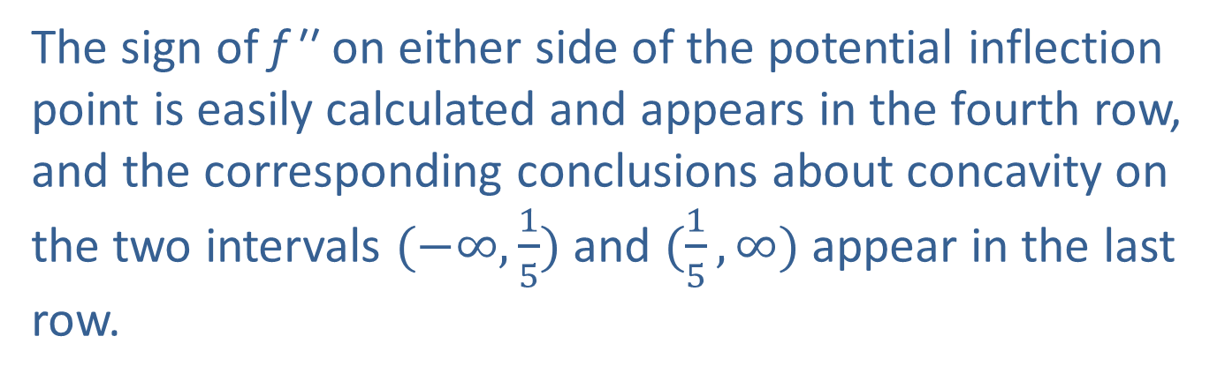
Example 1: Using the Curve-Sketching Strategy (cont.)
The sign of f ′′ on either side of the potential inflection point is easily calculated and appears in the fourth row, and the corresponding conclusions about concavity on the two intervals $(−∞,\frac{1}{5})$ and $(\frac{1}{5},∞)$ appear in the last row.

Slide 17
Example 1: Using the Curve-Sketching Strategy (cont.)
We are now ready to put all this knowledge together, and use it to refine any graphs we may obtain by calculator or computer. If we were to sketch the graph entirely by hand, we would calculate f at a few convenient points, paying special attention to the values at the extrema and the inflection point. If we are using technology to construct the graph, we would now know to zoom in on the portions around these same points.

Slide 18
Example 1: Using the Curve-Sketching Strategy (cont.)
The importance of this is illustrated by the fact that our graph in Figure 1 (created with a graphing calculator) may lead us to incorrectly assume that f is an increasing function on its entire domain, but a close‑up shows more interesting behavior near the inflection point as in Figure 2.

Slide 19
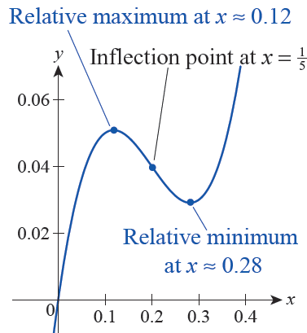
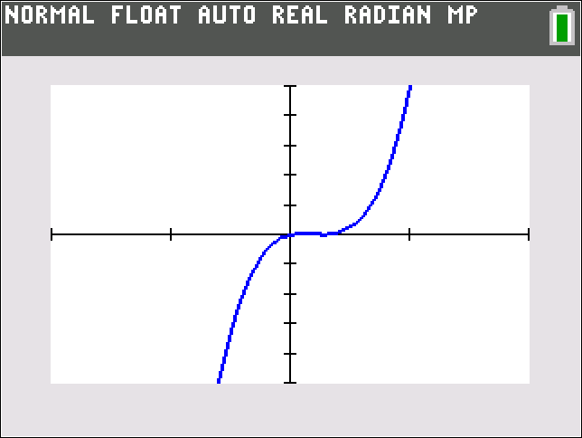
Example 1: Using the Curve-Sketching Strategy (cont.)
Figure 1
Figure 2

Slide 20
Example 2: Using the Curve-Sketching Strategy
Use the curve-sketching strategy to construct a graph of
Solution
Step 1: The denominator 2 + cos x is never 0, so f is defined for all x and the domain is all of ℝ. Since sin x is an odd function and 1/(2 + cos x) is even, f is an odd function (the product of an odd function and an even function is odd, but you can also verify that f(−x) = −f(x)). Moreover, since sine and cosine are both 2𝜋‑periodic, f is as well.

Slide 21
Example 2: Using the Curve-Sketching Strategy (cont.)
Step 2: Note that f(0) = 0, and the only solutions of f(x) = 0 are the solutions of sin x = 0, namely integer multiples of π. So the origin is the only y‑intercept and the x‑intercepts are (nπ, 0), n ∈ ℤ.
Step 3: No asymptotes

Slide 22
Example 2: Using the Curve-Sketching Strategy (cont.)
Step 4:

Slide 23
Example 2: Using the Curve-Sketching Strategy (cont.)

Slide 24
Example 2: Using the Curve-Sketching Strategy (cont.)
The first derivative is defined everywhere, and f ’(x) = 0 only when the numerator 1 + 2 cos x is 0.
Similarly, f ” is defined everywhere and equal to 0 only when sin x = 0 or cos x = 1; these points are x = nπ.
n ∈ ℤ

Slide 25
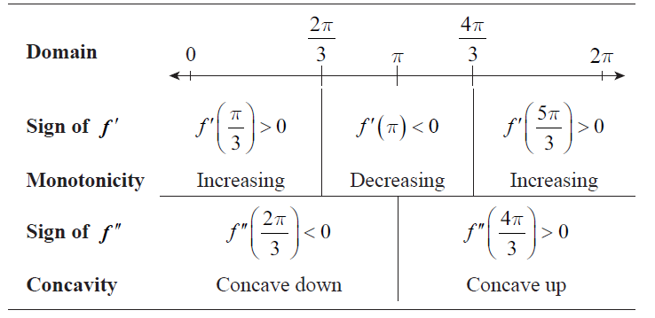
Example 2: Using the Curve-Sketching Strategy (cont.)
Step 5: Since f is 2π ‑periodic, we will make a chart for just one period of the graph.

Slide 26
Example 2: Using the Curve-Sketching Strategy (cont.)
Both derivative tests now tell us that 2π/3 is a relative maximum and that 4π/3 is a relative minimum, and we also now know that f has an inflection point at π. The absolute maximum value (which is attained at each relative maximum point) is and the absolute minimum value is The concavity changes at each multiple of π, so each is an inflection point.

Slide 27
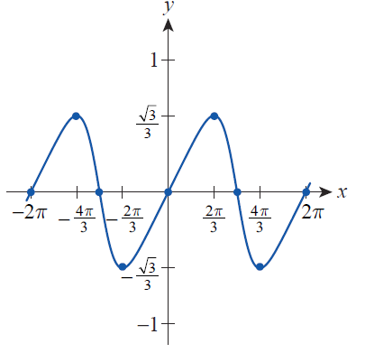
Example 2: Using the Curve-Sketching Strategy (cont.)
Step 6: The graph of f over two periods is shown in Figure 3.
Figure 3

Slide 28
Example 3: Using the Curve-Sketching Strategy
Use the curve-sketching strategy to construct a graph of
Solution
Step 1: The domain of f is all of ℝ , and since is nonnegative everywhere and is positive to the left of 3 and negative to the right of 3 we know f will behave the same way as this second factor. There is no apparent symmetry or periodicity.

Slide 29
Example 3: Using the Curve-Sketching Strategy (cont.)
Step 2: Note that f(0) = 0, and the only solutions of f(x) = 0 are 0 and 3. So other than the origin, the only x‑intercept is (3,0).
Step 3: No asymptotes

Slide 30
Example 3: Using the Curve-Sketching Strategy (cont.)
Step 4:

Slide 31
Example 3: Using the Curve-Sketching Strategy (cont.)

Slide 32
Example 3: Using the Curve-Sketching Strategy (cont.)
From the formulas for f ’ and f ” we see that f has critical points at 0, 2, and 3 and potential inflection points at 0 and 3.

Slide 33
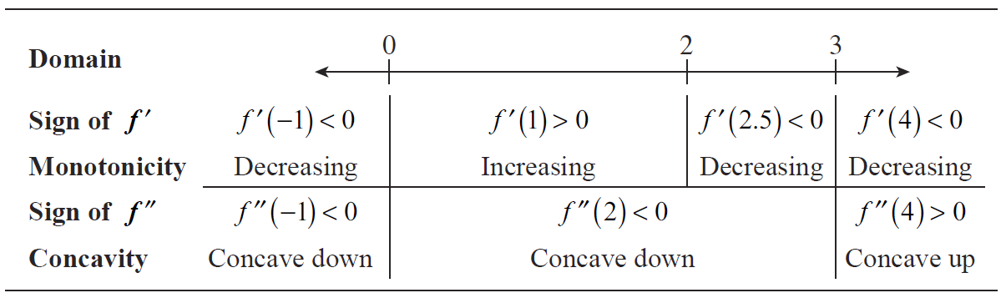
Example 3: Using the Curve-Sketching Strategy (cont.)
Step 5:
The First Derivative Test tells us that f has a relative minimum at 0 and that 3 is not a relative extremum. Both tests indicate that f has a relative maximum at 2.

Slide 34
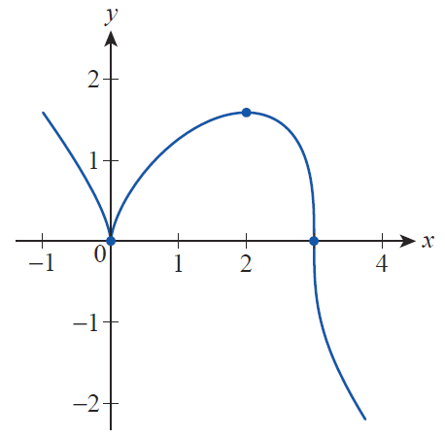
Example 3: Using the Curve-Sketching Strategy (cont.)
The concavity only changes at 3, so that is the only point of inflection.
Step 6: The graph of f is shown in Figure 4.
Figure 4

Slide 35
Example 4: Finding the Relative Extrema of a Rational Function
Use calculus to locate the relative extrema of the rational function from Example 3c of Section 1.2.
Solution
We have already determined the asymptotes of h, and our sketch from Section 1.2 contains quite a lot of information. But the relative extrema would be difficult to determine without calculus. We can locate them quickly with h’.

Slide 36
Example 4: Finding the Relative Extrema of a Rational Function (cont.)
Since 1 is not in the domain of h, the only critical points are where x² − 2x − 1 = 0; the solutions are

Slide 37
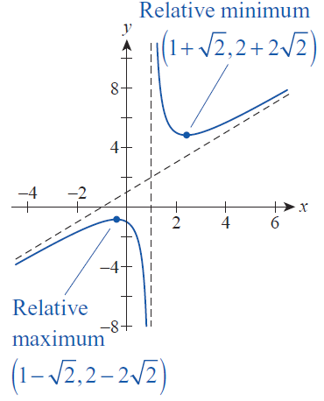
Example 4: Finding the Relative Extrema of a Rational Function (cont.)
Evaluating h at these points, we find a relative maximum value of
and a relative minimum value of
(see Figure 5). If we had not already sketched the graph of h, we could use either the First or Second Derivative Test to show that these were indeed relative extrema.

Slide 38
Example 5: Using the Curve-Sketching Strategy
Use the curve-sketching strategy to construct a graph of
Solution
Step 1: Note that e^{x} is defined for all x, so xe^{x} is as well. There is no apparent symmetry or periodicity.
Step 2: Since e^{x} is always positive, xe^{x} will be positive for positive x, negative for negative x, and 0 if, and only if, x = 0.

Slide 39
Example 5: Using the Curve-Sketching Strategy (cont.)
Step 3: It’s clear that f grows without bound as x → ∞, but the limit as x → −∞ is of indeterminate form 0 ⋅ ∞ (or, more precisely, of form −∞ ⋅ 0). We can determine the limit using L’Hôpital’s Rule.

Slide 40
Example 5: Using the Curve-Sketching Strategy (cont.)
Step 4: The first and second derivatives are as follows.
Step 5: So f has a critical point at −1 and a potential inflection point at −2.

Slide 41
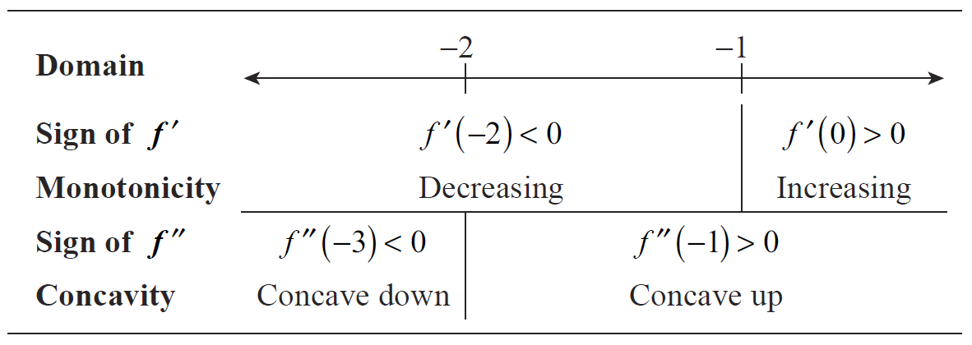
Example 5: Using the Curve-Sketching Strategy (cont.)
Both derivative tests tell us that f has a relative minimum at −1. And the concavity changes at −2, so that is an inflection point.

Slide 42
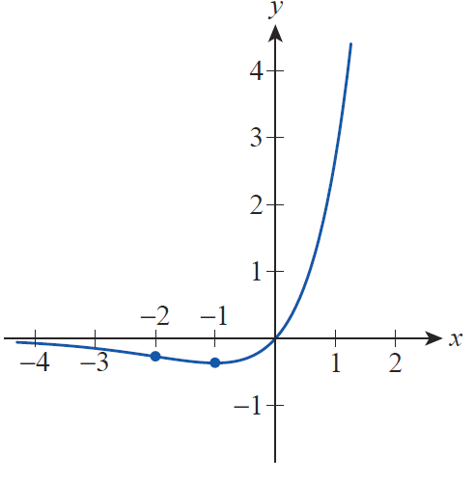
Example 5: Using the Curve-Sketching Strategy (cont.)
Step 6: The graph of f is shown in Figure 6.

Slide 43
Newton’s Method
The second step in the curve-sketching strategy says “Identify the intercepts, if possible.” This step is usually fairly important; in fact, depending on the particular application, locating the solutions of the equation f(x) = 0 may be the whole motivation for sketching the graph of f in the first place.

Slide 44
Newton’s Method (cont.)
Unfortunately, solving the equation f(x) = 0 is only a trivial task for a relatively small number of classes of functions. There are formulas for finding the roots of polynomials of degree four or less, but such a formula for degrees five and higher can’t exist (the
mathematicians Évariste Galois and Niels Henrik Abel, working independently, were the first to show this). And while the roots of the basic trigonometric functions are easy to determine, relatively simple algebraic combinations of them can be quite complicated.

Slide 45
Newton’s Method (cont.)
In practice, it is very common to wind up working with a function whose roots are elusive. And yet, graphing utilities seem to be able to at least give us approximations of roots of functions to seemingly any precision we need. How is that accomplished?
One of the simplest and most widely used techniques is called Newton’s method (or the Newton‑Raphson method), and questions of this sort belong to an area of mathematics called numerical analysis. We have all the knowledge we need at this point to understand how Newton’s method works.

Slide 46
Procedure: Newton’s Method
To find an approximation of a root of the function f(x), perform the following steps.
Step 1: Begin with a guess x₁ of a solution of the equation f(x) = 0. A sketch of the graph of f can be very helpful in this step.

Slide 47
Procedure: Newton’s Method (cont.)
Step 2: Define new approximations x₂, x₃, and so on by successively applying the following formula.
Step 3: Continue until the desired degree of precision is obtained.

Slide 48
Newton’s Method (cont.)
It is important to realize that Newton’s method is not guaranteed to work, a characteristic of nearly all numerical analysis techniques. But a certain amount of trial and error, combined with a good understanding of the underlying mathematics, is usually sufficient to overcome any difficulties. The ways in which Newton’s method may fail will become clear as we work
through its derivation.

Slide 49
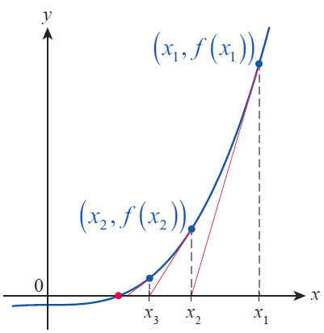
Newton’s Method (cont.)
Consider the function f , part of whose graph appears in Figure 7. In this portion of the graph, f has exactly one root (shown as a red dot).
Figure 7 Successive
Approximations to the Root

Slide 50
Newton’s Method (cont.)
If we didn’t know the exact value of this root, we might start with the guess depicted as x₁. The linearization of f at shown as a red line, is
and we determine where this linear approximation crosses the x‑axis as follows.

Slide 51
Newton’s Method (cont.)
If we label this result x₂ and repeat the process, we will (hopefully) obtain a sequence of points that converges to the actual root of f .

Slide 52
Newton’s Method (cont.)
But the process can go awry in several different ways. First, if for some x_{n}, the formula makes no sense. Geometrically, this means the linearization at this point is parallel to the x‑axis, so it has no x-intercept. Further, if the initial guess x₁ is not close enough to the desired root, the iterative process can actually result in a sequence that either doesn’t converge at all or else converges to a different root.

Slide 53
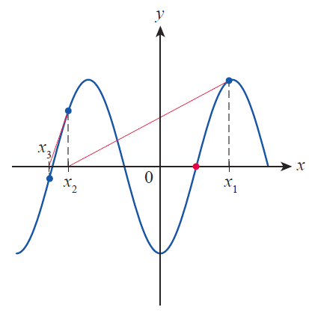
Newton’s Method (cont.)
Figure 8 illustrates this second possibility; the desired root is shown in red, but the sequence converges elsewhere.
Figure 8 Newton’s Method
Going Astray

Slide 54
Newton’s Method (cont.)
It is even possible for Newton’s method to never converge no matter how close the initial guess is to the actual root; Other approximation techniques exist to handle such unusual cases, however, and are studied in classes like Numerical Analysis.

Slide 55
Example 6: Using Newton's Method to Approximate a Root
Use Newton’s method to approximate to five decimal places.
Solution
We are looking for the value of in other words, a solution of the equation x³ = 2. So if we define f(x) = x³ − 2, we see that we are seeking a root of the function f. Since f ’(x) = 3x²,

Slide 56
Example 6: Using Newton's Method to Approximate a Root (cont.)
As a rule of thumb, we can feel comfortable with our approximation if we continue iterating Newton’s method until successive results agree to the number of decimal places we desire (more precise statements about convergence are studied in advanced classes). In our case, if we begin with a guess of x₁ = 2 we can obtain x₂ as follows.

Slide 57
Example 6: Using Newton's Method to Approximate a Root (cont.)
In a similar way, we obtain the subsequent approximations, truncating our results to six decimal places.
So to five decimal places, our approximation is

Slide 58
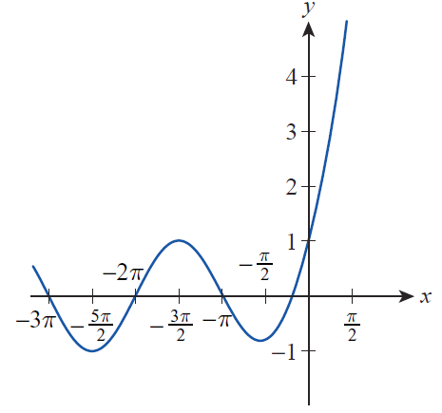
Example 7: Using Newton's Method to Approximate a Root
Use Newton’s method to approximate the largest negative root of to five decimal places.
Solution
Solving the equation
e^{x} + sin x = 0 is definitely not trivial, and a sketch of the graph (or at least a mental image of it) is immensely useful (see Figure 9).

Slide 59
Example 7: Using Newton's Method to Approximate a Root (cont.)
Since sin x oscillates between −1 and 1 over all of ℝ, while e^{x} gets very large for positive x and quickly approaches 0 for negative x, we should expect e^{x} to dominate to the right of 0 and sin x to dominate to the left. The graph supports this expectation.

Slide 60
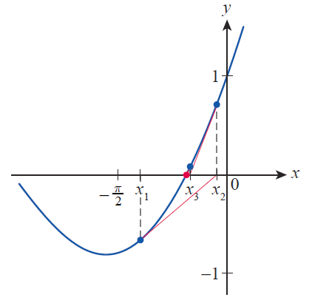
Example 7: Using Newton's Method to Approximate a Root (cont.)
The largest negative root of f lies somewhere to the
right of − π/2, as the close‑up in Figure 10 indicates. An initial guess of 0 would work well to begin Newton’s method, but for illustrative purposes we use
x₁ = −1.25. Applying Newton’s method, we obtain the following formula for x_{n + 1}.

Slide 61
Example 7: Using Newton's Method to Approximate a Root (cont.)
The first few approximations are as follows.
Since x₅ and x₆ agree to five decimal places, the largest negative root of f is approximately −0.58853.

