Slide 1
Section 4.7
Antiderivatives

Slide 2
Antiderivatives
The underlying goal of this chapter has been to use knowledge about the derivative of a function to gain a better understanding of the function itself. Given that, it’s fitting that in the last section of this chapter we ask the following question: If we have perfect knowledge of f’, can we recover f in its entirety? As we shall see, this question is rooted in more than mere intellectual curiosity. The answer, which we will fully develop in Chapter 5, has a great deal of both theoretical and practical importance.

Slide 3
Finding Antiderivatives
Since differentiation is the name we apply to the process of finding the derivative of a function, antidifferentiation is a natural name for the reverse process, and a function that results from antidifferentiation is termed an antiderivative.

Slide 4
Definition: Antiderivative
A function F is called an antiderivative of a given function f on an interval I if for all x in I.

Slide 5
Example 1: Finding Antiderivatives of Functions
Find an antiderivative of each of the following functions.
Solution
We have seen functions identical or similar to f , g, and h appear as the derivatives of other functions, so we can use our experience with differentiation to “work backward” and arrive at an antiderivative of each.

Slide 6
Example 1: Finding Antiderivatives of Functions (cont.)
a. qualifies as an antiderivative of f, since
Note that the interval on which this is valid is
b. To find an antiderivative of we can start
with the fact that The result of
this differentiation is off by a minus sign, but one of our many differentiation rules allows us to correct for that: if we define then
Again, this is true on all of

Slide 7
Example 1: Finding Antiderivatives of Functions (cont.)
c. We know that and so by the
additive property of differentiation, is an antiderivative of h. This makes sense for all x where H and h are defined, so it’s true for the interval and the interval

Slide 8
Finding Antiderivatives (cont.)
With a little thought, though, Example 1 already points out that the answer to the opening question of this section is “No, not uniquely.” Another differentiation fact that we know is that two differentiable functions have the same derivative on an interval if and only if they differ by no more than a constant (the “only if” part is the second corollary of the Mean Value Theorem). This has the practical effect that each of the functions in Example 1 has an infinite number of antiderivatives.

Slide 9
Finding Antiderivatives (cont.)
Once we have found one antiderivative of a function on a given interval, we know the form of all its antiderivatives on that interval. That is the meaning of the following theorem, which is a reformulation of the corollary mentioned above.

Slide 10
Theorem: General Antiderivative Theorem
If F is an antiderivative of the function f on a given interval I, then any other antiderivative of f can be written as F(x) + C for some constant C.

Slide 11
Definition: General Antiderivative
If F is an antiderivative of the function f on a given interval I, then the general antiderivative of f on I is F(x) + C where C represents an arbitrary constant.

Slide 12
Example 2: Finding the General Antiderivative and a
Particular Antiderivative of a Function
Find the general antiderivative of Then find the particular antiderivative F that satisfies
Solution
Using the same reasoning as in Example 1, we can quickly verify that e^{x} − x² is an antiderivative of f , so the general antiderivative is In order to determine the constant C that will satisfy the condition F(0) = −2, we can simply solve the equation
so C = −3.

Slide 13
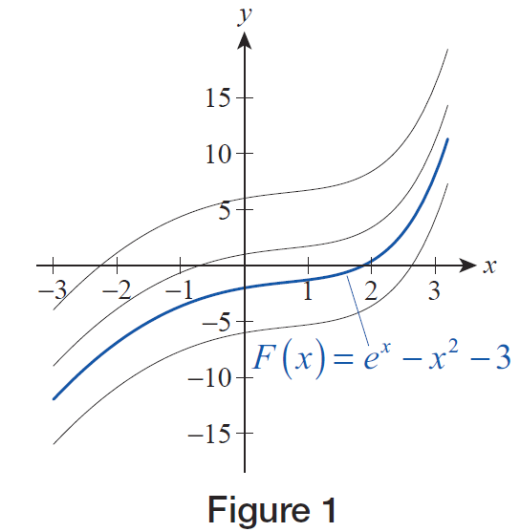
Example 2: Finding the General Antiderivative and a
Particular Antiderivative of a Function (cont.)
Graphically, the family of functions described by the general antiderivative consists of the same curve crossing at different points on the y‑axis. The particular antiderivative e^{x} − x² − 3 that satisfies the given condition, is depicted in blue in Figure 1, with a few other members of the family in black.
Figure 1

Slide 14
Finding Antiderivatives (cont.)
Over the course of the next several chapters, we will learn some particular techniques for finding antiderivatives for various classes of functions, but the most basic technique is that which we have used in the first two examples; namely, using rules of differentiation in reverse.
Table 1 indicates how a given differentiation rule can be restated as an antidifferentiation rule and, in the interest of brevity, Table 2 simply lists the general antiderivatives relating to basic trigonometric functions.

Slide 15
Finding Antiderivatives (cont.)
In the tables, F and G represent antiderivatives of f and g, respectively, and k represents a nonzero constant (note the frequent use of the Chain Rule).

Slide 16
Table 1: General Antiderivatives with Justifications
Function | General Antiderivative | Justification

Slide 17
Table 1: General Antiderivatives with Justifications (cont.)
Function | General Antiderivative | Justification

Slide 18
Table 2: General Antiderivatives of Trigonometric Functions
Function | General Antiderivative

Slide 19
Table 2: General Antiderivatives of Trigonometric Functions (cont.)
Function | General Antiderivative

Slide 20
Table 2: General Antiderivatives of Trigonometric Functions (cont.)
Function | General Antiderivative

Slide 21
Example 3: Finding General Antiderivatives of Functions
Find the general antiderivative of each of the following functions.

Slide 22
Example 3: Finding General Antiderivatives of Functions (cont.)
Solution
a. We can rewrite the function as
and we start by noting that the general antiderivative of is
and the general antiderivative of −csc² 5x is
where C₁ and C₂ represent arbitrary constants.

Slide 23
Example 3: Finding General Antiderivatives of Functions (cont.)
When we add these two antiderivatives, we get
But C₁ + C₂ also represents nothing more than an arbitrary constant, and it is customary to combine all arbitrary constants in an antiderivative together and denote their sum with a single symbol.

Slide 24
Example 3: Finding General Antiderivatives of Functions (cont.)
Hence, we write
as the general antiderivative of
(Remember: it is easy to check your work and verifying that

Slide 25
Example 3: Finding General Antiderivatives of Functions (cont.)
b. It would be difficult to come up with an antiderivative of g in the form given, but after breaking apart the fraction the way forward becomes clear.

Slide 26
Antiderivatives in Use
Example 2 is a simple example of a type of problem called a differential equation, which we will study in greater depth in Chapter 8. Informally, a differential equation is an equation that involves the derivative of an unknown function. Such equations arise naturally in many different settings, as it is often easiest to see how the derivative of a function (as opposed to the function itself) relates to other quantities.

Slide 27
Antiderivatives in Use (cont.)
And if a differential equation involving f ’(x) is accompanied by information about the value of f at a particular point, say f(x₀) = y₀, then a particular solution of the equation (as opposed to a family of solutions) can be determined; such equations are called initial value problems.

Slide 28
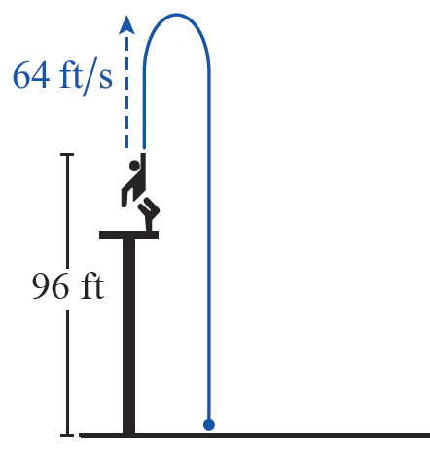
Example 4: Finding the Maximum Height of a Ball
A ball is thrown straight up at 64 ft/s by a person standing on the edge of a platform. At the moment the ball leaves the thrower’s hand, it is 96 ft above the ground. On its way back down, the ball misses the platform and hits the ground. When does the ball reach its maximum height? What is that maximum height? When does the ball hit the ground?
Figure 2

Slide 29
Example 4: Finding the Maximum Height of a Ball (cont.)
Solution
If we let h(t) denote the height (in feet) of the ball at time t (in seconds), then represents the ball’s vertical velocity and we are given the initial conditions
and Recall that the acceleration due to gravity is so the rate of change of must be −32; that is, Thus, the general antiderivative of is and the condition tells us that

Slide 30
Example 4: Finding the Maximum Height of a Ball (cont.)
We know that the ball will transition from a positive (upward) velocity to a negative (downward) velocity as it stops rising and starts to fall, and its maximum height is attained at that time t when h’(t) = 0, namely t = 2 s. This tells us when the ball reaches its maximum height, but not what that maximum height is—we still need to determine h(2).

Slide 31
Example 4: Finding the Maximum Height of a Ball (cont.)
To do so, we must perform another antidifferentiation: given we can determine that and for the condition to be true it must be the case that
Now, we can see that

Slide 32
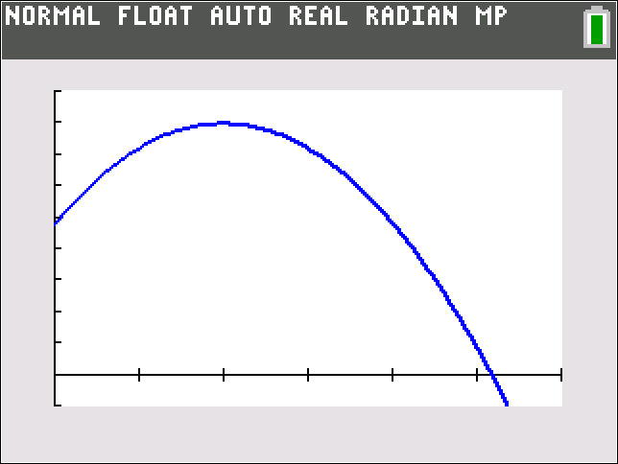
Example 4: Finding the Maximum Height of a Ball (cont.)
There is one question remaining, but we have all we need to answer it. The ball hits the ground when
so we solve the equation −16t² + 64t + 96 = 0 and obtain (the other solution is negative and doesn’t apply).
Figure 3 confirms our findings.

Slide 33
Example 5: Solving an Initial Value Problem
Given that and that
and find y.
Solution
We can determine the general form for by finding the antiderivative of each term in the expression for .

Slide 34
Example 5: Solving an Initial Value Problem (cont.)
And for the condition to be satisfied, it must be the case that
so C = 1.

Slide 35
Example 5: Solving an Initial Value Problem (cont.)
We can now repeat the process with
to obtain
and
implies C = −1. So our final answer is

Slide 36
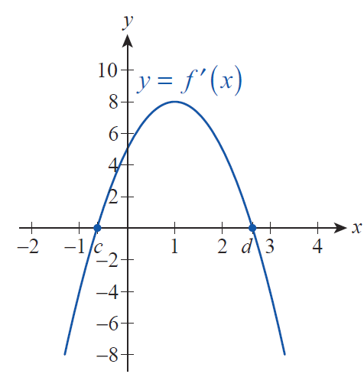
Example 6: Sketching the Graph of a Function
Given the Graph of Its Derivative
Given the graph of in Figure 4 and the knowledge that f passes through (1,2), sketch the graph of f.
Figure 4

Slide 37
Example 6: Sketching the Graph of a Function
Given the Graph of Its Derivative (cont.)
Solution
We begin by observing that f ’ is positive on the interval (c,d), negative on the intervals (−∞,c) and (d,∞), and that This tells us that f is increasing on (c,d), decreasing on (−∞,c) and (d,∞), and that f has a relative minimum at x = c and a relative maximum at x = d. Further, f ’ has a critical point at 1 and appears to be differentiable there (the graph of f ’ is nicely smooth), so f ”(1) = 0; moreover, since f ’ is increasing to the left of 1 and decreasing to the right of 1, it must be the case that f changes concavity as it passes through the point (1,2).

Slide 38
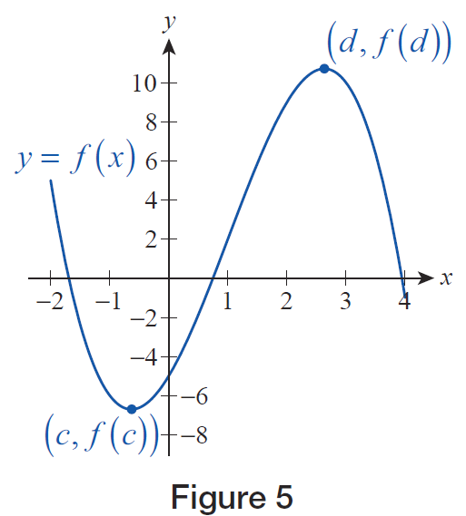
Example 6: Sketching the Graph of a Function
Given the Graph of Its Derivative (cont.)
Putting all these observations together, the graph of f must be something along the lines of the one in Figure 5, though the actual values of f(c) and f(d) can be nothing more than a rough guess.
Figure 5

Slide 39
Example 6: Sketching the Graph of a Function
Given the Graph of Its Derivative (cont.)
The values of from the original graph tell us approximately how fast the graph of f rises or falls near a given point—for instance, since the “slope” of f at (1, 2) should be 8.

