Slide 1
Section 5.1
Area, Distance, and Riemann Sums

Slide 2
Example 1: Estimating the Area Bounded by the x-Axis and the Graph of a Function
Find the area under the graph of f(x) = x² and above the x‑axis on the interval [0, 1].
Solution
At this point, we have nothing to work with other than our existing knowledge of area. We can certainly make some rough statements concerning the requested area. For instance, the area under the parabola on the interval [0,1] is less than half a square unit, which is the area of the triangular region bounded by the x‑axis and the line y = x.

Slide 3
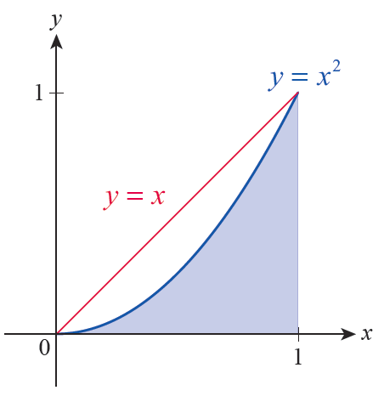
Example 1: Estimating the Area Bounded by the x-Axis and the Graph of a Function (cont.)
But we can also estimate the area under the curve by approximating it with
regions whose areas we do know.
Rectangles are easy to work with, and we can approximate the region under the parabola
with a collection of rectangles in many different ways.
Figure 2

Slide 4
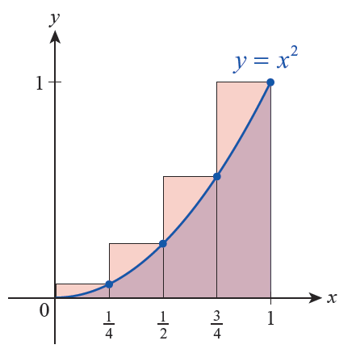
Example 1: Estimating the Area Bounded by the x-Axis and the Graph of a Function (cont.)
We could, for example, divide the interval [0, 1] into four subintervals of equal width and overestimate the desired area by covering it with four rectangles whose
heights are as shown in Figure 3. The combined area of these four rectangles, denoted O₄ for “Over,” is as follows.
Figure 3

Slide 5
Example 1: Estimating the Area Bounded by the x-Axis and the Graph of a Function (cont.)

Slide 6
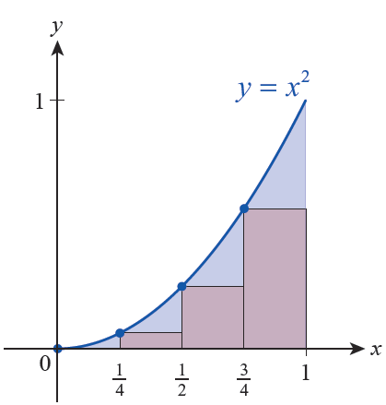
Example 1: Estimating the Area Bounded by the x-Axis and the Graph of a Function (cont.)
We could also underestimate the area by adding up the areas of the four rectangles whose heights are
(see Figure 4).
Figure 4

Slide 7
Example 1: Estimating the Area Bounded by the x-Axis and the Graph of a Function (cont.)
This would give us the approximation U₄ (U for “Under”).

Slide 8
Example 1: Estimating the Area Bounded by the x-Axis and the Graph of a Function (cont.)
Knowing that the area under the parabola is actually something between these two approximations, we might estimate the area with their average.

Slide 9
Example 1: Estimating the Area Bounded by the x-Axis and the Graph of a Function (cont.)
To obtain a better approximation of the desired area, we can increase the number of rectangles. Graphs of the results, such as those from Figure 5 for n = 10, certainly seem to indicate that the errors in the approximations get smaller as n increases, but
we can prove that this is indeed the case by noting the differences between O_{n} and U_{n}. The following table contains O_{n}, U_{n}, their difference, and their average for a few values of n.

Slide 10
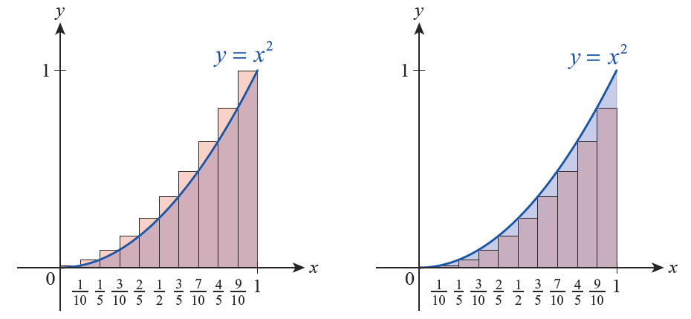
Example 1: Estimating the Area Bounded by the x-Axis and the Graph of a Function (cont.)
Figure 5 Approximating the Area with 10 Rectangles

Slide 11
Example 1: Estimating the Area Bounded by the x-Axis and the Graph of a Function (cont.)
n | O_{n} | U_{n} | O_{n} − U_{n} | (O_{n} + U_{n})/2
10 | 0.385 | 0.285 | 0.1 | 0.335
100 | 0.33835 | 0.32835 | 0.01 | 0.33335
1000 | 0.33383 | 0.33283 | 0.001 | 0.33333
Given the results in the table, we would be justified in guessing that the area under f(x) = x² over the interval [0, 1] is we already know this guess is correct to several decimal places. We will soon return to this problem and prove that this guess is indeed correct.

Slide 12
The Distance Problem
The symbol Σ is the capital Greek letter sigma (standing for “sum”), and the letter i is the index of summation.
In general, an expression such as stands for the
sum of all the terms a₁ through a_{n}; that is,

Slide 13
Example 2: Finding the Distance Traveled by a Falling Stone
A stone is released from a high cliff and falls for many seconds before hitting the canyon floor. Assuming air resistance is negligible, how far does the stone fall in the interval t = 1 second to t = 3 seconds?
Solution
Recall that the acceleration due to gravity is −32 ft/s², meaning that with every passing second a falling object changes in velocity by another −32 ft/s (recall also that the negative signs reflect the fact that objects fall downward).

Slide 14
Example 2: Finding the Distance Traveled by a Falling Stone (cont.)
So if we let t denote the time in seconds after release, the stone falls with velocity v(t) = −32t. Since we are interested only in determining the difference between the stone’s position at time t = 1 and time t = 3, we will work with the speed of the stone s(t) = |v(t)| = 32t.

Slide 15
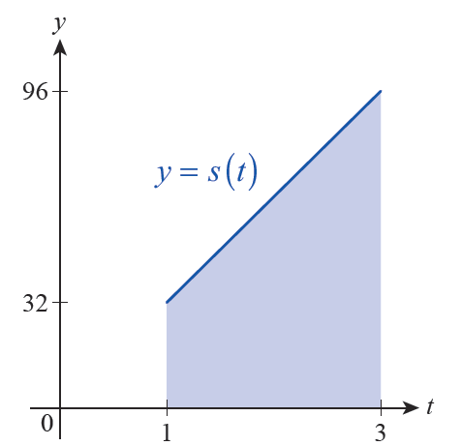
Example 2: Finding the Distance Traveled by a Falling Stone (cont.)
The graph of s is linear, and the distance traveled by the stone between t = 1 and t = 3 corresponds to the shaded area between the graph and the t‑axis (see Figure 9). The area of this polygonal region is 128 square units, so the distance traveled between these two points in time is 128 feet.
Figure 9

Slide 16
Example 2: Finding the Distance Traveled by a Falling Stone (cont.)
Although we now know the answer to our question, it is worthwhile to obtain it again through the approximation process we have developed—this will give us a chance to practice the techniques and notation that we will use for the next several sections. To this end, let O_{n} denote the overestimate that results by dividing the interval [1, 3] into n subintervals and defining to be the right endpoint of the subinterval note that by this definition, is the maximum value of s on the subinterval since s is an increasing function.

Slide 17
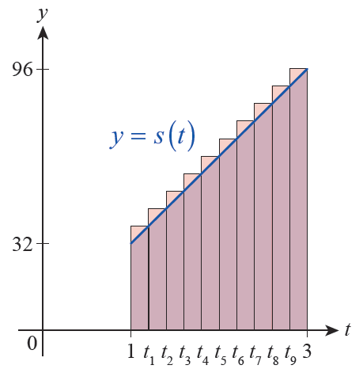
Example 2: Finding the Distance Traveled by a Falling Stone (cont.)
Using sigma notation,
While we could pick a specific value for n, calculate the n terms and add them up to arrive at an approximation, it is possible to achieve much more.
Figure 10 Depiction of 0₁₀

Slide 18
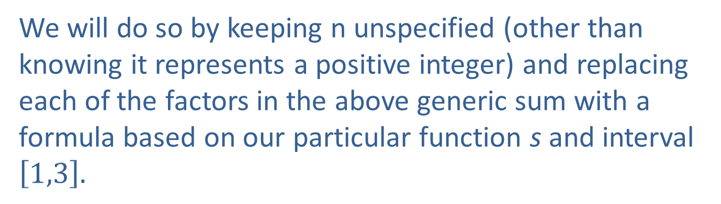
Example 2: Finding the Distance Traveled by a Falling Stone (cont.)
We will do so by keeping n unspecified (other than knowing it represents a positive integer) and replacing each of the factors in the above generic sum with a formula based on our particular function s and interval $\left[1,3\right].$

Slide 19
Example 2: Finding the Distance Traveled by a Falling Stone (cont.)
Note that

Slide 20
Example 2: Finding the Distance Traveled by a Falling Stone (cont.)
Hence,
Remember that this notation signifies nothing more than a sum and that all the usual properties of arithmetic hold. So we can reorder the terms as we like, factor out constants, and so forth.

Slide 21
Example 2: Finding the Distance Traveled by a Falling Stone (cont.)

Slide 22
Example 2: Finding the Distance Traveled by a Falling Stone (cont.)
Sums such as arise frequently, and it can be shown
that A catalog of other similar
formulas will be given shortly. Using this fact in the expression above, we have the following result.

Slide 23
Example 2: Finding the Distance Traveled by a Falling Stone (cont.)
In other words, we now have a simple expression giving us the overestimate resulting from approximating with n rectangles—there is no need to calculate this number repeatedly for different values of n. More importantly, we can study this expression to see what happens as n → ∞. Since as n → ∞, we see that O_{n} → 128, confirming that the distance the stone falls between the first and third seconds is 128 feet.

Slide 24
Riemann Sums and Summation Formulas
We have now seen sums of the form arise
several times, and we will study them further as we develop the notion of the integral. Such an expression is an example of a Riemann sum of the function f over an interval [a, b]. It is very helpful to keep in mind the geometric meaning of the individual pieces of a Riemann sum. Specifically, remember that each represents a sample point in the i^{th} subinterval, that is the width of each subinterval, and that is nothing more than the value of f at the i^{th} sample point.

Slide 25
Theorem: Summation Facts and Formulas
Constant Rule for Finite Sums
Constant Multiple Rule for Finite Sums
Sum/Difference Rule for Finite Sums
Sum of the First n Positive Integers

Slide 26
Theorem: Summation Facts and Formulas (cont.)
Sum of the First n Squares
Sum of the First n Cubes

Slide 27
Example 3: Using Summation Formulas to Simplify Sums
Simplify the following sums.
Solution

Slide 28
Example 3: Using Summation Formulas to Simplify Sums (cont.)

Slide 29
Example 4: Finding the Area Bounded by the x-Axis and the Graph of a Function
Find the area under the graph of f(x) = x² and above the x‑axis on the interval [0, 1].
Solution
For variety, we will construct an expression for U_{n} (the underestimate based on n subintervals) and evaluate

Slide 30
Example 4: Finding the Area Bounded by the x-Axis and the Graph of a Function (cont.)
If we divide [0, 1] into n subintervals of equal width, each one has width The minimum value of f on occurs at that is, at the left endpoint of each subinterval.
So in general So we have the following Riemann sum.

Slide 31
Example 4: Finding the Area Bounded by the x-Axis and the Graph of a Function (cont.)
We have already simplified the sum in part c. of Example 3.

