Slide 1
Section 5.2
The Definite Integral

Slide 2
Definition: Definite Integral
Given a function f defined on an interval [a, b], let
let [a, b] be divided into n subintervals of equal width, where
and let the i^{th} sample point satisfy
Then the (Riemann) definite integral of f
from a to b is denoted and is defined to be

Slide 3
Definition: Definite Integral (cont.)
provided the limit exists and is the same for every choice of the sample points. If so, we say f is integrable on [a, b], and call f the integrand of the integral. In this context, a and b are called, respectively, the lower and upper limits of integration.

Slide 4
Riemann Sums and the Definite Integral
The symbol ∫ was introduced by Leibniz and represents a stylized “S” as a reminder that the basis of the definite integral is summation. Similarly, the process of calculating the value of a definite integral is termed integration—this reflects the fact that we arrive at a definite integral by adding up (integrating) a finite number of summands, and taking the limit as the number of summands approaches infinity.

Slide 5
Riemann Sums and the Definite Integral (cont.)
Given an interval [a, b], a partition P of [a, b] is any finite set where (note that the x_{i}’s don’t have to be evenly spaced). The norm of the partition P is defined to be where that is, is the maximum of the subinterval widths. Using the epsilon‑delta formulation of limit, we say that f is integrable on [a, b] and that its definite integral is the number we denote as if for every ε > 0 there is a δ > 0 so that

Slide 6
Example 1: Finding the Height of a Stone Given Its Vertical Velocity Function
George uses a slingshot to shoot a small stone straight up into the sky with a vertical velocity of
What is the height of the stone, relative to its initial height, when t = 4 s?
Solution
Following our discussion in Section 5.1, we will take the limit of Riemann sums of the form in order
to deduce the position of the stone after 4 seconds—it is again the case that the distance traveled over the interval is approximately

Slide 7
Example 1: Finding the Height of a Stone Given Its Vertical Velocity Function (cont.)
However, as we will see, there is one important difference between this example and Example 2 of the previous section.
To set the stage, note that and, if we decide to let be the right endpoint of each subinterval, then
and, in general,

Slide 8
Example 1: Finding the Height of a Stone Given Its Vertical Velocity Function (cont.)
Using the integral notation, we write the following equation.

Slide 9
Example 1: Finding the Height of a Stone Given Its Vertical Velocity Function (cont.)
Continuing to use the summation formulas we listed in the previous section,

Slide 10
Example 1: Finding the Height of a Stone Given Its Vertical Velocity Function (cont.)
What does this answer mean? Surely the stone has traveled, so does an answer of 0 feet make sense? It does, but only if we understand exactly what the definite integral of velocity tells us. If we take a look at the graph of v, we see that it is positive for the first 2 seconds and negative for the last 2 seconds—that is, the stone first rises and then falls. At the end of 4 seconds, the stone has the same height that it had at time 0. This is the physical meaning of the result and a consequence of the fact that the signed areas in Figure 4 cancel one another out exactly.

Slide 11
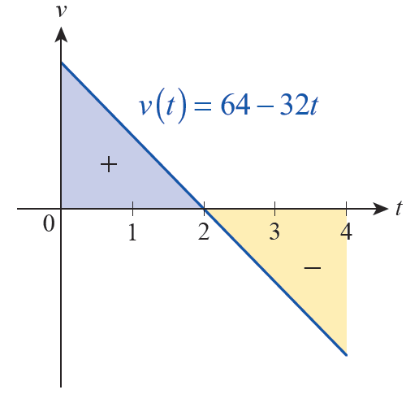
Example 1: Finding the Height of a Stone Given Its Vertical Velocity Function (cont.)
If instead of the position after 4 seconds we want to know how far the stone travels over the interval [0, 4], we need to
determine a task you will undertake in Exercise 2.
Figure 4

Slide 12
Theorem: Piecewise Continuous Functions Are Integrable
If f is a continuous function defined on [a, b], or if f is a piecewise continuous function on [a, b] (meaning it is continuous except for a finite number of jump discontinuities), then f is integrable on [a, b].

Slide 13
Definition: Left and Right Riemann Sums
Given a function f defined on the interval [a, b], let L_{n} and R_{n} denote the Riemann sums obtained by dividing [a, b] into n subintervals of equal width,
and defining the i^{th} sample point to be, respectively, the left and right endpoint of the i^{th} subinterval. That is,
where and

Slide 14
Example 2: Evaluating a Definite Integral as a Limit of a Right Riemann Sum
Evaluate by taking the limit of the associated right Riemann sum.
Solution
From the expression we see that a = −1, and b = 3.
So
and

Slide 15
Example 2: Evaluating a Definite Integral as a Limit of a Right Riemann Sum (cont.)
Hence,

Slide 16
Example 2: Evaluating a Definite Integral as a Limit of a Right Riemann Sum (cont.)
We can now apply the last three summation formulas from Section 5.1 to obtain
which, after significant simplification, yields

Slide 17
Example 3: Evaluating a Definite Integral by Using Geometry to Find the Signed Area
Evaluate
Solution
If we construct a Riemann sum based on the function we arrive at a limit that is quite difficult to evaluate. But if we think about the graph of f and what represents, we see that elementary geometry suffices to evaluate the integral.
The graph of the function f corresponds to the graph of the equation which upon squaring both sides yields Rewritten as

Slide 18
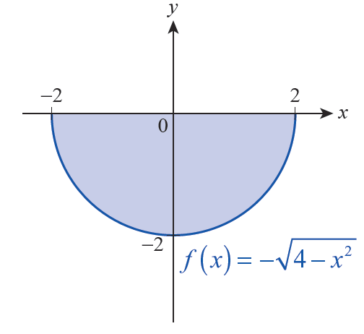
Example 3: Evaluating a Definite Integral by Using Geometry to Find the Signed Area (cont.)
this equation is familiar to us—its graph is the circle of radius 2 centered at the origin. If we think about what then represents, we realize its graph is the lower half of the circle (and
is the upper half); the graph of f is shown in Figure 5.
Figure 5

Slide 19
Example 3: Evaluating a Definite Integral by Using Geometry to Find the Signed Area (cont.)
Hence, represents the negative of half
of the area of a circle of radius 2. That is,

Slide 20
Theorem: Properties of the Definite Integral
Given the integrable functions f and g on the interval [a, b] and any constant k, the following properties hold.

Slide 21
Theorem: Properties of the Definite Integral (cont.)

Slide 22
Selected Proofs and Comments
The first two properties result from thinking about our definition of the Riemann integral and making logical extensions to cases not yet covered by the definition. Specifically, a reasonable interpretation of the expression is that it represents the signed area of a rectangle of height f(a) and width zero. Note also that any Riemann sum approximating the integral could consist only of exactly one term, namely f(a)Δx, with Δx = a − a = 0.

Slide 23
Selected Proofs and Comments (cont.)
Therefore, we should define to be 0. For the second property, consider the following argument.

Slide 24
Selected Proofs and Comments (cont.)
This is our justification for stating that reversing the order of the limits of integration of a given function changes the sign of the result.
To prove Property 3, it suffices to note that if
then

Slide 25
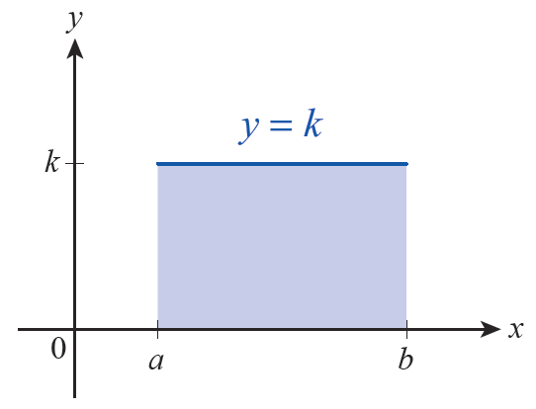
Selected Proofs and Comments (cont.)
for every n and for any choice of sample points. It is also useful, though, to visualize the meaning of This definite integral
corresponds to the signed area of the shaded rectangle in Figure 6, which is k(b − a).

Slide 26
Selected Proofs and Comments (cont.)
Similarly, Property 5 can be proved algebraically and interpreted graphically.

Slide 27
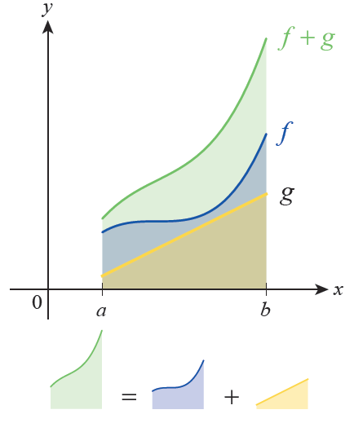
Selected Proofs and Comments (cont.)
Figure 7 shows the graphs of three functions f, g, and f + g and illustrates the fact that the sum of the areas under the graphs of f and g equals the area under the graph of f + g.

Slide 28
Example 4: Using the Properties of the Definite Integral
Given that and
determine
Solution
By Property 6, we know that
and so
Hence,

Slide 29
Example 5: Using the Properties of the Definite Integral
Use Property 8 to find lower and upper bounds on the
integral
Solution
The function is an increasing function, so
Hence,

Slide 30
Example 6: Finding the Average Value of a Function on an Interval
Determine the average value of on the interval
Solution
We have already determined in Example 3 that

Slide 31
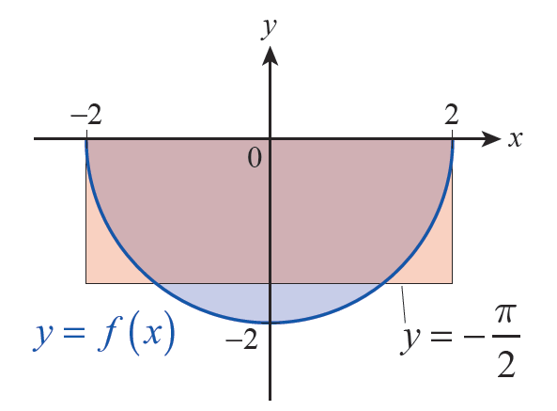
Example 6: Finding the Average Value of a Function on an Interval (cont.)
Note that, geometrically, this corresponds to transforming a half circle into a rectangle, as shown in Figure 10.
Figure 10

