Slide 1
Section 5.3
The Fundamental Theorem of Calculus

Slide 2
Theorem: The Mean Value Theorem for Definite Integrals
If f is a continuous function on the interval [a, b], then there exists a point c in [a, b] for which

Slide 3
Proof
The proof of this statement follows from the application of the Intermediate Value Theorem to a slight rephrasing of one of the definite‑integral properties seen in the previous section. Recall that for a continuous function f on [a,b],

Slide 4
Proof (cont.)
Dividing each side of the inequality by b − a, we see that
Since f is continuous, the Intermediate Value Theorem tells us that f takes on every value between m and M at least once on the interval [a,b]. In particular, there must exist a point c ∈ [a,b] such that f (c) is the value

Slide 5
Example 1: Finding Points Where a Function Takes on Its Average Value
Find every point c in the interval at which the
function takes on its average value.
Solution
In Example 6 of Section 5.2, we graphed this function and determined that its average value over the interval is So to find each point c at which f assumes its average value, we simply solve the equation

Slide 6
Example 1: Finding Points Where a Function Takes on Its Average Value (cont.)

Slide 7
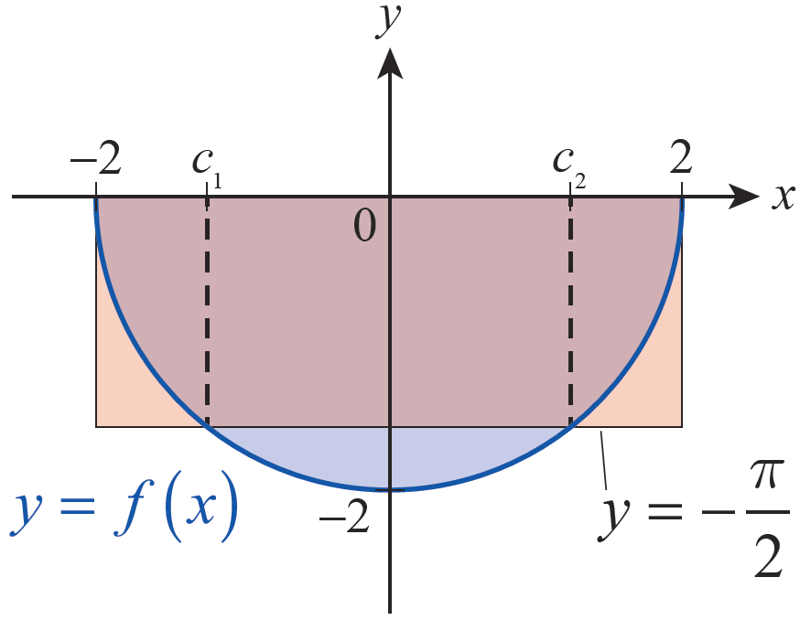
Example 1: Finding Points Where a Function Takes on Its Average Value (cont.)
These two solutions are labeled c₁ and c₂ in Figure 1.
Figure 1

Slide 8
Theorem: The Fundamental Theorem of Calculus, Part I
Given a continuous function f on an interval I and
a fixed point a ∈ I, define the function F on I by
Then for all x ∈ I.

Slide 9
Proof
We will prove that by showing that
for all x ∈ I. In what follows, we will assume that each h is sufficiently small so that both x − h ∈ I and x + h ∈ I. Further, if x happens to be an endpoint of I, then should be interpreted as a one‑sided derivative and the limit above restricted to h > 0 (if x is the left endpoint of I) or h < 0 (if x is the right endpoint).

Slide 10
Proof (cont.)
Note that one of the properties of the definite integral tells us that
and so, for each h sufficiently small,

Slide 11
Proof (cont.)
By the Mean Value Theorem for Definite Integrals, there is a point c between x and x + h for which
note that if h is
positive and if h is negative. As Figures 3a and 3b illustrate (for a positive h), F(x + h) − F(x) represents the signed area bounded by the graph of f between x and x + h, and this signed area is equal to the area of the rectangle with width (x + h) − x = h and height f(c).

Slide 12
Proof (cont.)
As h → 0, it must be the case that c → x, as c is squeezed between x and x + h. Hence,

Slide 13
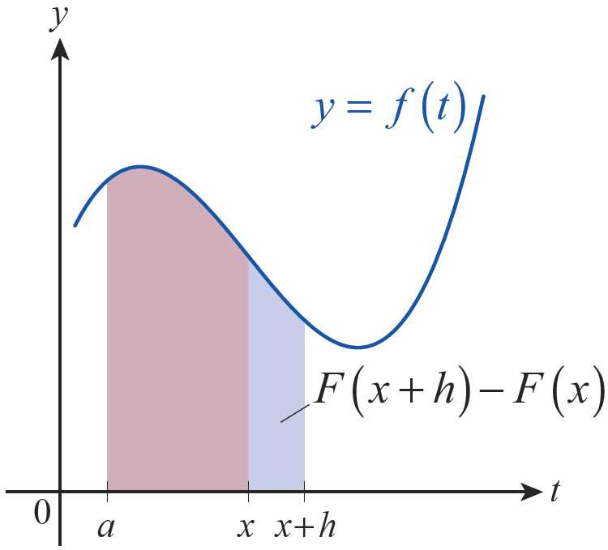
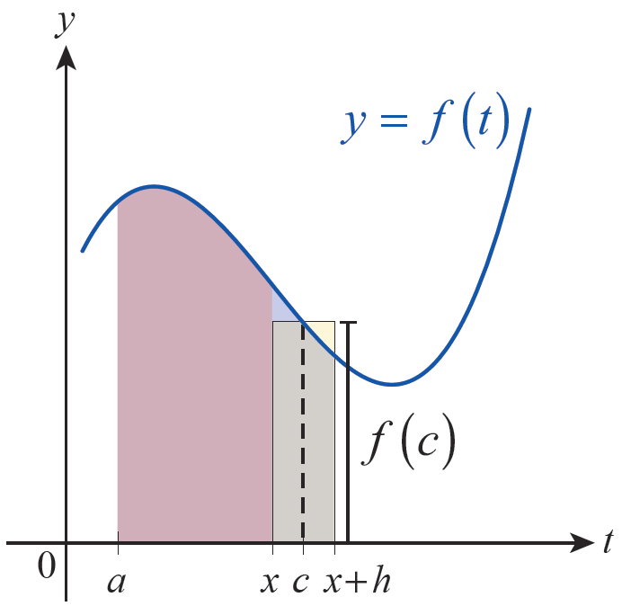
Proof (cont.)
Figure 3a
Figure 3b

Slide 14
Example 2: Using the Fundamental Theorem of Calculus, Part I
Given a function F defined by
determine the interval on which the Fundamental Theorem of Calculus can be applied and find on that interval.
Solution
First, note that is continuous on and that 4 (the lower limit of integration) is an element of I. So the FTC applies for each nonnegative x, and
In the particular case of x = 0, this means

Slide 15
Example 3: Using the Fundamental Theorem of Calculus, Part I
Use the FTC to evaluate the following derivatives.
a.
b.
c.

Slide 16
Example 3: Using the Fundamental Theorem of Calculus, Part I (cont.)
Solution
a. The expression does indeed represent a function in x, but because the upper limit of integration is x² and not x, dy/dx is not simply 1/(2+x). To understand why we shouldn’t expect this to be the case, note that for a small change from x to x + h, the upper limit changes from x² to x² + 2xh + h².

Slide 17
Example 3: Using the Fundamental Theorem of Calculus, Part I (cont.)
But we can find the requested derivative by using the Chain Rule: if we let u = x², then we proceed as follows.

Slide 18
Example 3: Using the Fundamental Theorem of Calculus, Part I (cont.)
b. To determine we must again use the
Chain Rule and also account for the fact that the variable limit of integration is the lower one, not the upper. We can do as follows.

Slide 19
Example 3: Using the Fundamental Theorem of Calculus, Part I (cont.)

Slide 20
Example 3: Using the Fundamental Theorem of Calculus, Part I (cont.)
c. The limits in the integral are both functions of x, but the two examples above guide us on how to proceed. Note that since the integrand is continuous everywhere, we can break the integral apart into a sum of two integrals, and the choice of a is immaterial—any fixed will do.

Slide 21
Example 3: Using the Fundamental Theorem of Calculus, Part I (cont.)

Slide 22
Example 4: Using the Fundamental Theorem of Calculus, Part I
Given the function define
functions F, G, and H by
Determine the intervals on which the FTC applies for each integral, and find on those intervals. How are F, G, and H similar and how are they different?

Slide 23
Example 4: Using the Fundamental Theorem of Calculus, Part I (cont.)
Solution
The function f has a single point of discontinuity at x = −1, and so the FTC is applicable for F and G on the interval (−1, ∞) and for the function H on the interval (−∞, −1) (note that the lower limit of integration is the key to determining the interval on which the FTC can be used). Next, the FTC tells us that for all and that for all

Slide 24
Example 4: Using the Fundamental Theorem of Calculus, Part I (cont.)
By Corollary 2 of the Mean Value Theorem from Section 4.2, we know that two functions with the same derivative on an open interval differ only by a constant. So it must be the case that on (−1, ∞) for some constant C. And while it’s also true that the domain of H does not overlap with the domain of F or G at all.

Slide 25
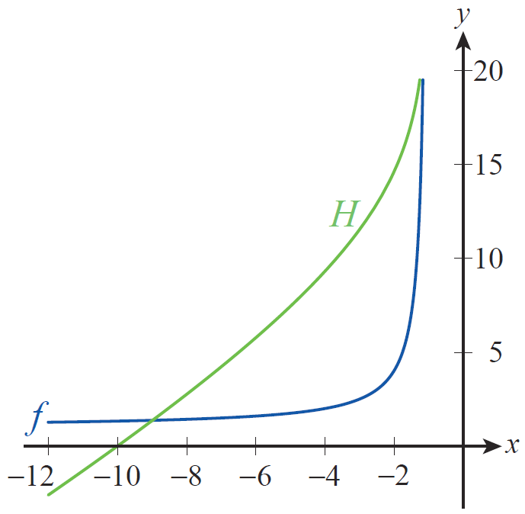
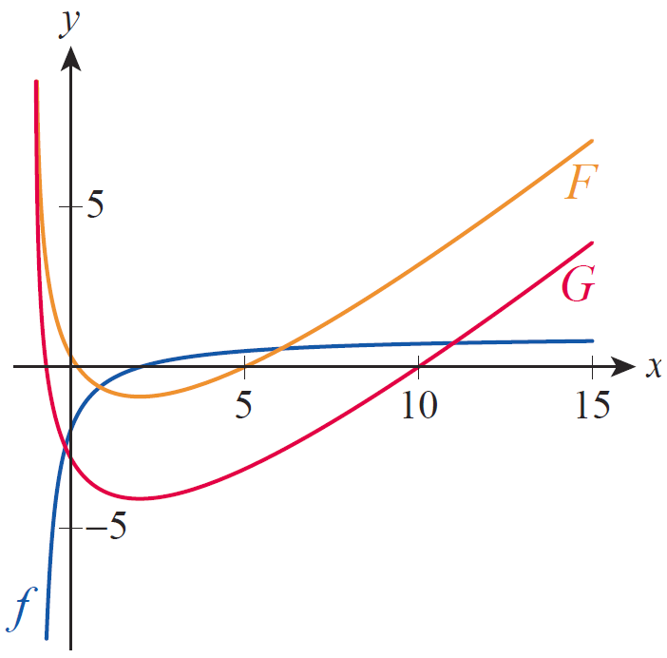
Example 4: Using the Fundamental Theorem of Calculus, Part I (cont.)
In Figures 4 and 5, the graphs of f, F, G, and H are shown.
Figure 4 Graphs of f and H
Figure 5 Graphs of f , F, and G

Slide 26
Example 4: Using the Fundamental Theorem of Calculus, Part I (cont.)
We will soon develop the tools needed to find explicit formulas for F, G, and H, but for the moment we will take the graphs as given. What we can do now is confirm that F, G, and H possess the properties that such functions should—remember that each was designed to return the signed area bounded by the graph of f over a (varying) interval.

Slide 27
Example 4: Using the Fundamental Theorem of Calculus, Part I (cont.)
For instance, it should be the case that since and that is indeed the case. Further, H(x) should be positive for since f is positive on the interval and we are integrating from left to right for such x’s. Similarly, H(x) should be negative for since f is again positive on the interval but for these values of x we are integrating from right to left. Note that for such an x,

Slide 28
Example 4: Using the Fundamental Theorem of Calculus, Part I (cont.)
Turning to F and G, we can say a bit more. First, both F and G should have a horizontal tangent line at x = 2, since f(2) = 0 and the FTC tells us that and And as with H, we know that
and that All of these facts are reflected in the graphs of F and G.

Slide 29
Example 4: Using the Fundamental Theorem of Calculus, Part I (cont.)
We have already determined that F(x) = G(x) + C for some constant C on (−1, ∞), and the graphs seem to confirm that fact. But what is the actual value of C? Based on Figure 5, it appears to be approximately 3—note the difference, for example, between F(2) and G(2) or between F(10) and G(10). More precisely, we can use two of the properties of the definite integral to note that for any

Slide 30
Example 4: Using the Fundamental Theorem of Calculus, Part I (cont.)
With the knowledge that we shall soon acquire, we will be able to determine that

Slide 31
Theorem: The Fundamental Theorem of Calculus, Part II
If f is a continuous function on the interval [a, b] and if F is any antiderivative of f on [a, b], then

Slide 32
Proof
First, we know the definite integral
exists, since f is continuous on the interval. Further, by Part I of the FTC, we know that the function
exists and is an antiderivative of f on
[a, b]. This means for all and we
know for all (since F is an
antiderivative of f ), so for all

Slide 33
Proof (cont.)
Hence, by Corollary 2 of the Mean Value Theorem for derivatives (Section 4.2) it must be the case that F(x) = G(x) + C for all and for some constant C—we have already seen this consequence in Example 4. Since differentiability implies continuity,
and

Slide 34
Proof (cont.)
So we have

Slide 35
The Fundamental Theorem, Part II
The relationship between differentiation and integration is now complete, and we can exploit the above result to evaluate definite integrals without resorting to a limit of Riemann sums whenever we know an antiderivative of the integrand. And since expressions of the form F(b) − F(a) arise so frequently in this context, the following notation is useful.
This may also appear as

Slide 36
Example 5: Using the Fundamental Theorem of Calculus, Part II to Evaluate Definite Integrals
Evaluate the following integrals.
a. b. c.
Solution
In each case, our knowledge of derivatives will be sufficient to “reverse differentiate” and find a suitable antiderivative—you may want to refer to Section 4.7 for a refresher. Remember, any antiderivative of the integrand will do.

Slide 37
Example 5: Using the Fundamental Theorem of Calculus, Part II to Evaluate Definite Integrals (cont.)
a. Since we will use F(x) = e^{x}.
Hence,
b. Recall that so

Slide 38
Example 5: Using the Fundamental Theorem of Calculus, Part II to Evaluate Definite Integrals (cont.)
c. Note that so

Slide 39
Example 6: Finding the Function with a Given Derivative That Passes through a Particular Point
Construct a function f(x) whose derivative is sin x and which has the value −3 at 0.
Solution
We can begin by noting that the function has the desired derivative, by Part I of the FTC. We can modify this function to have the correct value at 0 by defining now,

Slide 40
Example 6: Finding the Function with a Given Derivative That Passes through a Particular Point (cont.)
While f in this form defines a valid function, we can use the fact that to rewrite our answer as follows.

Slide 41
Example 7: Using the Fundamental Theorem of Calculus, Part II to Evaluate a Definite Integral
Recall that the difference between the functions F and
G in Example 4 was determined to be Evaluate this integral.
Solution
As always, an antiderivative of the integrand will make the evaluation of the integral an easy task. In this case, though, it will take a bit more thought to arrive at an antiderivative—it’s not immediately clear what sort of function has a derivative of

Slide 42
Example 7: Using the Fundamental Theorem of Calculus, Part II to Evaluate a Definite Integral (cont.)
We will learn many techniques for systematically developing antiderivatives in coming sections, but in this case rewriting the integrand as follows will suffice.

Slide 43
Example 7: Using the Fundamental Theorem of Calculus, Part II to Evaluate a Definite Integral (cont.)
The same result can be obtained by dividing x − 2 by x + 1.

Slide 44
Example 7: Using the Fundamental Theorem of Calculus, Part II to Evaluate a Definite Integral (cont.)
Also, since (you should verify this),

