Slide 1
Section 5.5
The Substitution Rule and Definite Integration

Slide 2
Theorem: The Substitution Rule for Definite Integrals
If g′ is a continuous function on the interval [a, b], and if f is continuous on the range of u = g(x), then

Slide 3
Proof
First, we know that both integrals exist since both integrands are continuous on their respective intervals: is a product of two continuous functions on [a, b], and f is continuous on the interval Our task is simply to prove that the integrals are equal.
∘

Slide 4
Proof (cont.)
As in the first version of the Substitution Rule, let F be an antiderivative of f.

Slide 5
Example 1: Using u-Substitution to Evaluate a Definite Integral
Evaluate
Solution
Using the substitution of u = x² + 1, we determined in Example 4a of Section 5.4 that

Slide 6
Example 1: Using u-Substitution to Evaluate a Definite Integral (cont.)
so

Slide 7
Example 1: Using u-Substitution to Evaluate a Definite Integral (cont.)
Alternatively, we can change every part of the definite integral, including the limits of integration: when x = 0, u = 0² + 1 = 1, and when x = 2, u = 2² + 1 = 5.

Slide 8
Caution
The two methods illustrated in Example 1 result in the same answer; the choice usually depends only on which seems easier to apply. Just be careful not to mix and match—don’t evaluate an antiderivative expressed in the variable u with limits that belong to the original variable! To keep track of which variable the limits correspond to, it can be useful to explicitly note the variable in the integral symbol as we did above.

Slide 9
Theorem: Definite Integrals of Even and Odd Functions
Assume f is continuous on the interval [−a, a]. Then
1. if f is even,
2. if f is odd,

Slide 10
Proof
We will prove the first statement here. Note the use of the Substitution Rule for Definite Integrals in the second-to-last step and, as an aid in making the change of variable, the explicit mention of the variable corresponding to the limits in two of the integrals.

Slide 11
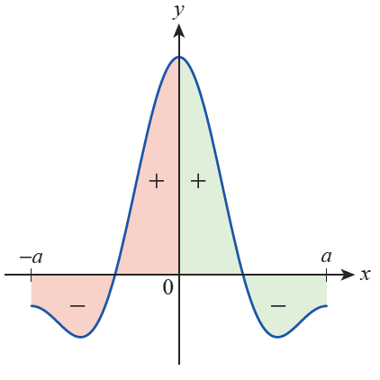
Proof (cont.)
The symmetry with respect to the y‑axis in Figure 1 illustrates why the signed area of an even function over the interval [−a, a] is twice its signed area over the interval [0, a].
Figure 1 Signed Area
of an Even Function

Slide 12
Proof (cont.)

Slide 13
Proof (cont.)
The proof of the second statement is similar, with the difference that in the third step above we will use −f(x) = f(−x) since f is odd.

Slide 14
Example 2: Evaluating the Definite Integral of an Odd Function
Evaluate
Solution
It would be very difficult to find an antiderivative of this integrand, but fortunately we don’t have to. The integrand

Slide 15
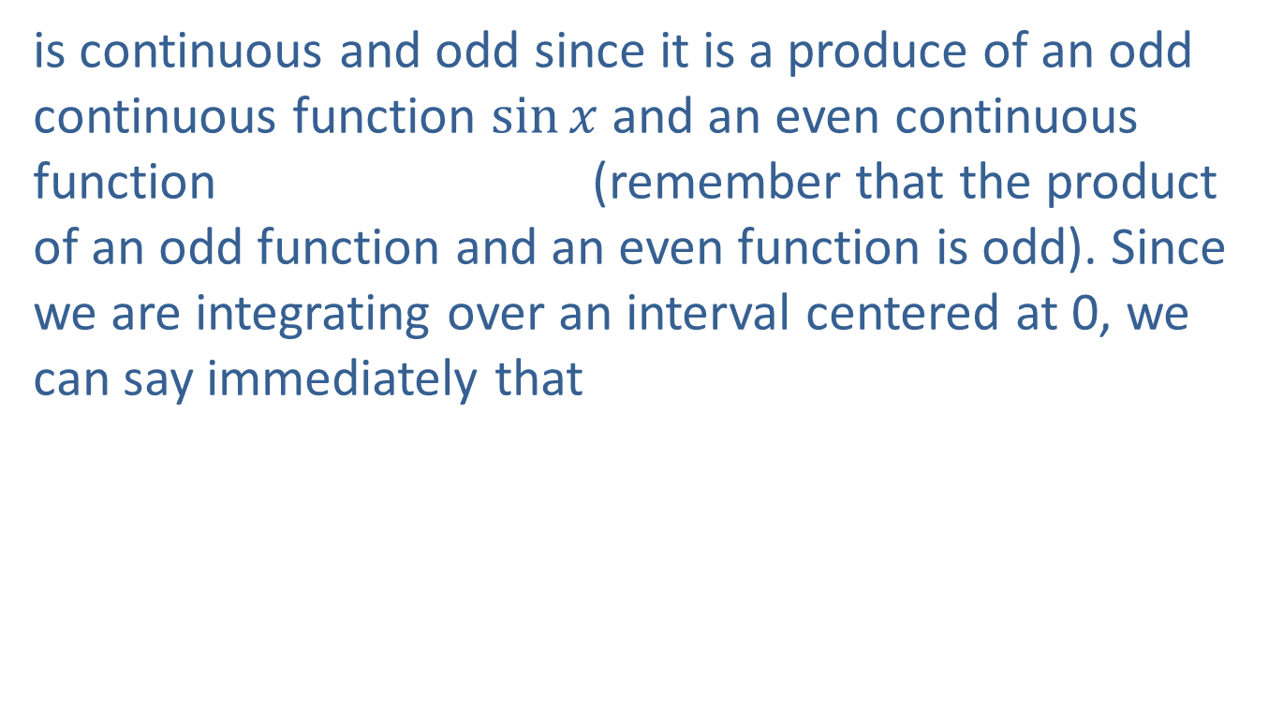
Example 2: Evaluating the Definite Integral of an Odd Function (cont.)
is continuous and odd since it is a produce of an odd continuous function $\sin{x}$ and an even continuous function (remember that the product of an odd function and an even function is odd). Since we are integrating over an interval centered at 0, we can say immediately that

Slide 16
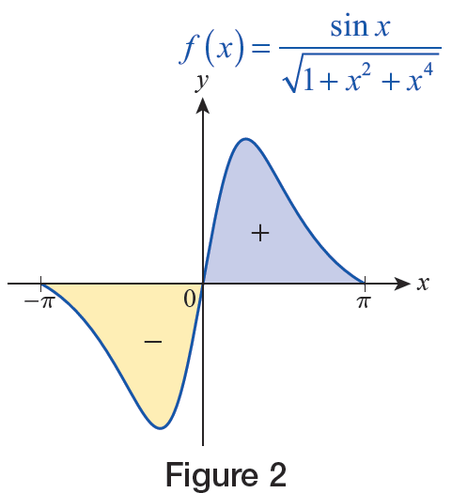
Example 2: Evaluating the Definite Integral of an Odd Function (cont.)
Geometrically, this reflects the fact that the signed areas in Figure 2 cancel each other out.
Figure 2

Slide 17
Area between Curves
Returning to the issue of finding areas bounded by curves, we are now equipped not only with powerful computational techniques, but also with an idea for how to attack such problems. In general, if we know the rate of change of an area A with respect to some variable, say x, over an interval [a, b], then we know that

Slide 18
Area between Curves (cont.)
In hindsight, we now know that this is simply one way of expressing the Fundamental Theorem of Calculus. If we rewrite it slightly, we arrive at a more philosophical statement, as follows.
This version reflects the key idea at the heart of integration—namely, that “adding up” all of the small elements dA over some interval [a, b] results in the total quantity A. We will apply this philosophy in many different contexts through the remainder of this text.

Slide 19
Definition: Area of a Region between Two Curves
Given two continuous functions f and g defined on an interval [a, b], with for all the area of the region bounded between the graphs of f and g
over [a, b] is

Slide 20
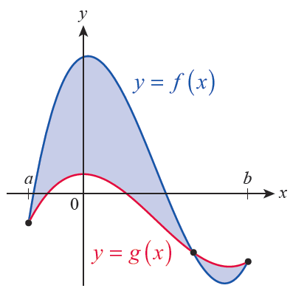
Example 3: Finding the Area Bounded between the Graphs of Two Functions
The graphs of the functions
are shown in Figure 5.
Determine the total area
of the shaded regions.
Figure 5

Slide 21
Example 3: Finding the Area Bounded between the Graphs of Two Functions (cont.)
Solution
Using the graphs depicted in Figure 5, it appears that f is the upper function on the first part of the interval [a, b] and that g is the upper function on the remainder of the interval.

Slide 22
Example 3: Finding the Area Bounded between the Graphs of Two Functions (cont.)
So in order to find the area of the shaded regions, we have to determine not only a and b but also the point inside the interval [a, b] where f and g intersect.
All three are points where so we begin by solving this equation.

Slide 23
Example 3: Finding the Area Bounded between the Graphs of Two Functions (cont.)
Remember that if a polynomial equation has a rational number solution, it must be of the form where p is a factor of the constant term and q is a factor of the
leading coefficient.

Slide 24
Example 3: Finding the Area Bounded between the Graphs of Two Functions (cont.)
Since the leading coefficient is 1 in this case, a rational root of the polynomial x³ − 4x² + x + 6 must be one of the numbers ± {1, 2, 3, 6}. As you can verify by synthetic or long division, −1, 2, and 3 are roots, so we know that a = −1, b = 3, and x = 2 must be the third point where

Slide 25
Example 3: Finding the Area Bounded between the Graphs of Two Functions (cont.)
So, the area of the shaded regions can be found as follows.

Slide 26
Example 4: Finding the Area Bounded by the Graphs of Equations
Find the area of the region bounded by the graphs of
the equations y = 0, 3x − 5y = 12, and
Solution
Two edges of the described region are lines, and the remaining edge is the graph of the function which we can also think of as the upper half of the parabola x = y².

Slide 27
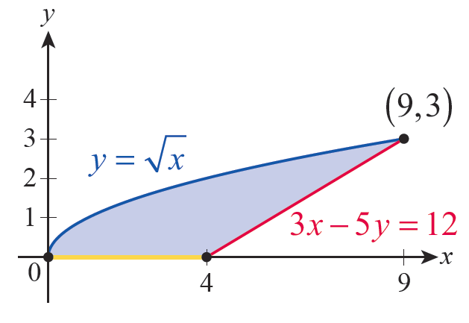
Example 4: Finding the Area Bounded by the Graphs of Equations (cont.)
As always, if it’s possible to sketch a picture of what we are doing, such a sketch is bound to be helpful—in this case, it’s easy to graph the region we’re discussing (see Figure 7).
Figure 7

Slide 28
Example 4: Finding the Area Bounded by the Graphs of Equations (cont.)
Note that we need two integrals if we want to express the area of the region as an integral in x, since the lower function changes at x = 4. On the interval [0, 4], the lower function is g(x) = 0, and on the interval [4, 9] the lower function is The upper function is for the entire interval [0, 9]. So the total area of the described region is

Slide 29
Example 4: Finding the Area Bounded by the Graphs of Equations (cont.)
This is certainly doable, and you are asked to evaluate the above integrals in Exercise 52. But if we think of the region as being composed of horizontal strips, we see that the left edge can be described as a single function of y, and the same is true for the right edge—we don’t have to divide the interval of integration into subintervals. Specifically, the left edge of the region is the function g(y) = y² (corresponding to the equation x = y²) and the right edge is the function (obtained by solving 3x − 5y = 12 for x).

Slide 30
Example 4: Finding the Area Bounded by the Graphs of Equations (cont.)
So, each horizontal differential element of area can be written as
and thus the area is calculated as follows.

