Slide 1
Section 6.2
Finding Volumes Using Cylindrical Shells

Slide 2
The Shell Method
As we have seen, it can be useful to decompose a solid of revolution into a sequence of disks or washers. But we have also seen that, even if a volume integral can be expressed using the disk or washer method, the resulting integral may not be as easy to evaluate as we would like—it’s possible that a different way of thinking about the volume would lead to an equivalent, but easier, integral. Another way of exploiting the radial symmetry of a solid of revolution is to visualize it as being made up of a sequence of cylindrical shells, all with the axis of revolution serving as the common axis.

Slide 3
The Shell Method (cont.)
Remember that the basis for all our volume computations is the statement so if we break down a given solid into a sequence of thin concentric cylinders, dV must represent the volume of each (vanishingly) thin cylindrical shell. As always, we can approximate dV with ΔV, which in this case will be the volume of a cylindrical shell of small, but nonzero, thickness.
We will use the following example to formulate the general shell method.

Slide 4
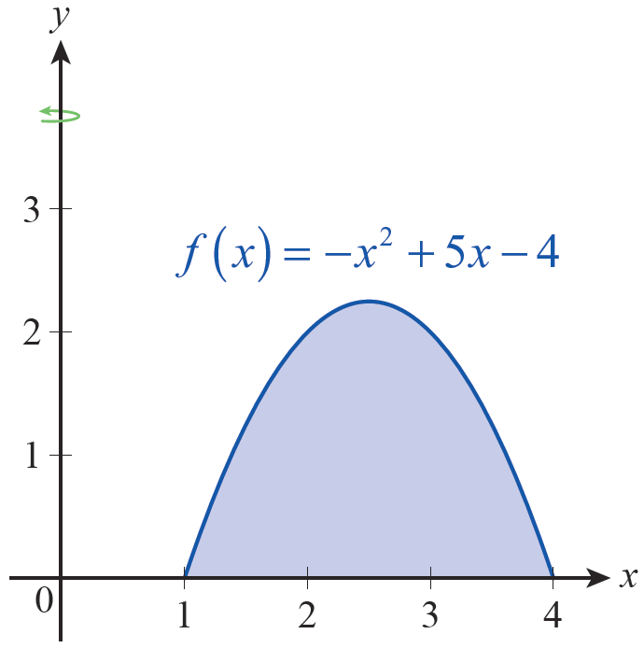
Example 1: Using the Shell Method to Find the Volume of a Solid of Revolution
Find the volume of the solid formed by revolving the region bounded by and the x‑axis about the y‑axis.
Solution
The bounded region described is shown in Figure 1
Figure 1 Plane Region

Slide 5
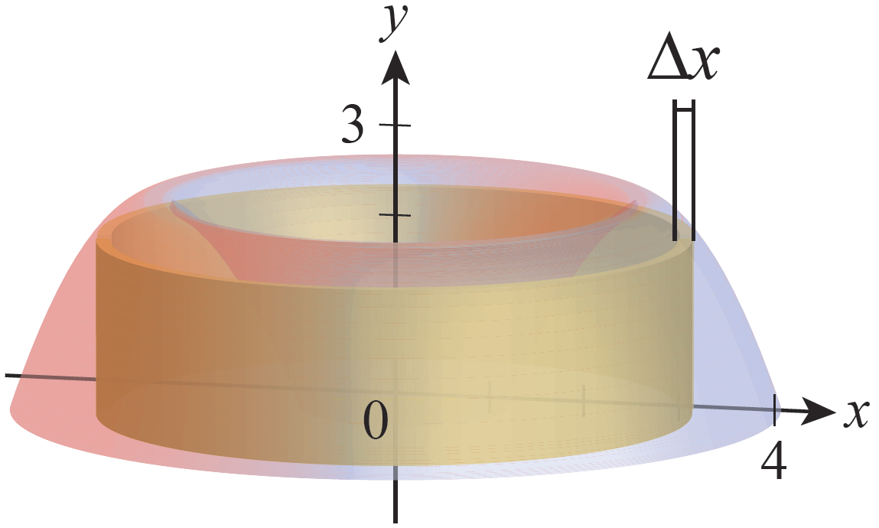
Example 1: Using the Shell Method to Find the Volume of a Solid of Revolution (cont.)
and the solid obtained by revolving it is shown in Figure 2. Also shown in Figure 2 is a representative cylindrical shell of thickness Δx; our method relies on being able to build up the entire solid layer by layer with such shells.
Figure 2 Solid of Revolution

Slide 6
Example 1: Using the Shell Method to Find the Volume of a Solid of Revolution (cont.)
The shell shown has a nonzero thickness, so it’s just a rough approximation of a thinner shell with thickness dx. But for the purpose of sketching what we are doing and setting up our integral, such an approximation is exactly what we need.

Slide 7
Example 1: Using the Shell Method to Find the Volume of a Solid of Revolution (cont.)
If we were to remove the representative shell, slice it from top to bottom vertically along a straight line, and lay it out flat, the cylindrical shell would take the form of a rectangular slab of width height and thickness Δx, where is a sample point in the selected subinterval and the subinterval has width Δx (see Figure 3). The volume ΔV_{i} of the slab is the product of its width, height, and thickness.

Slide 8
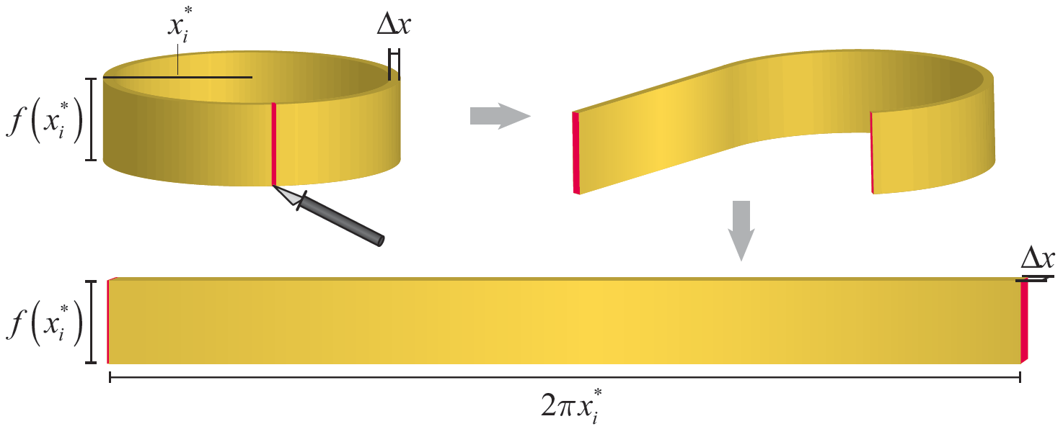
Example 1: Using the Shell Method to Find the Volume of a Solid of Revolution (cont.)
Figure 3

Slide 9
Example 1: Using the Shell Method to Find the Volume of a Solid of Revolution (cont.)
If we now construct an approximation of our solid with a sequence of n cylindrical shells, the volume of the solid is approximately the sum of the volumes of the n shells.
And, as we have by now come to expect, the exact volume of the solid is the limit of the above Riemann sum as n goes to infinity (and consequently as Δx → 0).

Slide 10
Example 1: Using the Shell Method to Find the Volume of a Solid of Revolution (cont.)

Slide 11
Definition: The Shell Method
Assume that the given solid of revolution can be formed by revolving the plane region R around the line x = L, that R is bounded below by the x‑axis and above by the graph of f(x) over the interval [a, b], and that L ≤ a ≤ b. Then, using the shell method, the volume V can be expressed as follows.
See Figure 4.

Slide 12
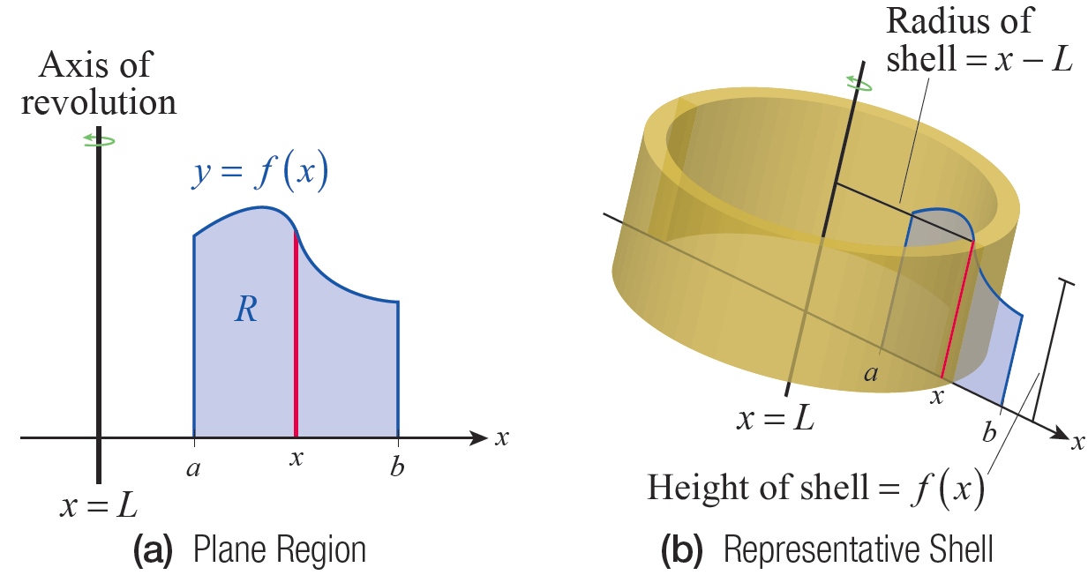
The Shell Method (cont.)
Figure 4

Slide 13
The Shell Method (cont.)
In this formula, the factor is
the circumference of a given shell element and corresponds to the width of the rectangular slab
if the shell is cut and laid out flat. In Example 1, the region R was rotated about the line x = 0, so the radius of each shell was simply the distance x from the origin; more generally, x − L is the radius of the shell that passes through x and has x = L as its axis. The height of that same shell is f(x), and dx corresponds, as usual, to Δx in the Riemann sum (which in this case can be interpreted as the thickness of each shell element).

Slide 14
The Shell Method (cont.)
In general, the solid of revolution under consideration may not have a vertical axis of revolution, the axis of revolution may lie to the right of the interval [a, b] of integration instead of to the left, or the region R may be defined by more than one function. But as long as the radii and heights of the shells can be determined, the formula
still applies and can be adapted as appropriate.

Slide 15
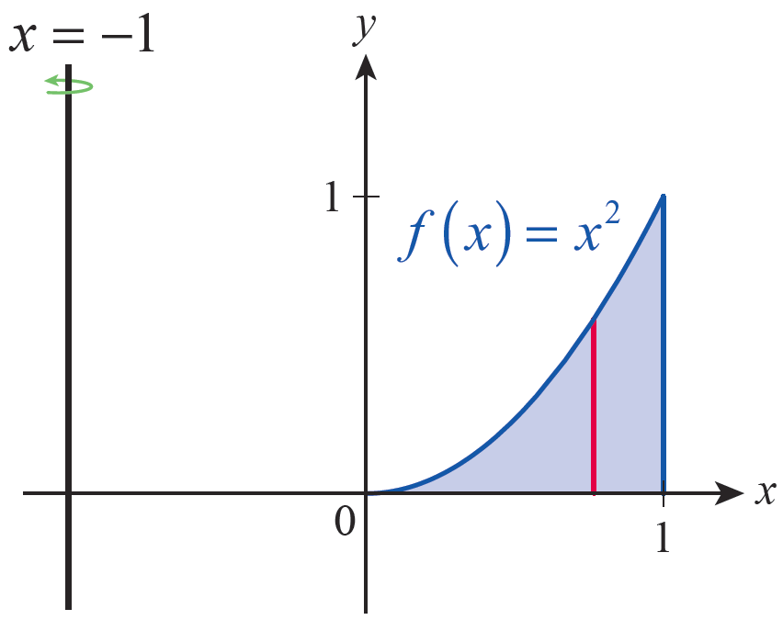
Example 2: Using the Shell Method to Find the
Volume of a Solid of Revolution
Find the volume of the solid formed by revolving the region shown in Figure 5 around the line x = −1.
Figure 5

Slide 16
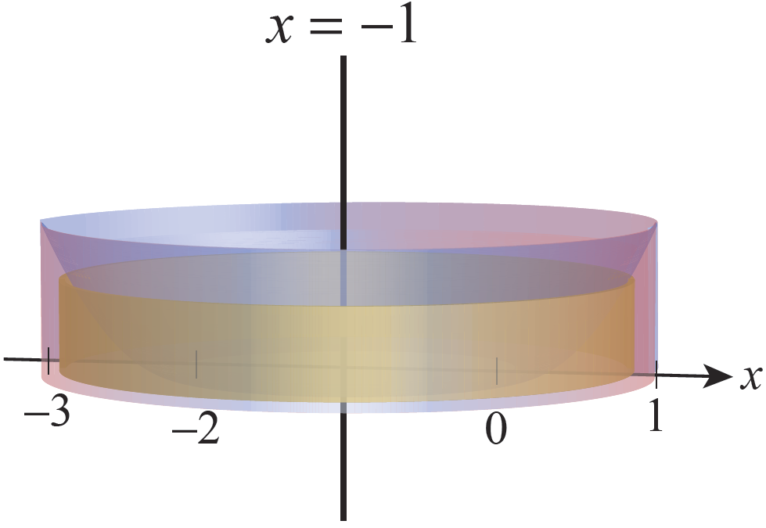
Example 2: Using the Shell Method to Find the
Volume of a Solid of Revolution (cont.)
Solution
The solid formed is shown in Figure 6.
Figure 6

Slide 17
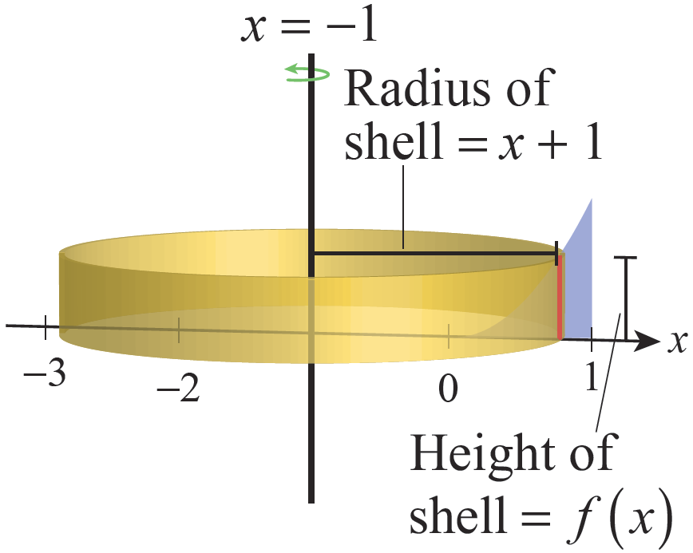
Example 2: Using the Shell Method to Find the
Volume of a Solid of Revolution (cont.)
The height of any given shell element is simply f(x) = x², 0 ≤ x ≤ 1, but the radius of the same shell is x − (−1), or x + 1 (see Figure 7).
Figure 7

Slide 18
Example 2: Using the Shell Method to Find the
Volume of a Solid of Revolution (cont.)
So, the volume of the solid generated is as follows.

Slide 19
Disks, Washers, and Shells Compared
We will conclude this section with some illustrations of volumes in which the disk/washer method and the shell method are compared. In some cases, one method may be clearly preferable to the other; in other cases, both are viable.

Slide 20
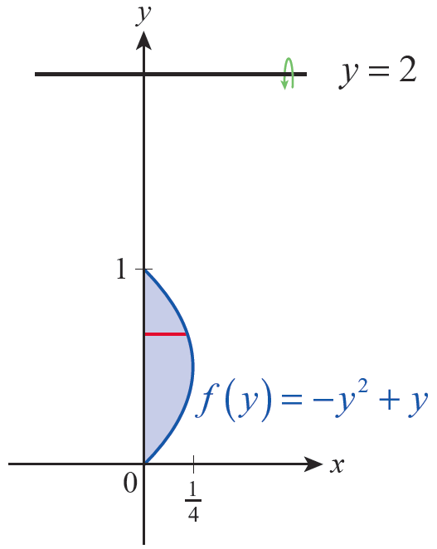
Example 3: Comparing the Shell Method and the Washer Method
Find the volume of the solid formed by revolving the region shown in Figure 8 around the line y = 2.
Solution
The height of each shell in this example is the distance between the y‑axis and the function f(y) = −y² + y, for 0 ≤ y ≤ 1. One such height is shown in red in Figure 8.
Figure 8

Slide 21
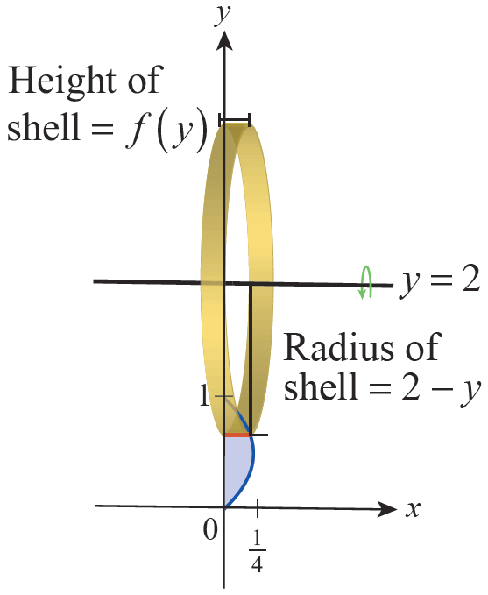
Example 3: Comparing the Shell Method and the Washer Method (cont.)
And since the region is being revolved around the line y = 2, the radius of any given shell is given by 2 − y (see Figure 10). Note that this corresponds to a maximum radius of 2 when y = 0 and a minimum radius of 1 when y = 1.
Figure 10

Slide 22
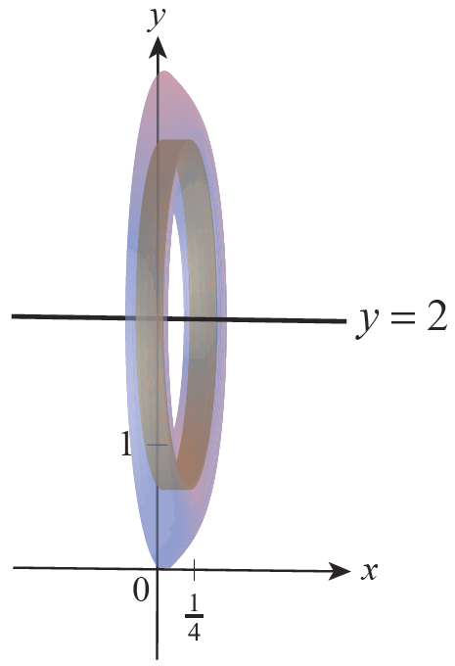
Example 3: Comparing the Shell Method and the Washer Method (cont.)
The volume of the solid generated (shown in Figure 9) can now be found.
Figure 9

Slide 23
Example 3: Comparing the Shell Method and the Washer Method (cont.)

Slide 24
Example 3: Comparing the Shell Method and the Washer Method (cont.)
In this case, the shell method is far preferable to the washer method. If we were to attempt to find the volume using the washer method, we would need to determine R_{in} and R_{out}, the inner and outer radii of the washers. These will be functions of x, for with R_{in} representing the distance from y = 2 to the upper half of the leftward-opening parabola x = −y² + y and R_{out} representing the distance from y = 2 to the lower half.

Slide 25
Example 3: Comparing the Shell Method and the Washer Method (cont.)
and that yields a volume of as
well, albeit with a lot more effort.

Slide 26
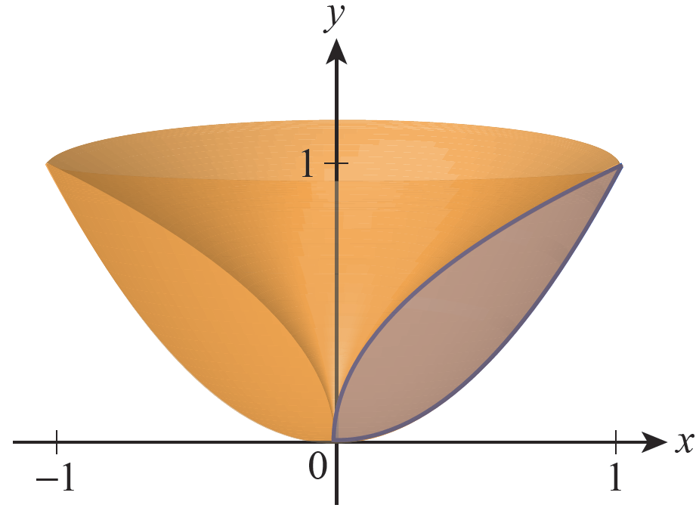
Example 4: Comparing the Shell Method and the Washer Method
Find the volume of the solid formed by revolving the region bounded between and y = x² around the y‑axis.
Solution
The solid formed is shown in Figure 11 and its volume is found in two ways.
Figure 11

Slide 27
Example 4: Comparing the Shell Method and the Washer Method (cont.)
Method 1: The Shell Method
The height of a typical cylindrical shell is given by and x ranges between 0 and 1. The radius of the shell whose height is is simply x, since the region is revolving around the line x = 0 (see Figure 12).

Slide 28
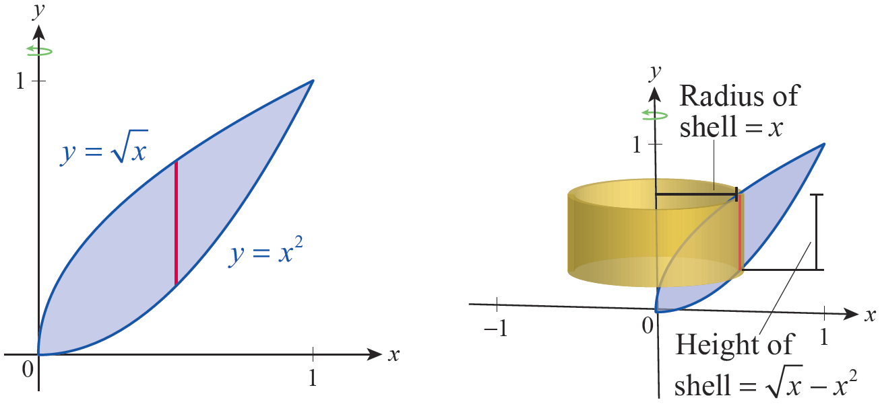
Example 4: Comparing the Shell Method and the Washer Method (cont.)
(a) (b)
Figure 12 The Shell Method

Slide 29
Example 4: Comparing the Shell Method and the Washer Method (cont.)
Hence, the volume of the solid can be found as follows.

Slide 30
Example 4: Comparing the Shell Method and the Washer Method (cont.)
Method 2: The Washer Method
In this example, the washer method applies just as well. The setup differs, of course, as we need to describe the inner and outer radii of a sequence of vertically stacked washers. Using this formulation, the outer radius R_{out} is the function and the inner radius R_{in} is the function y². Note that our integration will be with respect to y over the interval 0 ≤ y ≤ 1; Figure 13 illustrates the region and a typical washer cross‑sectional cut of the region.

Slide 31
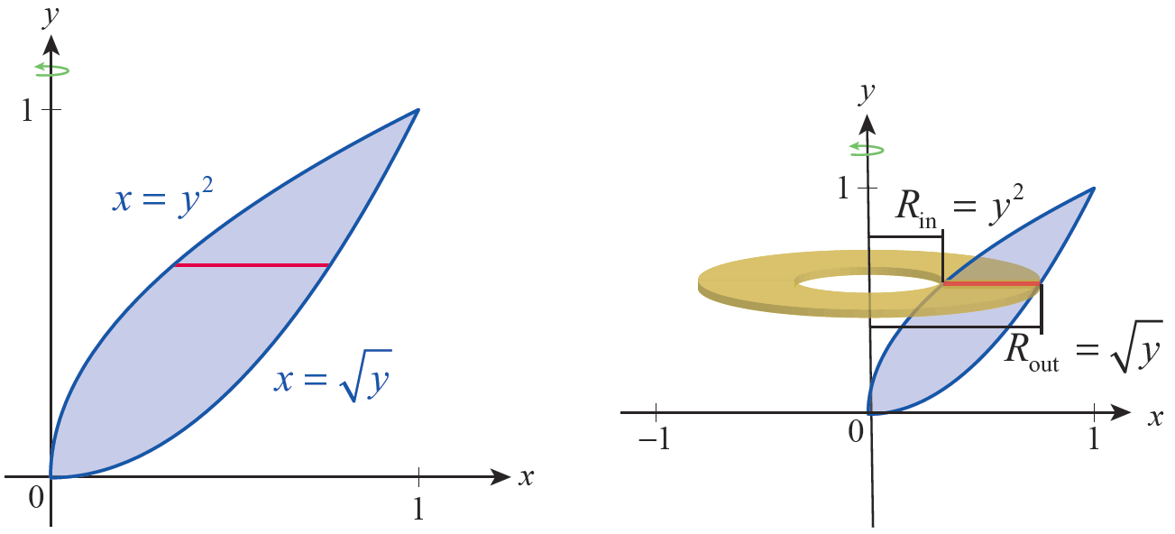
Example 4: Comparing the Shell Method and the Washer Method (cont.)
(a) (b)
Figure 13 The Washer Method

Slide 32
Example 4: Comparing the Shell Method and the Washer Method (cont.)
The volume computation is as follows.

