Slide 1
Section 6.3
Arc Length and Surface Area

Slide 2
Arc Lengths of Graphs of Functions
Formulas for the lengths of certain plane curves, such as the perimeters of circles and regular polygons, are familiar and widely used. And the lengths of some other curves can be found through the application of a few simple principles; for example, the perimeter of any polygon is simply the sum of the lengths of the straight lines that make up its edges. The same is true for any curve (closed or not) consisting of a finite number of line segments. But how should we define and then determine the length of an arbitrary plane curve?

Slide 3
Arc Lengths of Graphs of Functions (cont.)
Adapting the approach that has worked so well in defining area and volume, we will begin by approximating a given curve with a simpler curve whose length we know. Specifically, our approximation will consist of a finite number of lines drawn between points on the curve. In this initial stage, the curves we will work with are graphs of functions and have the form y = f(x) for a ≤ x ≤ b, where f ′ is continuous on [a, b] (such functions are called continuously differentiable and their graphs are said to be smooth curves).

Slide 4
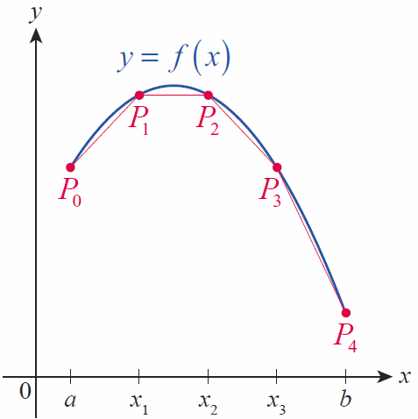
Arc Lengths of Graphs of Functions (cont.)
Figure 1 illustrates a rough approximation, shown in red, of a curve y = f(x). The interval [a, b] has been partitioned into four equal subintervals and straight line segments have been drawn from to for i = 1 to 4 (with, as per our custom, x₀ = a and x₄ = b).
Figure 1

Slide 5
Arc Lengths of Graphs of Functions (cont.)
If we denote the length of the line from to P_{i} by then by the distance formula
where and

Slide 6
Arc Lengths of Graphs of Functions (cont.)
So the total length of our approximating curve is as follows.
The difference is one that we have seen often. By the Mean Value Theorem, we know there is at least one point such that
so,

Slide 7
Arc Lengths of Graphs of Functions (cont.)
Making this substitution, we have the following.

Slide 8
Arc Lengths of Graphs of Functions (cont.)
More generally, we improve our approximation of the curve by dividing [a, b] into n subintervals and letting n grow larger and larger. The resulting sum is familiar to us as a Riemann sum, and in the limit we obtain the following definite integral.
This gives us our extended definition for the lengths of curves defined by continuously differentiable functions.

Slide 9
Definition: Arc Length of a Graph
If f′ is a continuous function on [a, b], then the arc length L of the curve y = f(x), a ≤ x ≤ b, is given by
Alternatively, using the Leibniz notation,

Slide 10
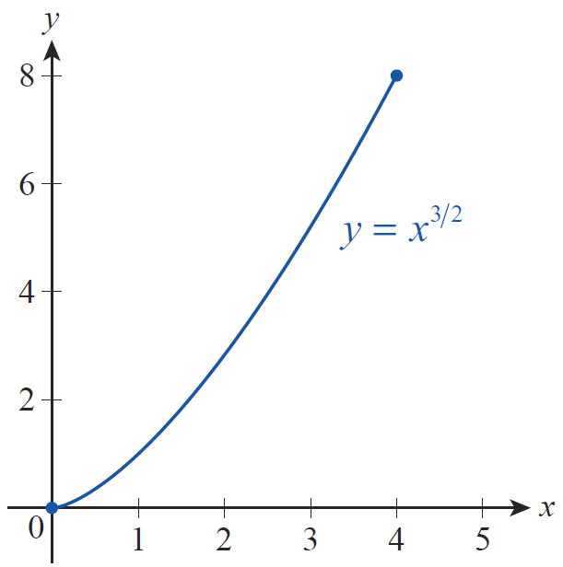
Example 1: Finding the Arc Length of a Curve
Determine the arc length L of the curve defined by over the interval 0 ≤ x ≤ 4.
Solution
Figure 2

Slide 11
Example 1: Finding the Arc Length of a Curve (cont.)
Now the arc length of the curve can be calculated as follows.

Slide 12
Arc Lengths of Graphs of Functions (cont.)
Recall that, given an integrable function f on an interval
[a, b], we can define a new function
which we might describe in words as “the area under f between a and the variable point x.” In similar fashion, given a curve defined by a continuously differentiable function f on the interval [a, b], we can define a new function s(x) as “the arc length of the curve over the interval from a to the variable point x.” Our arc length formula makes this definition precise.

Slide 13
Definition: Arc Length Function
Given a continuously differentiable function f defined on [a, b], we define its arc length function s(x) to be
for any

Slide 14
Arc Lengths of Graphs of Functions (cont.)
By the Fundamental Theorem of Calculus (Part I), we
then note that or, if we think of the curve as the graph of the equation y = f(x),

Slide 15
Arc Lengths of Graphs of Functions (cont.)
This last equation is often written in the form
which is an elegant and symmetric way of stating the relationship between the three differentials dx, dy, and ds.

Slide 16
Arc Lengths of Graphs of Functions (cont.)
From it, we can derive the following arc length formula in which the roles of x and y are reversed.

Slide 17
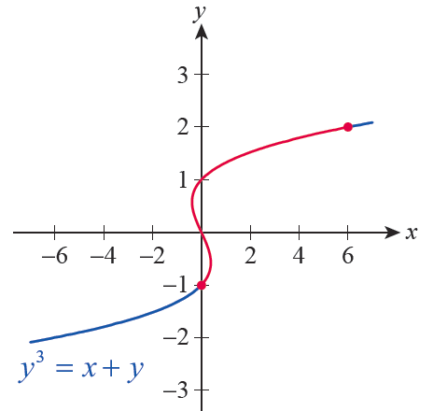
Example 2: Using the Arc Length Formula for a Function of y
Set up an integral defining the arc length of the graph of y³ = x + y between the two points (0, −1) and (6, 2).
Solution
The curve in question can be described as a function of y, but not as a function of x, so we will use the arc length formula that we just derived.
Figure 3

Slide 18
Example 2: Using the Arc Length Formula for a Function of y (cont.)

Slide 19
Example 2: Using the Arc Length Formula for a Function of y (cont.)
Thus the arc length of the graph is as follows.
Note that, more generally, the arc length of the curve between (0, −1) and an arbitrary point (y³ − y, y) is given by

Slide 20
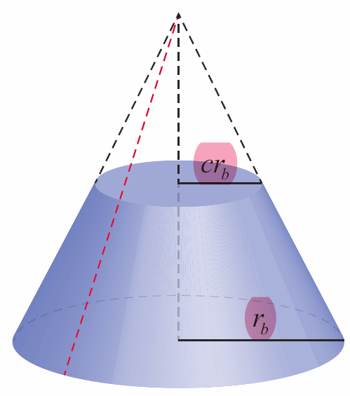
Surface Areas of Solids of Revolution
Now that we have a formula for arc length, we can put it to use immediately in calculating the surface area of a class of three‑dimensional objects. To do so efficiently, we’ll first develop a formula for the surface area A of an object known as a frustum, the formal name for a portion of a cone such as shown in Figure 4.
Figure 4 Frustum of a Cone

Slide 21
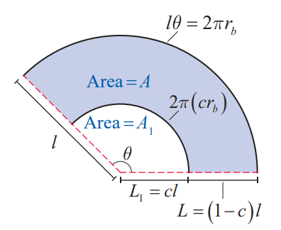
Surface Areas of Solids of Revolution (cont.)
If we were to cut the cone in Figure 4 along the red dashed line and flatten out the surface, the result would be a sector of a circle such as that shown in Figure 5.
Figure 5 Flattened Frustum

Slide 22
Surface Areas of Solids of Revolution (cont.)
Recall that the area of a sector defined by radius l and angle θ is and that the arc length of the portion of the same circle is lθ. This arc length equals the circumference of the base; that is, lθ = 2πr_{b}. So
θ = (2πr_{b})/l and the lateral surface area A_{w} of the whole cone is as follows.

Slide 23
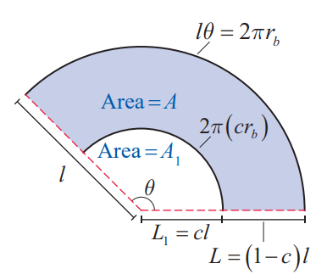
Surface Areas of Solids of Revolution (cont.)
Also notice that our labeling in Figure 5 takes advantage of geometric similarity, where the nonfrustum part of the cone is a “scaled‑down” version of the whole cone by a factor of c (where 0 < c < 1).
Figure 5 Flattened Frustum

Slide 24
Surface Areas of Solids of Revolution (cont.)
If we now let A₁ be the lateral surface area of the nonfrustum part of the cone, we obtain the area A of the frustum by subtraction as follows.
If we define r to be the average of the two radii,
we obtain A = 2πrL.

Slide 25
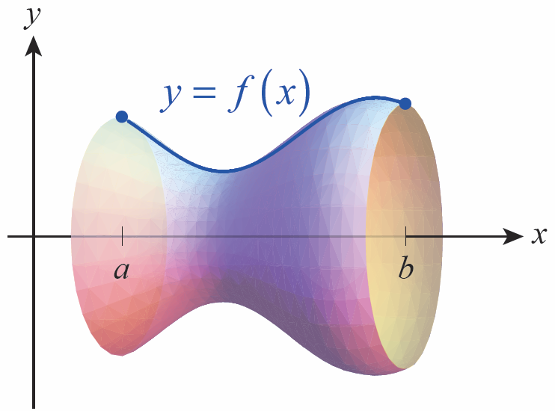
Surface Areas of Solids of Revolution (cont.)
Now consider a solid of revolution such as that shown in Figure 6a, in which the portion of the curve y = f(x) defined over the interval [a, b] has been revolved around the x‑axis.
Figure 6a
Surface Area Decomposition

Slide 26
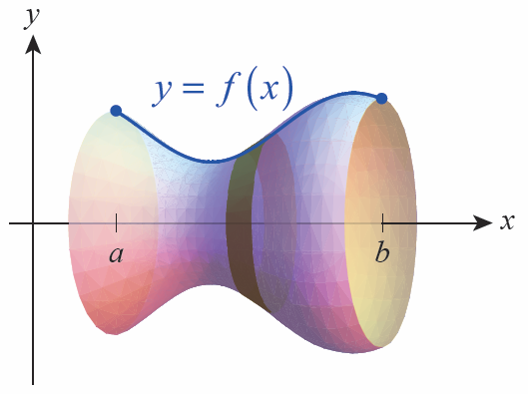
Surface Areas of Solids of Revolution (cont.)
We can decompose the surface by partitioning it into a sequence of bands such as the one shown in Figure 6b. Each band is approximately a frustum, so our formula for the surface area of a frustum is an approximation for the surface area of each one.
Figure 6b
Surface Area Decomposition

Slide 27
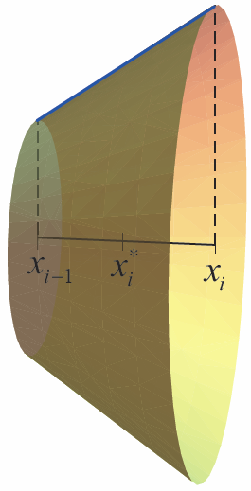
Surface Areas of Solids of Revolution (cont.)
In fact, given a representative band defined by the subinterval as shown in Figure 7, our formula for arc length tells
us that and so the
surface area of the band is approximately
where the average
of the two radii of the frustum.
Figure 7

Slide 28
Surface Areas of Solids of Revolution (cont.)
As we partition the interval [a, b] into finer and finer subintervals, we can use the fact that to replace r with and write

Slide 29
Surface Areas of Solids of Revolution (cont.)
We are now back on familiar ground. The surface area
of the solid of revolution is approximately
and we define the surface area to be the limit of these Riemann sum.

Slide 30
Definition: Surface Area of a Solid of Revolution
Given a continuously differentiable function on the interval a ≤ x ≤ b, the surface area A of the solid formed by revolving the graph y = f(x) around the x‑axis is

Slide 31
Definition: Surface Area of a Solid of Revolution (cont.)
Similarly, if the graph x = g(y) of the nonnegative and continuously differentiable function g is revolved around the y‑axis over the interval c ≤ y ≤ d, the surface area of the resulting solid is

Slide 32
Definition: Surface Area of a Solid of Revolution (cont.)
In both cases, the formula can be summarized as where r denotes the radius from the axis of revolution to the surface and ds denotes the arc length differential.

Slide 33
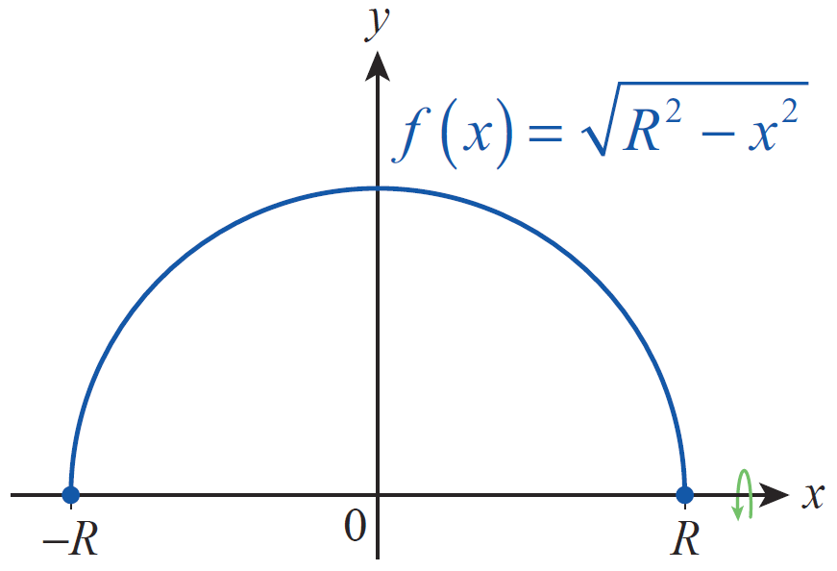
Example 3: Deriving the Formula for Surface Area of a Sphere
Find the formula for the surface area of a sphere of radius R.
Solution
We can generate a sphere of radius R by rotating the continuously differentiable function about the x‑axis over the interval −R ≤ x ≤ R.
Figure 8

Slide 34
Example 3: Deriving the Formula for Surface Area of a Sphere (cont.)

Slide 35
Example 4: Finding the Surface Area of a Solid of Revolution
Determine the surface area of the solid formed by revolving the curve y = x² about the y‑axis over the interval 1 ≤ y ≤ 2.
Solution
We will demonstrate two ways of using the surface area formulas we have developed to arrive at the same answer.

Slide 36
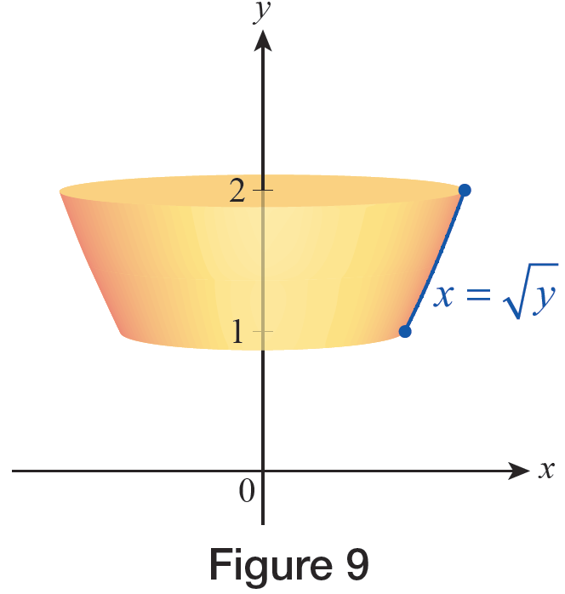
Example 4: Finding the Surface Area of a Solid of Revolution (cont.)
Method 1
One method is to express the given curve in the form
Figure 9

Slide 37
Example 4: Finding the Surface Area of a Solid of Revolution (cont.)
Given this equation, our surface area can be found as follows.

Slide 38
Example 4: Finding the Surface Area of a Solid of Revolution (cont.)

Slide 39
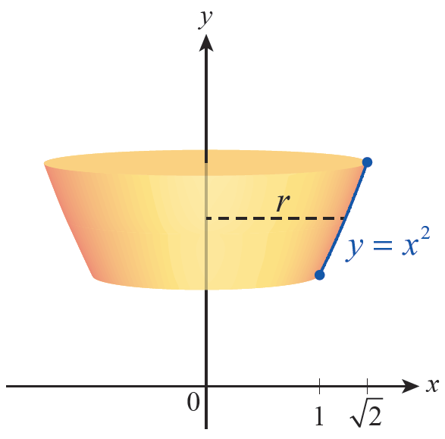
Example 4: Finding the Surface Area of a Solid of Revolution (cont.)
Method 2
Alternatively, we can begin with the general formula and express ds in terms of dx. If we do so, we must be sure to express r in terms of x as well.
Figure 10

Slide 40
Example 4: Finding the Surface Area of a Solid of Revolution (cont.)
Using this approach,
and the radius r, the distance from the axis of revolution to the surface, is simply r = x. Note that the
interval of integration in this case is

Slide 41
Example 4: Finding the Surface Area of a Solid of Revolution (cont.)
Therefore, the surface area is as follows.

