Slide 1
Section 6.4
Moments and Centers of Mass

Slide 2
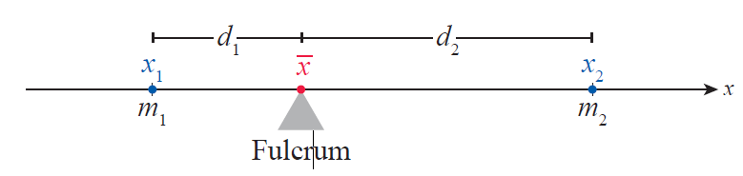
Moments, Mass, and Centers of Mass in One Dimension
We begin with a principle called the Law of the Lever, known intuitively to everyone who has ever played on a seesaw. Suppose two masses m₁ and m₂ are placed on a lever on opposite sides of a fulcrum, as in Figure 1.
Figure 1 Law of the Lever

Slide 3
Moments, Mass, and Centers of Mass in One Dimension (cont.)
Then the lever (or seesaw) will be perfectly balanced if m₁d₁ = m₂d₂; this implies that the heavier mass must be located closer to the fulcrum. We wish to describe the point of balance in terms of the masses and their locations, which we can do as follows.

Slide 4
Moments, Mass, and Centers of Mass in One Dimension (cont.)

Slide 5
Moments, Mass, and Centers of Mass in One Dimension (cont.)
In this context, is the center of mass of the two-body system whose total mass is m₁ + m₂. The numerator of the result above, m₁x₁ + m₂x₂, is called the moment of the system about the origin, and is the sum of the individual moments m₁x₁ and m₂x₂ of the two masses.

Slide 6
Moments, Mass, and Centers of Mass in One Dimension (cont.)
A body’s moment about the origin is a component of the torque that body contributes to a lever whose fulcrum is at x = 0, with bodies to the right of the origin applying positive torque and bodies to the left applying negative torque. As our intuition tells us, moments can be made larger in magnitude either by increasing the mass or by increasing the body’s distance from the origin.

Slide 7
Moments, Mass, and Centers of Mass in One Dimension (cont.)
The second step of the solution above can be rearranged and written in the form
which points the way toward a more general center of mass formula. Suppose n bodies with masses m₁ through m_{n} are located along the x‑axis at locations x₁ through x_{n} , respectively. Then the center of mass of this n‑body system is the point for which

Slide 8
Moments, Mass, and Centers of Mass in One Dimension (cont.)
Each term represents the moment of the i^{th} body about the point , and the center of mass of the system is the point for which the sum of the moments is zero.

Slide 9
Moments, Mass, and Centers of Mass in One Dimension (cont.)
Solving this equation for yields a formula similar to the two‑body case.

Slide 10
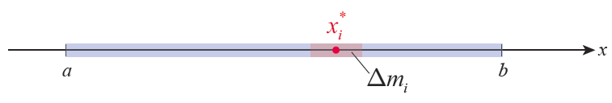
Moments, Mass, and Centers of Mass in One Dimension (cont.)
We now want to extend this formula to the case of a (nearly) one-dimensional rod, which we will model as a segment of the x‑axis as shown in Figure 2.
Figure 2 Center of Mass of a Rod

Slide 11
Moments, Mass, and Centers of Mass in One Dimension (cont.)
We can partition the rod into n small lengths in the usual manner, with
and The rod doesn’t have to be of uniform density, so let denote the density, measured in mass per unit length, of the rod at x—we will assume the density ρ to be a continuous function, a safe assumption for our purposes.

Slide 12
Moments, Mass, and Centers of Mass in One Dimension (cont.)
Then the mass of the i^{th} segment is approximately
(the density at the sample point x_{i}* times the length of the segment) and its moment is approximately We are, in effect, approximating the rod with n point masses, each of whose moments we have just determined.

Slide 13
Moments, Mass, and Centers of Mass in One Dimension (cont.)
And, since the mass of the rod is approximately the sum of the masses of the n segments, we note that the center of mass of the entire rod is

Slide 14
Moments, Mass, and Centers of Mass in One Dimension (cont.)
The numerator and denominator we have just constructed are Riemann sums for, respectively, the continuous functions and over the interval [a, b], so in the limit of finer and finer partitions we arrive at the three formulas that follow.

Slide 15
Definition: Moment about the Origin, Mass, and Center of Mass
Given an object modeled by the interval [a, b] of the x-axis, with continuous density function ρ, its moment about the origin M₀, its mass M, and its center of mass are as follows.
Moment about the origin
Mass
Center of mass

Slide 16
Moments, Mass, and Centers of Mass in One Dimension (cont.)
Note that an easy but important consequence of our work is that, as far as moments about the origin are concerned, a system’s mass can be assumed to be concentrated entirely at the center of mass. This follows from rewriting the last formula above as

Slide 17
Example 1: Comparing the Centers of Mass of Rods with Different Density Functions
Compare the centers of mass of two 1 m long steel rods, the first rod with a constant thickness and a density of 0.5 kg/m and the second one thickening from left to right so that its density x meters from the
Left end is

Slide 18
Example 1: Comparing the Centers of Mass of Rods with Different Density Functions (cont.)
Solution
Although no physical rod can truly be one‑dimensional, we are safe in making that approximation because we only really need to know the location of the center of mass lengthwise (each object is radially symmetric so we already know its center of mass lies on its axis of symmetry). Our intuition tells us that the center of mass of the constant-density rod should be at the halfway point, but we will verify that our formula produces that result.

Slide 19
Example 1: Comparing the Centers of Mass of Rods with Different Density Functions (cont.)
First rod:
ρ(x) = 0.5 kg/m

Slide 20
Example 1: Comparing the Centers of Mass of Rods with Different Density Functions (cont.)
Second rod:

Slide 21
Moments, Mass, and Centers of Mass in Two Dimensions
We can use the same sort of thinking to develop formulas for the moment, mass, and center of mass of a two‑dimensional plate lying in the xy-plane. Suppose n point objects with masses m₁, …, m_{n} lie in the plane at locations respectively. Then the center of mass of the objects will be the intersection of the two lines and where serves as the line of balance of the objects parallel to the y-axis and
is the line of balance parallel to the x-axis.

Slide 22
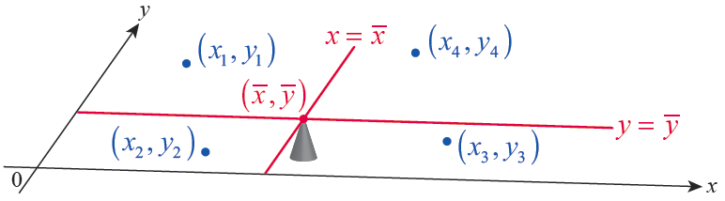
Moments, Mass, and Centers of Mass in Two Dimensions (cont.)
Figure 3 illustrates this fact with four masses.
Each mass has moment m_{i} y_{i} with respect to the x‑axis and moment m_{i} x_{i} with respect to the y‑axis.
Figure 3 Center of Mass in the Plane

Slide 23
Moments, Mass, and Centers of Mass in Two Dimensions (cont.)
So the system of masses has moments M_{x} and M_{y} about, respectively, the x‑ and y‑axes, where
And if we define M to be the sum of the masses, as before, then

Slide 24
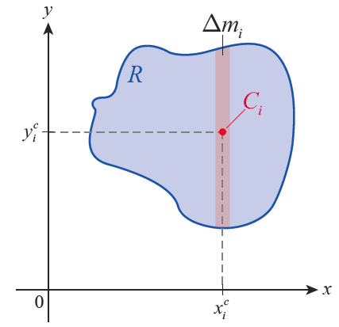
Moments, Mass, and Centers of Mass in Two Dimensions (cont.)
Now suppose we want to find the center of mass of a thin flat plate, which we can picture as a region R of the
xy‑plane (as in Figure 4). We can reduce this problem to one that is more familiar by approximating R with a sequence of either n vertical strips or n horizontal strips (we have chosen vertical strips in Figure 4) and assuming the mass of each strip is concentrated at its center of mass
Figure 4 Center of Mass
of a Plate

Slide 25
Moments, Mass, and Centers of Mass in Two Dimensions (cont.)
If we let Δm_{i} denote the mass of the i^{th} strip, then its moment about the x‑axis is and its moment about the y‑axis is So approximations of the two moments of the region R are
and hence

Slide 26
Moments, Mass, and Centers of Mass in Two Dimensions (cont.)
For now, we assume the plate is made of a material with constant density ρ measured in mass per unit area (we will show how to relax this assumption later). Given ρ, each small element of mass Δm_{i} is equal to ρΔA_{i} , where ΔA_{i} represents the area of the i^{th} strip.

Slide 27
Moments, Mass, and Centers of Mass in Two Dimensions (cont.)
So the approximations can also be written in the form
In the limit, these Riemann sums lead to the following formulas.

Slide 28
Definition: Moments about the Axes, Mass, and Center of Mass of a Plate
Given a thin flat plate of constant density ρ, modeled by a region R in the xy‑plane, its moments M_{x} and M_{y} about the coordinate axes, its mass M, and its center of mass are as follows.
Moment about the x-axis
Moment about the y-axis

Slide 29
Definition: Moments about the Axes, Mass, and Center of Mass of a Plate (cont.)
Mass
Center of mass
The differentials dm and dA represent, respectively, differential elements of mass and area making up region R, with the center of mass of each element.

Slide 30
Moments, Mass, and Centers of Mass in Two Dimensions (cont.)
In applying the above formulas, we will most often decompose region R into either vertical or horizontal strips, with our choice for a given region decided on the basis of whichever is easier. The next example illustrates both choices for the sake of comparison.

Slide 31
Example 2: Finding the Center of Mass of a Plate of Constant Density
Find the center of mass of a plate of constant density defined by the intersection of the two curves y = x and x = y².

Slide 32
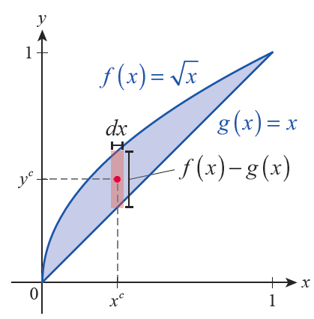
Example 2: Finding the Center of Mass of a Plate of Constant Density (cont.)
Solution
Method 1: Vertical Strips
If we define the upper curve by the function and the lower curve by the function g(x) = x, then the height of a given vertical strip is and its width is the differential dx (see Figure 5).
Figure 5

Slide 33
Example 2: Finding the Center of Mass of a Plate of Constant Density (cont.)
Since the plate has constant density, the vertical position of the center of mass of the strip shown is the average of f(x) and g(x).

Slide 34
Example 2: Finding the Center of Mass of a Plate of Constant Density (cont.)
The coordinates of the center of mass can be found as follows.

Slide 35
Example 2: Finding the Center of Mass of a Plate of Constant Density (cont.)

Slide 36
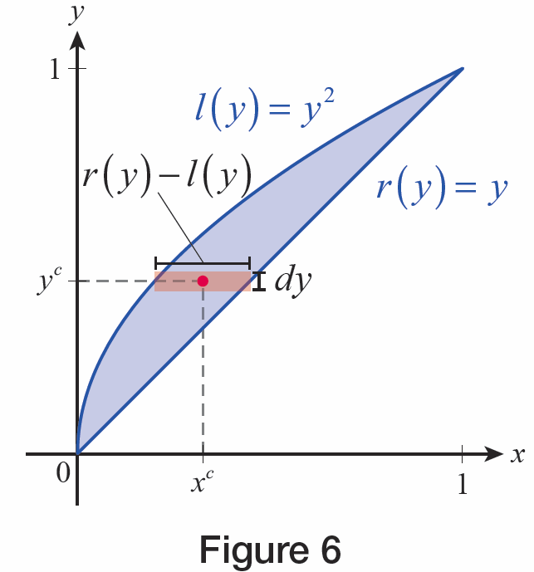
Example 2: Finding the Center of Mass of a Plate of Constant Density (cont.)
Method 2: Horizontal Strips
If we decompose the plate into horizontal strips, the width of each one is the distance between the left curve and the right curve. If we define the right curve as the function r(y) = y and the left curve as l(y) = y², then the width of a given horizontal strip is
r(y) − l(y) = y − y² and its height is the differential dy (see Figure 6).
Figure 6

Slide 37
Example 2: Finding the Center of Mass of a Plate of Constant Density (cont.)
Since the plate has constant density, the horizontal position of the center of mass of the strip shown is the average of r(y) and l(y).

Slide 38
Example 2: Finding the Center of Mass of a Plate of Constant Density (cont.)
The coordinates of the center of mass can be found as follows.

Slide 39
Example 2: Finding the Center of Mass of a Plate of Constant Density (cont.)

Slide 40
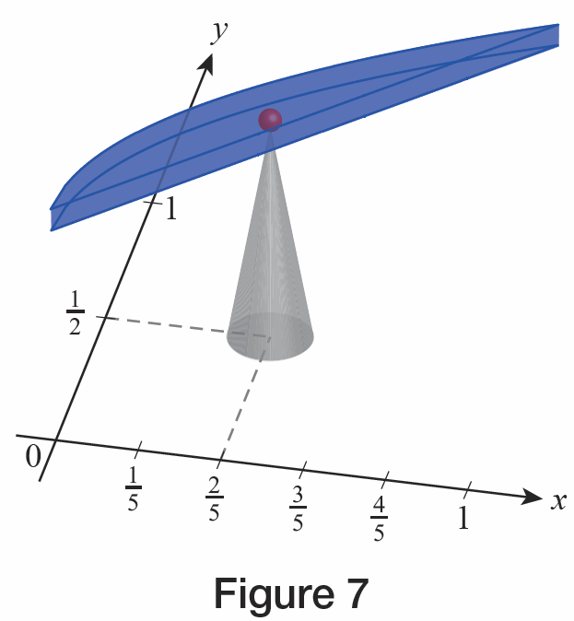
Example 2: Finding the Center of Mass of a Plate of Constant Density (cont.)
Both methods work well in this example, and we have now determined that the center of mass (or balance point, as shown in Figure 7) of the plate is In other problems, you may find that one method results in easier integrals to evaluate than the other.
Figure 7

Slide 41
Example 3: Finding the Center of Mass of a Plate of Varying Density
The plate bounded by the curve y = x² and the x‑axis over the interval [0, 1], has the density at the point (x, y) given by ρ = x³. Determine its center of mass.

Slide 42
Example 3: Finding the Center of Mass of a Plate of Varying Density (cont.)
Solution
Because the density function depends only on x, the center of mass (x^{c}, y^{c}) of a given vertical strip of the region is simply located halfway between the x‑axis and the upper edge (note, though, that the vertical strips increase in density moving from left to right). So if we decompose the plate into vertical strips, we have

Slide 43
Example 3: Finding the Center of Mass of a Plate of Varying Density (cont.)
Therefore,
and

Slide 44
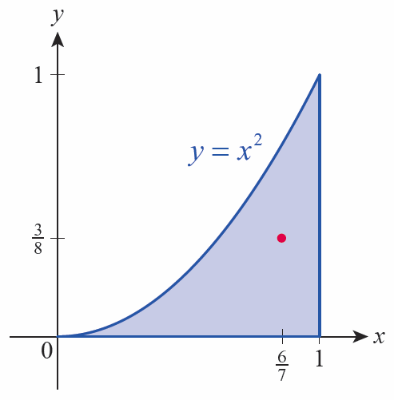
Example 3: Finding the Center of Mass of a Plate of Varying Density (cont.)
The plate’s center of mass is and is shown in Figure 8.
Since the plate increases in density toward the right‑hand side, its center of mass is shifted upward and to the right relative to a similar plate of constant density.
Figure 8

Slide 45
Moments, Mass, and Centers of Mass in Two Dimensions (cont.)
We can also adapt our two‑dimensional formulas to handle a curved one‑dimensional object in the plane. In the following example, note that we treat each differential element of the curve as a small element of mass dm. Note also that the center of mass of the curved object doesn’t actually lie on the object.

Slide 46
Example 4: Finding the Center of Mass of a Curved Wire
A length of wire of constant density is curved into a half circle of radius r. Find its center of mass.
Solution
A small differential segment of arc length ds has length rdθ, where dθ represents a differential element of the angle θ (recall that the arc length formula is s = rθ and hence ds = rdθ). So the small element of arc length has mass dm = ρds = ρrdθ.

Slide 47
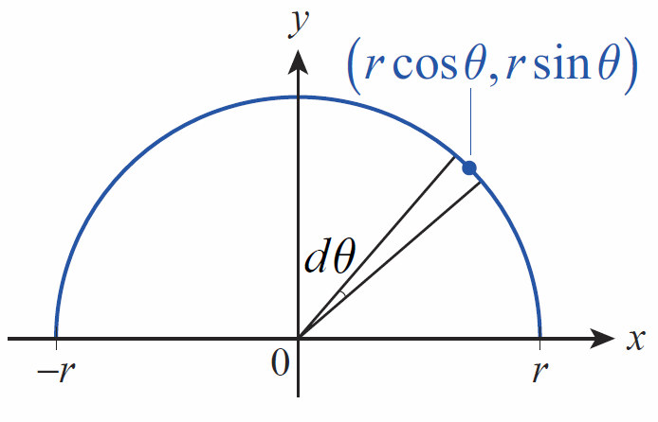
Example 4: Finding the Center of Mass of a Curved Wire (cont.)
The center of mass of the small element is as shown in Figure 9.
Figure 9

Slide 48
Example 4: Finding the Center of Mass of a Curved Wire (cont.)
By symmetry, we know , so we just need to determine

Slide 49
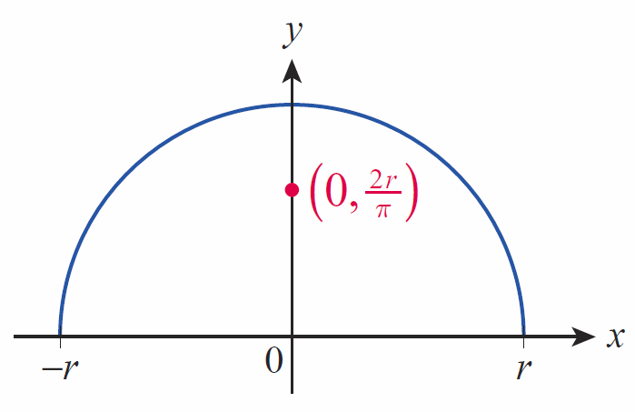
Example 4: Finding the Center of Mass of a Curved Wire (cont.)
So the center of mass of the curved length of wire is the point (see Figure 10).
Figure 10

Slide 50
The Theorems of Pappus
When the density ρ of an object is constant, the center of mass of the object is frequently called its centroid. This is a reflection of the fact that the mass of the object is irrelevant if its density is constant, since ρ cancels in the formulas for and —geometry alone determines the object’s center of mass. One of the last of the great Greek geometers of antiquity, Pappus of Alexandria (ca. 290-ca. 350), formulated two principles that make clever use of the centroid. The two principles allow us to quickly find volumes and surface areas of many objects formed by revolution.

Slide 51
Theorem: Pappus’ Theorem for Volumes
Given a plane region R and a line L in the plane that does not intersect the interior of the region, the volume V of the solid formed by revolving R about L is equal to the area of R times the distance traveled by the centroid of R as it revolves about L. That is, if d is the distance between the centroid of the region R and the line L, then V = 2πd ⋅ Area (R).

Slide 52

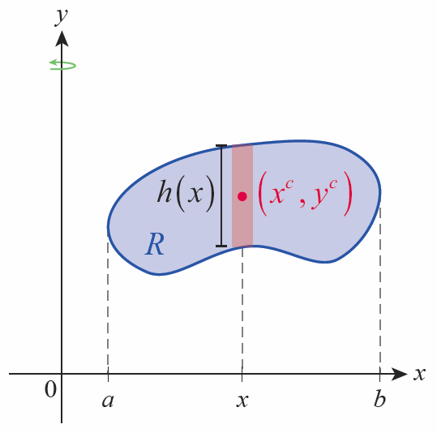
Proof
To simplify the proof, orient R and L so that R lies in the 1st quadrant of the xy‑plane and the axis of revolution L coincides with the y‑axis, as shown in Figure 11.
Figure 11 Revolving R

Slide 53
Proof (cont.)
Then the shell method tells us that
where h(x) denotes the height of the vertical strip of R at x, as illustrated. The distance d between the centroid and L is the x‑coordinate of the centroid.

Slide 54
Proof (cont.)
Multiplying through by Area (R) we obtain
Now we multiply both sides by 2π to lead us to the formula for the volume.

Slide 55
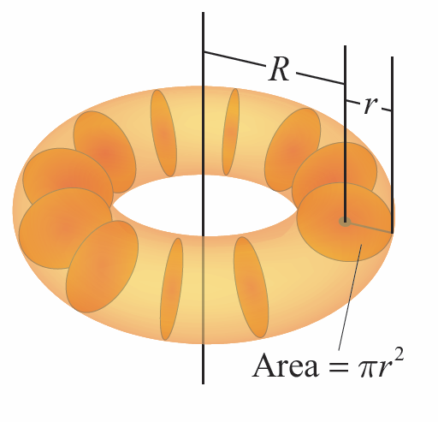
Example 5: Using Pappus' Theorem to Find the Volume of a Torus
The torus shown in Figure 12 is generated by revolving a disk of radius r about a line in the same plane located at a distance of R units from the center of the disk (R ≥ r). Find the volume of the torus.
Figure 12

Slide 56
Example 5: Using Pappus' Theorem to Find the Volume of a Torus (cont.)
Solution
The area of the region being revolved is πr² and its centroid (which coincides with the center of the disk) is R units from the line of revolution. Applying Pappus’ Theorem, the volume V of the torus is as follows.
Notice that Pappus’ Theorem provides a much more convenient way to arrive at this formula than that in Exercise 84 of Section 6.1 (also see Exercise 71 in Section 6.2).

Slide 57
Theorem: Pappus’ Theorem for Surface Areas
Given a smooth plane curve C and a line L in the plane that does not cross C, the area A of the surface formed by revolving C about L is equal to the arc length of C times the distance traveled by the centroid of C as it revolves about L. That is, if d is the distance between the centroid of the curve C and the line L, then A = 2πd ⋅ Length(C).

Slide 58
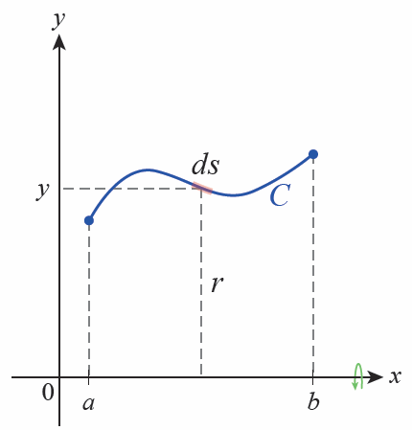
Proof
In the interest of brevity, we will restrict the proof to the case where C and L can be oriented so that L coincides with the x‑axis and C is a differentiable function over the interval [a, b], as depicted in Figure 13.
Figure 13 Revolving C

Slide 59
Proof (cont.)
Then by our surface area formula,
where r = y is the distance between the axis of revolution and the differential element ds.

Slide 60
Proof (cont.)
The distance d between the centroid and L is the coordinate of the centroid.
Multiplying through by 2π ⋅ Length(C) we obtain the formula for the area.

Slide 61
Example 6: Using Pappus' Theorem to Find the Surface Area of a Torus
Find the surface area of the torus shown in Figure 12.
Solution
The length of the curve being revolved is 2πr and its centroid’s distance from the line of revolution is R. By Pappus’ Theorem for surface areas we obtain the following.
Figure 12

Slide 62
Example 7: Using Pappus' Theorem for Surface Areas to Find Center of Mass
Use Pappus’ Theorem for surface areas to find the center of mass of the length of wire in Example 4.
Solution
If we were to revolve the length of wire about the x‑axis, the resulting surface would be a sphere of radius r centered at the origin. We know its surface area is 4πr² and we know the wire has length πr.

Slide 63
Example 7: Using Pappus' Theorem for Surface Areas to Find Center of Mass (cont.)
Using the formula we obtain d as follows.
So the center of mass is located at the point (0,2r/π), matching the answer previously obtained in Example 4.

