Slide 1
Section 6.6
Hyperbolic Functions

Slide 2
Definitions, Derivatives, and Integrals of Hyperbolic Functions
Recall from Section 1.1 that a function f is said to be even if f(−x) = f(x) and odd if f(−x) = −f(x), in each case for all x in the domain. Because these are fairly restrictive properties, it may be surprising to realize that any function defined on an interval centered at the origin can be written as the sum of an even function and an odd function. Further, the decomposition for any such function f is simple to describe, as follows.

Slide 3
Definitions, Derivatives, and Integrals of Hyperbolic Functions (cont.)
Since the function e^{x} is defined on the entire real line (and hence its domain can be said to be centered at 0), we can apply the above decomposition. Upon doing so, we label the even and odd parts as follows.
The notation cosh stands for hyperbolic cosine and sinh stands for hyperbolic sine; they are pronounced, respectively, as “kosh” (rhymes with “gosh”) and “cinch” (rhyming with “pinch”).

Slide 4
Definitions, Derivatives, and Integrals of Hyperbolic Functions (cont.)
By the derivation above, we already know that cosh is an even function and that sinh is odd. But their names come from the fact that, as u takes on different real values, cosh u and sinh u trace out the right‑hand branch of the hyperbola x² − y² = 1 in the same way that cos u and sin u trace out the circle x² + y² = 1. In fact, some early treatises on trigonometry made equal reference to circular trigonometric functions and hyperbolic trigonometric
functions and developed their theory in parallel.
Figures 1 and 2 illustrate how (cos u, sin u) and
(cosh u, sinh u) trace out their respective curves.

Slide 5
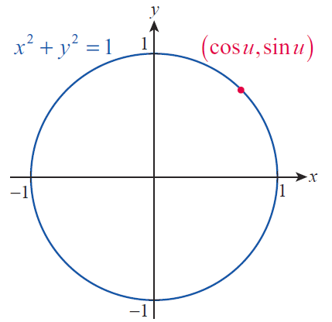
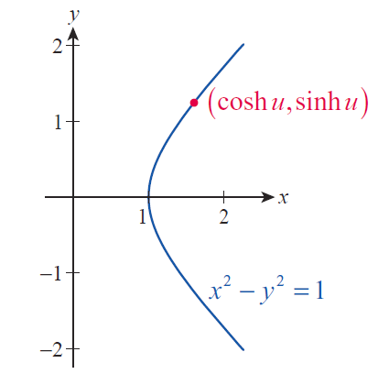
Definitions, Derivatives, and Integrals of Hyperbolic Functions (cont.)
Figure 1
Circular Cosine and
Sine Functions
Figure 2
Hyperbolic Cosine
and Sine Functions

Slide 6
Definitions, Derivatives, and Integrals of Hyperbolic Functions (cont.)
Note that in the case of the circular trigonometric functions, u represents the radian measure between the positive x‑axis and the ray passing through (cos u, sin u). The parameter u doesn’t have any similar physical meaning in the hyperbolic case, aside from the fact that if u is positive, (cosh u, sinh u) is a point on the upper half of the hyperbola, while a negative u corresponds to a point (cosh u, sinh u) on the lower half of the hyperbola. (You should verify that, given the definitions
it is indeed the case that cosh² u − sinh² u = 1.)

Slide 7
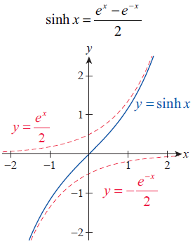
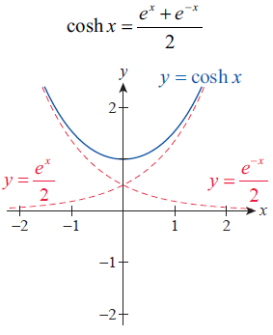
Table 1: Hyperbolic Functions
Hyperbolic Sine | Hyperbolic Cosine

Slide 8
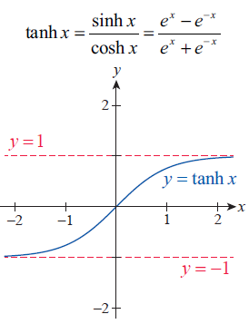
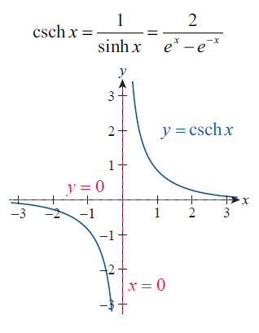
Table 1: Hyperbolic Functions (cont.)
Hyperbolic Tangent | Hyperbolic Cosecant

Slide 9
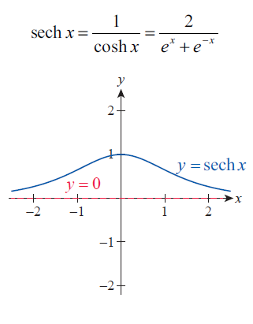
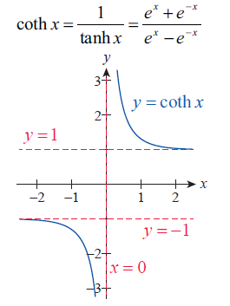
Table 1: Hyperbolic Functions (cont.)
Hyperbolic Secant | Hyperbolic Cotangent

Slide 10
Table 2: Elementary Hyperbolic Identities

Slide 11
Definitions, Derivatives, and Integrals of Hyperbolic Functions (cont.)
You have already verified the first identity—it is the one that gives rise to the name of these functions. We will verify two others.

Slide 12
Definitions, Derivatives, and Integrals of Hyperbolic Functions (cont.)
and

Slide 13
Definitions, Derivatives, and Integrals of Hyperbolic Functions (cont.)
Since the hyperbolic functions are simply algebraic combinations of exponential functions, they are differentiable everywhere they are defined and their derivatives are easily determined.

Slide 14
Example 1: Finding Derivatives of Hyperbolic Functions
Determine the derivatives of the hyperbolic cosine and hyperbolic secant functions.
Solution

Slide 15
Table 3: Derivatives and Integrals of Hyperbolic Functions

Slide 16
Table 3: Derivatives and Integrals of Hyperbolic Functions (cont.)

Slide 17
Example 2: Evaluating Derivatives and Integrals
Involving Hyperbolic Functions
Evaluate each of the following derivatives and integrals.

Slide 18
Example 2: Evaluating Derivatives and Integrals
Involving Hyperbolic Functions (cont.)
Solution

Slide 19
Example 2: Evaluating Derivatives and Integrals
Involving Hyperbolic Functions (cont.)

Slide 20
Example 2: Evaluating Derivatives and Integrals
Involving Hyperbolic Functions (cont.)

Slide 21
Definitions, Derivatives, and Integrals of Hyperbolic Functions (cont.)
Many of the most common uses of hyperbolic functions today reflect the fact that they often arise in the process of solving particular differential equations—that is, equations that relate the derivative(s) of a function to other quantities. While we won’t study techniques of solving differential equations until later, we can verify that hyperbolic functions do indeed serve as the solutions of some representative problems now.

Slide 22
Example 3: Verifying the Hyperbolic Function
Solution of a Differential Equation
A common model for the velocity v of an object of mass m falling under the influence of gravity says that the air resistance encountered by the object is proportional to v². Under this assumption, the velocity t seconds into a fall (starting with v(0) = 0) is described by the differential equation

Slide 23
Example 3: Verifying the Hyperbolic Function
Solution of a Differential Equation (cont.)
where g, as usual, denotes the acceleration due to gravity and k is a constant that depends on the object’s aerodynamic characteristics and the air’s density (the case k = 0 is valid only if there truly is no air resistance, and implies the object falls faster and faster until it hits the ground).

Slide 24
Example 3: Verifying the Hyperbolic Function
Solution of a Differential Equation (cont.)
The function is the solution of this differential equation, which we can verify as follows.
and

Slide 25
Example 3: Verifying the Hyperbolic Function
Solution of a Differential Equation (cont.)
Hence,

Slide 26
Example 3: Verifying the Hyperbolic Function
Solution of a Differential Equation (cont.)
We can apply this model to estimate the terminal, or limiting, velocity that a skydiver might attain before deploying his or her parachute. A typical value for k in this case is 0.005, and if we assume the skydiver’s weight is 160 pounds, then mg = 160 (remember that weight is mass times the acceleration due to gravity).

Slide 27
Example 3: Verifying the Hyperbolic Function
Solution of a Differential Equation (cont.)
Regardless of the values of g, k, and m, we have the following.
Therefore,
for sufficiently large t.

Slide 28
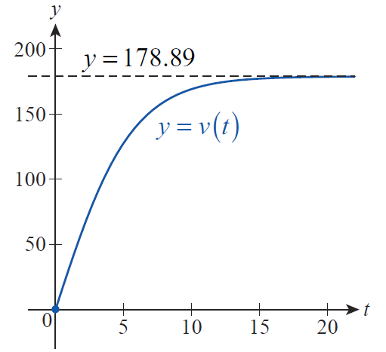
Example 3: Verifying the Hyperbolic Function
Solution of a Differential Equation (cont.)
We can get a good sense of how large qualifies as “sufficiently large” by graphing v with these values for m and k, as shown in Figure 3. Notice that by time
t ≈ 15 seconds, v(t) is close to the terminal velocity of 178.89 ft/s.
Figure 3

Slide 29
Inverse Hyperbolic Functions
The notation we use to denote inverse hyperbolic functions follows the standard practice of denoting the inverse of the function f by f ⁻¹. In each of the following graphs in Table 4, a hyperbolic function (or a restricted portion, if necessary) is shown in blue, with the inverse hyperbolic function in red being its reflection across the line y = x.

Slide 30
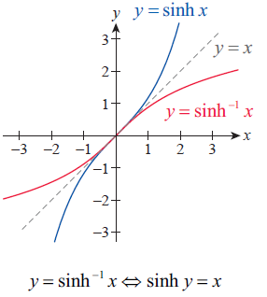
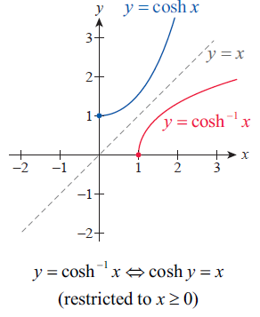
Table 4: Inverse Hyperbolic Functions

Slide 31
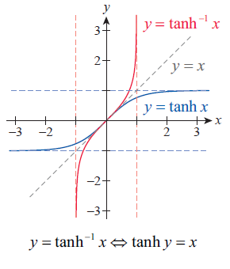
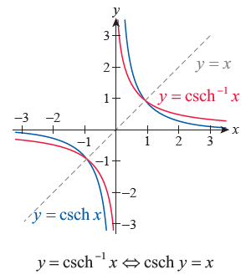
Table 4: Inverse Hyperbolic Functions (cont.)

Slide 32
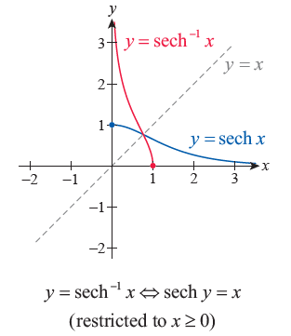
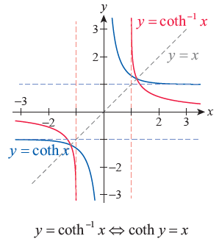
Table 4: Inverse Hyperbolic Functions (cont.)

Slide 33
Inverse Hyperbolic Functions (cont.)
As with the inverse trigonometric functions, there is an alternative way of denoting the inverse hyperbolic functions. Unfortunately, the meaning of the nomenclature has become clouded and somewhat confused over time.

Slide 34
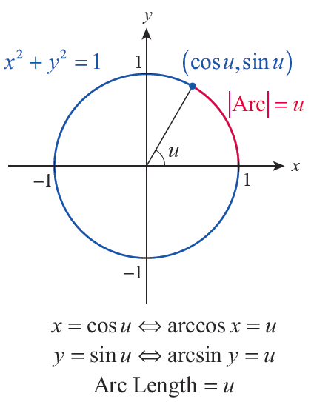
Inverse Hyperbolic Functions (cont.)
The alternatives arcsine and arccosine for sin⁻¹ and cos⁻¹ reflect the fact that, given a point (x, y) on the circle of radius 1 centered at the origin, arccos x and arcsin y both represent the radian angle u shown in Figure 4.
Figure 4 Arc Length

Slide 35
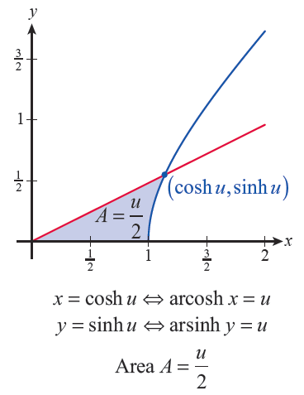
Inverse Hyperbolic Functions (cont.)
In similar fashion, cosh⁻¹ x and sinh⁻¹ y are related to the area of the hyperbolic sector shown in Figure 5—for this reason, arcosh and arsinh (where the ar stands for “area”) are synonyms for cosh⁻¹ and sinh⁻¹. As it turns out, the parameter u is equal to twice the area A.
Figure 5 Hyperbolic Sector

Slide 36
Inverse Hyperbolic Functions (cont.)
Unfortunately, the similarity between ar and arc led, over time, to the frequent use today of arccosh and arcsinh instead of arcosh and arsinh—these names are often seen in software packages and programming languages (Mathematica, for example, contains the built-in commands ArcCosh, ArcSinh, and so on).

Slide 37
Theorem: Derivatives of Inverse Hyperbolic Functions

Slide 38
Theorem: Derivatives of Inverse Hyperbolic Functions (cont.)

Slide 39
Proof
We will prove the first formula, and leave several of the others as exercises. If we let f (x) = sinh x, then by the Derivative Rule for Inverse Functions we have the follows.

Slide 40
Proof (cont.)

Slide 41
Proof (cont.)
(Alternatively, we could begin by defining y = sinh⁻¹ x, rewriting the equation as sinhy = x, and proceeding to implicitly differentiate both sides with respect to x. Solving the result for dy/dx would yield the same answer.)

Slide 42
Inverse Hyperbolic Functions (cont.)
Rephrasing the above derivative rules in terms of integrals expands the types of integrals we can evaluate. Each of the following statements can be verified by differentiating both sides (applying the Chain Rule as needed).

Slide 43
Table 5: Integrals and Inverse Hyperbolic Functions

Slide 44
Table 5: Integrals and Inverse Hyperbolic Functions (cont.)

Slide 45
Example 4: Evaluating Integrals Involving
Inverse Hyperbolic Functions
Evaluate each of the following integrals.
Solution

Slide 46
Example 4: Evaluating Integrals Involving
Inverse Hyperbolic Functions (cont.)
Note that we used tanh⁻¹ x as the antiderivative (as opposed to coth⁻¹ x) because, in the given interval of integration, x² < k² (k = 1). We can rewrite our answer as follows.

