Slide 1
Section 7.4
Trigonometric Substitutions

Slide 2
Three Common Trigonometric Substitutions
The basic idea behind trigonometric substitutions is a change of variables—the translation of an expression from one set of variables into another.
The Substitution Rule, or u-substitution, was our first example of a change of variables, and in fact the Substitution Rule is the basis of trigonometric substitutions.

Slide 3
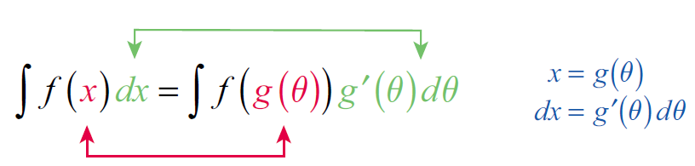
Three Common Trigonometric Substitutions
In general, given an integral we replace x with a differentiable one-to-one function and write the following equations.

Slide 4
Three Common Trigonometric Substitutions (cont.)
Note that this is just the Substitution Rule written in reverse (and with different variables), but the goal is the same—change the integral to one we know how to evaluate. We require g to be one-to-one so that we can, if desired, reverse the change of variables and express the evaluated integral in terms of the original variable.

Slide 5
Three Common Trigonometric Substitutions (cont.)
Three of the most frequently used trigonometry-based substitutions, and the expressions they help to simplify, are described below.
Table 1: Three Trigonometric Substitutions
Expression | Substitution | Useful Identity
 | x = a tanθ with | 1 + tan²θ = sec²θ
 | x = a sinθ with | 1 − sin²θ = cos²θ

Slide 6
Three Common Trigonometric Substitutions (cont.)
Table 1: Three Trigonometric Substitutions (cont.)
Expression | Substitution | Useful Identity
 | x = a secθ with | sec²θ − 1 = tan²θ

Slide 7
Example 1: Using a Trigonometric Substitution to Evaluate an Indefinite Integral
Evaluate
Solution
This integral contains an expression of the form
with a = 5, so we make the substitution x = 5 tanθ. Note that this means dx = 5 sec²θ dθ.

Slide 8
Example 1: Using a Trigonometric Substitution to Evaluate an Indefinite Integral (cont.)
We know that secθ > 0 on the interval
so our integral can be simplified further and then evaluated.
The only remaining step is to reverse the substitution and express our answer in terms of x.

Slide 9
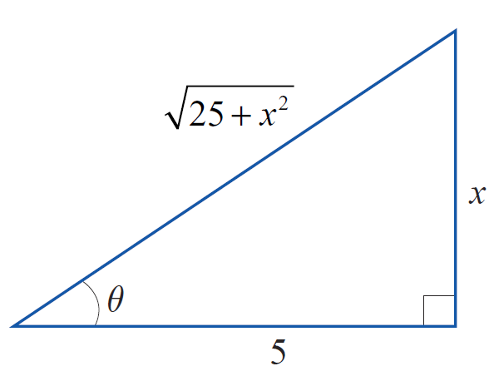
Example 1: Using a Trigonometric Substitution to Evaluate an Indefinite Integral (cont.)
Since x = 5 tanθ , we could do this by replacing each θ with and then simplify the result—no trivial task! Instead, it is far easier to sketch a diagram such as the one in Figure 2 that illustrates the relationship
From the angle θ and the known opposite and adjacent sides, we can determine the
hypotenuse to be and hence
Figure 2 tanθ = x/5

Slide 10
Example 1: Using a Trigonometric Substitution to Evaluate an Indefinite Integral (cont.)
~
~

Slide 11
Example 2: Using a Trigonometric Substitution to Evaluate an Indefinite Integral
Evaluate
Solution
First, we replace x with 2 sinθ, where

Slide 12
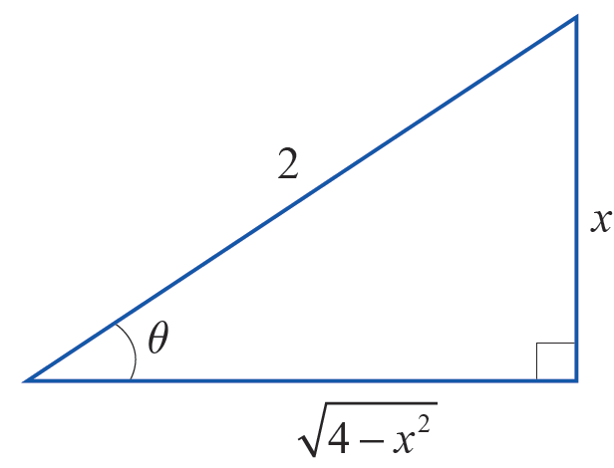
Example 2: Using a Trigonometric Substitution to Evaluate an Indefinite Integral (cont.)
Note that, as in Example 1, we have used the fact that
since cosθ ≥ 0 for θ in the specified interval. We can now proceed to integrate using another trigonometric identity.
We again need to express this answer back in x, and we can do so using Figure 3 and the identity sin 2θ = 2 sinθ cosθ.
Figure 3 sinθ = x/2

Slide 13
Example 2: Using a Trigonometric Substitution to Evaluate an Indefinite Integral (cont.)

Slide 14
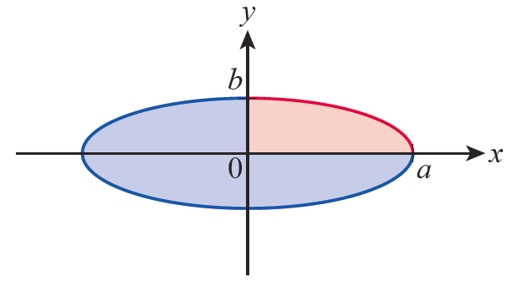
Example 3: Using Integration with Trigonometric Substitution to Derive the Formula for Area of an Ellipse
Find the area of the ellipse defined by the equation
Solution
The graph of the equation is shown in Figure 4; we will find the area of the ellipse by finding the area of the portion in the 1st quadrant and multiplying by 4.
Figure 4 Area of an Ellipse

Slide 15
Example 3: Using Integration with Trigonometric Substitution to Derive the Formula for Area of an Ellipse (cont.)
In order to work with a function of x that we can integrate, we solve the equation for y.
The integral corresponding to the area shaded red in
Figure 4 is which we can evaluate with
the substitution x = a sinθ.

Slide 16
Example 3: Using Integration with Trigonometric Substitution to Derive the Formula for Area of an Ellipse (cont.)

Slide 17
Example 3: Using Integration with Trigonometric Substitution to Derive the Formula for Area of an Ellipse (cont.)
Be sure to note how the change in the limits of integration corresponds geometrically to the area being found; although we determined the limits by solving two equations for θ, the variable of integration and its limits clearly describe a region in the first quadrant. We can now evaluate the integral by using a familiar identity to transform the integrand.

Slide 18
Example 3: Using Integration with Trigonometric Substitution to Derive the Formula for Area of an Ellipse (cont.)
Multiplying by 4 gives us the result that the area of an ellipse with semiaxes of lengths a and b is πab. In particular, if a = b = r, we have confirmed that the area of a circle is π r².

Slide 19
Example 4: Using a Trigonometric Substitution to Evaluate an Indefinite Integral
Find a general formula for under the assumption a > 0.
Solution
This uses the third of the three trigonometric substitutions: we let x = a secθ and specify that
(the reason for this will soon be apparent). So dx = a secθ tanθ dθ.

Slide 20
Example 4: Using a Trigonometric Substitution to Evaluate an Indefinite Integral (cont.)
To express the answer in terms of x, we sketch a right triangle illustrating the relationship between θ, a, and x.

Slide 21
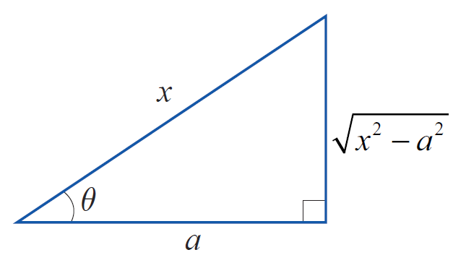
Example 4: Using a Trigonometric Substitution to Evaluate an Indefinite Integral (cont.)
Note that in order for the integrand to be real, and for the diagram in Figure 5 to make sense, we must assume that x ≥ a (so if we were evaluating a definite integral, this would restrict the interval of integration).
Also, the specification that
is consistent with the relationship between the variables, as shown in Figure 5.
Figure 5 secθ = x/a

Slide 22
Example 4: Using a Trigonometric Substitution to Evaluate an Indefinite Integral (cont.)
We can now rewrite our formula.
~
~

Slide 23
Example 5: Using a Hyperbolic Substitution to Evaluate an Indefinite Integral
Use the substitution x = a cosh u to find an alternative
general formula for under the assumption
a > 0.
Solution
Recall that cosh² u − sinh² u = 1.

Slide 24
Example 5: Using a Hyperbolic Substitution to Evaluate an Indefinite Integral (cont.)

Slide 25
Example 6: Using Two Changes of Variable to Evaluate a Definite Integral
Evaluate
Solution
The integrand contains an expression almost, but not quite, of the form We can easily eliminate the coefficient in front of x² by making the change of variable t = 3x. Note the change in the limits of integration that result.

Slide 26

Example 6: Using Two Changes of Variable to Evaluate a Definite Integral (cont.)
Now, proceed with t = 2 tanθ and dt = 2 $\sec^{2}$θ dθ.

Slide 27
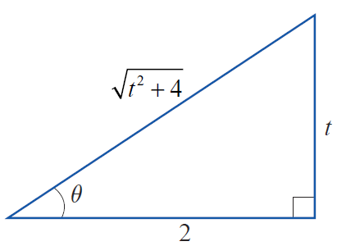
Example 6: Using Two Changes of Variable to Evaluate a Definite Integral (cont.)
Note that our antiderivative is a function of θ, but the limits of integration are still in terms of t. In order to evaluate the expression, we sketch the triangle in Figure 6 and write everything in terms of t.
Figure 6 tanθ = t/2

