Slide 1
Section 7.5
Integration Summary and Integration Using Computer Algebra Systems

Slide 2
Integration Recap and Guidelines
The techniques that we have learned are, in order, as follows.
The Substitution Rule (u-substitution)
Integration by parts
Partial fractions
Simplification through trigonometric identities
Trigonometric substitution
Given an integral, there is no “correct” strategy guaranteed to lead to its evaluation, but there are general guidelines to keep in mind.

Slide 3
Procedure: Integration Guidelines
1. Change the Appearance: Simplify and/or rewrite the integrand to put it into a recognizable form, perhaps matching an integral formula found in a table. This step may involve a change of variables to simplify the appearance of variables. Other options include completing the square of a quadratic expression, splitting apart fractions, rationalizing the denominator or numerator of a fractional expression, and carrying out polynomial long division.

Slide 4
Procedure: Integration Guidelines (cont.)
u-Substitution: Look for a factor of the integrand that is (up to a constant multiple) the derivative of the remainder of the integrand. Such integrals are good candidates for u-substitution (see Sections 5.4 and 5.5).
Integration by Parts: If the integrand is the product of two expressions, one of which is easily integrated, integration by parts may be called for (see Section 7.1).

Slide 5
Procedure: Integration Guidelines (cont.)
Partial Fractions Method: If the integrand is a proper rational function and not easily integrated by inspection, try partial fractions (see Section 7.2).
5. Trigonometric Identities: If the integrand consists of a product of sine and cosine functions or tangent and secant functions (or products that can be rewritten as such), try simplifying it with a trigonometric identity (see Section 7.3).

Slide 6
Procedure: Integration Guidelines (cont.)
6. Trigonometric Substitutions: Integrands containing
factors of the form are candidates for a trigonometric substitution. Remember that a change of variables may be necessary in order to get the integrand into a good form for this technique (see Section 7.4).

Slide 7
Example 1: Using Integration Guidelines to
Evaluate an Indefinite Integral
Evaluate
Solution
If we complete the square in the denominator, we get an integral that is close to one we’ve seen, one that appears in the table of integrals.

Slide 8
Example 1: Using Integration Guidelines to
Evaluate an Indefinite Integral (cont.)
If the denominator of the integrand were simply x² + 1, the integrand would be the derivative of tan⁻¹ x. But we can accomplish this with a change of variables.

Slide 9
Example 2: Using Integration Guidelines to
Evaluate an Indefinite Integral
Evaluate
Solution
The radicals in the numerator and denominator of this integrand make it difficult to work with, and such expressions are good candidates for rationalizing. We can choose to rationalize either part of the fraction, but rationalizing the denominator doesn’t immediately lead to anything that looks better. So we try the numerator.

Slide 10
Example 2: Using Integration Guidelines to
Evaluate an Indefinite Integral (cont.)
The presence of a quadratic polynomial in the denominator and a linear polynomial in the numerator looks promising, but u-substitution with u = 25 − x² doesn’t quite help yet. However, simply splitting the fraction into two pieces results in two integrals we can handle. The first, after dividing the top and bottom by 5, takes on a form we have seen before, and the second can be integrated with the u-substitution just mentioned.

Slide 11
Example 2: Using Integration Guidelines to
Evaluate an Indefinite Integral (cont.)

Slide 12
Example 3: Using Mathematica to Evaluate an Indefinite Integral
Find a general formula for the integral
Solution
We already know the answer, which we used repeatedly while learning the partial fractions method.

Slide 13
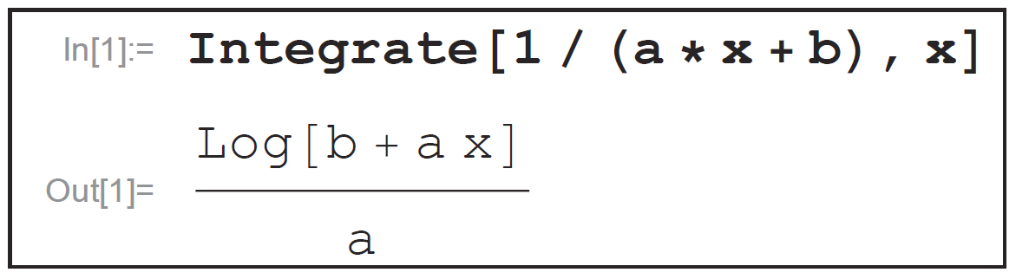
Example 3: Using Mathematica to Evaluate an Indefinite Integral (cont.)
Figure 1 shows the relevant Mathematica command and result. Note that the output cites the Log function (a built-in function); we must be familiar enough with Mathematica to know that Log, without any other qualifier, refers to the natural logarithm.
Figure 1 Basic Indefinite Integration

Slide 14
Example 3: Using Mathematica to Evaluate an Indefinite Integral (cont.)
Also, note that the Mathematica answer does not include absolute value signs—we need to know to include those. Finally, Mathematica, as is typical with CAS, does not include an arbitrary constant C in its answer.

Slide 15
Example 4: Using Mathematica to Evaluate an Indefinite Integral
Use Mathematica to evaluate and compare the result with our solution.

Slide 16
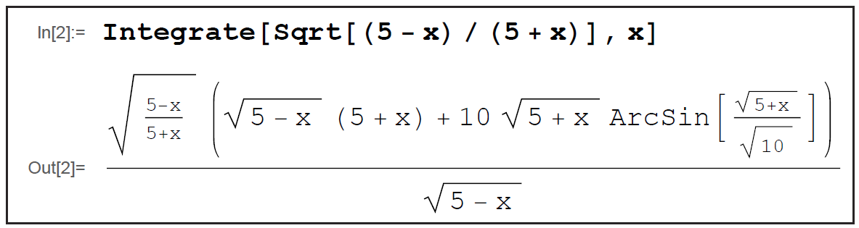
Example 4: Using Mathematica to Evaluate an Indefinite Integral (cont.)
Solution
Figure 2
As Figure 2 illustrates, the form of an answer provided by a CAS may not be aesthetically pleasing. Recall from Example 2 that our solution to this integral is

Slide 17
Example 4: Using Mathematica to Evaluate an Indefinite Integral (cont.)
The two answers are equivalent, a fact that can be verified by differentiating each one and showing that the result (after significant simplification) is the original integrand. Mathematica can also be used to confirm that our work is correct with the differentiation and simplification commands shown in Figure 3 (note that we must still simplify the output slightly to obtain the form of the original integrand).

Slide 18
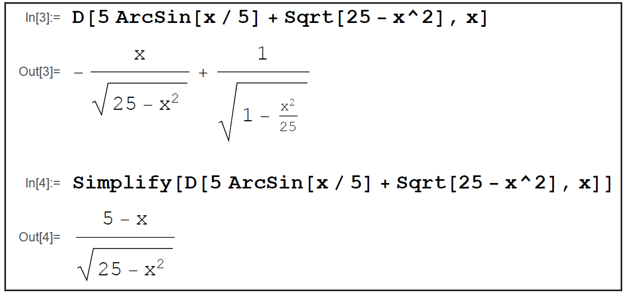
Example 4: Using Mathematica to Evaluate an Indefinite Integral (cont.)
Figure 3 Verifying the Solution of Example 2

Slide 19
Example 5: Using Mathematica to Evaluate a Definite Integral
Evaluate the integral
Solution
We could proceed directly to the definite integral calculation, but how would we know if the numerical result we obtain is reasonable or not? It would be nice to use the power of Mathematica to give us some measure of confidence in the answer.

Slide 20
Example 5: Using Mathematica to Evaluate a Definite Integral (cont.)
One way of doing that is to ask Mathematica to graph the function over an interval that contains the interval of integration and to visually compare the integral with the area between the graph and the t-axis. We are trusting Mathematica to provide a reasonably accurate graph, but at least this gives us a way to cross-check several answers. Figure 4 illustrates how to first define a function f(t) in Mathematica, then plot it over the interval [0, 5].

Slide 21
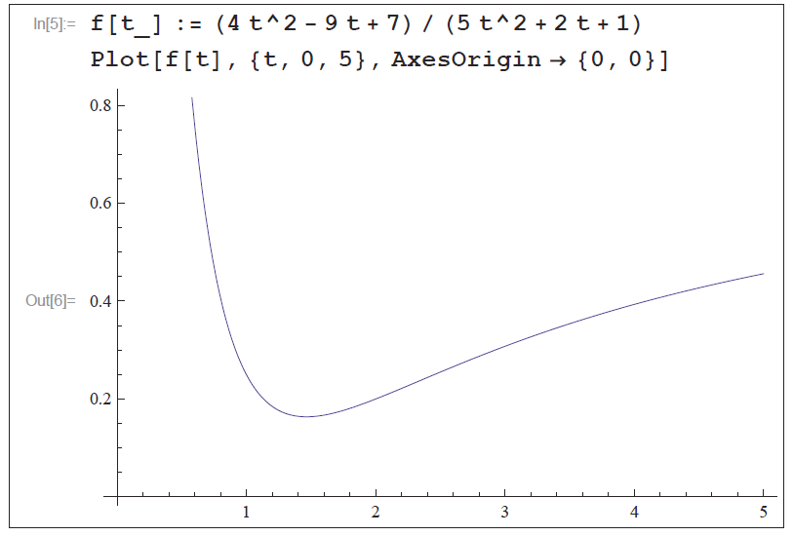
Example 5: Using Mathematica to Evaluate a Definite Integral (cont.)
Figure 4 Plotting a Function

Slide 22
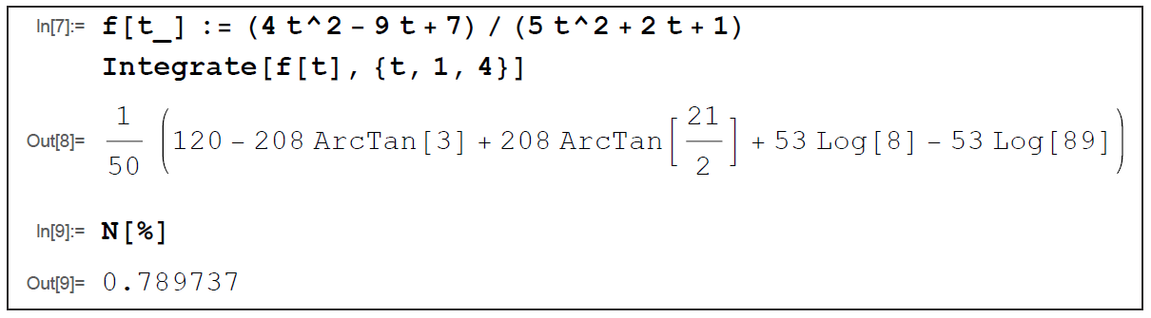
Example 5: Using Mathematica to Evaluate a Definite Integral (cont.)
Then we ask for the definite integral from 1 to 4. The exact answer that results is not especially meaningful, so the last command in Figure 5 asks for the numerical evaluation of the result immediately preceding it.
Figure 5 Evaluating a Definite Integral

Slide 23
Example 5: Using Mathematica to Evaluate a Definite Integral (cont.)
Since the interval of integration has width 3 and the function takes on values between approximately 0.2 and 0.4 over that interval, the numerical answer of 0.789737 throws up no red flags.

Slide 24
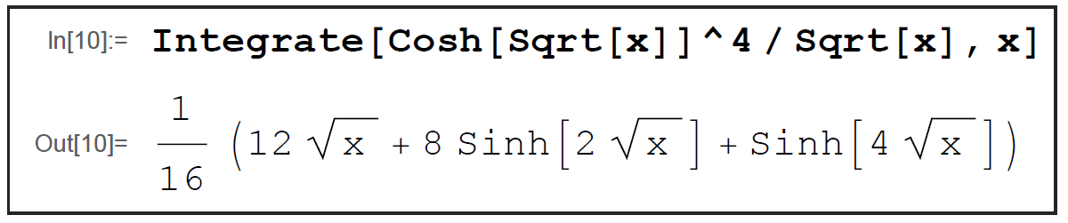
Example 6: Using Mathematica to Evaluate an Indefinite Integral
Evaluate the integral
Solution
Figure 6 Integrating a Hyperbolic Function

Slide 25
Example 6: Using Mathematica to Evaluate an Indefinite Integral (cont.)
The Mathematica command and output are shown in Figure 6. Note how the numerator of the integrand is expressed in Mathematica as Cosh[Sqrt[x]]^4,
which reflects the fact that an alternative way of writing the numerator is

