Slide 1
Section 7.6
Numerical Integration

Slide 2
Numerical Integration
If we can find an antiderivative of a given function f , evaluating is straightforward. But there are two fairly common circumstances under which this is difficult or impossible. The first is when the integrand f has no antiderivative expressible in terms of elementary functions, which are those we work with most frequently: polynomial functions, power functions, exponential and logarithmic functions, trigonometric and inverse trigonometric functions, hyperbolic and inverse hyperbolic functions, and all other functions that can be expressed as a combination of these through the operations of addition, subtraction, multiplication, division, and function composition.

Slide 3
Numerical Integration (cont.)
Such integrals are termed nonelementary, and include the following examples.

Slide 4
Numerical Integration (cont.)
The other circumstance is when the integral in question is defined by a function for which we know only a few values, such as a collection of data points from an experiment or a set of measurements of some physical object. Numerical integration is the name given to a set of techniques that can be used to provide approximations in these cases, along with estimates of the errors in the approximations. We study two such techniques in this section.

Slide 5
The Trapezoidal Rule
When we compute a Riemann sum with either left endpoints or right endpoints of subintervals as the sample points, the result is, of course, an approximation to the integral. The Trapezoidal Rule is a slight modification of such an approach that, in general, improves on the accuracy of the approximation.

Slide 6
The Trapezoidal Rule (cont.)
Recall that a Riemann sum approximation of the integral assuming equal-width subintervals,
has the form
Where and [a, b] is partitioned into n subintervals by the points The i^{th} sample point x_{i}* is equal to x_{i−1} if we choose to let each one be the left subinterval endpoint and is equal to x_{i} if we choose to use right endpoints.

Slide 7
The Trapezoidal Rule (cont.)
Since each Riemann sum is an approximation of the integral, we might hope that the average of the two approximations would be a better approximation. That average is

Slide 8
The Trapezoidal Rule (cont.)

Slide 9
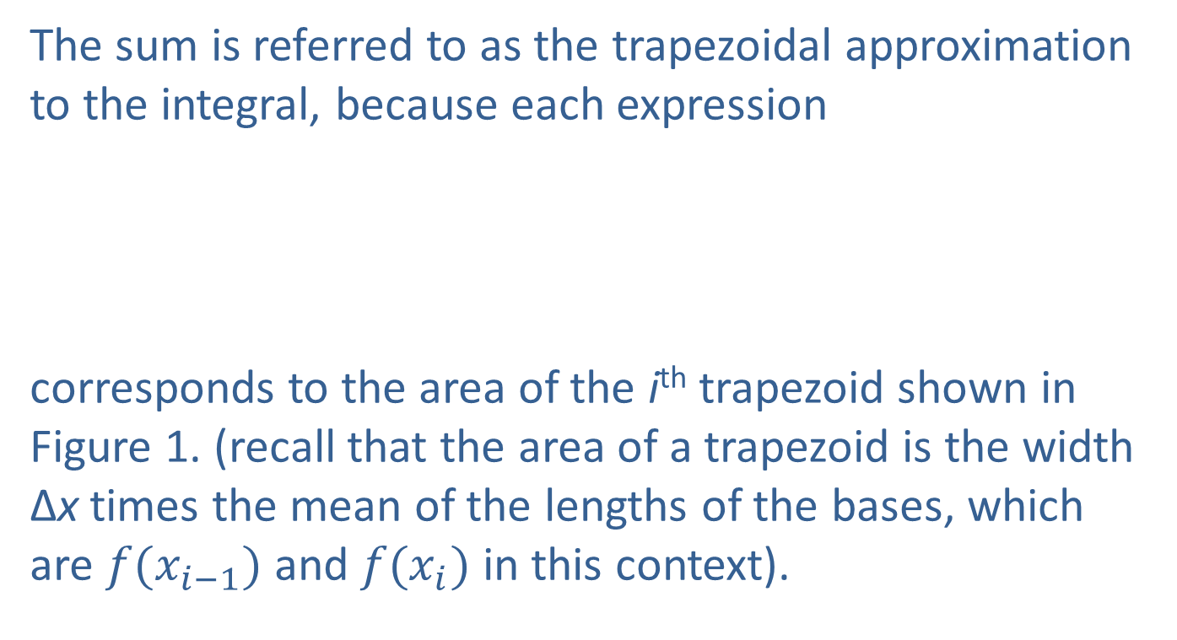
The Trapezoidal Rule (cont.)
The sum is referred to as the trapezoidal approximation to the integral, because each expression
corresponds to the area of the i^{th} trapezoid shown in Figure 1. (recall that the area of a trapezoid is the width Δx times the mean of the lengths of the bases, which are $f(x_{i−1})$ and $f(x_{i})$ in this context).

Slide 10
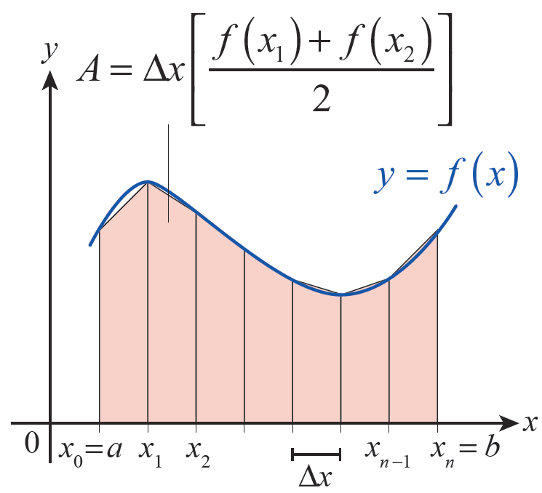
The Trapezoidal Rule (cont.)
Figure 1 Areas of Trapezoids

Slide 11
Definition: Trapezoidal Rule
An approximation of using the Trapezoidal Rule is the sum
where and x_{i} = a + iΔx for i = 0, 1, …, n.

Slide 12
Example 1: Using the Trapezoidal Rule to
Approximate a Definite Integral
Use the Trapezoidal Rule to approximate with n = 10, and compare the result to the exact value of this integral.
Solution
Given that a = 1, b = 2, and n = 10, we note that and for i from 0 to 10.

Slide 13
Example 1: Using the Trapezoidal Rule to
Approximate a Definite Integral (cont.)
Using integration by parts, we know that so
So
approximately 0.1% of the exact value.

Slide 14
Example 2: Using the Trapezoidal Rule to
Estimate Average Humidity
A hygrometer at a weather station records the following percent humidity measurements at the top of the hour from midnight to noon one day.
Use the Trapezoidal Rule to find the approximate average percent humidity over this 12-hour period.
Time | Humidity (%) | Time | Humidity (%)
12 a.m. | 55 | 7 a.m. | 70
1 a.m. | 57 | 8 a.m. | 62
2 a.m. | 60 | 9 a.m. | 50
3 a.m. | 65 | 10 a.m. | 48
4 a.m. | 72 | 11 a.m. | 48
5 a.m. | 75 | 12 p.m. | 47
6 a.m. | 74

Slide 15
Example 2: Using the Trapezoidal Rule to
Estimate Average Humidity (cont.)
Solution
Taking this approach to finding the average humidity, we are implicitly making the assumption that humidity h is a continuous function of time—under this
assumption, we know that exists, even if we
don’t actually know a formula for h. Assumptions like this are reasonable, because physical attributes like humidity don’t typically exhibit abrupt discontinuous changes.

Slide 16
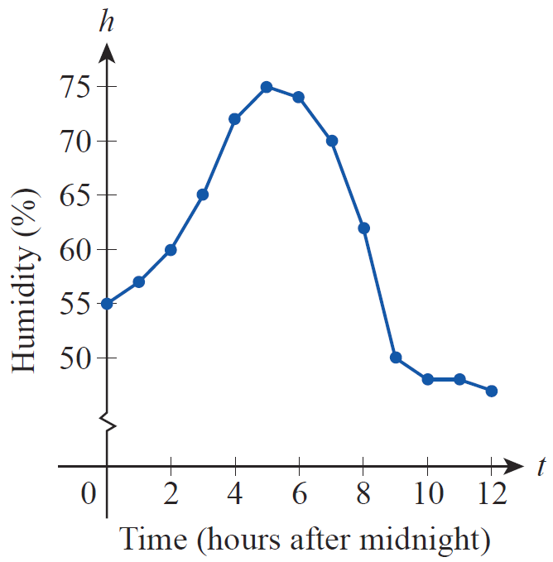
Example 2: Using the Trapezoidal Rule to
Estimate Average Humidity (cont.)
If we simply plot the 13 data points we have and connect them with straight lines, the result is the graph in Figure 2.
Figure 2
Humidity Measurements

Slide 17
Example 2: Using the Trapezoidal Rule to
Estimate Average Humidity (cont.)
Note that the data indicate sharper changes in humidity over some one-hour periods than others. Using our formula for the average value of a function over an interval we have
Since we don’t have a formula for h, we use the Trapezoidal Rule with Δt = 1 hour.

Slide 18
Example 2: Using the Trapezoidal Rule to
Estimate Average Humidity (cont.)
Compare this to the less sophisticated approach of simply taking the average of the 13 data points, which gives us an answer of approximately 60.2% humidity. The difference comes from the fact that a simple average does not take into account differing rates of change of the humidity over the interval.

Slide 19
Theorem: Error Estimate for the Trapezoidal Rule
If f ″ is continuous on [a, b] and M is an upper bound for | f ″ (x)|, then the error E_{T} between the exact value of
and the Trapezoidal Rule approximation T_{n}
satisfies
where n is the number of subintervals in the partition.

Slide 20
Example 3: Using the Error Estimate for the Trapezoidal Rule
Determine a number of subintervals that will guarantee
an approximation of to within an error of
0.01 using the Trapezoidal Rule.
Solution
Although an antiderivative of cannot be expressed in terms of elementary functions, its second derivative is easy enough to determine:

Slide 21
Example 3: Using the Error Estimate for the Trapezoidal Rule (cont.)
Since sine and cosine are always bounded by 1 in magnitude, we have the following inequalities.

Slide 22
Example 3: Using the Error Estimate for the Trapezoidal Rule (cont.)
Any upper bound M of |f″ (x)| on the interval will work, and M = 48 is a convenient number larger than 2 + 4π ². We can now ensure |E_{T}|< 0.01 by solving the inequality
for n.

Slide 23
Example 3: Using the Error Estimate for the Trapezoidal Rule (cont.)
So n = 112 subintervals will provide an approximation of the integral safely within an error of 0.01.

Slide 24
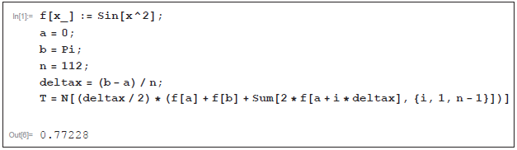

Technology Note: Calculating a Trapezoidal Rule Approximation
Referring back to Example 3, a computer algebra system like Mathematica can be used to calculate the approximation $T_{112}$ = 0.77228 with commands such as the ones shown in Figure 3.
Figure 3a Using the Trapezoidal Rule in Mathematica

Slide 25
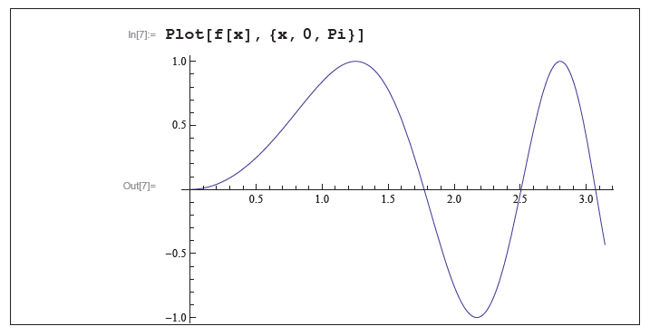
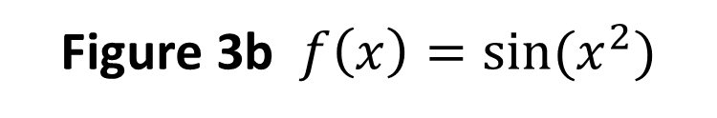
Technology Note: Calculating a Trapezoidal Rule Approximation (cont.)
Figure 3b $f\left(x\right)=sin⁡(x^{2})$

Slide 26
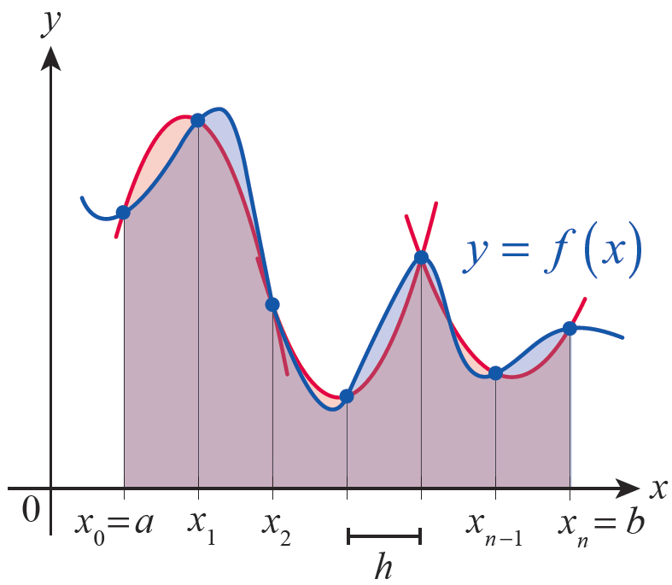
Simpson’s Rule
There are several variations of Simpson’s Rule, but the simplest assumes that the number of subintervals n is even; the resulting formula is then based on parabolas fitted through three points on the graph of the integrand f for each successive pair of subintervals. A representative illustration is shown in Figure 4.
Figure 4
Simpson’s Rule

Slide 27
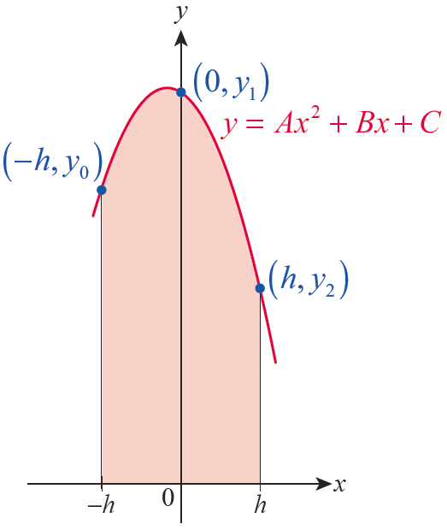
Simpson’s Rule (cont.)
To construct the formula, let y_{i} = f(x_{i}) for each i = 0, …, n and let For ease of calculation, we shift the graph of f left or right so that the first two subintervals [x₀, x₁] and [x₁, x₂] are located on either side of 0 as shown in Figure 5; doing so doesn’t affect the area between the graph of f and the x-axis over the interval [x₀, x₂]
Figure 5
Fitting a Parabola

Slide 28
Simpson’s Rule (cont.)
After shifting, note that x₀ = −h, x₁ = 0, and x₂ = h. So the parabola we are looking for must pass through the three points (−h, y₀), (0, y₁) and (h, y₂). If we assume the parabola is the graph of the quadratic y = Ax² + Bx + C, then we know the following equations.
y₀ = Ah² − Bh + C
y₁ = C,
and y₂ = Ah² + Bh + C

Slide 29
Simpson’s Rule (cont.)
The integral of the quadratic over the interval [−h, h] is
which can be expressed in terms of y₀, y₁, and y₂ by noting that y₀ + y₂ = 2Ah² + 2C and 4y₁ = 4C. So I = (h/3)(y₀ + 4y₁ + y₂).

Slide 30
Simpson’s Rule (cont.)
Similarly, shifting the graph of f so that the subintervals [x₂, x₃] and [x₃, x₄] are located on either side of 0 (so that x₃ = 0), the integral of the parabola fitted through (−h, y₂), (0, y₃), and (h, y₄) is equal to (h/3)(y₂ + 4y₃ + y₄).
Our approximation to is the sum of the
integrals of the parabolas.

Slide 31
Simpson’s Rule (cont.)
Rephrasing the formula back in terms of the integrand function f gives us Simpson’s Rule.

Slide 32
Theorem: Simpson’s Rule
An approximation of using Simpson’s Rule is the sum
where n is even, and x_{i} = a + iΔx for
i = 0,1, …, n. (Note the pattern of the coefficients:
1, 4, 2, 4, 2, …, 2, 4, 1.)

Slide 33
Example 4: Using Simpson’s Rule to Approximate a Definite Integral
Use Simpson’s Rule to approximate with n = 10.
Solution
As in Example 1, a = 1, b = 2, and x_{i} = I + i/10 for i from 0 to 10.
This is a considerable improvement over the Trapezoidal Rule approximation, and only differs in the 6th decimal place from the exact answer.

Slide 34
Simpson’s Rule (cont.)
As with the Trapezoidal Rule, a result from advanced calculus says that, under the assumption that f⁽⁴⁾ is continuous on [a, b], the exact integral and a Simpson’s Rule approximation of it are related by
where c is some point in [a, b]. So if we let
we know the following about the
accuracy of a Simpson’s Rule approximation.

Slide 35
Theorem: Error Estimate for Simpson’s Rule
If f⁽⁴⁾ is continuous on [a, b] and M is an upper bound for |f ⁽⁴⁾ (x)|, then the error E_{S} between the exact value
of and the Simpson’s Rule approximation S_{n}
satisfies
where n is the number of subintervals in the partition.

Slide 36
Example 5: Using Simpson’s Rule and Estimating the Error in the Approximation
Use Simpson’s Rule with n = 4 to approximate the
nonelementary integral and estimate the error
in the approximation.
Solution
With a = 0, b = 1, and n = 4, we have and x_{i} = i/4 for i = 0, …, 4.

Slide 37
Example 5: Using Simpson’s Rule and Estimating the Error in the Approximation (cont.)
The fourth derivative of is and for we know
so the error estimate E_{S} satisfies

Slide 38
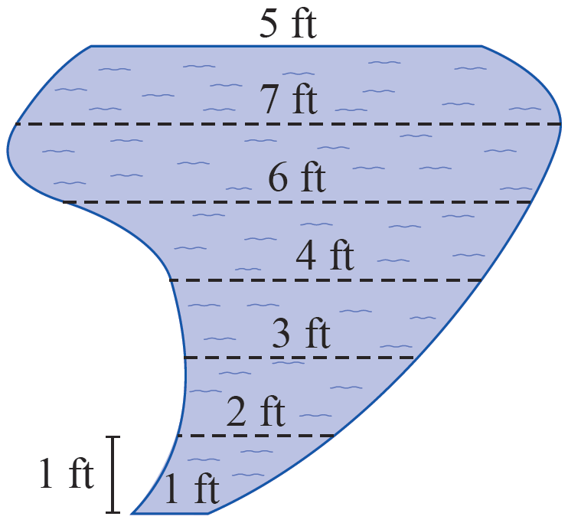
Example 6: Using Simpson’s Rule to Estimate Volume of a Pond
A landscape designer has planned a free-form garden pond with the shape shown in Figure 6 and needs to estimate its volume in cubic feet. The pond will have a uniform depth of 2 feet. At 1-foot intervals, the distances across the pond are to be as indicated in the diagram. Use Simpson’s Rule to estimate the volume of the pond.
Figure 6
Garden Pond

Slide 39
Example 6: Using Simpson’s Rule to Estimate Volume of a Pond (cont.)
Solution
To use Simpson’s Rule, we let Δx = 1 and take the distances as shown to be the values of a function. Note that n = 6.
So the estimated volume of the pond is this surface area times the depth, or

