Slide 1
Section 7.7
Improper Integrals

Slide 2
Improper Integrals
So far, all the definite integrals we have worked with have been defined over a finite interval [a, b] and the integrands have all been continuous (and hence bounded) over that interval. We now turn to definite integrals in which either the interval of integration is unbounded (extends to infinity in one or both directions) or in which the integrand has an unbounded range over the interval. Both types of integrals are termed improper, and skill in evaluating them is of great help in other areas of math such as probability and in analyzing infinite series.

Slide 3
Improper Integrals (cont.)
The fact that an infinite series, which is a sum of an infinite number of numbers, can be finite is at first counterintuitive, and the fact that improper integrals can also be finite is likely also surprising.

Slide 4
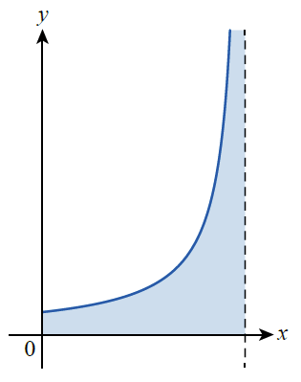
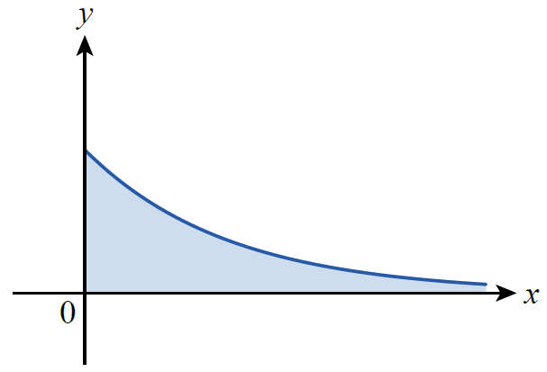
Improper Integrals (cont.)
This is especially so if we are faced with an improper integral of a positive function f and are interpreting the integral as the area of an unbounded region, as depicted in Figure 1.
Figure 1 Improper Integrals and Unbounded Regions

Slide 5
Improper Integrals (cont.)
In both cases, although the region is unbounded (meaning it cannot be captured inside a circle of radius R for any R), it is possible for its area to be finite. Understanding exactly how this can be, and how we evaluate such integrals, is the purpose of this section.

Slide 6
Example 1: Finding the Area under a Curve over an Unbounded Interval
If possible, find the area of the region bounded between the graph of and the x-axis over the interval
Solution
The area asked for corresponds to the integral
Since we don’t yet know how to evaluate
such an integral, we will first construct a reasonable interpretation of what it must mean, consistent with what we already know about integration.

Slide 7
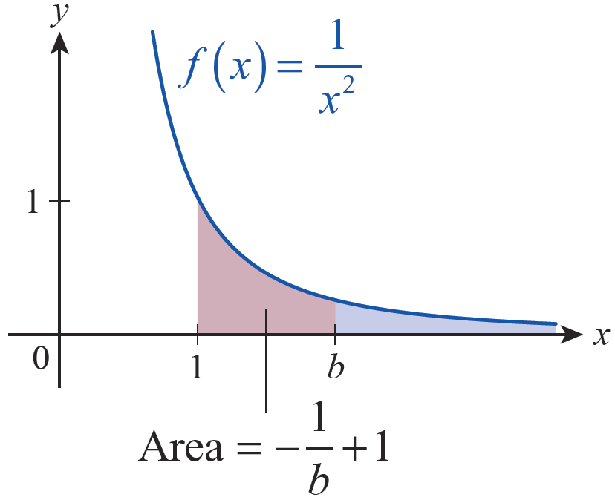
Example 1: Finding the Area under a Curve over an Unbounded Interval (cont.)
If the area under f over the interval is finite,
say then a
reasonable interpretation of area would indicate that the area over the interval must approach A as b → ∞ (see Figure 2).
Figure 2
Defining Area of an Unbounded Region

Slide 8
Example 1: Finding the Area under a Curve over an Unbounded Interval (cont.)
We know how to evaluate so we’ll use this interpretation to define

Slide 9
Definition: Improper Integrals of Type I
An improper integral of type I is an integral over an unbounded interval, and falls into one of the following classes if the interval is unbounded on one side only.

Slide 10
Definition: Improper Integrals of Type I (cont.)
In each case, the integral is said to converge if the limit exists, and if so we define the value of the improper integral to be the limit. If the limit does not exist, the integral is said to diverge.
If the interval of integration is and if both integrals on the right converge for some real number c, then we have the following.

Slide 11
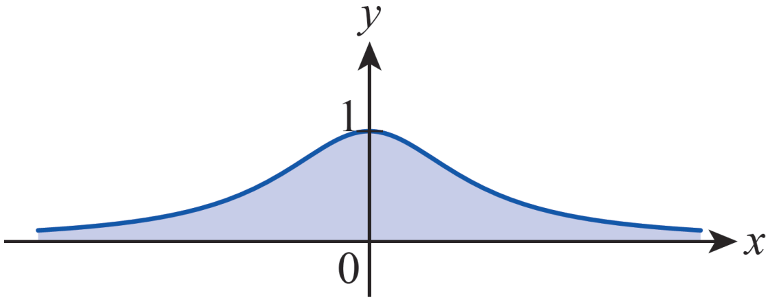
Example 2: Evaluating an Improper Integral of Type I
Evaluate
Solution
We can choose any value for c, but the most convenient value is c = 0.
Figure 3 Area under

Slide 12
Example 2: Evaluating an Improper Integral of Type I (cont.)

Slide 13
Example 3: Evaluating an Improper Integral of Type I
Evaluate
Solution
Since
we know that this integral diverges. The geometric interpretation of this result is that the area under over the interval is infinite.

Slide 14
Example 3: Evaluating an Improper Integral of Type I (cont.)
In Exercise 65 you’ll consider all integrals of the form
and show that such an integral converges if
p > 1 and diverges if p ≤ 1.

Slide 15
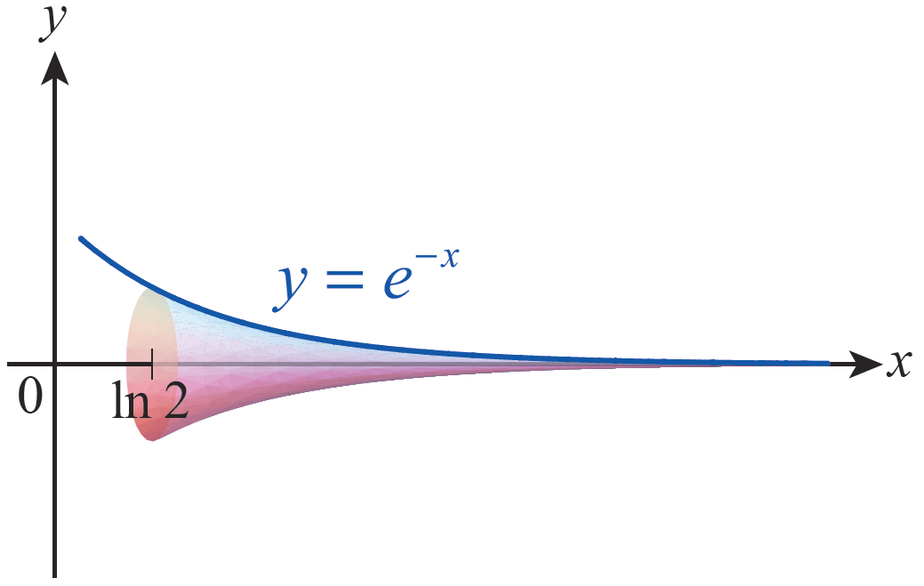
Example 4: Finding the Volume of an Infinitely Long Horn
The infinitely long horn depicted in Figure 4 extends from x = ln2 to infinity. The area of a typical cross-section is Determine the volume of the horn.
Figure 4 Infinitely Long Horn

Slide 16
Example 4: Finding the Volume of an Infinitely Long Horn (cont.)
Solution
Recall that so the volume of the horn is as follows.

Slide 17
Definition: Improper Integrals of Type II
An improper integral of type II is one in which the integrand has an unbounded range over the interval of integration, and falls into one of the following classes:
1. If f is continuous on (a, b] and discontinuous at a, then
2. If f is continuous on [a, b) and discontinuous at b, then

Slide 18
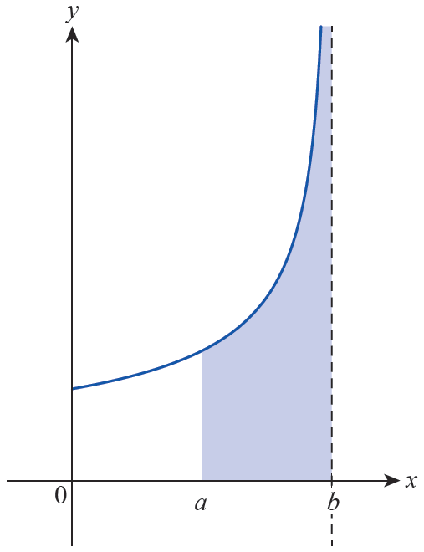
Definition: Improper Integrals of Type II (cont.)
In each case, the integral is said to converge if the limit exists, and if so we define the value of the improper integral to be the limit. If the limit does not exist, the integral is said to diverge.
Figure 5 Improper Integral of Type II

Slide 19
Definition: Improper Integrals of Type II (cont.)
3. If f is continuous on [a, b] except for a vertical asymptote at c, where a < c < b, then
assuming both
integrals on the right converge.

Slide 20
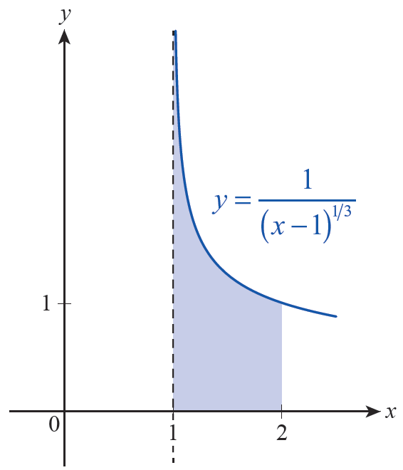
Example 5: Evaluating an Improper Integral of Type II
Evaluate
Solution
The integrand is continuous except at its vertical asymptote x = 1.
Figure 6

Slide 21
Example 5: Evaluating an Improper Integral of Type II (cont.)

Slide 22
Example 6: Evaluating an Improper Integral of Type II
Evaluate
Solution
In this example, the integrand has a vertical asymptote in the interior of the interval, so we must break it into two improper integrals.

Slide 23
Example 6: Evaluating an Improper Integral of Type II (cont.)
Remember that both of these integrals must converge for the original integral to converge. Examining the first one, we obtain the following.
We can stop right here, because the first improper integral diverges and hence diverges (there is no need to examine the second improper integral, but it also diverges).

Slide 24
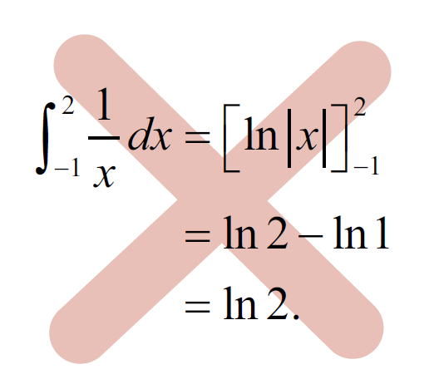
Caution
If we had missed the fact that is discontinuous at 0 and blindly proceeded to to evaluate the integral in Example 6, we would have obtained the incorrect result that

Slide 25
Example 7: Evaluating an Improper Integral of Type II
Evaluate ln x dx.
Evaluate
Solution
We know lnx is continuous for all x > 0 and that it has a vertical asymptote at x = 0.

Slide 26
Example 7: Evaluating an Improper Integral of Type II
Evaluate ln x dx. (cont.)
The remaining limit in the last expression is of an indeterminate form that we can evaluate with L’Hôpital’s Rule.
Therefore,

Slide 27
The Direct Comparison Test
Sometimes we care more about whether a given improper integral converges than we do about its value if it does converge. The Direct Comparison Test helps us answer this question.
The test is based on a very straightforward argument: if f and g are integrable and for all x on an interval of integration I (whether finite or infinite), then

Slide 28
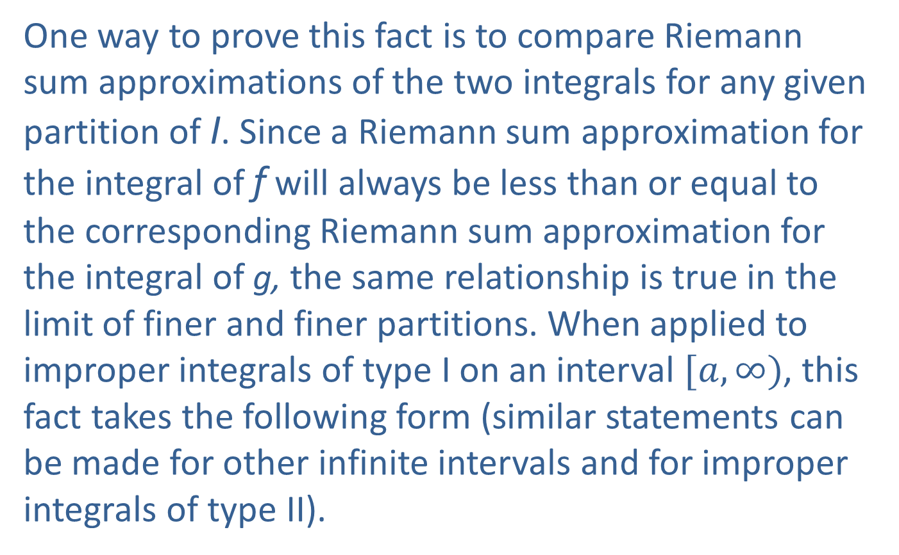
The Direct Comparison Test (cont.)
One way to prove this fact is to compare Riemann sum approximations of the two integrals for any given partition of I. Since a Riemann sum approximation for the integral of f will always be less than or equal to the corresponding Riemann sum approximation for the integral of g, the same relationship is true in the limit of finer and finer partitions. When applied to improper integrals of type I on an interval $[a,∞)$, this fact takes the following form (similar statements can be made for other infinite intervals and for improper integrals of type II).

Slide 29
Theorem: The Direct Comparison Test
If f and g are continuous functions on and for all a ≤ x < ∞, then
1. If converges, so does
2. If diverges, so does

Slide 30
Example 8: Using the Direct Comparison Test
Determine if the integral converges.
Solution
As we learned in Section 7.6, this integral is nonelementary—we can’t attempt to evaluate it by working with an antiderivative. But we can easily compare it to a simpler integral. Since −x² ≤ −x for all x ≥ 1, for all such x. Since
we know converges and hence so does

Slide 31
Example 9: Using the Direct Comparison Test
Determine whether converges.
Solution
For x ≥ 1, we have the following.
You will show in Exercise 17 that the integral
diverges, so diverges as well.

