Slide 1
Section 8.2
First-Order Linear Differential Equations

Slide 2
Definition: First-Order Linear Differential Equations
A first-order differential equation in the independent variable x and dependent variable y is linear if it can be written in the standard form of
where P and Q are continuous functions of x on a given interval.

Slide 3
Example 1: Identifying Linear and Nonlinear
Differential Equations
Classify the following differential equations as linear or nonlinear.

Slide 4
Example 1: Identifying Linear and Nonlinear
Differential Equations (cont.)
Solution
a. The equation
qualifies as a first-order linear differential equation, as is evident when written in standard form, as follows.

Slide 5
Example 1: Identifying Linear and Nonlinear
Differential Equations (cont.)

Slide 6
Example 1: Identifying Linear and Nonlinear
Differential Equations (cont.)
b. The first-order equation
is nonlinear, because y appears as an exponent—the linearity in the classification applies to (and only to) the dependent variable.

Slide 7
Identifying and Solving First-Order Linear Differential Equations
First-order linear equations cannot, in general, be solved by separating variables and integrating, but integration is still the key to their solution. Before integrating, though, we multiply both sides of the equation by an integrating factor I(x), a function whose formula we find by solving a separable equation.

Slide 8
Identifying and Solving First-Order Linear Differential Equations (cont.)
The motivation for the integrating factor is this: if we choose I(x) appropriately, the new left‑hand side of our equation, will be the derivative of the product I(x)y. We can then integrate both sides of the new equation to solve for y.

Slide 9
Identifying and Solving First-Order Linear Differential Equations (cont.)

Slide 10
Identifying and Solving First-Order Linear Differential Equations (cont.)
To see what this integrating factor accomplishes, note that our modified linear equation can now be solved.

Slide 11
Example 2: Solving an Initial Value Problem
Solve the equation on the interval (0, ∞)
with the initial condition y(1) = 1.
Solution
The equation is already in standard form, so we proceed to find the integrating factor I(x).

Slide 12
Example 2: Solving an Initial Value Problem (cont.)
Note that we have chosen to let the constant of integration be 0. Multiplying the original equation through by I(x), we obtain the following.
~

Slide 13
Example 2: Solving an Initial Value Problem (cont.)
Solving for y gives us the general solution
and since we want y(1) = 1 we require the following.
Thus, the particular solution to this IVP is

Slide 14
Example 3: Solving a First-Order Linear Differential Equation
Solve the equation
Solution
In standard form, the equation is and its integrating factor is
where we have again chosen to let the constant of integration be 0. Multiplying through by I, we have the following.

Slide 15
Example 3: Solving a First-Order Linear Differential Equation (cont.)
Integrating both sides, we can write where the constant of integration C comes from integrating the left-hand side (it is convenient to move it to the right-hand side). The integral is nonelementary, however, and thus can’t be written in terms of elementary functions.

Slide 16
Example 3: Solving a First-Order Linear Differential Equation (cont.)
Nevertheless, the expression defines a perfectly good function of x. Solving for y, we can write the solution as
or in terms of a definite integral as
(the lower limit of integration can be any fixed real number).

Slide 17
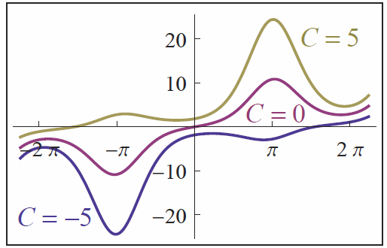
Example 3: Solving a First-Order Linear Differential Equation (cont.)
While we can’t evaluate this definite integral using an antiderivative, a computer algebra system can approximate its value for different x’s and for different choices of C. Figure 1 shows the graphs of three such choices.
Figure 1
Solutions of

Slide 18
Applications of First-Order Linear Differential Equations
We will continue to explore the many applications of differential equations as we acquire new solution techniques. The first example to follow is a variation of the mixture problem we studied in the last section; in this version, we are led to solve a nonseparable first-order linear differential equation.

Slide 19
Example 4: Solving a Mixture Problem
A 1000-gallon tank is filled with gasoline containing 15 pounds of a seasonal additive. A gasoline mixture containing 0.02 pounds of additive per gallon is added to the tank at the rate of 50 gallons per minute. The gasoline solution in the tank is continuously and thoroughly mixed and drained out at a faster rate of 60 gallons per minute. How many pounds of additive are in the tank 30 minutes into the operation?

Slide 20
Example 4: Solving a Mixture Problem (cont.)
Solution
The change in the problem is slight, but the effect on the resulting equation and solution technique is pronounced. The principle used in setting up the equation is, however, the same. If we let y(t) denote the pounds of additive in the tank t minutes into the mixing operation, then y′ = r_{in} − r_{out} (refer to the paragraph preceding Example 4 of Section 8.1 for a review of this principle).

Slide 21
Example 4: Solving a Mixture Problem (cont.)
In order to determine the concentration of additive in the tank at time t, we need to know the volume V(t) of the gasoline mixture. Since V(0) = 1000 and the mixture is added at a rate of 50 gal/min and drained out at 60 gal/min, we have the following.

Slide 22
Example 4: Solving a Mixture Problem (cont.)
So, the concentration of additive at time t is
and the rate at which the additive is leaving the tank is calculated as follows.

Slide 23
Example 4: Solving a Mixture Problem (cont.)
The rate at which the additive is being introduced to the tank remains as follows.
So the linear differential equation to solve is
or, in standard form, as follows.

Slide 24
Example 4: Solving a Mixture Problem (cont.)
This results in the integrating factor
and the following general solution.

Slide 25
Example 4: Solving a Mixture Problem (cont.)
Since y(0) = 15 pounds, we can determine C.
Therefore we have

Slide 26
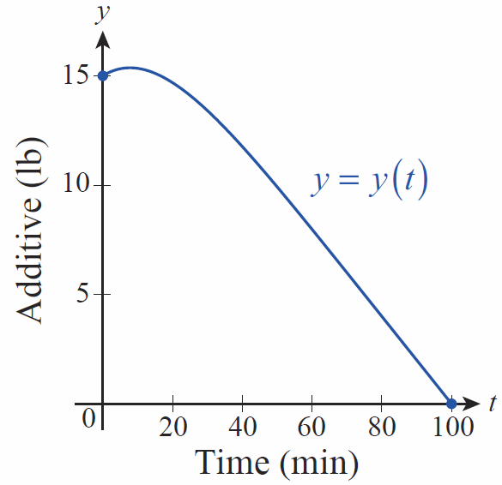
Example 4: Solving a Mixture Problem (cont.)
and the amount of additive in the tank after 30 minutes is y(30) ≈ 13.4 lb. Figure 2 is
a graph of y(t) over the 100 minutes it takes for the tank to empty completely—note that the amount of additive in the tank at first increases, and then begins to decrease.
Figure 2

Slide 27
Applications of First-Order Linear Differential Equations (cont.)
Electrical circuits with a changing current I(t) possess a property called inductance, caused by the magnetic field associated with the changing current. Inductance is given the symbol L and is measured in terms of units called henries.

Slide 28
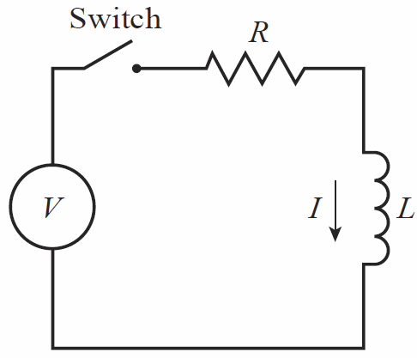
Applications of First-Order Linear Differential Equations (cont.)
Just as voltage V in a circuit relates to steady current I and resistance R according to Ohm’s Law, V = IR, the voltage, inductance, and current in an RL circuit with changing current (shown in Figure 3) are related by the following equation.
Figure 3 RL Circuit

Slide 29
Example 5: Finding a Formula for Changing
Current in an RL Circuit
Assume voltage V (in volts) is applied at time t = 0 in a simple circuit with inductance L (in henries) and resistance R (in ohms). Find a formula for the current I (in amperes) in the circuit at time t (assume V, L, and R are all constant).
Solution
The equation above is a first-order linear equation in I with standard form as follows.

Slide 30
Example 5: Finding a Formula for Changing
Current in an RL Circuit (cont.)
This gives rise to the integrating factor and then the following general solution.

Slide 31
Example 5: Finding a Formula for Changing
Current in an RL Circuit (cont.)
The current I begins at 0 when t = 0, so it must be the case that C = −V/R and hence the particular solution is as follows.
As t →∞, so the steady‑state current
in the circuit is simply V/R.

Slide 32
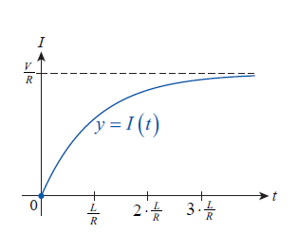
Example 5: Finding a Formula for Changing
Current in an RL Circuit (cont.)
The inductance in the circuit is most significant immediately after voltage is applied—it is then that
the term has greatest effect, as shown in Figure 4.
Figure 4

Slide 33
Example 5: Finding a Formula for Changing
Current in an RL Circuit (cont.)
The length of time L/R is referred to as the circuit’s time constant and is a measure of how its inductance and resistance interact to affect the current.

