Slide 1
Section 9.2
Calculus and Parametric Equations

Slide 2
Definition: Differentiability of Parametrized Curves
A curve C defined by the parametric equations x = f(t) and y = g(t) is differentiable at t₀ if both f and g are differentiable at t₀. Further, the parametrization (f(t), g(t)), is smooth at t₀ if both f  and g  are continuous at t₀ and at least one of f (t₀) and g (t₀) is nonzero.

Slide 3
Definition: Differentiability of Parametrized Curves (cont.)
Related to this, a given curve C is smooth at (x₀, y₀) if it has a parametrization (f(t), g(t)) that is smooth at t₀, where (x₀, y₀) = (f(t₀), g(t₀)). (As you will see in Exercise 5, however, a smooth curve may also be described by a nonsmooth parametrization.)

Slide 4
Example 1: Identifying Points of Differentiability and Smoothness of a Parametrization
Sketch the graph of the curve C parametrized by x = t² and y = t³ for −2 ≤ t ≤ 2, and identify points of differentiability and smoothness of the parametrization.
Solution
We can eliminate the parameter and express the curve as two functions of x as follows.

Slide 5
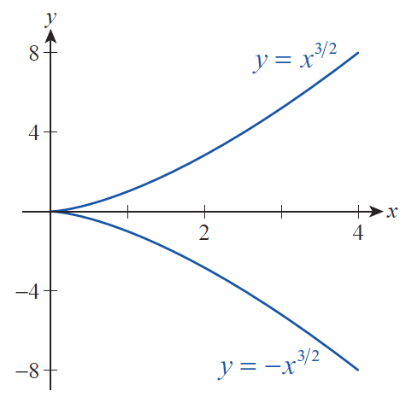
Example 1: Identifying Points of Differentiability and Smoothness of a Parametrization (cont.)
Individually, the two functions are easy to sketch and together they constitute C, as shown in Figure 1.
Figure 1 Graph of C

Slide 6
Example 1: Identifying Points of Differentiability and Smoothness of a Parametrization (cont.)
Note that the point corresponding to t = −2 is (4, −8), the point corresponding to t = 2 is (4, 8), and the value t = 0 corresponds to the point (0, 0). And since the two derivatives dx/dt = 2t and dy/dt = 3t² exist for all t ∈ [−2, 2], C is differentiable over the entire interval. But since dx/dt and dy/dt are both equal to 0 at t = 0, the parametrization is not smooth at this one point (it is smooth for every other t).

Slide 7
Tangent Lines and Planar Areas
Differentiability with respect to the parameter t is not sufficient to guarantee the existence of a tangent line, but smoothness is. Using the Chain Rule, we may in fact be able to write the slope of the tangent line as a derivative dy/dx even if we are not able to express the curve as an equation in y and x. If the three derivatives dy/dx, dy/dt, and dx/dt all exist, then
And if dx/dt ≠ 0, we can solve this equation for dy/dx to obtain the following.

Slide 8
Theorem: Parametric Formula for dy/dx
Assume the curve C is defined parametrically by x = f(t) and y = g(t). If each of the three derivatives dy/dx, dy/dt, and dx/dt exists at a given point, and if dx/dt ≠ 0, then
The curve C has a vertical tangent line (and hence dy/dx does not exist) at a point of smoothness where dx/dt = 0 (that is, dy/dt ≠ 0 and dx/dt = 0).

Slide 9
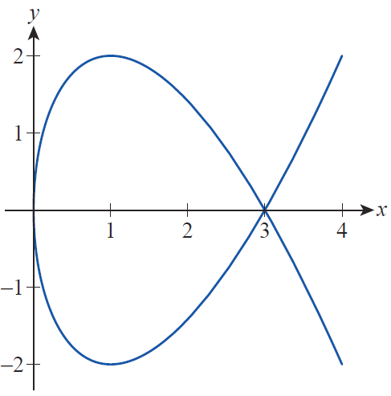
Example 2: Finding Equations of Lines Tangent to a Parametric Curve
The portion of the curve parametrized by x = t² and y = t³ − 3t for −2 ≤ t ≤ 2 is shown in Figure 2. Find the equations for the tangent lines that a. are horizontal, b. are vertical, and c. pass through the point (3, 0).
Figure 2

Slide 10
Example 2: Finding Equations of Lines Tangent to a Parametric Curve (cont.)
Solution
First, note that dx/dt = 2t and dy/dt = 3t² − 3. Since these two derivatives are never both equal to 0 for the same t, the curve is smooth everywhere.

Slide 11
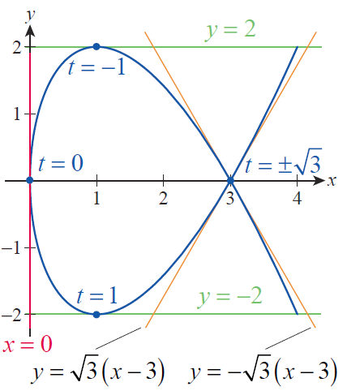
Example 2: Finding Equations of Lines Tangent to a Parametric Curve (cont.)
a. The curve has horizontal tangent lines at those values of t for which dy/dt = 0 or 3t² − 3 = 0. This gives us t = ±1, corresponding to the two points (1, 2) and (1, −2) as shown in Figure 3. The equations for the tangent lines at these points are y = 2 and y = −2.
Figure 3

Slide 12
Example 2: Finding Equations of Lines Tangent to a Parametric Curve (cont.)
The single vertical tangent line occurs at the point where dx/dt = 0, giving us t = 0 and the point (0, 0) on the curve. The equation for this tangent line is x = 0.
Visually, it appears there should be two lines tangent to the curve through the point (3, 0). The first step in finding them is to determine the two values of t for which the curve passes through (3, 0)—since x = t², this happens when t² = 3 or

Slide 13
Example 2: Finding Equations of Lines Tangent to a Parametric Curve (cont.)
At these values,
and
leading to the respective tangent line equations

Slide 14
Theorem: Parametric Formula for d²y/dx²
If the parametric equations x = f(t) and y = g(t) define y as a twice‑differentiable function of x, we can substitute y  for y in the parametric formula for dy/dx to obtain a parametric formula for y  = d²y/dx²:

Slide 15
Example 3: Finding the Inflection Points of a Parametric Curve
Let C be the curve defined by x = t³ − t and y = t + 1, t ∈ θ. Find the inflection points of C.
Solution
We first note that dx/dt = 3t² − 1 and dy/dt = 1, telling us that C is differentiable everywhere and, further, that it is smooth everywhere.

Slide 16
Example 3: Finding the Inflection Points of a Parametric Curve (cont.)
So and the parametric formula for the second derivative tells us

Slide 17
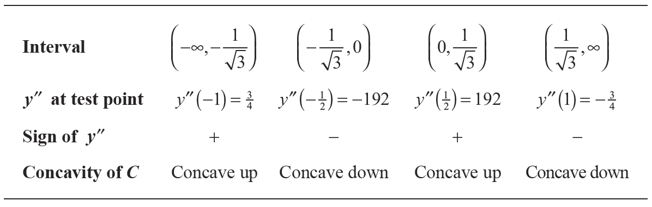
Example 3: Finding the Inflection Points of a Parametric Curve (cont.)
Recall that the possible inflection points are the points where d²y/dx² is either equal to 0 or undefined, corresponding to t = 0 and in this example. Testing the concavity of C on the four t-intervals defined by these points, we find the following.

Slide 18
Example 3: Finding the Inflection Points of a Parametric Curve (cont.)
Since C changes concavity at each point, these possible inflection points are actual inflection points. Remember, though, that these are values of the parameter—the corresponding ordered pairs are as follows.

Slide 19
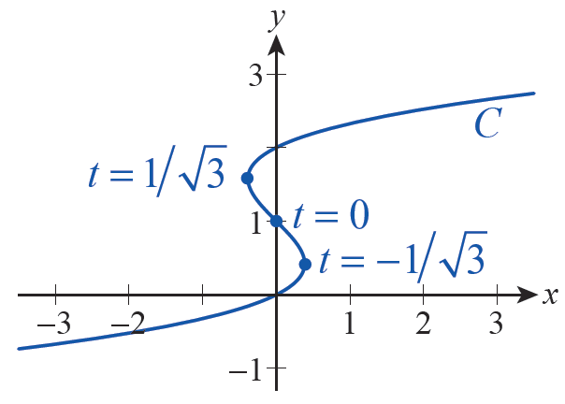
Example 3: Finding the Inflection Points of a Parametric Curve (cont.)
A sketch of C is shown in Figure 4, with the three inflection points noted.
Figure 4

Slide 20
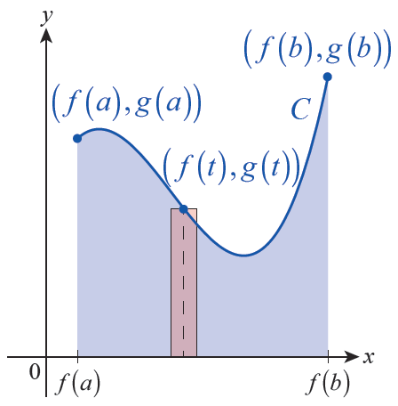
Tangent Lines and Planar Areas (cont.)
Let us turn now to the matter of finding the area of a plane region bounded (at least in part) by a parametrized curve. First, as depicted in Figure 5, suppose we want to find the area A of a region bounded below by the x-axis and above by a curve C parametrized as (f(t), g(t)), over the t‑interval [a, b].
Figure 5

Slide 21
Tangent Lines and Planar Areas (cont.)
In Figure 5, the shaded rectangle is an approximation of the differential element of area dA = y dx, where the height of the rectangle is y = g(t) and the width is approximately dx. If f(a) < f(b), as shown, then

Slide 22
Tangent Lines and Planar Areas (cont.)
Since dx/dt = f (t), we can write dx = f (t)dt and use the Substitution Rule to obtain
thereby expressing the area in terms of the functions f and g and the parameter t.
In general, a variation of the formula above can be used to find the area between a parametrized curve and an axis, as long as changes in sign are made to ensure that y dx (or x dy) is nonnegative. Example 4 shows how these adjustments are made in practice.

Slide 23
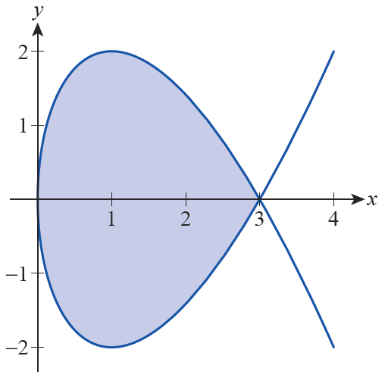
Example 4: Finding the Area of the Region Bounded by a Parametric Curve
Find the area of the region bounded entirely by the curve parametrized by x = t² and y = t³ − 3t.
Solution
Figure 6 depicts the described region in blue. We can find its area by first finding the area of the portion above the x-­axis, shown in Figure 7, and then the portion below the x-­axis, shown in Figure 8.
Figure 6

Slide 24
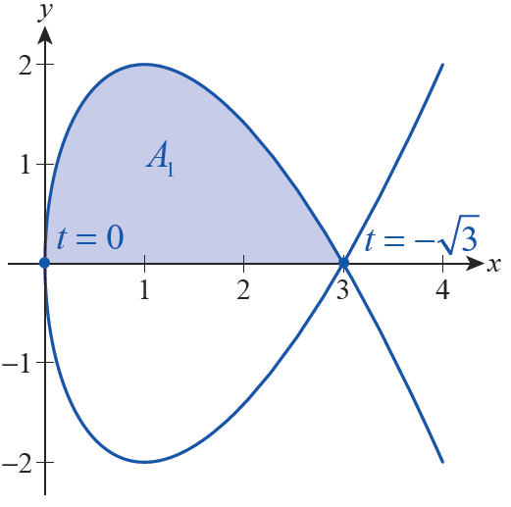
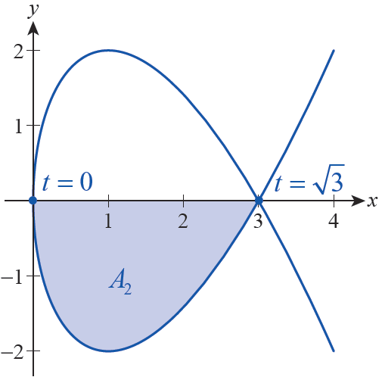
Example 4: Finding the Area of the Region Bounded by a Parametric Curve (cont.)
Figure 7
Figure 8

Slide 25
Example 4: Finding the Area of the Region Bounded by a Parametric Curve (cont.)
Both portions are defined over the x-axis interval [0, 3], but it is more important to note that the upper portion is defined parametrically over the t‑interval while the lower portion is defined over the t‑interval
The integral is an integral that goes
from “right to left” in the xy-plane, since the initial point of the parametrized curve, (3, 0), lies to the right of the terminal point (0, 0).

Slide 26
Example 4: Finding the Area of the Region Bounded by a Parametric Curve (cont.)
So unless a change of sign is made, the resulting integral will be negative.

Slide 27
Example 4: Finding the Area of the Region Bounded by a Parametric Curve (cont.)
By symmetry, we expect the area A₂ of the lower portion to be identical, but we’ll set up and evaluate the integral to demonstrate the accommodation for a function below the axis. For this portion, dx has the right sign (the integral goes from left to right in the plane), but y is negative for

Slide 28
Example 4: Finding the Area of the Region Bounded by a Parametric Curve (cont.)
So we again change the sign.
Hence, the total area bounded by the curve is

Slide 29
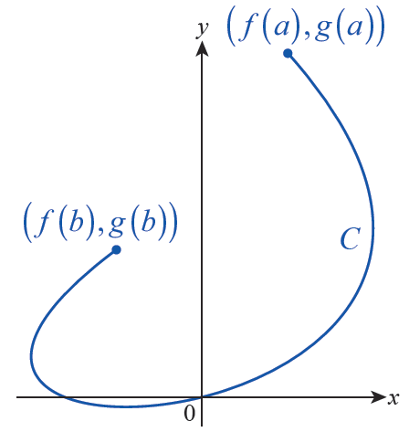
Arc Length and Surface Area
For a smooth curve C defined parametrically by x = f(t) and y = g(t) over the t-interval [a, b], such as the curve
shown in Figure 9, the formula for arc length takes the pleasantly symmetric form
Figure 9

Slide 30
Theorem: Parametric Arc Length Formula
Assume that C is defined by the smooth parametrization x = f(t) and y = g(t) over the t‑interval [a, b] and C is traced out only once by the parametrization over the interval (except possibly for a finite number of self-intersections). Then the arc length L of C is given by

Slide 31
Example 5: Using Parametric Arc Length to Derive the Formula for Circumference of a Circle
Use the parametric arc length formula to verify that the circumference of a circle of radius r is 2π r.
Solution
The simplest parametrization of such a circle is x = r cos t, y = r sin t, for t ∈ [0, 2π ] (note that the initial and terminal point are the same).

Slide 32
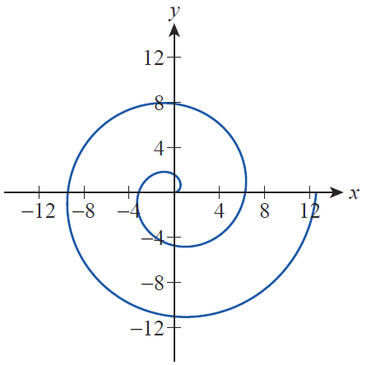
Example 6: Finding the Arc Length of a Spiral
Find the arc length of the spiral defined by x = t cos t and y = t sin t over the t‑interval [0, 4π ].
Solution
The graph of the spiral is illustrated in Figure 10.
Figure 10

Slide 33
Example 6: Finding the Arc Length of a Spiral (cont.)
The formula for its arc length is easy enough to write down.

Slide 34
Example 6: Finding the Arc Length of a Spiral (cont.)
The evaluation of this integral is a good opportunity to use the integration techniques that we have developed previously. One approach would be to use the trigonometric substitution t = tanθ, and you will be guided through an alternative sequence of steps in Exercise 60. Once done, you will have found that
or approximately
80.8 units.

Slide 35
Example 7: Finding the Arc Length of One Arch of a Cycloid
Find the arc length of one arch of the cycloid generated by a circle of radius a.
Solution
Recall from Example 4 of Section 9.1 that our parametrization of a cycloid is x = a(θ – sinθ ) and y = a(1 – cosθ ), and that one arch is traced out over the θ ‑interval [0, 2π ].

Slide 36
Example 7: Finding the Arc Length of One Arch of a Cycloid (cont.)
So one arch of the cycloid has an arc length eight times as long as the radius of the circle that generates it.

Slide 37
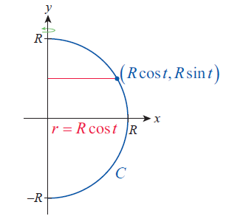
Example 8: Finding the Surface Area of a Sphere Formed by Revolving a Parametric Curve
Find the surface area of a sphere of radius R by revolving an appropriately chosen parametrically defined curve C.
Solution
There are several choices for C; we will define C to be the curve x = R cos t, y = R sin t over the t‑interval [−π/2, π/2], and revolve C once about the y-axis as shown in Figure 11.
Figure 11

Slide 38
Example 8: Finding the Surface Area of a Sphere Formed by Revolving a Parametric Curve (cont.)
With this choice, the distance r from the axis of revolution to the surface is R cos t. So the surface area is calculated as follows.

