Slide 1
Section 9.3
Polar Coordinates

Slide 2
The Polar Coordinate System
The polar coordinate system, like the Cartesian coordinate system, serves as a means of locating points in the plane, and both systems are centered at a point O called the origin, sometimes referred to as the pole in the polar system. Starting from the origin O, a ray (or half-line) called the polar axis is drawn; in practice, the polar axis is usually drawn extending horizontally to the right, so that it corresponds with the positive x-axis in the Cartesian system.

Slide 3
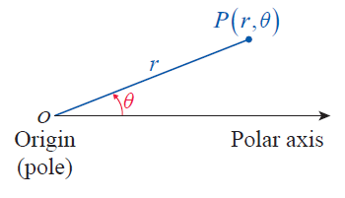
The Polar Coordinate System (cont.)
Now, given any point P in the plane other than the origin, the line segment has a unique positive length; we will label this length r (as in radius). Finally, we let θ denote the angle, measured counterclockwise, between the polar axis and the segment and we say (r, θ ) are polar coordinates of the point P (see Figure 1).
Figure 1

Slide 4
The Polar Coordinate System (cont.)
The origin is the unique point for which r = 0 and for which the angle θ is irrelevant; the coordinates (0, θ ) refer to O for any angle θ. Figure 2 illustrates the process of determining r and θ for several points.

Slide 5
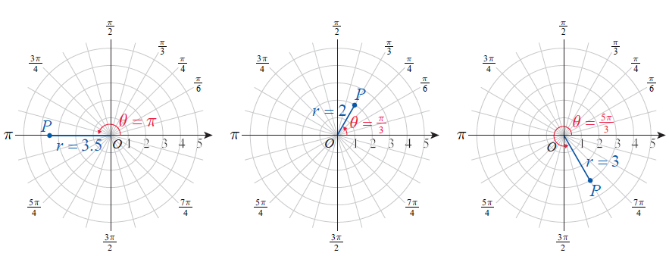
The Polar Coordinate System (cont.)
Figure 2 The Polar Coordinate System

Slide 6
The Polar Coordinate System (cont.)
Before proceeding further, it is important to recognize one very critical difference between Cartesian and polar coordinates. A given point P corresponds to unique Cartesian coordinates (x, y), but the polar coordinates (r, θ ) of P as described above are only one of an infinite number of ways of specifying P in the polar system.

Slide 7
The Polar Coordinate System (cont.)
Our familiarity with trigonometric functions indicates one reason for this: (r,θ +2nπ ) also represents P, since θ and θ + 2nπ have the same terminal sides for any integer n. Further, (–r,θ + (2n + 1)π ) also represents P for any integer n, given the interpretation that –r indicates travel in the opposite direction through the origin.

Slide 8
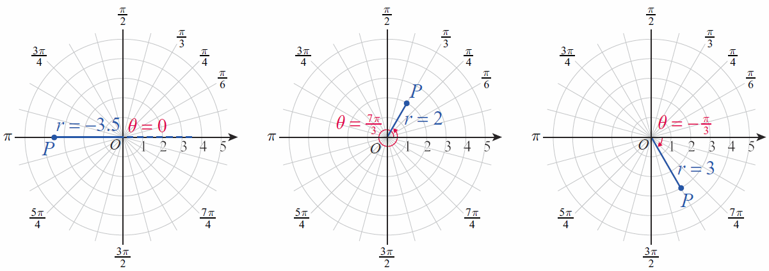
The Polar Coordinate System (cont.)
These observations are illustrated in Figure 3 with alternate descriptions of the points from Figure 2.
Figure 3 Alternate Polar Coordinates

Slide 9
Example 1: Plotting Points in Polar Coordinates
Plot the points given by the following polar coordinates.

Slide 10
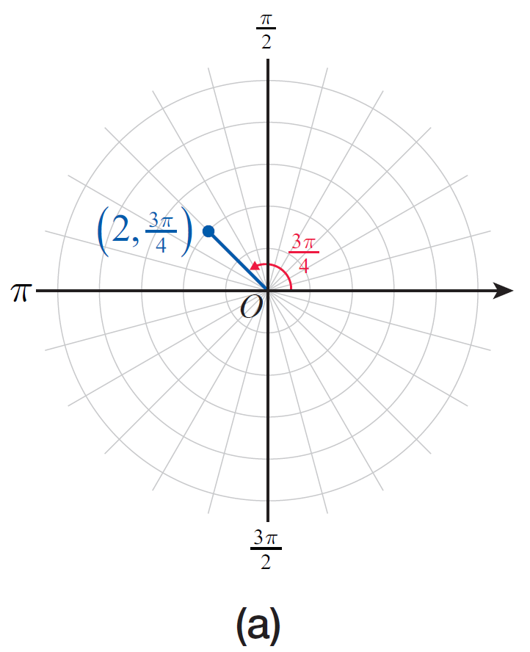
Example 1: Plotting Points in Polar Coordinates (cont.)
Solution

Slide 11
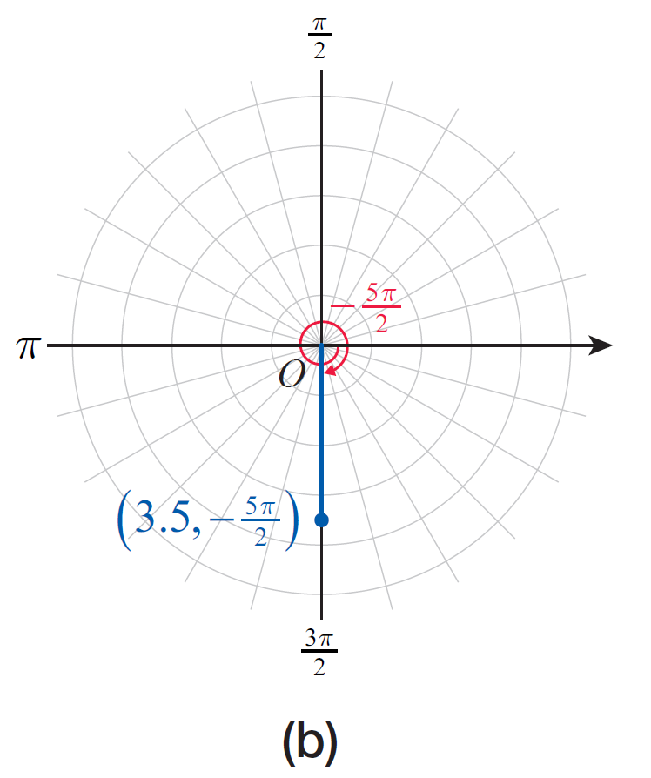
Example 1: Plotting Points in Polar Coordinates (cont.)

Slide 12
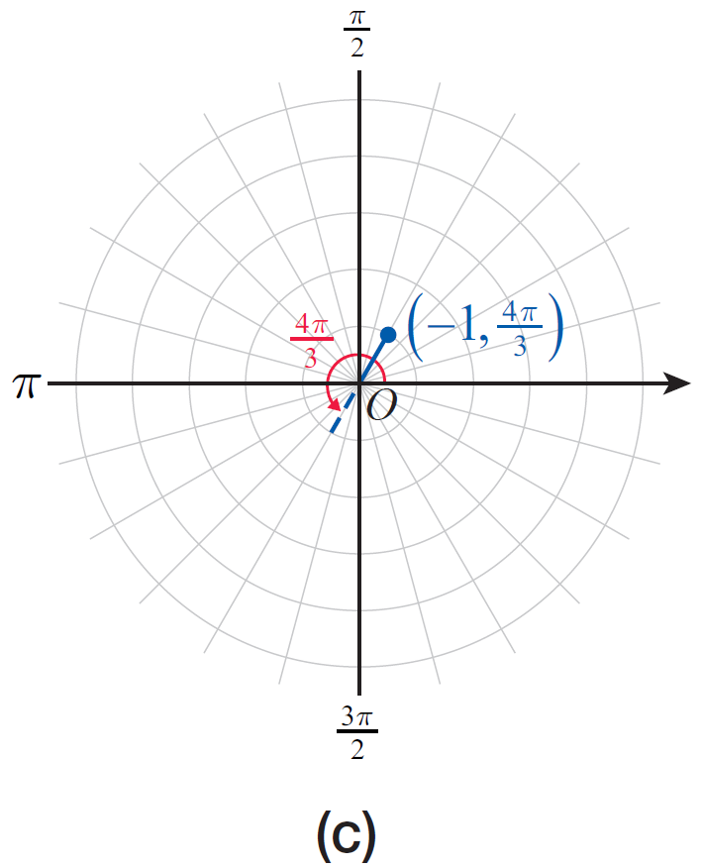
Example 1: Plotting Points in Polar Coordinates (cont.)
Figure 4

Slide 13
Coordinate Conversion
Converting from Cartesian coordinates to polar coordinates, and vice versa, is easily accomplished. To do so, we will assume that the polar axis is aligned with the positive x-axis and that a fixed point P has Cartesian coordinates (x, y) and polar coordinates (r, θ ).

Slide 14
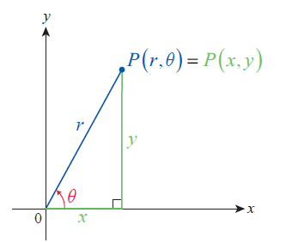
Coordinate Conversion (cont.)
Then, as seen in Figure 5, r² = x² + y² and
Figure 5
Converting between Polar and Cartesian Coordinates

Slide 15
Theorem: Coordinate Conversion
Converting from Polar to Cartesian Coordinates
Given (r, θ), x and y are defined as follows.
x = r cosθ, y = r sinθ
Converting from Cartesian to Polar Coordinates
Given (x, y), r and θ are defined as follows.

Slide 16
Theorem: Coordinate Conversion (cont.)
Make note of the quadrant of the original Cartesian coordinates when converting, to be sure the polar coordinates fall in the same quadrant (see Example 3).

Slide 17
Example 2: Converting from Polar to Cartesian Coordinates
Convert the following points from polar to Cartesian coordinates.

Slide 18
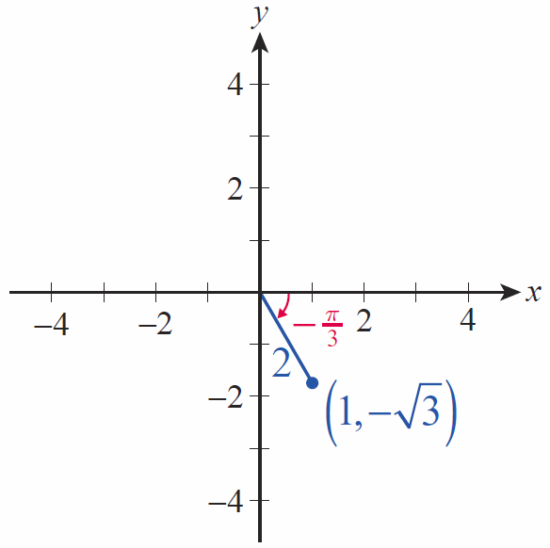
Example 2: Converting from Polar to Cartesian Coordinates (cont.)
Solution
a. We calculate
and so the Cartesian coordinates
are (see Figure 6).
Figure 6

Slide 19
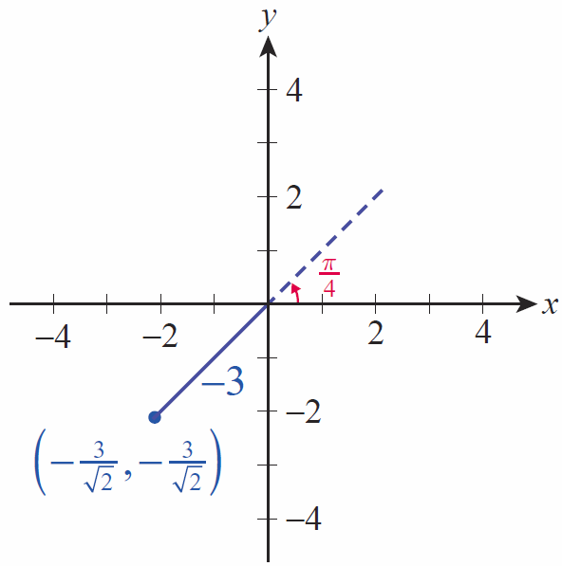
Example 2: Converting from Polar to Cartesian Coordinates (cont.)
b. We calculate
and so the Cartesian coordinates
are
(see Figure 7).
Figure 7

Slide 20
Example 3: Converting from Cartesian to Polar Coordinates
Convert the following points from Cartesian to polar coordinates.
Solution
a. To avoid making an error, be sure you have some rough idea of what the answer should be before doing any calculations. Since (−3, 2) is in the second quadrant, one possible conversion will lead to
π/2 < θ < π.

Slide 21
Example 3: Converting from Cartesian to Polar Coordinates (cont.)
To get the exact angle, we use the fact that so (remember, this is in radians). Depending on your calculator, though, you may have found an angle in the fourth quadrant; if so, it is up to you to remember to either add π in order to get an angle in the second quadrant, or to use a negative value for r.

Slide 22
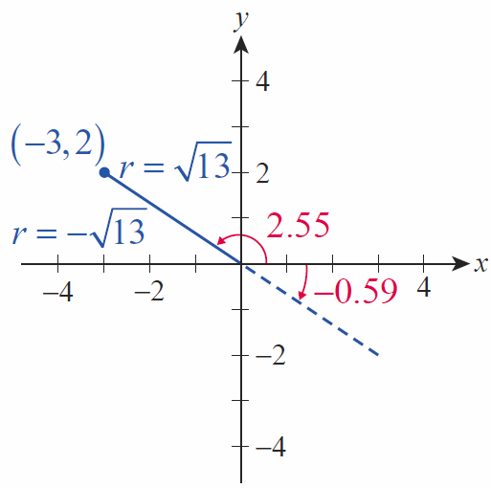
Example 3: Converting from Cartesian to Polar Coordinates (cont.)
The radius is more easily determined:
The two answers we have
found are thus
and
(see Figure 8).
Figure 8

Slide 23
Example 3: Converting from Cartesian to Polar Coordinates (cont.)
b. The polar coordinates of are more easily determined. The point lies in the fourth quadrant, so the two most obvious conversions will lead to either or The coordinates give rise to a familiar triangle with convenient angles, and it’s probably easiest to use

Slide 24
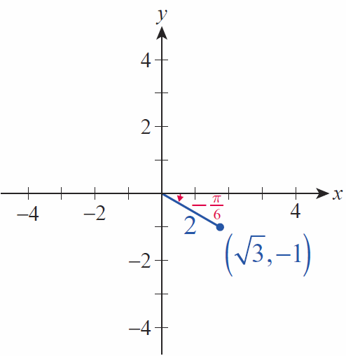
Example 3: Converting from Cartesian to Polar Coordinates (cont.)
The radius is r = 2, so one set of polar coordinates for the point is
(see Figure 9).
Figure 9

Slide 25
The Form of Polar Equations
In the most general terms, a polar equation is an equation in the variables r and θ that defines a relationship between these polar coordinates (just as equations in x and y define a relationship between rectangular coordinates). A solution to a polar equation is thus an ordered pair (r, θ ) that makes the equation true, and the graph of a polar equation consists of all such ordered pairs. Many polar equations can be written in the form r = f(θ ); in such a form, the distance from the origin is expressed as a function of the angle θ and the graph of the equation is usually fairly easy to determine.

Slide 26
Example 4: Rewriting a Rectangular Equation in Polar Form
Rewrite the equation x² – 2x + y² = 0 in polar form.
Solution
Making the appropriate substitutions in the equation x² – 2x + y² = 0 and simplifying, we obtain the following polar equation.

Slide 27
Example 5: Rewriting a Polar Equation in Rectangular Form
Rewrite the equation 2r = sec θ in rectangular form.
Solution
One good way to begin is to rewrite the equation as follows.
Now we recognize the term on the left-hand side as x, and we see that the equation is

Slide 28
Example 6: Graphing Polar Equations and Converting to Rectangular Coordinates
Sketch the graphs of the following polar equations, and then convert the equations to rectangular coordinates.

Slide 29
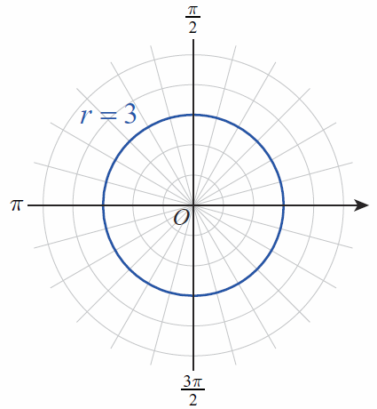
Example 6: Graphing Polar Equations and Converting to Rectangular Coordinates (cont.)
Solution
a. Since θ doesn’t appear in the equation r = 3, θ is allowed to take on any value. The equation thus describes all points (r, θ ) for which r = 3; that is, a circle of radius 3 as shown in Figure 10. The equation in rectangular coordinates is x² + y² = 9.
Figure 10

Slide 30
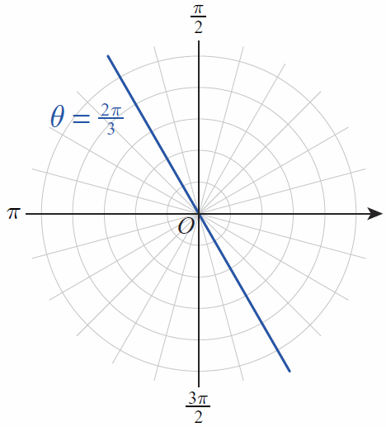
Example 6: Graphing Polar Equations and Converting to Rectangular Coordinates (cont.)
b. In this equation, r is allowed to take on any value. But every point (r,θ) that satisfies the equation must have θ = 2π/3. The graph is thus a straight line passing through the origin (see Figure 11), and
so
Figure 11

Slide 31
Example 7: Graphing a Polar Equation
Sketch the graph of the equation r = 2 cos θ.
Solution
We can begin by calculating some values of r for given values of θ.
θ | 0
r | 2 |  |  | 1 | 0 | −1

Slide 32
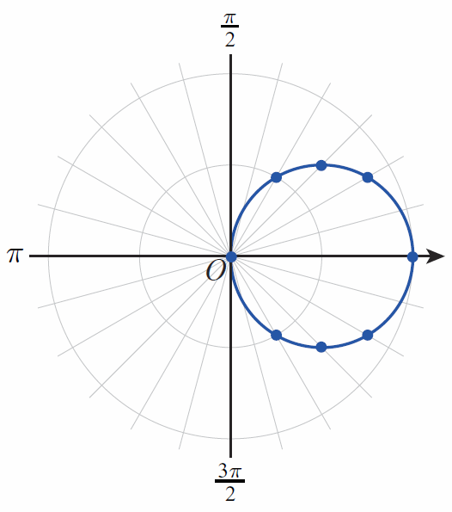
Example 7: Graphing a Polar Equation (cont.)
Now if we plot the pairs (r, θ ) from the table, we obtain the points shown in Figure 12. These certainly appear to lie along the circumference of a circle, so the points have been connected with a curve.
Figure 12 r = 2 cosθ

Slide 33
Example 7: Graphing a Polar Equation (cont.)
If we convert the equation into rectangular coordinates as shown below, we see that the graph indeed is a circle of radius 1 centered at x = 1, y = 0.

Slide 34
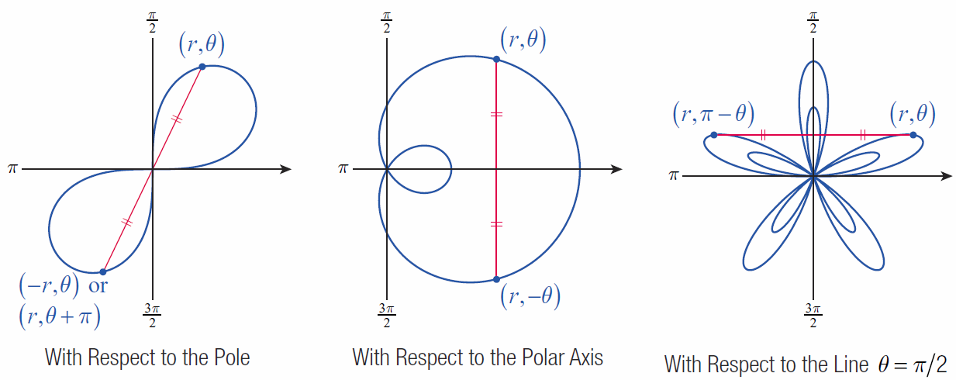
Graphing Polar Equations
Consider the three types of symmetry illustrated in Figure 13.
Figure 13 Symmetry in Polar Coordinates

Slide 35
Definition: Symmetry of Polar Equations
An equation in r and θ is symmetric with respect to
1. the pole if replacing r with −r (or replacing θ with
θ + π) results in an equivalent equation;
2. the polar axis if replacing θ with −θ results in an equivalent equation;
3. the vertical line θ =π/2 if replacing θ with π − θ results in an equivalent equation.

Slide 36
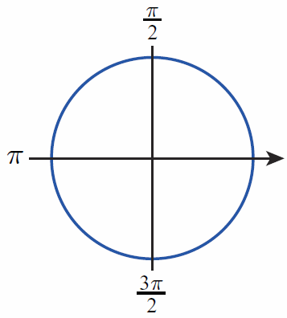
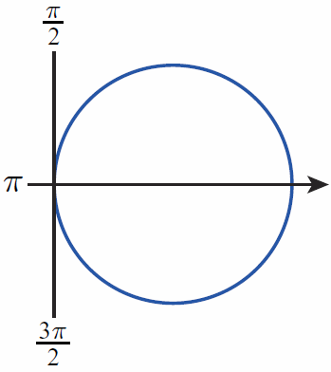
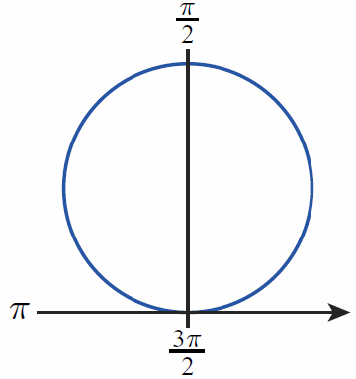
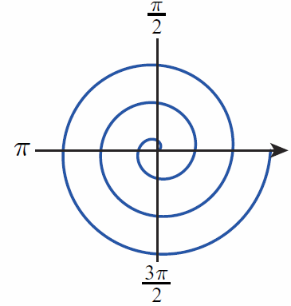
Common Polar Equations and Graphs
Circles and Archimedes’ Spirals (a > 0)
r = a
Circle
r = a cosθ
Circle
r = a sinθ
Circle
r = aθ
Archimedes’
Spiral

Slide 37
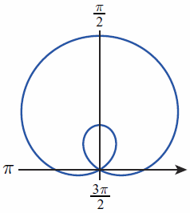
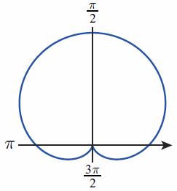
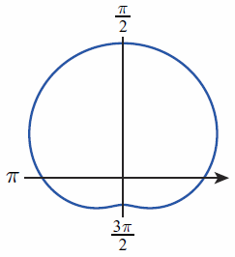
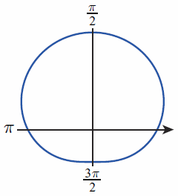
Common Polar Equations and Graphs (cont.)
Limaçons r = a ± b sinθ r = a ± b cosθ (a > 0, b > 0)
Limaçon with
Inner Loop
Cardioid
(Heart Shape)
Dimpled Limaçon
Convex
Limaçon

Slide 38
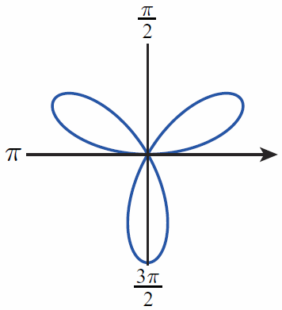
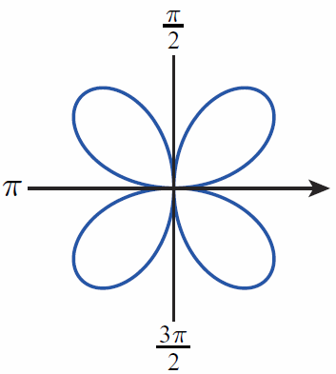
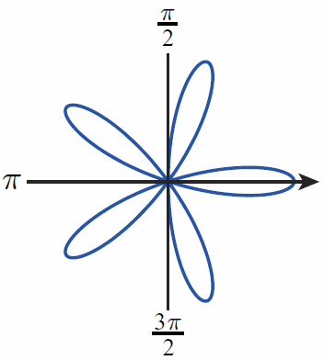
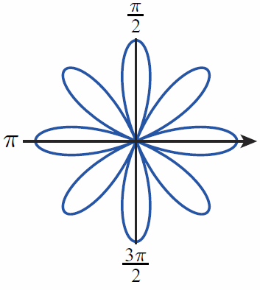
Common Polar Equations and Graphs (cont.)
Roses r = a sin nθ r = a cos nθ (a > 0) n‑petaled if n is odd 2n‑petaled if n is even
r = a sin 3θ
3-Petaled Rose
or Trifolium
r = a sin 2θ
4-Petaled Rose or Quadrifolium
r = a cos 5θ
5-Petaled Rose
r = a cos 4θ
8-Petaled Rose

Slide 39
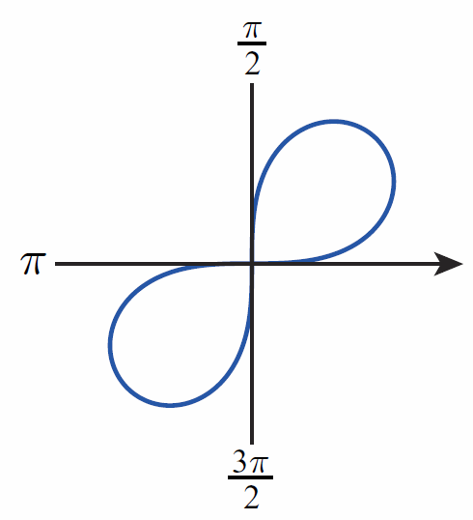
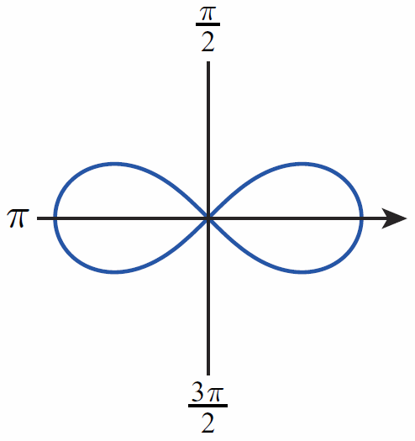
Common Polar Equations and Graphs (cont.)
Lemniscates (figure-eight shapes)
r² = a² sin 2θ
Lemniscate
r² = a² cos 2θ
Lemniscate

Slide 40
Example 8: Graphing Common Polar Equations Using Symmetry
Use symmetry and the table of common polar equations and graphs to sketch the graph of r = 3 cos 4θ.
Solution
The equation r = 3 cos 4θ possesses all three kinds of symmetry, and reference to the preceding table indicates that the graph is an 8-petaled rose. Several aspects of the graph can be determined easily, such as the fact that the maximum distance between the origin and points on the graph is 3; this follows from the fact that −1 ≤ cos 4θ ≤ 1 for all θ.

Slide 41
Example 8: Graphing Common Polar Equations Using Symmetry (cont.)
Some points can be easily calculated by hand, but a graphing utility is very useful in generating a large number of points. The polar coordinates of points on the graph for 0 ≤ θ ≤ 2π in increments of π/16, are shown in the next slide.

Slide 42
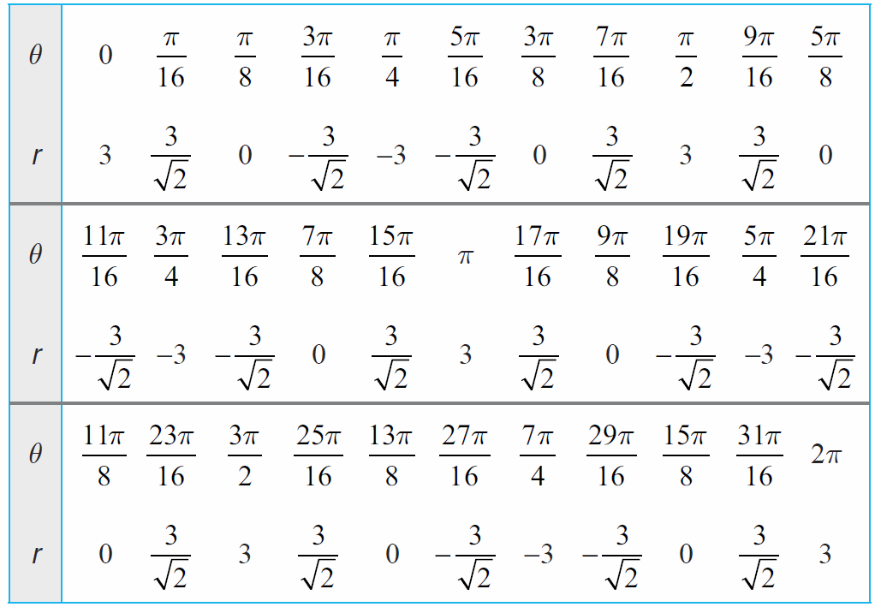
Example 8: Graphing Common Polar Equations Using Symmetry (cont.)

Slide 43
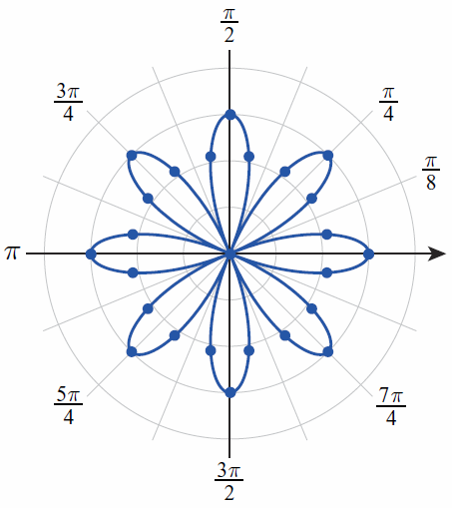
Example 8: Graphing Common Polar Equations Using Symmetry (cont.)
These points, and the rest of the graph, are plotted in Figure 14.
Figure 14 r = 3 cos 4θ

Slide 44
Example 9: Graphing Common Polar Equations Using Symmetry
Use symmetry and the table of common polar equations and graphs to sketch the graph of r = 1 + 2 cosθ.
Solution
The graph of r = 1 + 2 cosθ is a limaçon with an inner loop. Since cosine is an even function,
and the graph is symmetric with respect to the polar axis.

Slide 45
Example 9: Graphing Common Polar Equations Using Symmetry (cont.)
Some points on the graph are as follows.
θ | 0
r | 3 | 2 | 1 | 0 | −1 | 0 | 1 | 2 | 3

Slide 46
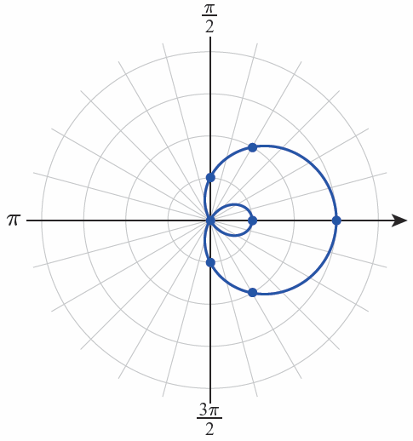
Example 9: Graphing Common Polar Equations Using Symmetry (cont.)
The graph of r = 1 + 2 cosθ is shown in Figure 15.
Figure 15 r = 1 + 2 cosθ

Slide 47
Technology Note: Graphing Polar Equations
Graphing utilities can be very useful in constructing accurate graphs of polar equations, though their capabilities are limited and vary considerably.

Slide 48
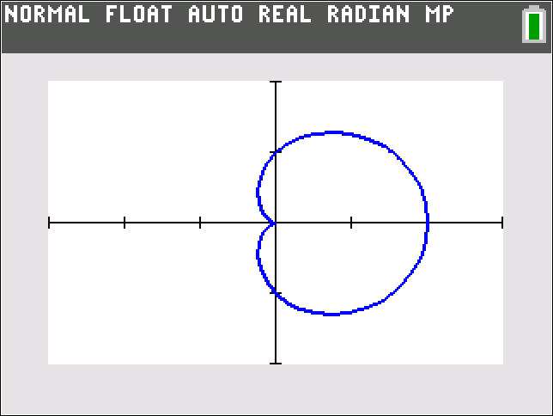
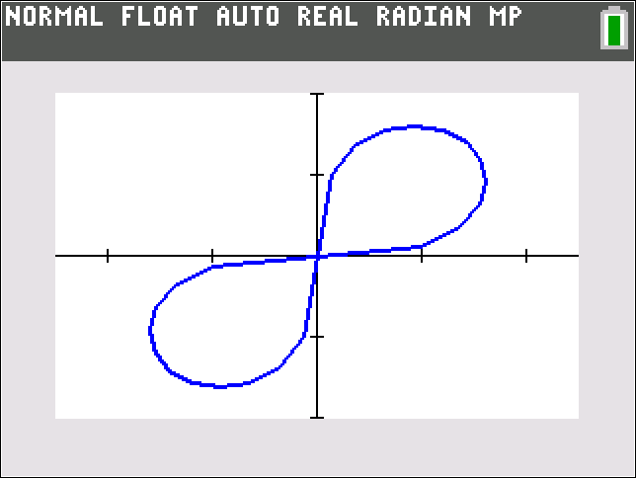
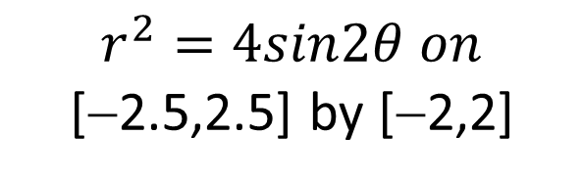
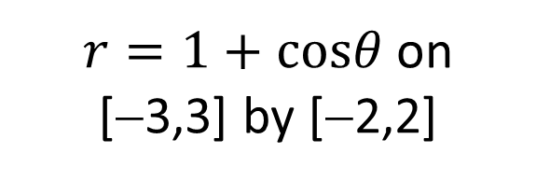
Technology Note: Graphing Polar Equations (cont.)
Figure 16 shows the graphs of a cardioid and a lemniscate on a TI-84 Plus.
$r=1+cosθ$ on
[−3,3] by [−2,2]
$$r^{2}=4sin2θ on$$
[−2.5,2.5] by [−2,2]
Figure 16

Slide 49
Technology Note: Graphing Polar Equations (cont.)
To generate those graphs the selected graphing mode needs to be POLAR and the polar equations are entered in the Y= editor. Figure 17 illustrates how Mathematica is used to graph the same cardioid and lemniscate. The built-in command is PolarPlot.

Slide 50
Technology Note: Graphing Polar Equations (cont.)
Often, a polar equation must be solved for r in order to use the graphing feature of a particular technology. Note that in order to graph the lemniscate shown, we solved the equation for r and then typed in both the positive and negative square roots that resulted.

Slide 51
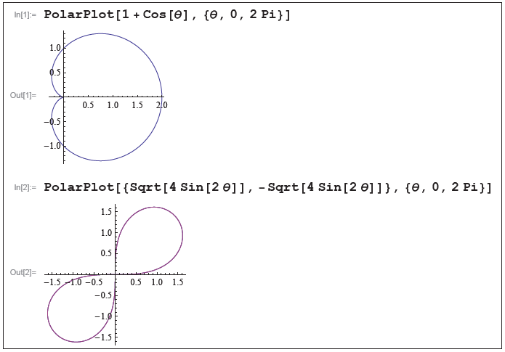
Technology Note: Graphing Polar Equations (cont.)
Figure 17 Graphing Polar Equations in Mathematica

