Slide 1
Section 9.4
Calculus in Polar Coordinates

Slide 2
Tangents to Polar Curves
We will focus on the most commonly occurring polar curves, those defined by an equation of the form r = f(θ ). If we are interested in determining the tangent to a polar curve at a particular point, it is important to realize we are still primarily interested in dy/dx — Exercise 19 and the examples below illustrate why. And to find dy/dx, we use the coordinate conversion equations to write

Slide 3
Tangents to Polar Curves (cont.)
We now have two equations in the parameter θ describing the curve, and if f is a differentiable function of θ, then when

Slide 4
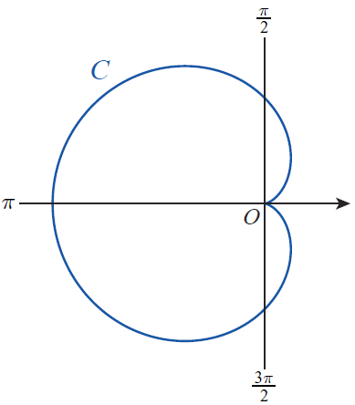
Example 1: Finding Points Where a Polar Curve Has a Horizontal or Vertical Tangent
Find all points where the cardioid C defined by r = 1 − cosθ has a horizontal or vertical tangent.
Figure 1 r = 1 − cosθ

Slide 5
Example 1: Finding Points Where a Polar Curve Has a Horizontal or Vertical Tangent (cont.)
Solution
Using the notation above, and so

Slide 6
Example 1: Finding Points Where a Polar Curve Has a Horizontal or Vertical Tangent (cont.)
By determining where the numerator and denominator of this fraction are equal to 0, we can locate the horizontal and vertical tangent lines of the cardioid (we restrict attention to since the cardioid is traced out exactly once over this parametric interval).

Slide 7
Example 1: Finding Points Where a Polar Curve Has a Horizontal or Vertical Tangent (cont.)
The fraction as a whole is 0 when the numerator is 0 and the denominator is not 0, and the fraction is undefined when the exact opposite occurs. Thus,
C has horizontal tangent lines at θ = 2π/3 and θ = 4π/3;
C has vertical tangent lines at θ = π, θ = π/3, and θ = 5π /3.

Slide 8
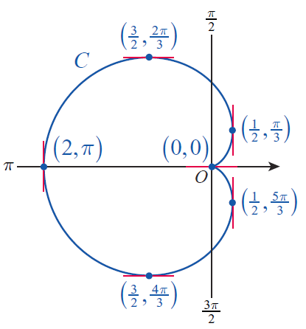
Example 1: Finding Points Where a Polar Curve Has a Horizontal or Vertical Tangent (cont.)
The points on C corresponding to these values of the parameter θ are shown in Figure 2.
Figure 2

Slide 9
Example 1: Finding Points Where a Polar Curve Has a Horizontal or Vertical Tangent (cont.)
The point (0, 0), which is both the initial and terminal point of C, requires a bit more analysis to prove the existence of a tangent line. Since both the numerator and denominator are 0 at θ = 0 (or 2π ), L’Hôpital’s Rule is called for:
so C has a horizontal tangent line at (0, 0).

Slide 10
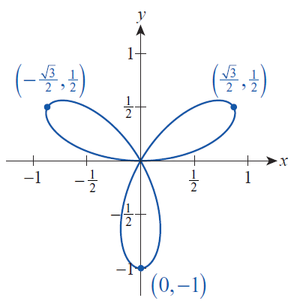
Example 2: Finding Slopes of Lines Tangent to a Polar Curve
Figure 3 depicts the 3-petaled rose r = sin 3θ. Determine the slopes of the lines tangent to the tips of each petal.
Figure 3 r = sin 3θ

Slide 11
Example 2: Finding Slopes of Lines Tangent to a Polar Curve (cont.)
Solution
Although we want to find dy/dx at each petal tip, we must first identify the value of the parameter θ at each tip by solving the equation dr/dθ = 0. This works because each tip is a point on the parametric curve where r makes the transition from being an increasing function of θ to a decreasing function of θ. Note that the rose is traced out entirely over a parametric interval of [0, π ], so we look for values of θ restricted to this interval.

Slide 12
Example 2: Finding Slopes of Lines Tangent to a Polar Curve (cont.)
Now, since y = sin 3θ sinθ and x = sin 3θ cosθ, we know that
We leave it as an exercise (Exercise 63) to show that

Slide 13
Example 2: Finding Slopes of Lines Tangent to a Polar Curve (cont.)
Alternatively, since dr/dθ = 0 at each point (x, y) at the tip of a petal, and the slope of the line passing through the origin and (x, y) is y/x, we can find the slope of these three specific tangent lines by calculating the negative reciprocal, or −x/y, at each of the three tips. But this only works for these particular tangents to the curve—other tangents require knowing dy/dx.

Slide 14
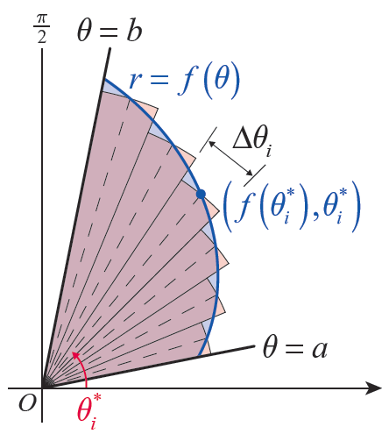
Area and Arc Length in Polar Coordinates
Suppose R is a region bounded between two rays θ = a and θ = b, where 0 < b − a ≤ 2π, and by the polar equation r = f(θ ), where f is a continuous positive function as shown in Figure 4. We can find the area A of the region by following the same sort of Riemann sum construction that we used in Chapter 5.
Figure 4
Area of a Polar Region

Slide 15
Area and Arc Length in Polar Coordinates (cont.)
To do so, recall that the area of a sector of a circle is given by the formula where r is the radius of the circle and θ is the angle defining the sector (this follows from the fact that the sector’s area is θ /2π times the area of the complete circle, π r²).

Slide 16
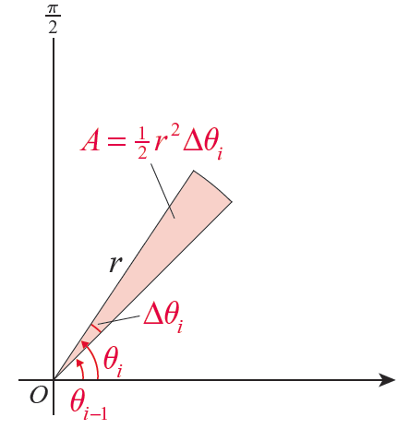
Area and Arc Length in Polar Coordinates (cont.)
If we partition the θ ‑interval [a, b] into n subintervals defined by the n + 1 points
as shown in Figure 4, then the area of the i^{th} sector is depicted in Figure 5.
Figure 5

Slide 17
Area and Arc Length in Polar Coordinates (cont.)
And similar to our previous Riemann sum approximations, the radius r of this i^{th} sector can be given the value where is any sample angle chosen from the subinterval
Adding up the areas of the n sectors, we have the following Riemann sum.

Slide 18
Area and Arc Length in Polar Coordinates (cont.)
In the limit of finer and finer partitions, we arrive at the following formula for the area of such a polar region.

Slide 19
Theorem: Area of a Polar Region
The area A of a region bounded between two rays θ = a and θ = b, where 0 < b − a ≤ 2π, and by the polar equation r = f (θ ), where f is a continuous positive function, is given by

Slide 20
Example 3: Finding the Area of a Polar Region
Find the area enclosed by the rose r = sin 3θ.
Solution
The graph of the polar equation r = sin 3θ is shown in Figure 3. By symmetry, we only need to find the area of one petal and then triple it to find the total area. But in order to find the area of one petal, we need to determine appropriate rays θ = a and θ = b that bound the petal.
Figure 3 r = sin 3q

Slide 21
Example 3: Finding the Area of a Polar Region (cont.)
If we choose to work with the petal in the first quadrant, then it is fairly clear that θ = 0 is the lower bound (we will verify that guess soon). And since we have already determined that the tip of the petal occurs at θ = π/6, we might feel comfortable guessing that θ = π /3 is the other bounding ray. But how would we determine this if we hadn’t already done the work of Example 2? We would do so by identifying the values of θ for which r = f(θ ) = 0; remember that the entire polar curve is traced out over the interval [0, π], so we only need to look for θ ’s in that interval.

Slide 22
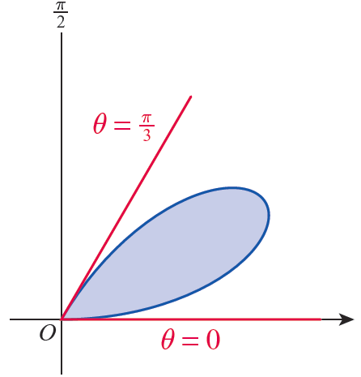
Example 3: Finding the Area of a Polar Region (cont.)
Since sin 3θ = 0 when 3θ is a multiple of π, the values we seek are θ = 0, π/3, 2π /3, and π. The first‑quadrant petal is bounded by θ = 0 and θ = π /3, as shown in Figure 6. (Note that, somewhat counterintuitively, the downward-pointing petal is bounded by θ = π /3 and θ = 2π /3, since sin 3θ is negative for θ ’s in that interval.)
Figure 6
One Petal of r = sin 3θ

Slide 23
Example 3: Finding the Area of a Polar Region (cont.)
We are now ready to find the area enclosed by one petal.
And so the entire area enclosed by r = sin 3θ is as follows.

Slide 24
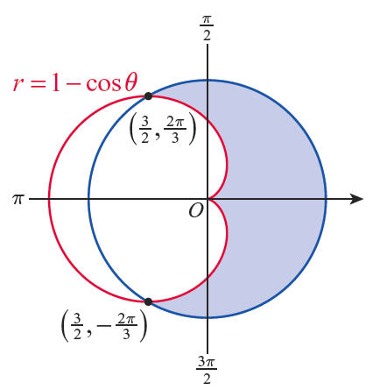
Example 4: Finding the Area between Two Polar Curves
Find the area of the region outside the cardioid r = 1 − cosθ and inside the circle that intersects the cardioid at the two points indicated in Figure 7.
Figure 7
Area between Polar Curves

Slide 25
Example 4: Finding the Area between Two Polar Curves (cont.)
Solution
We find the area between two polar curves in the same way we find the area between two functions of x—by subtracting the area under the smaller function from the area under the larger function. The only difference is that in this context, “larger” means farther away from the origin, and we must remember to use the polar integral formula for area.

Slide 26
Example 4: Finding the Area between Two Polar Curves (cont.)
In general, if for a ≤ θ ≤ b, the area bounded by the rays θ = a and θ = b and the two curves r = g(θ) and r = f(θ) is given by

Slide 27
Example 4: Finding the Area between Two Polar Curves (cont.)
In this example, and the two rays are as shown in Figure 7. And from the two points of intersection of the curves, we can deduce that that is, the larger curve is the circle of radius centered at the origin. So the area between the two curves is calculated as follows.

Slide 28
Example 4: Finding the Area between Two Polar Curves (cont.)

Slide 29
Area and Arc Length in Polar Coordinates (cont.)
The last formula we will restate in terms of polar coordinates is the arc length formula, and we will again make use of what we already know about parametric equations. In Section 9.2, we determined that the arc length of a curve defined parametrically over an interval [a, b] is
In this context, the parameter is θ, and if our polar curve is given as then we know and

Slide 30
Area and Arc Length in Polar Coordinates (cont.)
This formula is often written in terms of r, in which case it appears as follows.

Slide 31
Theorem: Arc Length of a Polar Curve
Assume the curve C is defined by r = f (θ ) over the θ ‑interval [a, b], where f has a continuous first derivative over the interval and the curve is traced out exactly once (except possibly for a finite number of self‑intersections). Then the arc length of C is given by

Slide 32
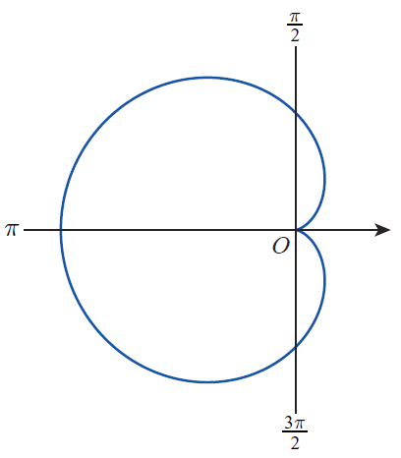
Example 5: Finding the Arc Length of a Polar Curve
Find the arc length of the cardioid r = 1 − cosθ.
Solution
The curve from Figure 1, which we are very familiar with now, is shown again in Figure 8.
Figure 8 r = 1 − cosθ

Slide 33
Example 5: Finding the Arc Length of a Polar Curve (cont.)
Note that
Since we need to integrate the square root of this expression, the trigonometric identity is useful.

Slide 34
Example 5: Finding the Arc Length of a Polar Curve (cont.)

