Slide 1
Section 9.5
Conic Sections in Cartesian Coordinates

Slide 2
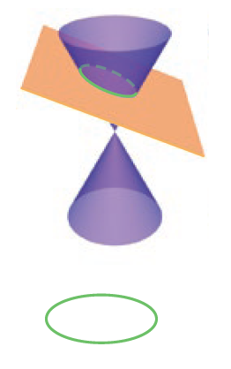

Conic Sections in Cartesian Coordinates
To begin, the three families of curves are collectively known as conic sections because each type of curve arises from the intersection of a plane with a (double) circular cone.
As shown in Figure 1, an ellipse is a closed curve resulting from the intersection of a plane with only one nappe of the cone (the two nappes of a cone each extend outward from the common vertex).
Ellipse

Slide 3
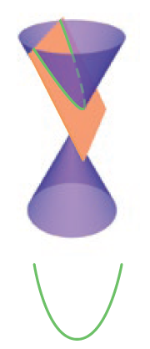
Conic Sections in Cartesian Coordinates (cont.)
A parabola results from intersecting a cone with a plane that is parallel to a line on the surface of the cone passing through the vertex; note that a parabola also intersects only one nappe of the cone.
Parabola

Slide 4
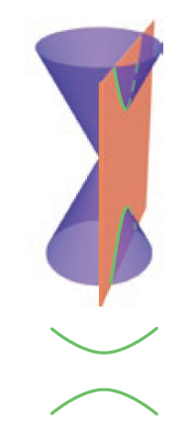
Conic Sections in Cartesian Coordinates (cont.)
Finally, a hyperbola is the intersection of a cone with a plane that intersects both nappes. In each case, we specify that the intersecting plane does not contain the vertex—a figure that results when the intersecting plane does contain the vertex is called a degenerate conic section and is a point, a line, or a pair of intersecting lines.
Hyperbola

Slide 5
Definition: Algebraic Classification of Conic Sections
As a curve in the Cartesian plane, every conic section is the graph of an equation of the form
Ax² + Bxy + Cy² + Dx + Ey + F = 0, where the coefficients are real constants.

Slide 6
Definition: Algebraic Classification of Conic Sections (cont.)
Assuming the conic section described by such an equation is nondegenerate, the curve is
1. an ellipse if B² − 4AC < 0;
2. a parabola if B² − 4AC = 0;
3. a hyperbola if B² − 4AC > 0.
The quantity B² − 4AC is called the discriminant of the equation.

Slide 7
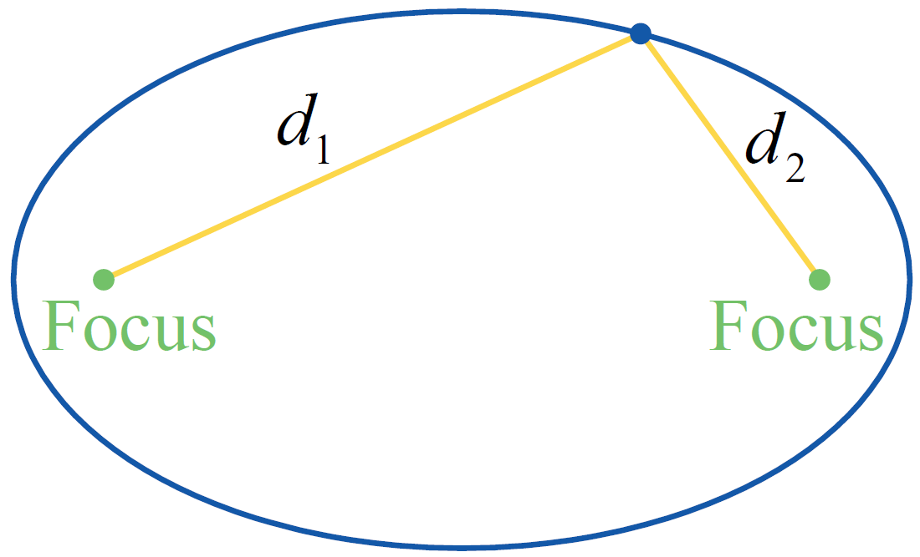
Definition: Geometric Characteristic of Ellipses
An ellipse consists of the set of points in the plane for which the sum of the distances d₁ and d₂ to two foci is a fixed constant (see Figure 2).
Figure 2 Ellipse

Slide 8
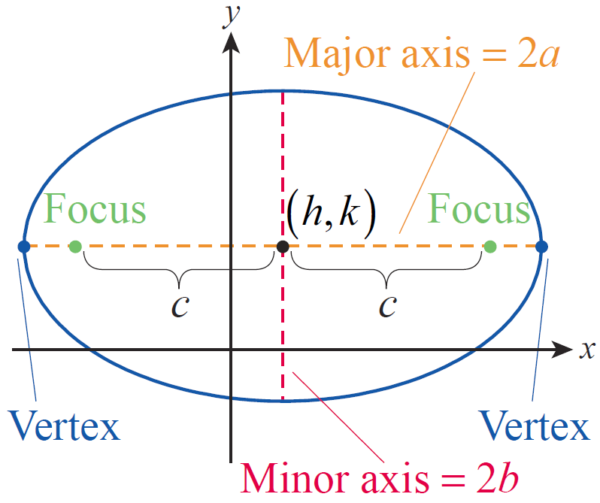
Ellipses
An ellipse with major and minor axes parallel to the x- and y-axes, respectively, can be written in the standard form
Figure 3

Slide 9
Ellipses (cont.)
where (h, k) is the center of the ellipse and 2a and 2b are, respectively, the lengths of the horizontal and vertical axes of the ellipse (see Figure 3). The two foci lie on the major axis (the longer axis) of the ellipse, each a distance c from the center of the ellipse, where c² = a² − b².
Figure 3

Slide 10
Ellipses (cont.)
In general, we assume a ≥ b; note that c = 0 if and only if a = b, in which case the ellipse is a circle and the two foci coincide with the center. The two vertices are located at the ends of the major axis, each a distance a from the center. If the equation above is rewritten in the form
it is clear that it falls under the algebraic classification of an ellipse, as the discriminant is

Slide 11
Ellipses (cont.)
For an ellipse whose major axis is parallel to the y‑axis, the corresponding equation has the form
where we again assume a ≥ b.

Slide 12
Example 1: Graphing an Ellipse and Finding Its Foci
Graph the equation 25x² + 4y² + 100x − 24y + 36 = 0, and determine the foci of the resulting ellipse.
Solution
The fact that the coefficients of x² and y² are both positive tells us that the discriminant is negative and thus falls into the classification of an ellipse, but we know little else from the equation in this form.

Slide 13
Example 1: Graphing an Ellipse and Finding Its Foci (cont.)
By completing the square in both variables and rearranging terms, we can learn more.

Slide 14
Example 1: Graphing an Ellipse and Finding Its Foci (cont.)
In this form, we can infer that the center of the ellipse is the point (−2, 3), that a = 5 and b = 2, and that the major axis is vertical. Further, since c² = a² − b² = 21, , and so the foci are located ±4.6 units away from the center, or at approximately (−2, −1.6) and (−2, 7.6).

Slide 15
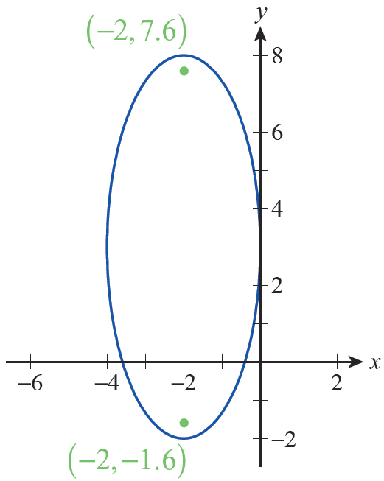
Example 1: Graphing an Ellipse and Finding Its Foci (cont.)
A graph of the ellipse is shown in Figure 4.
Figure 4

Slide 16
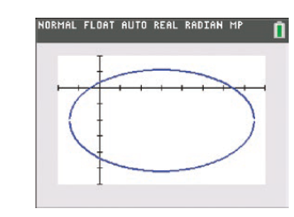
Technology Note: Graphing an Ellipse
A graphing calculator or CAS can be used to sketch the graph of an ellipse, with the specific commands varying with the technology. Figure 5 shows the graph of the ellipse x² − 6x + 2y² + 8y = 3 on a TI-84 Plus.
Figure 5 [−2,8] by [−6,2]

Slide 17
Technology Note: Graphing an Ellipse (cont.)
In order to generate this graph, the equation of the ellipse needs to be solved for y and then both the positive and negative square roots that result entered into the Y= editor.
The Mathematica command ContourPlot, used for this purpose, requires only three arguments: an equation, an interval for the variable x, and an interval for the variable y.

Slide 18
Technology Note: Graphing an Ellipse (cont.)
Figure 6 illustrates the use of ContourPlot to graph the same ellipse, x² − 6x + 2y² + 8y = 3, with two additional arguments included that tell Mathematica to display the coordinate axes but not to display a frame around the graph.

Slide 19
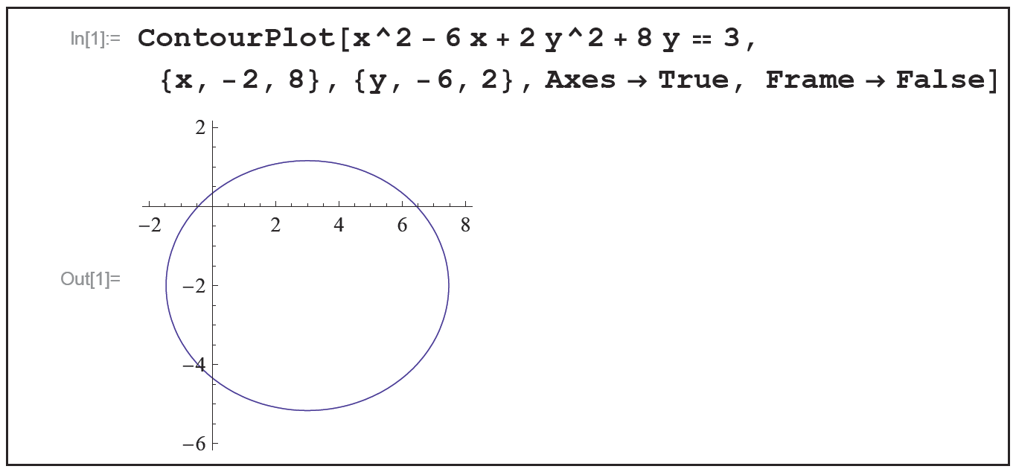
Technology Note: Graphing an Ellipse (cont.)
Figure 6

Slide 20
Definition: Eccentricity of an Ellipse
Given an ellipse with major and minor axes of lengths 2a and 2b, respectively, the eccentricity of the ellipse, often denoted by the symbol e, is defined by
If e = 0, then c = 0 and the ellipse is actually a circle. At the other extreme, c may be close to (but cannot equal) a, in which case e is close to 1. An eccentricity close to 1 indicates a relatively narrow ellipse.

Slide 21
Theorem: Kepler’s Laws of Planetary Motion
1. Each planet revolves around the sun in an elliptical orbit, with the sun at one focus of the ellipse.
2. A line segment between the sun and a given planet sweeps out equal areas of the ellipse over equal periods of time.
3. The ratio of the square of the period of one revolution of a planet and the cube of the length of the semimajor axis of its orbit is a constant independent of the planet.

Slide 22
Example 2: Estimating the Closest Approach of Earth to the Sun
Given that the furthest Earth gets from the sun is approximately 94.56 million miles and that the eccentricity of Earth’s orbit is approximately 0.017, estimate the closest approach of the Earth to the sun.
Solution
Kepler’s First Law states that each planet follows an elliptical orbit and that the sun is positioned at one focus of the ellipse. Thus, Earth is furthest from the sun when Earth is at the end of the ellipse’s major axis on the other side of the center from the sun.

Slide 23
Example 2: Estimating the Closest Approach of Earth to the Sun (cont.)
Using our standard terminology, and units of millions of miles, this means that
a + c = 94.56.
By the definition of eccentricity, we also know that
or c = 0.017a. Combining these pieces of information, we get 1.017a = 94.56, leading to a ≈ 92.98 million miles. From this, we know c ≈ (0.017)(92.98) ≈ 1.58 million miles. The closest approach to the sun must be a − c, which is approximately 91.40 million miles.

Slide 24
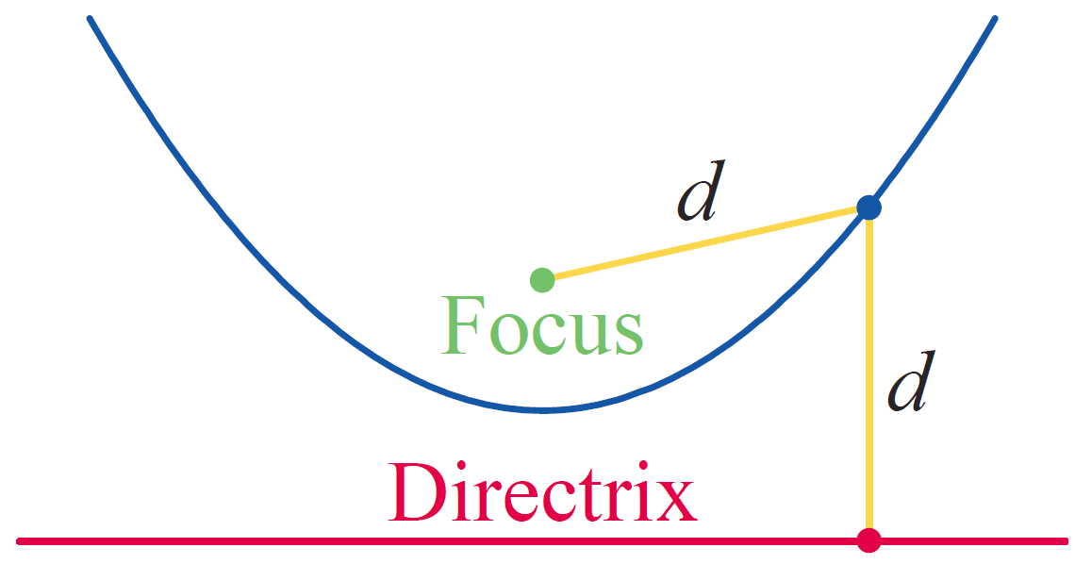
Definition: Geometric Characteristic of Parabolas
A parabola consists of the set of points in the plane that are the same distance d from a line (called the directrix) and a point not on the line (called the focus). See Figure 7 for an illustration of this property.
Figure 7 Parabola

Slide 25
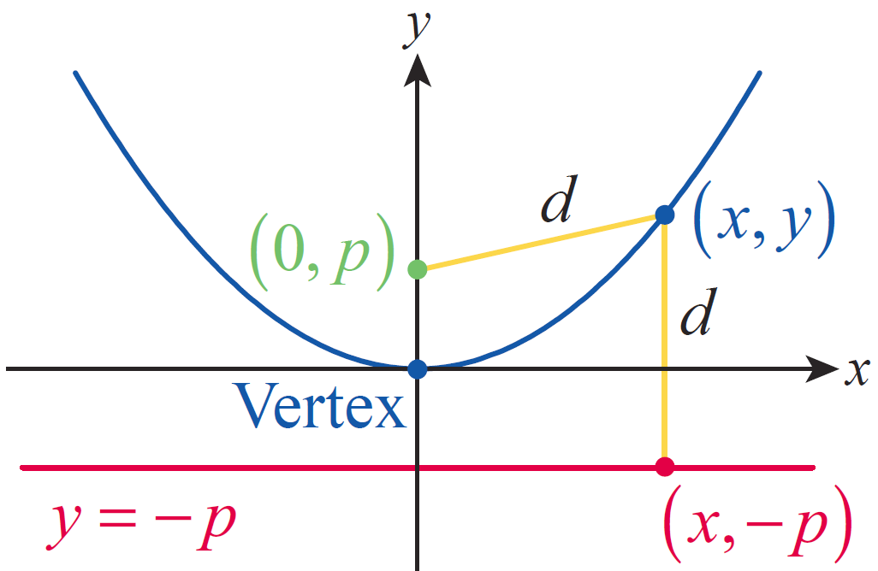
Parabolas
The general form for the equation of a parabola can be constructed by beginning with a parabola oriented as in Figure 8, where the vertex of the parabola has been
placed at the origin, the focus is the point (0, p), and the directrix is the line y = −p (the distance |p| is called the focal length of the parabola).
Figure 8

Slide 26
Parabolas (cont.)
The geometric property above leads immediately to the algebraic relationship
which, after
squaring both sides and simplifying, becomes x² = 4py. This can be generalized to describe a parabola with vertex at (h, k) by replacing x with x − h and y with y − k, giving us the equation (x − h)² = 4p(y − k). And to describe parabolas opening horizontally, the roles of x and y are simply reversed.

Slide 27
Parabolas (cont.)
In sum, a parabola oriented vertically or horizontally with vertex at (h, k) and focus p units from the vertex can be written in one of the two standard forms below.

Slide 28
Parabolas (cont.)
Vertically oriented parabola:
Horizontally oriented parabola:
Note that if either equation is written in the form
Ax² + Bxy + Cy² + Dx + Ey + F = 0, B = 0 and either A = 0 or C = 0, so the discriminant B² − 4AC = 0 and indicates that the equation corresponds to a parabola.

Slide 29
Example 3: Finding the Focus and Directrix of a Parabola
Find the focus and directrix of the parabola
−y² + 2x + 2y + 5 = 0.
Solution
Since y is the squared variable, we know from the outset that the parabola is oriented horizontally. To identify the focus and directrix, we rewrite the equation by completing the square and factoring out a 4 in the final form.

Slide 30
Example 3: Finding the Focus and Directrix of a Parabola (cont.)
In this form, we can see that the vertex of the parabola is at (−3, 1) and that

Slide 31
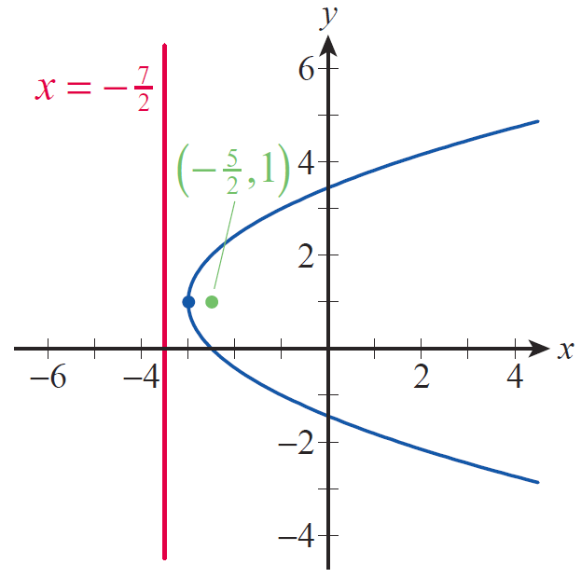
Example 3: Finding the Focus and Directrix of a Parabola (cont.)
Since p is positive the parabola opens to the right, the focus is at and the directrix is the line as illustrated in Figure 9.
Figure 9

Slide 32
Parabolas (cont.)
An important example of a parabola is the path of a thrown object under the influence of gravity (ignoring friction and other forces). Algebraically, we know that the height h(t) of an object with initial velocity v₀ and initial height h₀ is
where g, a constant, is the acceleration due to gravity (see Example 3 in Section 3.1).

Slide 33
Example 4: Finding the Focus of a Parabolic Mirror
The Hale Telescope at Palomar Observatory in California is a very large reflecting telescope. The paraboloid is the top surface of a large cylinder of Pyrex glass 200 inches in diameter. Along the outer rim, the cylinder is 26.8 inches thick, while at the center, it is 23 inches thick. Where is the focus of the parabolic mirror located?

Slide 34
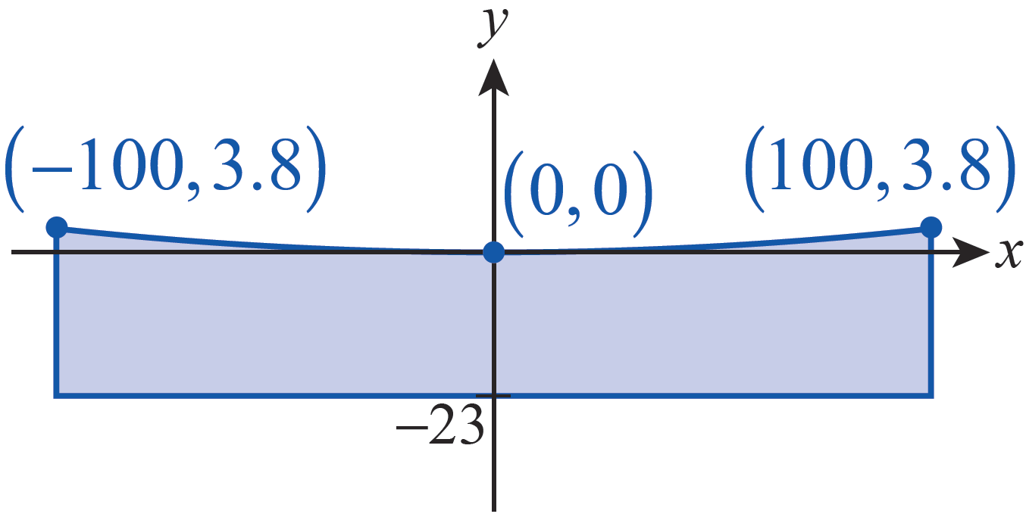
Example 4: Finding the Focus of a Parabolic Mirror (cont.)
Solution
First, we need to draw a picture of the situation. In order to make the math as easy as possible, we can locate the origin of our coordinate system at the vertex
of a parabolic cross-section of the mirror, and we can assume the parabola opens upward (see Figure 11).
Figure 11

Slide 35
Example 4: Finding the Focus of a Parabolic Mirror (cont.)
Since we placed the vertex at (0, 0), we know the equation x² = 4py describes the shape of the cross-section for some value p. If we can determine p, we can find the focus of the parabola.
To find p, we need the coordinates of another point on the parabola. The difference in thickness of the mirror between the center and the outer rim is 3.8 inches, and the mirror has a diameter of 200 inches, so the two points (−100, 3.8) and (100, 3.8) must lie on the graph.

Slide 36
Example 4: Finding the Focus of a Parabolic Mirror (cont.)
Substituting the coordinates of one of these points into the equation x² = 4py, we can solve for p.
We know that the focus of a parabola is p units from the vertex, so the focus of the Hale Telescope is nearly 55 feet from the mirror.

Slide 37
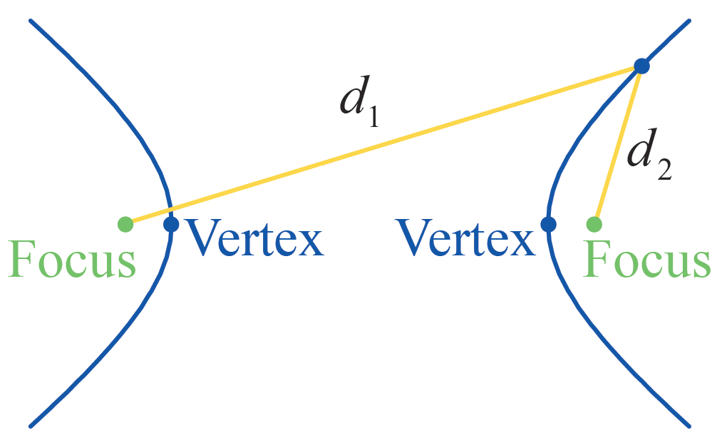
Definition: Geometric Characteristic of Hyperbolas
A hyperbola consists of the set of points in the plane for which the absolute value of the difference between the distances d₁ and d₂ to two foci is fixed (see Figure 12).
Figure 12 Hyperbola

Slide 38
Hyperbolas
The standard form of the equation for a hyperbola whose foci are aligned horizontally or vertically is shown below.
Foci aligned horizontally:
with asymptotes
Foci aligned vertically:
with asymptotes

Slide 39
Hyperbolas (cont.)
In both cases, the center of the hyperbola is (h, k), the vertices are located a units on either side of the center, and the foci are c units away from the center, where
c² = a² + b². Note that if either equation is rewritten in the form Ax² + Bxy + Cy² + Dx + Ey + F = 0, the discriminant is equal to B² − 4AC = 4a²b² > 0.

Slide 40
Example 5: Finding the Foci, Vertices, and
Asymptotes of a Hyperbola
Find the foci, vertices, and asymptotes of the hyperbola.
−16x² + 9y² + 96x + 18y = 279
Solution
As in Examples 1 and 3, we complete the square and rewrite the equation to put it in a more meaningful form.

Slide 41
Example 5: Finding the Foci, Vertices, and
Asymptotes of a Hyperbola (cont.)
This tells us that the foci are aligned vertically (since the positive fraction is in terms of y), that a = 4, b = 3, and the center is (3, −1). So the vertices are the two points (3, −1 −4) = (3, −5) and (3, −1 +4) = (3, 3).

Slide 42
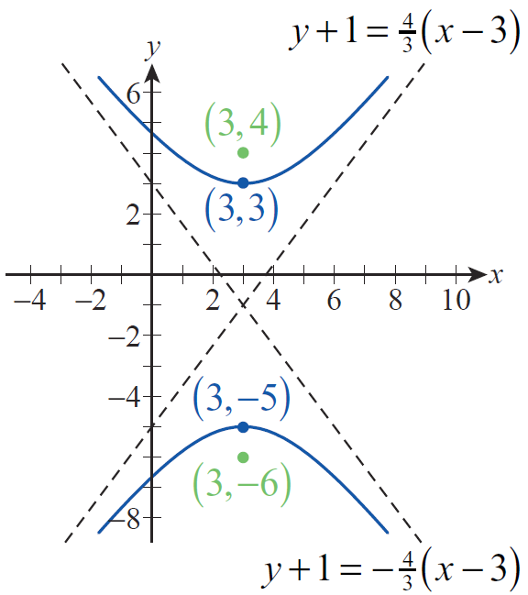
Example 5: Finding the Foci, Vertices, and
Asymptotes of a Hyperbola (cont.)
To locate the foci, we first calculate c from the fact that c² = a² + b²; this gives us c = 5 in this case, so the two foci are the points (3, −1 − 5) = (3, −6) and (3, −1 +5) = (3, 4). Finally, the two asymptotes are the lines shown as dashed lines in Figure 13.
Figure 13

Slide 43
Rotating Conic Sections
Recall that the general form of the equation for a conic section is Ax² + Bxy + Cy² + Dx + Ey + F = 0. Geometrically, the condition B ≠ 0 leads to a conic that is not oriented vertically or horizontally. The ellipses, parabolas, and hyperbolas graphed so far have all been aligned so that the axis (or axes in the case of ellipses or hyperbolas) of symmetry is parallel to the x-axis or y-axis. If B ≠ 0, the graph is a conic section that has been rotated through some angle θ. We can exploit this fact to make the graphing of a rotated conic section relatively easy.

Slide 44
Rotating Conic Sections (cont.)
Our method will be to introduce a new set of coordinate axes (i.e., a second Cartesian plane) rotated by an acute angle θ with respect to the original coordinate axes and then to graph the conic in the new coordinate system. Algebraically, the goal is to begin with an equation of the form
Ax² + Bxy + Cy² + Dx + Ey + F = 0
and define a new set of coordinate axes x′ and y′ in which the equation has the form

Slide 45
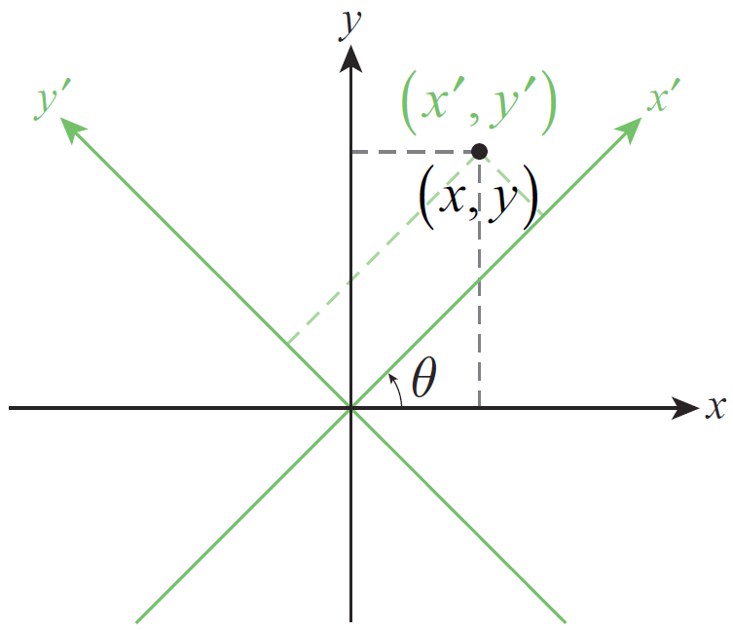
Rotating Conic Sections (cont.)
We begin with a picture. Figure 14 is an illustration of two rectangular coordinate systems, with the new system rotated by an acute angle with respect to the original. The point in Figure 14 has two sets of coordinates corresponding to the two coordinate planes.
Figure 14 Two Coordinate Systems

Slide 46
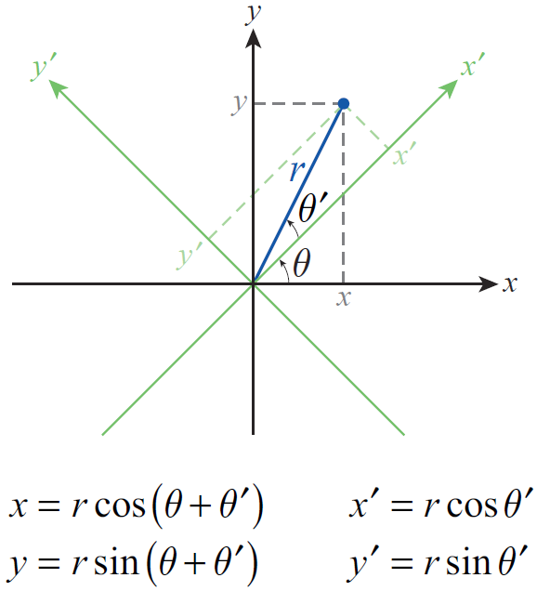
Rotating Conic Sections (cont.)
However, the distance r between the origin and the point is the same in both, and this fact along with the introduction of the angle
θ ′ shown in Figure 15 allow us to relate the two sets of coordinates.
Figure 15 Relation between x′, y′, x, and y

Slide 47
Rotating Conic Sections (cont.)
We can now apply one of the trigonometric identities.
Similarly,

Slide 48
Rotating Conic Sections (cont.)
We will also need to be able to express x′ and y′ in terms of x and y, and we can do so through the clever application of another trigonometric identity. By multiplying the two equations we have just derived by respectively, and then adding the results, we obtain the following relation.

Slide 49
Theorem: Rotation Relations
Given a rectangular coordinate system with axes x′ and y′ rotated by an acute angle θ with respect to axes x and y, as in Figure 14, the two sets of coordinates
(x′, y′) and (x, y) for the same point are related by the following equations.

Slide 50
Example 6: Using Rotation Relations to Find x′y′-Coordinates
Given find the x′ y′-coordinates of the point with xy‑coordinates (−1, 5).
Solution
Using the rotation relations we calculate the x′ y′­coordinates as follows.

Slide 51
Example 6: Using Rotation Relations to Find x′y′-Coordinates (cont.)
The x′y′-coordinates are thus

Slide 52
Example 7: Using Rotation Relations to Convert an Equation to x′y′-Coordinates
Use the rotation to show that the graph of
xy = 1 is a hyperbola.
Solution
Using the angle in the rotation relations, we convert the equation as follows.

Slide 53
Example 7: Using Rotation Relations to Convert an Equation to x′y′-Coordinates (cont.)

Slide 54
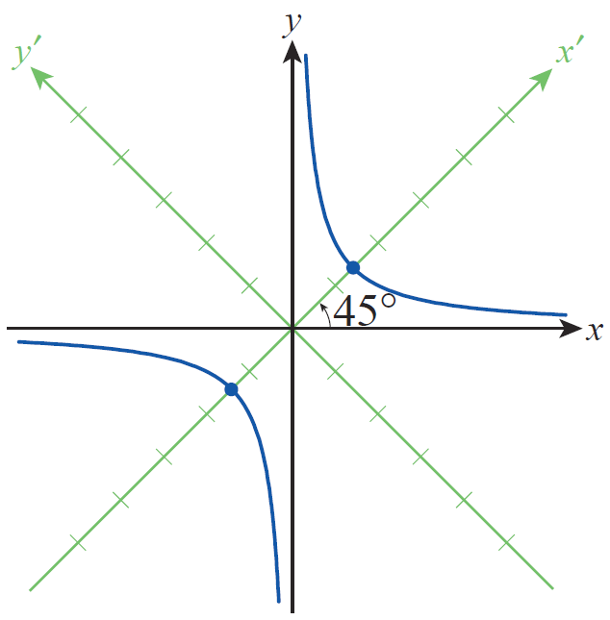
Example 7: Using Rotation Relations to Convert an Equation to x′y′-Coordinates (cont.)
We recognize this last equation as a hyperbola in the x′ y′-plane with its center at the origin and vertices away from the center on the x′‑axis. The asymptotes are which correspond to the x- and y-axes (see Figure 16).
Figure 16

Slide 55
Rotating Conic Sections (cont.)
Remember that the goal in general is to determine θ so that the conversion of the equation
has no x′ y′-term. Example 7 will serve as the inspiration; by replacing x and y with the corresponding expressions for x′ and y′ and then simplifying the result, we can derive a formula for the appropriate angle θ.
We begin with the replacements.

Slide 56
Rotating Conic Sections (cont.)
When the left-hand side of this equation is expanded and like terms collected, the result is an equation of the form

Slide 57
Rotating Conic Sections (cont.)
where

Slide 58
Rotating Conic Sections (cont.)
Since we want B′ = 0, this gives us an equation in 𝜃 to solve. To do so, we will use the double‑angle identities for both sine and cosine in reverse.

Slide 59
Definition: Elimination of the xy‑Term
The graph of the equation
Ax² + Bxy + Cy² + Dx + Ey + F = 0 in the xy-plane is the same as the graph of the equation in the x′y′‑plane, where the acute angle of rotation θ between the two coordinate systems satisfies

Slide 60
Example 8: Graphing a Rotated Conic Section
Graph the conic section by first determining the appropriate angle 𝜃 by which to rotate the axes.
Solution
Since the angle θ is to be acute, it must be the case that and hence

Slide 61
Example 8: Graphing a Rotated Conic Section (cont.)
By the rotation relations, then
and

Slide 62
Example 8: Graphing a Rotated Conic Section (cont.)
We make these substitutions in the given equation as follows.

Slide 63
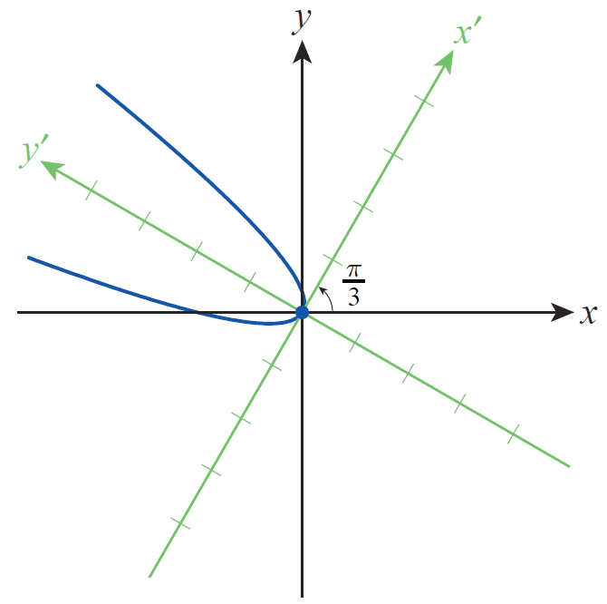
Example 8: Graphing a Rotated Conic Section (cont.)
Multiplying out and collecting like terms in this equation results in
which we recognize as the equation of a parabola with its vertex at the origin. The graph of this equation in the x′ y′-plane is shown in Figure 17.
Figure 17

