Slide 1
Section 1.1
Functions and How We Represent Them

Slide 2
TOPICS
Relations and Functions
The Language of Functions
Ways of Describing Functions
The Power of Graphs

Slide 3
Definition: Relation, Domain, and Range
Relation, Domain, and Range
Given two sets A and B, a relation R from A to B is a set of ordered pairs of the form (a,b), where a ∈ A and b ∈ B. (An ordered pair is just what it sounds like—a pair of elements written in such a way that it is obvious which is the first element and which is the second.)

Slide 4
Definition: Relation, Domain, and Range
Relation, Domain, and Range (cont.)
Given any particular relation R from A to B, the set of all the first elements (the first coordinates) of the ordered pairs is called the domain of R, and the set of all second elements (the second coordinates) is called the range of R. Using set-builder notation, we can write
and

Slide 5
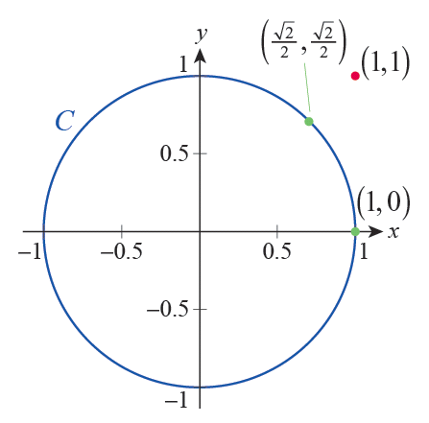
Example 1 – Examples of Relations
a. For real numbers x and y, suppose they are in relation C (i.e., (x,y)∈C) if they satisfy the equation x² + y² = 1. For example, (1, 0)∈C, but (1, 1)∉C. Figure 1 shows the graph of the equation defining C. (Can you see why we called the relation C?)
Figure 1

Slide 6
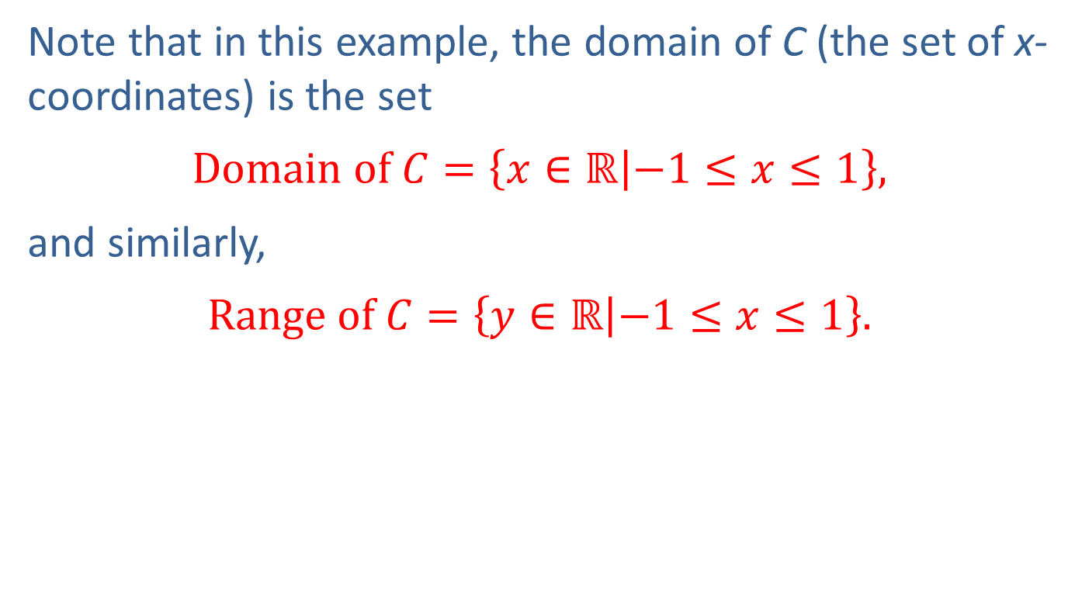
Example 1a (cont.)
Note that in this example, the domain of C (the set of x­coordinates) is the set
$$Domain of C=\left\{x∈ℝ | −1≤x≤1\right\},$$
and similarly,
$$Range of C=\left\{y∈ℝ | −1≤x≤1\right\}.$$

Slide 7
Example 1 (cont.)
b. The following set of ordered pairs is a relation from ℝ to ℝ.
Examining the first and second coordinates of the ordered pairs, respectively, we see that
while

Slide 8
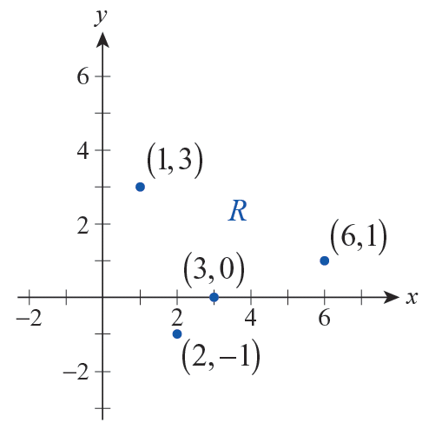
Example 1b (cont.)
Notice that just as we did in part a., we can represent this relation in the Cartesian coordinate system.
Figure 2

Slide 9
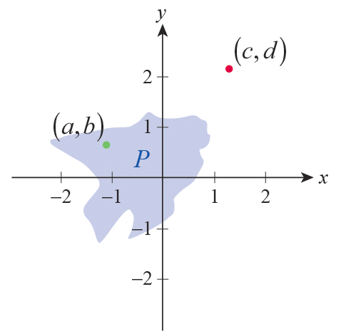
Example 1 (cont.)
c. Figure 3 can be used to define relation P. Note that two real numbers x and y are in relation P if the point (x,y) falls in the shaded area or its boundary. For example, as shown by the illustration, but
Figure 3

Slide 10
Example 1 (cont.)
d. Suppose that the student population on a particular college campus speaks a total of five languages: English, Chinese, German, Japanese and Spanish. If we represent the above set of languages by {E, C, G, J, S} the following relation L from the set of students to the set of languages arises quite naturally.

Slide 11
Example 1d (cont.)
Notice that the domain of L is the set of students at the college, while the range is the set of the five given languages. Supposing that Chihiro speaks English and Japanese, but not Spanish, we can express this in symbols by writing

Slide 12
Definition: Functions and Function Notation
Functions and Function Notation
A function f from a set A to a set B is a relation from A to B with the additional property that each element a ∈ A is related to exactly one element b ∈ B. Instead of writing we typically use function notation and write b = f(a). In other words, given a ∈ A, f(a) is the unique element of B associated with a.

Slide 13
Definition: Functions and Function Notation
Functions and Function Notation (cont.)
The notation f(a) is read “f of a,” and when A and B are sets of numbers, f(a) is often referred to as the value of f at a. The notation f : A → B is used to indicate that f is a function (not just a relation) from the set A to the set B.

Slide 14
Caution
Caution
Don’t be misled by the parentheses in the function notation to think that f(a) might represent the product of f and a! While parentheses do often indicate multiplication, they are also used in defining functions.

Slide 15
The Language of Functions
The notation f : A → B automatically indicates that the domain of f is A. In this context, the set B is called the codomain of f . As with relations, the range of f is the set of elements of B that are “used” by f. Using function notation, we can quickly note that the range of f is thus the set

Slide 16
The Language of Functions
If a is a symbol representing an arbitrary element of the domain of f, then a is called an independent variable. And, as above, if b is used to represent an arbitrary element of the range of f, then b is called a dependent variable.

Slide 17
Example 2
Indicate which of the relations from Example 1 are functions, and for those functions make the distinction between the codomain and the range.
Solution
a. The way in which y depends on x in part a. of Example 1 does not demonstrate functional dependence. Consider, for example, the fact that both of the pairs (0, 1) and (0, −1) are in the relation C, and thus 0 is related to both 1 and −1.

Slide 18
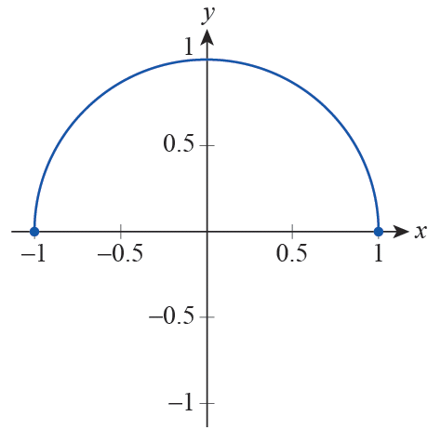
Example 2a (cont.)
However, if we express y from the equation by considering only the positive square root as follows:
then the above difficulty is eliminated. Indeed, we obtained a function whose graph is the upper semicircle of radius 1, centered at the origin.

Slide 19

Example 2a (cont.)
Notice that we can still consider $\left\{x∈\text{ℝ} | −1≤x≤1\right\}$ to be the domain of our function; however, the set of elements “used” by f, the range of f, is the following smaller set.
$$\left\{y∈\text{ℝ} | 0≤y≤1\right\}$$

Slide 20
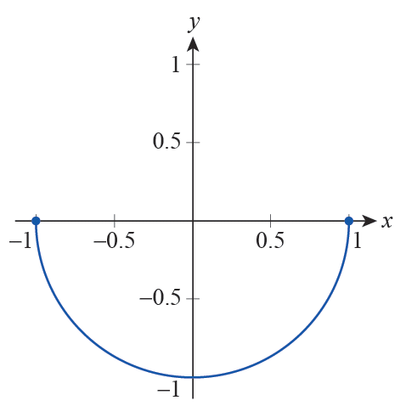
Example 2a (cont.)
Finally, let us also note that in the case of we obtain a different function whose graph is the lower semicircle.

Slide 21
Example 2 (cont.)
b. The relation defined in part b. of the previous example is a function. It is easy to check by inspection that each domain element is related to exactly one value.
The codomain of R is ℝ while the range of R is {−1, 0, 1, 3}.

Slide 22
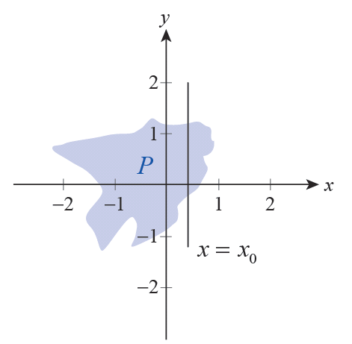
Example 2 (cont.)
c. Examining the graph of the relation given in part c. of Example 1, it is easily seen that this relation is not a function. By picking an appropriate x­-value x = x₀ and drawing a vertical line through it, we see that the y‑coordinate of any point falling on the line segment in the interior of the shading is related to x₀, thus leaving us with many choices for y₀.
Figure 6

Slide 23
Example 2 (cont.)
d. With regards to relation L given in part d. of Example 1, since there are students on campus (such as Chihiro) who speak more than one language, the relation L is not a function either.

Slide 24
Example 3
As we have seen in the preceding examples, we can define a relation or even a function by writing an equation in two variables and considering the set of ordered pairs satisfying our equation. Find the function defined by the given equation, and note the dependent and independent variables.

Slide 25
Example 3 (cont.)
Solution
a. Moving the terms containing y to the left side, we obtain

Slide 26
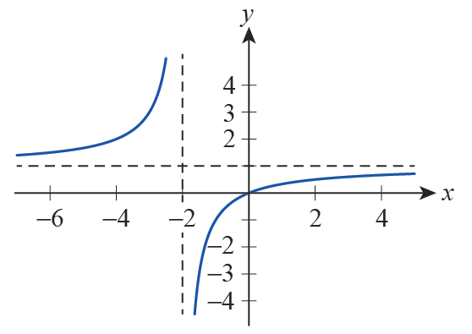
Example 3a (cont.)
We see that y is completely and unambiguously determined by x, so this is clearly a functional relationship with y being the dependent variable and x the independent variable. In other words, y is a function of x.

Slide 27
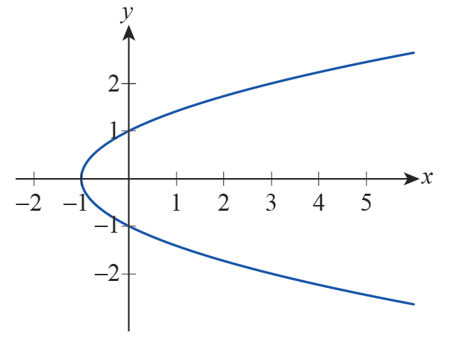
Example 3 (cont.)
b. Trying to express y as in part a. leads to the ambiguity
However, we can express x as a function of y in this case: x = y² − 1 defines x as a function of y; that is, y is the independent variable, and x is the dependent variable.

Slide 28
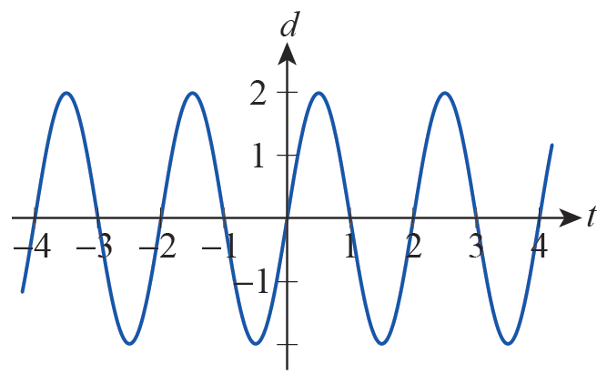
Example 3 (cont.)
c. We divide both sides of the equation by t for t ≠ 0 and obtain
with d being the dependent, and t the independent variable.
(This function is an
example of simple harmonic motion.)

Slide 29
The Language of Functions
Sometimes a function is given to us by means of a formula with no information regarding the domain. In such cases, by convention, the implied domain is the largest collection of points for which the formula returns a real number.

Slide 30
Example 4
Find the implied domain for each of the following functions, and also determine the range in each case.

Slide 31
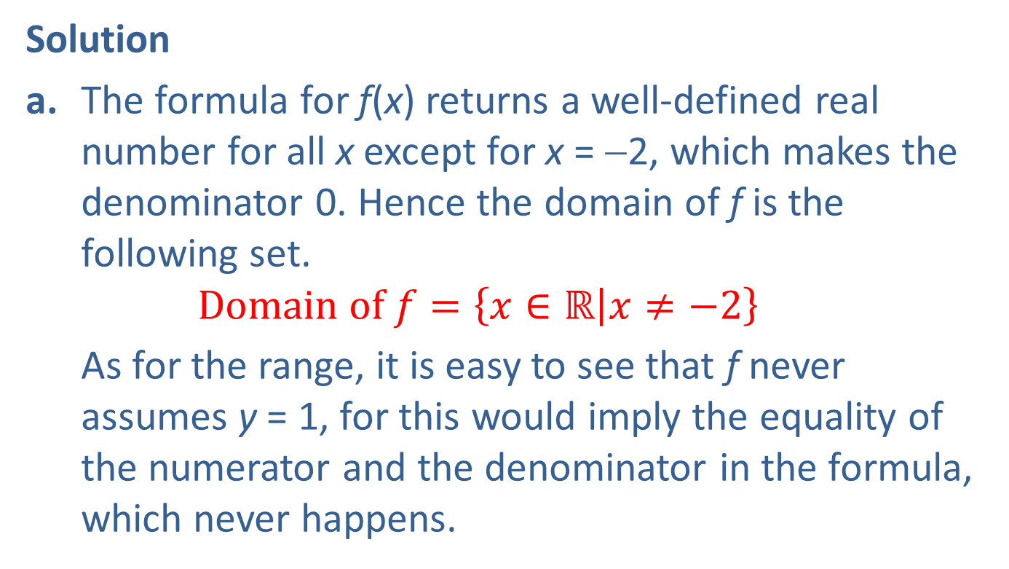
Example 4 (cont.)
Solution
a. The formula for f(x) returns a well‑defined real number for all x except for x = −2, which makes the denominator 0. Hence the domain of f is the following set.
$$Domain of f=\left\{x∈\text{ℝ} | x≠−2\right\}$$
As for the range, it is easy to see that f never assumes y = 1, for this would imply the equality of the numerator and the denominator in the formula, which never happens.

Slide 32
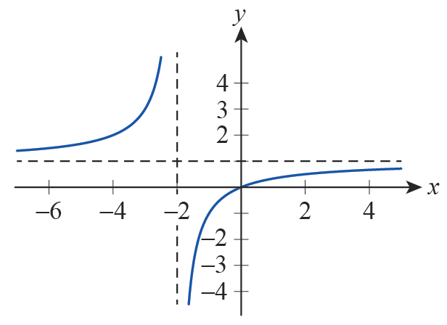

Example 4a (cont.)
In fact, being a rational function with the horizontal asymptote of y = 1, and having “opposing behavior” on the two sides of its vertical asymptote x = −2, we see that f assumes every real value except y = 1. Thus, the range of f is as follows.
$$Range of f=\left\{y∈\text{ℝ} | y≠−1\right\}$$

Slide 33

Example 4 (cont.)
b. Since we cannot have negative values under the square root, the only real numbers for which g(x) makes sense are those satisfying 4 − x² ≥ 0.
$$\text{D}\text{omain} \text{of} g=\left\{x∈\text{ℝ} | x^{2}≤4\right\}=\left\{x∈\text{ℝ} | −2≤x≤2\right\}$$

Slide 34
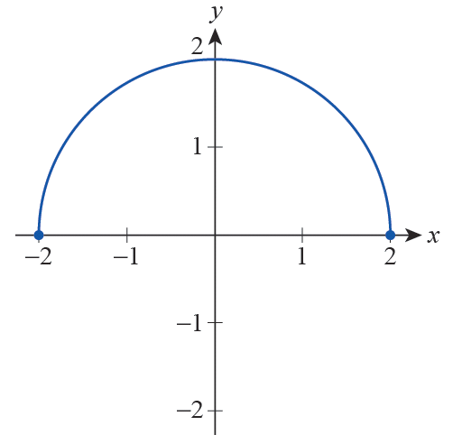
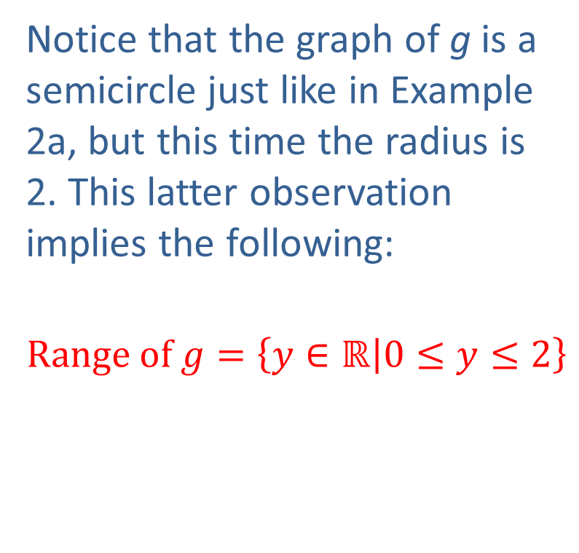
Example 4b (cont.)
Notice that the graph of g is a semicircle just like in Example 2a, but this time the radius is 2. This latter observation implies the following:
$$Range of g=\left\{y∈\text{ℝ} | 0≤y≤2\right\}$$

Slide 35
Ways of Describing Functions
The four most common ways to describe functional relationships are mathematical formulas, tables of data, graphs, and verbal descriptions.
In a formula such as A(r) = π ², the variable r is sometimes referred to as the argument of the function, but the exact symbol used for the argument is irrelevant. That is, A(s) = π ², A(radius) = π (radius)², and A(□) = π □ ² all describe exactly the same function A.

Slide 36
Example 5
Find the following formulas and rewrite them so as to explicitly express the functional relationship between the variables. Identify the argument in each case.
a. The area of an equilateral triangle
b. The stopping distance required by a car traveling at speed v from the moment the brakes are applied
c. The volume of a circular cylinder

Slide 37
Example 5 (cont.)
Solution
a. The area of an equilateral triangle of side length s is
(using the fact that the height h of an
equilateral triangle is
This formula can be rewritten as a
functional relationship with s being the argument explicitly showing how the area of an equilateral triangle depends on its side length.

Slide 38
Example 5 (cont.)
b. The stopping distance d required by a car traveling at speed v when the brakes are applied is estimated by the formula where μ is the coefficient of friction between the tires and the pavement, and g is the gravity constant. Since μ can also be considered a constant (at least in the short term, when conditions are nearly unchanging) we see that stopping distance depends on initial speed only.

Slide 39
Example 5b (cont.)
This can be expressed by the function
with v being the argument of function d. (Note the quadratic dependence of d on v! It certainly pays to observe all speed limit signs and warnings.)

Slide 40
Example 5 (cont.)
c. The volume of a circular cylinder is calculated by V = π r²h, where r is the radius of the base, and h stands for the height of the cylinder. Note that the volume here is a function of two independent quantities. We can express this functional relationship as follows.
Both r and h are considered arguments here, and thus V(r, h) is our first example of a function of two variables.

Slide 41
Technology Note
Technology Note
Functions and function notation are immensely important not just as mathematical concepts but also in the way we use technology as a mathematical aid. Graphing calculators and computer algebra systems (CAS) all have methods for defining functions and then making use of them.

Slide 42
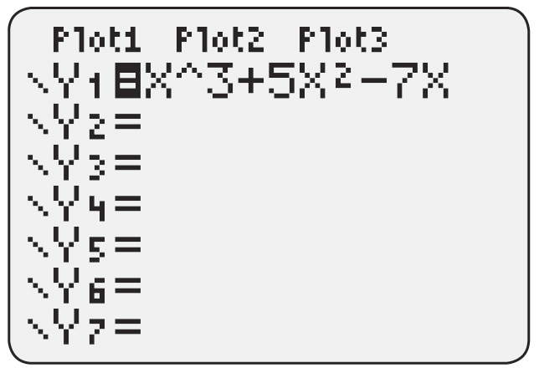
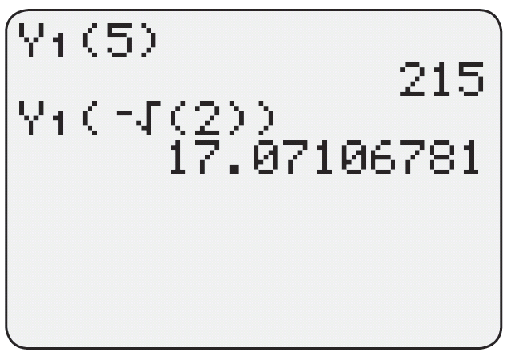
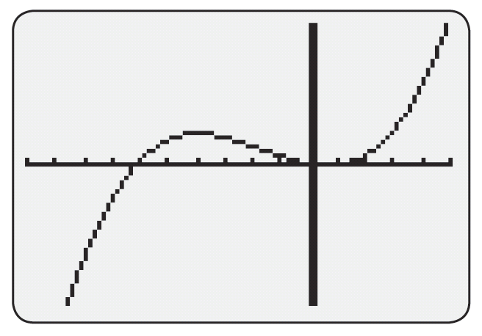
Technology Note
Technology Note (cont.)
Figure 12 shows how the function f(x) = x³ + 5x² − 7x is defined using a graphing calculator and how the function is then evaluated at several points and graphed for x∈[−10, 5].
Figure 12

Slide 43
Technology Note
Technology Note (cont.)
Figure 13 on the next slide shows how the same function f(x) = x³ + 5x² − 7x is defined in Mathematica, evaluated, and then graphed over the specified region. (See Appendix A for a brief introduction to using Mathematica.)

Slide 44
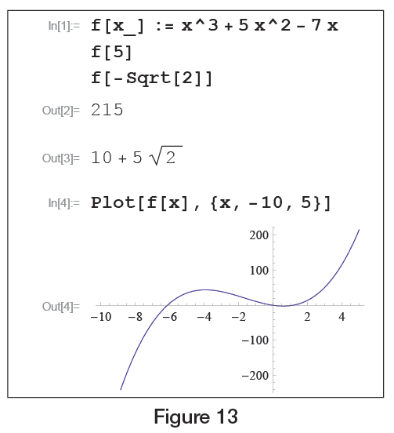
Technology Note
Technology Note (cont.)
Figure 13

Slide 45
Ways of Describing Functions
Tables of data almost always implicitly describe a function. Table 1 only defines seven values for the function P(t). Often we need to be able to extend the knowledge presented in a table to other values of the independent variable.
Source: www.census.gov
Table 1
US Population As Measured by the Census Bureau
Year | Population
1950 | 151,325,798
1960 | 179,323,175
1970 | 203,211,926
1980 | 226,545,805
1990 | 248,709,873
2000 | 281,421,906
2010 | 308,745,538

Slide 46
Ways of Describing Functions
For example, we might want estimates of the US population for every year between 1950 and 2010, or we might desire a projected population for the year 2050. The acts of estimating values of a function based on given data are called interpolation and extrapolation, and are perhaps best introduced with a picture.

Slide 47
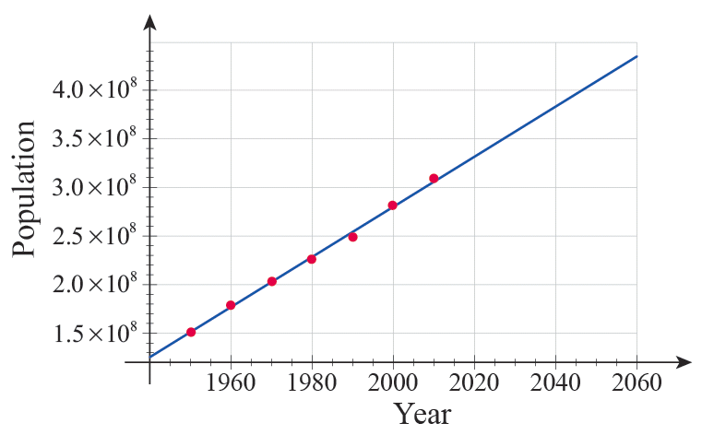
Ways of Describing Functions
Figure 14 contains a plot of the seven data points from Table 1, along with a line that seems to approximate the general behavior of the points well.
Figure 14 Graph of US Population Data, 1950–2010

Slide 48
Ways of Describing Functions
To interpolate a value from a table or graph means to arrive at an estimate for the value of the implied function between two known data points, while to extrapolate means to guess at a value beyond the given points.

Slide 49
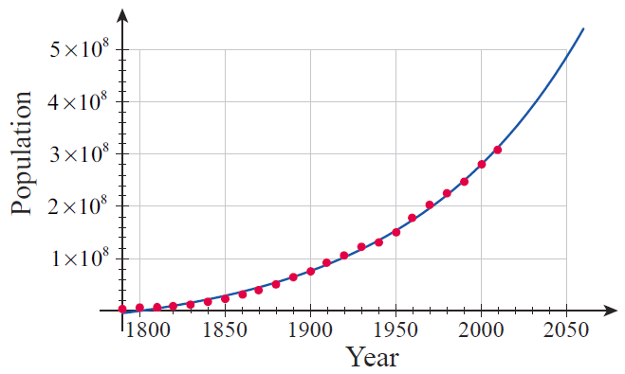
Ways of Describing Functions
Figure 15 Graph of US Population Data, 1790-2010

Slide 50
Technology Note
Technology Note
You may be wondering how the blue line and blue curve in Figures 14 and 15 were drawn and whether they can be improved upon. There is no definitive answer to the second question, as curve fitting (the act of constructing a curve that closely approximates given data) depends upon making some assumptions about the mathematical nature of the data, and it is often the case that different but equally defensible assumptions can be made.

Slide 51
Technology Note
Technology Note (cont.)
In this case, it was assumed that the seven data points in Figure 14 lay approximately along a straight line (that is, that P(t) = a + bt for some choice of a and b) and that the expanded data set in Figure 15 could be approximated by an exponential curve (specifically, that P(t) = a + b^{t} for some a and b).

Slide 52
Technology Note
Technology Note (cont.)
The answer to the first question above (the how question) is that the parameters a and b were chosen in each case so that the sum of the squares of the differences between the given data and the fitted curve was as small as possible. This method, called the least‑squares method of curve fitting, will be fully discussed later, but for now we will focus on the results rather than the method.

Slide 53
Technology Note
Technology Note (cont.)
Many software packages (such as Mathematica, Maple, and spreadsheet programs such as Microsoft Excel) and graphing calculators are capable of calculating a least‑squares fit. Using the command Fit from Mathematica, we arrive at the linear function
(whose graph is the blue line in Figure 14)

Slide 54
Technology Note
Technology Note (cont.)
and the exponential function
(whose graph is the blue curve in Figure 15).
(See Appendix A for a brief introduction to using Mathematica.)

Slide 55
Ways of Describing Functions
Recall that, mathematically, the graph of a function f that maps real numbers to real numbers is the collection of all points of the form (x, f(x)), where x takes on all the values in the domain of f.

Slide 56
Ways of Describing Functions
Consider the act of filing correspondence in a filing cabinet according to the last name of the sender. This act represents a function, which we might name F for File. Thus, a letter from James Childress would be filed in the F(Childress) = C folder, and one from Deanna Jones would be filed in the F(Jones) = J folder.

Slide 57
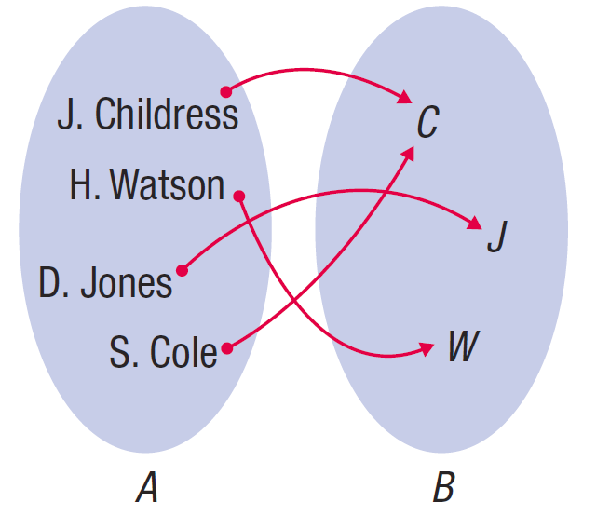
Ways of Describing Functions
Figure 17 is an arrow diagram illustrating how F relates the domain set A of correspondents to the codomain set B of file folders. Note that this act F satisfies all the requirements to be a function.
Figure 17
Arrow Diagram of Filing Function F

Slide 58
Example 6
Below, we will give examples of functions that are easily described verbally, the likes of which you meet on a daily basis, perhaps without even thinking of them as functions.

Slide 59
Example 6 (cont.)
a. In California, license plates of passenger vehicles follow the pattern of a number followed by three letters and then by three digits, such as, “4ZNR915.” Since every registered car has a unique license plate with no duplications allowed, we can think of this as a functional relation between the set of registered California passenger cars as the domain and the set of strings following the above pattern as the codomain.

Slide 60
Example 6 (cont.)
b. When a class of calculus students walks into a classroom and sits down, the students define a function with its domain being the students themselves and the codomain being the chairs in the room. Since each student is able to sit and do so on no more than one chair at a time, we see that this is a functional relationship between the two sets.

Slide 61
Example 6b (cont.)
Note that coming back to class two days later and sitting down in a slightly different order amounts to no more than redefining the function. Also, since every chair may not always be used, there is a clear distinction here between codomain and range.

Slide 62
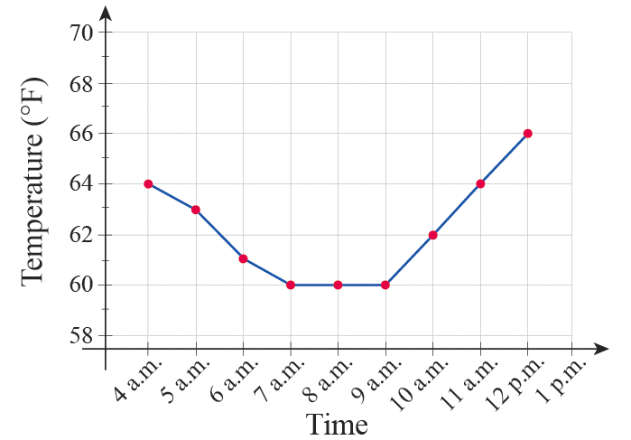
Example 6 (cont.)
c. The temperature on a given day in Shreveport, Louisiana, is a function of time, with its values being numbers from the Fahrenheit temperature scale. This is a function we can graph on a particular day, as shown.
Figure 18

Slide 63
Definition: The Vertical Line Test
Given a graph of a relation, how do we determine whether it represents a functional relationship? For graphs there is a simple test to apply.
The Vertical Line Test
Given a graph of a relation in the Cartesian plane, the graph represents a function if no vertical line passes through the graph more than once. If even one vertical line intersects the graph in two or more points, the relation fails to be a function.

Slide 64
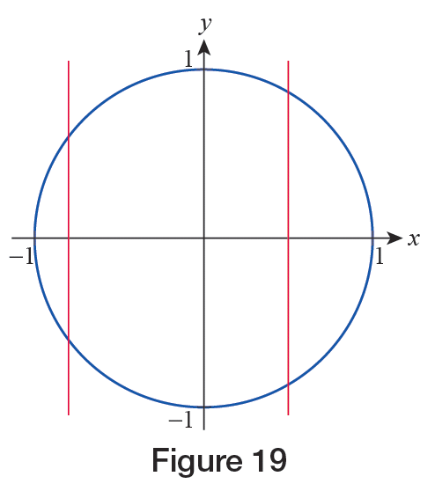
Example 7
Below, we provide examples of the use of the vertical line test.
a. The unit circle centered at the origin does not define y as a function of x, since there are plenty of vertical lines intersecting the graph more than once.
Figure 19

Slide 65
Example 7a (cont.)
In fact, as we have seen in Example 2a, the equation of the unit circle x² + y² = 1 defines both functions each having a semicircle for its graph, and thus both satisfying the vertical line test.

Slide 66
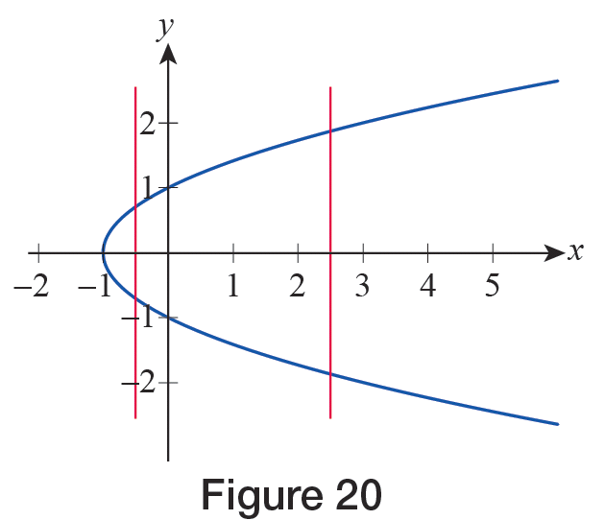
Example 7 (cont.)
b. An easy application of the vertical line test on the graph of y² = x + 1 shows that y is not a function of x.
Figure 20

Slide 67
Example 7b (cont.)
We note, however, that again both functions
are defined by the original equation. Furthermore, as we noted in Example 3b, our equation does actually define x as a function of y. (Note that because of the change in roles between the variables, from the perspective of the dependent variable x, “vertical lines” are the ones that appear horizontal in the traditional xy‑coordinate system. With this interpretation, the “vertical line test” still applies to x as a function of y!)

Slide 68
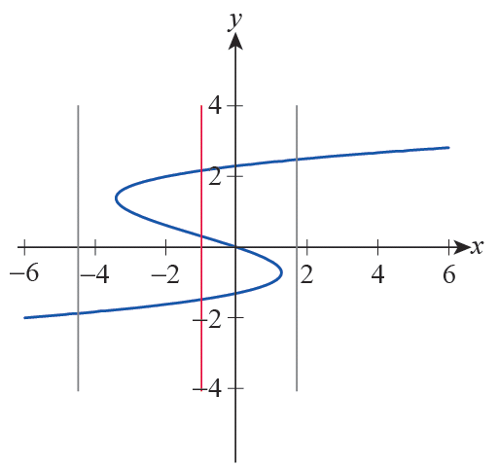
Example 7 (cont.)
c. The graph in Figure 21 is not a function either. Note that while a lot of vertical lines intersect the graph only once, it is enough to find one that doesn’t.
Figure 21

Slide 69
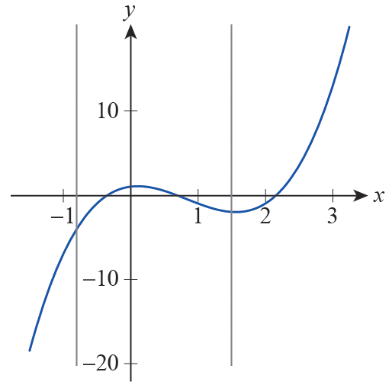
Example 7 (cont.)
d. Finally, we mention that the graphs of all functions
you worked with in your precalculus course (such as polynomials, rational and trigonometric functions, etc.) do pass the vertical line test. As an example, the function
shown in Figure 22, intersects every vertical line exactly once.
Figure 22

Slide 70
Definition: Increasing/Decreasing
Increasing/Decreasing
A real‑valued function f is said to be increasing on an interval I if whenever x₁ and x₂ are in I,
Similarly, f is said to be decreasing on I if whenever x₁ and x₂ are in I,

Slide 71
Definition: Increasing/Decreasing
Increasing/Decreasing (cont.)
In either case, f is said to be monotone on I, and if the inequality that compares the function values is strict, the function is said to be strictly increasing or decreasing on I.

Slide 72
Example 8
Identify intervals of monotonicity (intervals where the function is increasing or decreasing) for the following functions.

Slide 73
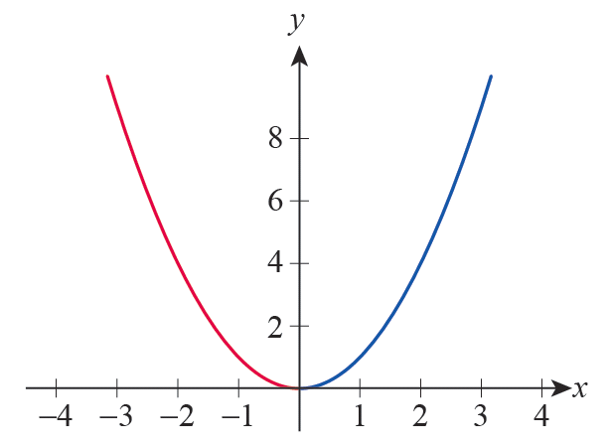
Example 8 (cont.)
Solution
a. The graph of f(x) = x² is a prototypical parabola, opening upward, centered at the origin.
Figure 23 f(x) = x²

Slide 74
Example 8a (cont.)
It is clear that f is decreasing on the interval (−∞, 0) while it is increasing on (0, ∞). Visually, this means that the graph is “falling” as we scan it from left to right along the negative x‑axis, while it is “rising” for positive x‑values.

Slide 75
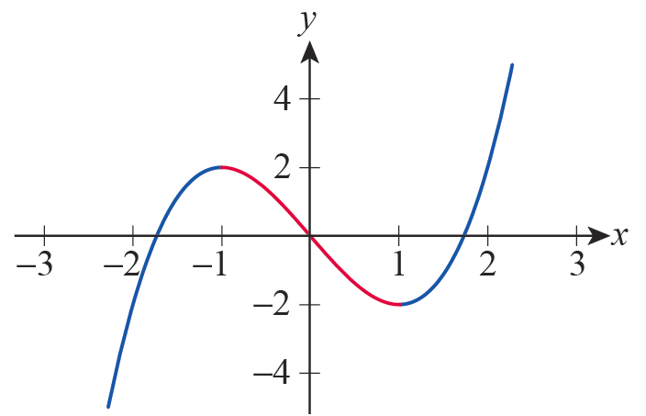
Example 8 (cont.)
b. Examining the graph of g(x) = x³ − 3x , we see g is increasing on (−∞, −1) and (1, ∞) while it is decreasing “in between” these half lines, that is, on the interval (−1, 1).
Figure 24 g(x) = x³ – 3x

Slide 76
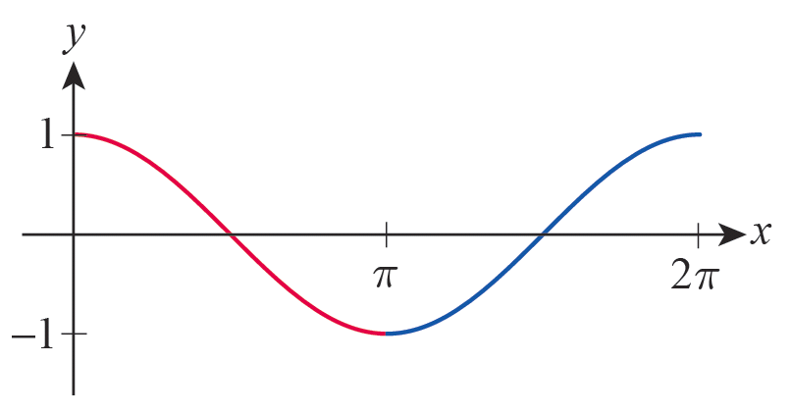
Example 8 (cont.)
From the graph of h(x) = cos x, we conclude that h is decreasing on the interval (0,π)and increasing on (π, 2π). More than that, because of 2π periodicity, cos x is decreasing on all intervals of the form (2kπ, (2k+1)π) for an arbitrary integer k, while it is increasing on all intervals ((2k−1)π, 2kπ).
Figure 25 h(x) = cos x

Slide 77
Definition: Even and Odd Functions
The two most elementary kinds of symmetry are termed even and odd.
Even and Odd Functions
If a real‑valued function f has the property that f(− x) = f(x) for all x in its domain, f is said to be an even function. Its graph will display symmetry with respect to the y‑axis, as shown on the next slide.
If a real‑valued function f has the property that
f(−x) = − f(x) for all x in its domain, f is said to be an odd function. Its graph will display symmetry with respect to the origin, as shown on the next slide.

Slide 78
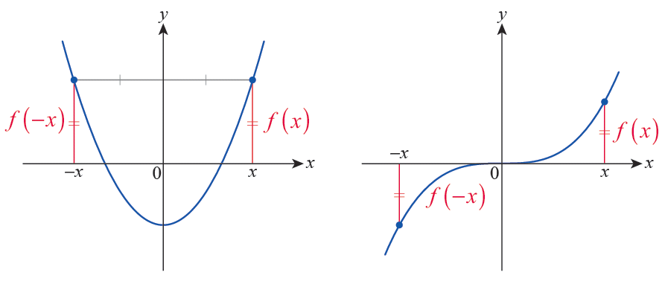
Definition: Even and Odd Functions
Even and Odd Functions (cont.)
Figure 26 An Even Function
Figure 27 An Odd Function

Slide 79
Definition: Symmetry of Equations
Symmetry of Equations
An equation in x and y is symmetric with respect to
1. the y‑axis if replacing x with −x results in an equivalent equation;
2. the x‑axis if replacing y with −y results in an equivalent equation;
3. the origin if replacing x with −x and y with −y results in an equivalent equation.

Slide 80
Example 9
Discuss the symmetry of the following functions and equations.

Slide 81
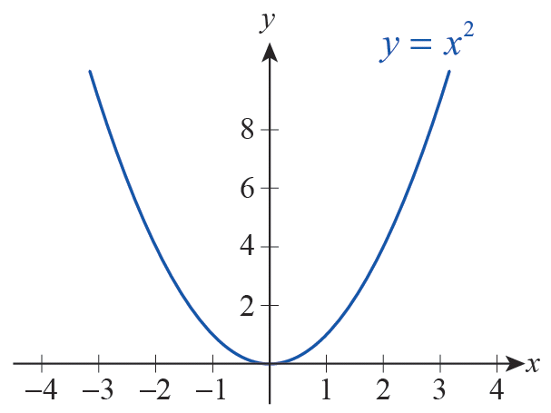
Example 9 (cont.)
a. Since (−x)² = x², we see that replacing x by −x yields an equivalent equation, so the graph must be symmetric with respect to the y‑axis. Note that we
can rewrite this equation as y = x², and so its graph is the graph of the function f(x) = x². This graph, the prototypical parabola, displays symmetry with respect to the y‑axis.
Figure 28

Slide 82
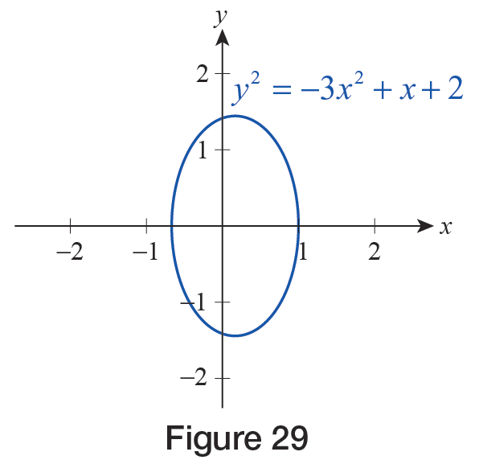
Example 9 (cont.)
b. If we replace y with −y, we obtain an equivalent equation, since (−y)² = y². The same is not true of x, since replacing it by −x turns the right‑hand side of the equation into −x + 2. Hence the graph of this equation is symmetric with respect to the x‑axis, but not the y‑axis.
Figure 29

Slide 83
Example 9 (cont.)
c. If we simultaneously replace x with −x and y with −y in this equation, we obtain
and this latter equation is seen to be equivalent to the original, so we conclude that its graph is symmetric with respect to the origin.

Slide 84
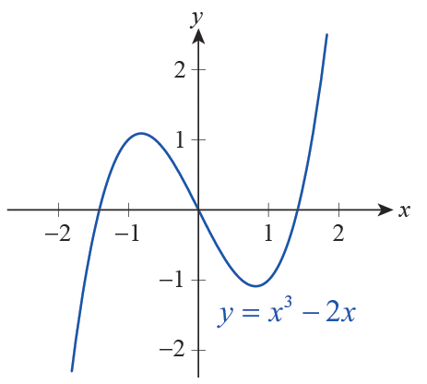
Example 9c (cont.)
Finally, note that this graph is the same as that of the function g(x) = x³ − 2x .
Figure 30

Slide 85
Example 9 (cont.)
d. This example is more easily done algebraically instead of graphically. By substituting −x for x we obtain

Slide 86
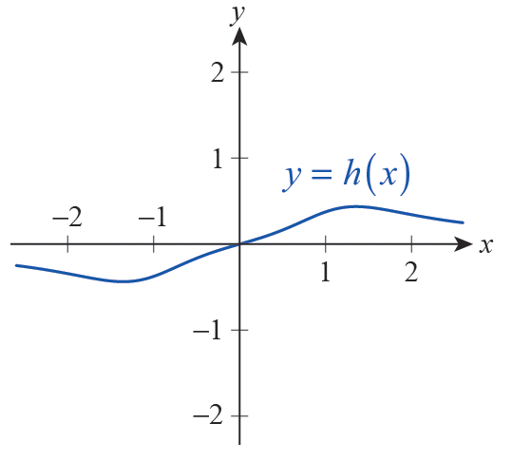
Example 9d (cont.)
We conclude that h is an odd function; thus its graph is symmetric with respect to the origin.
Figure 31

Slide 87
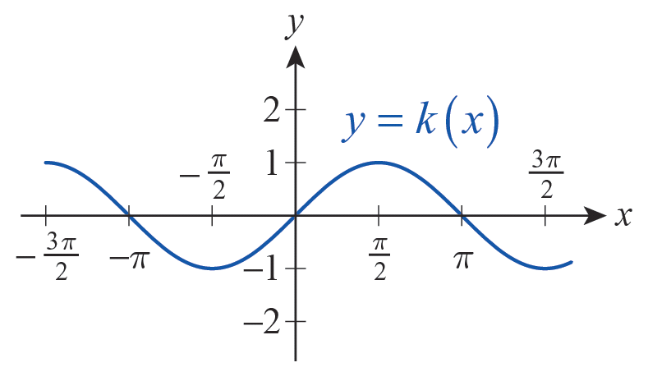
Example 9 (cont.)
e. The trigonometric function k(x) = sin x is odd, since sin(−x) = −sin x, and so its graph displays symmetry with respect to the origin (see Figure 32).
Finally, we also note
that g(x) = cos x is even, for we know cos(−x) = cos x to be true for all x. These facts are also clearly seen by visually examining these basic trigonometric graphs.
Figure 32

