Slide 1
Section 1.5
Calculus, Calculators, and Computer Algebra Systems

Slide 2
TOPICS
Graphs via Calculators and Computers
Animations and Models
Least-Squares Curve Fitting

Slide 3
Graphs via Calculators and Computers
One of the most basic features of calculators and mathematical software is the ability to choose the display or viewing window when graphing a function. When graphing functions from ℝ to ℝ, this is simply the choice of the minimum and maximum values for the horizontal and vertical axes. For the purposes of illustration, we will refer to these values as xMin, xMax, yMin, and yMax (on some calculators, these are the exact labels for these quantities).

Slide 4
Graphs via Calculators and Computers
The display window is then a rectangle in the plane bounded by these values, [xMin, xMax] by [yMin, yMax], and their choice determines the portion of the function being graphed. This choice gives the user the ability to zoom in (or out) on a a particular part of the graph.

Slide 5
Example 1
Graph the function in the following viewing windows using a graphing calculator.

Slide 6
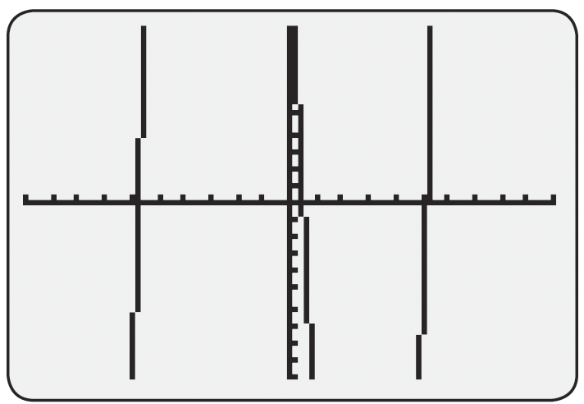
Example 1 (cont.)
Solution
a. We set xMin = −10, xMax = 10, yMin = −10, and yMax = 10. Note that the resulting figure appears to be cut off at the top and bottom, indicating that the graph continues vertically beyond the viewing window.
Figure 1
f(x) = x³ − 30x + 15
on [−10, 10] by [−10, 10]

Slide 7
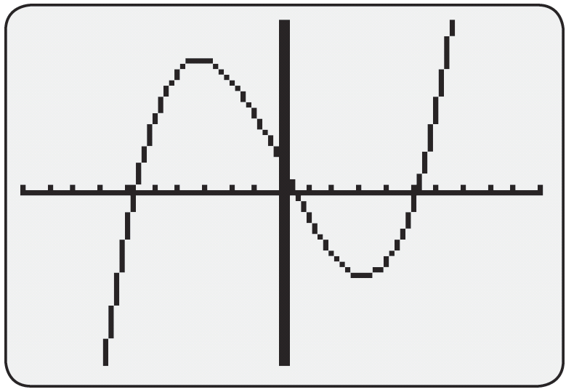
Example 1 (cont.)
b. For this viewing window we just need to change the range of y‑values to be from yMin = −100 to yMax = 100. Figure 2 shows the graph in this new viewing window. This is a more complete picture of the graph of f(x), revealing the significant parts of the graph.
Figure 2
f(x) = x³ − 30x + 15
on [−10, 10] by [−100, 100]

Slide 8
Example 2
We will illustrate the graph of the
showing the graph at different magnifications or viewing windows.
The first observation we wish to make is that since
cannot take any values above 1 or below −1, the graph of f(x) cannot go above x² or below −x², as illustrated in Figure 3 on the next slide.

Slide 9
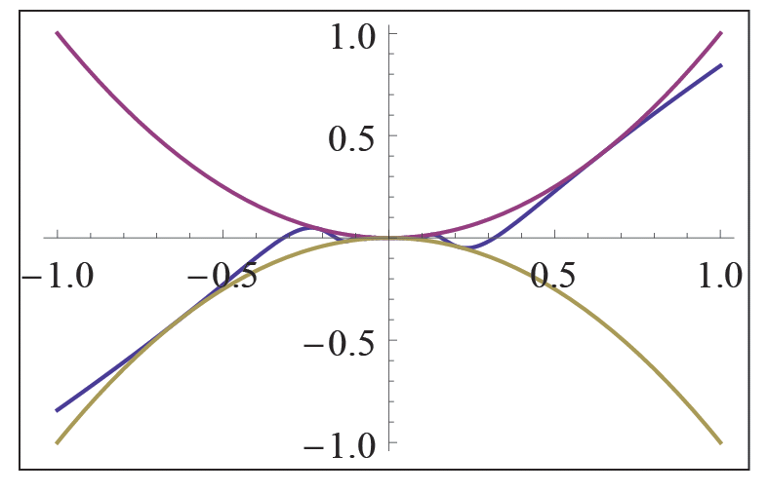
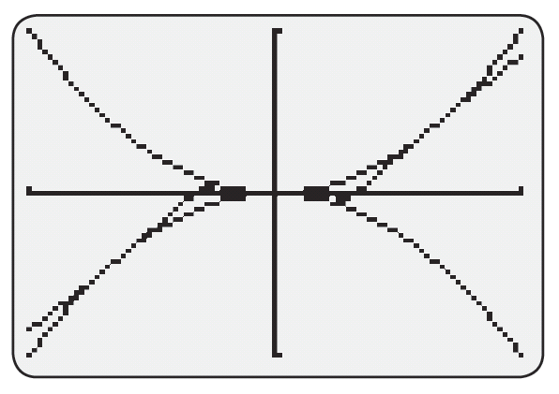
Example 2 (cont.)
Figure 3 Graphs of x², f(x), and −x²

Slide 10
Example 2 (cont.)
In order to better understand the graph of f(x), let us take a closer look at g(x) = sin(1/x). Note from Figure 4 on the next slide that g(x) oscillates between −1 and +1, but it does so in a surprising way: it makes infinitely many oscillations near 0 on both sides of the y‑axis.

Slide 11
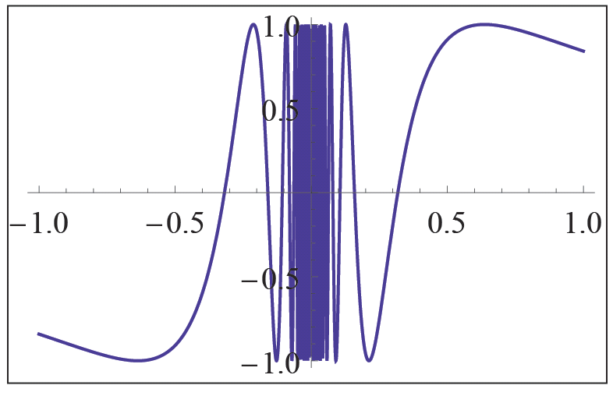
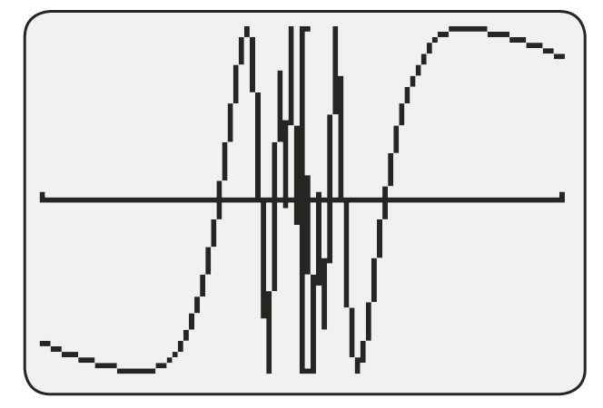
Example 2 (cont.)
Figure 4 g(x) = sin(1/x)

Slide 12
Example 2 (cont.)
This is most easily checked by noting that g(x) = sin(1/x) = 0 for x = 1/(nπ), n = ±1, ±2, …. In other words, g(x) = 0 for infinitely many values of x that approach 0 as n grows large. In a similar fashion, one can show that g(x) = 1 and g(x) = −1 infinitely many times on both sides of 0.

Slide 13
Example 2 (cont.)
The effect of multiplying g(x) by x² is that
will still oscillate in a similar fashion, but now between x² and −x² (you might recall “damped trigonometric graphs” from your prior studies). The oscillation of f(x) is not very clear in Figure 3 but is well illustrated if we ask our technology to “zoom in” or, equivalently, choose a “smaller” viewing window, as shown in Figure 5.

Slide 14
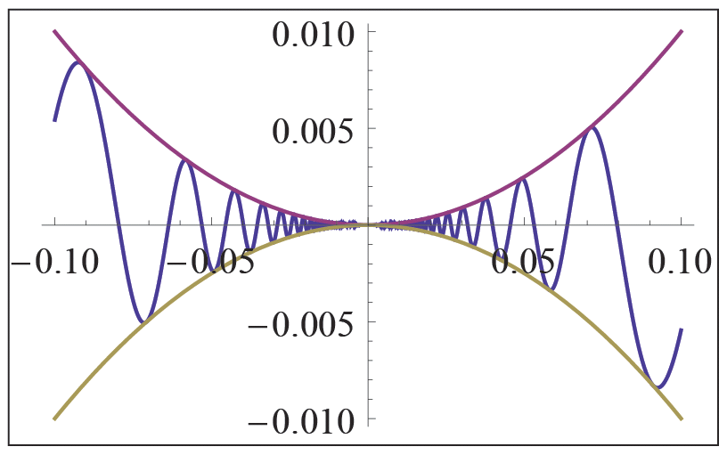
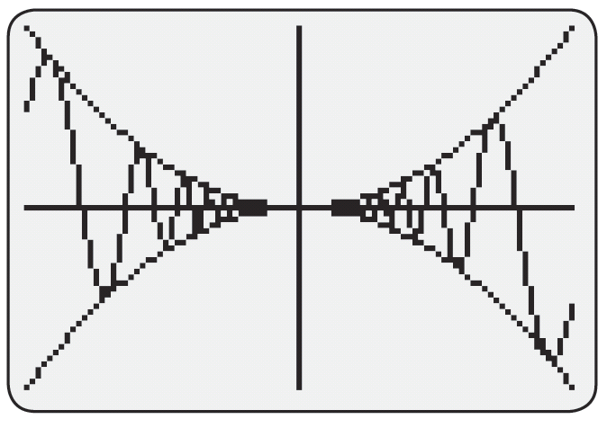
Example 2 (cont.)
Figure 5

Slide 15
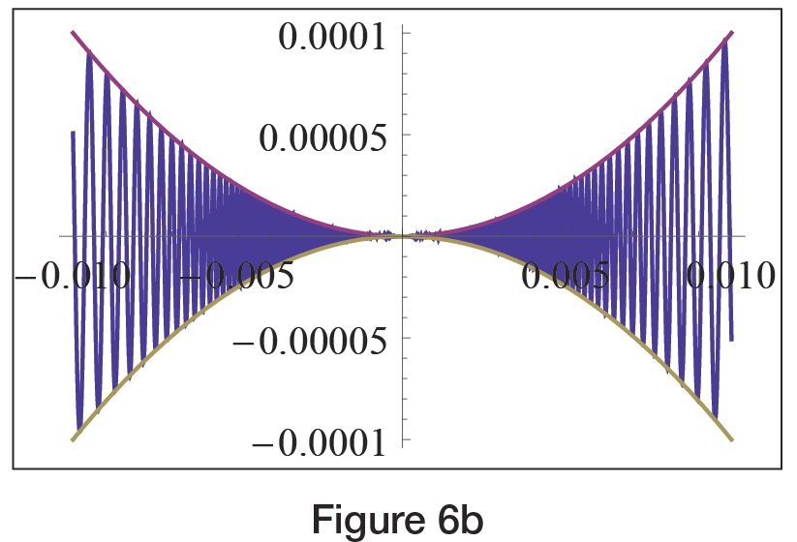
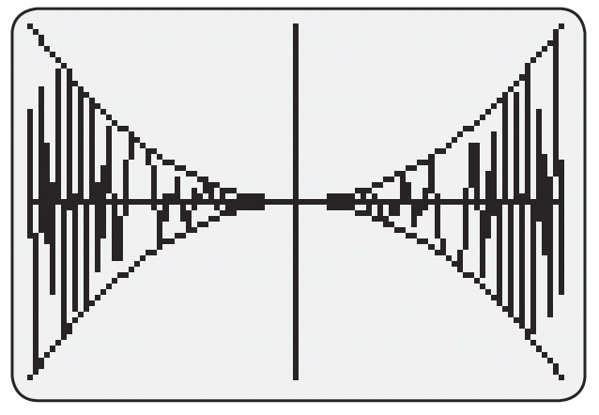
Example 2 (cont.)
In order to get a better sense of the infinitude of oscillations, we can zoom in even further, as shown in Figure 6.
Figure 6

Slide 16
Example 2 (cont.)
Finally, we wish to note that f(x) is not defined for x = 0; that is, there is no function value for x = 0, which is not clear from the graphs we received. Graphing technology, however, is still an extremely useful tool, if we stay aware of its limitations.

Slide 17
Technology Note
Technology Note
With guidance by the user, the graphs generated by calculators and software can usually be much improved in the cases where the default algorithm leads to misleading (or even wildly inaccurate) pictures. Most graphing calculators, for example, allow the user to specify that the “sampled” points on a graph not be connected by line segments. This can be done by changing the graphing mode from CONNECTED to DOT.

Slide 18
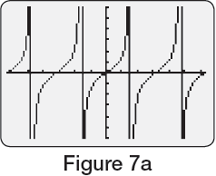
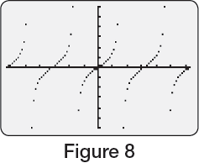
Technology Note
Technology Note (cont.)
The result is a picture that may not look very smooth, but at least is free of such erroneous artifacts as vertical segments (see Figures 7a and 8).

Slide 19
Technology Note
Technology Note (cont.)
Software such as Mathematica allows the user much more control. Figure 9 illustrates the use of options in Plot that direct Mathematica to skip over values of x for which cos x equals 0 and to indicate those “exclusions” with dashed lines, a notation we commonly use for asymptotes.

Slide 20
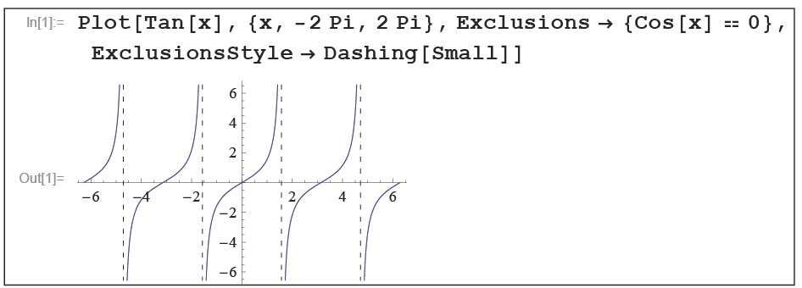
Technology Note
Technology Note (cont.)
Figure 9

Slide 21
Example 3
The graph of sin 25x oscillates with a high-enough frequency to warrant caution when using a graphing tool. The following screenshots show the use of the Manipulate command in Mathematica. If you have access to this software package, type in and execute the command as shown and then use the slider to dynamically zoom in and out of the picture. What we are actually doing is dynamically changing the horizontal extent of the viewing window from a minimum of [−0.1, 0.1] to a maximum of [−10, 10].

Slide 22
Example 3 (cont.)
We have also instructed Mathematica to increase the number of sampled points (with the PlotPoints option) in order to capture the oscillatory behavior more accurately. (See Appendix A for more guidance on using Mathematica.)

Slide 23
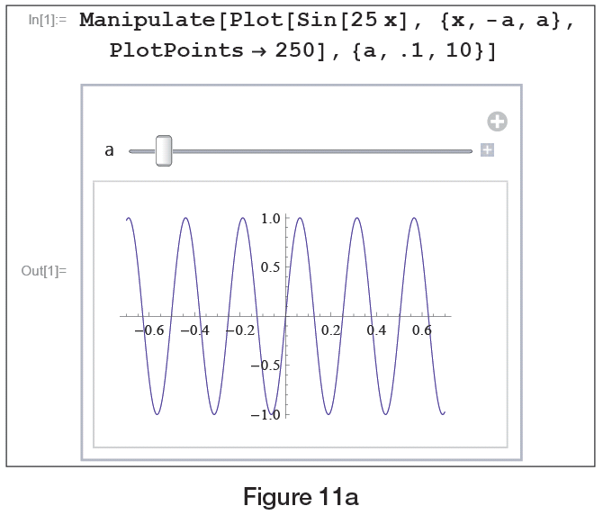
Example 3 (cont.)
Figure 11a

Slide 24
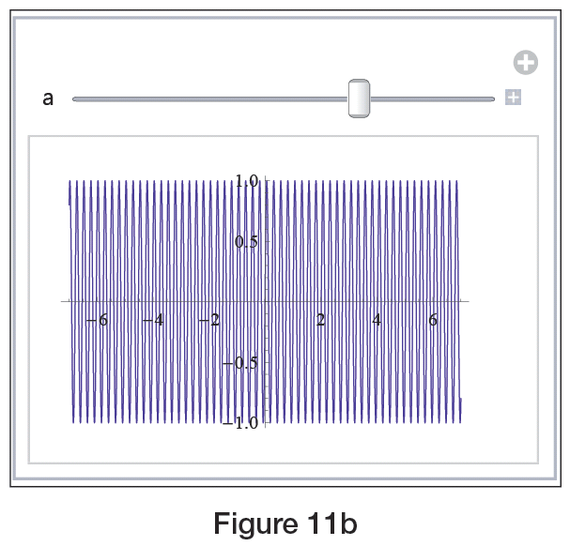
Example 3 (cont.)
Figure 11b

Slide 25
Animations and Models
In Example 3, the variable a is referred to as a parameter, a quantity that we want to allow to vary in order to gain insight into some particular behavior. In the usage above, changing a equates to changing the viewing window, but parameters can appear in many different ways. Example 4 illustrates the use of two parameters, one controlling the size of the viewing window and the other appearing in the definition of the function itself.

Slide 26
Example 4
Graph the function
Solution
The function f(x) exhibits different characteristics depending on both the value of the parameter c and whether we are interested in the behavior close to 0 or on a larger scale. The next screenshots show just a few of the possible choices for c and for the viewing window. Note that the width of the viewing window can vary from [0, 0.1] to [0, 20] and that c can take on values between 1 and 100.

Slide 27
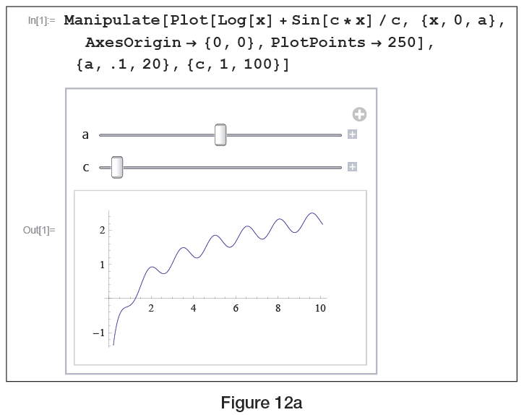
Example 4 (cont.)
Figure 12a

Slide 28
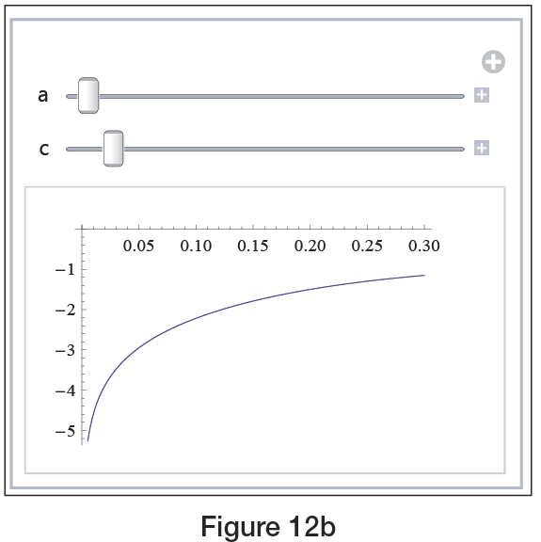
Example 4 (cont.)
Figure 12b

Slide 29
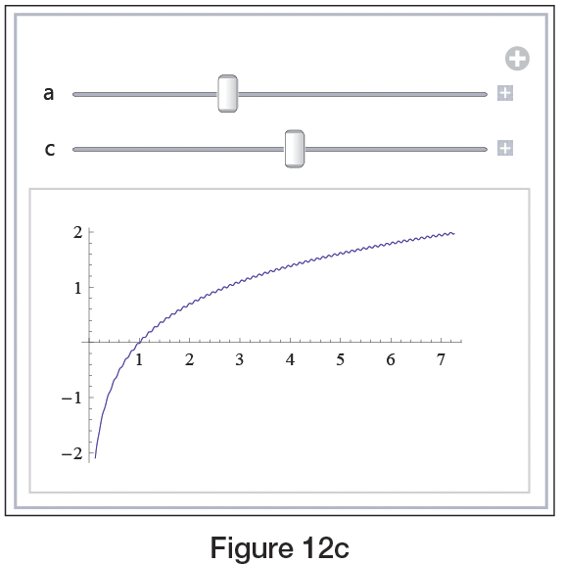
Example 4 (cont.)
Figure 12c

Slide 30
Constructing a Mathematical Model
Constructing a Mathematical Model
The process of constructing a mathematical model is one you are familiar with—you have worked with many models already, though they may not have been labeled as such. In general, the steps in making a model of a real‑world phenomenon are as follows.
Step 1: Identify the measurable or observable quantities and label them as variables.

Slide 31
Constructing a Mathematical Model
Constructing a Mathematical Model (cont.)
Step 2: Find mathematical relationships between the variables, making simplifying assumptions about the phenomenon if necessary.
Step 3: Draw mathematical conclusions from the equations, functions, or other mathematical relationships found (this usually amounts to solving equations or performing mathematical operations).

Slide 32
Constructing a Mathematical Model
Constructing a Mathematical Model (cont.)
Step 4: Interpret the mathematical conclusions in terms of the real‑world phenomenon, and test the descriptive/predictive power of the model against reality. Adjust and improve the model if necessary.

Slide 33
Example 5
Build a mathematical model to predict an automobile’s total stopping distance d (i.e., the total distance traveled from the moment the driver decides to stop until the car comes to a complete stop) as a function of its initial speed v. Then construct a graph with animation that is dependent on road conditions and the driver’s response time.

Slide 34
Example 5 (cont.)
Solution
First, we identify time, speed, and distance as the most important measurable quantities for the purposes of our model. Next, observe that the actual stopping distance will consist of two parts: the distance the car travels after the driver decides to stop but before the brakes start to work, that is, the “response distance,” and the actual “braking distance” (the distance traveled while braking).

Slide 35
Example 5 (cont.)
Labeling these by d₁ and d₂, respectively, yields
where d is the total stopping distance. Next, we will let v stand for the speed of the car before braking, M for the total mass of the car and passengers, and μ for the coefficient of friction between the tires and the pavement.

Slide 36
Example 5 (cont.)
We will make the simplifying assumptions that the brakes come on instantly and operate with constant force. The road surface is assumed to be uniform and level. Finally, we ignore air resistance and heat loss. Note that d₁ can be calculated as
where t is the time the driver requires to respond. In order to find d₂ note that the car’s kinetic energy (the energy stemming from its forward motion) is dissipated during braking, all the way down to 0.

Slide 37
Example 5 (cont.)
Since the braking force F_{b} arises as a result of friction between the tires and the pavement, we have
where g is the gravity constant. By the law of conservation of energy, the total work done by F_{b} must equal the car’s initial kinetic energy of so
from which we obtain

Slide 38
Example 5 (cont.)
Thus our mathematical model for the total stopping distance becomes
Since experimental data show the value of t to be approximately 0.75 seconds for the average driver, and μ = 0.9 is realistic on dry pavement, we can complete our model by writing

Slide 39
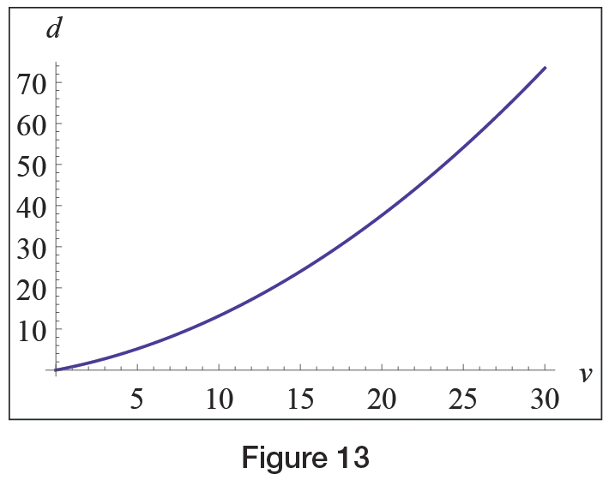
Example 5 (cont.)
In Figure 13, v is assumed to be in meters per second (note that 30 m/s corresponds to 67.1 mph and that g ≈ 9.81 m/s² in the metric system). Observe the quadratic functional dependence, which definitely warns us to observe speed limit signs!
Figure 13

Slide 40
Example 5 (cont.)
The flexibility of our model is demonstrated by the fact that we can treat the driver’s response time t and the friction coefficient m as parameters, corresponding to the facts that no two drivers are equal and road conditions often change. Exploiting the capabilities of Mathematica’s Manipulate command, we can easily create animations of the previous graph that are dependent on said parameters.

Slide 41
Example 5 (cont.)
Notice from the following graphs that while a slower driver response does result in increased stopping distance as predicted by our model, the real drama happens on a slippery road surface. For small μ ‑values, stopping distance can easily more than double even if the driver has a really short reaction time!

Slide 42
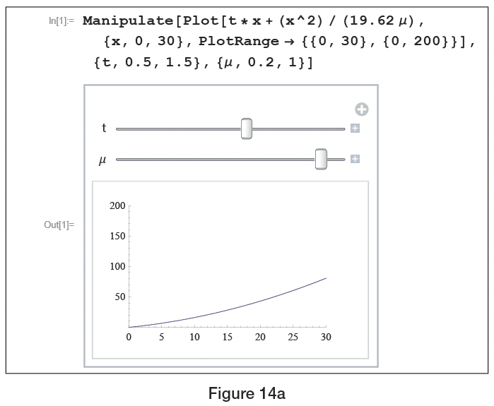
Example 5 (cont.)
Figure 14a

Slide 43
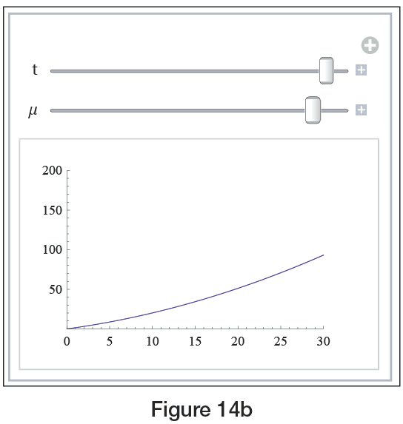
Example 5 (cont.)
Figure 14b

Slide 44
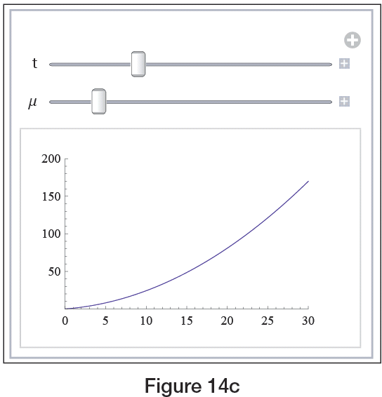
Example 5 (cont.)
Figure 14c

Slide 45
Least-Squares Curve Fitting
In some cases, especially where the relevant measurable quantities consist only of collected data, the “simplifying assumptions” in the modeling process may be nothing more complicated than something like “assume the data lie along a straight line” or “assume the data exhibit exponential behavior.” In such cases, an empirical model may be all that is desired; such a model is based only on the data—no underlying physical principles are used.

Slide 46
Least-Squares Curve Fitting
Least‑squares curve fitting is a useful technique for constructing a function (of a predetermined form) that best approximates a given collection of data points. To illustrate the technique, suppose we wish to fit a line to the n data points (x₁, y₁), (x₂, y₂), …, (x_{n}, y_{n}). Every line in the plane has the form y = mx + b for some slope m and y‑intercept b, so the task is to determine the best choices for m and b.

Slide 47
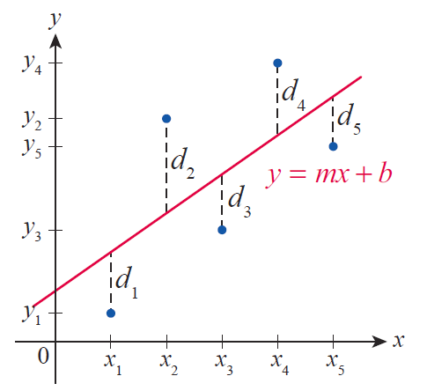
Least-Squares Curve Fitting
If we let d_{i} = y_{i} – (mx_{i} + b), then each d_{i} represents the vertical difference between the i^{th} data point and the line y = mx + b. The least‑squares method gets its name from the objective of choosing m and b so that is minimized.
Figure 15

Slide 48
Least-Squares Curve Fitting
As we will see later, calculus allows us to fairly easily determine the following formulas for m and b.

Slide 49
Least-Squares Curve Fitting
(Recall that the notation stands for the sum
These are exactly the formulas that graphing calculators and computer software programs use when determining the line of best fit for a given data set.

Slide 50
Example 6
Continuing along the lines of Example 5, suppose that Table 1 contains driver response distances (denoted by d in this example) as a function of initial speed v. Use the least‑squares method to find the best‑fitting line for the data, and give an interpretation for the slope of the line.
Table 1
v (km/h) | 40 | 48 | 56 | 64 | 72 | 82 | 88 | 96 | 104 | 112 | 120
d (m) | 8.5 | 10.0 | 11.9 | 13.4 | 15.2 | 16.8 | 18.6 | 20.1 | 21.9 | 23.5 | 25.3

Slide 51
Example 6 (cont.)
Solution
Note that for the purpose of using our formulas, the numbers in the left column are the values of x_{i}, while the right column provides the y_{i}‑values. However, using Mathematica’s Fit command (see Figure 16) or a graphing calculator (see Figure 17), we can obtain the equation of the best-fitting line much quicker:

Slide 52
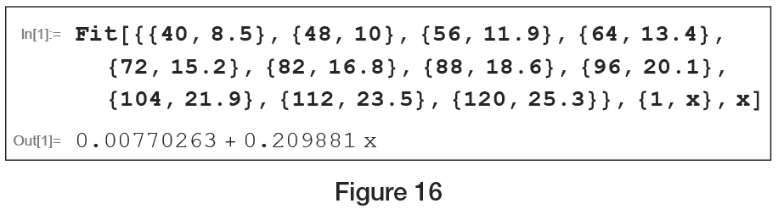
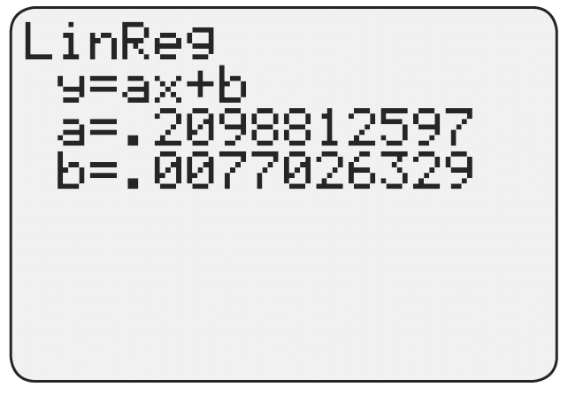
Example 6 (cont.)
Figure 16
Figure 17

Slide 53
Example 6 (cont.)
Since the constant term is close to 0, ignoring it we obtain
and thus the slope of the best‑fitting line is
which is the driver’s response time.

Slide 54
Example 6 (cont.)
In order to express t in seconds, we note that since
1 m/s = 3.6 km/h , if v̄ is the speed expressed in meters per second, we have v̄ = v/3.6, and thus t (in seconds) can be obtained as
In other words, the slope of the best-fitting line indicates that based upon this particular data set, the average driver response time is approximately 0.76 seconds.

