Slide 1
Section 10.1
Sequences

Slide 2
TOPICS
Convergence and divergence of sequences
Determining limits of sequences
Monotonicity and boundedness

Slide 3
Definition: Infinite Sequences
Infinite Sequences
An infinite sequence is a function whose domain is the set of natural numbers. Typically, notation such as a₁ is used for the element associated with the number 1, a₂ for the element associated with the number 2, and so on, as opposed to function notation like f(1) and f(2).

Slide 4
Example 1
a. For the sequence {1, 4, 9, 16, …} the first term is 1, the second term is 4, and in general we would likely guess that the n^{th} term is n². Using sequence notation, we write a_{n} = n².

Slide 5
Example 1 (cont.)
b. In the sequence {1, −1, 1, −1, …} the pattern so far indicates that the odd-numbered terms are 1 and the even-numbered terms are −1. One way of expressing this is with the formula b_{n} = (−1)^{n + 1}. Note that this example illustrates an important distinction between sets and sequences: in a set, repeated elements are redundant and order does not matter. The above list would simply reduce to {−1, 1}, which is equivalent to {1, −1}. But as a sequence, each element in the list is distinct because it occupies a unique position (first, second, and so on) in the sequence.

Slide 6
Example 1 (cont.)
c. The notation tells us that the n^{th} term
is n/(n + 1) and defines the following sequence:

Slide 7
Example 1 (cont.)
d. The notation is also a sequence. It defines
the sequence {5, 6, 7, …}, which can be reindexed as
to make it clear that it fits the formal
definition of a sequence. In practice, if a given sequence can be described with a simpler formula by beginning with an index other than 1, we often do so.

Slide 8
Convergence and Divergence of Sequences
Although we may feel confident that we have spotted a pattern in the first few elements of a sequence, there are actually always multiple formulas that describe the first few terms of any given sequence and then differ thereafter. For example, consider the sequence defined by the rule If we calculate the first few terms, we find
a sequence matching a_{n} = n² up to n = 4. For this reason, it is far preferable to describe sequences with precise formulas when possible.
ã_{n}

Slide 9
Convergence and Divergence of Sequences
Formulas such as c_{n} = n/(n + 1) are called explicit, because they explicitly define the n^{th} term of a sequence. Sometimes, however, the n^{th} term of a sequence is most easily defined in terms of preceding terms, in which case the formula is said to be recursive. Example 2 illustrates the difference between the two types of formulas.

Slide 10
Example 2
a. The sequence defined by a₁ = 2 and a_{n} = 2a_{n} ₋ ₁ for n ≥ 2 is {2, 4, 8, …}. By this definition, the value of the n^{th} term depends on the value of a_{n − 1}, so the definition is recursive. But many types of recursive formulas can also be rewritten explicitly, and this is one such example: the sequence is also defined by the explicit formula a_{n} = 2^{n}.

Slide 11
Example 2 (cont.)
b. The Fibonacci sequence is a sequence introduced to Europeans by Leonardo of Pisa (nicknamed Fibonacci) in his book Liber Abaci (published in 1202). It is defined by F₀ = 0, F₁ = 1, and F_{n} = F_{n − 2} + F_{n − 1} for n ≥ 2, so F₂ = F₀ + F₁ = 0 + 1 = 1, F₃ = F₁ + F₂ = 2, F₄ = F₂ + F₃ = 3, and so on. By this definition, any term in the sequence (for n ≥ 2) can only be determined once the previous two terms are known, so it is recursive.

Slide 12
Example 2b (cont.)
This is another example, however, of a recursive formula that has an equivalent explicit formula:
We leave it to the reader to show that this explicit formula matches the recursive formula for as many terms as you would like to verify.

Slide 13
Convergence and Divergence of Sequences
Our primary concern at the moment is whether a given sequence converges or diverges; in other words, whether the terms of the sequence approach a finite limit. The sequences in parts a., b., and d. of Example 1 do not appear to be approaching any particular limiting value, and we will soon see that they qualify as divergent sequences. But the terms in part c. approach the value 1 as n increases. Figure 1 depicts the four sequences of Example 1 as graphs of functions from ℕ to ℝ.

Slide 14
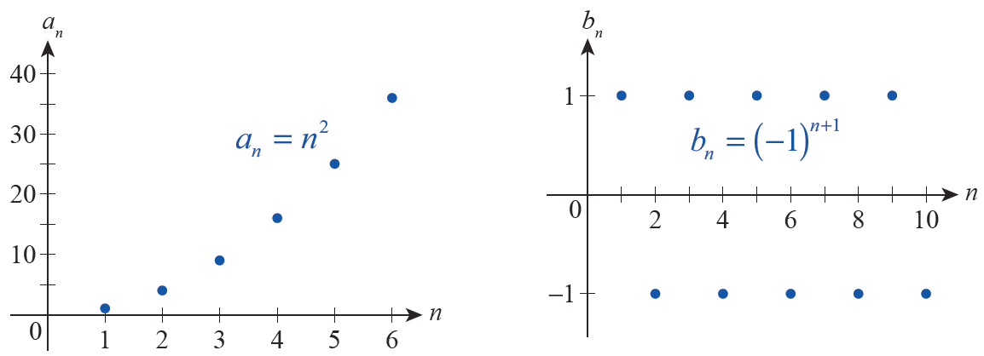
Convergence and Divergence of Sequences
Figure 1

Slide 15
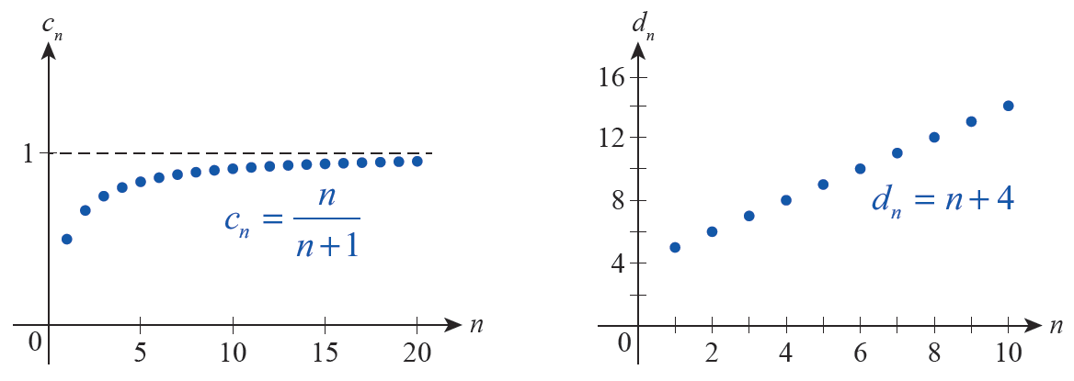
Convergence and Divergence of Sequences
Figure 1

Slide 16
Definition: Limit of a Sequence, Convergence, and Divergence
Limit of a Sequence, Convergence, and Divergence
A given sequence {a_{n}} has the limit L if for every number ε > 0 there is a natural number N such that for all n > N. We write
and say that {a_{n}} converges to L (or is convergent). If no such limit exists, {a_{n}} diverges (or is divergent).

Slide 17
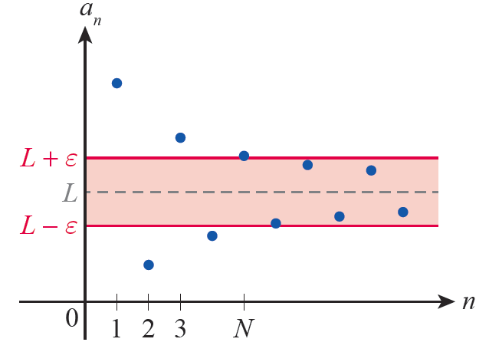
Convergence and Divergence of Sequences
Graphically, we can show the relationship between the terms of a sequence {a_{n}}, its limit L, and a representative ε in two different ways. In Figure 2, the sequence is graphed as the sequences in Figure 1 were, as functions from ℕ to ℝ.
Figure 2

Slide 18
Convergence and Divergence of Sequences
In this format, the line y = L plays the same role as it
does when we write and the positive
number ε gives rise to an ε -band below and above y = L. For all n > N, a_{n} lies within the ε -band; that is,
a_{n} is within ε of L.

Slide 19
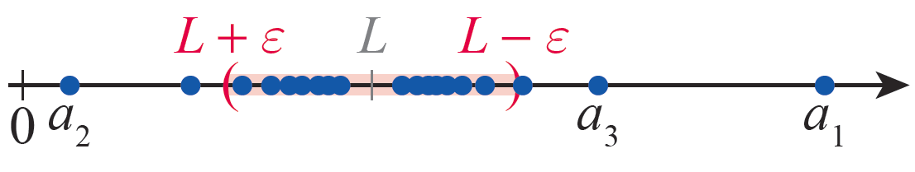
Convergence and Divergence of Sequences
In Figure 3, the same sequence is depicted as a collection of values on a horizontal real number line centered around the value L. Some of the terms of the sequence may lie to the right of L, some to the left, but for all n > N it will be the case that a_{n} lies within the open interval (L − ε, L + ε).
Figure 3

Slide 20
Example 3
Newton’s method for root approximation generates endless examples of recursively defined sequences and provides a setting in which graphs like that in Figure 3 are the most natural. For instance, given the function f(x) = e^{x} + sin x, Newton’s method leads to the recursive formula

Slide 21
Example 3 (cont.)
If we begin with x₁ = −1.25, the terms generated (to six decimal places) by this recursive formula are
and they cluster around the limit of the sequence, which is a root of f(x) = e^{x} + sin x.

Slide 22
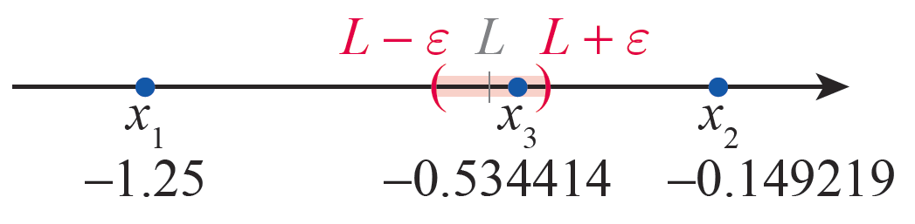
Example 3 (cont.)
In Figure 4, the first three terms and the limit L are depicted, along with an ε -interval corresponding to
ε = 0.1. All the remaining terms of the sequence fall within the ε -interval.
Figure 4 A Newton’s Method Sequence

Slide 23
Example 4
The recursively generated Mandelbrot set is one of the few examples in this text of a sequence whose terms are not real numbers. Using our current notation, the
sequence is based on the complex-valued
function f(z) = z² + c and the recursive formula

Slide 24
Example 4 (cont.)
In this formula, c is a fixed complex number serving as the “seed” of the sequence. In this context, the limit of a sequence, if it exists, is a complex number in the plane that the terms of the sequence approach as
n → ∞.

Slide 25
Determining Limits of Sequences
To show that a given sequence either converges to a limit or to show that it diverges, we use the same reasoning and techniques that we developed when determining the limits of functions. This is not surprising since sequences are functions—they differ from the functions previously studied only in that their domains are restricted to the natural numbers.

Slide 26
Example 5
For each of the following sequences, prove its convergence to a limit or prove it diverges.

Slide 27
Example 5 (cont.)
Solution
a. Suppose a limit L exists for the sequence. Then for any fixed ε > 0 there must exist a corresponding N
such that In particular, this
must be the case for So for all n past some
natural number N, Since
for all odd n, this means

Slide 28
Example 5a (cont.)
Similarly, since for all even n, it is also the
case that But these two inequalities can be rewritten as
Since no number L can satisfy both of these conditions, no such limit exists and the sequence diverges.

Slide 29
Example 5 (cont.)
b. We have already guessed that L = 1 for this sequence, so we merely need to prove it according to the limit definition. Accordingly, let ε > 0 be a fixed number. Let N be fixed as any natural number greater than 1/ε. This means that 1/N < ε, and so for all n > N,
This proves the sequence converges and that

Slide 30
Example 5 (cont.)
c. The sequence also diverges because as n
increases, n² increases without bound and eventually surpasses any fixed real number no matter how large. As we have seen in the past, we often describe how this sequence diverges by
writing but this notation should never be
taken to mean the sequence converges. This is simply an indication that its terms grow without bound.

Slide 31
Example 5 (cont.)
d. For any given positive integer n, the number n! (which is read “n factorial”) is defined as
(Because it is convenient in some contexts, we also define 0! = 1, but this fact is not needed here.)
Given this, the sequence also clearly grows
without bound and thus is another example of a divergent sequence.

Slide 32
Determining Limits of Sequences
Because sequences are functions, we are able to take advantage of all the theorems we have previously developed regarding limits of functions. The next theorem establishes the connection between our earlier work and limits of sequences.

Slide 33
Theorem: Limits of Sequences and Limits of Functions
Limits of Sequences and Limits of Functions
Suppose f is a function defined for all x ≥ x₀ and suppose a_{n} = f(n) for all natural numbers n ≥ x₀. Then

Slide 34
Theorem: Limits of Sequences and Limits of Functions
Proof
The only purpose of the x₀ in the statement of the theorem is to emphasize that we don’t care about the behavior of the function f or the sequence {a_{n}} initially if we are looking at the limit as x or n approaches ∞. With that in mind, let ε > 0 be fixed. Then there is a real number M such that for all x > M. So if N is a natural number greater than M,
and hence

Slide 35
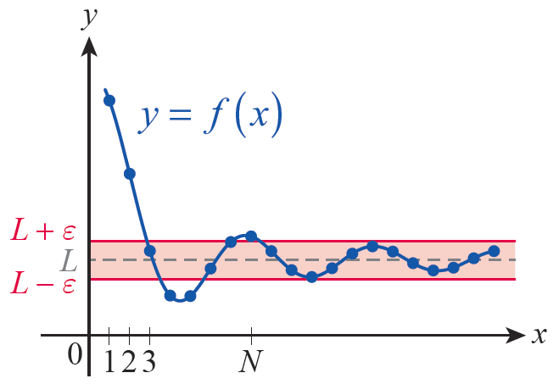
Theorem: Limits of Sequences and Limits of Functions
Proof (cont.)
Figure 5 illustrates how the behavior of {a_{n}} reflects the behavior of f.
Figure 5

Slide 36
Theorem: Sequence Limit Laws
Sequence Limit Laws
Let {a_{n}} and {b_{n}} be two sequences such that both
exist, and let k be a fixed real number.
Then the following laws hold.

Slide 37
Theorem: Sequence Limit Laws
Sequence Limit Laws (cont.)

Slide 38
Theorem: The Squeeze Theorem for Sequences
The Squeeze Theorem for Sequences
Let {a_{n}}, {b_{n}}, and {c_{n}} be sequences such that a_{n} ≤ b_{n} ≤ c_{n} for all n greater than some natural number
N. Then if as well.

Slide 39
Theorem: Continuous Function Theorem for Sequences
Continuous Function Theorem for Sequences
Let {a_{n}} be a sequence with If f is a function
that is continuous at L and defined for all a_{n}, then

Slide 40
Example 6
Find the limit of each of the following sequences, if the limit exists.
Solution
a. Note that and the function f(x) = 5^{x} is continuous at 0. So by the continuous function theorem,

Slide 41
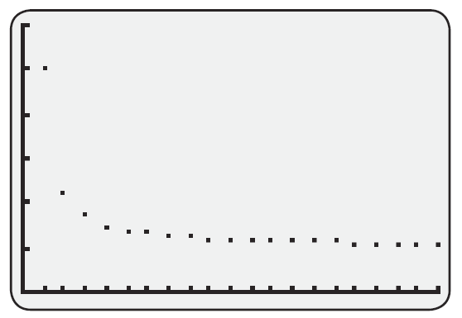
Example 6a (cont.)
Figure 6 visually confirms the limit we found.

Slide 42
Example 6 (cont.)
b. The sequence limit laws allow us to easily evaluate a limit of this form, just as the original limit laws allow us to evaluate similar limits.

Slide 43
Example 6 (cont.)
c. The sequence is the restriction of the
function to the domain of natural numbers, and analyzing the function f is the key to understanding the sequence. The limit of f can be found using l’Hôpital’s Rule:
and

Slide 44
Example 6c (cont.)
So,
This means as well.

Slide 45
Definition: Monotonic Sequences
Monotonic Sequences
A sequence {a_{n}} for which for all n is called an increasing sequence, and a sequence {b_{n}} for which for all n is called a decreasing sequence (in each case, the adjective strictly may be optionally added if the inequality is a strict inequality). A sequence that is increasing or decreasing is called a monotonic sequence.

Slide 46
Example 7
a. The sequence whose n^{th} term is given by is strictly increasing. To prove this, note that
and so

Slide 47
Example 7 (cont.)
b. The sequence whose n^{th} term is given by b_{n} = n² + 6n is also a strictly increasing sequence, as shown by the following:

Slide 48
Monotonicity and Boundedness
While both sequences in Example 7 are (strictly) increasing, they differ in one important respect. We
have already proved that but it isn’t
difficult to see that that is, the
sequence {a_{n}} converges and the sequence {b_{n}} diverges. The following definition and theorem characterize this behavior in general.

Slide 49
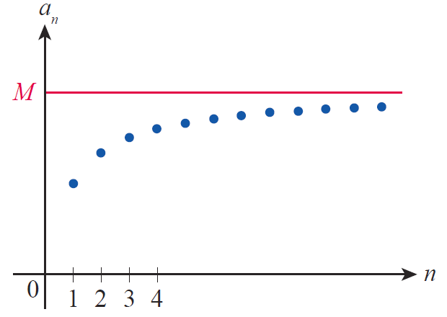
Definition: Bounded Sequences
Bounded Sequences
A sequence {a_{n}} is bounded above if there is a number M (called an upper bound) for which a_{n} ≤ M for all n.
Figure 7 Sequence Bounded Above

Slide 50
Definition: Bounded Sequences
Bounded Sequences (cont.)
Similarly, {a_{n}} is bounded below if there is a number m (called a lower bound) for which a_{n} ≥ m for all n.
If {a_{n}} is bounded both above and below, it is a bounded sequence.
If {a_{n}} is bounded above by an upper bound M₀, and if M₀ ≤ M for all other upper bounds M of {a_{n}}, then M₀ is called the least upper bound of {a_{n}}. The definition of the greatest lower bound is similar in nature.

Slide 51
Theorem: Bounded Monotonic Sequence Theorem
Bounded Monotonic Sequence Theorem
An increasing sequence converges if and only if it is bounded above, and a decreasing sequence converges if and only if it is bounded below. In particular, if an increasing sequence converges, it converges to its least upper bound (that is, the least of all the upper bounds of the sequence). Similarly, if a decreasing sequence converges, it converges to its greatest lower bound.

Slide 52
Monotonicity and Boundedness
The proof of this theorem will be left as an exercise;
its truth derives from the Completeness Property of the real numbers, which states that every nonempty set of real numbers that is bounded above (respectively, below) has a least upper bound (respectively, a greatest lower bound). The name “completeness” reflects the fact that there are no breaks or gaps in the real number line.

Slide 53
Monotonicity and Boundedness
Although the Bounded Monotonic Sequence Theorem is often cited when we need to know that a limit exists, without necessarily caring what that limit is, we can also use it to actually find the limit in some situations.

Slide 54
Example 8
Define the sequence {a_{n}} recursively by and for n ≥ 2. Use the Bounded Monotonic
Sequence Theorem to find
Solution
First, we will use the theorem to prove that
exists, and we do so by using induction arguments to show that the sequence is increasing and bounded above. Recall that such arguments call for a basis step and an inductive step.

Slide 55
Example 8 (cont.)
Basis Step:
Inductive Step: Assume Then
and hence That is, This
proves that {a_{n}} is an increasing sequence.

Slide 56
Example 8 (cont.)
To prove that {a_{n}} is bounded above, we can do some brute‑force calculations to arrive at the guess that a_{n} < 2 for all n (see Table 1 for approximations of the first 10 terms of the sequence). If this guess happens to be wrong, we will find out in the course of the next induction proof.
n | a_{n}
1 | 1.414214
2 | 1.847759
3 | 1.961571
4 | 1.990369
5 | 1.997591
6 | 1.999398
7 | 1.999849
8 | 1.999962
9 | 1.999991
10 | 1.999998
Table 1

Slide 57
Example 8 (cont.)
Basis Step:
Inductive Step: Assume a_{n} < 2. Then 2 + a_{n} < 2 + 2 = 4,
so This proves {a_{n}} is bounded
above by 2.
By the Bounded Monotonic Sequence Theorem, we
know for some L; we just don’t know what L is
yet (though we might suspect that L = 2 after the brute‑force calculations).

Slide 58
Example 8 (cont.)
We can determine L by the following argument (be sure you understand why each equality is true).
Squaring both sides, we obtain the equation L² = 2 + L, or L² − L − 2 = 0. One of the solutions of this equation is L = 2 and the other (L = −1) is extraneous to this problem.

