Slide 1
Section 10.2
Infinite Series

Slide 2
TOPICS
Partial sums, convergence, and divergence
Geometric, telescoping, and harmonic series

Slide 3
Definition: Infinite Series
Infinite Series
An infinite series is the sum of an infinite sequence of numbers, We typically use sigma
notation and write to indicate the series
obtained by adding together the terms of the infinite sequence

Slide 4
Partial Sums, Convergence, and Divergence
The notation is an example of formal notation—
we use it to refer to the series even if the sum doesn’t actually exist. We use the terms converge and diverge again, this time to indicate whether the sum exists or not. Our understanding of what it means to add infinitely many numbers is based on the behavior of the sequence of partial sums of the series.

Slide 5
Definition: Partial Sums and Series Convergence
Partial Sums and Series Convergence
Given a series the sum is
called the n^{th} partial sum of the series, and the
sequence is called the sequence of partial sums
associated with

Slide 6
Definition: Partial Sums and Series Convergence
Partial Sums and Series Convergence (cont.)
If we say the series converges (or is
convergent) and has the sum L, and we write
If the sequence diverges, we say that the series
also diverges (or is divergent).

Slide 7
Example 1
Determine whether the series converges or diverges.
Solution
This series is a particular example of a geometric series, which we will soon study in full generality. We determine whether it converges or not by examining its partial sums, where represents the terms of the series.

Slide 8
Example 1 (cont.)
.
.
.

Slide 9
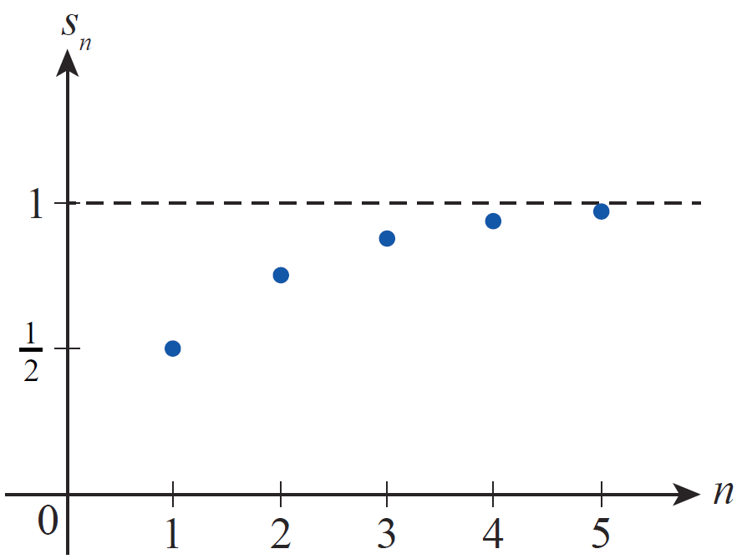
Example 1 (cont.)
The behavior of this sequence of partial sums, shown in Figure 1, can be analyzed by relating it to everyday experiences.
Figure 1

Slide 10
Example 1 (cont.)
For instance, if we think of the series as fractions of an inch, s₁ and a₁ both represent half an inch—the beginning point of the series. The second partial sum s₂ is the result of adding half the remaining distance (to the one-inch mark) to s₁, and of course half an inch plus half the remaining distance gets us to the three‑quarter mark. If we add half the remaining distance again, we arrive at seven‑eighths of an inch, and in general each successive partial sum is halfway closer to 1 than the previous partial sum.

Slide 11
Example 1 (cont.)
In terms of a formula, the above paragraph suggests
and we can make our reasoning rigorous
with the following inductive argument.
Basis Step:

Slide 12
Example 1 (cont.)
Inductive Step: Assume Then
We can now examine the limit of the sequence of partial sums to determine if the series converges. Since
we know converges and we write

Slide 13
Definition: Geometric Series
Geometric Series
Let a and r be fixed real numbers with a ≠ 0. The series
is called a geometric series. The number r is the common ratio of the series.

Slide 14
Theorem: Convergence and Divergence of Geometric Series
Convergence and Divergence of Geometric Series
The geometric series converges if |r|<1 and
diverges if When r < 1,

Slide 15
Proof: Convergence and Divergence of Geometric Series
Proof
We show convergence or divergence by examining the sequence of partial sums, and we begin with two specific cases.
If r = 1,
and clearly as n → ∞ (remember that a ≠ 0).

Slide 16
Proof: Convergence and Divergence of Geometric Series
Proof (cont.)
If r = −1,
so the sequence of partial sums is which again clearly diverges.

Slide 17
Proof: Convergence and Divergence of Geometric Series
Proof (cont.)
We now consider all cases where with the following formula for the partial sums:

Slide 18
Proof: Convergence and Divergence of Geometric Series
Proof (cont.)
If |r| < 1,
and the series converges.
But if |r| > 1, as n → ∞ and hence as well, so the series diverges.

Slide 19
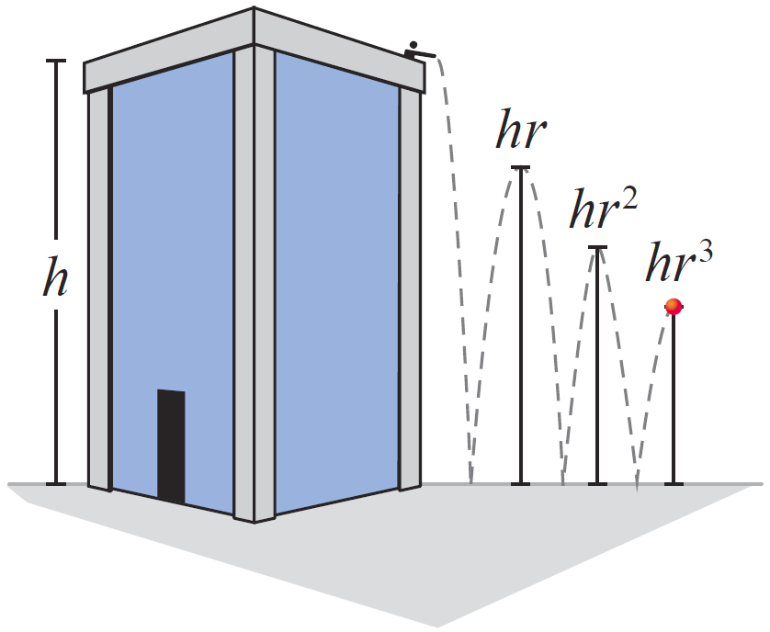
Example 2
A ball is dropped from an initial height of h units onto a flat surface and bounces repeatedly. After each bounce, the ball rebounds up to a height that is r times its previous height (with the ratio r positive and less than 1). Find the total distance the ball travels as it bounces up and down (see Figure 2).
Figure 2

Slide 20
Example 2 (cont.)
Solution
The ball bounces straight up and down and we are only interested in the vertical distance traveled. Note that in this ideal scenario, the ball bounces an infinite number of times. Nevertheless, the distance the ball travels is finite. It travels h units on its initial drop, then travels upward hr units after its first bounce, travels another hr units on its way back down, up hr² after the second bounce, and so on.

Slide 21
Example 2 (cont.)
Thus, we calculate the total distance as follows:
For instance, if the initial height is h = 5 m and the ratio r = 0.9 (a typical ratio if both the ball and surface are made of a hard material such as steel), then

Slide 22
Example 3
Determine the time required for the bouncing ball in Example 2 to come to rest.
Solution
The function where g is the acceleration due to gravity, describes the vertical position at time t of an object dropped from an initial height h. Setting y(t) = 0 and solving the resulting equation for t gives us the time required for an object to fall to the ground from a height of h.

Slide 23
Example 3 (cont.)
This is also the time required for a ball to attain a height of h after a bounce, so the total time that the ball in Example 2 bounces is given in the following formula.

Slide 24
Example 3 (cont.)

Slide 25
Example 3 (cont.)
If h = 5 m and r = 0.9, T ≈ 38.36 seconds (using g = 9.8 m/s²). So the ball in this example bounces an infinite number of times while traveling a total distance of 95 meters in a little over 38 seconds—this sort of scenario is the basis for many of the paradoxes devised by the early Greek mathematician Zeno of Elea (5th century BC).

Slide 26
Example 4
Express the repeating decimal as a ratio of two integers.
Solution
The notation stands for the sum
which is a geometric series with and a ratio of So

Slide 27
Geometric, Telescoping, and Harmonic Series
Sometimes, the terms in a series partially cancel one another in a nice way and leave expressions that are easy to analyze. The following is an example of a telescoping series, so named because the terms collapse much like the segments of a telescope.

Slide 28
Example 5
Show that the series converges and determine its sum.
Solution
By partial fraction decomposition,
Writing out the first few terms of the series as above points out that a great deal of cancellation can be done.

Slide 29
Example 5 (cont.)
In fact, the n^{th} partial sum has the form
and
So the series converges and has a sum of 1.

Slide 30
Theorem: Terms of a Convergent Series Go to Zero
With a few examples of series out of the way, we can proceed to generalize and prove some theorems that characterize convergent and divergent series.
Terms of a Convergent Series Go to Zero
If converges, then

Slide 31
Theorem: Terms of a Convergent Series Go to Zero
Proof
If we let s_{n} represent the n^{th} partial sum, then
a_{n} = s_{n} − s_{n − 1}. Since converges, exists and
is equal to some number L. Note that since n − 1 → ∞ as n → ∞, as well. So

Slide 32
Theorem: The n^{th}‑Term Divergence Test
The theorem above is often used to immediately determine that a given series diverges, as we can now
say that if then does not converge. This
fact is important enough to state as a theorem in its own right.
The n^{th}‑Term Divergence Test
If does not exist or is different from 0, then
diverges.

Slide 33
Geometric, Telescoping, and Harmonic Series
It is very important to realize, however, that
is necessary but not sufficient to guarantee that
converges. One of the classic illustrations of this fact is
the harmonic series

Slide 34
Example 6
Show that diverges.
Solution
This example introduces a technique that we often use to prove that a series diverges. It may be difficult to show directly that the sequence of partial sums diverges, but relatively easy to show that a subsequence diverges. And the divergence of a subsequence is sufficient to prove that the whole sequence diverges.

Slide 35
Example 6 (cont.)
With this in mind, note the following:

Slide 36
Example 6 (cont.)
.
.
.

Slide 37
Example 6 (cont.)
In general, so We haven’t
determined anything specific about the other partial sums, but we don’t need to—the fact that this subsequence of the partial sums grows unbounded
suffices to show that diverges.

Slide 38
Theorem: Combining Convergent Series
Combining Convergent Series
Assume that and are convergent series (we omit the index of summation for simplicity of presentation) and k is a fixed real number. Then and are also convergent.
Sum Law
Difference Law
Constant Multiple Law

Slide 39
Example 7
Determine whether each of the following series converges or diverges.
b.
Solution
a. The first step is to rewrite the terms of the series in a more useful form.

Slide 40
Example 7a (cont.)
Since both and converge, we
know that the original series converges and

Slide 41
Example 7a (cont.)
This result may be surprising at first, but writing out the beginning of the series we see that the first term is apparently canceled by the sum of the remaining terms.

Slide 42
Example 7 (cont.)
b. We can use partial fraction decomposition to again rewrite the terms, hopefully in a more useful form.
Both and diverge—the first is 2 times
the harmonic series, and the second is the harmonic series with the first term omitted, which still diverges.

Slide 43
Example 7b (cont.)
But our theorem doesn’t tell us anything about the difference of two divergent series—as we’ve seen, expressions such as ∞ − ∞ are indeterminate. So we need to find another way of rewriting the terms that is more informative.

Slide 44
Example 7b (cont.)
The expression is somewhat similar to the
partial fraction decomposition of Example 5, and we can easily make the connection more apparent.
We could also have arrived at this immediately if we had decomposed the original fraction another way:

Slide 45
Example 7b (cont.)
We know that converges. Suppose that
converged. Then by the last theorem,
would also converge, which we know is not true. So it
must be the case that diverges.

Slide 46
Example 8
Find the sums of each of the following series.
Solution
Each of these is a geometric series, though the form of the index and its beginning value are slightly different than in our definition. Nevertheless, if the first few terms are written out, it is easy to identify the first term and the common ratio.

Slide 47
Example 8 (cont.)
a. Note that so the first
term is 9 and the common ratio is leading to

Slide 48
Example 8 (cont.)
b. Note that so the first
term is and the common ratio is leading to

