Slide 1
Section 10.3
The Integral Test

Slide 2
TOPICS
The Integral Test
Series and remainder estimates

Slide 3
The Integral Test
Consider the series It passes the n^{th}-Term
Divergence Test (1/n² → 0 as n → ∞), but this only tells us that the series may converge. Remember that this condition is necessary but not sufficient to prove convergence. The series is neither geometric nor telescoping, so we don’t have a convenient formula to use for the partial sums. No theorem that we learned in the previous section seems to help, but a depiction of the series as in Figure 1 at least gives us a way to compare it to something we are familiar with.

Slide 4
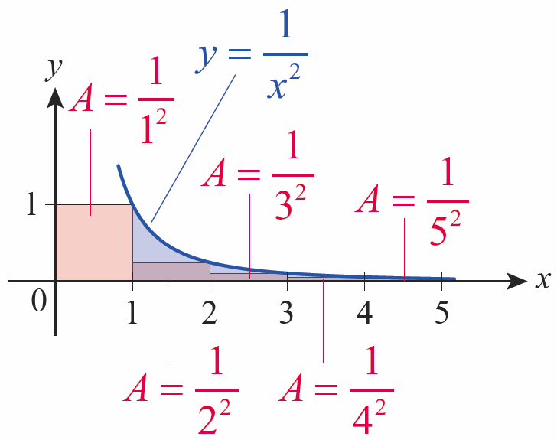
The Integral Test
In Figure 1, the n^{th} rectangle has a width of 1 and a height of 1/n², so its area is equal to the n^{th}
term of the series
If we define f(x) = 1/x², we can write
Figure 1 Area Depiction of

Slide 5
The Integral Test
Expressed this way, the series takes the form of a very coarse Riemann sum (coarse because the width of each subinterval is 1, a relatively large ∆x). And since f is a decreasing function, the Riemann sum is an underestimate of the area between the graph of f and the positive x-axis—that is clear from Figure 1, since each rectangle lies under the graph of f. In fact, treating the first term separately, we note that

Slide 6
The Integral Test
Recall that an integral of the form
is called an improper integral of type I, and its value
is defined as a limit, if the limit exists—we have seen that

Slide 7
The Integral Test
We can often compare a series, or at least all the terms of a series past some point N, to an integral just as we did above. When we can, the behavior of the series and the integral coincide—they either both converge or both diverge. The formal statement of this fact is called the Integral Test.

Slide 8
Theorem: The Integral Test
The Integral Test
Assume that is a decreasing sequence of positive terms and a_{n} = f(n), where f(x) is a continuous, positive, and decreasing function for all x greater than or equal to some natural number N. Then the series
and the improper integral both
converge or both diverge.

Slide 9
Theorem: The Integral Test
Proof
For simplicity of presentation, we will prove the theorem for N = 1; the proof is similar for all other values of N.
The fact that both the sequence and the function f are positive means that the sequence of partial sums
is an increasing sequence and that
increases as b → ∞. So by the Bounded Monotonic Sequence Theorem, we can show converges by showing it is bounded above.

Slide 10
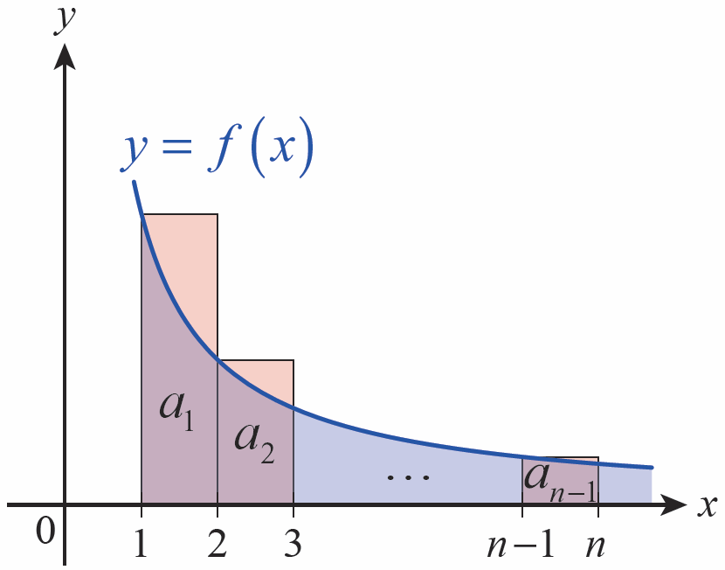
Theorem: The Integral Test
Proof (cont.)
The decreasing nature of both and f allows us to relate the partial sums to the integrals, as follows. If we
construct a Riemann sum for
the integral
using left endpoints of the subintervals [1, 2],…,[n − 1, n] (as shown in Figure 2), then
Figure 2

Slide 11
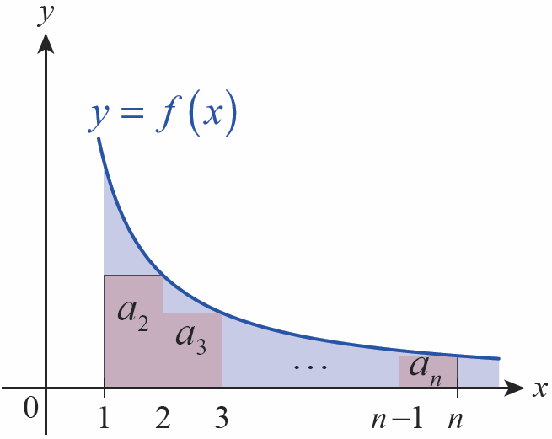
Theorem: The Integral Test
Proof (cont.)
But if we construct a Riemann sum for the same integral using right endpoints for our sample points (as in Figure 3) then
which, if we add the first term of the series to both sides, gives us
Figure 3

Slide 12
Theorem: The Integral Test
Proof (cont.)
So if converges, we know that
and hence converges as well (and its sum is less
than

Slide 13
Theorem: The Integral Test
Proof (cont.)
If diverges, then diverges too, since
(By the same reasoning, convergence of implies
convergence of and divergence of
implies divergence of

Slide 14
Caution
Caution
Although a series and integral meeting the conditions of the Integral Test will either both converge or both diverge, it should not be inferred, in the case of convergence, that they converge to the same value. For
example, and both converge, but
the series converges to a value of while the integral converges to a value of 1.

Slide 15
Example 1
Use the Integral Test to prove the divergence of the harmonic series.
Solution
We have already concluded that by
showing there is a subsequence of partial sums that grows unbounded. But we can now use the Integral Test to more directly show divergence.

Slide 16
Example 1 (cont.)
Since is a sequence of positive but decreasing terms, and since
as well.

Slide 17
The Integral Test
The convergent series and the divergent
series are two examples of a p‑series, which is
any series of the form with p a fixed real
number. Example 2 resolves the question of their convergence in full generality.

Slide 18
Example 2
Determine for which values of p a p-series converges.
Solution
We already know that the harmonic series, p = 1, diverges. If p = 0, and if p < 0,
so also diverges by the
n^{th}-Term Divergence Test for p ≤ 0.

Slide 19
Example 2 (cont.)
For 0 < p < 1 and p > 1, is a sequence of positive but decreasing terms and we can apply the Integral Test. We first note that

Slide 20
Example 2 (cont.)
If p > 1, −p + 1 < 0 so
and the integral and series converge (remember though that the Integral Test doesn’t tell us the sum of the series).

Slide 21
Example 2 (cont.)
If 0 < p < 1, −p + 1 > 0, and b^{−p +1} increases without bound as b → ∞. That is,
and the integral diverges. In summary, a p-series converges if p > 1 and diverges if p ≤ 1.

Slide 22
Series and Remainder Estimates
Suppose we have been able to use the Integral Test to
show that converges. Since the Integral Test only
provides an upper bound for the sequence of partial sums it doesn’t tell us the actual sum
of the series. But we can use the reasoning behind the proof of the Integral Test to come up with an estimate for the sum that is as precise as we desire.

Slide 23
Series and Remainder Estimates
To do so, we introduce the idea of the series remainder r_{n} = s − s_{n}. Referring to Figure 4, we see that
and, referring to Figure 5,
where, as before, f is a continuous, positive, and decreasing function with a_{n} = f(n)

Slide 24
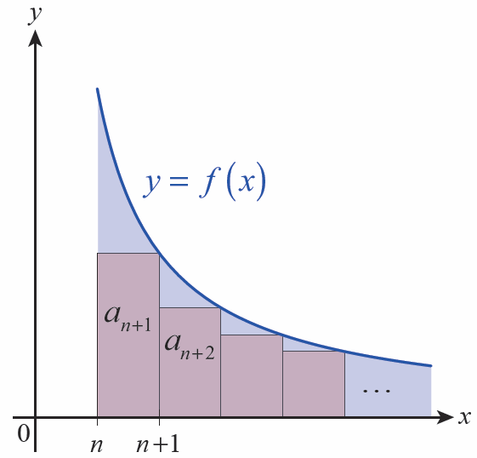
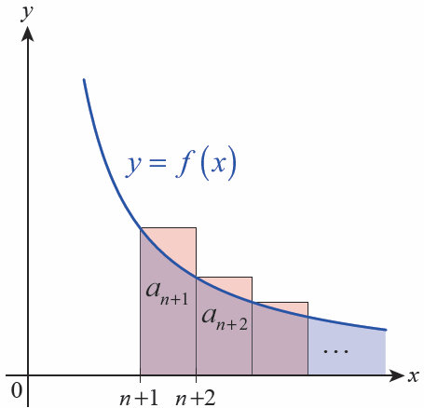
Series and Remainder Estimates
Figure 4
Figure 5

Slide 25
Series and Remainder Estimates
This gives us a lower and upper bound on the remainder r_{n} and, if we rewrite it in terms of s and the n^{th} partial sum s_{n}, a lower and upper bound on the actual sum of the series:
For reference, we state these two results as a theorem.

Slide 26
Theorem: Series and Remainder Estimates
Series and Remainder Estimates
Assume that is a convergent series and a_{n} = f(n),
where f(x) is a continuous, positive, and decreasing function. Then the sum s, the n^{th} partial sum s_{n}, and the n^{th} remainder r_{n} satisfy the inequalities
and

Slide 27
Example 3
Let
a. Rounded to two decimal places, the 10th partial sum s₁₀ is 1.55; based on this, find lower and upper bounds for s.
b. With what accuracy do we know s if we instead use s₁₀₀₀₀ ≈ 1.643935?

Slide 28
Example 3 (cont.)
Solution
Since
we can make the following estimates:
a.

Slide 29
Example 3 (cont.)
b.
Since s lies within an interval of width 1 × 10⁻⁶, we could approximate s by the average of the two values, 1.6449345, and know that the approximation is accurate to within (The exact value of s is )

Slide 30
Series and Remainder Estimates
Although the harmonic series diverges, we can still use an integral comparison to gain an appreciation for how slowly the sum grows. As we saw in proving the Integral
Test, the relationship is valid for any
series of positive but decreasing terms.

Slide 31
Example 4
Find a lower bound for the sum of the first 1 million terms of the harmonic series.
Solution
Using with n = 1,000,001 gives us

Slide 32
Example 4 (cont.)
In fact, after a significant amount of computation, a computer algebra system can tell us that s_{1,000,000} ≈ 14.393, so the lower bound given by the integral is a very quick and reasonable indication of the rate at which a divergent series of positive decreasing terms grows.

