Slide 1
Section 10.7
Power Series

Slide 2
TOPICS
Power series
Radius of convergence
Calculus and power series

Slide 3
Definition: Power Series
Power Series
A power series centered at 0 (or power series about 0) in the variable x is a series of the form
where the c_{n}’s are constants called the coefficients of the series. More generally, a power series centered at a (or power series about a) is a series of the form

Slide 4
Power Series
For any fixed x, a power series is a series similar to those we have studied over the past five sections, and we can determine if the series converges or diverges at that particular value of x. In practice, we typically want to determine all values of x for which a power series converges.

Slide 5
Example 1
Determine the values of x for which each of the following power series converges.
Solution
We will examine the limit of where a_{n} is the n^{th} term of each series, and thereby find conditions on x that guarantee absolute convergence.

Slide 6
Example 1 (cont.)
By the Ratio Test, the power series converges absolutely if |x − 5| < 1 and diverges if |x − 5| > 1. If x − 5 = 1, the series is the harmonic series and diverges, and if x − 5 = −1 it is the alternating harmonic series and converges. So in summary, this power series converges for 4 ≤ x < 6 and diverges for all other x.

Slide 7
Example 1a (cont.)
Figure 1 shows how the first four partial sums of the power series approach a limiting function, shown in black as a dashed curve. We will discover in Example 5 what this limiting function actually is.

Slide 8
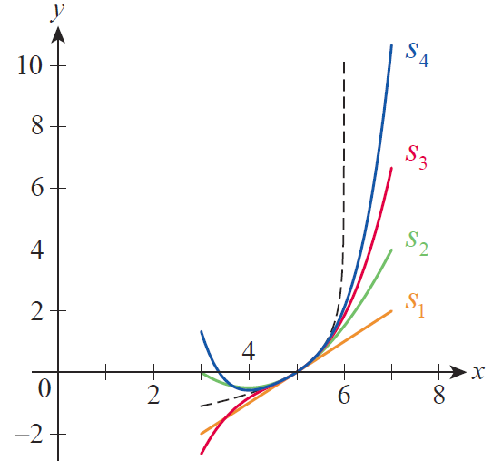
Example 1a (cont.)
Figure 1
Power Series Convergence

Slide 9
Example 1 (cont.)
By the Ratio Test, this power series converges absolutely if |x| < 1 and diverges if |x| > 1. In this example, however, the series converges when x = 1 (by the Alternating Series Test) and diverges when x = −1 (the series becomes the negative of the harmonic series), so we have convergence for −1 < x ≤ 1 and divergence elsewhere.

Slide 10
Example 1 (cont.)
This power series diverges everywhere except for the one value x = 0, for which the series has a sum of 0.

Slide 11
Power Series
If the coefficients of a power series are 0 for all n > N, then the power series (whether centered at 0 or some other real number a) is simply a polynomial of degree N. It is for this reason that power series with an infinite number of terms are informally thought of as “infinite” polynomials—polynomials with both an infinite number of terms and infinite degree. Just as infinite series have some properties in common with finite sums, power series have some properties in common with polynomials. Both the similarities and the differences are important to us.

Slide 12
Power Series
Because polynomials are so easily differentiated and integrated, it is perhaps no surprise that being able to equate a function with a power series is useful. Later, we will learn when this is possible and, in such cases, how to systematically find the series that corresponds to any given function. But it is also sometimes possible to begin with a power series and find the closed form (nonseries form) of the function to which it is equivalent.

Slide 13
Example 2
Determine the values of x for which each of the following series converges and the limiting function of the series for those values.
Solution
Our knowledge of geometric series will tell us both when these series converge and, for those values of x, what the sum is.

Slide 14
Example 2 (cont.)
a. Note that converges when |x| < 1, and for any
such fixed x, In other words, the
function can be approximated by
the successive partial sums of the series each of which is a polynomial:

Slide 15
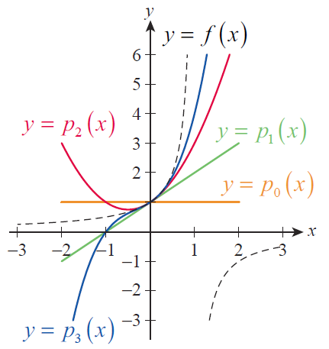
Example 2a (cont.)
The graphs of each of these, along with the graph of as a dashed black curve, are shown in Figure 2. Note that the polynomials only show promise of converging to f on the interval (−1, 1).
Figure 2

Slide 16
Example 2 (cont.)
b. We conduct a similar analysis for the series
First, we know this geometric series
converges when
which implies −2 < x < 4. Second, for any x in this interval,

Slide 17
Radius of Convergence
Although we have studied only a few power series to this point, the examples so far all have a characteristic in common: in each case, we have been able to show convergence for all x within a certain distance R of the point about which the power series is centered (the distance R may be 0). This is no coincidence—such behavior is common to all power series.

Slide 18
Theorem: The Power Series Convergence Theorem
The Power Series Convergence Theorem
If a power series converges for some value x = b ≠ 0, then it converges for all x such that |x|<|b|. On the other hand, if a power series diverges for some value x = d ≠ 0, then it diverges for all x such that |x|>|d|.

Slide 19
Theorem: The Power Series Convergence Theorem
Proof
If converges, then we know that
and so there is a natural number N such that
Note that for any x, n ≥ N implies

Slide 20
Theorem: The Power Series Convergence Theorem
Proof (cont.)
If and hence is a convergent
geometric series. By the Direct Comparison Test, the
above inequality shows that converges, so
converges.
Now, suppose that diverges. Then for any x
such that must also diverge, because
otherwise the proof above would imply that converges.

Slide 21
Radius of Convergence
The Power Series Convergence Theorem also applies to
series of the form with the conditions
replaced by The proof follows
immediately from the change of variables and applying the result of the theorem to the series
~
~

Slide 22
Definition: Radius of Convergence and Interval of Convergence
Radius of Convergence and Interval of Convergence
If converges for all and diverges
for all we call R the radius of convergence of the power series
If R = 0, the series converges only at x = a; and if R = ∞, the series converges for all x. When 0 < R < ∞, the series may or may not converge at x = a − R and x = a + R, meaning that the interval of convergence may be any of the four possibilities

Slide 23
Theorem: Existence of the Radius of Convergence of a Power Series
Existence of the Radius of Convergence of a Power Series
Given a power series exactly one of the following is true:
1. The series converges only for x = a (radius of convergence R = 0).
The series converges for all x (radius of convergence
R = ∞).
3. There is a real number 0 < R < ∞ such that
converges for all and diverges for all

Slide 24
Theorem: Existence of the Radius of Convergence of a Power Series
Proof
To prove this theorem, we must show that there is no interval of values for x on which the convergence or divergence of the series is unknown. To do so, suppose neither of the first two statements of the theorem is
true. Then for some b with
converges and for some d with
diverges.

Slide 25
Theorem: Existence of the Radius of Convergence of a Power Series
Proof (cont.)
Let
Then S ≠ ∅ since and S has an upper bound since By the Completeness Property of the real numbers, S has a least upper bound R, which makes the third statement above true (note that this theorem says nothing about convergence at either x = a − R or x = a + R).

Slide 26
Example 3
Find the radius of convergence and interval of convergence of the following series.

Slide 27
Example 3 (cont.)
Solution
a. Using the Ratio Test, we see
for every x ∈ℝ, so the radius of convergence is R = ∞ and the interval of convergence is (−∞, ∞).

Slide 28
Example 3 (cont.)
The series converges when This means the radius of convergence is about the center x = 0. To determine the interval of convergence, we must test the endpoints separately.

Slide 29
Example 3b (cont.)
When the series reduces to the alternating series
which converges. But when the series reduces to the divergent p-series
Thus, the interval of convergence is

Slide 30
Theorem: Differentiation and Integration of Power Series
Differentiation and Integration of Power Series
Suppose the power series has a
radius of convergence R > 0. Then

Slide 31
Theorem: Differentiation and Integration of Power Series
Differentiation and Integration of Power Series (cont.)
where both new series have the same radius of convergence R. Note that f is differentiable (and thus continuous) on (a − R, a + R). (In words, differentiation and integration of a power series can be performed term by term.)

Slide 32
Calculus and Power Series
Although power series behave exactly as we would like with regard to differentiation and integration, it should not be assumed that all series are so well behaved. It should also be noted that while the radius of convergence of the new power series obtained is the same as the original radius of convergence, the behavior at the interval endpoints can change—in particular, the original series may converge at an endpoint, while its derivative diverges .

Slide 33
Example 4
Differentiate the power series and express the result in closed form.
Solution
Differentiating the series is easily done term by term, according to the last theorem. And since we discovered
in Example 2a that expressing the
derivative in closed form is also easily accomplished.

Slide 34
Example 4 (cont.)
The radius of convergence of the original series is 1, so that is the radius of convergence of the new series as well. And in this case, the interval of convergence of both series is (−1, 1).

Slide 35
Example 5
Find the closed form of the series by first
determining the closed form of the series
Solution
The second series is a geometric series whose sum we can find.
Note that the radius of convergence of the series is R = 1, and that the interval of convergence is (4, 6).

Slide 36
Example 5 (cont.)
The first series,
is, term by term, an antiderivative of the second (with a constant of integration of −5), so

Slide 37
Example 5 (cont.)
By substituting x = 5 we determine that C = 0, so
And as we noted in Example 1a, its interval of convergence is [4, 6).

Slide 38
Calculus and Power Series
Power series (in fact, all absolutely converging series) behave like polynomials in another respect: they can be multiplied term by term.

Slide 39
Theorem: Multiplication of Power Series
Multiplication of Power Series
If both converge
absolutely for |x|< R, then
also converges absolutely for |x|< R, where

Slide 40
Example 6
Use the Multiplication of Power Series Theorem to express as a power series.
Solution
Since we begin by rewriting
these factors as the following two series.

Slide 41
Example 6 (cont.)
(Both have radius of convergence R = 1.) The formula for multiplying power series tells us that the coefficient of the term with degree n comes from all possible products of the two series that result in degree n—just the same as with the product of polynomials.

Slide 42
Example 6 (cont.)

