Slide 1
Section 10.8
Taylor and Maclaurin Series

Slide 2
TOPICS
Taylor and Maclaurin series
Remainder estimates and convergence for Taylor series

Slide 3
Taylor and Maclaurin Series
Assume we can represent a given function f as a power series for all x within a convergence radius R about a fixed real number a:
We then determine what the coefficients c_{n} must be, given this assumption. First, by letting x = a, we see immediately that f(a) = c₀.

Slide 4
Taylor and Maclaurin Series
Next, since we can differentiate a power series (within its radius of convergence) term by term, we note that
and substituting x = a into this equation tells us that
f ’(a) = c₁. We proceed to differentiate and substitute x = a repeatedly, to obtain

Slide 5
Taylor and Maclaurin Series
and, in general,
.
.
.

Slide 6
Taylor and Maclaurin Series
Solving for each c_{n}, and using the conventions that and 0! = 1, we have discovered that
Remember that this all hinges upon the key assumption that f can be represented as a power series about a—we will soon revisit this assumption to answer the question of when this is possible. But for now, we have motivated the following definition.

Slide 7
Definition: Taylor Series and Maclaurin Series
Taylor Series and Maclaurin Series
Given a function f with derivatives of all orders throughout an open interval containing a, the power series
is called the Taylor series generated by f about a.

Slide 8
Definition: Taylor Series and Maclaurin Series
Taylor Series and Maclaurin Series (cont.)
The Taylor series generated by f about 0 is also known as the Maclaurin series generated by f .

Slide 9
Taylor and Maclaurin Series
Note that the definition above formally describes Taylor and Maclaurin series as series—there is no claim (yet) that the Taylor series associated with a given function f actually converges to that function on any interval.

Slide 10
Example 1
Find the Taylor series expansion of f(x) = 1/x about a = 3, and determine where, if anywhere, the Taylor series converges to f.
Solution
We determine the coefficients c_{n} of the series as follows:

Slide 11
Example 1 (cont.)
and, in general, and

Slide 12
Example 1 (cont.)
So the Taylor series generated by f about a = 3 is
Since the series was generated by f(x) = 1/x we are certainly justified in hoping that it actually equals 1/x somewhere.

Slide 13
Example 1 (cont.)
That hope may be in vain, as we will see in Example 5, but in this case we can easily determine exactly where the series converges to the function because it is of a form we understand well. It is a geometric series with ratio −(x − 3)/3 and it converges when or 0 < x < 6. And, for those values of x,

Slide 14
Taylor and Maclaurin Series
If we were to discard all the terms of the Taylor series of Example 1 with degree greater than n, we would wind up with a polynomial of degree n that approximates 1/x on the interval (0, 6). Specifically, the first four such polynomial approximations from Example 1 are as follows:

Slide 15
Taylor and Maclaurin Series

Slide 16
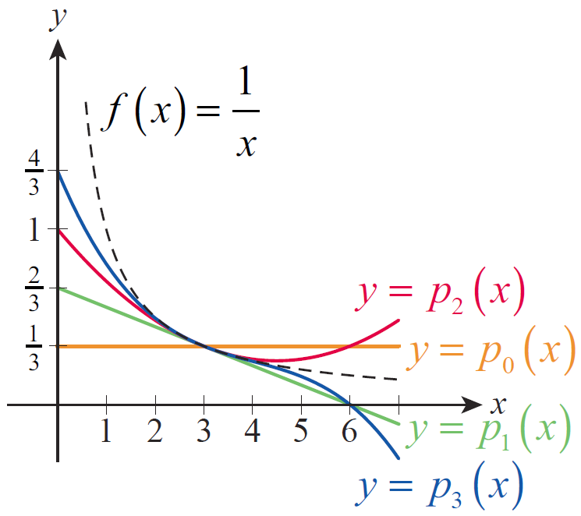
Taylor and Maclaurin Series
These polynomials are shown in Figure 1. They are called Taylor polynomials and they generalize the idea of approximating a function with its linearization, p₁(x) .
Figure 1 Taylor Polynomials

Slide 17
Definition: Taylor Polynomial of Order n
Taylor Polynomial of Order n
Given a function f with derivatives up through order N throughout an open interval containing a, the polynomial

Slide 18
Definition: Taylor Polynomial of Order n
Taylor Polynomial of Order n (cont.)
is called the Taylor polynomial of order n generated by f about a. If a = 0, the Taylor polynomial is also known as the Maclaurin polynomial.

Slide 19
Example 2
Find the Maclaurin polynomials generated by f(x) = sinx.
Solution
The derivatives of f exhibit a nice cyclical pattern, and we leave it to the reader to verify that

Slide 20
Example 2 (cont.)
So the Maclaurin series generated by f is

Slide 21
Example 2 (cont.)
Since all the terms with an even exponent are absent, we can describe the family of Maclaurin polynomials with the formulas
and

Slide 22
Example 2 (cont.)
As a consequence, the Maclaurin polynomials of order 2n + 1 and order 2n + 2 are the same and both have degree 2n + 1. For instance, the Maclaurin polynomials of order 5 and order 6 are
and both have degree 5.

Slide 23
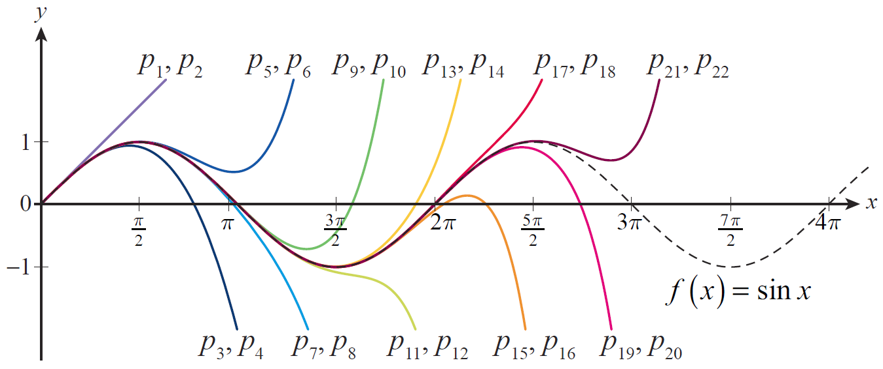
Example 2 (cont.)
Figure 2 is an illustration of how the Maclaurin polynomials of increasing order approximate f(x) = sin x. Keep in mind, however, that we still have the task of determining where this Maclaurin series actually converges to its generating function.
Figure 2 Maclaurin Polynomial Approximations of Sine

Slide 24
Remainder Estimates and Convergence for Taylor Series
We are now ready to tackle the question of when (and where) Taylor series converge to their generating functions, and we do so with a theorem that generalizes the Mean Value Theorem.

Slide 25
Theorem: Taylor’s Theorem
Taylor’s Theorem
If f and its derivatives up through f^{(n)} are all continuous on the closed interval [a, b] and if f^{(n+1)} exists on the open interval (a, b), then there is a number such that

Slide 26
Remainder Estimates and Convergence for Taylor Series
In applying Taylor’s Theorem, we typically desire an approximation for the value f(x) based on the known value of f and its first n derivatives at some fixed point a, so we replace b in the theorem with x and express the result as a formula.

Slide 27
Formula: Taylor’s Formula
Taylor’s Formula
If f has derivatives of all orders throughout an open interval I containing a, then for each natural number n and for each x ∈ I,

Slide 28
Formula: Taylor’s Formula
Taylor’s Formula (cont.)
In this formula, c is some number between a and x. Defining p_{n}(x) and r_{n}(x) as above, we can write where p_{n} is a polynomial of degree at most n and r_{n} is called the remainder (or error) of order n.

Slide 29
Remainder Estimates and Convergence for Taylor Series
So given a function f meeting the conditions of Taylor’s formula, we now note that the Taylor polynomials p_{n} converge to f for all x in the open interval I if as n → ∞ for each x. If this is the case, we write
and say that the Taylor series generated by f converges to f on I. We are often able to show that on I by knowing something about the behavior of the derivatives of f throughout I.

Slide 30
Example 3
Find the Maclaurin series generated by f(x) = e^{x} and determine where it converges to f.
Solution
The function f has derivatives of all orders on the entire real line, and f^{(n)}(0) = 1 for every n, so the formal Maclaurin series generated by f(x) = e^{x} is

Slide 31
Example 3 (cont.)
The only remaining step is to determine for which values of x this series converges to f. We do so by splitting the real number line into three cases. In two of them, we make use of the fact that
for every real number x.

Slide 32
Example 3 (cont.)
This is true because the series is absolutely
convergent for any x (by the Ratio Test) and hence convergent (absolute convergence implies convergence), so the terms x^{n}/n! must converge to 0.

Slide 33
Example 3 (cont.)
(1) If x < 0, Taylor’s formula tells us that the remainder r_{n}(x) of order n is
for some x < c < 0. And since
and hence as well.

Slide 34
Example 3 (cont.)
(2) If x = 0, r_{n}(x) = 0 for every n ≥ 1, so
(3) If x > 0, Taylor’s formula again tells us that
this time for some 0 < c < x. But since f is an increasing function, we know e^{c} < e^{x} so

Slide 35
Example 3 (cont.)
Since for every real number x,
everywhere.

Slide 36
Remainder Estimates and Convergence for Taylor Series
We often make use of the fact that in showing Taylor series convergence.

Slide 37
Example 4
For which values of x does
Solution
In Example 2, we constructed the formal Maclaurin series above for f(x) = sinx. And since for all n and all possible values of c, the remainder of order n satisfies
and hence as well.

Slide 38
Example 4 (cont.)
So the Maclaurin series generated by sin x is another example of a series that converges to its generating function for all x.

Slide 39
Remainder Estimates and Convergence for Taylor Series
So far, we have determined that e^{x} and sin x converge to their respective Maclaurin series, that is, Taylor series about a = 0 for all x, and Example 1 demonstrated that 1/x converges to its Taylor series about a = 3 on the interval 0 < x < 6 (and by checking the endpoints 0 and 6 individually, its easy to see that they cannot be included in the interval of convergence). The next example demonstrates that not all Taylor series are so well behaved.

Slide 40
Example 5
Let f be defined by
It is easy to see that f has derivatives of all orders for every x ≠ 0, and with a bit of work we can show that f^{(n)}(0) = 0 for every n. First, by the definition of the derivative,

Slide 41
Example 5 (cont.)
This limit is of indeterminate form 0/0 and we could apply l’Hôpital’s Rule to it directly—unfortunately, as you can verify, this leads to a limit that’s harder to analyze. But we can transform the limit into one of indeterminate form and make progress.

Slide 42
Example 5 (cont.)
We use the same principle to show that higher derivatives of f evaluated at 0 are also 0. For instance,
and two applications of the same trick result in
By induction, and through repeated application of l’Hôpital’s Rule, we obtain f^{(n)}(0) = 0 for every n.

Slide 43
Example 5 (cont.)
So the Maclaurin series generated by f is the series
or 0. But clearly for every x ≠ 0. So the
Maclaurin series for this particular function converges to it at one and only one point—not a very useful expansion at all.

Slide 44
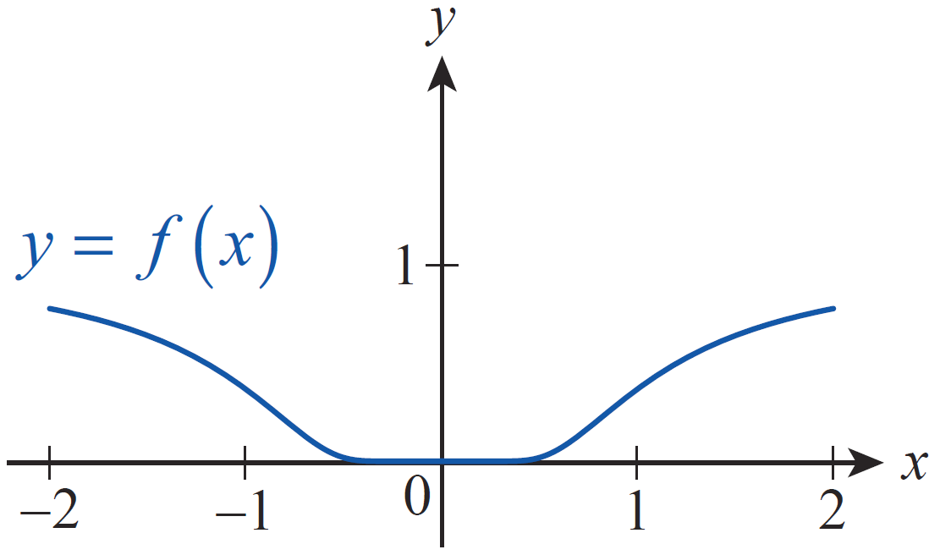
Example 5 (cont.)
What goes wrong in this example? Actually, nothing at all—Taylor’s Theorem is not contradicted by this function. Figure 3 shows that f is extremely flat near 0,
but not exactly flat. For any x ≠ 0, f^{(n)}(x) will eventually begin to diverge rapidly from 0 as n → ∞, resulting in
Figure 3

Slide 45
Example 6
Find the Maclaurin series expansion of cos x.
Solution
Since for all x (see Example 4), we
know we can differentiate it term by term. So
for all x.

Slide 46
Example 7
Find the Maclaurin series expansion of
Solution
We could construct the series expansion directly, but it is far quicker to simply use the known series expansion of e^{x} (which from Example 3 we know converges for all x) and substitute −x² for x.

Slide 47
Example 8
Approximate to within 0.001.
Solution
The integral is an example of a nonelementary integral, so we cannot evaluate it using an antiderivative of But we can make use of the series expansion we just found in Example 7. Since the series converges for all x, we can integrate it term by term without hesitation.

Slide 48
Example 8 (cont.)

Slide 49
Example 8 (cont.)
The absolute value of the next term in the series would be so by the Alternating Series Test we know the approximation 0.7475 is correct to within 0.001.

Slide 50
Example 9
Find the Taylor series expansion of ln x about a = 1.
Solution
We leave it as an exercise to find the Taylor series expansion directly, and instead demonstrate how several facts we already know can be combined:

Slide 51
Example 9 (cont.)
Note that the expansion we just found remains valid for |x − 1|< 1. Note also that the interval of convergence now includes the endpoint x = 2 but not the endpoint x = 0.

Slide 52
Example 9 (cont.)
The expansion may appear in several slightly different forms. For instance, if (−1)^{n+1} is factored out of each numerator and the series reindexed to begin with 1, it can be written as

Slide 53
Example 10
Find a. the Maclaurin series expansion of x sinx and
b. the Taylor series expansion of x lnx about a = 1.
Solution
a. Since our series expansion of sinx is valid for all x (see Example 4), we can simply multiply it by x (which is, trivially, the Maclaurin series of x).

Slide 54
Example 10 (cont.)
b. To quickly find the series expansion of x lnx about a = 1, we want to use the result of Example 9 along with the series expansion of x about a = 1, which is x = 1 + 1(x − 1).

Slide 55
Example 10b (cont.)

Slide 56
Table 1
Function | Taylor Series | Convergence Condition
e^{x}
sinx

Slide 57
Table 1 (cont.)
Function | Taylor Series | Convergence Condition
cosx
lnx

