Slide 1
Section 10.9
Further Applications of Series

Slide 2
TOPICS
Applications using series
Fourier series
Summary of common Taylor series

Slide 3
Further Applications of Series
We have already determined that the Taylor series expansion
is valid for all x ∈ ℝ. One way to extend this exponential function to the complex numbers is to use its series expansion as the basis for the definition of e^{iθ}, as follows.

Slide 4
Further Applications of Series

Slide 5
Further Applications of Series
The equation e^{iθ} = cosθ + i sinθ is called Euler’s formula, which allows us to relate the constants e, i, and π with the equation e^{iπ} = cosπ + i sinπ = −1, or e^{iπ} + 1 = 0 called Euler’s identity. It also allows us to now define the value of e^{z} for any complex number
z = x + iy, as follows.

Slide 6
Example 1
Express e^{iπ /4} and e^{1−3iπ} in the form x + iy.
Solution

Slide 7
Applications Using Series
We have previously found and used linear approximations such as which is valid for x ≈ 0. The Taylor series for about x = 0, where m represents any fixed constant, is called the binomial series expansion of it is a generalization of formulas like with many uses, and we are now ready to derive it.

Slide 8
Applications Using Series

Slide 9
Applications Using Series
In general,
We can now extend the meaning of the binomial coefficient by defining, for any real number m and nonnegative integer n,

Slide 10
Applications Using Series
and,
(note that if m is a natural number, this new definition
of reduces to
Given this extended meaning for the binomial coefficient, we can define the following type of series.

Slide 11
Definition: Binomial Series
Binomial Series
For any real number m and −1 < x < 1, the series
is called a binomial series.

Slide 12
Applications Using Series
By the Ratio Test, it is easy to see that the binomial series converges for |x| < 1. This does not prove that it converges to (1 + x)^{m}, but that is indeed the question of whether the series converges at the endpoints of the convergence interval depends on m: for example, if
−1 < m ≤ 0, the series converges at x = 1; and if m ≥ 0, it converges at both x = −1 and x = 1.

Slide 13
Applications Using Series
Note also that the series is finite (and hence convergent for all x) if m is a natural number, since in this case all the binomial coefficients past some point are equal to 0. In other words, when m is a natural number, the binomial series expansion simply reduces to the Binomial Theorem.

Slide 14
Example 2
Use the binomial series to find the series expansions of a. and b. about x = 0.
Solution
a. This confirms the power series expansion of 1/(1 − x) we have previously found.

Slide 15
Example 2a (cont.)
We know this converges for |x| < 1, and by examining the series with the specific values x = −1 and x = 1 it’s easy to see it diverges at both endpoints.

Slide 16
Example 2 (cont.)
b.

Slide 17
Example 2b (cont.)
The series converges for |x²| < 1, so the radius of convergence is again 1. In this case, however, the Alternating Series Test tells us that the series also converges at both x = −1 and x = 1.

Slide 18
Example 3
If a particle of mass m is moving with velocity v, the total relativistic energy of the particle is
where c is the speed of light in a vacuum. We can use the binomial series to expand this as follows:

Slide 19
Example 3 (cont.)

Slide 20
Example 3 (cont.)
The term mc² is called the particle’s rest-mass energy, and the remainder of the series is called the particle’s kinetic energy E_{k}. When a particle is moving with a velocity v much smaller than c (the so-called classical case), v²/c² and all its positive powers are very close to 0 and

Slide 21
Applications Using Series
When a closed-form solution to a differential equation is difficult (or impossible) to find, a polynomial approximation may be attainable by beginning with the assumption that the solution has a power series representation.

Slide 22
Example 4
Find a power series solution of the equation y′′ − x²y = 0.
Solution
We begin by assuming the solution y can be written in the form

Slide 23
Example 4 (cont.)
Then
and
So

Slide 24
Example 4 (cont.)
To satisfy the equation y′′ − x²y = 0, it must be the case that each coefficient in the power series expression is 0, so
c₂ = 0, c₃ = 0, and for n ≥ 2.

Slide 25
Example 4 (cont.)
If the differential equation is associated with other information, such as initial conditions like y(0) = a and y′ (0) = b, then we would know that a = y(0) = c₀ and b = y′ (0) = c₁ and it would make sense to express all the coefficients in terms of a and b.
c₀ = a, c₁ = b, c₂ = 0, c₃ = 0 and for n ≥ 2

Slide 26
Example 4 (cont.)
This would allow us to express the solution y as a sum of two series.

Slide 27
Example 4 (cont.)
Both of the series converge absolutely for all x, as can be verified by the Ratio Test. In many applications, a polynomial approximation of the solution would be sufficient, so the above two series would be truncated at the desired degree of accuracy.

Slide 28
Fourier Series
As we have seen, a Taylor series expansion of a function represents a limit of polynomials of increasing degree. As such, the polynomials are better able to approximate the original function as the order of the Taylor polynomials increases. But there is no escaping the fact that for any fixed Taylor
Polynomial p_{n}. That is, polynomials grow unbounded in magnitude as x gets further and further from 0, which is not the kind of behavior exhibited by a periodic function.

Slide 29
Fourier Series
As a consequence, there is no hope that any fixed Taylor polynomial generated by a periodic function could approximate that function well outside of a bounded interval.

Slide 30
Fourier Series
On the other hand, sine and cosine are familiar functions that are easy to manipulate and that exhibit exactly the kind of periodicity that might be needed. For this reason, the French mathematician Jean-Baptiste Joseph Fourier (1768–1830) used them as the basis for solving differential equations describing the flow of heat in physical objects.

Slide 31
Fourier Series
The decomposition of functions into sums (possibly infinite sums) of sines and cosines has come to be a part of what is now called Fourier analysis, a branch of mathematics that deals with problems in electrical engineering, acoustics, vibration analysis, optics, signal and image processing, and quantum mechanics, in addition to the original heat flow problems. We introduce the subject here with an outline of the theory of Fourier series.

Slide 32
Fourier Series
Suppose f is a periodic function and we hope to express it as a sum of sines and cosines of differing frequencies over the interval [−π, π]. Specifically, we want to find coefficients {a_{k}} and {b_{k}} such that

Slide 33
Fourier Series
We do so by multiplying the above equation through by a particular cos px or sin px, and integrating the resulting expressions from −π to π, making use of the following facts.
p, q ∈ℤ
p, q ∈ℤ

Slide 34
Fourier Series
For instance, multiplying through by cos(0 ⋅ x), which is the constant function 1, and integrating results in
since all the other integrals on the right hand side are equal to 0. After multiplying through by cos x and sin x, respectively, and integrating we obtain

Slide 35
Fourier Series
In general, if k is a positive integer, then
which, when we solve for the coefficients, gives us the following definition.

Slide 36
Definition: Fourier Coefficients and Fourier Series
Fourier Coefficients and Fourier Series
Given a function f that is integrable on the interval [−π, π ], we define its Fourier coefficients with the formulas

Slide 37
Definition: Fourier Coefficients and Fourier Series
Fourier Coefficients and Fourier Series (cont.)
and the corresponding Fourier series for f by

Slide 38
Fourier Series
We will not explore in this text the question of when the Fourier series for a given function converges to the original function. This question actually leads into a rich
area of mathematical research known as harmonic analysis; for our purposes, it will suffice to simply determine the Fourier coefficients for various common functions.

Slide 39
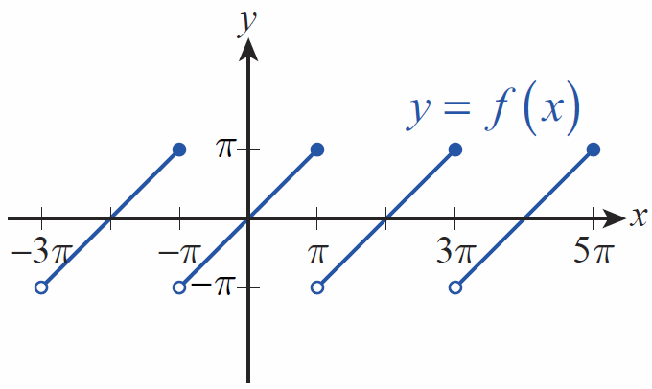
Example 5
In electrical engineering applications, the sawtooth function defined by
arises frequently; its graph appears in Figure 1.
Figure 1 Sawtooth Function

Slide 40
Example 5 (cont.)
This function poses both mathematical and practical difficulties because of its points of discontinuity. Fortunately, it can be approximated as accurately as desired with the first few terms of its Fourier series, and any such approximation has derivatives of all orders.

Slide 41
Example 5 (cont.)

Slide 42
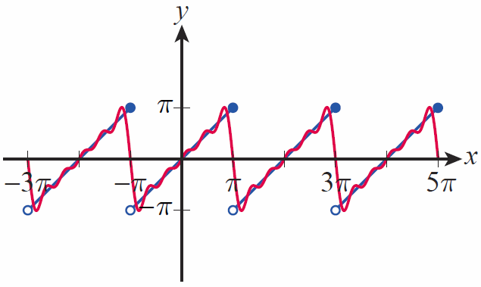
Example 5 (cont.)
If we let g(x) be the truncated Fourier series then
A graph of g appears with the graph of f in Figure 2.
Figure 2
Sawtooth Function f and Fourier Approximation g

Slide 43
Summary of Common Taylor Series
Function | Taylor Series | Convergence Condition
e^{x}
Sin x

Slide 44
Summary of Common Taylor Series
Function | Taylor Series | Convergence Condition
cos x
lnx

Slide 45
Summary of Common Taylor Series
Function | Taylor Series | Convergence Condition
tan⁻¹x
 |  | Varies with m, but at least |x| < 1

