Slide 1
Section 11.1
Three-Dimensional Cartesian Space

Slide 2
TOPICS
Cartesian coordinates in three dimensions
Distance in three dimensions

Slide 3
Cartesian Coordinates in Three Dimensions
Cartesian three-dimensional space, denoted ℝ³ or ℝ×ℝ×ℝ, is a natural extension of the Cartesian plane, and is constructed by adding a third coordinate axis, the z‑axis, perpendicular to the plane defined by the x‑ and y‑axes. In doing so, we are immediately faced with the choice of deciding which of the two directions away from the origin should correspond to positive
z­-values.

Slide 4
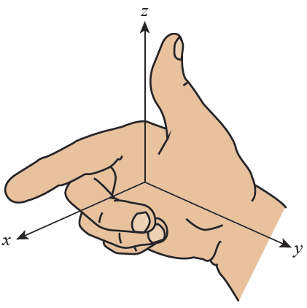
Cartesian Coordinates in Three Dimensions
The usual choice is called a right-handed rectangular coordinate system, as shown in Figure 1.
Figure 1
Right-Handed Rectangular Coordinate System

Slide 5
Cartesian Coordinates in Three Dimensions
The name reflects the fact that if you curl the fingers of your right hand from the positive x-axis toward the positive y-axis, your thumb will point in the direction of the positive z-axis. We can orient the axes on the page in any way that is convenient for a given drawing, but all three-dimensional coordinate drawings in this text will be based on a right-handed system. (If we had chosen to make the positive z-axis point down, the result would have been a left-handed rectangular coordinate system.)

Slide 6
Cartesian Coordinates in Three Dimensions
Points in three-dimensional Cartesian space correspond to ordered triples, just as points in the plane correspond to ordered pairs. For instance, the triple (a, b, c) is the unique point in space reached by beginning at the origin (0, 0, 0) and traveling a units along the x-axis, then b units parallel to the y-axis, and finally c units parallel to the z-axis.

Slide 7
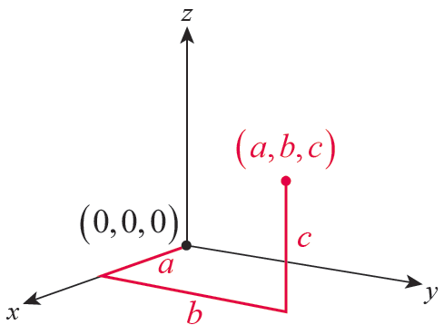
Cartesian Coordinates in Three Dimensions
In Figure 2, the triple (a, b, c) depicts a point with three positive coordinates.
Figure 2
Point in Three­-Dimensional Cartesian Space

Slide 8
Cartesian Coordinates in Three Dimensions
All points with three positive coordinates constitute the portion of space called the first octant, with the other seven octants similarly bordered by the three coordinate planes meeting at the origin.

Slide 9
Cartesian Coordinates in Three Dimensions
The three coordinate planes are frequently identified as the xy‑plane, the yz‑plane, and the xz‑plane; they are, as you would expect, the planes defined by the two axes lying in them. For instance, the yz-plane is the plane containing the y-axis and the z-axis, and consists of all those points whose x-coordinate is 0. In fact, this property completely characterizes the yz-plane: the graph of the equation x = 0 is the yz-plane, since the graph of x = 0 consists of all those points in space with an x-coordinate of 0.

Slide 10
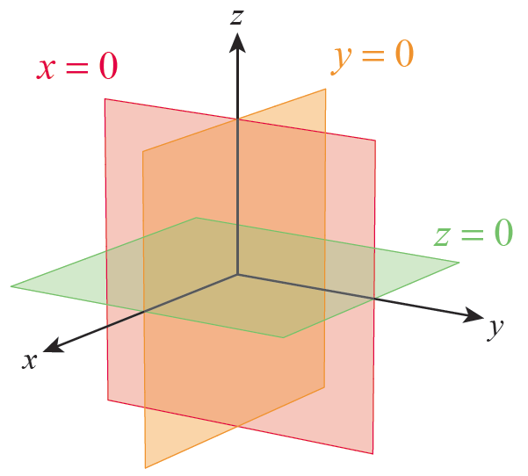
Cartesian Coordinates in Three Dimensions
Similarly, the equation z = 0 defines the xy-plane and the equation y = 0 defines the xz-plane (see Figure 3).
Figure 3
Coordinate Planes

Slide 11
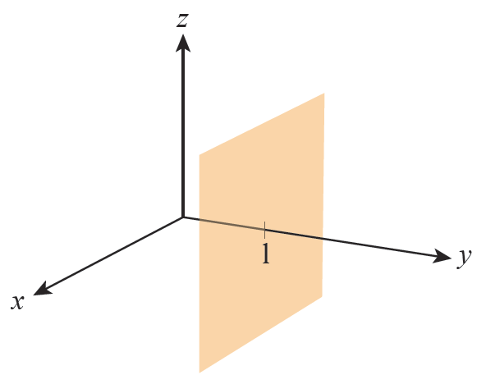
Example 1
a. The graph of the equation y = 1 is the plane consisting of all those points whose
y-coordinate is 1. It is parallel to the xz-plane (y = 0), and is shown in Figure 4.
Figure 4
Graph of y = 1

Slide 12
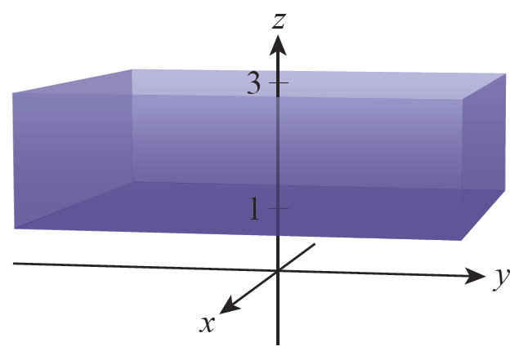
Example 1 (cont.)
b. The region in ℝ³ defined by the compound inequality 1 ≤ z < 3 consists of all those points between the two planes z = 1 and z = 3, with those points comprising the plane z = 1 included (see Figure 5).
Figure 5
Graph of the Region Defined by 1 ≤ z < 3

Slide 13
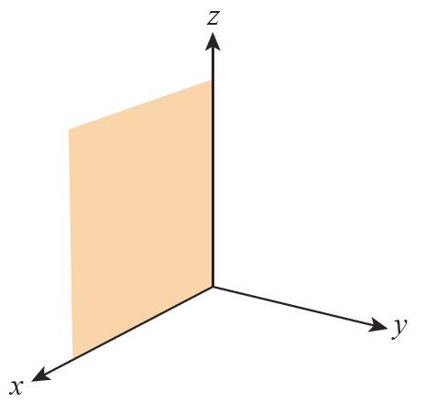
Example 1 (cont.)
c. Those points satisfying the three relations x ≥ 0, y = 0, and z ≥ 0 constitute the first quadrant of the
xz-­plane, as shown
in Figure 6.
Figure 6
First Quadrant of the xz-Plane

Slide 14
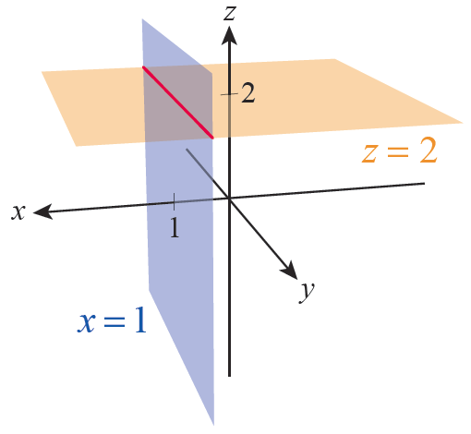
Example 1 (cont.)
d. Those points satisfying the two equations x = 1 and z = 2 lie at the intersection of two planes, and constitute a line parallel to the
y­-axis (see Figure 7).
Figure 7
Intersection of the Planes
x = 1 and z = 2

Slide 15
Example 1 (cont.)
e. In the yz-plane, the graph of the equation y + z = 0 consists of all those points for which z = −y. In ℝ³, the graph of the equation y + z = 0 still consists of all those points for which z = −y; that is, those points for which the third coordinate is the negative of the second coordinate. But since x doesn’t appear in the equation, there is no constraint at all on the first coordinate.

Slide 16
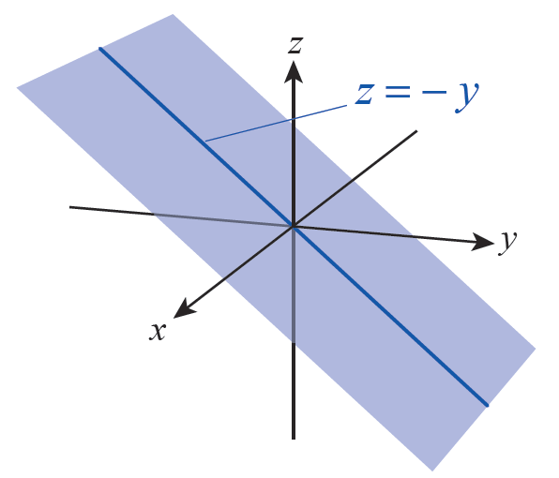
Example 1 (cont.)
Thus the graph of y + z = 0 in ℝ³ consists of all those points of the form
these
points form the plane illustrated in Figure 8.
ℝ
Figure 8 Graph of y + z = 0

Slide 17
Cartesian Coordinates in Three Dimensions
The projection of a point (x, y, z) in ℝ³ onto a plane is the point in that plane closest to (x, y, z) . The projection of the points constituting a given object onto a coordinate plane is often useful in helping to visualize or better understand the object.

Slide 18
Example 2
Determine the projections of the following points and objects onto the indicated planes.
a. Projection of (3, −2, 7) onto the three coordinate planes.
b. Projection of (3, −2, 7) onto the plane y = 5.
c. Projection of the plane defined by the equation y + z = 0 onto the yz‑plane.

Slide 19
Example 2 (cont.)
Solution
a. The projection of (3, −2, 7) onto the xy-plane is (3, −2, 0).
The projection of (3, −2, 7) onto the yz-plane is (0, −2, 7).
The projection of (3, −2, 7) onto the xz-plane is (3, 0, 7).
b. The projection of (3, −2, 7) onto the plane y = 5 is (3, 5, 7).

Slide 20
Example 2 (cont.)
c. The projection of the graph (in ℝ³) of the equation y + z = 0 onto the yz-plane is the line in the yz-plane illustrated in Figure 8.
Figure 8 Graph of y + z = 0

Slide 21
Example 3
Graph the equation x² + y² = 1 in ℝ³.
Solution
In the xy-plane, the graph of x² + y² = 1 consists of all those points 1 unit from the origin (a circle of radius 1). To graph this equation in three‑dimensional space, the only adjustment we need make is to note that the
z­-coordinate of any given solution point is irrelevant. That is, (x, y, z) will be a solution of the equation if and only if x² + y² = 1.

Slide 22
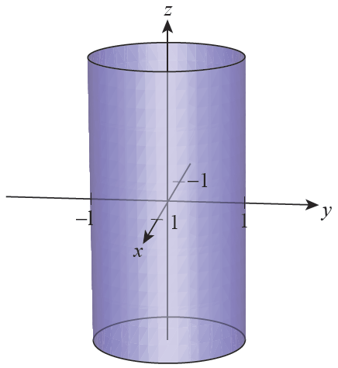
Example 3 (cont.)
So the graph is a cylinder of radius 1 whose axis is the z-axis; in other words, all points for which x² + y² = 1, without regard to the value of the
z­-coordinate. Figure 9 depicts the graph.
Figure 9 Cylinder of Radius 1

Slide 23
Distance in Three Dimensions
The rectangular nature of the three-dimensional coordinate system just introduced allows us to easily extend our two-dimensional distance formula. Two points (x₁, y₁, z₁) and (x₂, y₂, z₂) in space, with x₁ ≠ x₂, y₁ ≠ y₂, and z₁ ≠ z₂, can always be taken to define diagonally opposite corners of a box whose sides are parallel to the coordinate axes, as illustrated in Figure 10a.

Slide 24
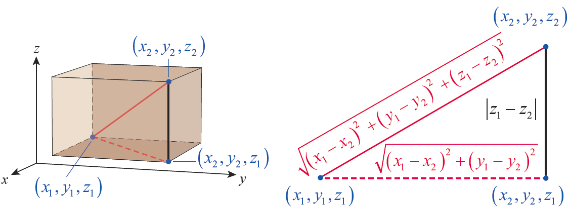
Distance in Three Dimensions
(a) Distance in Three Dimensions
(b) Applying the Pythagorean Theorem
Figure 10

Slide 25
Distance in Three Dimensions
By the two-dimensional distance formula (Pythagorean Theorem), the length of the dashed red line in Figure 10a is

Slide 26
Distance in Three Dimensions
Applying the Pythagorean Theorem again, this time to the right triangle whose hypotenuse is the line segment joining (x₁, y₁, z₁) to (x₂, y₂, z₂) as shown in Figure 10b, we see that the distance between the two points is

Slide 27
Example 4
Find the distance between the points (−2, 5, 1) and (3, 0, −1).
Solution
Applying the previous formula, the distance is as follows:

Slide 28
Example 5
Construct an equation whose graph is the sphere of radius 2 centered at the point (2, 3, −1).
Solution
We seek an equation in x, y, and z that describes all those points (x, y, z) that are 2 units from (2, 3, −1). So using the distance formula, we need
or, squaring both sides,

Slide 29
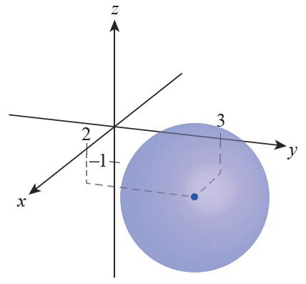
Example 5 (cont.)
The graph of such a sphere is shown in Figure 11.
Figure 11 Sphere of Radius 2 Centered at (2, 3, −1)

Slide 30
Example 5 (cont.)
More generally, the graph of the equation
is a sphere of radius r
centered at the point (a, b, c).

