Slide 1
Section 11.5
Describing Lines and Planes

Slide 2
TOPICS
Lines in space
Planes

Slide 3
Lines in Space
The position vector of a point P is a vector in standard position having P as its terminal point—we use position vectors to describe a point’s location.

Slide 4
Example 1
Construct position vectors describing the points making up the line L passing through A(4, 2, −1) and B(1, 2, 3).
Solution
The position vector describes one point of L, namely the point A.

Slide 5
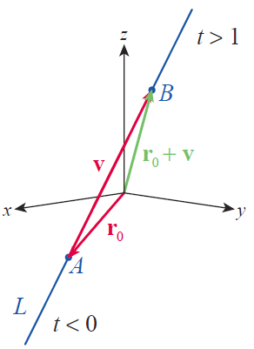
Example 1 (cont.)
We can add the vector to r₀ to construct a position vector whose terminal point is B; Figure 1 illustrates the fact that
Figure 1
Vector Description of a Line

Slide 6
Example 1 (cont.)
We can describe any other point between A and B with a position vector of the form r₀ + tv, for some 0 ≤ t ≤ 1. But by merely allowing t to take on all possible real values, we describe all the points that can be reached by starting at A and traveling in the direction of v by some scalar multiple (including negative scalar multiples). So the position vector
is a function of t that describes all the points of the line L (Figure 1) as t takes on all real values.

Slide 7
Definition: Vector Form and
Parametric Form of a Line
Vector Form and Parametric Form of a Line
The vector form for the line L containing the point and parallel to the direction vector
is
Note that if we let denote the components of r(t), then the equations
x = x₀ + at, y = y₀ + bt, and z = z₀ + ct
are parametric equations (in the parameter t) describing the line L.

Slide 8
Example 2
Find both the vector form and the parametric equations of the line parallel to the direction vector 3i − j + 2k and passing through the point (−7, 2, 5).
Solution
The line passing through the given point and parallel to 3i − j + 2k can be described in vector form as follows.
The parametric equations are
x = −7 + 3t, y = 2 − t, and z = 5 + 2t.

Slide 9
Lines in Space
Parametrizations are not unique. For instance, the parametrizations
x = −1 + 3t, y = −t, and z = 9 + 2t
(different initial point)
and
x = −7 + 3t³, y = 2 − t³, and z = 5 + 2t³
(different tracing rate)
both describe the same line as the parametrization in Example 2.

Slide 10
Example 3
Determine the points of intersection of the line with the three coordinate planes.
Solution
This is the line from Example 1—you may want to refer to Figure 1 as we work through this problem.

Slide 11
Example 3 (cont.)
The yz-plane corresponds to the equation x = 0, and we find the point of intersection of the line with the plane x = 0 by determining the value of the parameter for which the x‑component of r(t) is 0.
For this value of t, y = 2 and
So the point of intersection between the line and the yz‑plane is the point

Slide 12
Example 3 (cont.)
The line intersects the xy-plane when z = 0, and the z‑component of r(t) is 0 when For this value of t, and y = 2, so the point of intersection between the line and the xy‑plane is the point
Since y = 2 always, the line never intersects the xz­-plane.

Slide 13
Example 4
Determine the point of intersection of each of the following pairs of lines, if possible.

Slide 14
Example 4 (cont.)
Solution
If the two lines r(u) and s(v) intersect, there must be values of u and v for which r(u) = s(v). For those values of u and v, it must be the case that
Solving the first two yields u = 1 and v = −1,
and these values also satisfy the third equation.

Slide 15
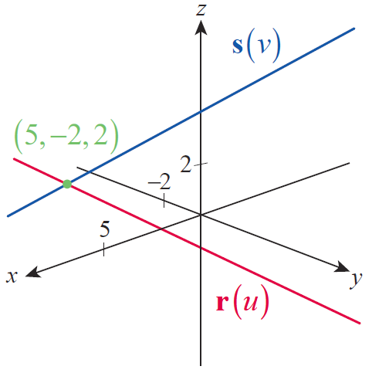
Example 4a (cont.)
So the two lines intersect at the point (5, −2, 2) shown in Figure 2.
Figure 2

Slide 16
Example 4 (cont.)
b. Proceeding in the same manner, the solution of the first two of the three equations
is u = 0 and v = 1. But these values don’t satisfy the third equation, so it is impossible to find a point of intersection of these two lines. Moreover, the lines are not parallel since their direction vectors are not scalar multiples of one another.

Slide 17
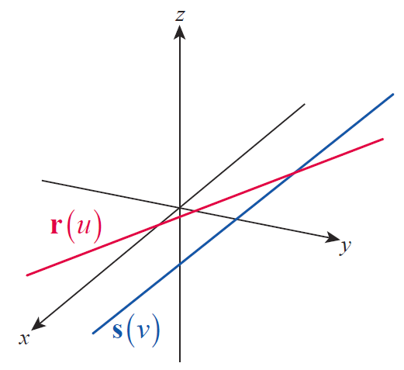
Example 4b (cont.)
Nonparallel lines with no point of intersection are called skew lines. Skew lines, while not parallel to each other, do have the property that they lie in two planes that are parallel to each other.
Figure 3 Skew Lines

Slide 18
Definition: Equation for a Plane with a Known Normal Vector
Equation for a Plane with a Known Normal Vector
If the vector is normal to a given plane, and if the point lies in the plane, then any point (x, y, z) in the plane must satisfy the vector equation
In scalar form, this becomes the linear equation

Slide 19
Example 5
Find a vector equation and a scalar equation for the plane containing the point (−3, 1, 5), and having as a normal vector.
Solution
The vector equation for the plane is
and carrying out the scalar product operation and simplifying results in the scalar equation

Slide 20
Example 6
Describe the plane 2x − 4y + z = −5 as a two-parameter set of points in ℝ³.
Solution
By solving the equation 2x − 4y + z = −5 for any one of the three variables, we can describe the plane as a set of points in terms of the other two variables. For instance,
is one description of all the ordered triples making up the plane.
ℝ
ℝ

Slide 21
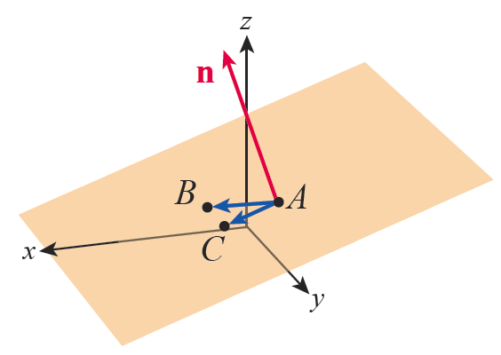
Example 7
Find an equation for the plane containing the three points A(−1, 2, 2), B(2, −1, 1), and C(2, 2, 1).
Solution
To use the formulation above,
we need a vector n normal to
the plane; we can construct
such a vector by taking the
cross product of two
vectors u and v in the plane.
Figure 4 Plane Containing A, B, C

Slide 22
Example 7 (cont.)
To that end, let
Then,
and, using the fact that A is a point in the plane, a vector equation for the plane is

Slide 23
Example 7 (cont.)
Or, as linear equation, 3x + 9z = 15. Using either of the other two points B and C would have resulted in an equivalent answer.

Slide 24
Planes
If a line is not parallel to a plane, it must intersect it at some point. The next example illustrates how that point can be determined.

Slide 25
Example 8
Find the point of intersection between the line
and the plane 4x − y + 2z = 5.
Solution
Each point on the line has the form (2 − 3t, 1 + 4t, −3 − t), for some t ∈ ℝ, and we seek the value of t for which such a point also satisfies
4x − y + 2z = 5. So we solve the following equation for t.

Slide 26
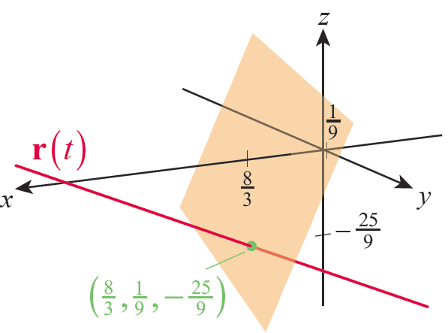
Example 8 (cont.)
The point of intersection
occurs when and
Therefore is the point of intersection and it is shown in Figure 5.
Figure 5

Slide 27
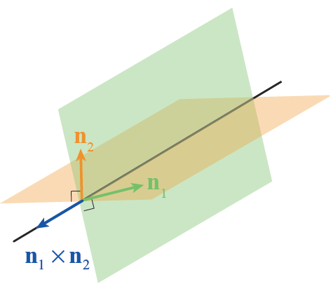
Example 9
Find parametric equations for the line formed by the intersection of the two planes x − 2y + 4z = 7 and 2x − y + 3z = 0.
Solution
The line of intersection of
two planes lies in each
plane, so it is orthogonal to
a vector that is orthogonal
to either plane (see Figure 6).
Figure 6
Line of Intersection of Two Planes

Slide 28
Example 9 (cont.)
We can use this fact to quickly find a direction vector for the line we seek. From the given equations for the planes, we know that is normal to the first plane and is normal to the second plane. So the vector
will serve as a direction vector for the line.

Slide 29
Example 9 (cont.)
To complete the characterization of the line of intersection, we need a point on the line. Any such point will suffice, so we can choose to use the point where it intersects the xy-plane—that is, where z = 0 (if the line doesn’t intersect the xy-plane, that will become apparent in the next step). Setting z = 0 in the two plane equations and solving for x and y yields the point

Slide 30
Example 9 (cont.)
So the vector form of the line of intersection is
and the parametric equations describing this line are

Slide 31
Example 10
Find the shortest distance between the point A(3, 1, −2) and the plane 2x − 3y + 6z = 2.
Solution
We are looking for the distance d between A and the point on the plane closest to A. If B is any point on the plane, then d is equal to the length of the projection of onto a vector orthogonal to the plane.

Slide 32
Example 10 (cont.)
From the equation 2x − 3y + 6z = 2, we know that the vector is normal to the plane and we can say that
All that remains is to find a convenient point B and carry out the computation. By inspection, the point
(1, 0, 0) is an easily found point on 2x − 3y + 6z = 2, and this gives us

Slide 33
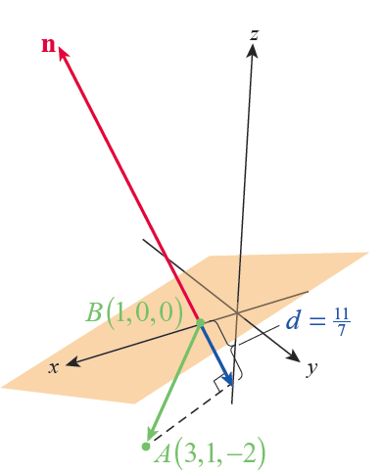
Example 10 (cont.)
Figure 7

Slide 34
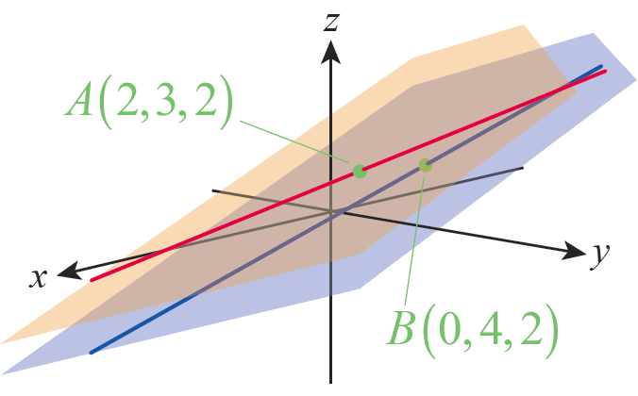
Example 11
Find the shortest distance d between the skew lines
Solution
We determined in Example 4b
that the lines are skew, so we
know that they lie in two
parallel planes.
Figure 8

Slide 35
Example 11 (cont.)
If we can determine those planes, the shortest distance between the lines will be the same as the distance between the planes. A variation of our work in
Example 10 will let us find that distance.

Slide 36
Example 11 (cont.)
Since and
the direction vector for the line r(u) is and the direction vector for the line s(v) is Any vector n normal to the two parallel planes must be orthogonal to both
p and q, so we can define

Slide 37
Example 11 (cont.)
The point A(2, 3, 2) lies in the plane containing the line r(u) and the point B(0, 4, 2) lies in the plane containing the line s(v). So the length of the projection of the vector onto n is the distance d between the two planes.

