Slide 1
Section 11.6
Cylinders and Quadric Surfaces

Slide 2
TOPICS
Cylinders
Quadric surfaces

Slide 3
Definition: Cylinders, Generating Curves, and Cross-Sections
Cylinders, Generating Curves, and Cross-Sections
A cylinder is a surface consisting of all lines (called rulings) parallel to a given line and passing through a fixed planar curve, called the cylinder’s generating curve. Cylinders are often described in terms of their intersections with planes parallel to the coordinate planes; each such intersection is called a cross-section or trace of the surface.

Slide 4
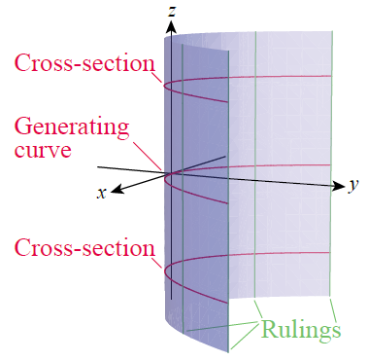
Example 1
The equation x² = 4y corresponds to the surface depicted in Figure 1.
In the xy-plane, the graph of the equation x² = 4y is the parabola labeled in Figure 1 as the generating curve; the other two parabolas shown in red qualify as cross-sections of the surface, but we could actually use any one of them as the generating curve.
Figure 1 Parabolic Cylinder

Slide 5
Example 1 (cont.)
Each line on the surface parallel to the z-axis is a ruling. The surface can be thought of as being generated by one such ruling, as its point of intersection with the generating curve traces out the parabola.
Because of the shape of its generating curve, this surface is called a parabolic cylinder.

Slide 6
Cylinders
The other two conic sections, ellipses and hyperbolas, give rise to elliptic and hyperbolic cylinders in a similar fashion. In general, any graph lying in one of the three coordinate planes can be used as the generating curve for a cylinder with rulings perpendicular to that plane. Our familiarity with conic sections allows us to readily sketch the cylinders associated with them.

Slide 7
Example 2
Sketch the surfaces defined by the equations below by determining their cross-sections.
a. 4y² − 16y + 9z² − 18z = 11 b. z² + 2z − 4x² = 3
Solution
Each surface is defined by an equation in only two variables, meaning that the missing variable is free to take on any value whatsoever. Geometrically, this means that the rulings are parallel to the axis of the missing variable.

Slide 8
Example 2 (cont.)
To determine the cross-sections of each surface, we use the familiar technique of completing the square.

Slide 9
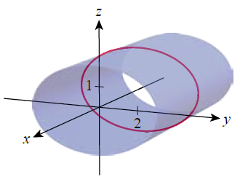
Example 2 (cont.)
In the yz-plane, the cross-section of the surface is the ellipse centered at (2, 1) with major axis of length and minor axis of length Figure 2 is an illustration, with the cross-section in the yz‑plane shown as a red curve.
Figure 2 Elliptic Cylinder

Slide 10
Example 2 (cont.)

Slide 11
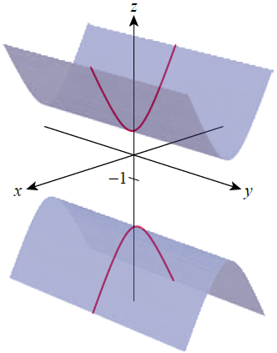
Example 2 (cont.)
In the xz-plane, the cross-section of the surface is a vertically oriented hyperbola centered at (0, −1) with asymptotes of z = −1 ± 2x. Figure 3 is a depiction of the surface, with a cross-section again shown as a red curve.
Figure 3 Hyperbolic Cylinder

Slide 12
Quadric Surfaces
The three varieties of cylinders just shown are particular examples of quadric surfaces, which in general are graphs of equations of the form
where A, B, …, J are real constants. Quadric surfaces are the three-dimensional analogs of conic sections.

Slide 13
Quadric Surfaces
Like those two-dimensional curves, a given quadric surface can be rotated and translated so that its corresponding equation is simpler, namely of the form
Ax² + By² + Cz² + J = 0, Ax² + By² + Iz = 0,
By² + Cz² + Gx = 0, or Ax² + Cz² + Hy = 0.

Slide 14
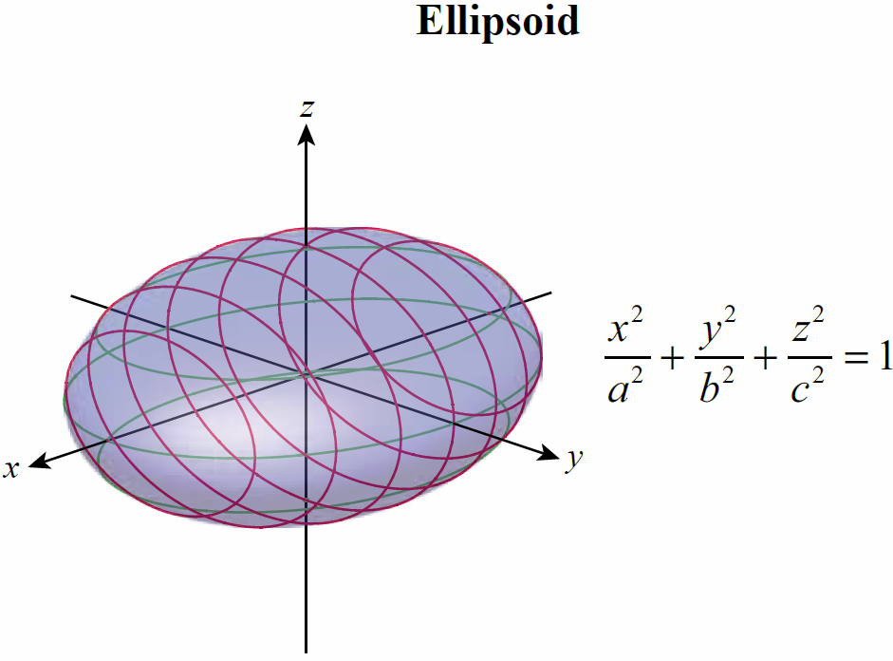
Table 1: Quadric Surfaces
(Not Including Parabolic, Elliptic, and Hyperbolic Cylinders)

Slide 15
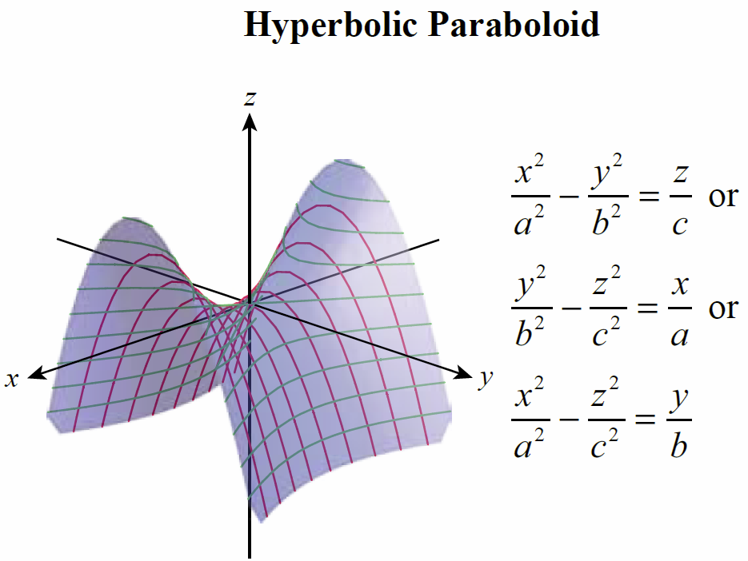
Table 1: Quadric Surfaces
(Not Including Parabolic, Elliptic, and Hyperbolic Cylinders) (cont.)

Slide 16
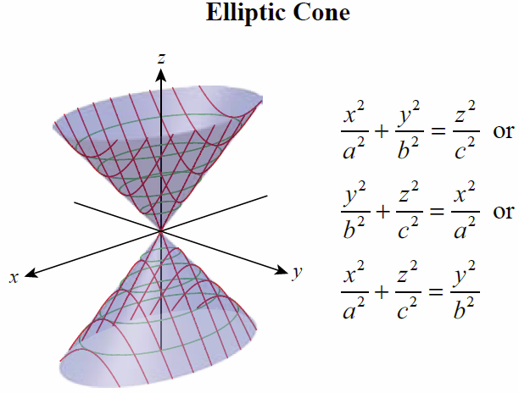
Table 1: Quadric Surfaces
(Not Including Parabolic, Elliptic, and Hyperbolic Cylinders) (cont.)

Slide 17
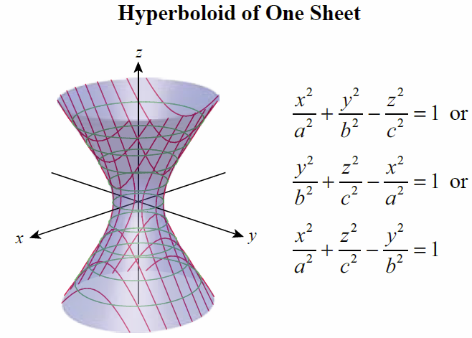
Table 1: Quadric Surfaces
(Not Including Parabolic, Elliptic, and Hyperbolic Cylinders) (cont.)

Slide 18
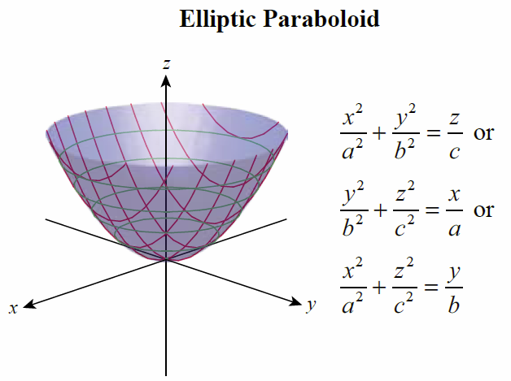
Table 1: Quadric Surfaces
(Not Including Parabolic, Elliptic, and Hyperbolic Cylinders) (cont.)

Slide 19
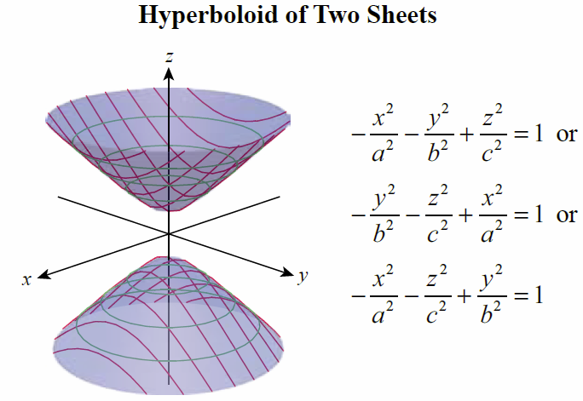
Table 1: Quadric Surfaces
(Not Including Parabolic, Elliptic, and Hyperbolic Cylinders) (cont.)

Slide 20
Example 3
Sketch the surface x² + 4y² + 4z = 0.
Solution
By rewriting the equation in the form
we identify it as an elliptic paraboloid.

Slide 21
Example 3 (cont.)
If k is a positive constant, setting z = −k reduces the
equation to
an ellipse in the plane z = −k centered at the origin with major axis of length and minor axis of length Note that there are no real values of x and y that satisfy the equation for positive values of z. Similarly, setting either x or y equal to a constant results in a parabolic cross-section parallel to, respectively, the yz-plane or the xz-plane.

Slide 22
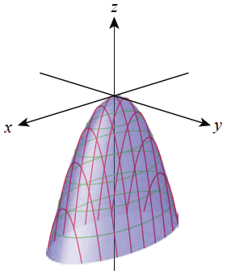
Example 3 (cont.)
Figure 4 illustrates the surface with elliptic horizontal traces and parabolic traces corresponding to fixed x-values.
Figure 4

Slide 23
Example 4
Describe the traces of the surface
Solution
Matching this equation against the given patterns of quadrics, we identify it as a hyperbolic paraboloid. Fixing x = k reduces the equation to a hyperbola, while fixing either y = k or z = k reduces the equation to a parabola. That is, traces parallel to the yz-plane are hyperbolas (Figure 5) and traces parallel to either the xz-plane or the xy-plane are parabolas (Figures 6 and 7, respectively)—this characteristic is reflected in the name of the surface.

Slide 24
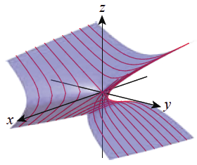
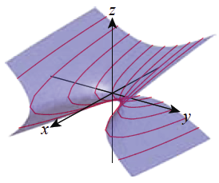
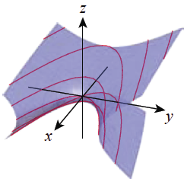
Example 4 (cont.)
Figure 5
Traces of Form
Figure 6
Traces of Form
Figure 7
Traces of Form

Slide 25
Example 4 (cont.)
Note that for any positive fixed x, the hyperbolas open left and right, while for any negative fixed x the hyperbolas open downward and upward. In contrast, because they are squared, fixing either y or z results in a family of parabolas all opening in the same direction.

Slide 26
Example 5
Sketch the surface 9x² − 9y² − 4z² + 18y + 16z = 61.
Solution
We recognize the equation as a quadric surface immediately, but to identify it further requires a bit more analysis. The most efficient approach is usually to manipulate the equation, completing the square as required, in order to match it against one of the standard forms; by doing so, we also identify some of the particular features of the surface.

Slide 27
Example 5 (cont.)

Slide 28
Example 5 (cont.)
In this form we recognize the surface as a hyperboloid of two sheets (the two negative signs on the left distinguish hyperboloids of two sheets from hyperboloids of one sheet). Further, the center of the hyperboloid has been shifted from the origin to the point (0,1,2).

Slide 29
Example 5 (cont.)
Fixing x = k gives us the family of equations
which only have real solutions for |k| ≥ 2. The graphs in the plane x = k are ellipses (as seen in red in Figure 8), and the ellipses reduce to a point when k = 2 and k = −2; that is, the points (2,1,2) and (−2,1,2) are the vertices of the hyperboloid.

Slide 30
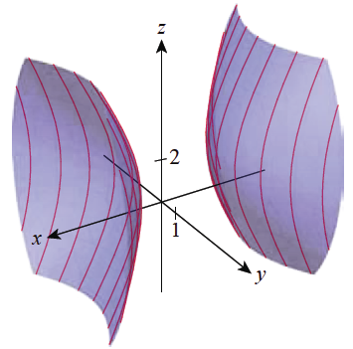
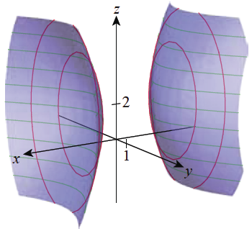
Example 5 (cont.)
Fixing z = k results in a hyperbola in the plane z = k (shown in green in Figure 8), while fixing y = k results in a hyperbola in the plane y = k; this family of hyperbolas is illustrated in Figure 9.
Figure 8
Figure 9

Slide 31
Technology Note
Technology Note
Graphing calculators and computer algebra systems are very useful tools for visualizing quadric surfaces, especially if the technology allows the surface to be “grabbed” and spun in space—doing so gives us the ability to look at parts of the surface obscured by any one static snapshot. The basic command in Mathematica for plotting three-dimensional surfaces is ContourPlot3D, and most other computer algebra systems have comparable graphing capability.

Slide 32
Technology Note
Technology Note (cont.)
Each computer algebra system offers its own particular set of options, which may allow specification of which traces to draw and the transparency of the surface. Figures 10 and 11 illustrate the use of two of Mathematica’s graphing options in drawing the surface of Example 4.

Slide 33
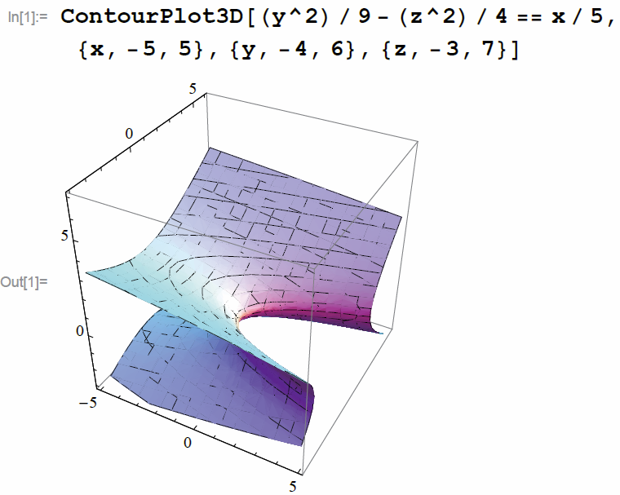
Technology Note
Technology Note (cont.)
Figure 10

Slide 34
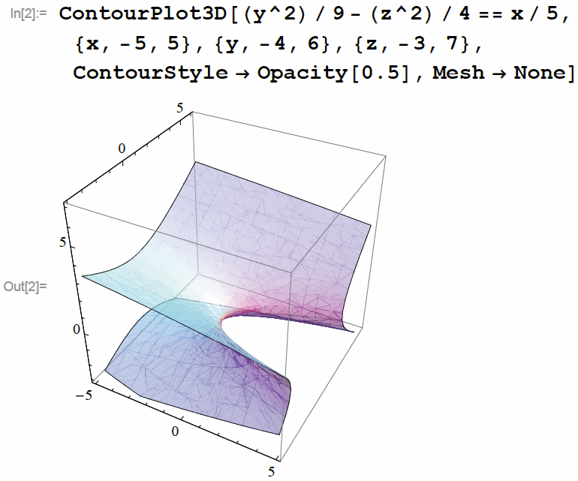
Technology Note
Technology Note (cont.)
Figure 10

